Slide 1

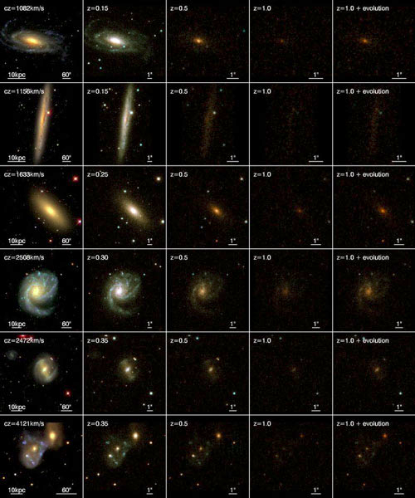
2022 International Workshop in Applied Statistics and Data Science (Cartagena – Colombia) June 29 – July 1, 2022
Machine Learning for Astronomy and Astrophysics
D. Sierra Porta
Faculty of Basic Sciences
Universidad Tecnológica de Bolivar
dporta@utb.edu.co

Slide 2
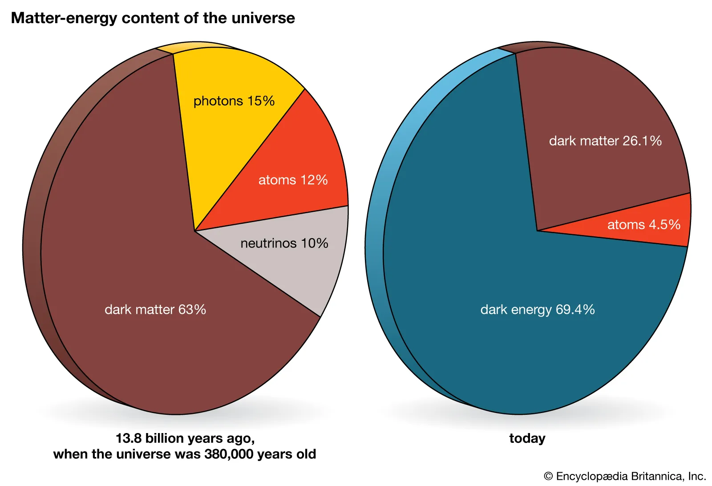
Dark matter, a component of the universe whose presence is discerned from its gravitational attraction rather than its luminosity. Dark matter makes up 30.1 percent of the matter-energy composition of the universe; the rest is dark energy (69.4 percent) and “ordinary” visible matter (0.5 percent).
matter-energy content of the universeMatter-energy content of the universe.
Encyclopædia Britannica, Inc.

Slide 3
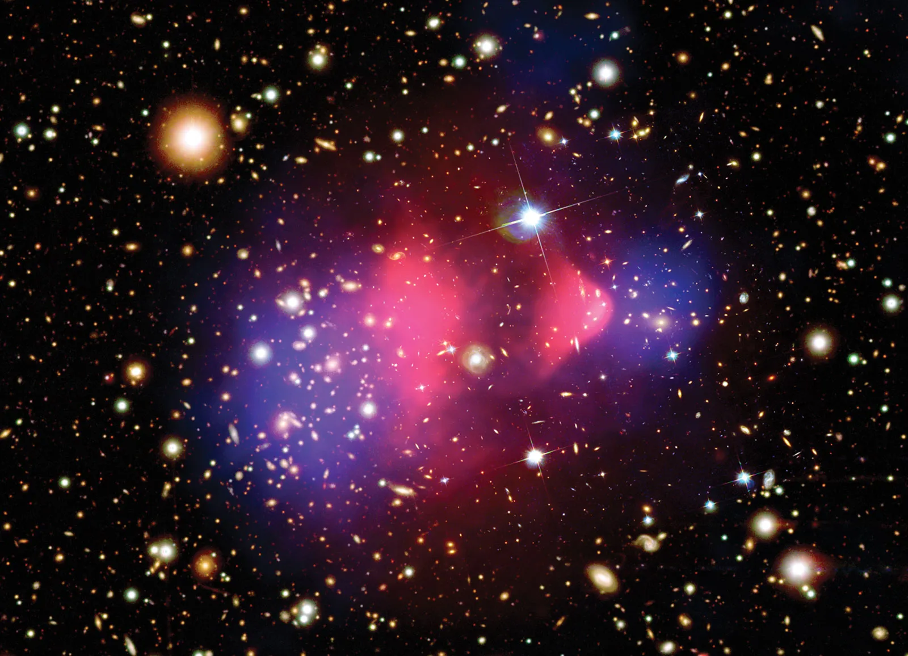
galaxy cluster 1E0657-56
Composite image showing the galaxy cluster 1E0657-56, the Bullet cluster.
X-ray: NASA/CXC/CfA/M.Markevitch Optical: NASA/STScI; Magellan/U.Arizona/D.Clowe Lensing Map: NASA/STScI; ESO WFI; Magellan/U.Arizona/D.Clowe

Slide 4
Expanding Universe
Dark energy is even more mysterious, and its discovery in the 1990s was a complete shock to scientists. Previously, physicists had assumed that the attractive force of gravity would slow down the expansion of the universe over time. But when two independent teams tried to measure the rate of deceleration, they found that the expansion was actually speeding up. One scientist likened the finding to throwing a set of keys up in the air expecting them to fall back down-only to see them fly straight up toward the ceiling.
Scientists now think that the accelerated expansion of the universe is driven by a kind of repulsive force generated by quantum fluctuations in otherwise "empty" space. What's more, the force seems to be growing stronger as the universe expands. For lack of a better name, scientists call this mysterious force dark energy.

Slide 5
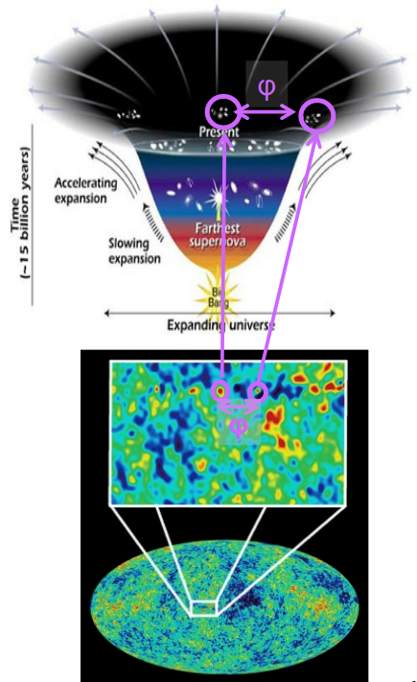
Mystery of Dark Energy
What is the source of the accelerated expansion of the universe
    Cosmological constant (w= -1)?
    New long-range repulsive force?
    Modification of gravity?
    Other ideas?
Experimentally we study two major aspects of our universe
    The expansion history of the universe
    The growth of structures (such as galaxies and galaxy clusters)
DESI focuses primarily on measuring the expansion history using a standard ruler:
    Baryon Acoustic Oscillations (BAO)

Slide 6
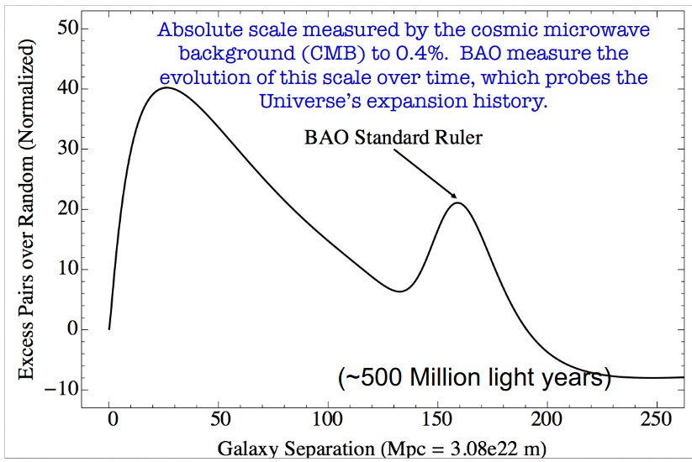
Baryon Acoustic Oscillations
Sound waves in the early Universe (~ 400,000 yrs after the big bang) produce a peak in the clustering of matter that shows up in the distribution of galaxies we see today ~ 13 billion years later. Standard Ruler!
BAO is fundamentally a measurement of the separations between galaxies, not the properties of the
galaxies themselves:
low systematic
uncertainties
Clustering of galaxies tells us about gravity and the neutrino mass

Slide 7
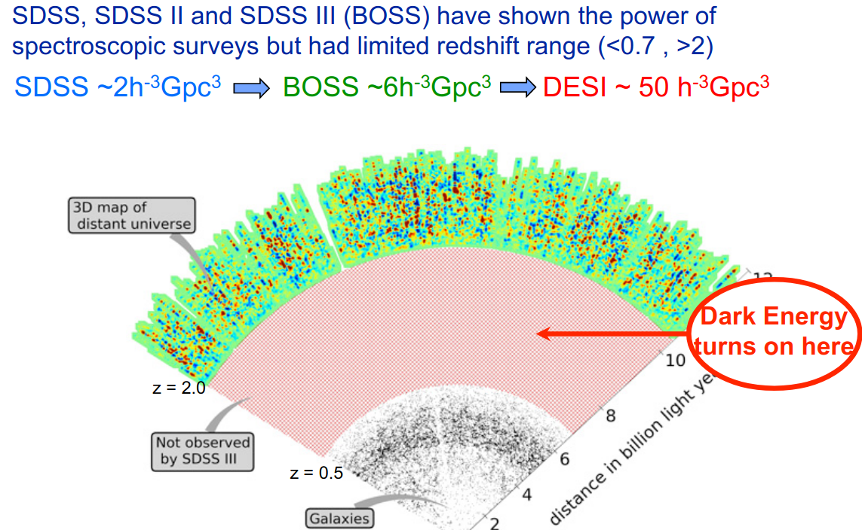

Slide 8
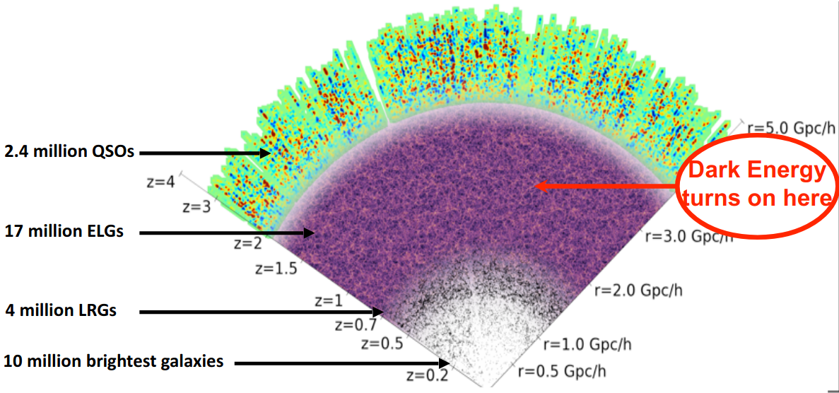
DESI Survey: ~ 34M Galaxies, 14K deg2
• 10 million Bright Galaxies 0.0<z<0.4
• 4 million Luminous Red Galaxies (LRGs) 0.4<z<1
• 17.1 million Emission Line Galaxies (ELGs) 0.6<z<1.6
• 1.7 million Tracer Quasars (QSOs) 1<z<2.1
• 0.7 million High redshift Quasars probe IGM
(Lyman-alpha forest) (z>2.1)

Slide 9
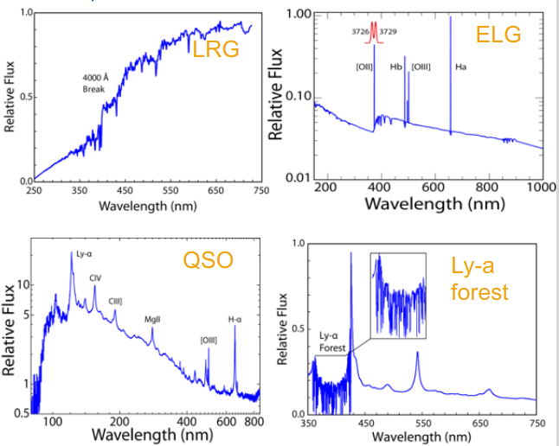
DESI Science Requirements
• Identify spectral features for each type of target
  Bandpass from 360 – 980 nm, Δz/(1+z) ~0.0005, λ/Δλ resolution ~ 2000-4000
  3 arm spectrographs to cover full range
• 5 year survey (~ 100% of the time)
• 14000 deg2 survey size
• 5000 spectra per exposure
• 34 Million targets
• ~20 min exposure times.
• ~10,000 total number of exposures
• Goal: <0.3% uncertainty in the distance scale at z ~ 1 and <1% for z < ~3

Slide 10
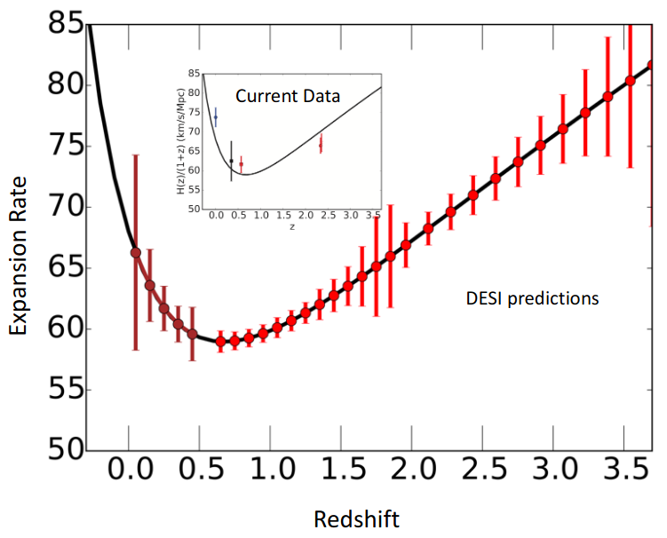
DESI Hubble Diagram:
• Estimated Errors after 5 year survey

Slide 11
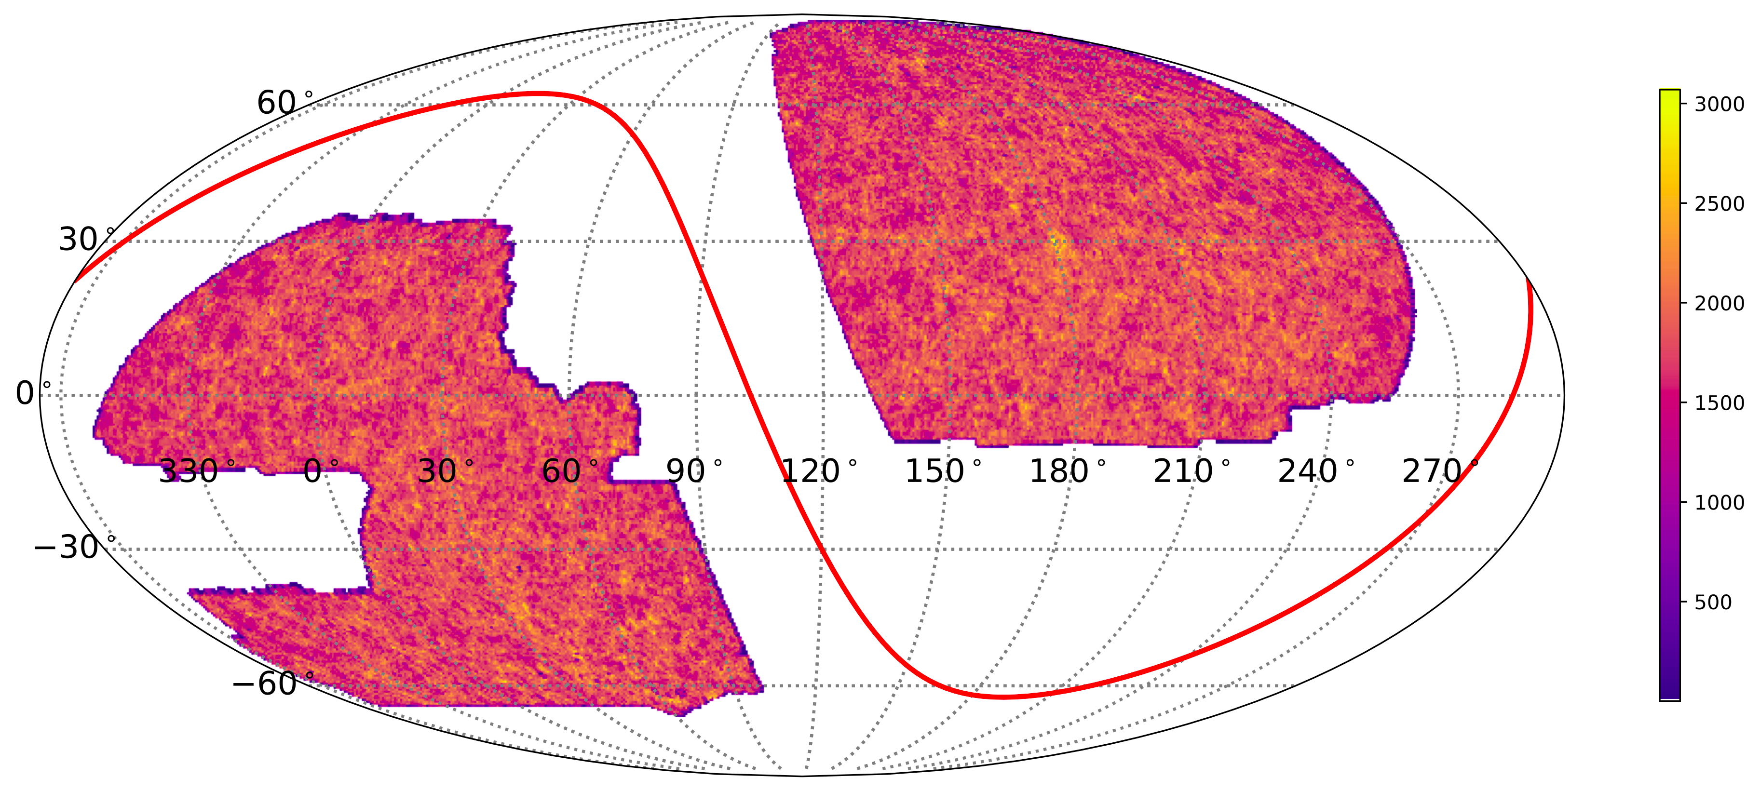
DESI Survey: Targets
• DESI collaboration Imaging surveys (BASS, MzLS and DECALs) will provide targets for DESI.
DECALS uses DECam to survey the southern 9000 deg2 of the DESI area Northern area is being covered by a Mayall z and BASS Regular public data releases

Slide 12
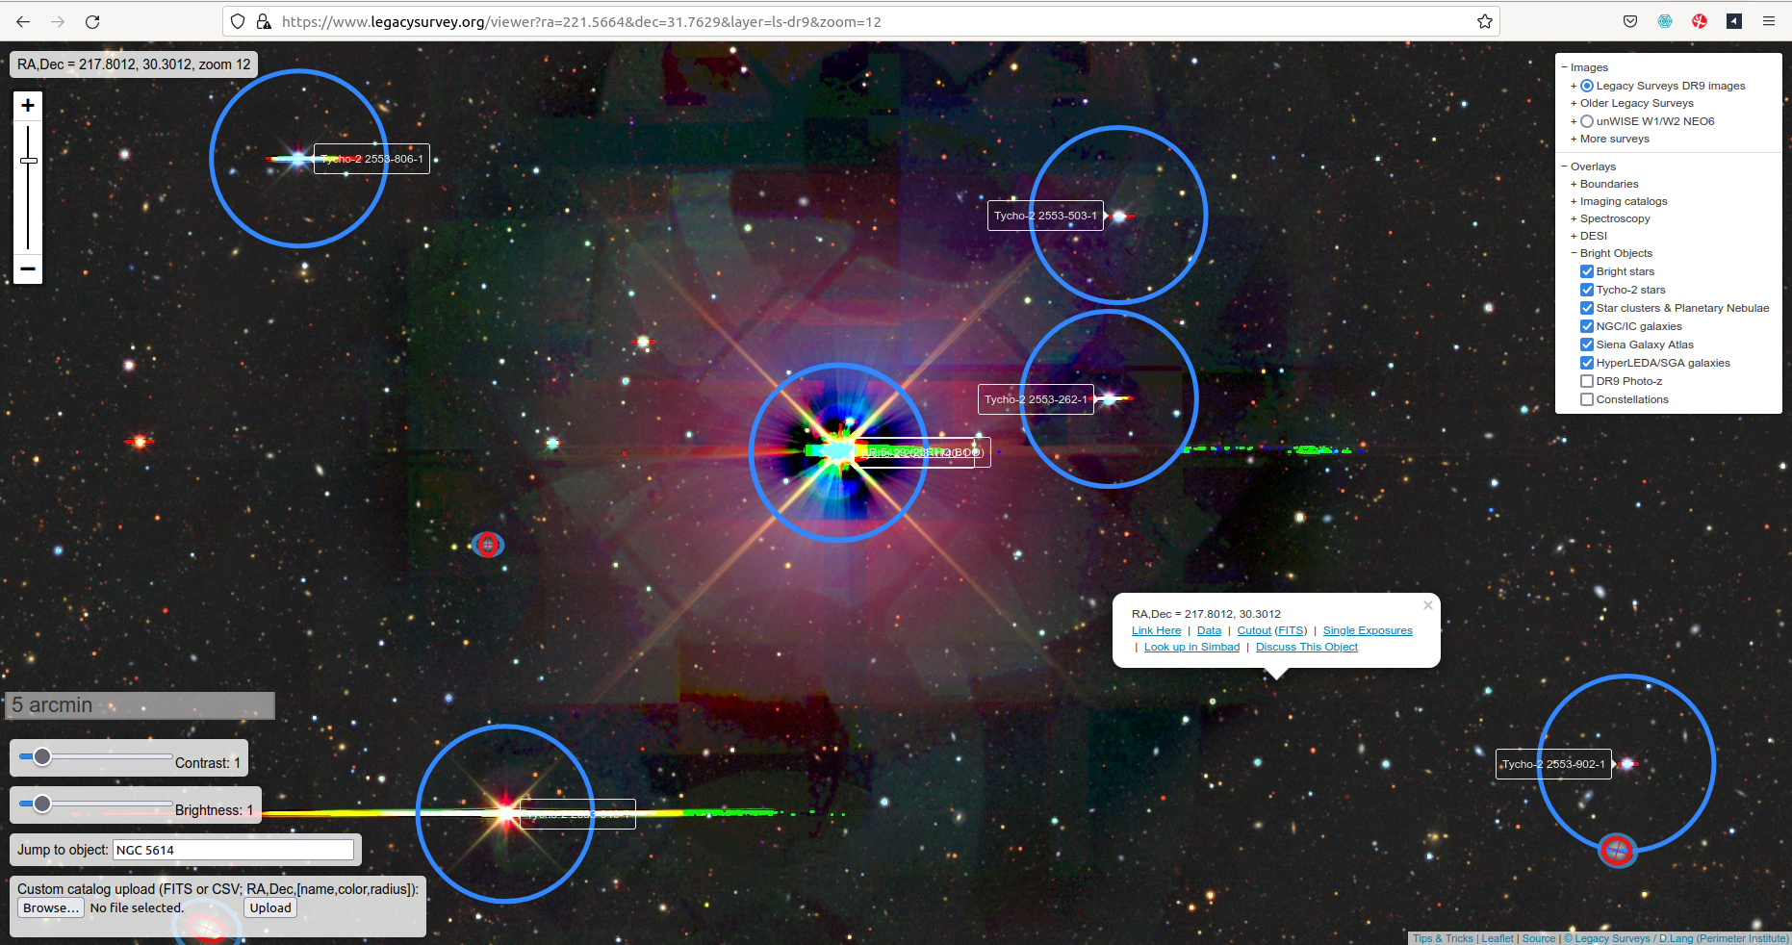
legacysurvey.org/viewer

Slide 13
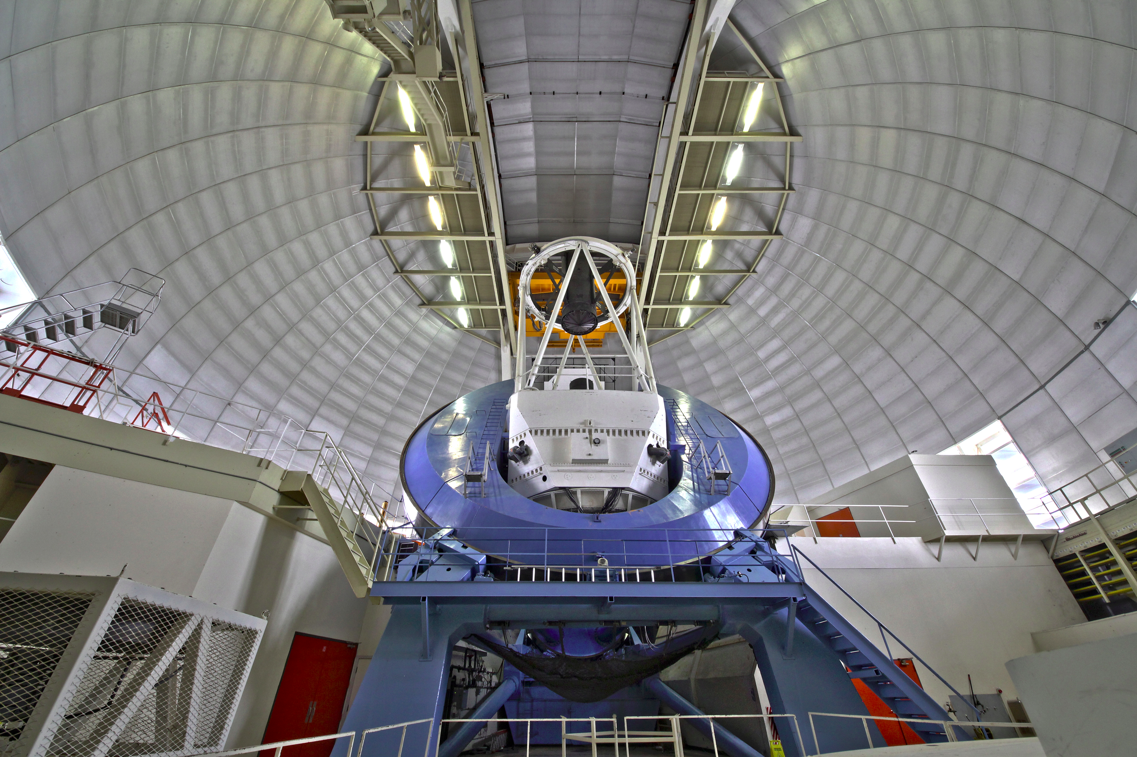
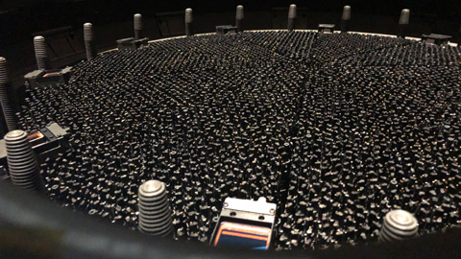
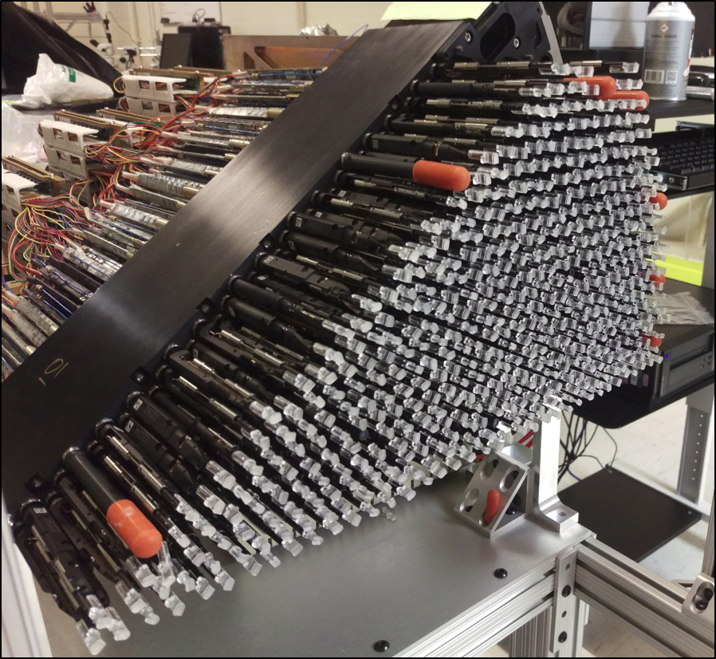
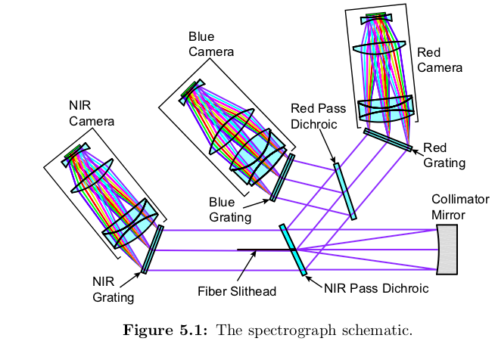
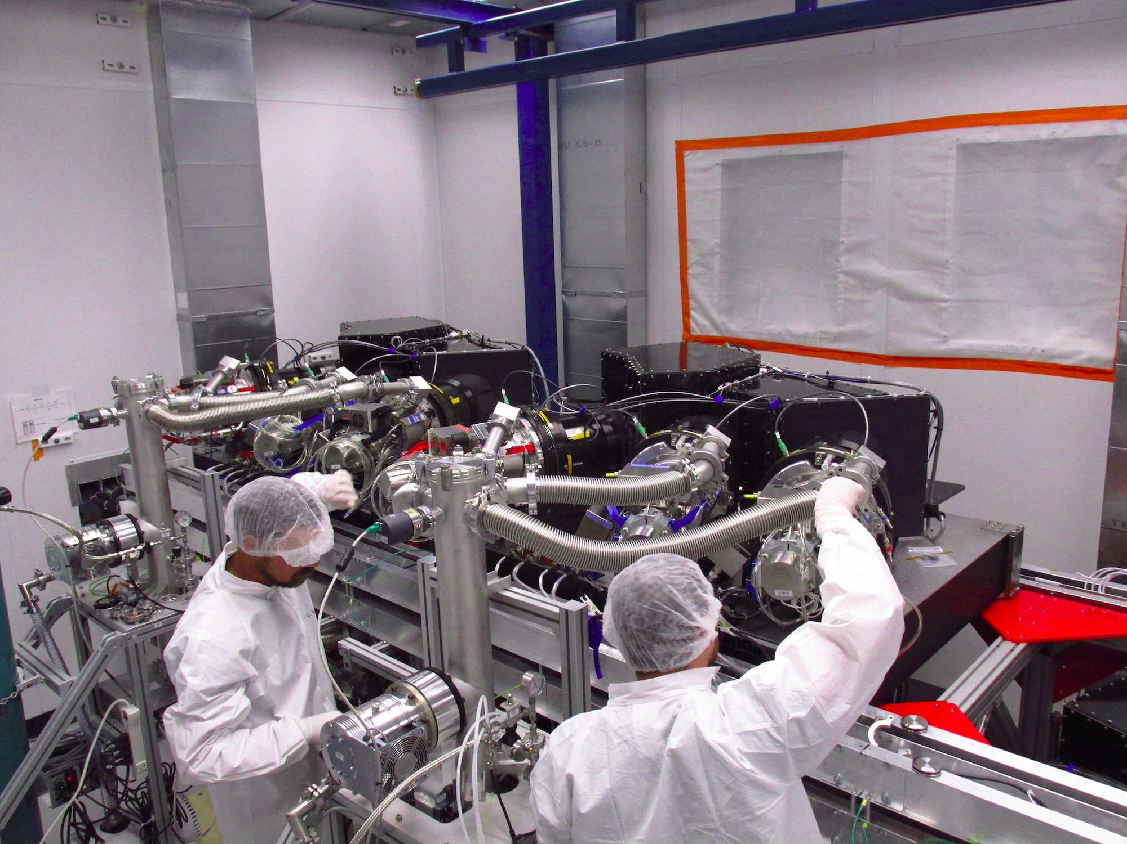

Slide 14
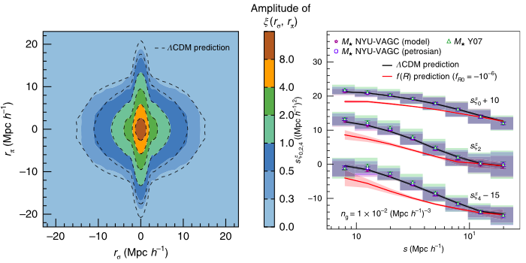

Slide 15
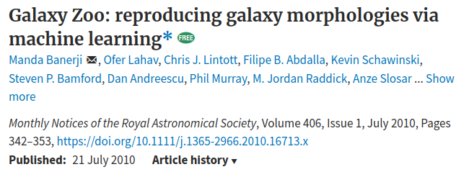
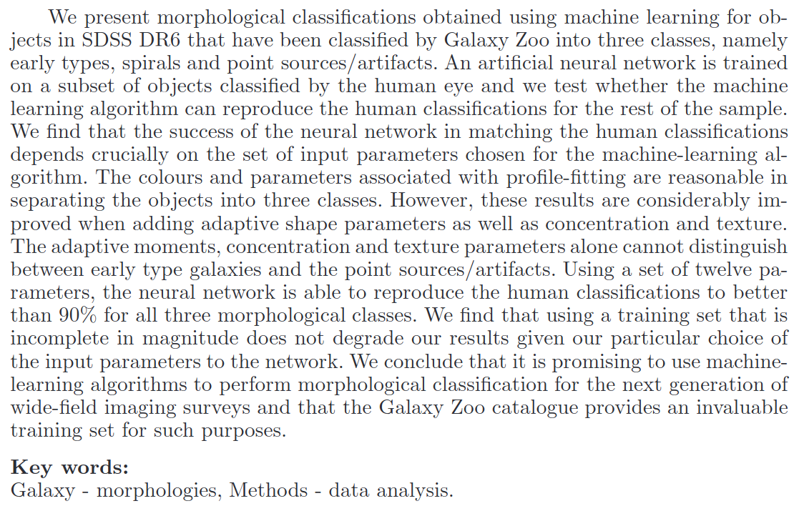

Slide 16
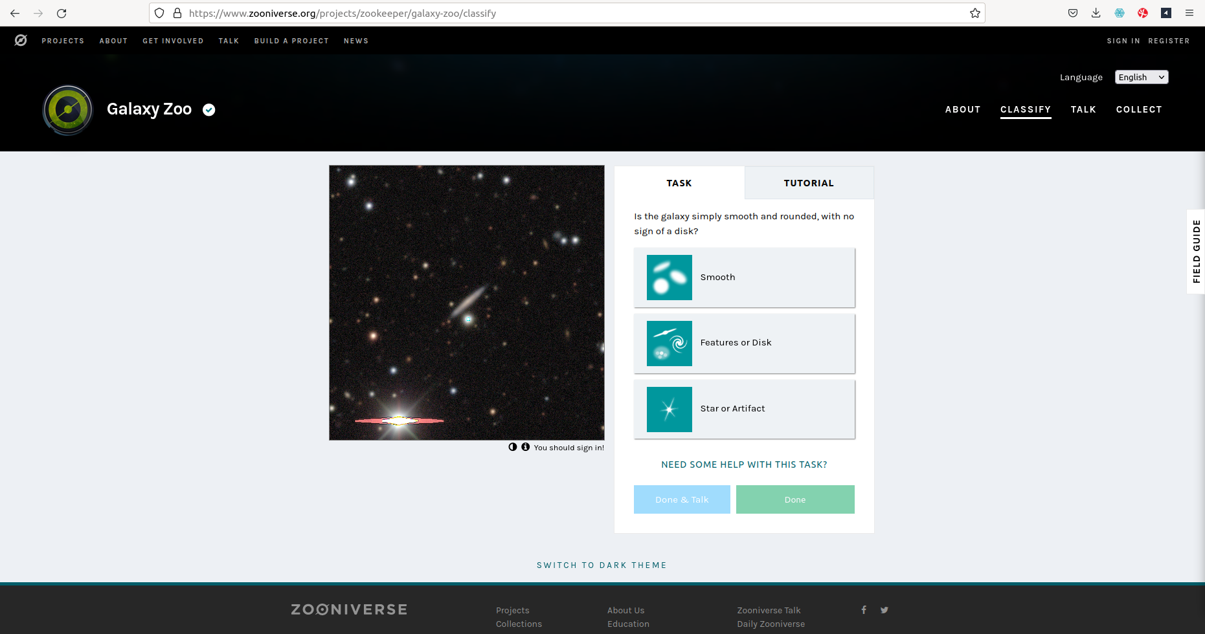

Slide 17
Galaxy Zoo is a web-based project that aimed to obtain morphological classifications for roughly a million objects in the Sloan Digital Sky Survey by harnessing the power of the internet and recruiting members of the public to perform these classifications by eye. The first part of this project is now complete and the morphological classifications subsequently obtained have been described in detail in Lintott et al. (2008) where these classifications have also been shown to be credible based on comparison with classifications by professional astronomers.

Slide 18
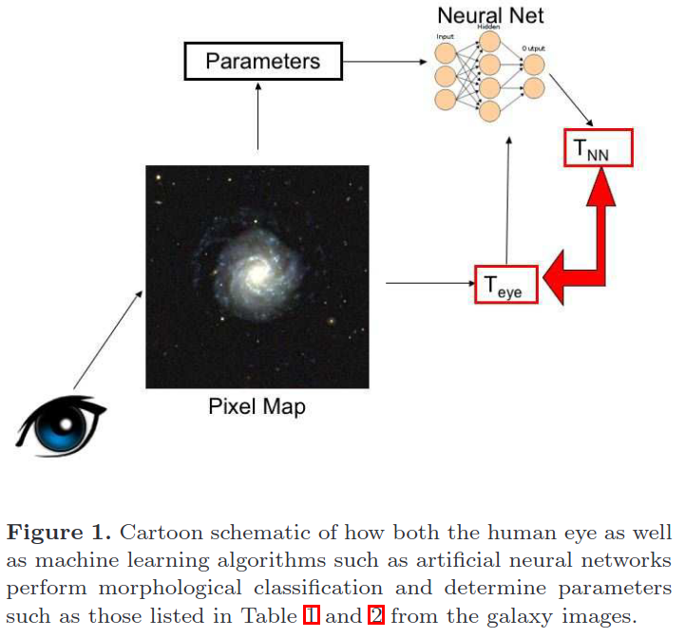
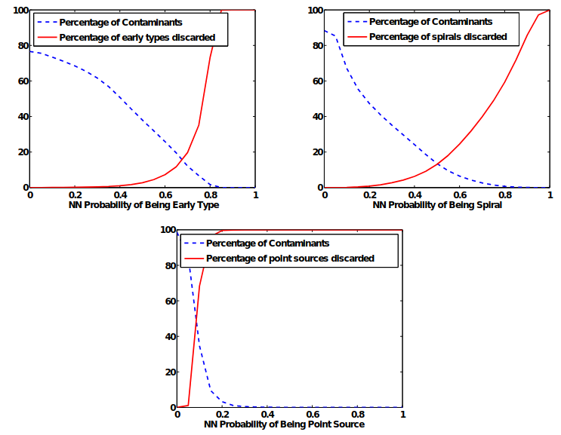


Slide 19
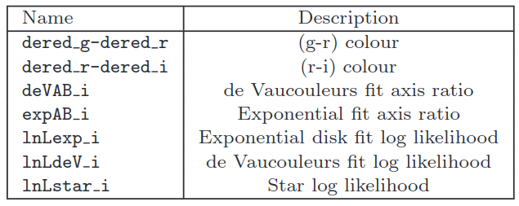
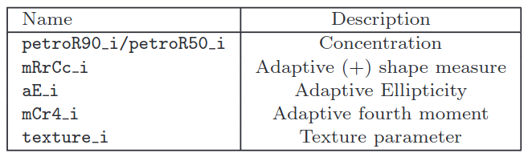
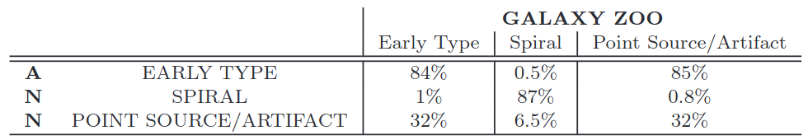
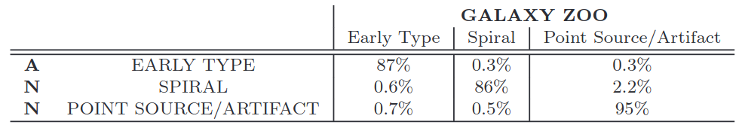
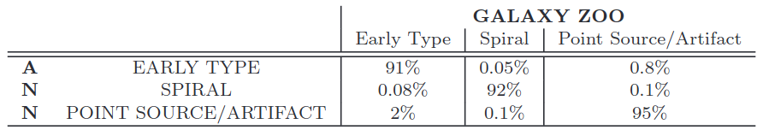
Summary of results for entire sample when using input parameters specified in Table 1 and Table 2 and only bright galaxies with r < 17 to train the network.

Slide 20
…we still have much to do…
Thanks
D. Sierra Porta
Faculty of Basic Sciences
Universidad Tecnológica de Bolivar
dporta@utb.edu.co

