Slide 1
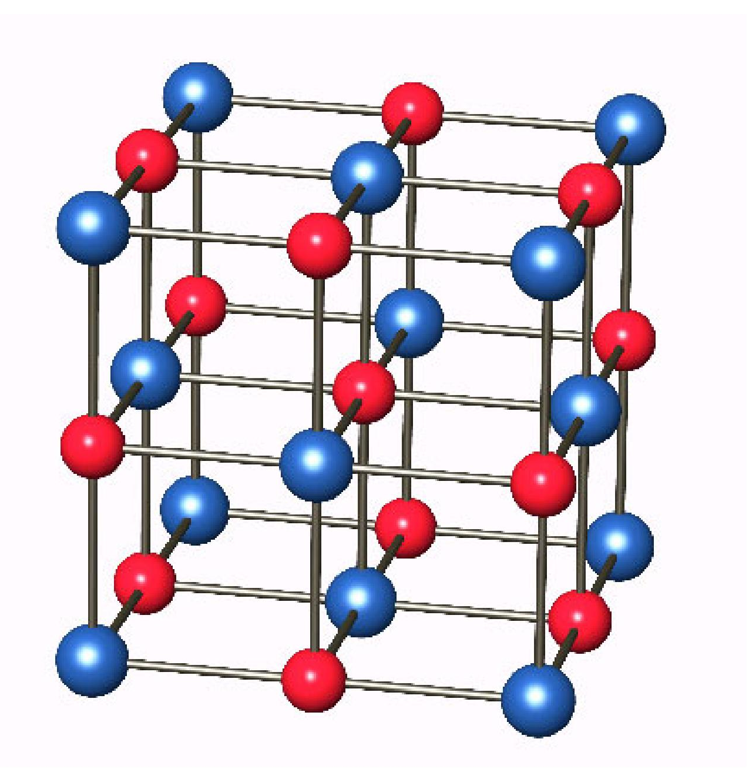
The LDA+U method: materials with strong electron correlations
Objectives
-Use of the LDA+U method within SIESTA
-Study the electronic structure of MnO

Slide 2
Transition metal oxides are prototypes of highly correlated materials
An example: MnO (NaCl structure)
The NaCl structure follows a FCC lattice with 2 atoms of basis, however….

Slide 3
MnO (NaCl structure)
The NaCl structure follows a FCC lattice with 2 atoms of basis, however…. the ground state of MnO corresponds to a ferromagnetic alignment of the Mn atoms within the (111) planes and the antiferromagnetic alignment of those planes

Slide 4
MnO (NaCl structure)
The NaCl structure follows a FCC lattice with 2 atoms of basis, however…. the ground state of MnO corresponds to a ferromagnetic alignment of the Mn atoms within the (111) planes and the antiferromagnetic alignment of those planes
Lattice vectors
Thus we need to have at least 4 atoms in the unit cell (2 Mn atoms and 2 O atoms)

Slide 5
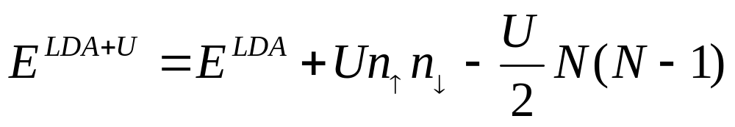
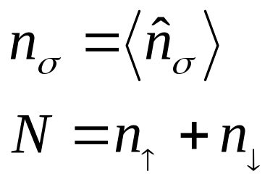
LDA+U method
LDA (or GGA) is supplemented with a Hubbard-like term in order to have a better description of the effect of electron-electron interactions in a localized atomic shell of a particular atom in the solid, i.e. 3d shell of Mn in MnO
In particular this reduces the problem of Self-Interaction
with
Double counting term (cancels the electron-electron interaction in the localized shell in LDA)

Slide 6
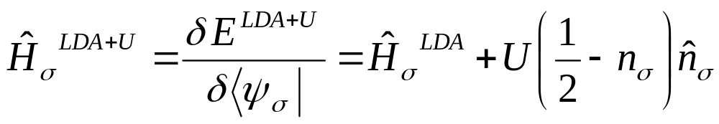
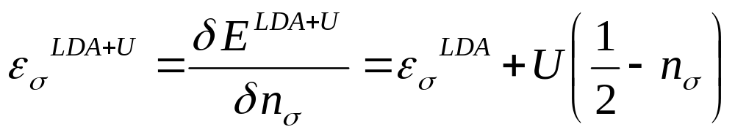
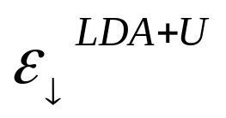
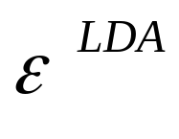
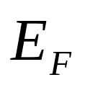

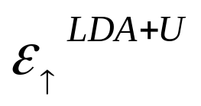
LDA+U method

Slide 7
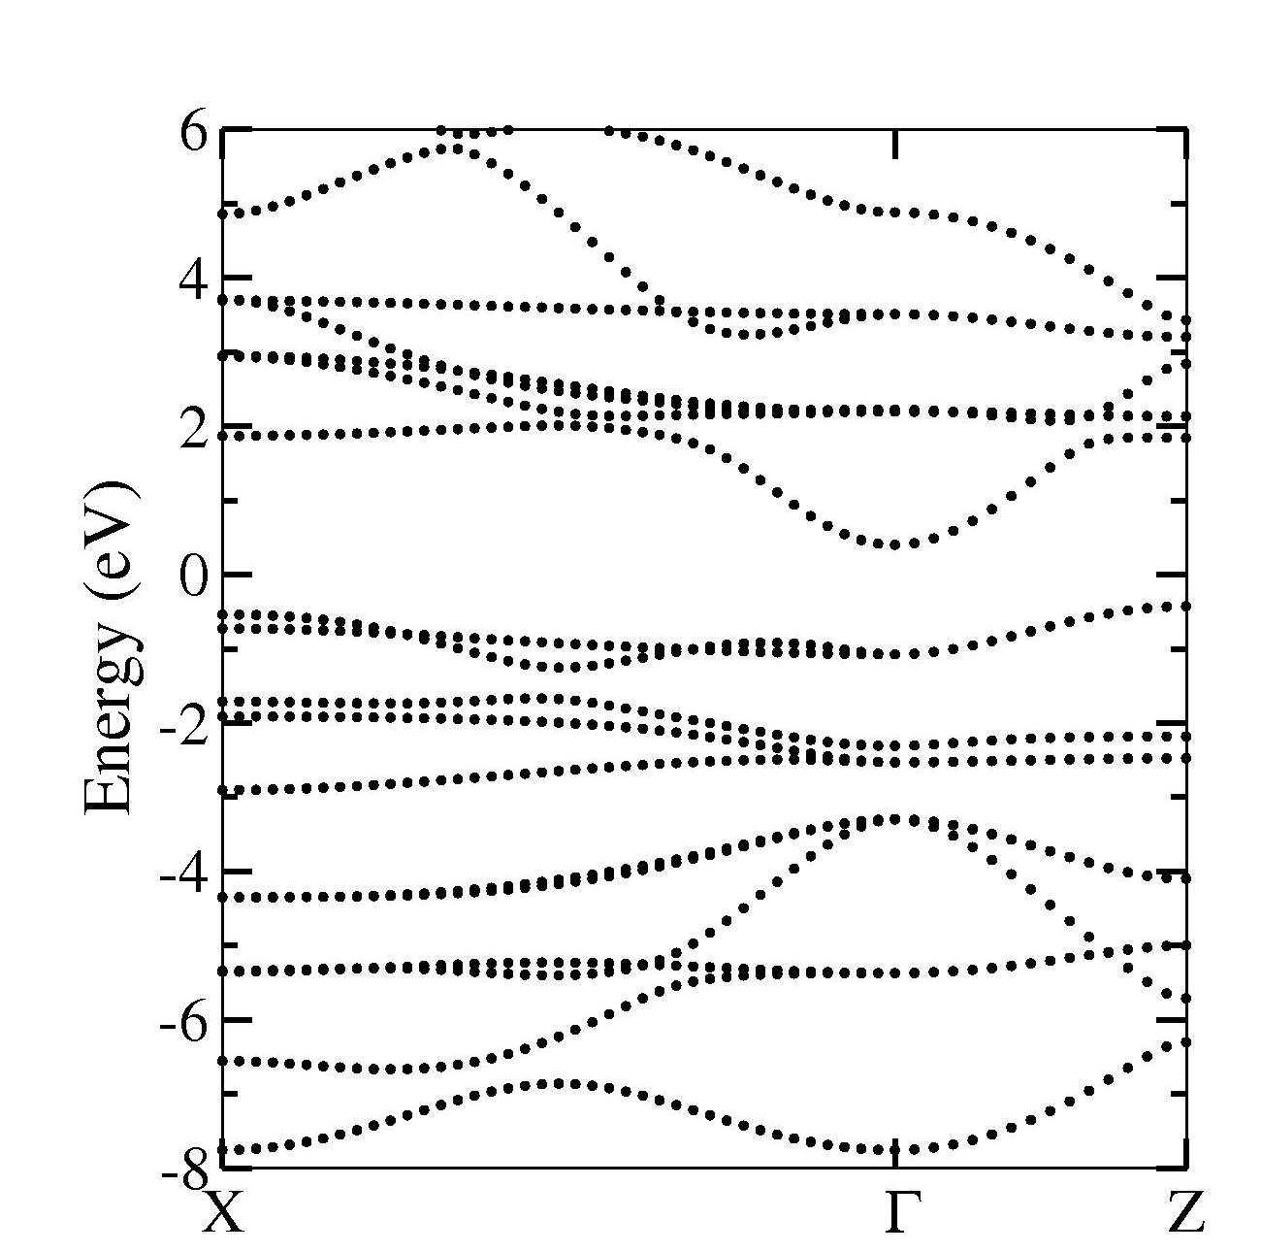
GGA gap is too small for MnO
Mn 3d
Mn 4sp
Mn 3d
O 2p

Slide 8
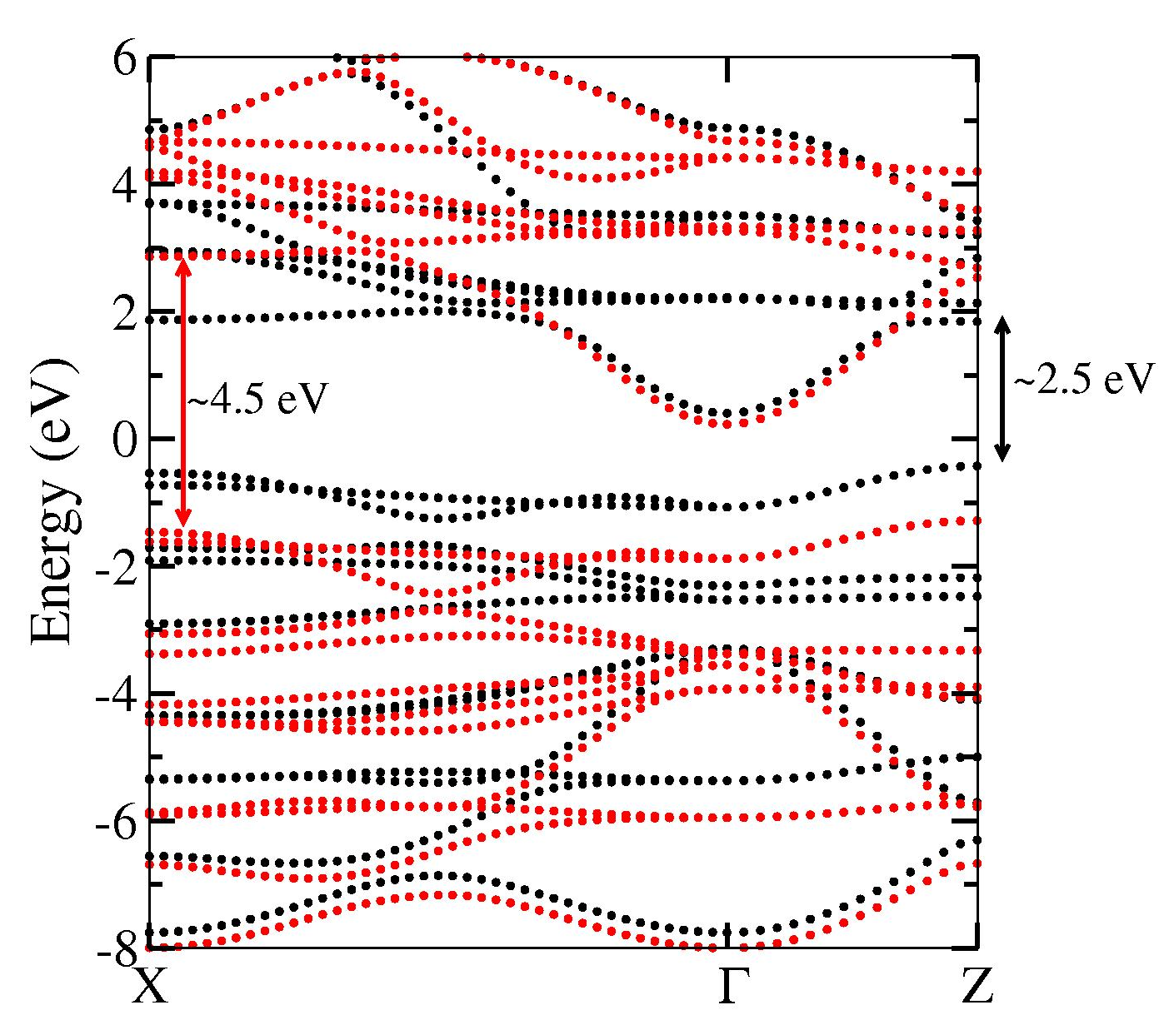
MnO bands can be corrected with the +U method
%block LDAU.proj
Mn 1 # number of shells of projectors
n=3 2 # n, l
3.000 0.000 # U(eV), J(eV)
0.000 0.000 # rc, \omega (default values)
%endblock LDAU.proj
Notice that only the 3d Mn states are significantly shifted (~2 eV, of the order of U)

Slide 9
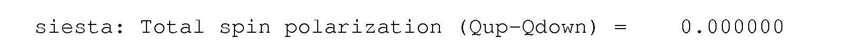
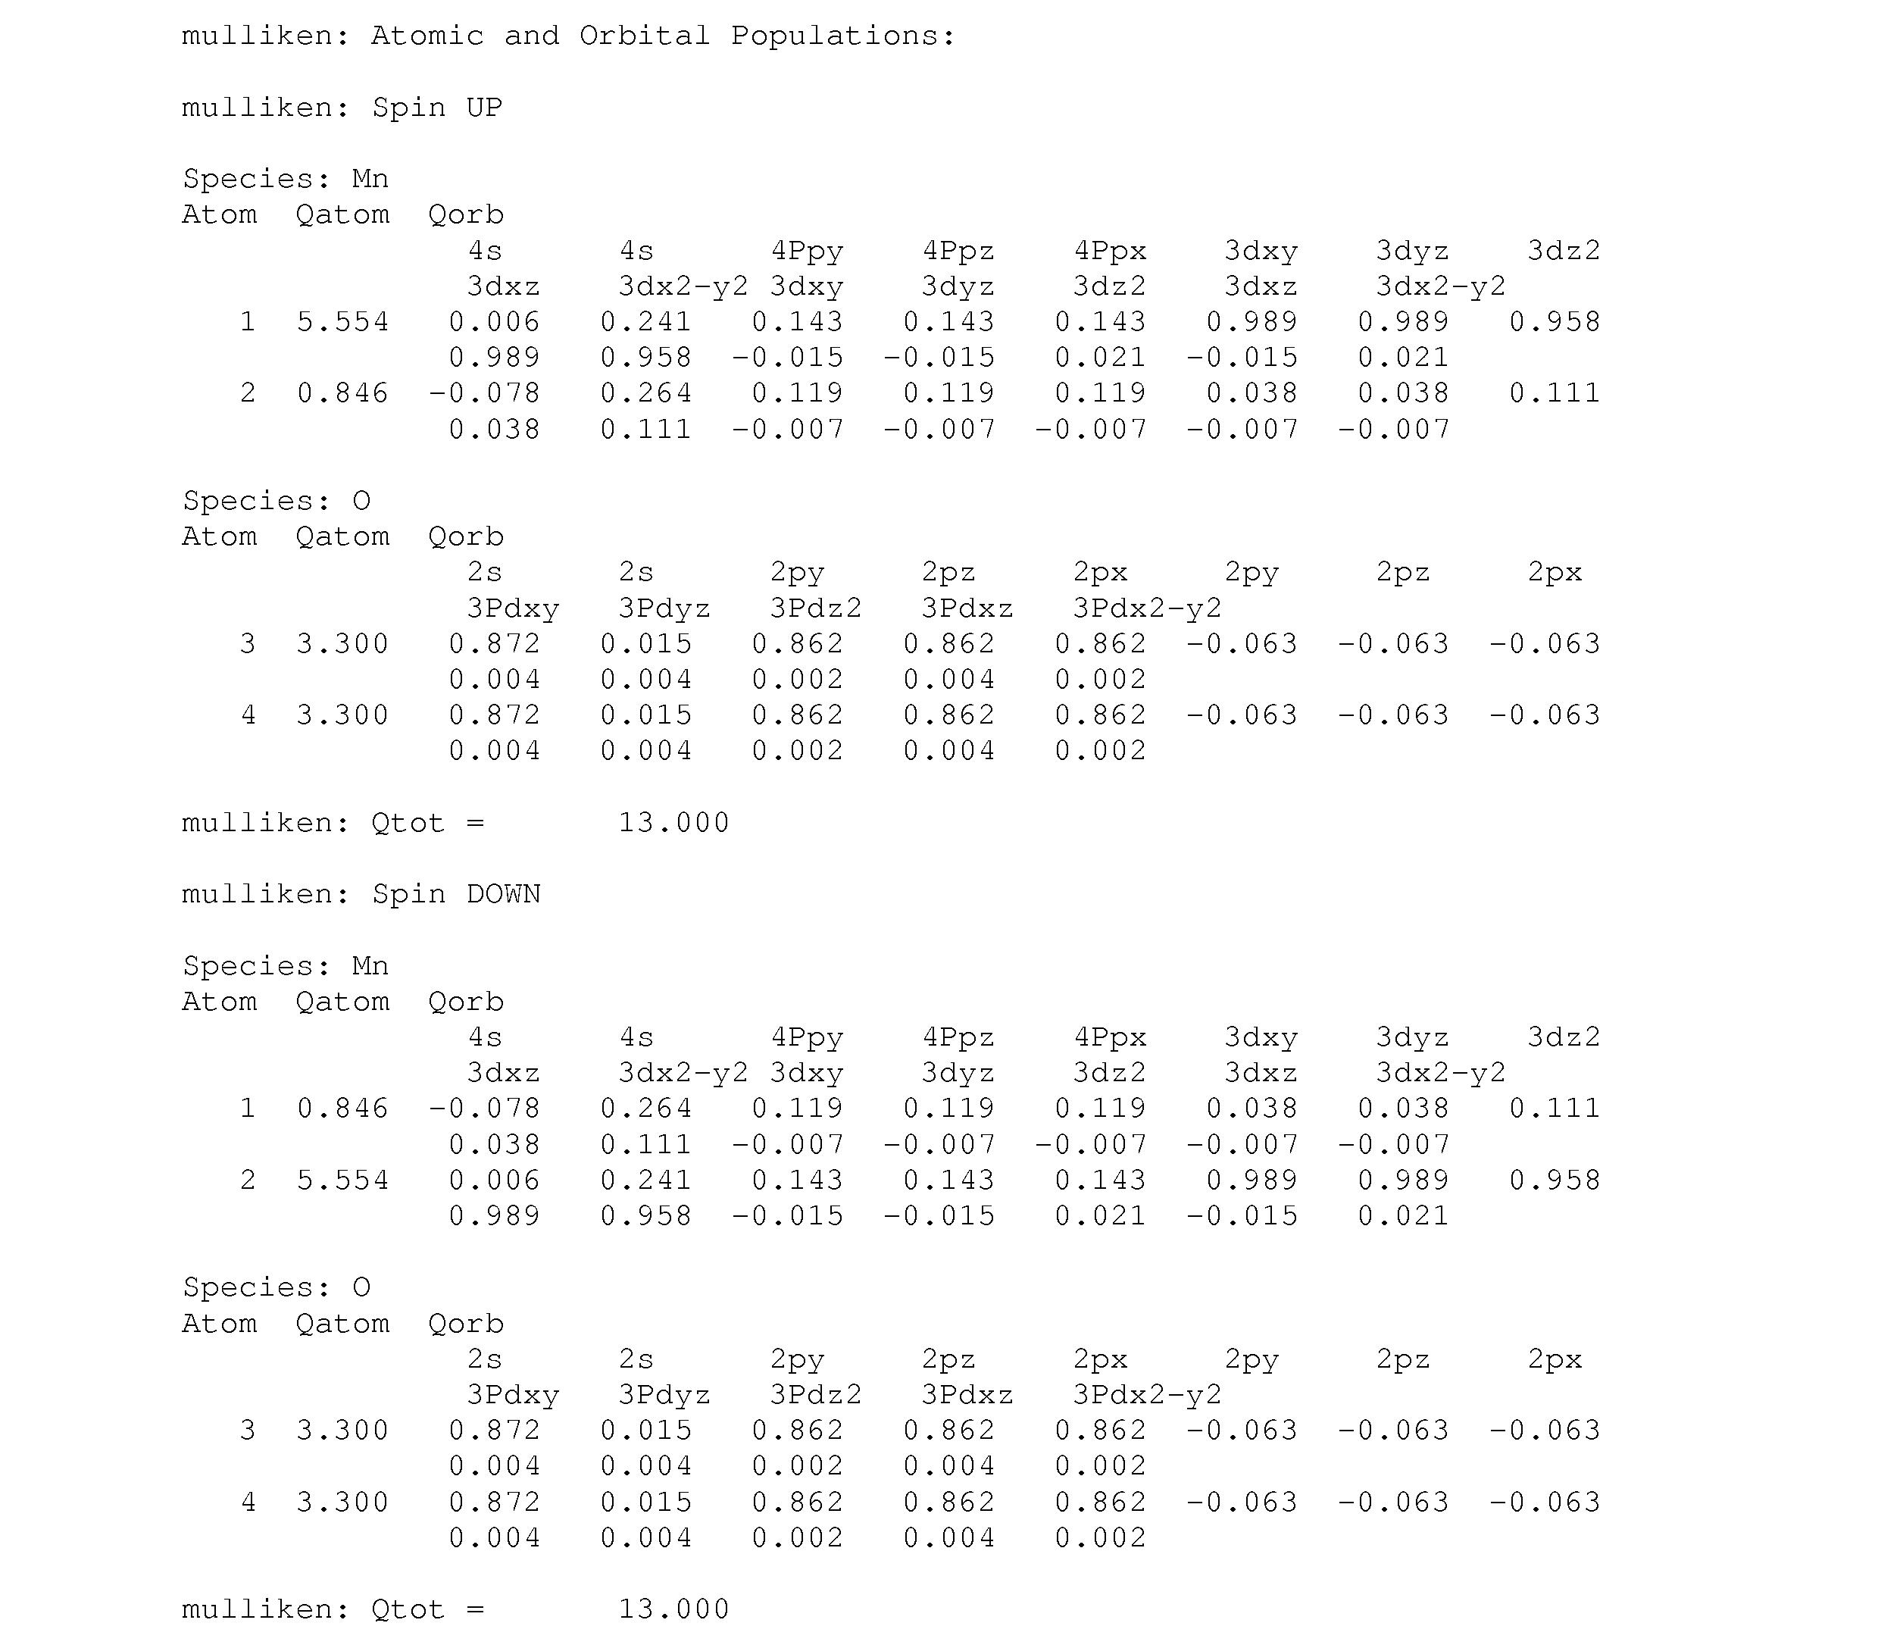
Mulliken population to obtain the local moment
SIESTA output
WriteMullikenPop 1

Slide 10
Some important variables to control convergence
If .false. the Hubbard term is ignored in the first iterations
Local populations that define that the Hamiltonian are only updated is converged within this value
LDAU.FirstIteration .true.
LDAU.ThresholdTol 1.0d-2
LDAU.PopTol 4.0d-4
Local populations have to be converged below this value in order for the calculations to be considered as converged

Slide 11
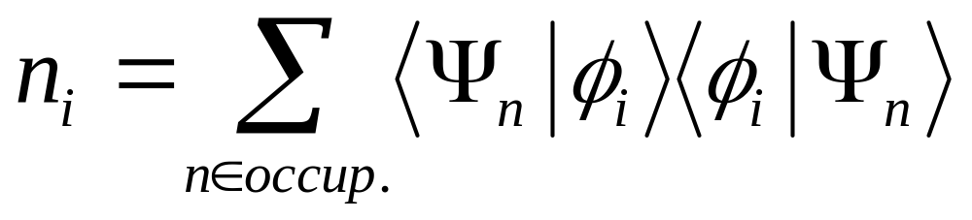
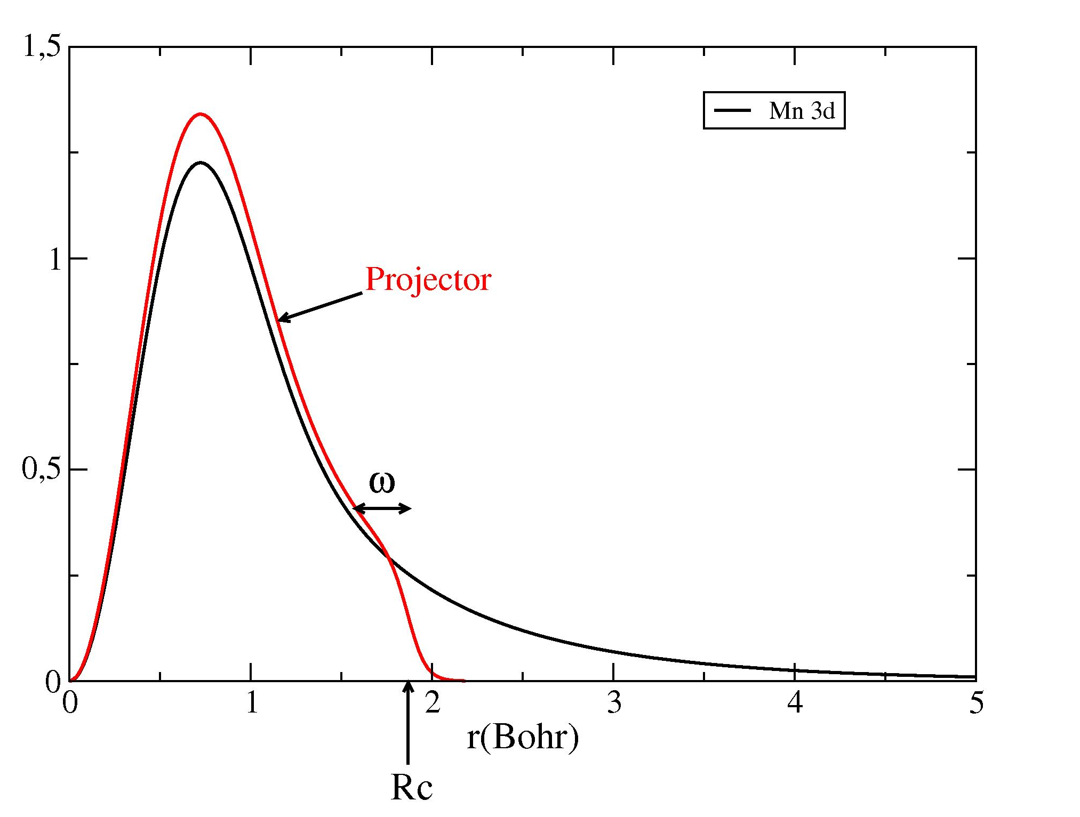
Populations calculated using localized projectors
LDAU.ProjectorGenerationMethod 2
%block LDAU.proj
Mn 1 # number of shells of projectors
n=3 2 # n, l
3.000 0.000 # U(eV), J(eV)
0.000 0.000 # rc, \omega (default values)
%endblock LDAU.proj

Slide 12
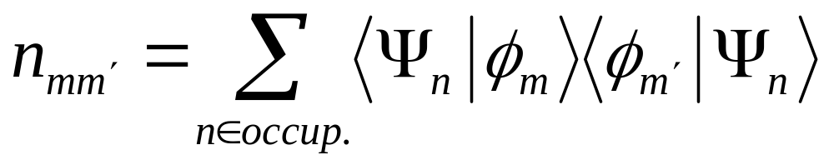
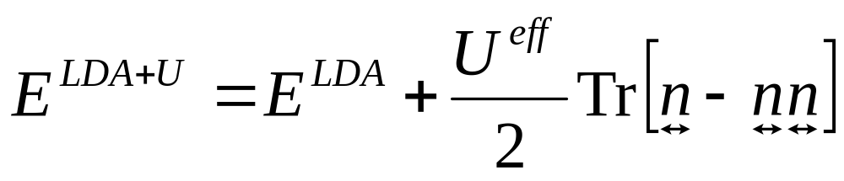
Rotationally invariant formulation
Dudarev et al., Phys. Rev. B 57, 1505 (1998)

Slide 13
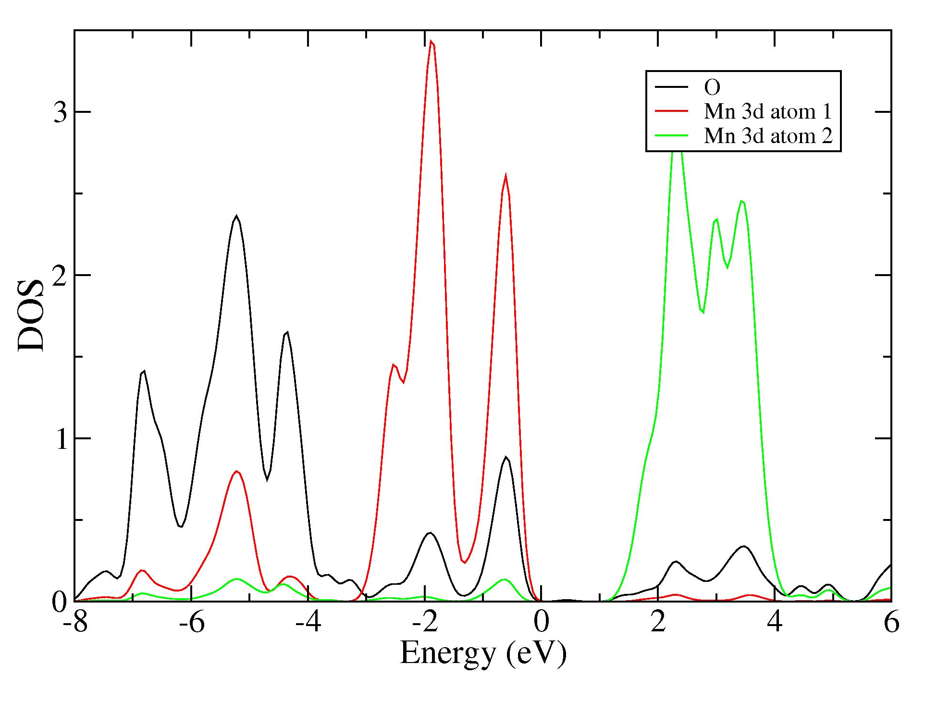
Shift of the 3d Mn states (PDOS)
Majority Spin
%block ProjectedDensityOfStates
-25.00 10.00 0.200 600 eV
%endblock ProjectedDensityOfStates
%block PDOS.kgrid_Monkhorst_Pack
16 0 0 0.5
0 16 0 0.5
0 0 16 0.5
%endblock PDOS.kgrid_Monkhorst_Pack
U=0

Slide 14
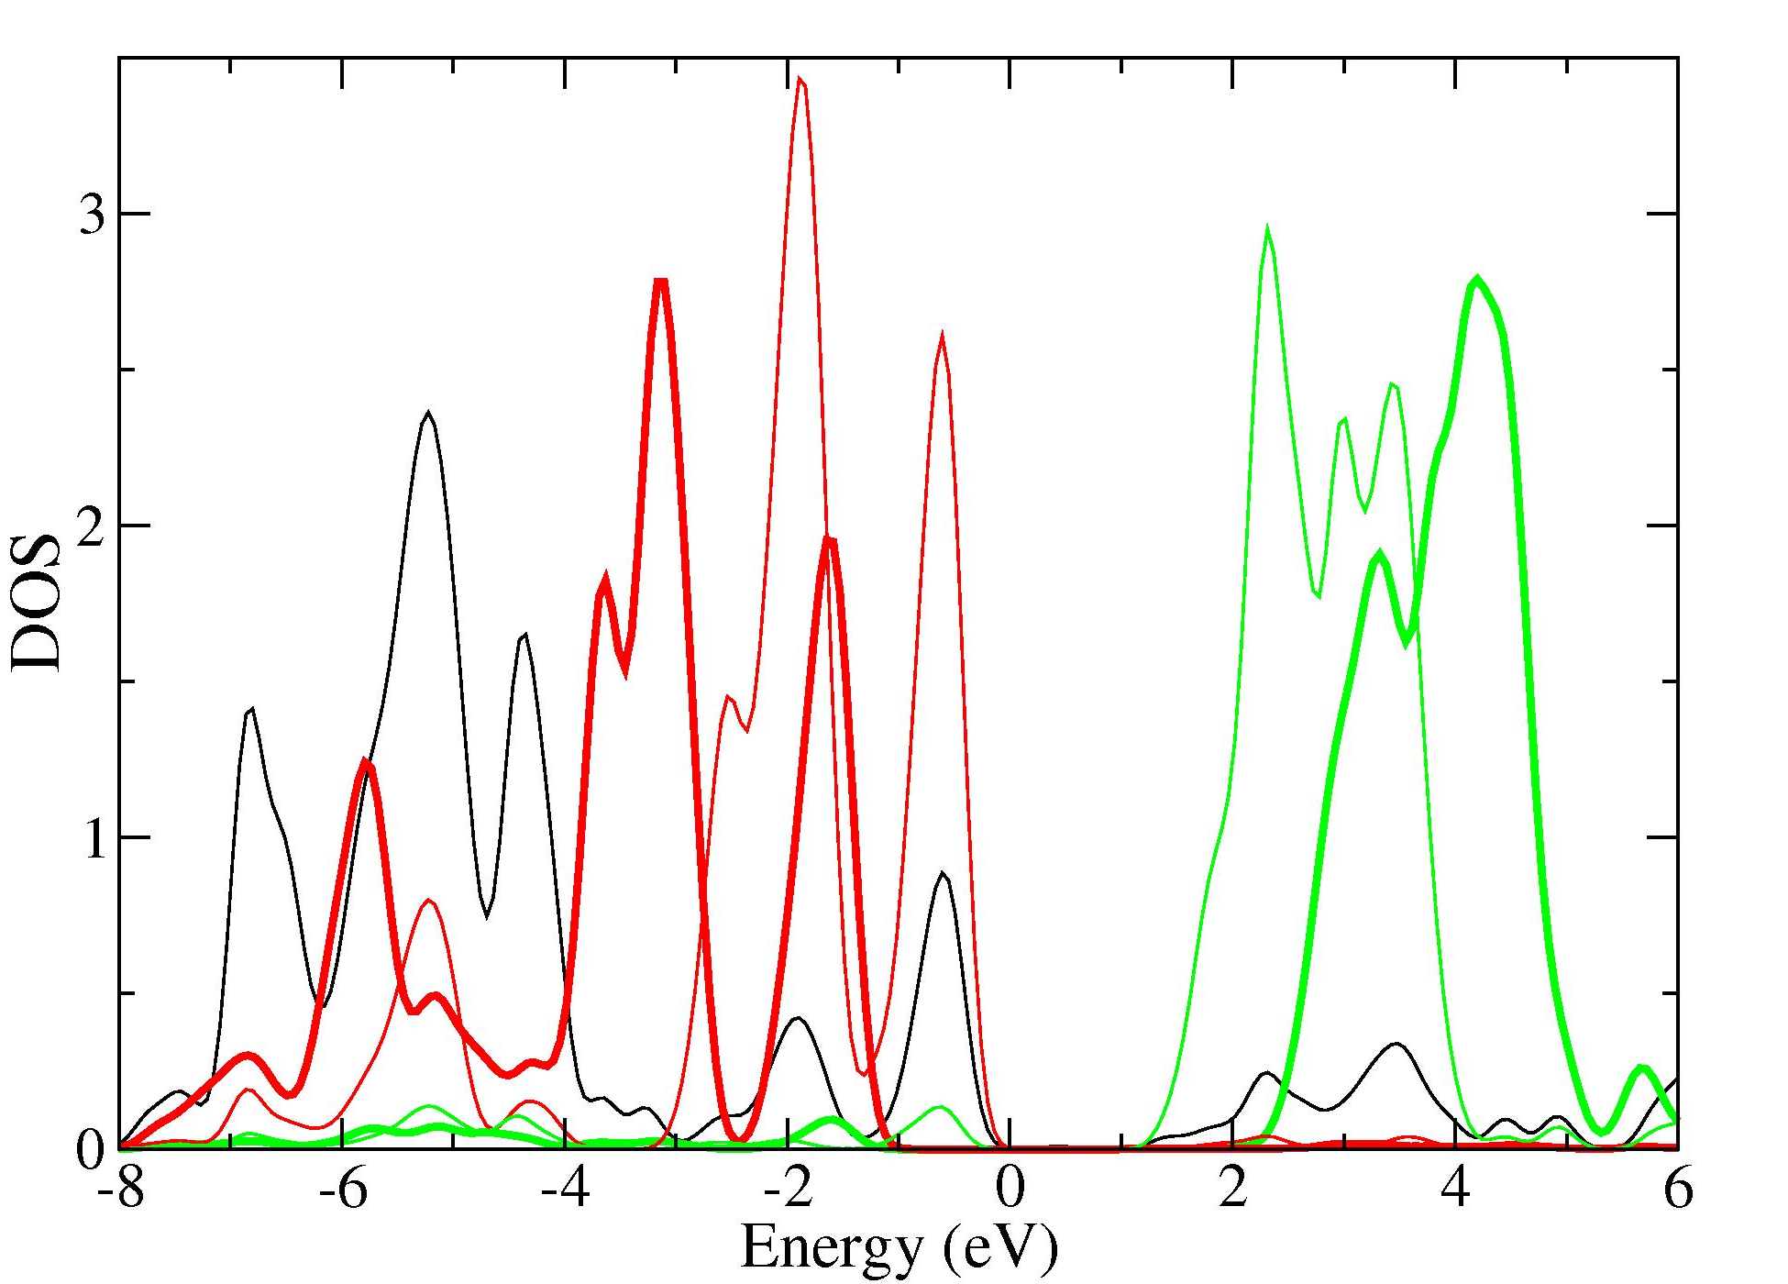
Shift of the 3d Mn states (PDOS)
Majority Spin
U=0 .vs. U=3 eV

Slide 15
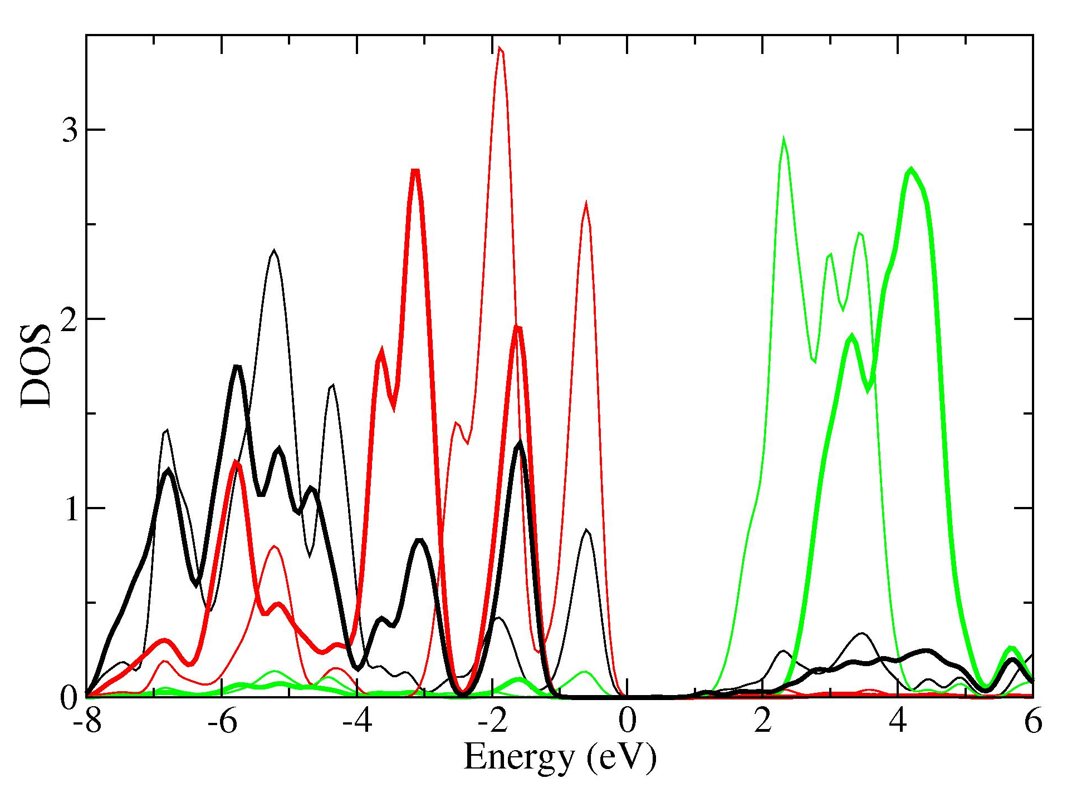
Shift of the 3d Mn states (PDOS)
Majority Spin
Oxygen states almost does not shift

