Slide 1
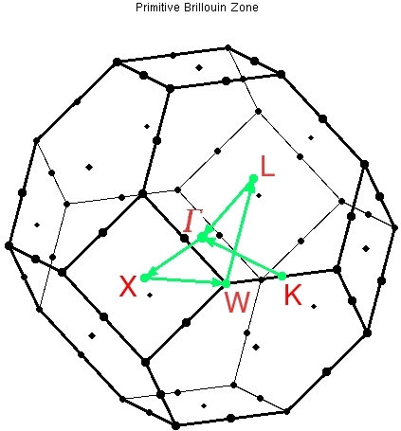
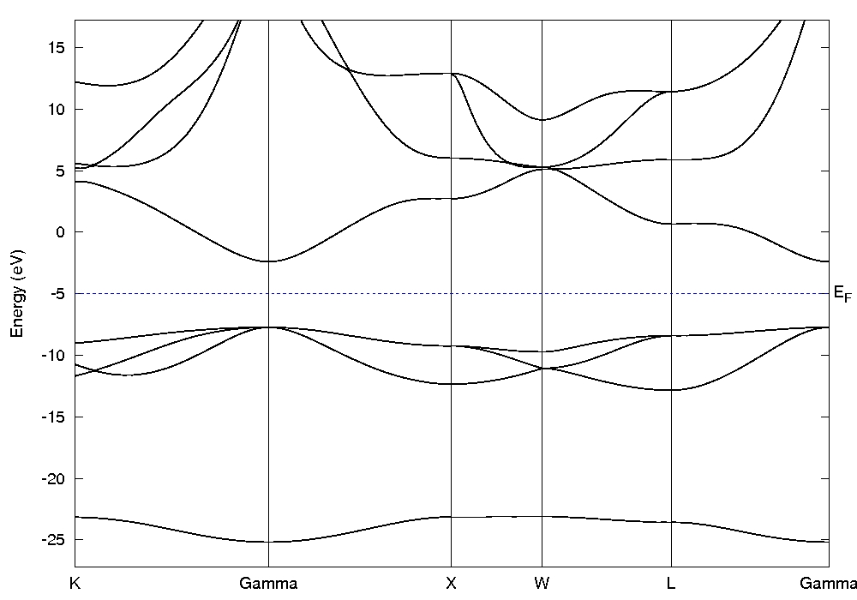
Band structure of an ionic solid: The case of MgO
Objectives
- Compute and analyze the band structure of an ionic solid

Slide 2
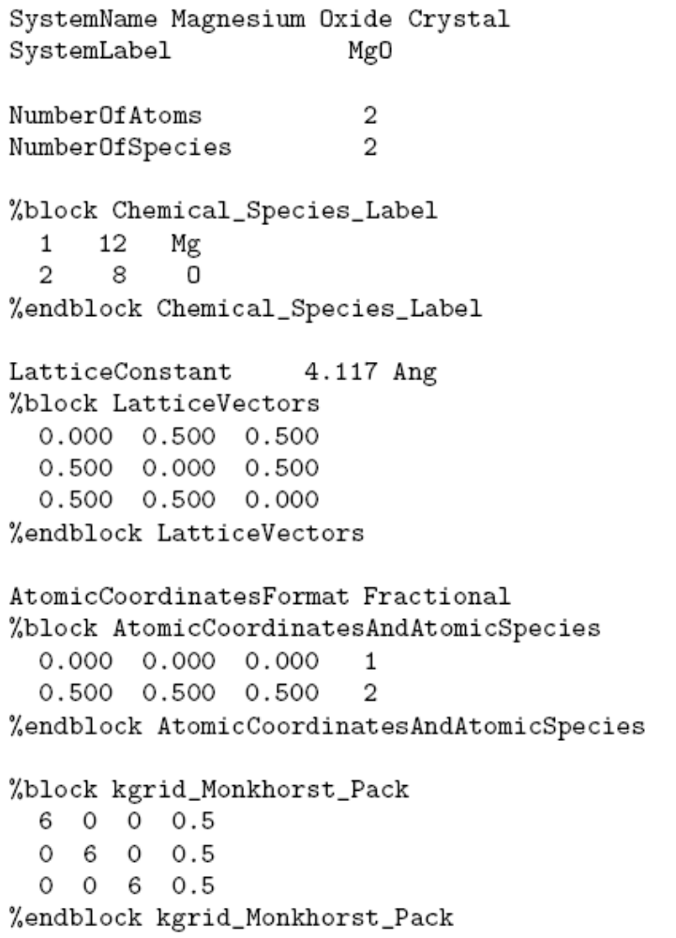
MgO an ionic solid that crystallizes in the rocksalt structure
Go to the directory where the exercise of the bands of MgO is included
Inspect the input file, MgO.fdf
More information at the Siesta web page http://www.icmab.es/siesta and follow the link Documentations, Manual
The equilibrium lattice constant within LDA has been computed for you…
Rocksalt structure:
FCC lattice
+ a basis of two atoms
Sampling in k in the first Brillouin zone to achieve self-consistency

Slide 3
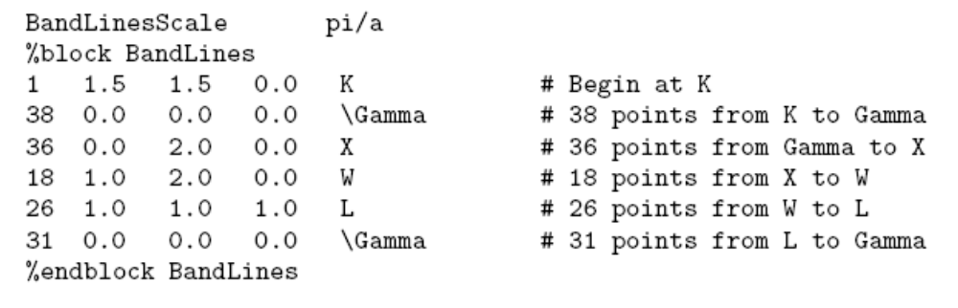
Once SCF has been achieved, we compute the bands along the high symmetry points in the First-Brillouin zone
First-Brillouin zone of a FCC , with the high symmetry points
New variables to plot the band structure

Slide 4
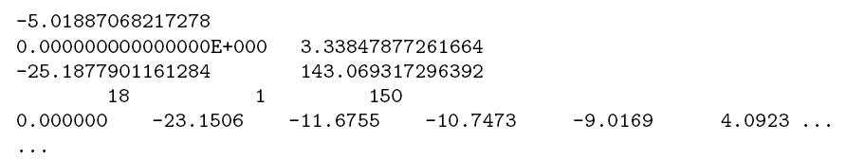
Once SCF has been achieved, we compute the bands along the high symmetry points in the First-Brillouin zone
Check that you have all the required files
A pseudopotential file (.vps or .psf) for every atomic specie included in the input file
For Mg and O within LDA, you can download it from the Siesta web page.
Run the code,
siesta < MgO.fdf > MgO.out
Wait for a few seconds… and then you should have an output, and a file called MgO.bands
If you inspect this file, you will find something like
Energy of the Fermi level
Minimum and maximum length of the path in k-space
Minimum and maximum eigenvalues
Number of orbitals in the unit cell, number of different spin polarization, and number of k-points in the walk through the 1BZ
Coordinate of the k-point in the path, and eigenvalues (in eV). There are as many eigenvalues as orbitals in the unit cell.

Slide 5
Once SCF has been achieved, we compute the bands along the high symmetry points in the First-Brillouin zone
To plot the band structure, there is a Utility in the directory Util, called gnubands.f
To use it:
cp ~/siesta/Util/gnubands.f .
<your_fortran_compiler> -o gnubands.x gnubands.f
gnubands.x < MgO.bands > MgO.bands.gnuplot.dat
The name of this file is free
gnuplot
plot “MgO.bands.gnuplot.dat” using 1:2 with lines
set xrange [0:3.34] → 3.34 is the position of the last k-point in the path in k-space
set yrange [-30.0:25.0] → this is large enough to include all the valence bands
replot

Slide 6
Once SCF has been achieved, we compute the bands along the high symmetry points in the First-Brillouin zone

Slide 7
The most important point: analyze your results
The Fermi energy lies in a gap ⇒ insulator
Theo. direct gap = 5.3 eV
Expt. Gap = 7.8 eV
(LDA band gap understimation)

Slide 8
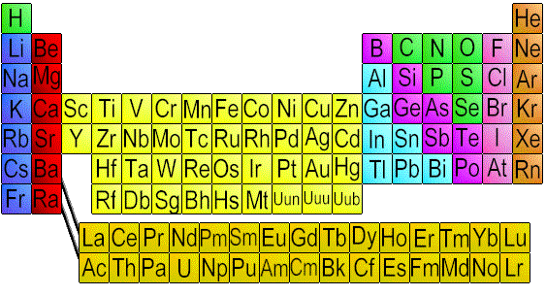
The most important point: analyze your results
Mg: 1s² 2s² 2p⁶ 3s²
→
Mg²⁺
Mg loses two electrons
that are gained by O
O: 1s² 2s² 2p⁶
→
O²⁻
One would expect O (one s band and three p bands) bands completely full and Mg bands completely empty

Slide 9
The most important point: analyze your results
The Fermi energy lies in a gap ⇒ insulator
Theo. direct gap = 5.3 eV
Expt. Gap = 7.8 eV
(LDA band gap understimation)
O 2p
(three bands)
O 2s

Slide 10
Once the transfer of charge is produced, the atoms only interact electrostatically
E
α−2γ
4
γ
α
α+2γ
k
-π/a 0 π/a
In a very simplified tight-binding model,
the width of the band is proportional to the interactions with nearest neighbours
If the interaction is small, the bands are very flat.

Slide 11
The most important point: analyze your results
The Fermi energy lies in a gap ⇒ insulator
Theo. direct gap = 5.3 eV
Expt. Gap = 7.8 eV
(LDA band gap understimation)
O 2p
(three bands)
O 2s
Very small disperion of the O s and O p bands

