Slide 1
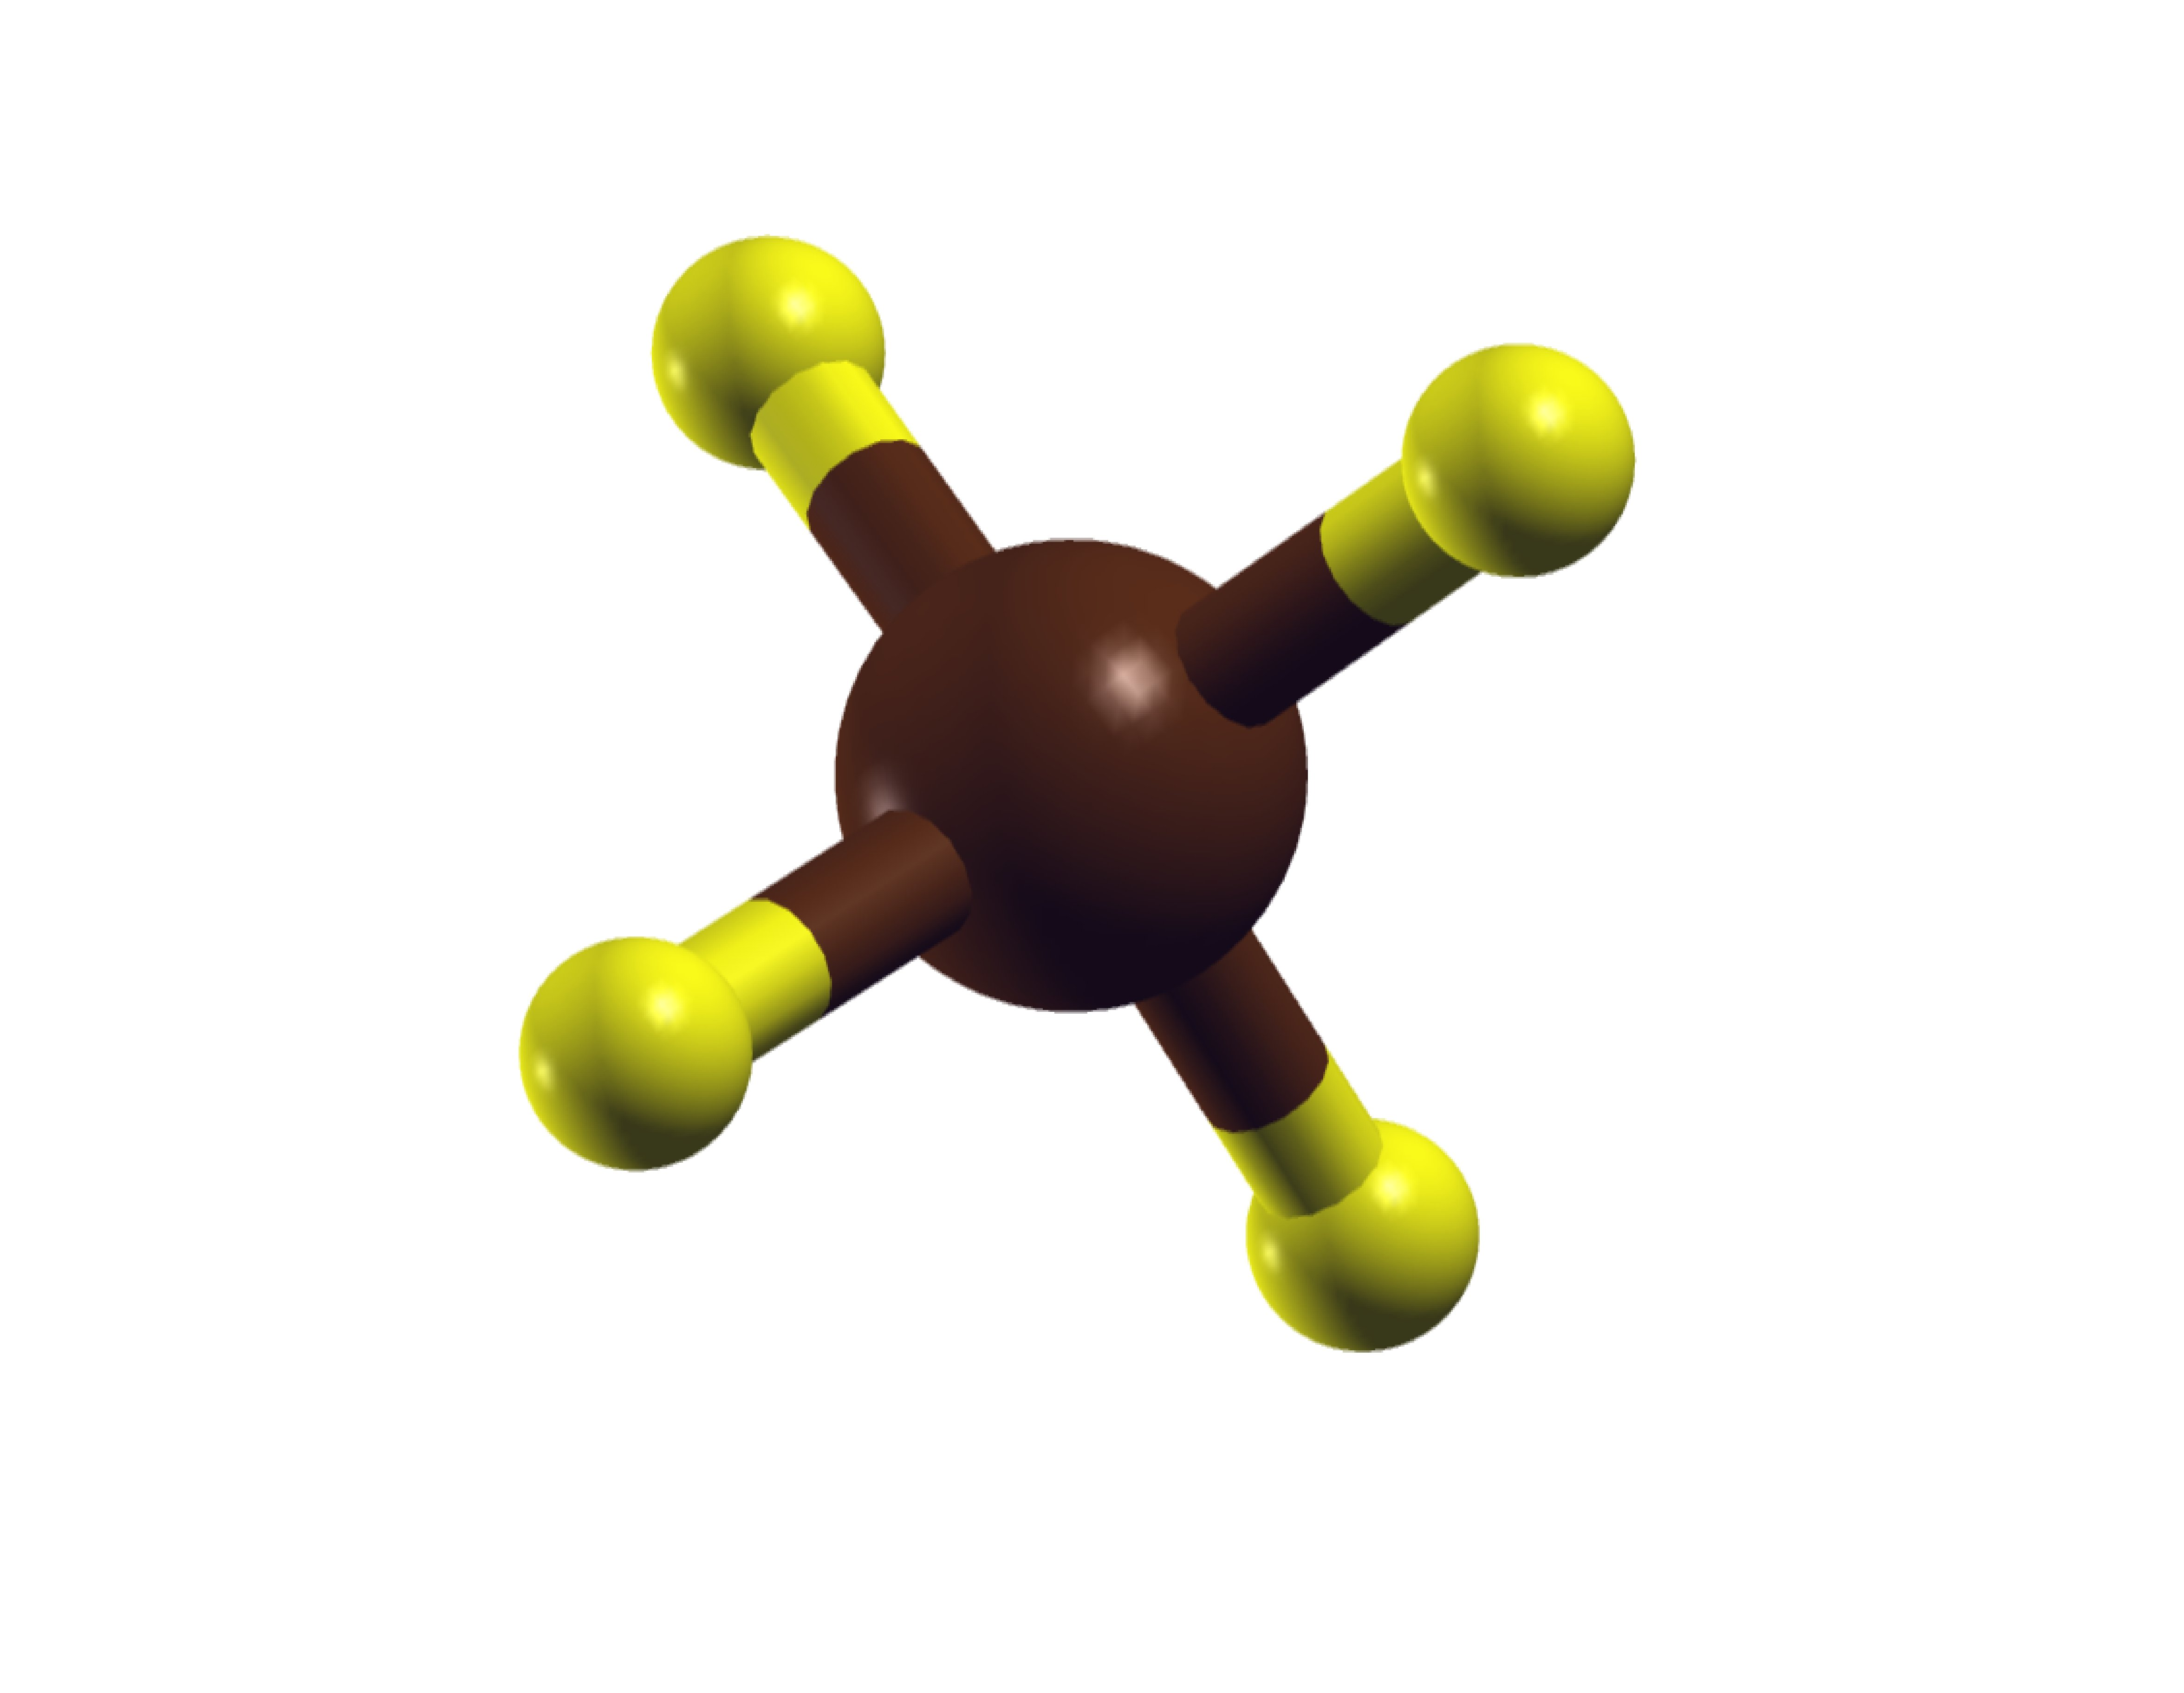
Introducing the coordinates in Z-matrix form
Objectives
study how to introduce the coordinates of a molecule in Z-matrix form

Slide 2
The Z-matrix provides a description of each atom in a molecule in terms of the internal coordinates
Internal coordinates:
Species of each atom
Distances
Angles
Torsion (dihedral) angles
This is particularly useful when working with molecular systems or restricted optimizations (control optimization variables)
The name arises because the Z-matrix assigns the second atom along the Z-axis from the first atom, which is at the origin.

Slide 3
Examples of the Z-matrix input in Siesta
%block Zmatrix
molecule
This specifies the atoms that make up each molecule and their geometry.

Slide 4
Examples of the Z-matrix input in Siesta
In addition, an option may be passed, that indicates the units in which distances are specified in
%block Zmatrix
molecule fractional
%block Zmatrix
molecule scaled
%block Zmatrix
molecule
In the absence of such an option, the distance units are taken to be the value of “ZM.UnitsLength”

Slide 5
Examples of the Z-matrix input in Siesta
%block Zmatrix
molecule
Nspecie i j k r a t ifr ifa ift
One line per each atom in the molecule
Integers
Double precision
Integers

Slide 6
Examples of the Z-matrix input in Siesta
%block Zmatrix
molecule
Nspecie i j k r a t ifr ifa ift
One line per each atom in the molecule
Integers
Double precision
Integer flags that indicate whether r, a, and t, respectively, should be varied in a relaxation or molecular dynamics ;
0 for fixed,
1 for varying.
Species number of the atom

Slide 7
Examples of the Z-matrix input in Siesta
The coordinates of the first atom… the easiest one. It will be taken as the origin
%block Zmatrix
molecule
Nspecie1 0 0 0 0.0 0.0 0.0 0 0 0
For the first atom, set them to 0
Cartesian coordinates
(let us take as the origin in this example)
Species number of the atom

Slide 8
Examples of the Z-matrix input in Siesta
The coordinates of the second atom
%block Zmatrix
molecule
Nspecie1 0 0 0 0.0 0.0 0.0 0 0 0
Nspecie2 1 0 0 d12 0.0 0.0 0 0 0
Coordinates, in spherical coordinates, of the second atom with respect to the atom first
In this particular example, this is just the distance along the z-axis of the second atom with respect the first

Slide 9
Examples of the Z-matrix input in Siesta
The coordinates of the third atom
%block Zmatrix
molecule
Nspecie1 0 0 0 0.0 0.0 0.0 0 0 0
Nspecie2 1 0 0 d12 0.0 0.0 0 0 0
Nspecie3 1 2 0 d31
Distance of the third atom to the atom indicated in this position (in this example, this number indicates the distance between atom 3 and atom 1)

Slide 10
Examples of the Z-matrix input in Siesta
The coordinates of the third atom
%block Zmatrix
molecule
Nspecie1 0 0 0 0.0 0.0 0.0 0 0 0
Nspecie2 1 0 0 d12 0.0 0.0 0 0 0
Nspecie3 1 2 0 d31 a123
Angle made by the third atom with respect atoms indicated here and here (in this example, this number indicates the angle formed between atoms 1, 2, and 3)

Slide 11
Examples of the Z-matrix input in Siesta
The coordinates of the third atom
%block Zmatrix
molecule
Nspecie1 0 0 0 0.0 0.0 0.0 0 0 0
Nspecie2 1 0 0 d12 0.0 0.0 0 0 0
Nspecie3 1 2 0 d31 a123 t1234 0 0 0
Torsional angle made by the third atom with respect atoms indicated here, here, and here (for the third atom is defined relative to a notional atom 1 unit in the z-direction above the atom j)

Slide 12
Examples of the Z-matrix input in Siesta
The rest of the atoms follow the same specification:
Distance with respect atom i
Angle with respect atom j and i
Torsional angle with respect atoms k, j, and i
%block Zmatrix
molecule
Nspecie1 0 0 0 0.0 0.0 0.0 0 0 0
Nspecie2 1 0 0 d12 0.0 0.0 0 0 0
Nspecie3 1 2 0 d31 a123 t1234 0 0 0
…
NspecieX …….
%endblock Zmatrix

Slide 13
Instead of specifying a numerical value, it is possible to specify a symbol within the above geometry definitions.
Example, the water molecule
%block Zmatrix
molecule fractional
1 0 0 0 0.0 0.0 0.0 0 0 0
2 1 0 0 HO1 90.0 37.743919 1 0 0
2 1 2 0 HO2 HOH 90.0 1 1 0
variables
HO1 0.956997
HO2 0.956997
constant
HOH 104.4
%endblock Zmatrix
Define the symbol as variables
Define the symbol as a constant

Slide 14
Exercise: define the coordinates of a CH4 molecule in Z-matrix form
%block Zmatrix
molecule
1 0 0 0 0.0 0.0 0.0 0 0 0
2 1 0 0 CH 0.0 0.0 1 0 0
2 1 2 0 CH 109.471 0.0 1 0 0
2 1 2 3 CH 109.471 120.0 1 0 0
2 1 2 3 CH 109.471 240.0 1 0 0
variables
CH 1.089
%endblock Zmatrix
ZM.UnitsLength Ang
ZM.UnitsAngle Deg
Modify the distance CH by hand and find the equilibrium distance

