Slide 1
The H₂ molecule without convergence studies
r
H
H
Objectives:
- the (pseudo)total energy
- the bond length
Acknowledgment: exercise inspired on the first exercise of the Abinit tutorial (http://www.abinit.org)

Slide 2
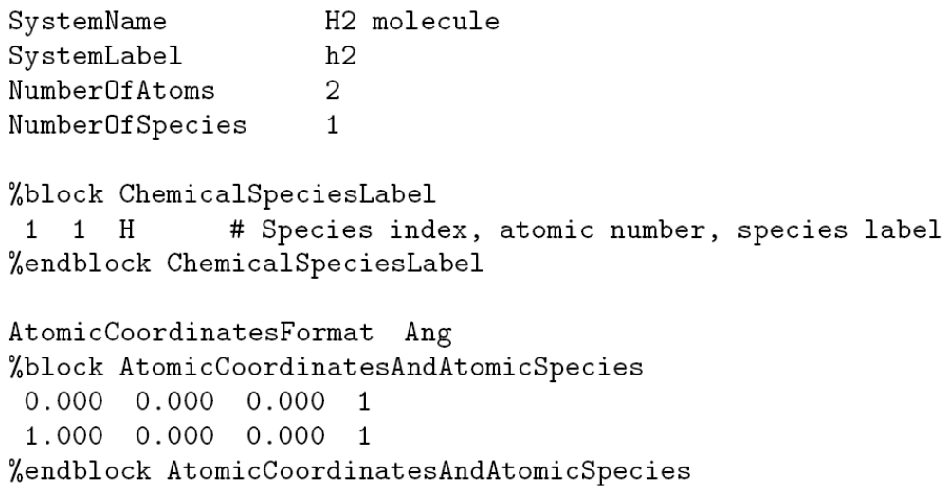
H₂ molecule: example of a very simple input file
Go to the directory where the exercise of the H₂ molecule is included
Inspect the input file, h2.fdf
Examine in detail the different input variables, more information at
http://www.icmab.es/siesta and follow the link Documentations, Manual
Number of different species and atoms present in the unit cell
List of different species
Position of the atoms
Example of a first-principles simulation: no input from experiment

Slide 3
Many variables will take the default value
PAO.BasisSize (Basis set quality) DZP
MeshCutoff (Fineness of real space integrations) 100 Ry
XC.Functional (Exchange and correlation functional) LDA
XC.Authors (Flavour of the exchange and correlation) CA
SpinPolarized (Are we performing an spin polarized calc.) .false.
… and many others. For a detailed list, see fdf.log after running the code.

Slide 4
H₂ molecule: the first run of Siesta (0.002 thousand of atoms)
Check that you have all the required files
A pseudopotential file (.vps or .psf) for every atomic specie included in the input file
For H within LDA, you can download it from the Siesta web page.
Run the code,
siesta < h2.fdf > h2.1.00.out
The name of the output file is free, but since we are running the H₂ molecule with an interatomic distance of 1 Å, this seems very sensible…
Wait for a few seconds… and then you should have an output

Slide 5
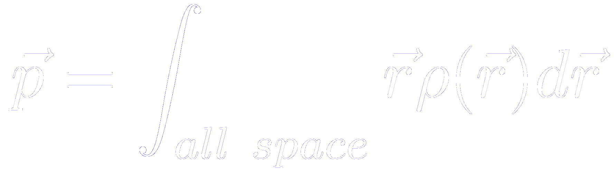
H₂ molecule: taking a glance to the output files
Let’s make a tour on the different output files:
Inspect the output file, h2.1.00.out
How many SCF cycles were required to arrive to the convergence criterion?
How much is the total energy of the system after SCF?
How large is the unit cell automatically generated by Siesta?
How much is the electric dipole of the molecule (in electrons × bohr)?
For molecules,
Inspect the output file where the forces are written, SystemLabel.FA
What is the value of the force on each atom, in eV/Å?
Is the system in the equilibrium configuration?

Slide 6
H₂ molecule: the interatomic distance
Goal: find the equilibrium structure of the molecule
Method 1:
- compute the total energy for different values of the interatomic distance,
- make a fit through the different points,
- determine the minimum of the fitting function.
Method 2:
- compute the forces for different values of the interatomic distance,
- make a fit through the different points,
- determine the zero of the fitting function.
Method 3:
- use an automatic algorithm to minimize the energy

Slide 7
H₂ molecule: the interatomic distance using Method 1
Run again the code, changing the interatomic distance from 0.40 Å to 3.00 Å by steps of 0.10 Å
Modify the input file, changing the position of this atom
Run the code, saving each output in a separate file
siesta < h2.fdf > h2.your_interatomic_distance.out

Slide 8
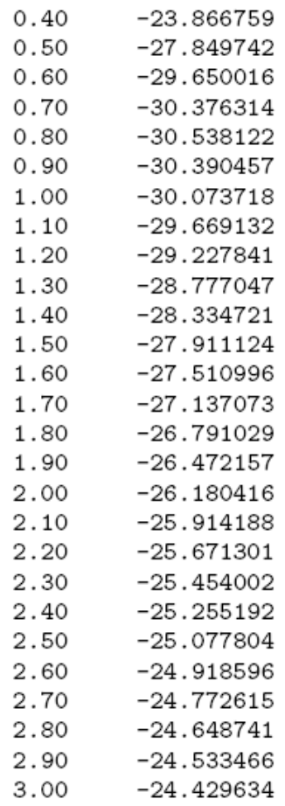
H₂ molecule: the interatomic distance using Method 1
Tabulate the total energy as a function of the interatomic distance
grep “Total =” h2.*.out > h2.distance.dat
Edit the h2.distance.dat file, and leave only two columns
Interatomic distance (Å)
Total energy (eV)

Slide 9
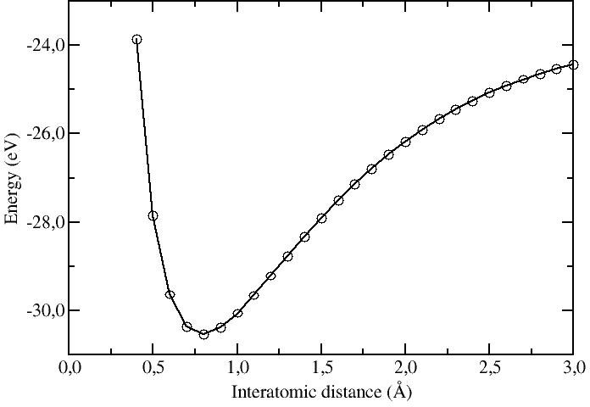
H₂ molecule: the interatomic distance using Method 1
Plot the total energy versus interatomic distance
gnuplot
plot “h2.distance.dat” using 1:2 with lines

Slide 10
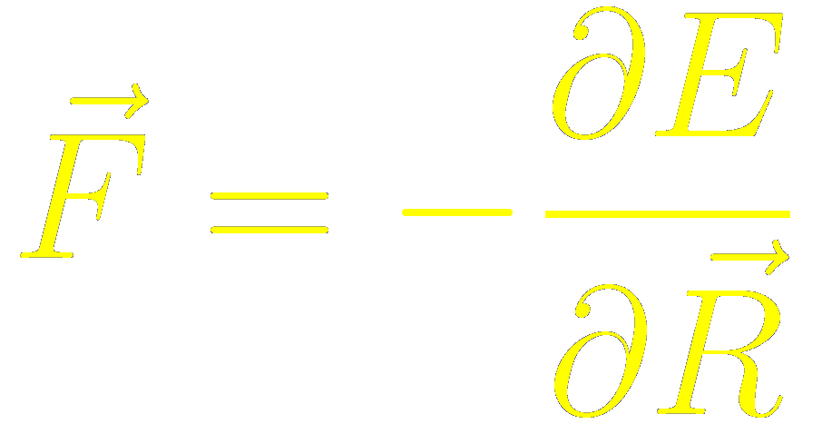
H₂ molecule: the most important point:
analyze the results
When atoms or molecules get too close, they repel each other with a very large repulsion
For non-polar molecules, the interaction at very large distances is an attraction, and varies inversely as the sixth power of the distance
E ∝ r⁻⁶
(Thought LDA does not capture Van-der-Waals interation)
Close to the minimum, we can approximate the curve as a parabola (harmonic approximation)
Minimum at the equilibrium distance, around 0.8 Å (For comparison, Abinit 0.805 Å)
At this point, the forces on the atoms vanish ( )

