Slide 1
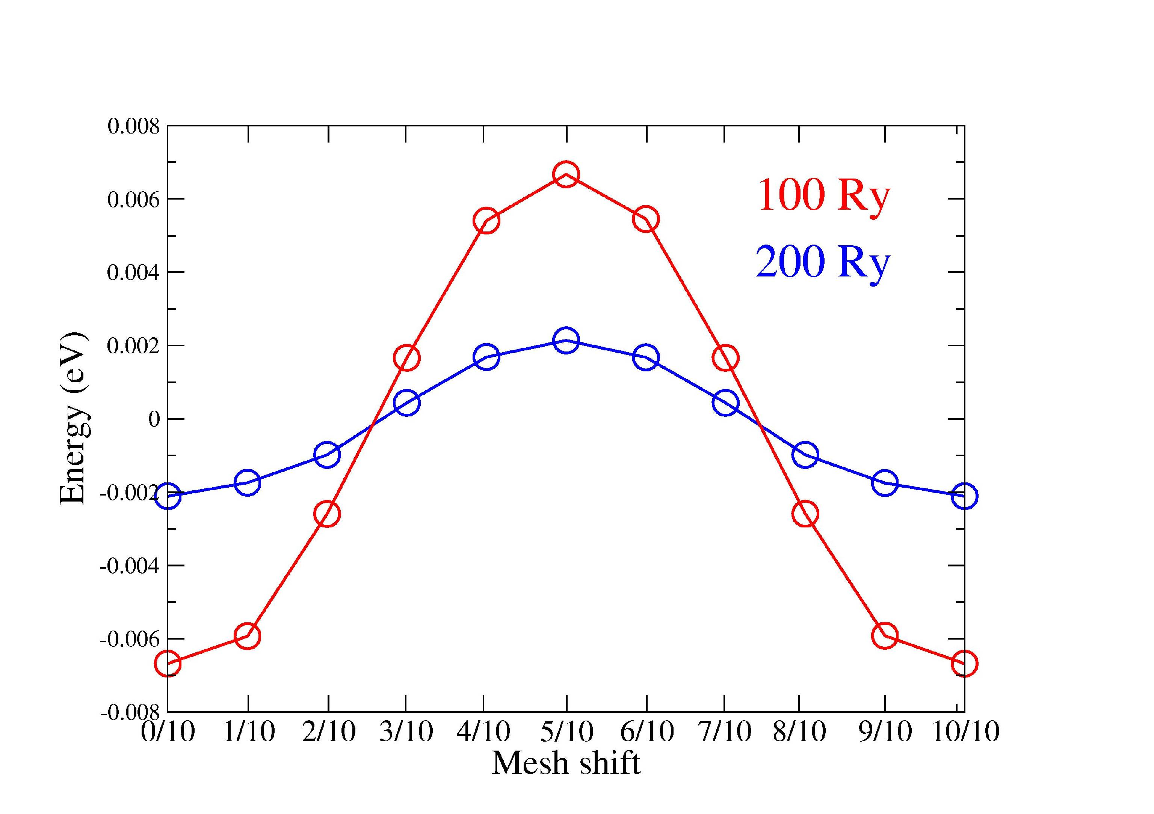
The eggbox effect: converging the mesh cutoff
Objectives
- study the convergence of the energy and the forces with respect to the real space grid.

Slide 2
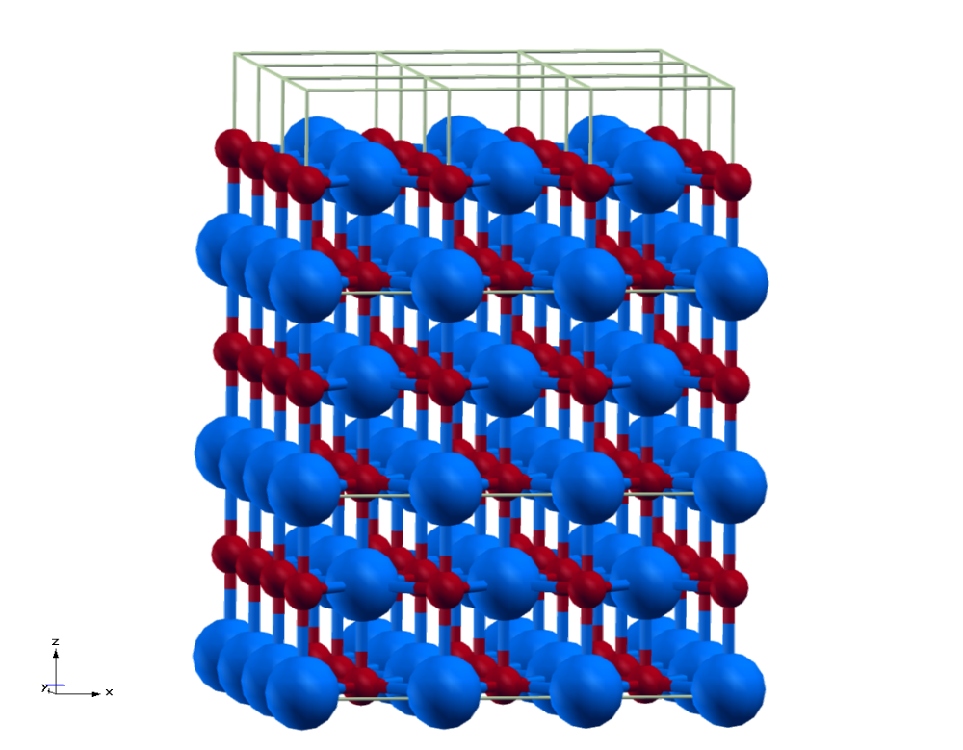
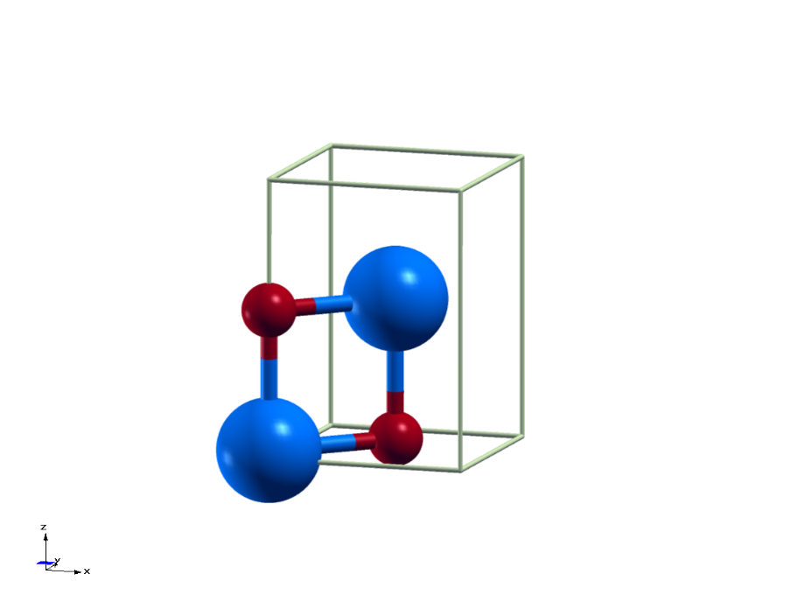
System where the tests will be performed: bulk MgO (rocksalt structure)
Instead of using the unit cell (FCC + 2 atoms of basis), the exercise will be more transparent if we use a conventional unit cell with orthogonal lattice vectors
Simulation cell:
Tetragonal
4 atoms/cell

Slide 3
Some of the integrals are computed in a three dimensional grid in real space
Let us project the atomic position in the (x,z) plane
Simulation cell:
Tetragonal
4 atoms/cell
Mg
O
y=0
y=0.5
z
y=0
y=0.5
x

Slide 4
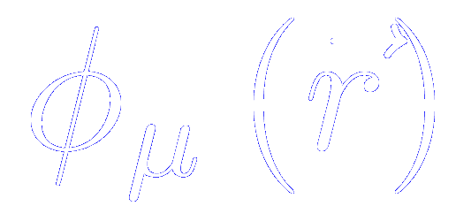
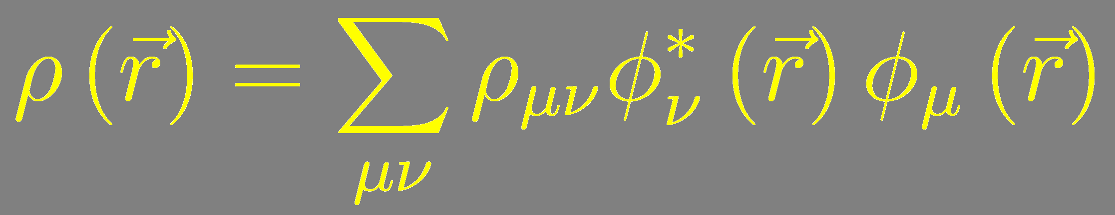
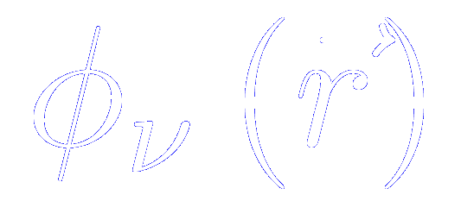
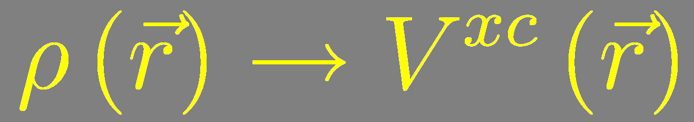
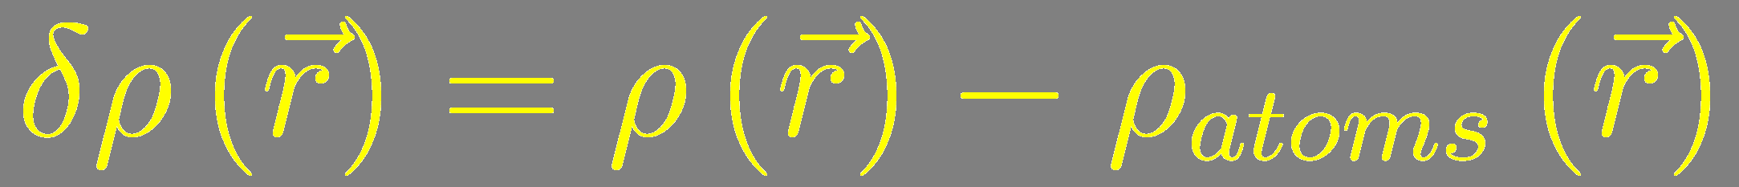
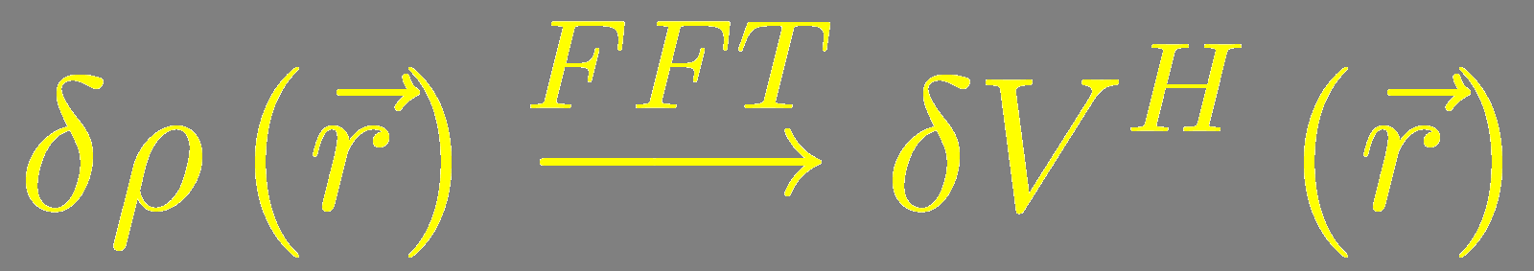
Three dimensional grid to compute Hartree, exchange correlation and neutral atom potentials
Find all the atomic orbitals that do not vanish at a given grid point
(in practice, interpolate the radial part from numerical tables)
EVERYTHING O(N)
Once the density is known, we compute the charge density and the potentials

Slide 5
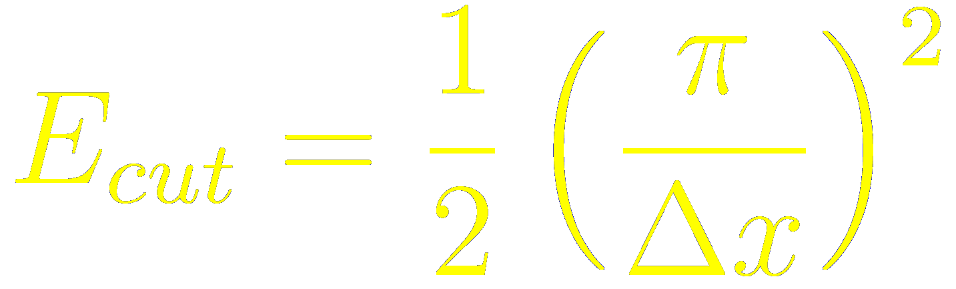
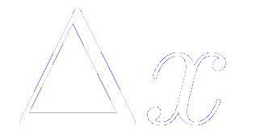
Fineness of the grid controlled by a single parameter, the “MeshCutoff”
E_{cut} : maximum kinetic energy of the plane waves that can be represented in the grid without aliasing
where is the grid interval
Δx
In the grid, we represent the density ⇒ grid cutoff not directly comparable
with the plane wave cutoff to represent wave functions
(Strictly speaking, the density requires a value four times larger)

Slide 6
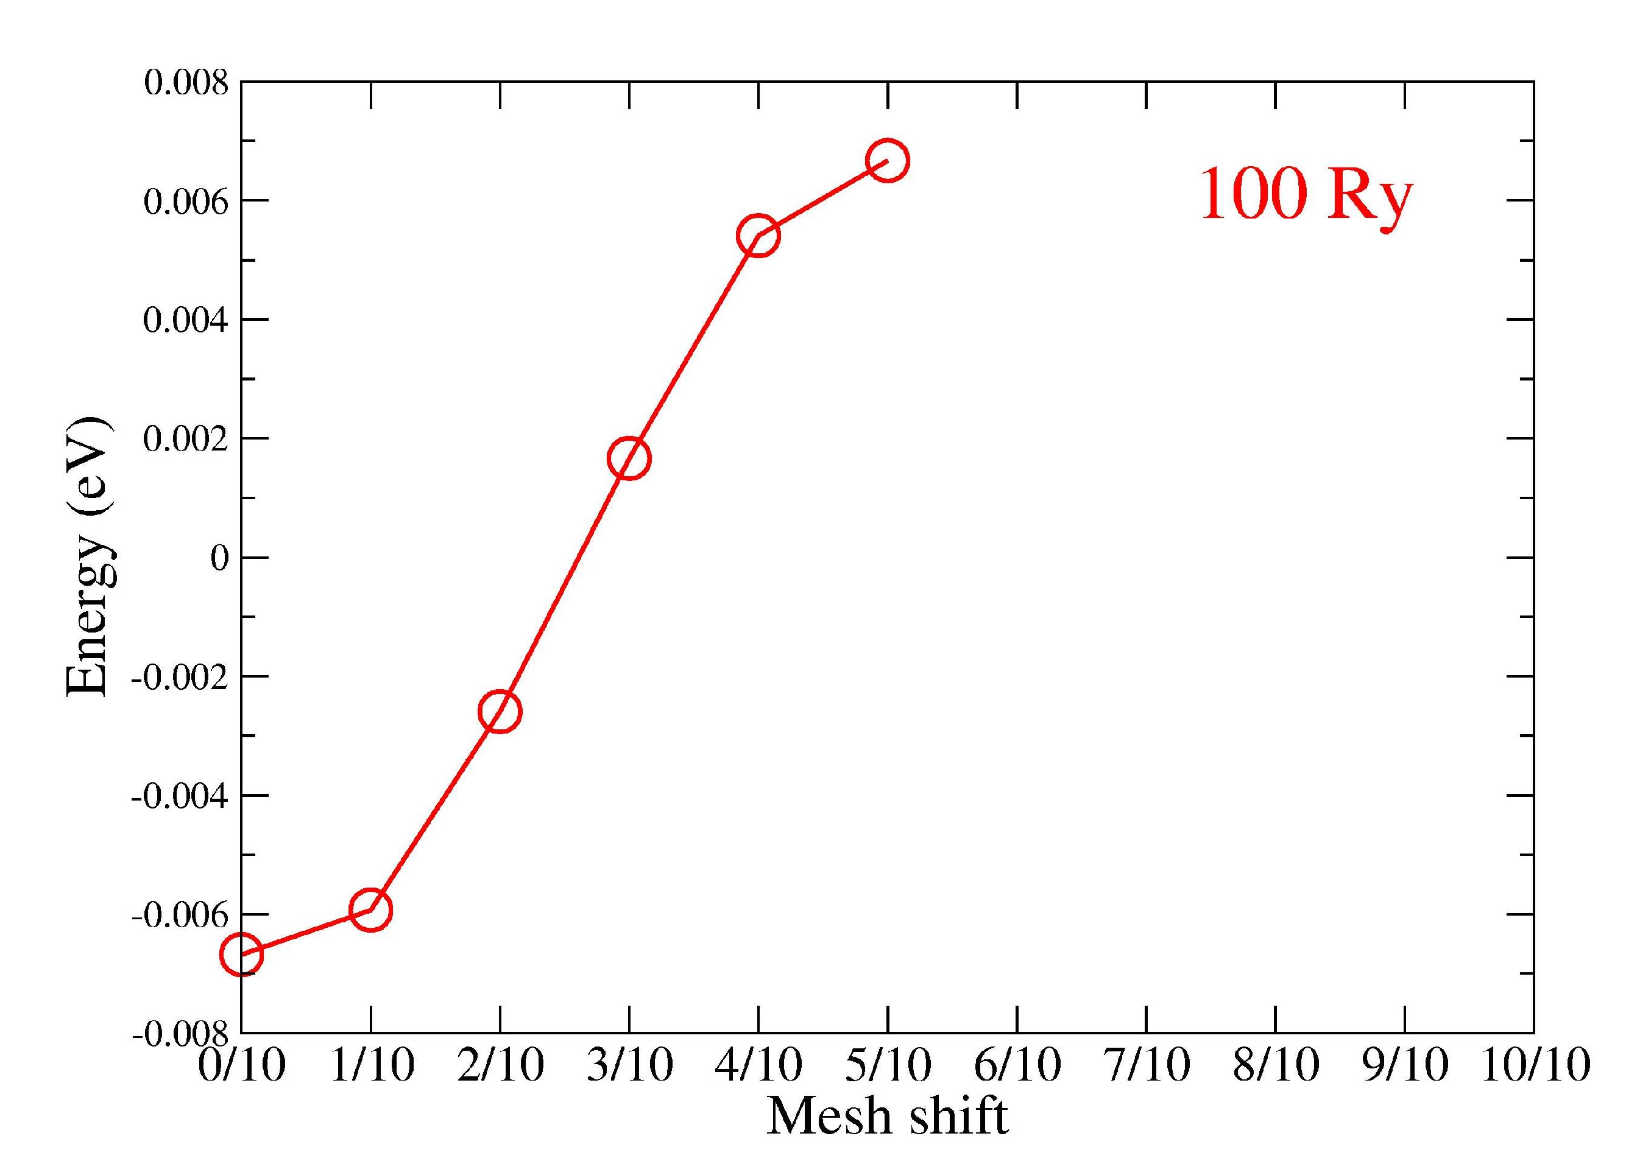
Fineness of the grid controlled by a single parameter, the “MeshCutoff”
MeshCutOff = 100 Ry
Grid of 18 x 18 x 30 points along the three lattice vectors
Mg
O
y=0
y=0.5
z
y=0
y=0.5
x

Slide 7
All the quantities should be invariant under translation as a whole, but the grid breaks translation symmetry.
The grid integrals make the energy dependent on the position of the atoms relative to the grid
Mg
Relative position can be controlled by the input variable:
%block AtomicCoordinatesOrigin
The origin is given in the same units as the atomic coordinates.
O
y=0
y=0.5
z
y=0
y=0.5
x

Slide 8
The grid integrals make the energy dependent on the position of the atoms relative to the grid
MeshCutOff = 100 Ry
Grid of 18 x 18 x 30 points along the three lattice vectors
Mg
O
Distance between consecutive points in the grid along z (in reduced coordinates):
1/30
y=0
y=0.5
Let us compute the change in the energy and the forces when we displace rigidly all the atoms in the unit cell from one point of the grid to the next one (let us assume, in this case, in 10 steps)
%block AtomicCoordinatesOrigin
0.0 0.0 (1/30)/10
%endblock AtomicCoordinatesOrigin
z
y=0
y=0.5
x

Slide 9
The grid integrals make the energy dependent on the position of the atoms relative to the grid
%block AtomicCoordinatesOrigin
0.0 0.0 1/30/10
%endblock AtomicCoordinatesOrigin
Mg
O
y=0
y=0.5
z
y=0
y=0.5
x

Slide 10
The grid integrals make the energy dependent on the position of the atoms relative to the grid
%block AtomicCoordinatesOrigin
0.0 0.0 2/30/10
%endblock AtomicCoordinatesOrigin
Mg
O
y=0
y=0.5
z
y=0
y=0.5
x

Slide 11
The grid integrals make the energy dependent on the position of the atoms relative to the grid
%block AtomicCoordinatesOrigin
0.0 0.0 3/30/10
%endblock AtomicCoordinatesOrigin
Mg
O
y=0
y=0.5
z
y=0
y=0.5
x

Slide 12
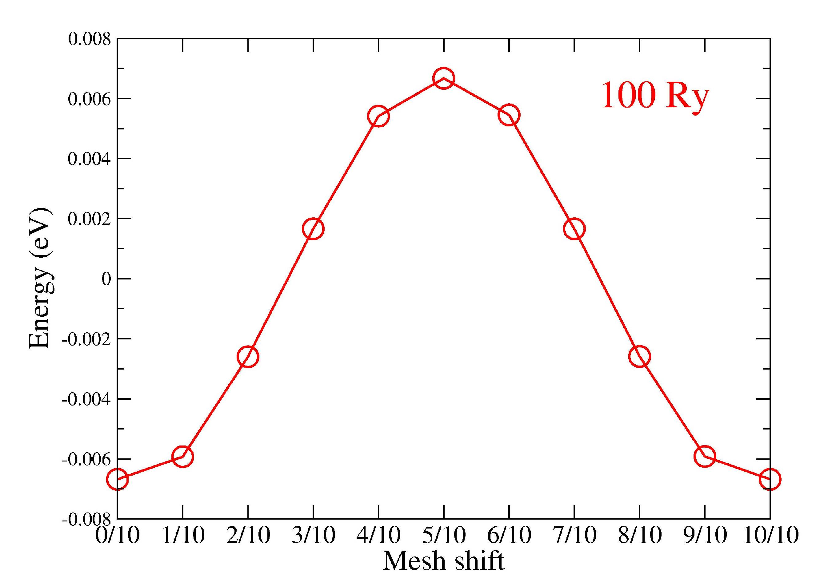
The grid integrals make the energy dependent on the position of the atoms relative to the grid
%block AtomicCoordinatesOrigin
0.0 0.0 10/30/10
%endblock AtomicCoordinatesOrigin
Mg
O
y=0
y=0.5
z
Eggbox effect
y=0
y=0.5
x

Slide 13
The war against the eggbox… Solution 1: Increase the MeshCutoff
MeshCutOff = 100 Ry
MeshCutOff = 200 Ry
Grid 18 x 18 x 30
Grid 30 x 30 x 36
Extra cost in:
CPU time
Memory

Slide 14
The war against the eggbox… Solution 2: the Grid-cell sampling
Achieve SCF for a given MeshCutoff and relative positions of the atoms with respect the grid points.
Freeze in the Density Matrix.
Translate the whole system rigidly by a set of points in a finer mesh.
Recalculate energy, forces, and stresses in the shifted configuration, using the Density Matrix frozen before (that is, the shifted calculations are non self-consistent).
Take the average of the energies, forces, and stresses between all the sampled points.
No extra cost in memory.
It is done only at the end of the SCF iteration, for fixed DM. Only moderate cost in CPU time.

Slide 15
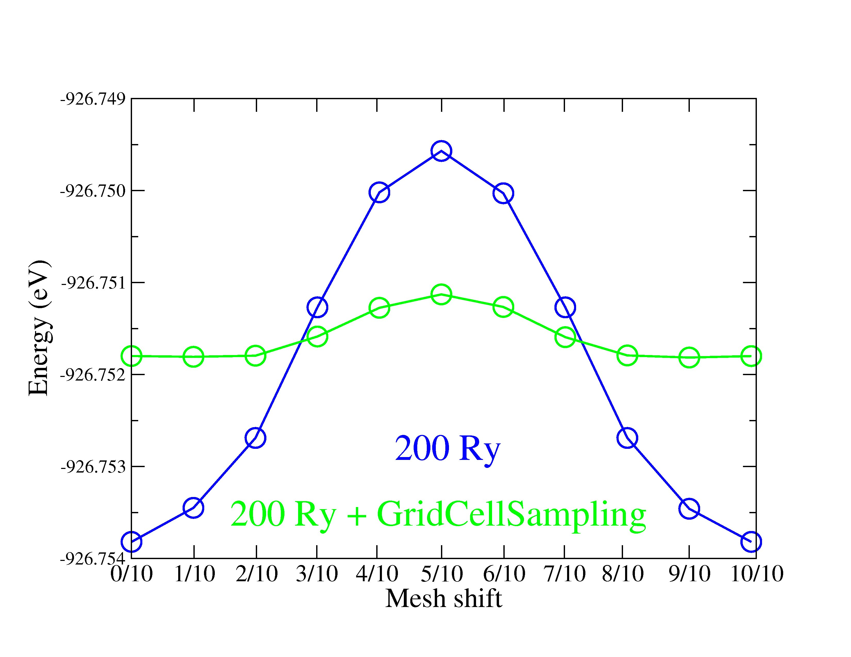
The war against the eggbox… Solution 2: the Grid-cell sampling
%block GridCellSampling
0.5 0.0 0.0
0.0 0.5 0.0
0.0 0.0 0.5
%endblock GridCellSampling

Slide 16
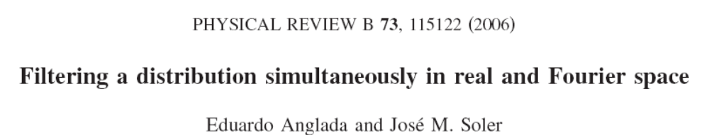
The war against the eggbox… Solution 3: filtering the atomic orbitals
arXiV: 0807.5030

Slide 17
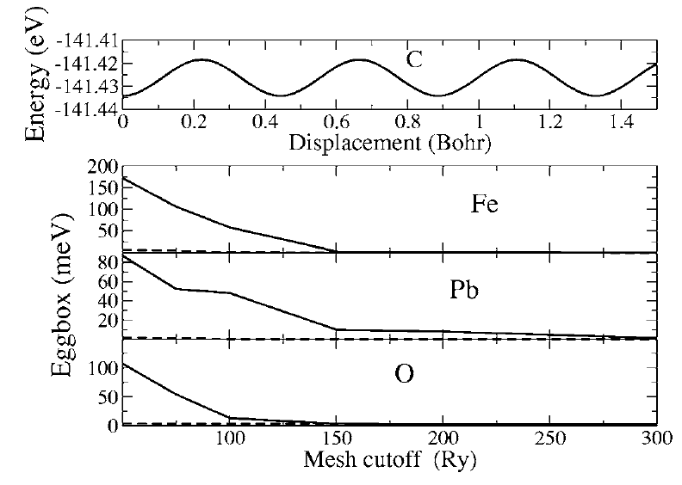
The war against the eggbox… Solution 3: filtering the atomic orbitals

