Slide 1
Electric motorbike (n): xe máy điện
Electric
motorbike

Slide 2
Traffic light (n): đèn giao thông run a red light: vượt đèn đỏ
_ra_fi_ l_ _ht

Slide 3
Traffic jam = traffic congestion (n): kẹt xe get stuck in traffic jam:
Jam
traffic

Slide 4
Get along/ on well with leisure activity be responsible for started working environment generous
I chịu trách nhiệm……………………and I like my job because môi trường làm việc is…………………
My favorite hoạt động vui chơi is…………………..I ……………………
I bắt đầu ……………………………when……………………..And now I ……
I hòa hợp với…………………….He/ she is rộng lượng………

Slide 5
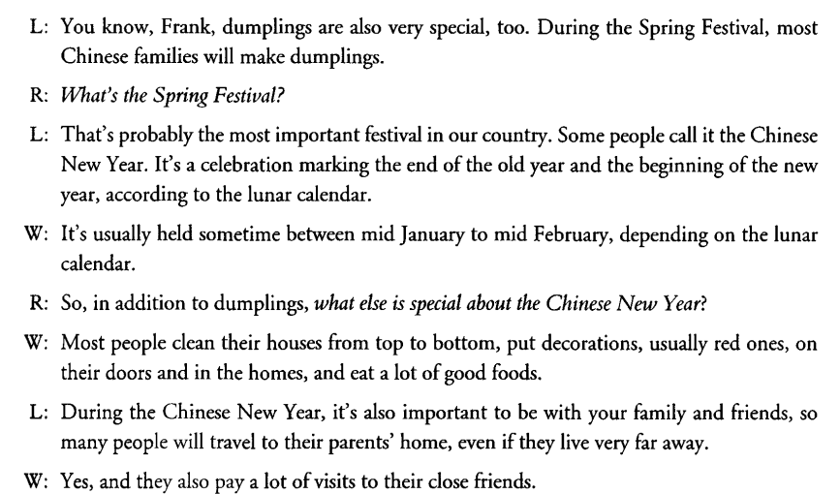

Slide 6
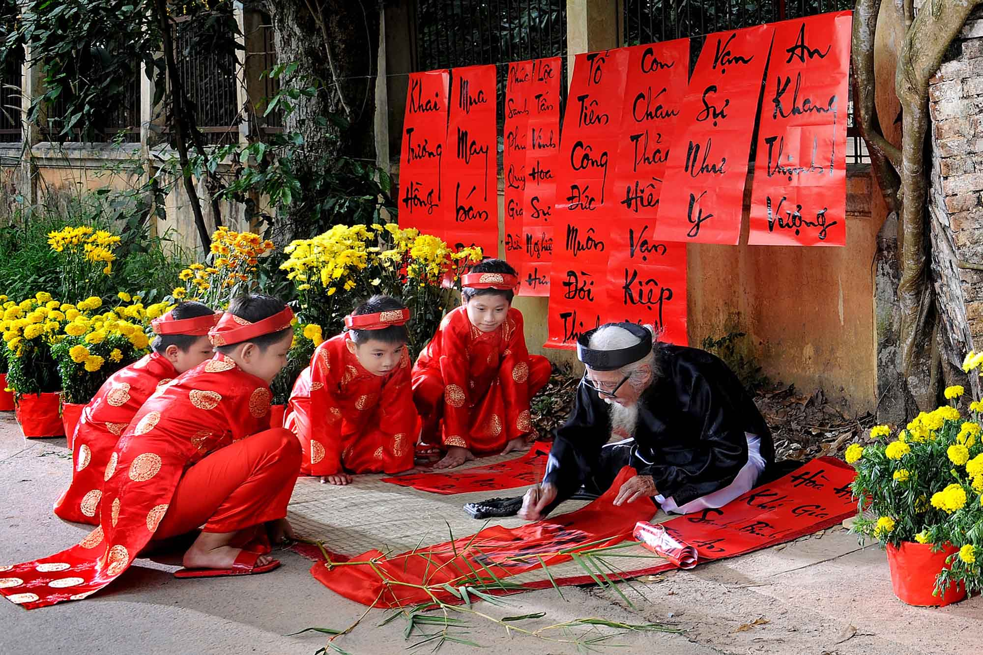
A sign of good luck (n): dấu hiệu của sự may mắn

Slide 7
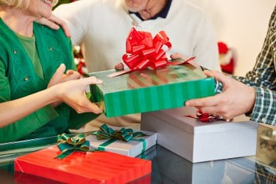
Exchange gifts (v): trao đổi quà

Slide 8
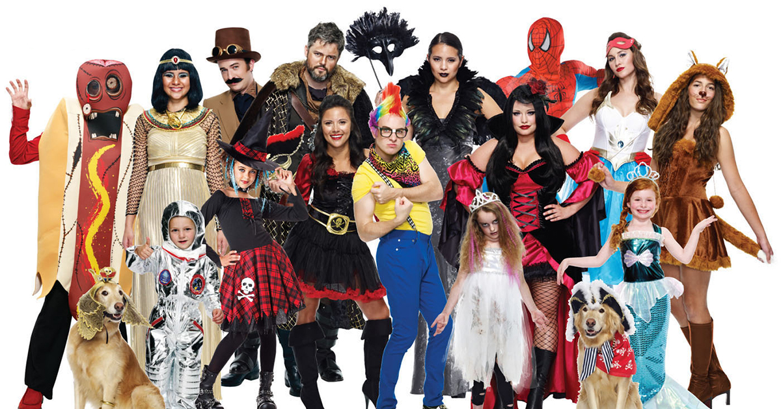
Special costume (n): trang phục đặc biệt

Slide 9
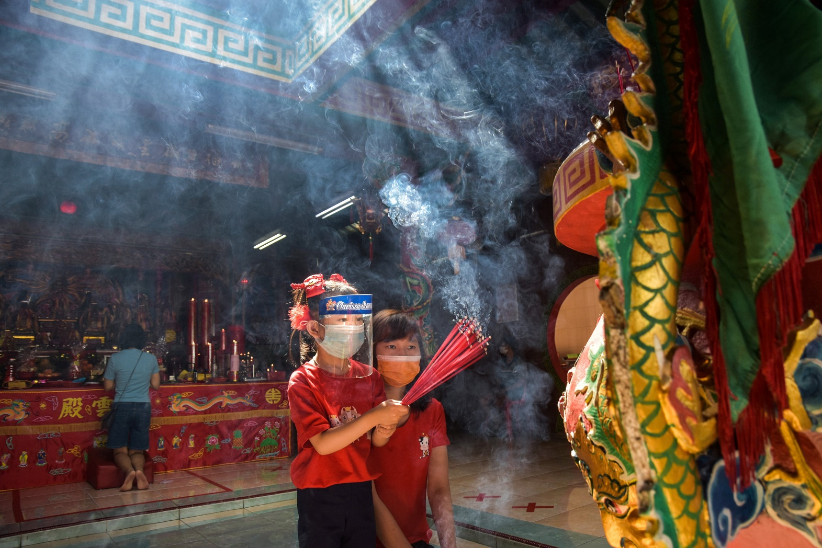
Social custom (n): phong tục xã hội

Slide 10
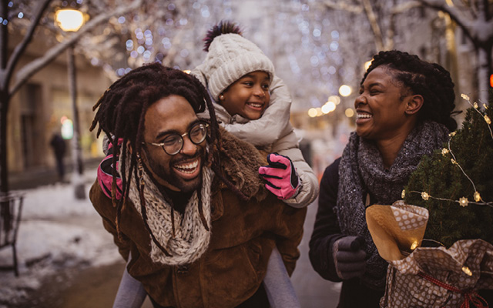
Share the joy/ happiness with… (v): chia sẻ niềm vui với

Slide 11
What do Vietnamese people do during Tet holiday?
During………………………….., most of Vietnamese families………

Slide 12
What’s an important holiday in your country?
……………………..is a very important holiday because……………

Slide 13
What do you like about Tet holiday?
What I can enjoy the most about…………….is………..
I love special food like………………

Slide 14
What are some international holidays you know?
They are………………………….
In those holidays, people………………..

Slide 15
What are the advantages of holiday?
There are a lot of benefits of holiday.
First,…………………..
Second,…………….
Finally,…………………

Slide 16
What are the disadvantages of holiday?
There are some drawbacks of it.
First, it’s bad for people to……………..
Second,…………..
Finally,……………..

Slide 17
Describe a holiday you like
I love Tet holiday, which is the biggest holiday in Vietnam. It takes place in January or February During Tet holiday, people often prepare buy new clothes, buy new shoes, beer and snacks and home decoration, make your own Chung cakes Tet cakes What I enjoy the most about this holiday is lucky money, free time to rest

