Slide 1

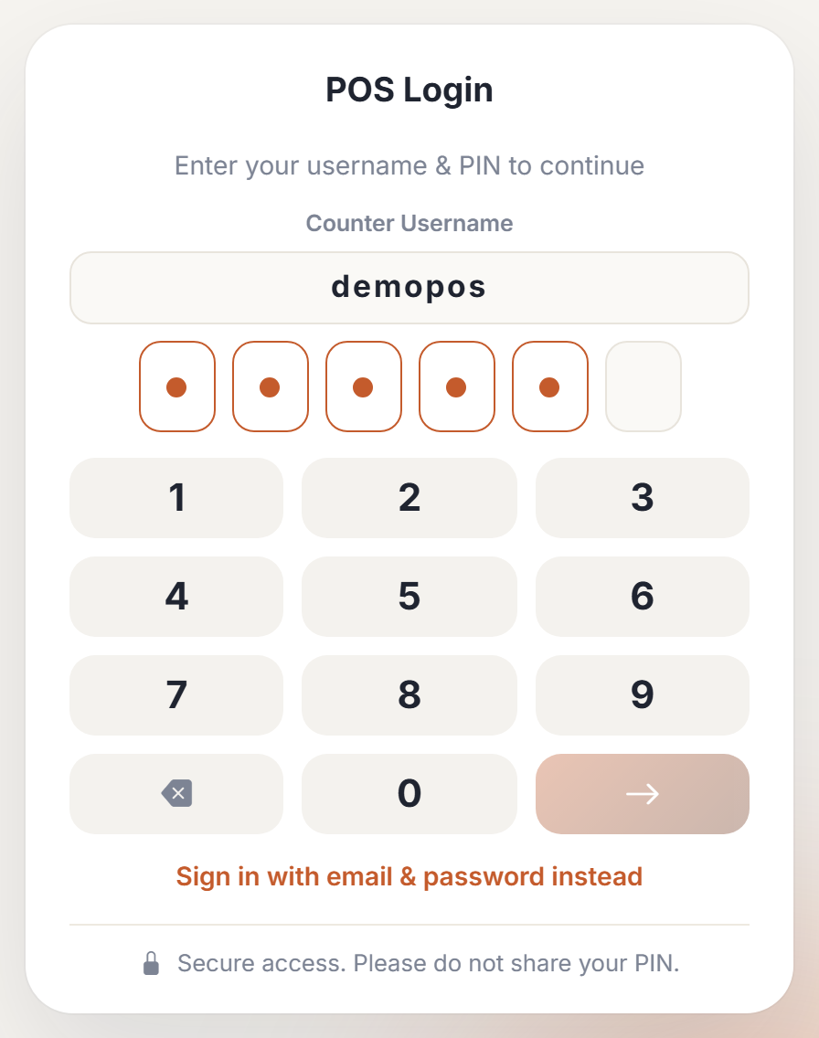
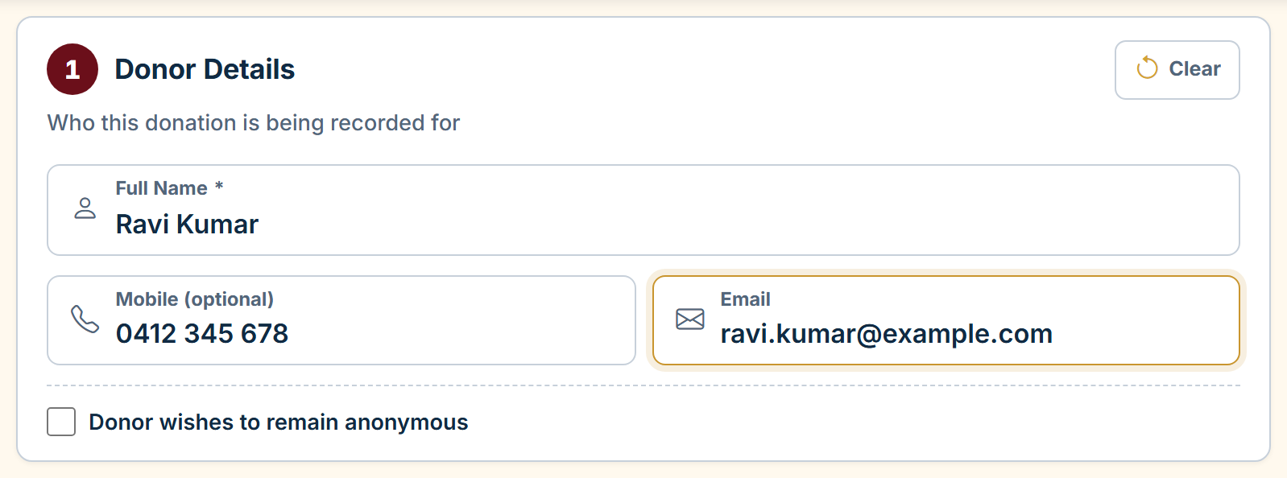
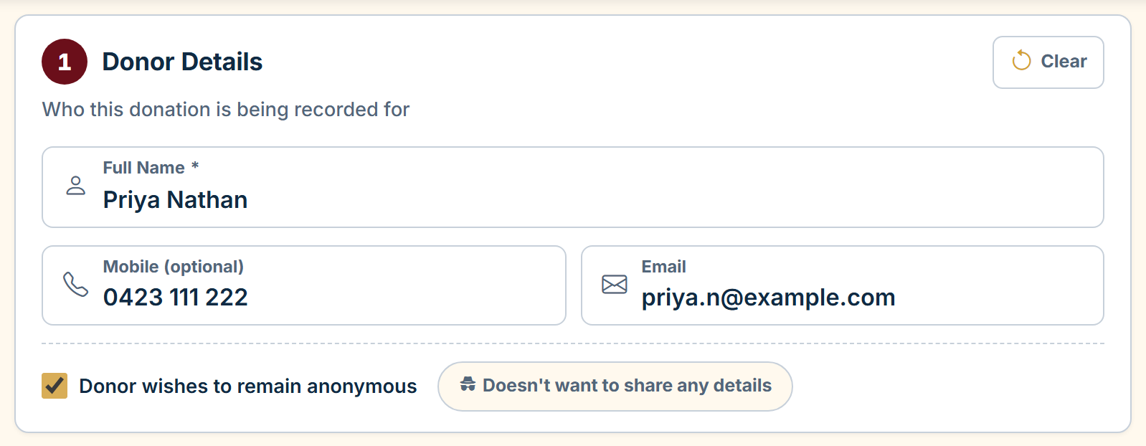
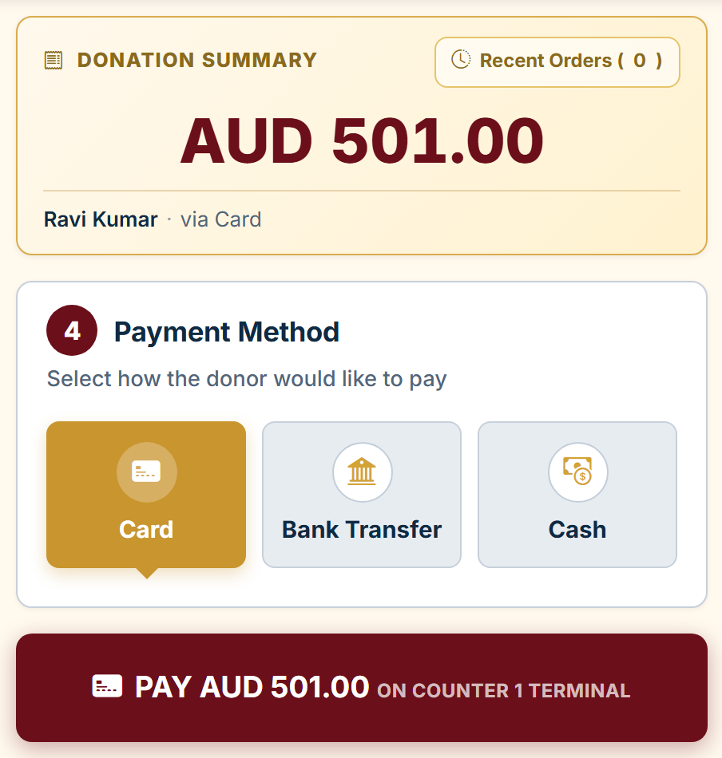
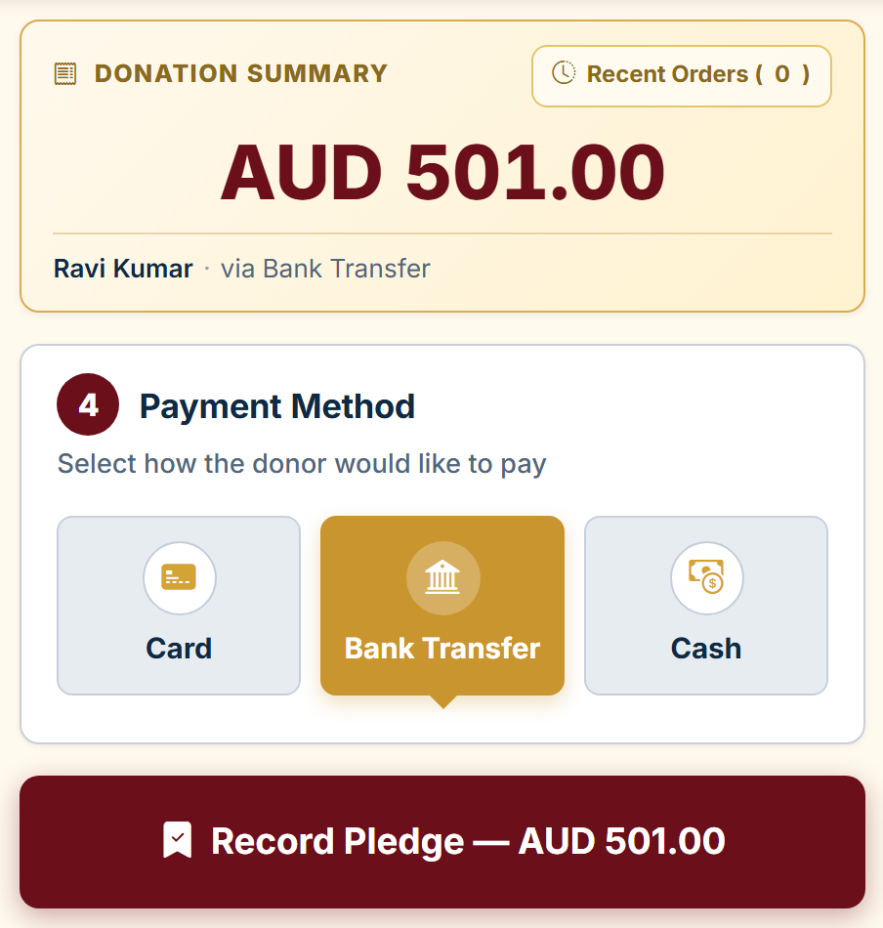
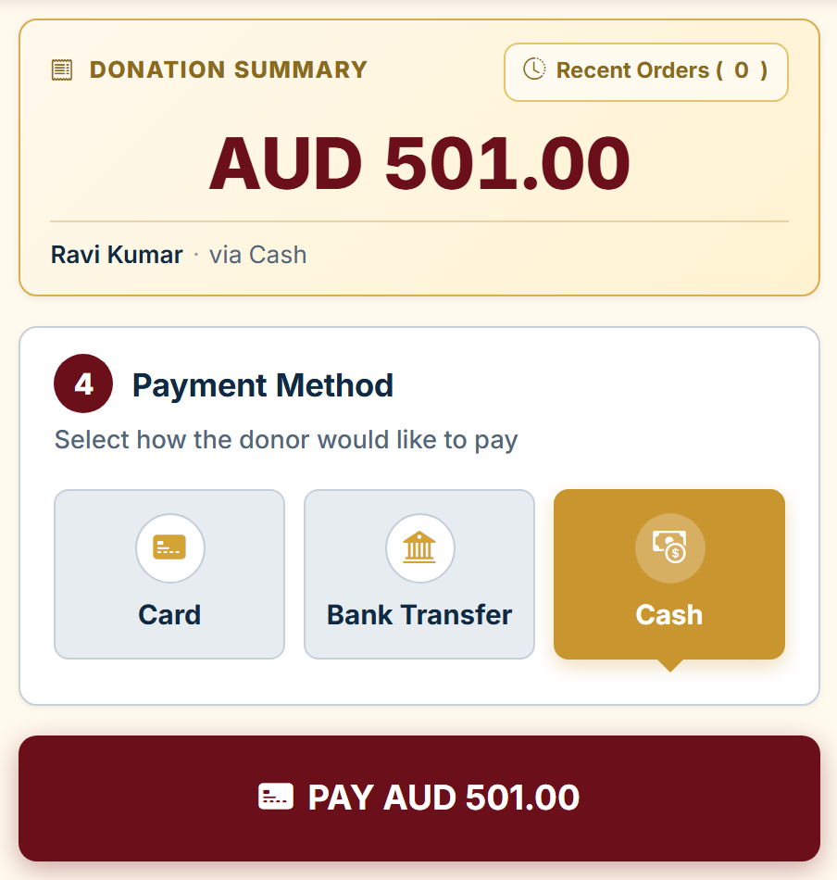

SRI SELVA VINAYAKAR TEMPLE
KUMBHABHISHEKAM 2027 | DONATION COUNTER
1. SIGN IN
2. DONOR DETAILS
RESPECT ANONYMITY
Enter Username
Enter your 6-digit PIN.
Sign-in is automatic after entering the sixth digit, or you can press the arrow to sign in.
If you don’t know your login details, please contact a committee member or administrator.
Full Name and Email are required.
Email is used to send the donation receipt. Please ensure the address is correct and confirm it with the devotee.
Mobile is optional but recommended for future communication.
The doner can choose to be anonymous.
Ask: "May we keep your name and email privately for our records and receipt?“
YES: enter real details, tick anonymous.
NO: Tick "Doesn't want to share any details"; the form fills The well wisher / admin@hasq.org
3. SELECT AMOUNT AND PAYMENT METHOD
CARD
BANK TRANSFER
CASH
Amount appears automatically on the card terminal.
Wait for Approved.
Receipt is emailed automatically.
Tap Record Pledge; payment remains pending.
Transfer details are emailed to the devotee (coordinator CC’d).
Admin verifies payment and emails the receipt
Count the cash and place it in the designated Kumbhabhishekam drawer/envelope.
A confirmation receipt is emailed automatically.
After saving, the form clears for the next devotee. Receipts are sent automatically when payment is completed.
COUNTER QUICK GUIDE v4.1.0 • sievesvision.com
1 / 2

Slide 2
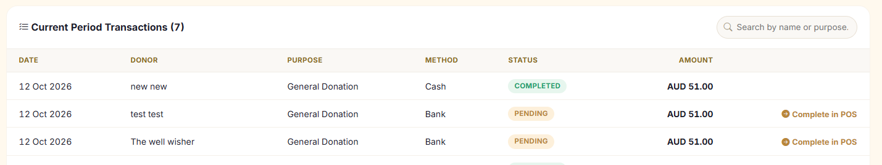
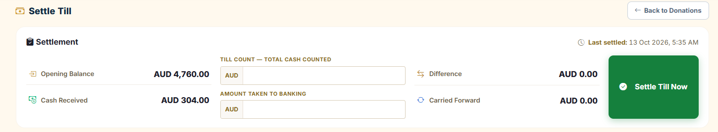
SRI SELVA VINAYAKAR TEMPLE
KUMBHABHISHEKAM 2027 | DONATION COUNTER
COMPLETION OF PENDING TRANSACTION
Devotees who have pre-filled their details using the QR code can complete their payment at the temple counter by cash or card.
Counter staff can retrieve these details to speed up payment processing and reduce data entry errors.
1. Tap the Account icon (top right) → Settle Till.
2. Find the transaction under Current Period Transactions and tap Complete in POS.
3. Verify the details and follow the normal payment steps to complete the transaction.
Note: Public donation link https://hasq.org/events/kumbabishekam-2027
SETTLE TILL — END OF SHIFT
It’s best practise to settle the till when finishing the shift that helps to track down and manage the cash payment and banking.
1. Tap Account icon (top right) → Settle Till.
2. Count all notes and coins in the till.
3. Enter Till Count and Amount Taken to Banking.
4. Review Difference; explain any non-zero amount.
5. Tap Settle Till Now. Remainder becomes Opening Balance.
QUICK TROUBLESHOOTING
PIN rejected: Sign in with email/password after lockout; ask admin to reset PIN.
Card greyed out: No terminal paired; use Cash and notify admin.
Card declined: Cancel Payment, retry or change method.
Network error: Check connection, refresh and sign in again.
Wrong donation: Use Clear Form before PAY/Record Pledge.
Wrong receipt details or settlement: Contact an admin.
KEEP YOUR PIN PRIVATE • COUNT CASH AT EVERY TRANSACTION • ASK AN EVENT OR TEMPLE ADMIN IF UNSURE.
COUNTER QUICK GUIDE v4.1.0 • sievesvision.com
2 / 2

