Slide 1
Group name : latakuloDB (section-B)
Project name : Military DBMS
Group members :
1) Jahid Rayhan (2020331034)
2) Mohammad Noyeem Uddin
Sifat(2020331038)
3) Yarus Hossain Rafi (2020331046)

Slide 2
Military Database Management System
Our project aims to develop a comprehensive Military Database Management System (DBMS) tailored to optimize operational efficiency and discipline within military organizations. Leveraging web technologies, Additionally, the system will store training details, including the type of training undergone by each soldier. Moreover, it will incorporate performance analysis and growth reports to monitor and evaluate soldiers' progress over time. Ensuring stringent data security measures and scalability, authorized users, including admin, military personnel, or database handlers, can seamlessly insert soldier data into the database through a user-riendly interface.

Slide 3
Through continuous refinement and user feedback, we aim to provide a dynamic tool tailored to the unique needs and challenges faced by military personnel.We will try to keep the interface as user–friendly as possible though we may use extratables or details about the soldiers if required when adding new features.

Slide 4
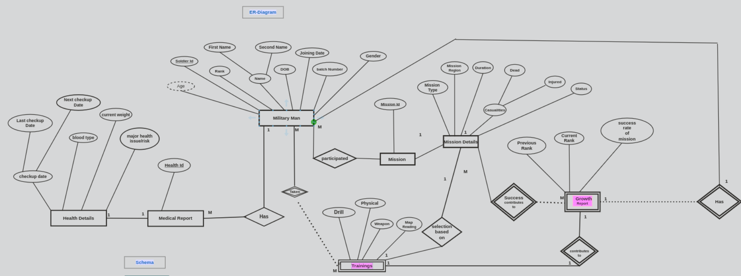
E-R Diagram(final)

Slide 5
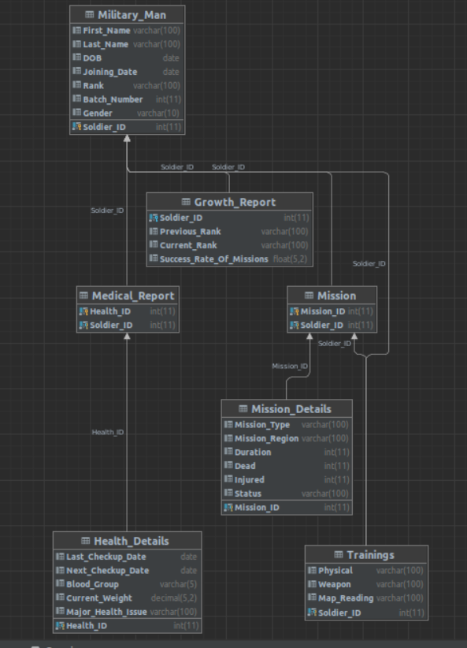
E-R Schema(final)

Slide 6
Problems :
1 ) We haven’t much knowledge about E-R diagram so , when we were making E-R diagram we faced small issues like how to create those relation like one to one or many to many..
2) We also faced problems with Datagrip or running those sql code in any IDE as our datagrip was not well set-up.
3) Military Eco-system is totally different from our social-eco-system , so we had problems when creating the table or attributes as we haven’t that much available data about military.

Slide 7
Conclusion :
We were focused to all of your lectures though we haven’t implemented the topics in any real life environment. So , this project gaves us the opportunity to implement DBMS in real-life project. After , completing the project we have gained clear idea how to create E-R diagram ,schema and implement their sql code and also how to write queries for them..We have also get to know with the attributes and entities ,data safety and integrity.

