Slide 1
EasyOrdering Web-Based Restaurant Ordering System
Yong(Sifa) Zhang
July 2025
MCSD51 – Certificate in Software Development
Notes:
Good evening, everyone. My name is Yong Zhang, also known as Sifa.
Today, I’m excited to present my final project for the MCSD51 Certificate – My project is a web-based restaurant ordering system called EasyOrdering.
This system aims to improve the dining experience through QR code technology.

Slide 2
Background & Motivation
Inspired by QR-based systems in China
Traditional methods inefficient
Gap in local NZ restaurants

Slide 3
Project Goals
01
Improve Customer Experience
Real-Time Flexibility
03
Contactless or quieter dining experience
Place orders at their own pace
Update menu instantly
Limited-time offers
01
03
02
Reduce Costs
Advance Operational Efficiency
04
02
Labour
Printed menus
Reduce human errors
Highlight chef’s specials
04

Slide 4
User Roles & Features
Four roles
Administrator
1
Customer
Manage menu
Manage accounts
Manage QR codes
Scan
Order
Pay
2
Receptionist
4
Guest
Place orders
Manage orders
Reservation
View menu
Reservation
Contact
3

Slide 5
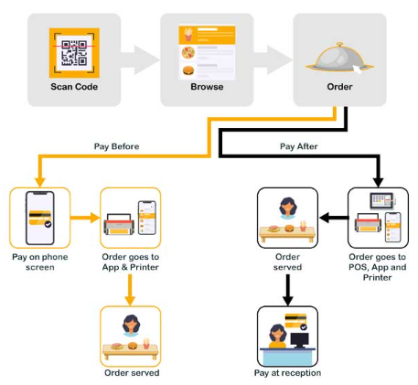
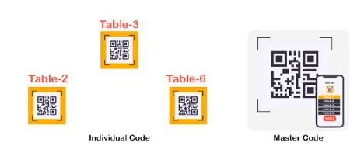
Customer Order Flow

Slide 6
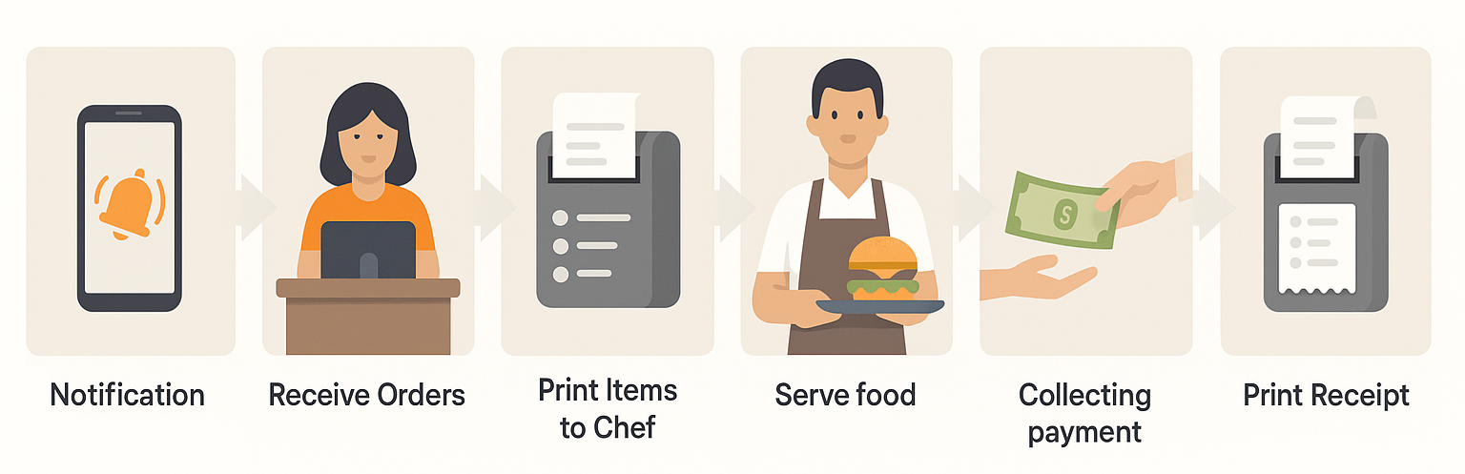
Receptionist Workflow

Slide 7
System Architecture
Frontend
Backend
Database
HTML/CSS, Bootstrap, EJS
Node.js and Express
MySQL
(Hosted locally using XAMPP)

Slide 8
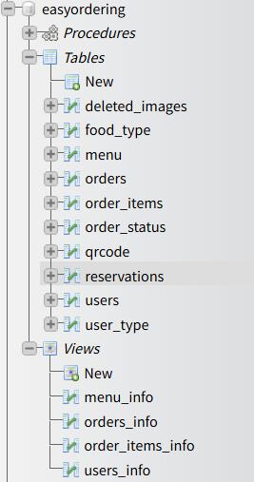
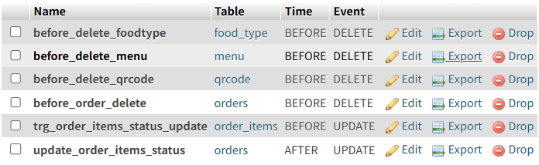
Database Design

Slide 9
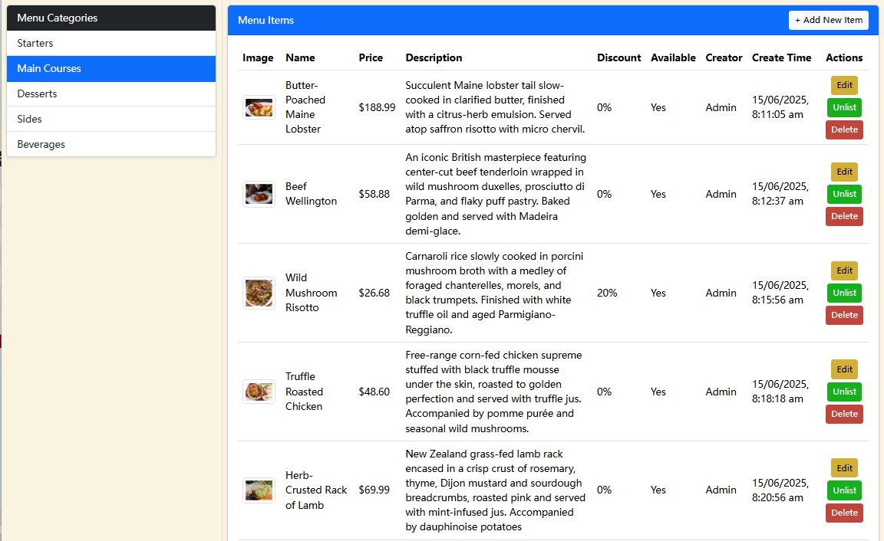
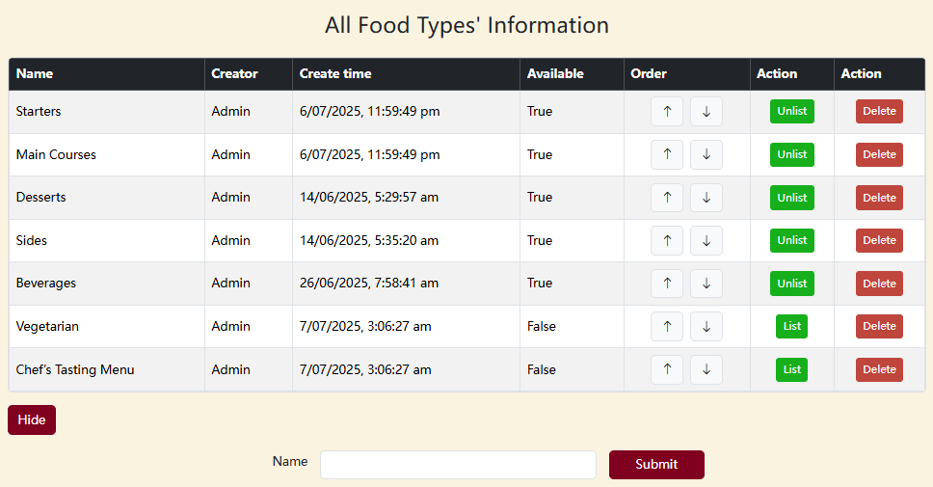
Core Functions(Admin)

Slide 10
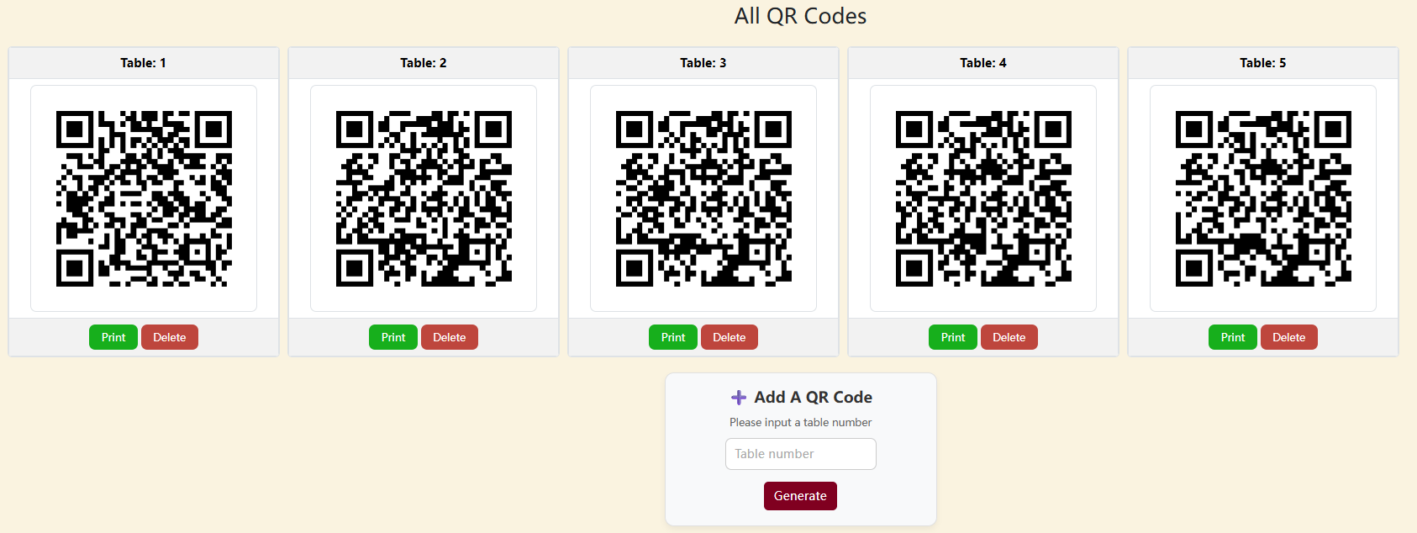
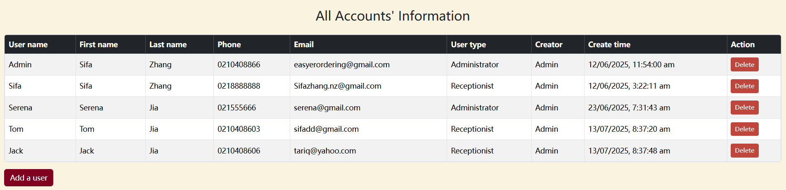
Core Functions(Admin)

Slide 11
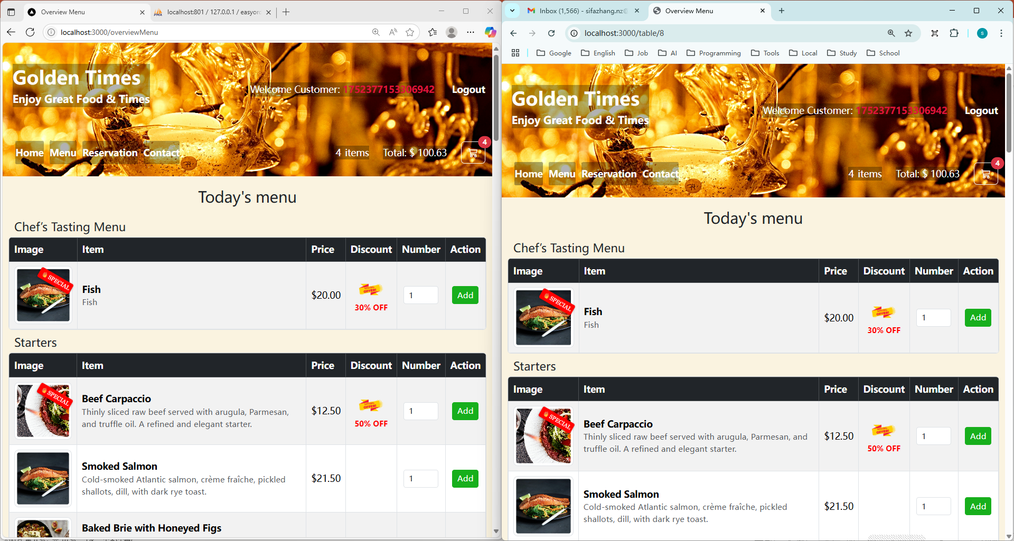
Core Functions(Customer)

Slide 12
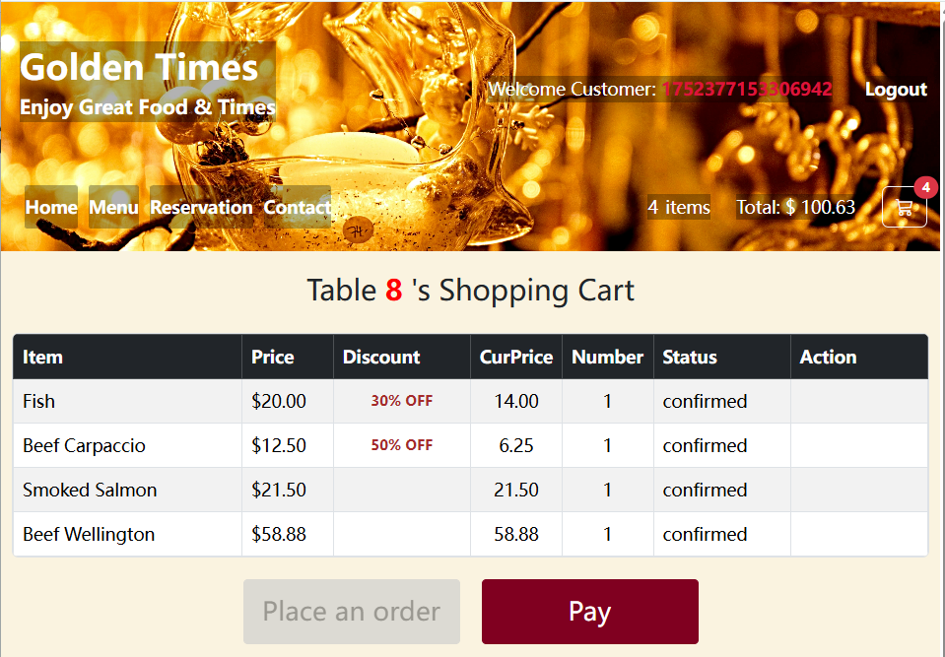
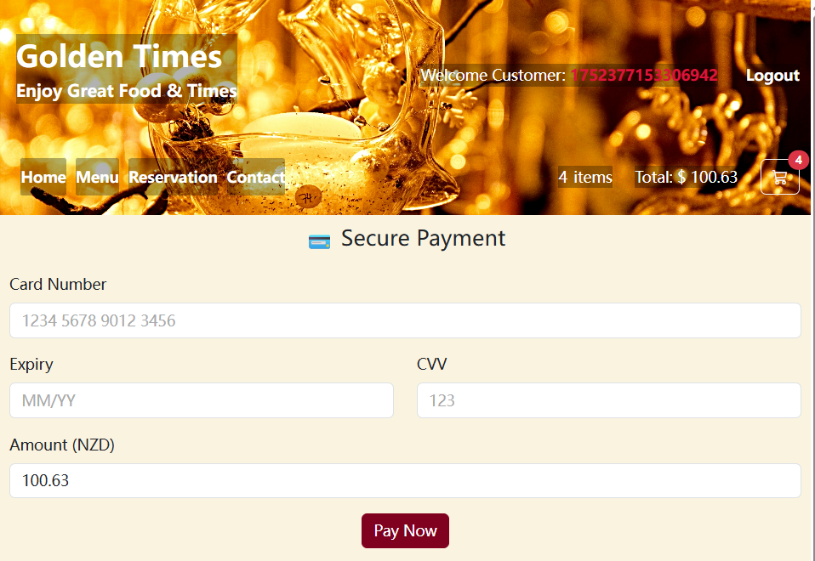
Core Functions(Customer)

Slide 13
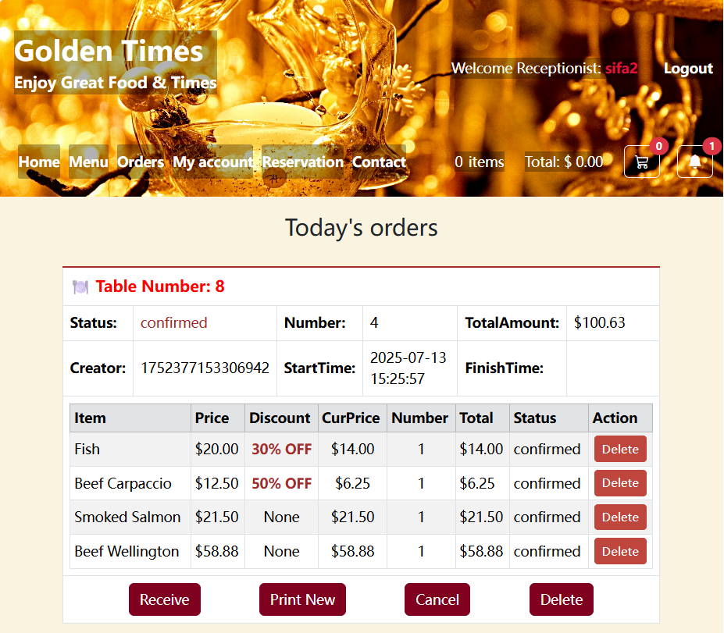
Core Functions(Receptionist)

Slide 14
Order Status
Append items
Order Status:
pending
confirmed
preparing
ready
completed
Item Status:
cancelled

Slide 15
Testing
01
02
Integration testing
Unit testing
Login, Order, Menu, QR, Reservation All major use cases passed
Jest
Part of the code

Slide 16
Agile Development Process
1
Sprint 1
Header, Footer, Navigation, Login and Account Management；
2
Sprint 2
Menu Management
3
Sprint 3
QR Code Management and Order for Customer
4
Sprint 4
Reception Panel
5
Sprint 5
Home, Contact, Reservation

Slide 17
Limitations
No payment gateway
Not mobile tested
.env required
for credentials

Slide 18
Future Enhancements
Design
Feature
Separate frontend/backend
Split app.js files
Customer Login
Analytics dashboard
Feedback system
Staff management

Slide 19
Demo
01
Admin
02
Customer
03
Receptionist
Add food type
Add items
Add QR code
Add account
Reservation
View menu
Share the cart
Place an order
Pay online
Append items
Pay at the reception
Update account
Receive an order
Ready
Receive appendix
Print new
Ready new
Finish an order
Print receipt
History orders
Cancel reservations

Slide 20
Thank You Q&A

