Slide 1

NASA Exoplanet Detection and Classification
Presented by : Sifana P V
Program : Advanced Program in Data Science
Project type : Final Capstone Project
Technologies Used : Python | Data Science | ML | Deployment .

Slide 2
Project Overview
Problem : Identify whether astronomical observations correspond to exoplanet-related classes.
Data : NASA/TESS exoplanet candidate observations with stellar and planetary measurements.
Approach : Cleaning | EDA | feature engineering | model training | tuning | evaluation.
Output taken : Binary classification + multiclass classification + Flask deployment.
Problem type : Classification in Machine Learning
Exoplanets :
planets that exist beyond our Solar System and are an important area of modern astronomical research.
TESS(Transiting Exoplanet Survey Satellite) :
NASA space telescope designed to discover exoplanets by observing temporary changes in the brightness of stars during planetary transits.

Slide 3
Objectives
Explore the NASA/TESS exoplanet dataset and understand its structure and variables.
Clean missing, invalid and inconsistent astronomical measurements.
Perform EDA to understand confirmed, candidate and false-positive observations.
Select relevant numerical features and apply preprocessing and feature engineering.
Train and compare multiple classification algorithms.
Evaluate models using Accuracy, Precision, Recall and F1-score.
Tune promising models using cross-validation and hyperparameter search.
Deploy the selected models through a Flask web application.

Slide 4
Dataset and Selected Features
Column | Meaning
ra | Right Ascension — the position of the star in the sky, similar to longitude on Earth.
dec | Declination — the position of the star north or south in the sky, similar to latitude on Earth.
st_pmra | Star's proper motion in Right Ascension — how the star appears to move across the sky in that direction.
st_pmdec | Star's proper motion in Declination — how the star appears to move across the sky in that direction.
pl_tranmid | Transit midpoint time — the time at which the planet is approximately in the middle of its transit across the star.
pl_orbper | Orbital period — how long the planet takes to complete one orbit around its star.
pl_trandep | Transit depth — how much the star's brightness decreases when the planet passes in front of it.
pl_rade | Planet radius — estimated radius of the planet, generally expressed relative to Earth.
pl_insol | Planetary insolation — amount of stellar energy received by the planet compared with Earth.
pl_eqt | Equilibrium temperature — estimated temperature of the planet based mainly on the energy received from its star.
st_tmag | TESS magnitude — brightness of the star as measured in the TESS observation system. Lower magnitude generally means a brighter star.
st_dist | Stellar distance — distance between Earth and the star, usually measured in parsecs.
st_teff | Stellar effective temperature — temperature representing the star's surface radiation, measured in Kelvin.
st_logg | Stellar surface gravity — a measure of the gravitational acceleration at the star's surface.
st_rad | Stellar radius — estimated size/radius of the star, usually relative to the Sun.
Dataset Source : NASA Exoplanet Archive / TESS Project Candidates Table
Target : “ tfopwg_disp ” , represents the TFOPWG (TESS Follow-up Observing Program Working Group) disposition of each objects.
Features : They represent sky position, stellar motion/properties, and transit/planet properties, giving the models both stellar and planetary information.

Slide 5
Data Cleaning and Preprocessing
Data Inspection | Checked columns, data types, statistical information, missing values, and target distribution.
Cleaning | Handled duplicates, missing/invalid observations(by Simple Imputer) and removed highly correlated features also prepared the modeling dataset.
Outlier analysis | Investigated extreme astronomical values; treatment was based on feature behaviour rather than blindly removing extremes using IQR method.
Encoding | Both Features and Target Columns are encoded using Label Encoding to train the model easily.
Create Binary Target | The target column converted into binary as ‘planet Candidate’ and ‘False-Signal’ side to make the problem as binary classification.
Preparation | Prepared consistent features and labels for model training including feature scaling.

Slide 6
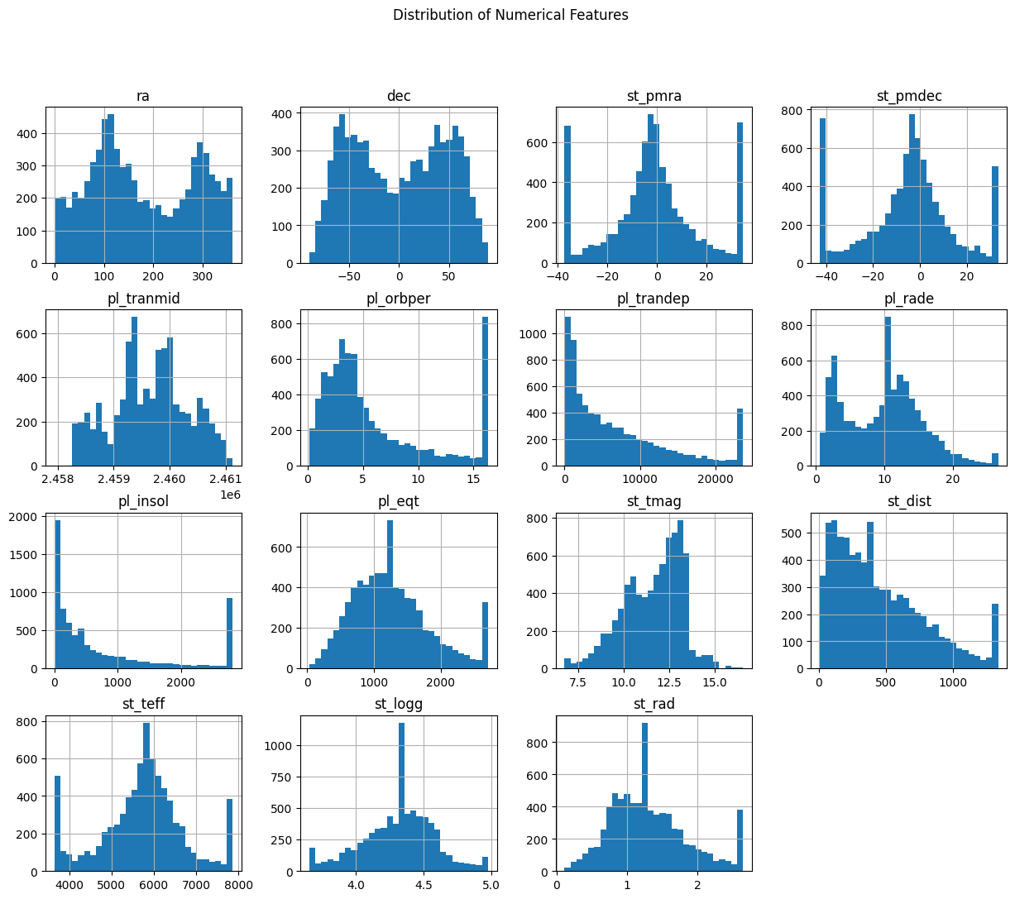
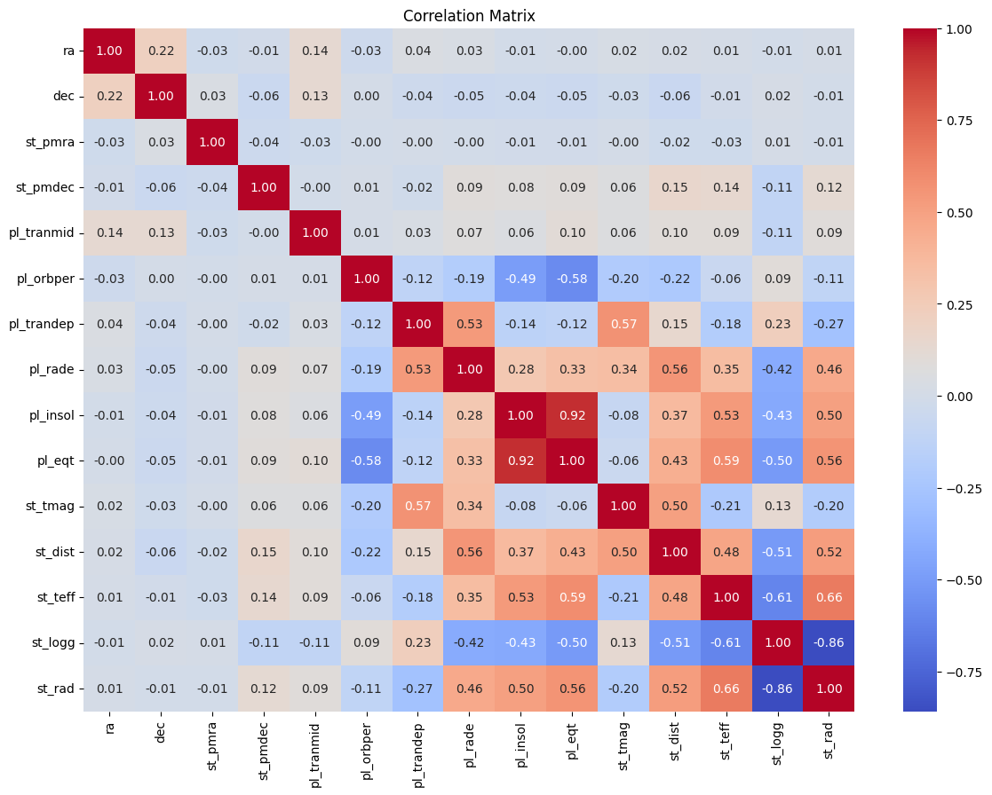
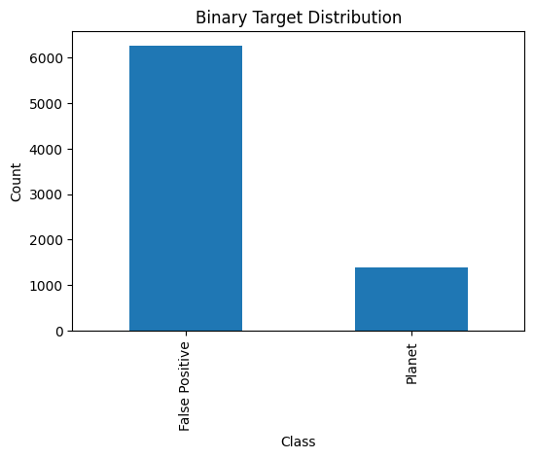
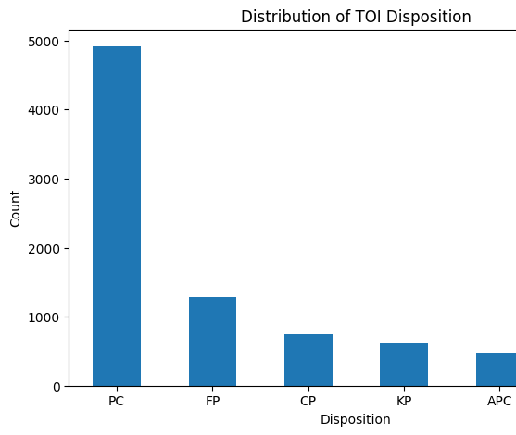
Exploratory Data Analysis (EDA)
Used distributions, class analysis and relationships between important variables to understand the data.
The EDA results guide subsequent feature selection, preprocessing, and model development.

Slide 7
Feature Engineering
Stellar Luminosity
Derived from stellar radius/temperature-related information to represent stellar energy output.
Stellar Surface Area
Derived from stellar radius to provide an additional physical property.
Transit Signal
Combines transit-related measurements to represent the strength of the observed transit signal.
The engineered variables were created to provide the algorithms with additional domain-informed signals beyond the raw measurements.

Slide 8
Classification Strategy
Binary classification | Multiclass classification
Planet-related observations - 1 | Classes: PC, FP, CP, KP, APC and FA
False alarm / false positive observations - 0 | Used class-aware modeling to address class imbalance.
Used stratified train/test splitting. | Evaluated with macro Precision, Recall and F1-score.
Compared five classification algorithms. | Confusion matrix used to inspect class-level performance.
Train/test split: 80% training • 20% testing • random_state = 42 • stratified by target

Slide 9
Models & Hyperparameter Tuning
Model | Purpose in comparison
Logistic Regression | Linear baseline
Decision Tree | Tree-based nonlinear baseline
Random Forest | Ensemble of decision trees
KNN | Distance-based classifier
SVM | Margin-based classifier
Tuning approach: GridSearchCV with 5-fold cross-validation was used for the candidate models. The binary tuning objective used F1-score, balancing precision and recall.
Model selection: Random Forest produced the strongest F1-score among the compared models and was selected for the final binary and multiclass modeling workflow.

Slide 10
Binary Classification - Result
Model | Accuracy | Precision | Recall | F1 Score
Random Forest | 0.858170 | 0.873290 | 0.967305 | 0.917896
SVM | 0.847059 | 0.854167 | 0.980861 | 0.913140
KNN | 0.837255 | 0.855626 | 0.964115 | 0.906637
Logistic Regression | 0.835294 | 0.846953 | 0.975279 | 0.906597
Decision Tree | 0.798693 | 0.873618 | 0.881978 | 0.877778
Random Forest test-set performance :
The final binary model achieved an F1-score of 0.9179. Recall was particularly high, meaning the model identified a large proportion of the positive class in the evaluated test set.

Slide 11
Multiclass Classification - Result
Model | Accuracy | Precision | Recall | F1 Score
Logistic Regression | 0.486928 | 0.360304 | 0.453465 | 0.351211
Decision Tree | 0.637908 | 0.447799 | 0.460065 | 0.452707
Random Forest | 0.701961 | 0.540989 | 0.554168 | 0.538426
KNN | 0.679085 | 0.472881 | 0.386899 | 0.416049
SVM | 0.571895 | 0.430765 | 0.590714 | 0.448049
Classes modeled: PC • FP • CP • KP • APC • FA
Class imbalance: Used class-aware Random Forest modeling so minority classes receive appropriate attention during training.
Evaluation: Macro Precision, Macro Recall and Macro F1-score provide equal importance to each class.
Error analysis: Confusion matrix helps identify which astronomical classes are most frequently confused.
Final model: Random Forest was retained as the selected model for the multiclass workflow.

Slide 12
Deployment - Flask Web Application
User
Enters 15 feature values
Flask App Receives and validates input
Predictor
Loads saved Random Forest models
Models
Binary + multiclass prediction
Result
Prediction displayed in browser
Project structure:
app.py handles the Flask application
src/ contains configuration and prediction logic
templates/ contains the HTML interface
static/ contains styling
models/ stores the trained models.
The deployment demonstrates how a trained ML model can be packaged into a simple user-facing prediction application.

Slide 13
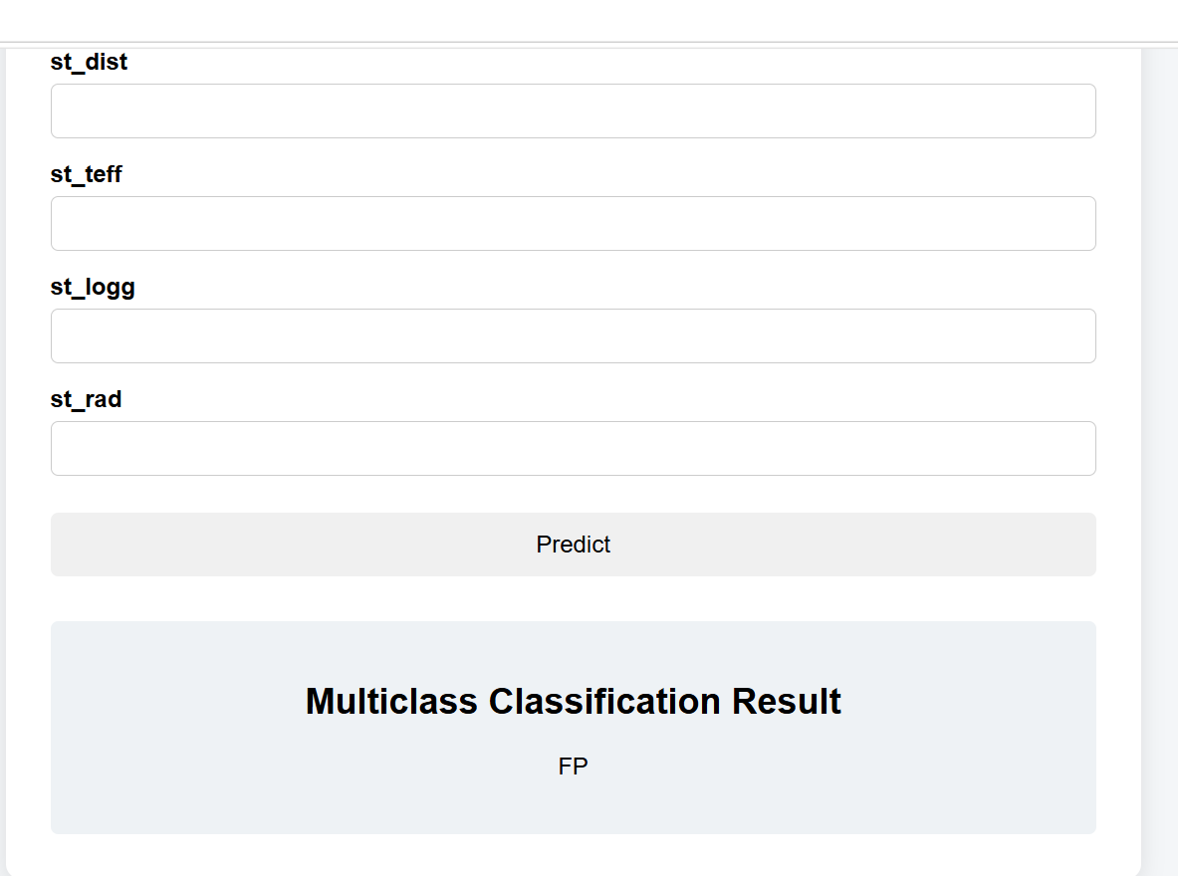
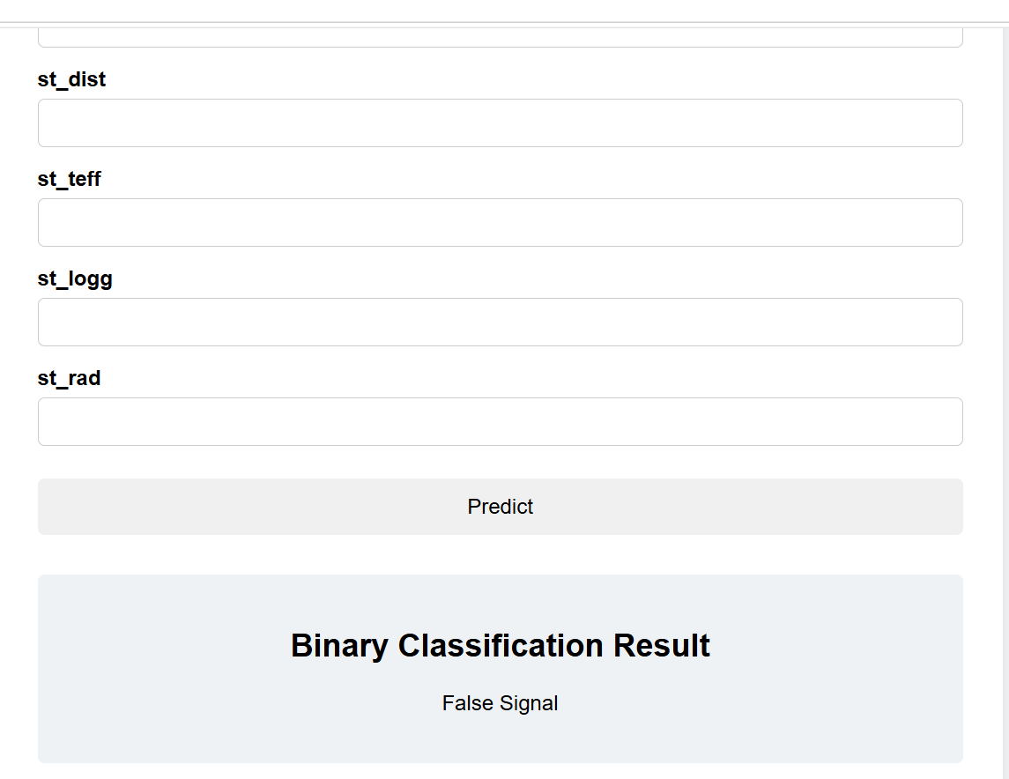
Conclusion
Key outcome: Built an end-to-end exoplanet classification pipeline from astronomical data preparation to model deployment.
Modeling: Compared multiple algorithms and selected Random Forest based on the project evaluation results.
Two prediction tasks: Binary classification provides a broad decision, while multiclass classification provides more detailed categories.
Deployment: Integrated the selected models into a Flask application for interactive predictions.

Slide 14
Future Scope
Deep Learning Enhancement – Apply advanced models such as CNNs, LSTMs, and Transformers to improve the detection of weak and complex exoplanet signals.
Real-Time Data Integration – Integrate new observations from NASA missions such as TESS and JWST to continuously update and improve the prediction models.
Improved Classification – Develop more advanced multi-class and probabilistic models to distinguish confirmed planets, candidates, false positives, and other astronomical objects more accurately.
Automated Astronomical Discovery – Build a scalable AI-based detection system that can assist astronomers in analyzing large volumes of space data and identifying promising exoplanet candidates faster.
Thank You !

