Slide 1
LEARNING FROM DATA
Multi-Class Classification of Consumer Complaints Using Machine Learning and Deep Learning Approaches

Slide 2
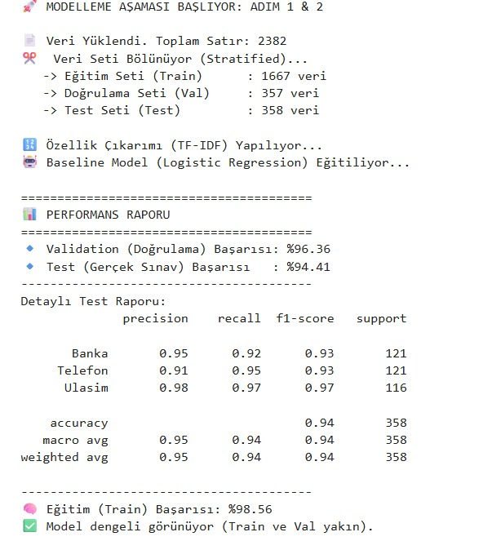
What the Baseline (Logistic Regression) Shows
Even a simple baseline is very strong: TF-IDF captures keyword patterns that separate the classes well.
Train performance is higher, but the gap is not large, so there is no clear sign of severe overfitting.
Class-wise behavior suggests Transportation complaints contain more distinctive domain terms (e.g., trip/cancellation/ticket-related wording), making them easier to classify.

Slide 3
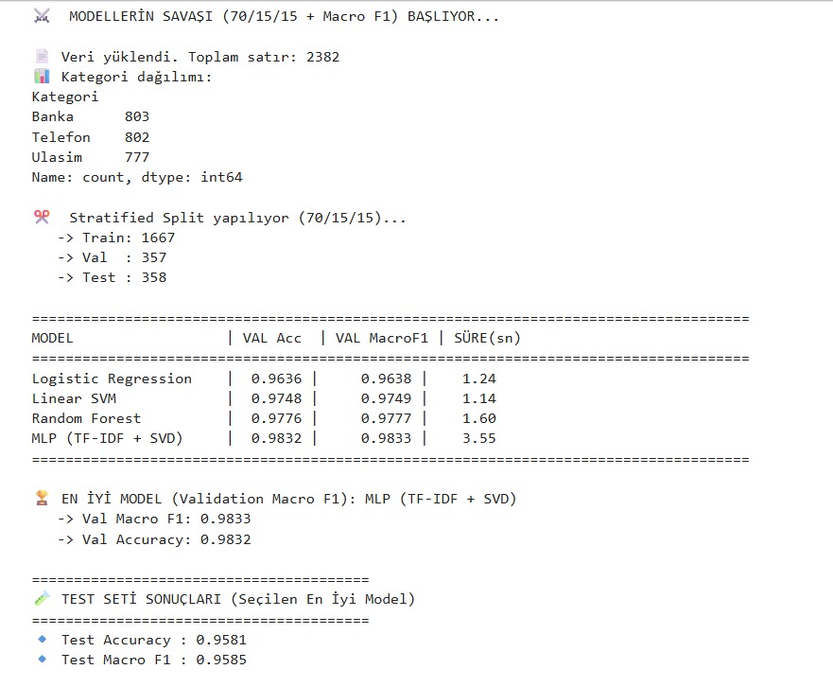
Model Comparison: Why MLP + SVD Performs Best
Linear models (Logistic Regression / Linear SVM) typically work very well on TF-IDF because many text patterns are close to linearly separable.
SVD compresses high-dimensional TF-IDF into a denser, lower-noise representation, which helps the neural model learn better decision boundaries.
As a result, MLP + SVD achieves the most balanced performance and the highest Macro F1.

Slide 4
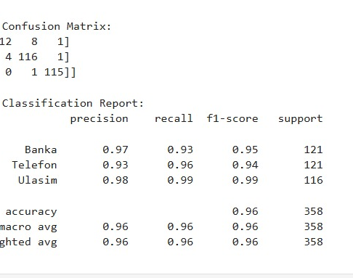
Final Test Performance: Generalization Insight
Strong test results indicate the model is not just memorizing the training data and can generalize to unseen complaints.
A high Macro F1 also means performance is reasonably balanced across classes, not dominated by a single category.

Slide 5
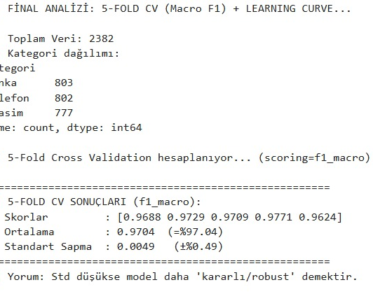
Confusion Matrix: Why Banking ↔ Telecommunication Confuse
Banking and Telecommunication complaints often share similar wording such as billing/fees/charges/customer support, which increases confusion.
Transportation texts usually include more domain-specific cues, so they are misclassified less often.
To reduce Banking–Telecommunication confusion, richer semantic representations (embeddings/transformers) or more category-specific data could help.

Slide 6
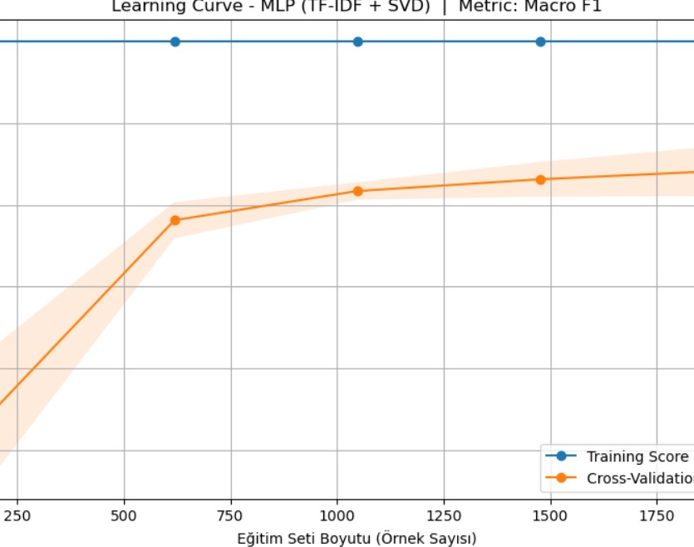
Learning Curve: Bias–Variance Interpretation
The cross-validation score improves as more data is used, meaning additional training data directly helps the model.
The convergence trend between training and CV curves suggests improving generalization and a healthier bias–variance balance.

Slide 7
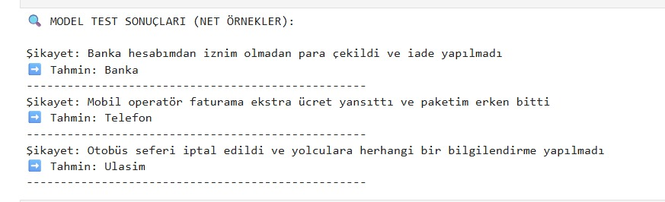
Manual Tests: Real-World Behavior
The model performs very well on complaints that contain clear domain cues.
Errors mostly happen for short or ambiguous texts that do not include strong category keywords.
This is expected in real-world settings; more context and stronger language models can reduce such errors.

