Slide 1
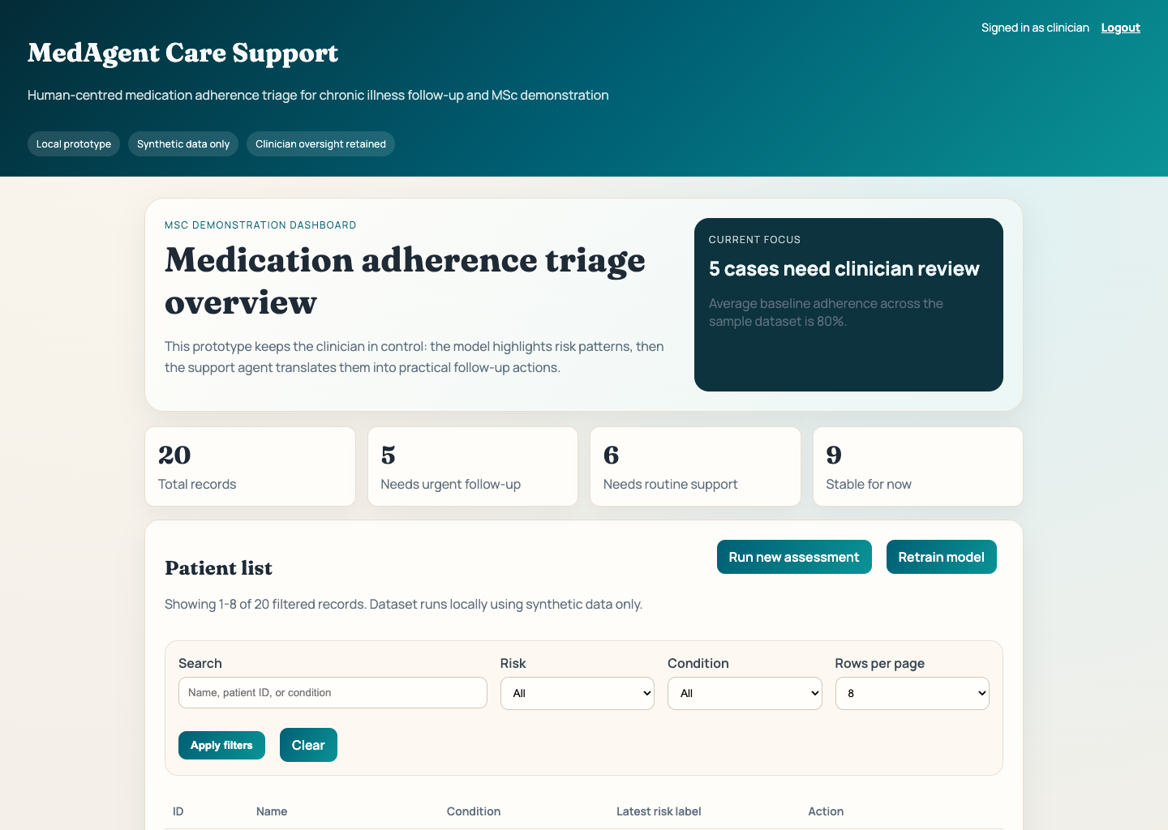
MedAgent: Human-Centred AI Support for Medication Adherence in Chronic Illness
MSc prototype deck for supervisor meetings, viva preparation, and project review
Early identification of medication non-adherence risk in chronic illness follow-up
Local, reproducible prototype built with synthetic data only
Clinician-supporting workflow rather than autonomous decision-making
Presentation focus
Open with the problem clearly: clinicians need earlier, more structured visibility of adherence risk without losing human judgment.
Slide 1 | Project framing

Slide 2
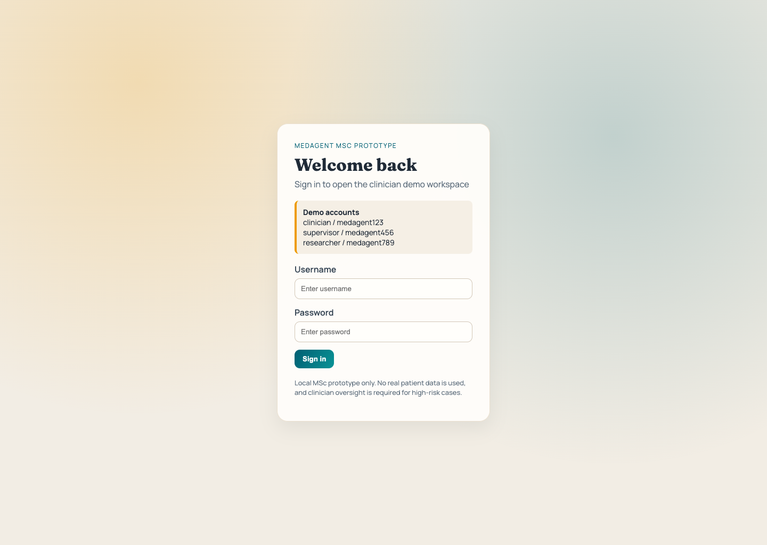
MedAgent supervisor presentation
Why This Problem Matters
Key message
Missed medication can worsen long-term outcomes and destabilise chronic care
Non-adherence is shaped by routine, side effects, behaviour, and follow-up barriers
Research goal: combine prediction with practical, human-readable action support
Professional local login boundary for demo use
Speaker note
Explain that the project is not only about predicting a label. The goal is to make the output usable in practice by translating risk into readable summaries and realistic follow-up actions.
Slide 2 | Motivation

Slide 3
MedAgent supervisor presentation
Prototype Architecture Overview
Key message
Flask web interface for login, dashboard, assessment, and model maintenance
Random Forest model for medication adherence risk prediction
Agent layer for explanation and support-plan generation
CSV-backed synthetic dataset for simple, local reproducible execution
Data layer
Synthetic patient records patients_seed.csv -> patients.csv
Prediction layer
Random Forest model prediction_model.py
Agent layer
Explanation + support plan agent.py
Clinician inputs and patient context
Risk label, explanation, and support plan
Speaker note
Walk from input to output: user interaction, model prediction, then agent-generated explanation and support guidance.
Slide 3 | Architecture

Slide 4
MedAgent supervisor presentation
Clinician-Facing Dashboard
Key message
Summary cards provide a quick view of case distribution across risk levels
Search, filtering, and pagination support structured review of the patient list
The dashboard acts as the triage entry point into the system
Population-level overview with case summary and triage entry point
Speaker note
Use this slide to explain the move from a rough prototype table to a more realistic case-review workflow.
Slide 4 | Dashboard

Slide 5
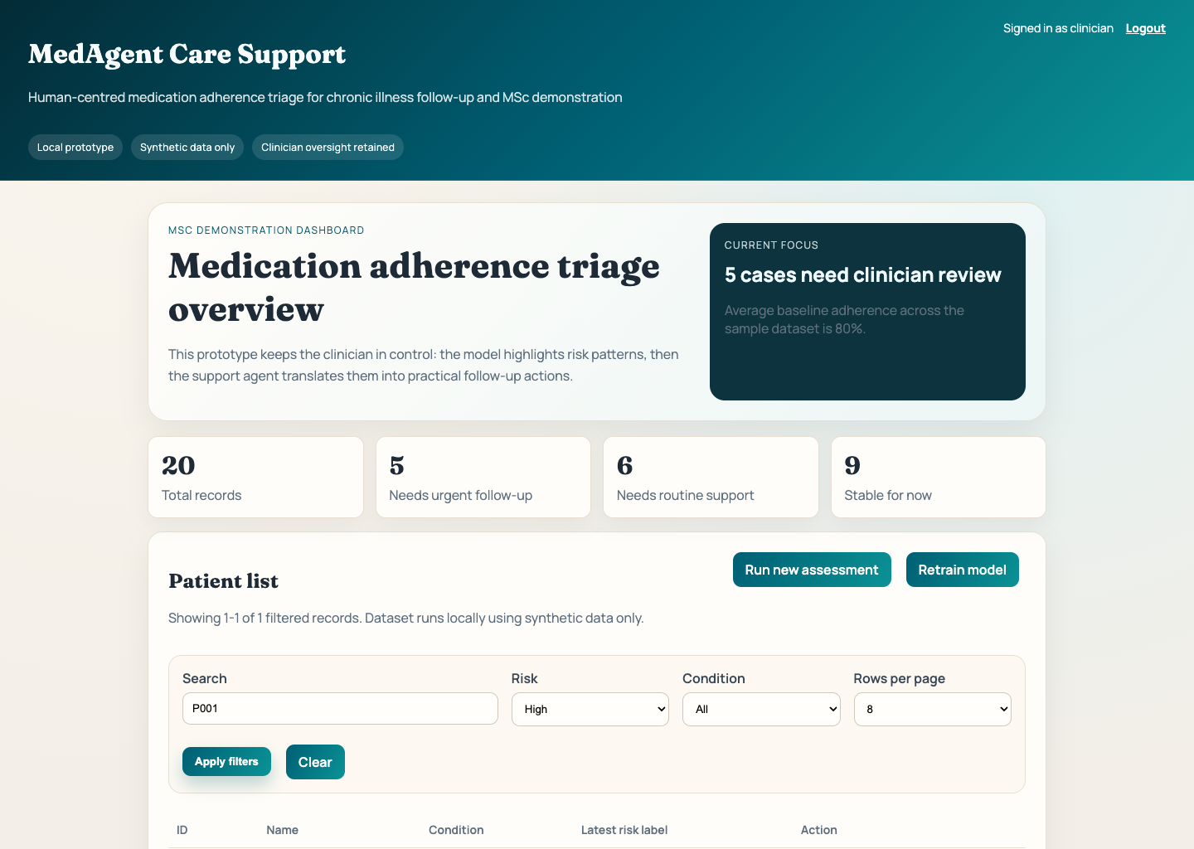
MedAgent supervisor presentation
Usability Improvements for Review Workflows
Key message
Filtered dashboard states show targeted exploration by risk and condition
Pagination improves readability and keeps the interface presentation-ready
UI polish supports clearer supervisor review and MSc demonstration quality
Filtered dashboard showing targeted case review
Speaker note
Justify the polish work here: these changes improve both usability and the credibility of the project demonstration.
Slide 5 | UX polish

Slide 6
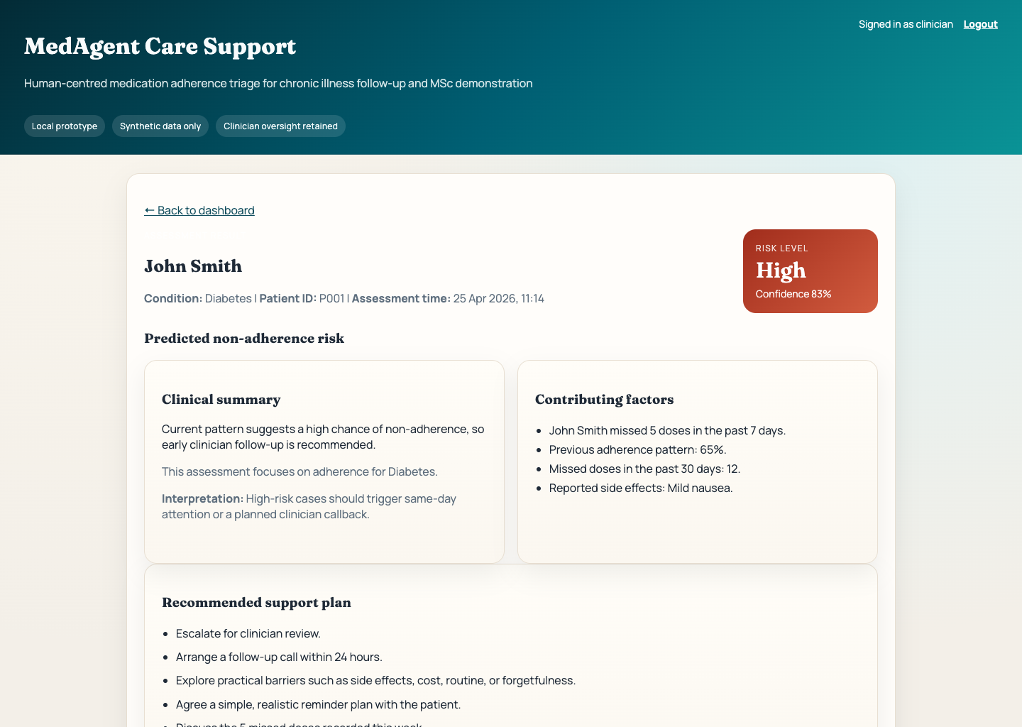
MedAgent supervisor presentation
From Risk Prediction to Human-Readable Guidance
Key message
Risk level and confidence are shown clearly at patient level
Explanatory factors summarise why a patient may be concerning
Support recommendations translate analytics into follow-up actions
High-risk cases explicitly retain clinician oversight
Patient assessment screen with risk panel and support plan
Speaker note
Emphasise that the system does not stop at prediction. It also helps interpret the result in a way that is easier to discuss and act on.
Slide 6 | Patient result

Slide 7
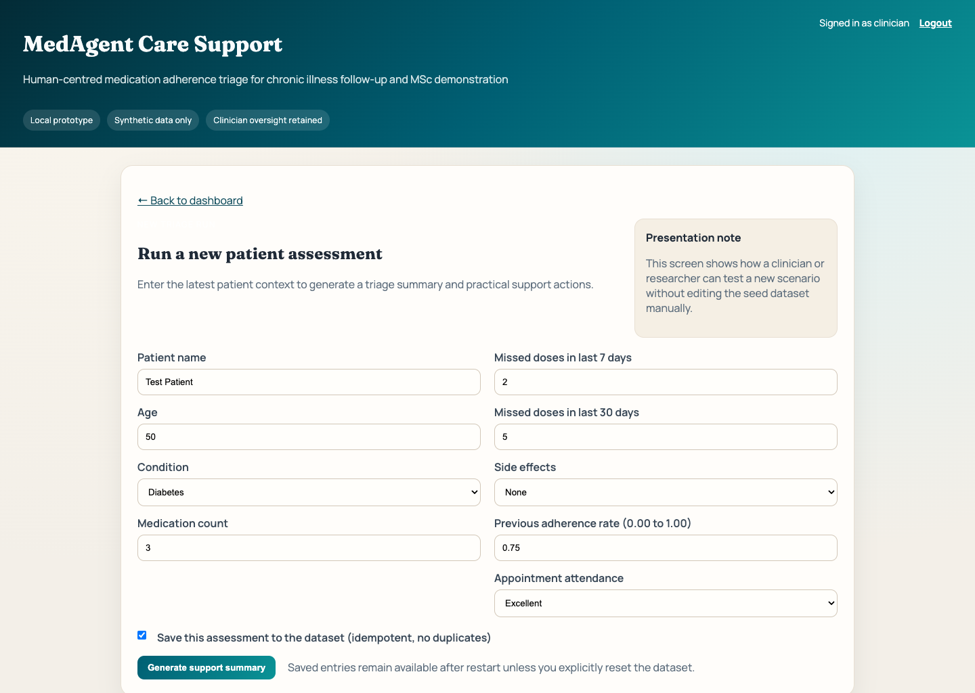
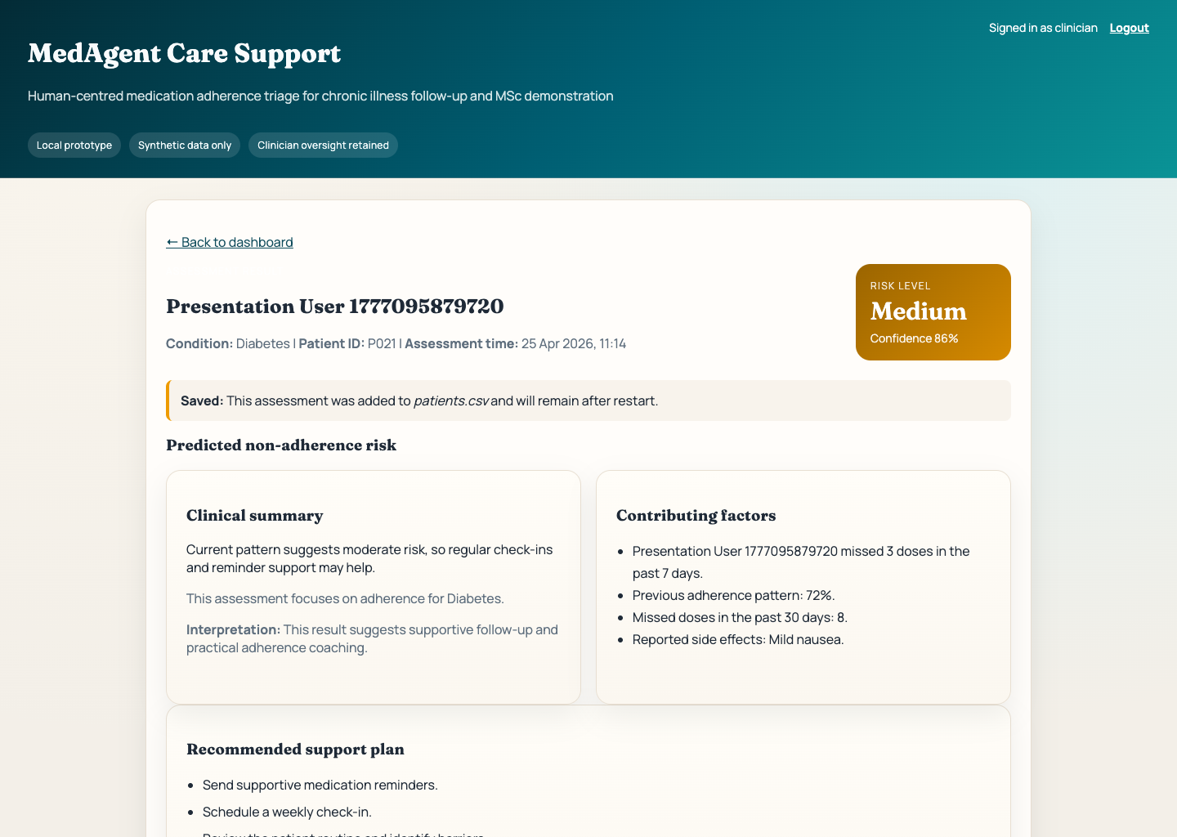
MedAgent supervisor presentation
Running a New Assessment Live
Key message
New patient scenarios can be entered directly through the web form
Optional persistence allows demo records to be kept in the working dataset
Duplicate protection prevents repeated accidental insertion of the same case
Scenario entry
Result with persistence
Speaker note
Describe how a live demo works: enter a case, generate a result, optionally save it, then show duplicate protection on re-submit.
Slide 7 | Live workflow

Slide 8
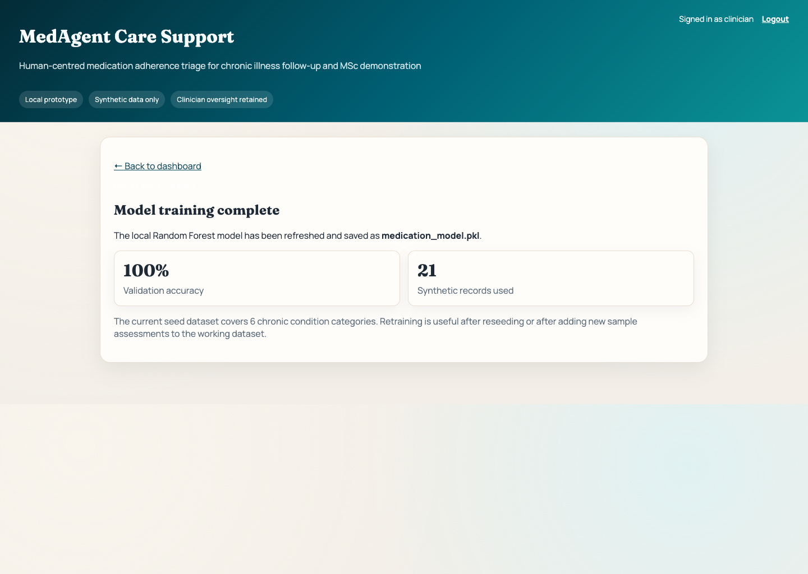
MedAgent supervisor presentation
Reproducibility, Idempotency, and Local Execution
Key message
Health-checked startup and controlled shutdown scripts support reliable demonstrations
Fresh-start and reseed controls allow deterministic dataset restoration
Default restart behaviour preserves user-added records unless reset is explicit
Windows, macOS, and Ubuntu execution guidance is documented
Model maintenance remains local and reproducible
Speaker note
Use this slide to defend engineering quality. The prototype is runnable, testable, and repeatable rather than a single-use demo.
Slide 8 | Operations

Slide 9
MedAgent supervisor presentation
What Was Tested
Key message
Shell smoke validation covers login, dashboard, assessment, save, and dedupe flow
Playwright browser tests cover lifecycle behaviour and UI interaction
The current build passed both shell and browser validation
Verification evidence
MedAgent is running (PID 13127) URL: http://127.0.0.1:5000
Speaker note
Keep this factual: the project was validated with executable checks, not only manual clicking.
Smoke + browser QA passed
Slide 9 | Validation

Slide 10
MedAgent supervisor presentation
Contribution and Next Development Steps
Key message
Contribution: predictive triage combined with human-readable support recommendations
Current limitation: synthetic data and local prototype scope only
Next steps: richer analytics, report outputs, and broader clinical validation
Final prototype state ready for supervisor review
Speaker note
Close with a balanced evaluation: be clear about the contribution, but equally clear about current prototype boundaries.
Slide 10 | Closing

