Slide 1
OOP concepts

Slide 2
Agenda
Programming
Procedural programming
Object oriented programming.
Features of OOP
OOP concepts
Object oriented programming design principles

Slide 3
Programming
Programming is the craft of transforming requirements into something that computer can execute.

Slide 4
Procedural programming
Programmer implements requirement by breaking down them to small steps (functional decomposition).
Programmer creates the “recipe” that computer can understand and execute.

Slide 5
Procedural programming …..
What’s wrong with procedural programming language?
When requirements change
It hard to implement new feature that were not planned in the beginning.
Code blocks gets bigger and bigger.
Changes in code introduce many bugs.
Code gets hard to maintain.

Slide 6
Worst thing is that
Requirement always change

Slide 7
Object oriented programming
Break down requirements into objects with responsibilities, not into functional steps.
Embraces change of requirements.
By minimizing changes in code.
Lets you think about object hierarchies and interactions instead of program control flow.
A completely different programming paradigm.

Slide 8
Why OOPS?
To modularize software development, just like any other engineering discipline.
To make software projects more manageable and predictable.
For better maintainability, since software maintenance costs were more than the development costs.
For more re-use code and prevent ‘reinvention of wheel’** every time.
**reinventing the wheel is a phrase that means to duplicate a basic method that has already previously been created or optimized by others

Slide 9
Features of OOP
Emphasis on data rather on procedure.
Programs are divided into what are known as “objects”.
Functions that operate on data of an object are tied together in a data structure.
Object may communicate with each other through functions.
New data and functions can be added easily whenever necessary.

Slide 10
Java – An Example of OOP
Developed by Sun Microsystems (James Gosling)
Originally called “Oak”
Java, May 20, 1995, Sun World
A general-purpose object-oriented language
Based on C/C++
Designed for easy Web/Internet applications
Widespread acceptance

Slide 11
Why Java?
solve a number of problems in modern programming practice.
develop advanced software for consumer electronics:
embedded processors need small, reliable, portable, distributed, real-time codes.
Intended to use C++, but encountered a number of problems. Initially these were just compiler technology problems, but as time passed more problems emerged that were best solved by changing the language.

Slide 12
Characteristics of Java
Java is simple
Java is object-oriented
Java is distributed
Java is interpreted
Java is robust
Java is secure
Java is architecture-neutral
Java is portable
Java’s performance
Java is multithreaded
Java is dynamic

Slide 13
Java is Simple?
Java has automatic memory management
Does Windows and takes out the garbage
No dangling pointers. No memory leaks.
Java simplifies pointer handling
No explicit reference/dereference operations
Everything is a pointer (like Lisp)
Syntax is just like C++.

Slide 14
Object-Oriented (more pure than C++)
Everything is an object! All methods are virtual.

Slide 15
Network-Savvy
Can access networks as easily as files.
Many tools/libraries, run inside browsers.

Slide 16
Interpreted
Compile for a “Virtual Machine” (VM) based on bytecodes (.class file)
Have an interpreter (a simulator for the virtual machine).
“Just-in-time” compiler: translate bytecodes into machine code just before execution

Slide 17
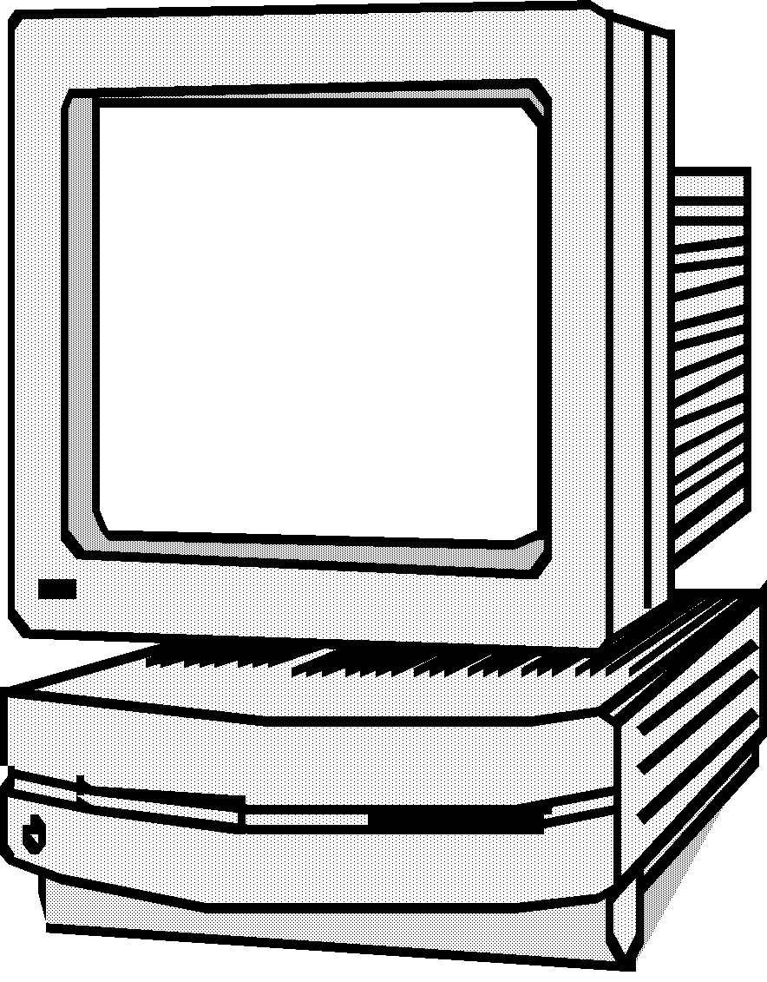

Java is Cross-Platform?
Truth: Java programs can compile to
machine-independent bytecode
Truth: All major operating systems have Java runtime environments
Most bundle it (Solaris, MacOS, Windows 2000, OS/2)
Java
Source Code
Java Bytecode
JIT Compiler
or Interpreter
Compiler
(javac)
Java Bytecode
Execution
Compile Time
Run Time

Slide 18
Robust
A lot more compiler and runtime checks than C++.
(eg. impossible to overwrite memory and corrupt data, exception handling, runtime checks of casts, …)

Slide 19
Architecture-Neutral
Java executables will run on any machine!
(provided it has a Java bytecode interpreter)

Slide 20
Portable
Standard (fixed) data sizes:
byte = 8 bits float = 32 bits
short = 16 bits double = 64 bits
int = 32 bit unicode characters
long = 64 bits
Libraries: Java includes libraries for graphics, sound, etc., and these are implemented on all machines (UNIX, Windows 95, Mac…)
This means all Java programs are portable!

Slide 21
High Performance
Java runtimes interpret programs
s l o w l y . . .
However, it is possible to translate the Java bytecodes into native machine code just before a program is run.
These "just-in-time compilation" runtimes can make Java nearly as fast as C++.

Slide 22
Multi-Threaded
Several "threads" can run in parallel. Direct standard language support for multitasking.

Slide 23
Dynamic
Libraries are linked in later than in C++
(Java: at runtime, C++: at compiletime)
Installing a new version of a library automatically updates all programs!
Even load classes (=code) while running!

Slide 24
Java Class Libraries
Java contains class libraries
Known as Java APIs (Application Programming Interfaces)
Classes
Include methods that perform tasks
Return information after task completion
Used to build Java programs

Slide 25
The Java APIs
Sun are constantly adding new features and APIs
The Core Java API is now very large
Separate set of extension APIs for specific purposes
E.g. Telephony, Web applications, Game programming

Slide 26
Versions of Java
Three versions of the Java 2 Platform, targetted at different uses
Java 2 Micro Edition (J2ME)
Very small Java environment for smart cards, pages, phones, and set-top boxes
Subset of the standard Java libraries aimed at limited size and processing power
Java 2 Standard Edition (J2SE)
The basic platform
J2SE can be used to develop client-side standalone applications or applets.
Java 2 Enterprise Edition (J2EE)
For business applications, web services, mission-critical systems
Transaction processing, databases, distribution, replication

Slide 27
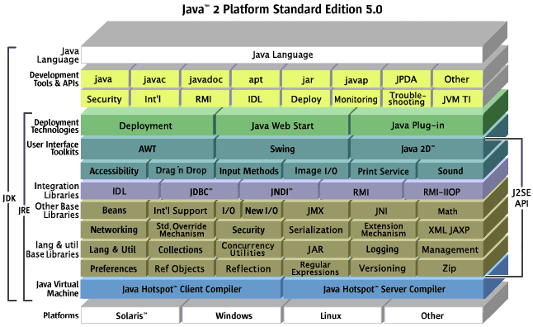
J2SE 5.0

Slide 28
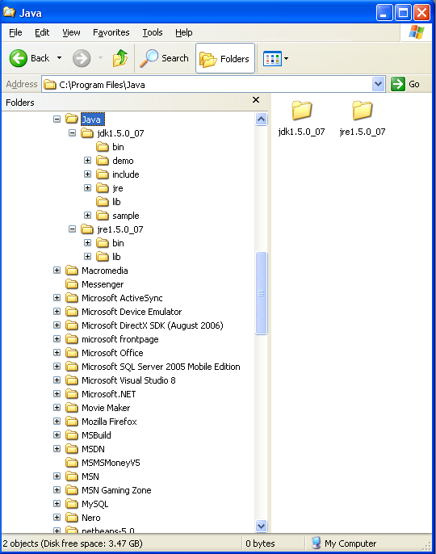
JRE and JDK
JRE: J2SE Runtime Environment
provides
libraries,
Java virtual machine,
other components necessary for you to run applets and applications
JDK: J2SE Development Kit
includes
JRE
command-line development tools such as compilers and debuggers

Slide 29
JVM
JVM: Java Virtual Machines
The Java virtual machine is an abstract computing machine that has an instruction set and manipulates memory at run time.
The Java virtual machine is ported to different platforms to provide hardware- and operating system-independence.

Slide 30
Software required:
Java Compiler:
JDK (Java Development Kit):
J2SE 5.0 (JDK 1.5.0)
Download from:
http://java.sun.com/j2se/1.5.0/download.jsp
Java Editor
JCreator 3.00 or JCreator 3.50 (simple)
NetBeans (little bit slow, good for software development)
JBuilder
J#
IntelliJ
Eclipse
TextPad
BlueJ

Slide 31
Getting Started with Java Programming
A Simple Java Application
Compiling Programs
Executing Applications

Slide 32
The edit-compile-execute cycle
virtual machine
source file
class file
011010
110101
1001
10
011010
110101
010001
1
1
1
0111
0110110
compiler
(javac)
editor
(java)

Slide 33
Standard Java files
source files: *.java Java source files contain the source code in readable form, as typed in by the programmer.
class files: *.class Java class files contain byte code (a machine readable version of the class). They are generated by the compiler from the source file.

Slide 34
Command line invocation
compilation and execution of Java in JDK are done from a command line
On Microsoft systems: DOS shell
On Unix: Unix shell

Slide 35
First Java Program
Comments
/* My first simple Java program */
public class Hello
{
public static void main (String[] args)
{
System.out.println ("Hello World");
}
}
All Java programs have a main function;
they also start at main
Function to print to screen
What to print
Braces indicate start
and end of main
End of
statement

Slide 36
Compiling
Name of the JDK compiler: javac
To invoke: javac <source name>
compiles <source name> and all classes it depends on
Example: cd C:\example javac Hello.java

Slide 37
Execution
C:\example> java Hello
“java” starts the Java virtual machine
Wrong! > java Hello.class
The named class is loaded and execution is started
Other classes are loaded as needed
Only possible if class has been compiled

Slide 38
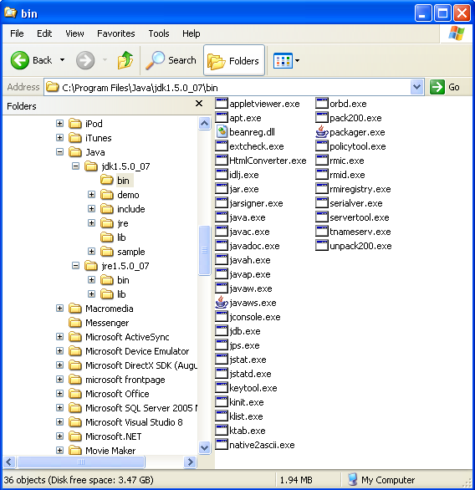
Java/Jdk1.5.0_07/bin

Slide 39
Problems on compiling:
Compile the program:
compile Hello.java by using the following command:
javac Hello.java
it generates a file named Hello.class
‘javac’ is not recognized as an internal or external command, operable program or hatch file.
javac: Command not found
if you see one of these errors, you have two choices:
1) specify the full path in which the javac program locates every time. For example:
C:\program files\java\jdk1.5.0_07\bin\javac Hello.java
2) set the PATH environment variable

Slide 40
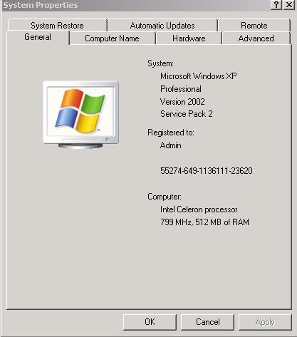
Windows XP Procedure to Set Path
XP-step 1
Choose Control Panel-> System.
Choose ADVANCED

Slide 41
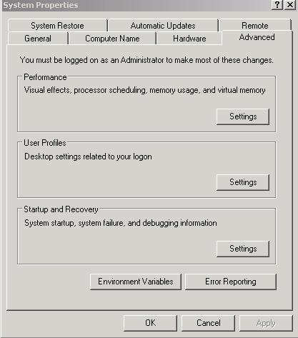
Windows XP Procedure to Set Path
XP-step 2
Choose Environment Variables.

Slide 42
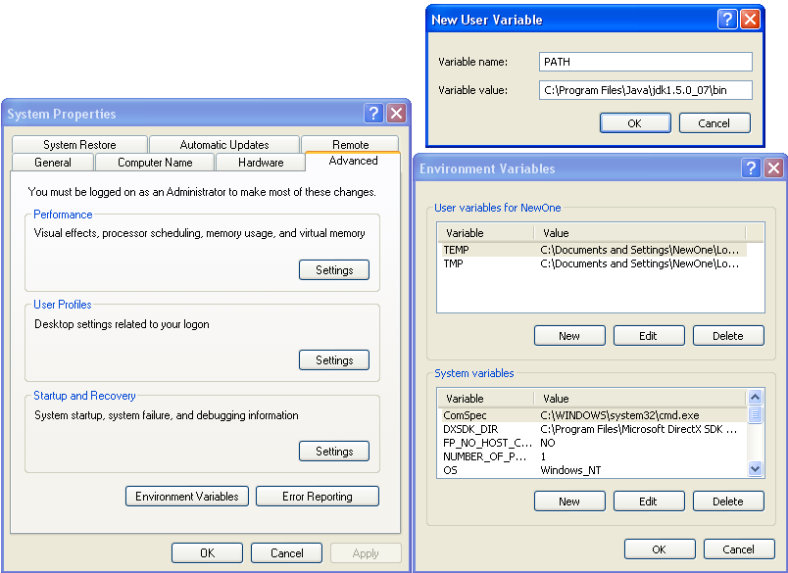
Windows XP Procedure to Set Path

Slide 43
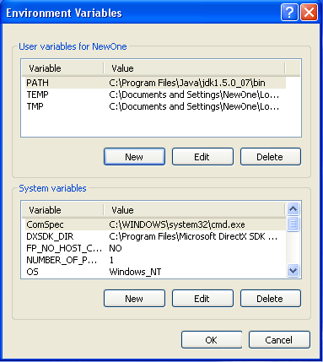
Windows XP Procedure
XP-step 3
Choose New and enter the path(which one??)
Variable: PATH
Value:
c:\program files\java\ jdk1.5.0_07\bin
(or wherever is the above bin folder)

Slide 44
OOPS Concepts
Classes and Objects
Message and Methods
Encapsulation
Association, Aggregation and Composition
Inheritance
Polymorphism
Abstraction
Modularity
Coupling
Cohesion
Interfaces, Implementation?

Slide 45
Classes and Objects
Object oriented programming uses objects.
An object is a thing, both tangible and intangible. Account, Vehicle, Employee etc.
To create an object inside a compute program we must provide a definition for objects – how they behave and what kinds of information they maintain – called a class.
An object is called an instance of a class.
Object interacts with each other via message.

Slide 46
Message and Methods
To instruct a class or an object to perform a task, we send message to it.
You can send message only to classes and objects that understand the message you sent to them.
A class or an object must posses a matching method to be handle the received message.
A method defined for a class is called class method, and a method defined for an object is called an instance method.
A value we pass to an object when sending a message is called an argument of the message.

Slide 47
Message Passing
The process by which an object:
Sends data to other objects
Asks the other object to invoke the method.
In other words, object talks to each other via messages.

Slide 48
Encapsulation
Encapsulation is the integration of data and operations into a class.
Encapsulation is hiding the functional details from the object calling it.
Can you drive the car?
Yes, I can!
So, how does acceleration work?
Huh?
Details encapsulated (hidden) from the driver.

Slide 49
Association, Aggregation and Composition
Association → Whenever two object are related with each other the relationship is called association between objects.
Aggregation → Aggregation is specialized form of association. In aggregation objects have their own life-cycle but there is ownership and child object can not belongs to another parent object. But this is only an ownership not the life-cycle control of child control through parent object. Ex: Student and teacher, Person and address etc.
Composition → Composition is again specialize form of aggregation and we can call this as a “life and death” relationship. It is a strong type of aggregation. Child object dose not have their life-cycle and if parent object deletes all child object will also be deleted. Ex: House and room

Slide 50
Inheritance
Inheritance is a mechanism in OOP to design two or more entities that are different but share many common features.
Feature common to all classes are defined in the superclass.
The classes that inherit common features from the superclass are called subclasses.

Slide 51
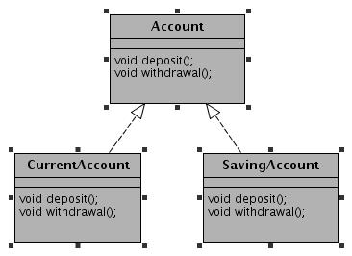
Inheritance Example

Slide 52
Why inheritance?
Classes often share capabilities.
We want to avoid re-coding these capabilities.
Reuse of these would be best to
Improve maintainability
Reduce cost
Improve “real world” modeling.

Slide 53
Why Inheritance? Benefits
No need to re-invent the wheel.
Allow us to build on existing codes without having to copy it, paste it or rewrite it again, etc.
To create the subclass, we need to program only the differences between the superclass and subclass that inherits from it.
Make class more flexible.

Slide 54
Composition(has-a)/Inheritance(is-a)
Prefer composition when not sure about inheritance.
Prefer composition when not all the superclass functions were re-used by subclass.
Inheritance leads to tight coupling b/w subclass with superclass. Harder to maintain.
Inheritance hides some of compilation error which must be exposed.
Inheritance is easier to use than composition.
Composition make the code maintainable in future, especially when your assumption breaks (Using inheritance).
Discussion is incomplete without discussion of Liskov substitution principle.

Slide 55
Composition/Inheritance…..
Idea is to think twice while making decision.
One has to have proper reason while choosing composition/inheritance.
A car has “engine”.
A car is a “vechicle”.
Discussion?

Slide 56
Polymorphism
Polymorphism indicates the meaning of “many forms”.
Polymorphism present a method that can have many definitions. Polymorphism is related to “overloading” and “overriding”.
Overloading indicates a method can have different definitions by defining different type of parameters.
getPrice() : void
getPrice(string name) : void

Slide 57
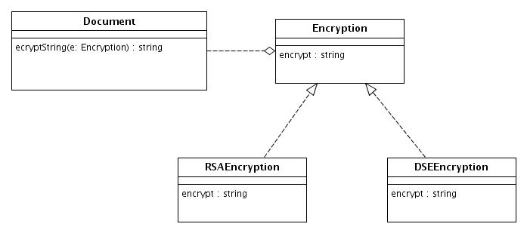
Polymorphism….
Overriding indicates subclass and the parent class has the same methods, parameters and return type(namely to redefine the methods in parent class).

Slide 58
Abstraction
Abstraction is the process of modeling only relevant features
Hide unnecessary details which are irrelevant for current for current purpose (and/or user).
Reduces complexity and aids understanding.
Abstraction provides the freedom to defer implementation decisions by avoiding commitments to details.

Slide 59
Abstraction example
#include <iostream>
using namespace std;
class Adder{
public:
// constructor
Adder(int i = 0)
{
total = i;
}
// interface to outside world
void addNum(int number)
{
total += number;
}
// interface to outside world
int getTotal()
{
return total;
};
private:
// hidden data from outside world
int total;
};
int main( )
{
Adder a;
a.addNum(10);
a.addNum(20);
a.addNum(30);
cout << "Total " << a.getTotal() <<endl;
return 0;
}

Slide 60
Modularity
The modularity means that the logical components of a large program can each be implemented separately. Different people can work on different classes. Each implementation task is isolated from the others.
This has benefits, not just for organizing the implementation, but for fixing problems later.

Slide 61
Coupling
Coupling defines how dependent one object on another object (that is uses).
Coupling is a measure of strength of connection between any two system components. The more any one components knows about other components, the tighter(worse) the coupling is between those components.

Slide 62
Tight coupling
class Traveler
{
Car c=new Car();
void startJourney()
{
c.move();
}
}
class Car
{
void move()
{
// logic...
}
}

Slide 63
Loose coupling
class Traveler
{
Vehicle v;
public void setV(Vehicle v)
{
this.v = v;
}
void startJourney()
{
v.move();
}
}
Interface Vehicle
{
void move();
}
class Car implements Vehicle
{
public void move()
{
// logic
}
}
class Bike implements Vehicle
{
public void move()
{
// logic
}
}

Slide 64
Cohesion
Cohesion defines how narrowly defined an object is. Functional cohesion refers measures how strongly objects are related.
Cohesion is a measure of how logically related the parts of an individual components are to each other, and to the overall components. The more logically related the parts of components are to each other higher (better) the cohesion of that component.
Low coupling and tight cohesion is good object oriented design (OOD).

Slide 65
Interface
An interface is a contract consisting of group of related function prototypes whose usage is defined but whose implementation is not:
An interface definition specifies the interface’s member functions, called methods, their return types, the number and types of parameters and what they must do.
These is no implementation associated with an interface.

Slide 66
Interface Example
class shape
{
public:
virtual ~shape();
virtual void move_x(distance x) = 0;
virtual void move_y(distance y) = 0;
virtual void rotate(angle rotation) = 0;
//...
};

Slide 67
Interface implementation
An interface implementation is the code a programmer supplies to carry out the actions specified in an interface definition.

Slide 68
Implementation Example
class line : public shape
{
public:
virtual ~line();
virtual void move_x(distance x);
virtual void move_y(distance y);
virtual void rotate(angle rotation); private:
point end_point_1, end_point_2;
//...
};

Slide 69
Interface vs. Implementation
Only the services the end user needs are represented.
Data hiding with use of encapsulation
Change in the class implementation should not require change in the class user’s code.
Interface is still the same
Always provide the minimal interface.
Use abstract thinking in designing interfaces
No unnecessary steps
Implement the steps in the class implementation

Slide 70
How to determine minimum possible interface?
Only what user absolutely needs
Fewer interfaces are possible
Use polymorphism
Starts with hiding everything (private)
Only use public interfaces (try not to use public attributes, instead get/set).
Design your class from users perspective and what they need (meet the requirements)

