Slide 1
Classes (Part 4)
MITE 412

Slide 2
Objects Life Cycle
Stages
  creation
  use
  cleanup

Slide 3
Creation of an object
Class Declaration (providing name and definition for the object)
instantiation (setting aside memory for the object)
optional initialization (providing initial values for the object via constructors)

Slide 4
Use of an object
We activate the behavior of an object by invoking one of its methods (sending it a message).
When an object receives a message (has one of its methods invoked), it either performs an action, or modifies its state, or both.

Slide 5
Cleanup
What happens to all the objects that are instantiated?
  When an object is no longer needed, we simply forget it. Eventually, the garbage collector may (or may not) come by and pick it up for recycling

Slide 6
Cleanup Approach
The good news
  if things work as planned, the Java programmer never needs to worry about returning memory to the operating system. This is taken care of automatically by a feature of Java known as the garbage collector.
The bad news
  Java does not support anything like a destructor that is guaranteed to be called whenever the object goes out of scope or is no longer needed. Therefore, other than returning allocated memory, it is the responsibility of the programmer to explicitly perform any other required cleanup at the appropriate point in time.
  Other kinds of cleanup could involve closing files, disconnecting from open telephone lines, etc.

Slide 7
Garbage Collection
The sole purpose of garbage collection is to reclaim memory occupied by objects that are no longer needed.
Eligibility for garbage collection
  An object becomes eligible for garbage collection when there are no more references to that object. You can make an object eligible for garbage collection by setting all references to that object to null, or allowing them to go out of scope.

Slide 8
No Guarantees
However, just because an object is eligible for garbage collection doesn't mean that it will be reclaimed.
The garbage collector runs in a low-priority thread, and presumably is designed to create minimal interference with the other threads of the program. Therefore, the garbage collector may not run unless a memory shortage is detected. And when it does run, it runs asynchronously relative to the other threads in the program.

Slide 9
Finalize Method
  Before the garbage collector reclaims the memory occupied by an object, it calls the object's finalize() method.
  The finalize() method is a member of the Object class. Since all classes inherit from the Object class, your classes also contain the default finalize() method. This gives you an opportunity to execute your special cleanup code on each object before the memory is reclaimed
  In order to make use of the finalize() method, you must override it, providing the code that you want to have executed before the memory is reclaimed.

Slide 10
When do I use the finalize() method
Is the cleanup timing critical?
  If you simply need to do cleanup work on an object sometime before the program terminates, (and you have specified finalization on exit) you can ALMOST depend on your overridden finalize() method being executed sometime before the program terminates.
  If you need cleanup work to be performed earlier (such as disconnecting an open long-distance telephone call), you must explicitly call methods to do cleanup at the appropriate point in time and not depend on finalization to get the job done.
If you use the finalize() method, make sure that you call the super.finalize() method at the end of it.

Slide 11
Static vs. non-static

Slide 12
Methods
Instance (or member) method
  Operates on a object (i.e., and instance of the class)
    String s = new String("Help every cow reach its "
    + "potential!");
    int n = s.length();
Class (i.e. static) method
  Service provided by a class and it is not associated with a particular object
  String t = String.valueOf(n);
Instance method
Class method

Slide 13
Variables
Instance variable and instance constants
  Attribute of a particular object
  Usually a variable
    Point p = new Point(5, 5);
    int px = p.x;
Class variables and constants
  Collective information that is not specific to individual objects of the class
  Usually a constant
  Color favoriteColor = Color.MAGENTA;
  double favoriteNumber = Math.PI - Math.E;
Instance variable
Class constants

Slide 14
static and non-static rules
Member/instance (i.e. non-static) fields and methods can ONLY be accessed by the object name
Class (i.e. static) fields and methods can be accessed by Either the class name or the object name

Slide 15
Static vs. non-static (Read yourself)
Consider the following code:
  public class Staticness {
  private int a = 0;
  private static int b = 0;
  public void increment() {
  a++;
  b++;
  }
  public String toString() {
  return "(a=" + a + ",b=" + b + ")";
  }
  }

Slide 16
Static vs. non-static (Read yourself)
And the code to run it:
  public class StaticTest {
  public static void main (String[] args) {
    Staticness s = new Staticness();
    Staticness t = new Staticness();
    s.increment();
    t.increment();
    t.increment();
    System.out.println (s);
    System.out.println (t);
  }
  }

Slide 17
Static vs. non-static (Read yourself)
Execution of the code…
Output is:
  (a=1,b=3)
  (a=2,b=3)

Slide 18
Static vs. non-static: memory diagram
(Read yourself)
Staticness s = new Staticness();
Staticness t = new Staticness();
s.increment();
t.increment();
t.increment();
System.out.println (s);
System.out.println (t);
Staticness s = new Staticness();
Staticness t = new Staticness();
s.increment();
t.increment();
t.increment();
System.out.println (s);
System.out.println (t);
s
t
Staticness
Staticness
Staticness
Staticness
Staticness
a = 0
a = 1
a = 1
a = 2
a = 0
0
1
2
3
b

Slide 19
Parameter passing

Slide 20
Java parameter passing
Consider the following code:
  static void foobar (int y) {
  y = 7;
  }
  public static void main (String[] args) {
  int x = 5;
  foobar (x);
  System.out.println(x);
  }
What gets printed?
7
y
5
y
x
5
formal parameter
actual parameter

Slide 21
Java parameter passing
Consider the following code:
  static void foobar (String y) {
  y = “7”;
  }
  public static void main (String[] args) {
  String x = “5”;
  foobar (x);
  System.out.println(x);
  }
What gets printed?
y
“7"
x
“5"
formal parameter
actual parameter

Slide 22
Java parameter passing
Consider the following code:
  static void foobar (Rectangle y) {
  y.setWidth (10);
  }
  public static void main (String[] args) {
  Rectangle x = new Rectangle();
  foobar (x);
  System.out.println(x.getWidth());
  }
What gets printed?
formal parameter
actual parameter
y
width = 10
x
width = 0

Slide 23
Java parameter passing
Consider the following code:
  static void foobar (Rectangle y) {
  y = new Rectangle();
  y.setWidth (10);
  }
  public static void main (String[] args) {
  Rectangle x = new Rectangle();
  foobar (x);
  System.out.println(x.getWidth());
  }
What gets printed?
formal parameter
actual parameter
width = 10
y
width = 0
x
width = 0

Slide 24
Java parameter passing
Consider the following code:
  static void swap (int a, int b) {
  int temp=a;a=b;b=temp;
  }
  public static void main (String[] args) {
  int x=10, y=20;
  swap (x,y);
  System.out.println(x,y);
  }
What gets printed?
formal parameter
actual parameter
x
10
y
20

Slide 25
Java parameter passing
Consider the following code:
  static void swap (Integer a, Integer b) {
  Integer temp=a;a=b;b=temp;
  }
  public static void main (String[] args) {
  Integer x=10, y=20;
  swap(x,y);
  System.out.println(x,y);
  }
What gets printed?
formal parameter
actual parameter
x
20
y
10

Slide 26
Java parameter passing
The value of the actual parameter gets copied to the formal parameter
  This is called pass-by-value
  C/C++ is also pass-by-value
Any changes to the formal parameter are forgotten when the method returns
However, if the parameter is a reference to an object, that object can be modified
  Similar to how the object a final reference points to can be modified

Slide 27
Value parameter passing demonstration
public class ParameterDemo {
public static double add(double x, double y) {
double result = x + y;
return result;
}
public static double multiply(double x, double y) {
x = x * y;
return x;
}
public static void main(String[] args) {
double a = 8, b = 11;
double sum = add(a, b);
System.out.println(a + " + " + b + " = " + sum);
double product = multiply(a, b);
System.out.println(a + " * " + b + " = " + product);
}
}

Slide 28
PassingReferences.java

Slide 29
PassingReferences.java
Import java.awt.*;
public class PassingReferences {
public static void f(Point v) {
v = new Point(0, 0);
}
public static void g(Point v) {
v.setLocation(0, 0);
}
public static void main(String[] args) {
Point p = new Point(10, 10);
System.out.println(p);
f(p);
System.out.println(p);
g(p);
System.out.println(p);
}
}

Slide 30
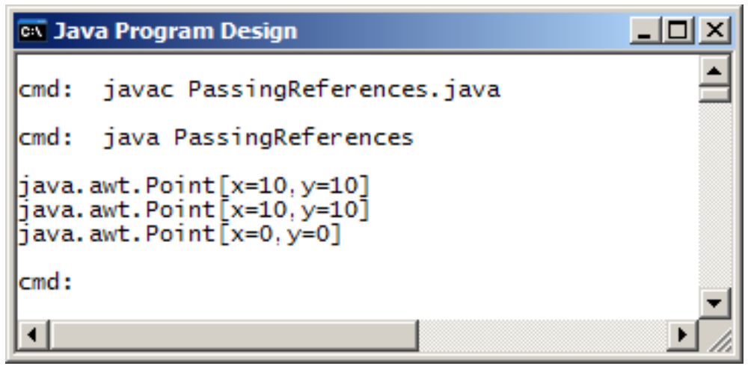
PassingReferences.java run
g() can change the attributes of the object to which p refers

Slide 31
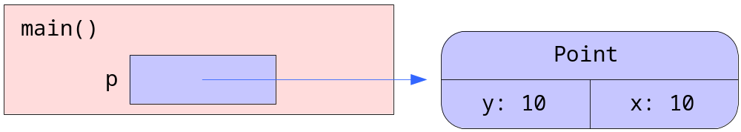
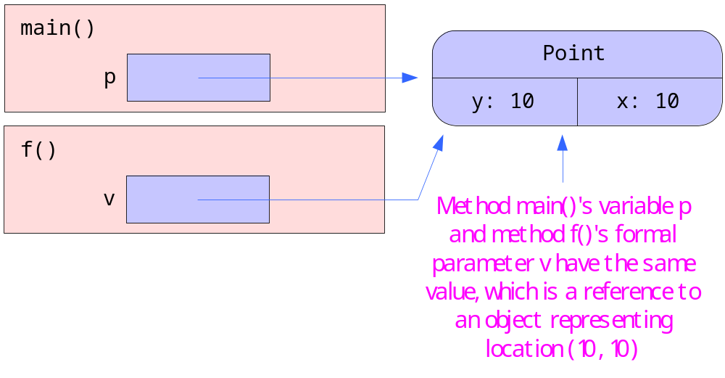
PassingReferences.java
public static void main(String[] args) {
  Point p = new Point(10, 10);
  System.out.println(p);
  f(p);
java.awt.Point[x=10,y=10]

Slide 32
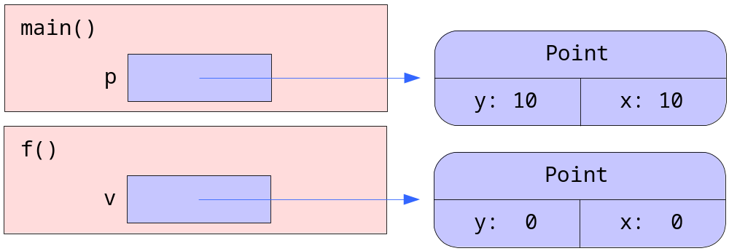
PassingReferences.java
public static void f(Point v) {
  v = new Point(0, 0);
}

Slide 33
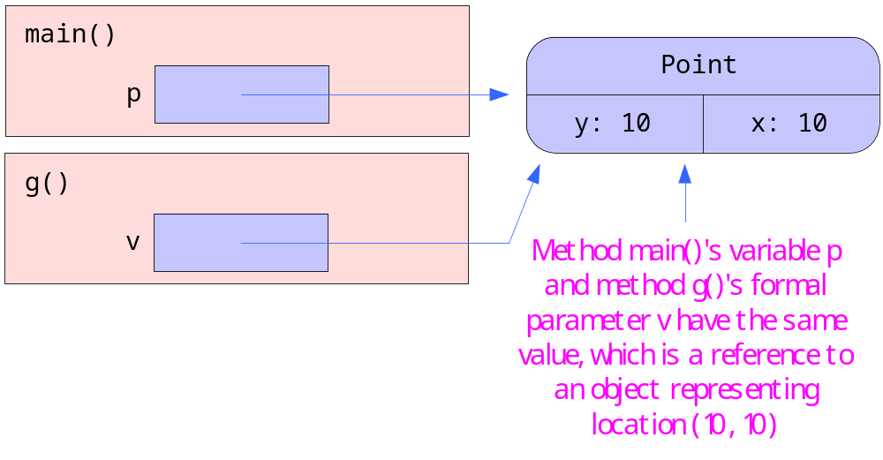
PassingReferences.java
public static void main(String[] args) {
  Point p = new Point(10, 10);
  System.out.println(p);
  f(p);
  System.out.println(p);
  g(p);
java.awt.Point[x=10,y=10]
java.awt.Point[x=10,y=10]

Slide 34
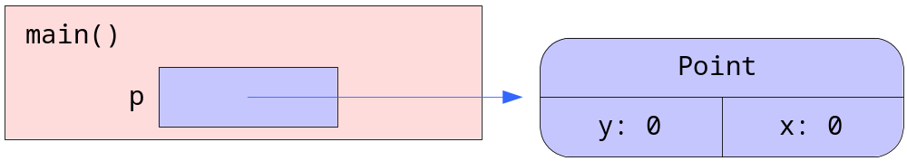
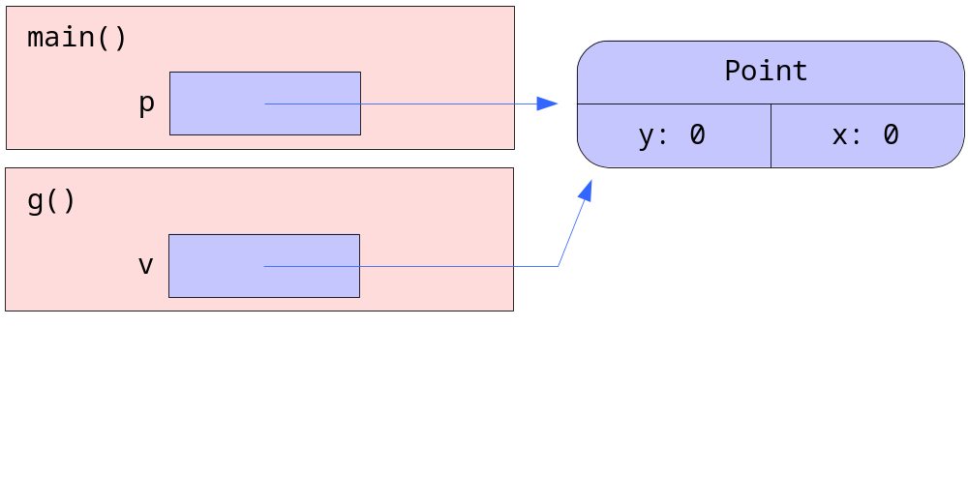
PassingReferences.java
public static void g(Point v) {
  v.setLocation(0, 0);
}

Slide 35
PassingReferences.java
public static void main(String[] args) {
  Point p = new Point(10, 10);
  System.out.println(p);
  f(p);
  System.out.println(p);
  g(p);
  System.out.println(p);
java.awt.Point[x=10,y=10]
java.awt.Point[x=10,y=10]
java.awt.Point[x=0,y=0]

Slide 36
Overloading

Slide 37
Overloading
Have seen it often before with operators
  int i = 11 + 28;
    double x = 6.9 + 11.29;
    String s = "April " + "June";
Java also supports method overloading
  Several methods can have the same name
  Useful when we need to write methods that perform similar tasks but different parameter lists
  Method name can be overloaded as long as its signature is different from the other methods of its class
    Difference in the names, types, number, or order of the parameters

Slide 38
Legal
public static int power(int x, int n) {
int result = 1;
for (int i = 1; i <= n; ++i) {
result *= x;
}
return result;
}
public static double power(double x, int n) {
double result = 1;
for (int i = 1; i <= n; ++i) {
result *= x;
}
return result;
}

Slide 39
What’s the output?
public static void f(int a, int b) {
System.out.println(a + b);
}
public static void f(double a, double b) {
System.out.println(a - b);
}
public static void main(String[] args) {
int i = 19;
double x = 54.0;
f(i, x);
}

Slide 40
Inheritance
Inheritance allows us to derive a new class from an existing one
The existing class is called the superclass or base-class.
derived class is called the subclass or derived-class.
Instances of the derived class inherit all the properties and functionality that is defined in the base class.
Usually, the derived class adds more functionality and properties.

Slide 41
Inheritance
Class A
Class A is the superclass of B
Class B is the subclass of A
Class B is the superclass of C, D, E
Class C, D and E are subclasses of B
Class B
Class C
Class D
Class E

Slide 42
Inheritance
  we can build class hierarchies using the keyword extends
  each child (subclass) inherits all the data and methods of its parent (superclass)
  we can add new methods in the subclass, or override the inherited methods
  private data and methods are inherited, but cannot be accessed directly; protected data and methods can be accessed directly
  constructor methods must be invoked in the first line in a subclass constructor as a call to super
  inheritance allows us to re-use classes by specialising them

Slide 43
Inheritance Example 1
class BaseClass
{
public void doSomething()
{
System.out.println("BaseClass doSomething");
}
}
class SubClass extends BaseClass
{
}
public class InheritanceExample1
{
public static void main(String args[])
{
SubClass sc = new SubClass();
sc.doSomething();
BaseClass bc = new SubClass();
bc.doSomething();
}
}

Slide 44
Inheritance Example 2
class BaseClass{
public void doSomething() {
    System.out.println("BaseClass doSomething");
}
}
class SubClass extends BaseClass{
public void doSomething() {
System.out.println("SubClass doSomething");
}
}
public class InheritanceExample2 {
public static void main(String args[]) {
SubClass sc = new SubClass();
sc.doSomething();
BaseClass bc = new SubClass();
bc.doSomething();
}
}

Slide 45
Example 3 (with super)
class BaseClass{
public void doSomething(){
    System.out.println("BaseClass doSomething");
}
}
class SubClass extends BaseClass{
public void doSomething() {
System.out.print("Super: ");
super.doSomething();
System.out.println("SubClass doSomething");
}
}

Slide 46
Inheritance: a Basis for Code Reusability
Fast implementation - we need not write the implementation of all classes from scratch, we just implement the additional functionality.
Ease of use - If someone is already familiar with the base class, then the derived class will be easy to understand.
Less debugging - debugging is restricted to the additional functionality.
Ease of maintenance - if we need to correct/improve the implementation of base class, derive class is automatically corrected as well.
Compactness - our code is more compact and is easier to understand.

Slide 47
Rules of Overriding
When you derive a class B from a class A, the interface of class B will be a superset of that of class A (except for constructors)
You cannot remove a method from the interface by sub-classing
However, class B can override some of the methods that it inherits and thus change their functionality.
The over-ridden methods of the super-class are no longer accessible from a variable of the sub-class type.
They can be invoked from within the sub-class definition using the super.method(…) syntax.
The contract of a method states what is expected from an overriding implementation of the method.

