Slide 1
Computer Peripherals and Interfacing
Lecture-3
Tumpa Rani Shaha
Assistant Professor, Dept of CSE
BSMRSTU

Slide 2
8255 - PROGRAMMABLE PERIPHERAL INTERFACE (PPI )
Intel 8255 Programmable Peripheral Interface(PPI) chip was developed and manufactured by Intel for use with their 8085 and 8086 microprocessor and their descendants.
Is a peripheral chip, is used to give the CPU access to programmable parallel I/O. It can be programmable to transfer data under various conditions from simple I/O to interrupt I/O. it is flexible versatile and economical but some what complex. It is an important general purpose I/O device that can be used with almost any Microprocessor.

Slide 3
8255 - PROGRAMMABLE PERIPHERAL INTERFACE (PPI )
The 8255A has 24 I/O pins that can be grouped primarily in two 8-bit parallel ports: A and B with the remaining eight bits as port C. The eight bits of port C can be used as individual bits or be grouped in to 4-bit ports: CUpper (Cu) and CLower (CL). The function of these ports is defined by writing a control word in the control register.

Slide 4
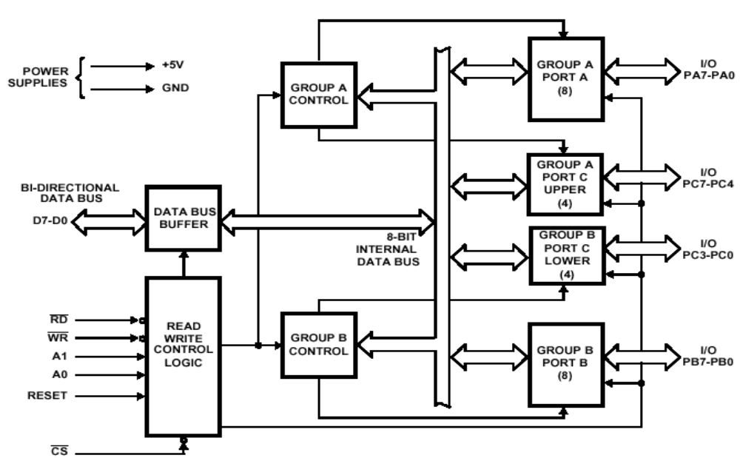
8255 – Block diagram

Slide 5
8255 – Block diagram Description
Data Bus Buffer
This three-state bi-directional 8-bit buffer is used to interface the 8255 to the system data bus. Data is transmitted or received by the buffer upon execution of input or output instructions by the CPU. Control words and status information are also transferred through the data bus buffer.
Read/Write and Control Logic
The function of this block is to manage all of the internal and external transfers of both Data and Control or Status words. It accepts inputs from the CPU Address and Control busses and in turn, issues commands to both of the Control Groups.

Slide 6
8255 – Block diagram Description
(CS) Chip Select. A "low" on this input pin enables the communication between the 8255 and the CPU.
(RD) Read. A "low" on this input pin enables 8255 to send the data or status information to the CPU on the data bus. In essence, it allows the CPU to "read from" the 8255.
(WR) Write. A "low" on this input pin enables the CPU to write data or control words into the 8255.
(RESET) Reset. A "high" on this input initializes the control register to 9Bh and all ports (A, B, C) are set to the input mode.

Slide 7
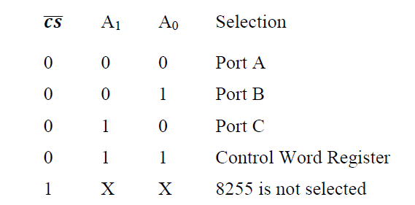
8255 – Block diagram Description
(A0 and A1) Port Select 0 and Port Select 1. These input signals, in conjunction with the RD and WR inputs, control the selection of one of the three ports or the control word register. They are normally connected to the least significant bits of the address bus (A0 and A1).

Slide 8
8255 – Block diagram Description
Group A and Group B Controls
The functional configuration of each port is programmed by the systems software. In essence, the CPU "outputs" a control word to the 8255. The control word contains information such as "mode", "bit set", "bit reset", etc., that initializes the functional configuration of the 8255. Each of the Control blocks (Group A and Group B) accepts "commands" from the Read/Write Control logic, receives "control words" from the internal data bus and issues the proper commands to its associated ports.

Slide 9
8255 – Block diagram Description
Port A One 8-bit data output latch/buffer and one 8-bit data input latch.
Port B One 8-bit data input/output latch/buffer and one 8-bit data input buffer.
Port C One 8-bit data output latch/buffer and one 8-bit data input buffer (no latch for input). This port can be divided into two 4-bit ports under the mode control. Each 4-bit port contains a 4-bit latch and it can be used for the control signal output and status signal inputs in conjunction with ports A and B.

Slide 10
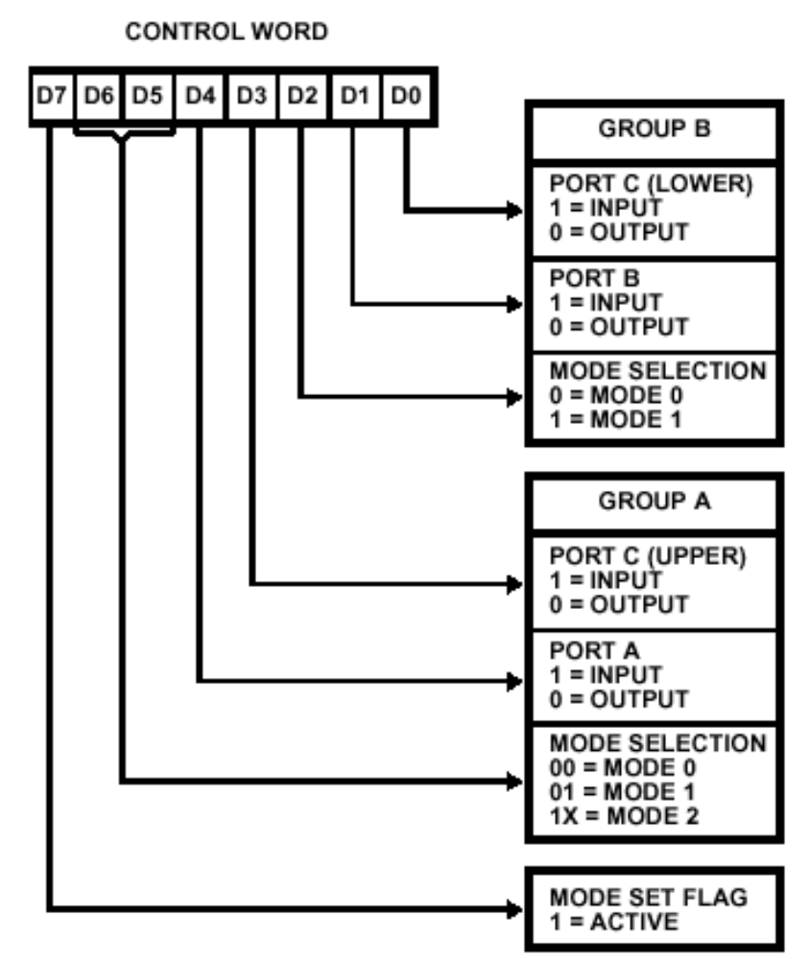
Control word Register format

Slide 11
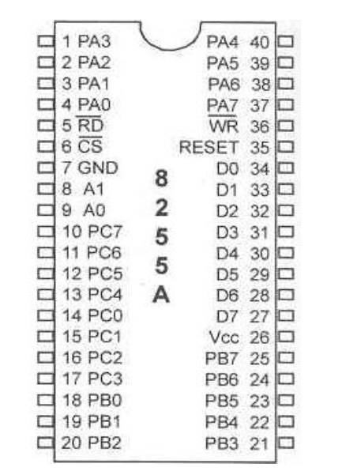
Pin diagram

Slide 12
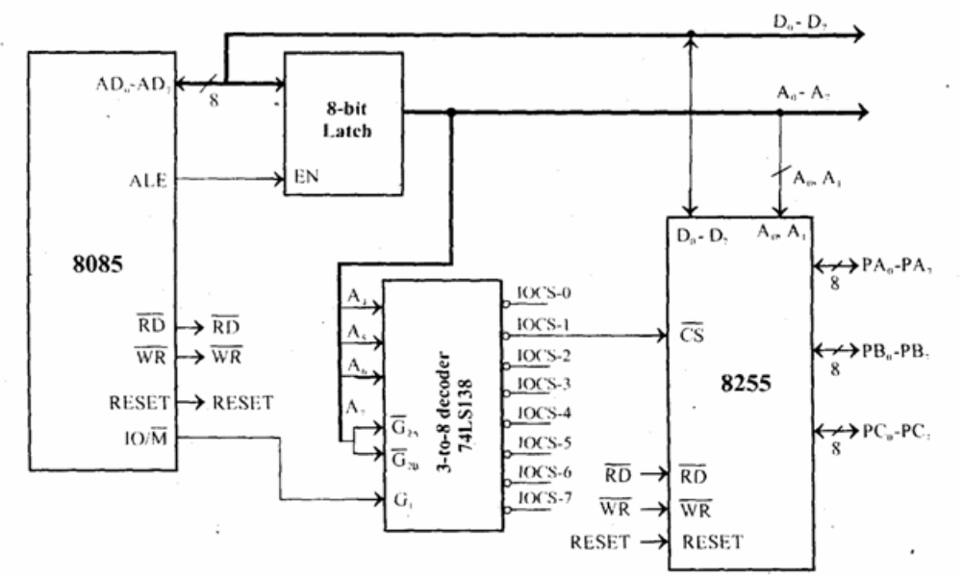
Interfacing 8255 with 8085 processor

Slide 13
Interfacing 8255 with 8085 processor
Using a 3-to-8 decoder generates the chip select signals for I/O mapped devices.
The address lines A4, A5 and A6 are decoded to generate eight chip select signals (IOCS-0 to IOCS-7) and in this, the chip select IOCS- 1 is used to select 8255.
The address line A7 and the control signal IO/M (low) are used as enable for the decoder.
The address line A0 of 8085 is connected to A0 of 8255 and A1 of 8085 is connected to A1 of 8255 to provide the internal addresses.
The data lines D0-D7 are connected to D0-D7 of the processor to achieve parallel data transfer.

