Slide 1
Stepper Motors
A stepper motor is a special electrical machine which rotates in discrete angular steps in response to a programmed sequence of input electrical pulses.
Working Principle
A magnetic interaction takes place between the rotor and the stator, which make rotor move.

Slide 2
Construction
The stator has windings
The rotor is of salient structure without any windings, and it may or may not have permanent magnets
Application
Application of stepper motor in diverse areas ranging from a small wrist watch to artificial satellites.
Power range 1W to 2.5KW
Torque range 1µN to 40 Nm

Slide 3
Stepper Motors
The stepper motor can be considered as a digital device which converts electrical pulses into proportionate mechanical movement.
Each revolution of the stepper motor's shaft is made up of a series of discrete individual steps. Being bidirectional, it is ideally suited for a wide variety of control and positioning applications in the industrial world.
The stepper motors may be used in educational and hobby robots which can take lighter loads. Conventional ac and dc motors have a free turning shaft. The stepper motor shaft rotation is incremental. It is designed to rotate a specific number of degrees, (usually 7.5° or 15°) for each electrical pulse received by its control unit. This increment is known as step angle.

Slide 4
Stepper Motors
Applications
It is used in digital control systems where the motor receives open loop commands as a train of pulses to turn a shaft or move a plate by a specific distance.
The basic feature of a stepper motor is that upon being energized it will move and come to rest after some number of steps in strict accordance with the digital input commands provided.
The repeatability (the ability to position through the same pattern of movements a number of times) is very good. With a stepper motor, a position sensor or feedback system is not normally required to make the output member follow the input instructions.

Slide 5
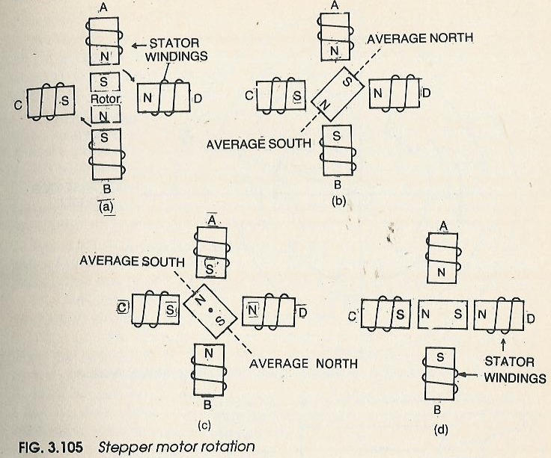
Stepper Motors: Principle of Operation

Slide 6
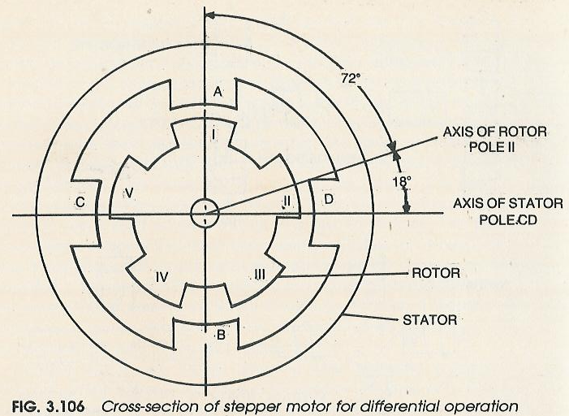
Stepper Motors: Principle of Operation

Slide 7
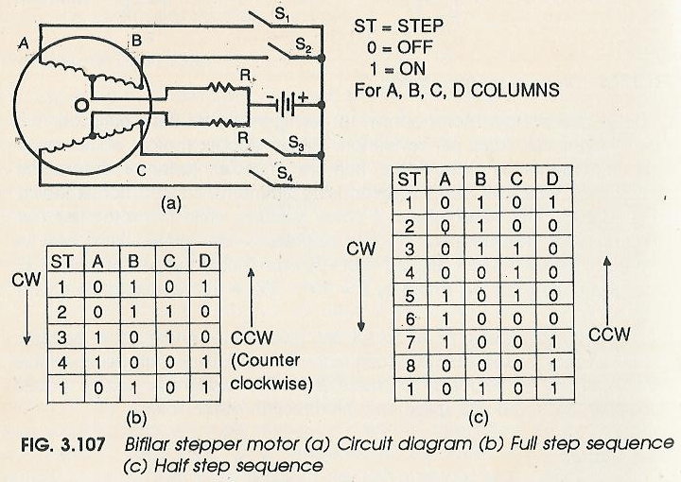
Stepper Motors: Drive Circuit

Slide 8
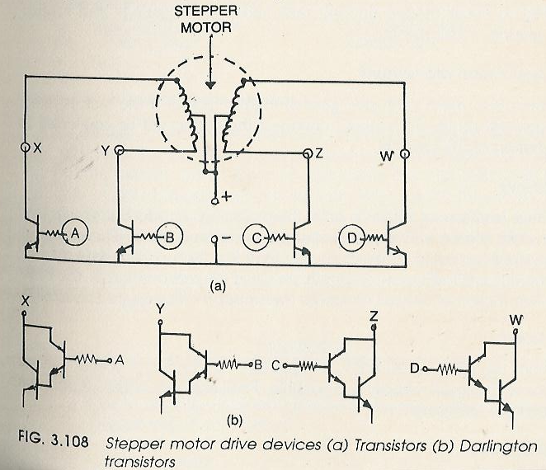
Stepper Motors: Drive Circuit

Slide 9
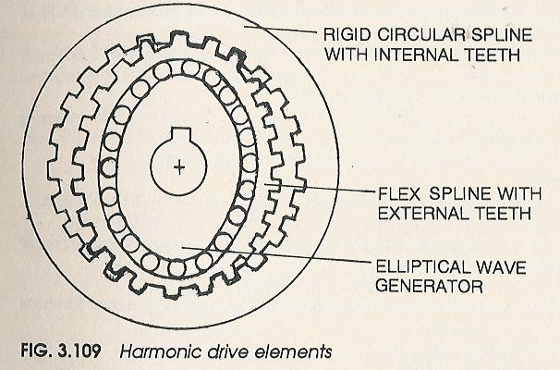
Stepper Motors: Drive Mechanisms
Rack and Pinion Movement
Ball Screws
Gear Trains
Harmonic Drive

