Slide 1
Robotic Manipulator Arm
There are several designs of the arm to facilitate movement with in work envelope with maximum possible load, speed, high precision and repeatability.
The simplest robot may be a two or three-axes arm. The axis is meant to understand independent movement or degree of freedom (DOF).
Robots are built with several degrees of freedom that may vary from two to ten. Most of the industrial robots have, of course, five or six degrees of freedom.

Slide 2
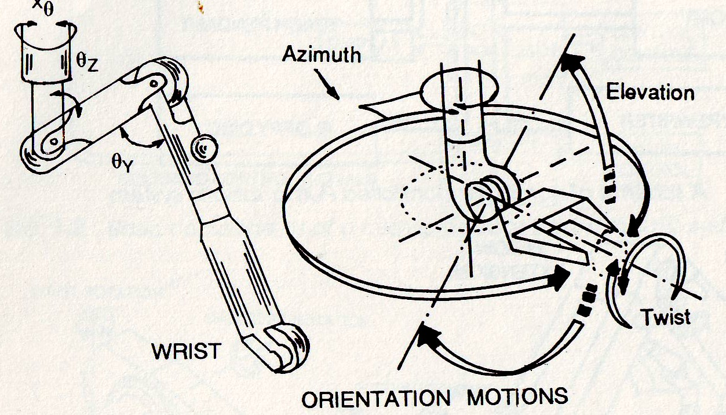
Robotic Manipulator Arm
A 3 DOF Arm is shown Here and another 6 DOF is shown next.

Slide 3
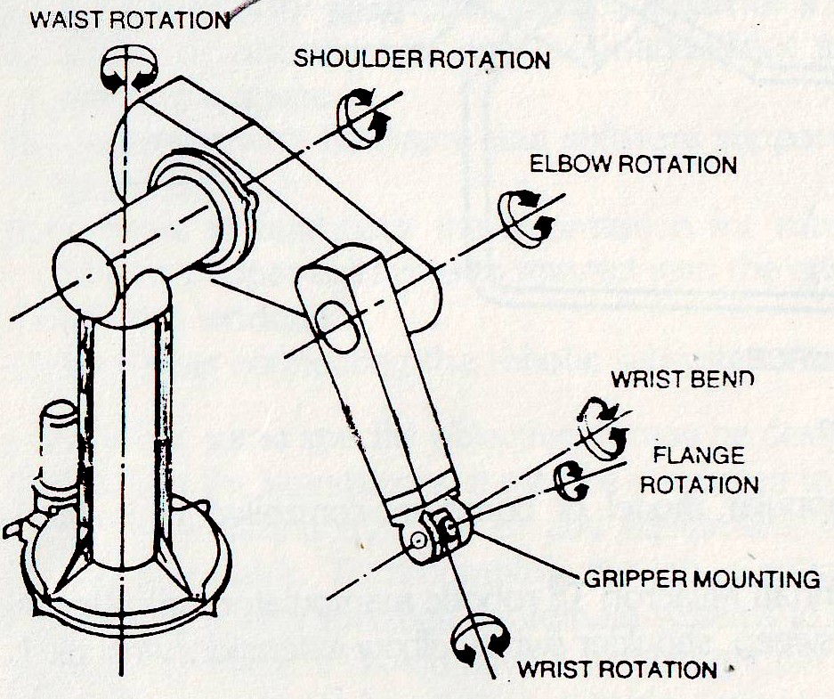
Robotic Manipulator Arm Six Axis PUMA Robot

Slide 4
Robotic Manipulator Arm
A robot is essentially a movable open chain of successively coupled bodies with one end fixed to the ground and the free end containing an end effectors.
The bodies of the open chain are usually links which are joined together by some lower pair connectors.

Slide 5
Robotic Manipulator Arm
The most common types of lower pair connectors are:
Revolute pair (1 DOF)
Prismatic pair (1 DOF)
Cylindrical pair (2 DOF)
Spherical pair (3 DOF)
Hooke joint (2 DOF)

Slide 6
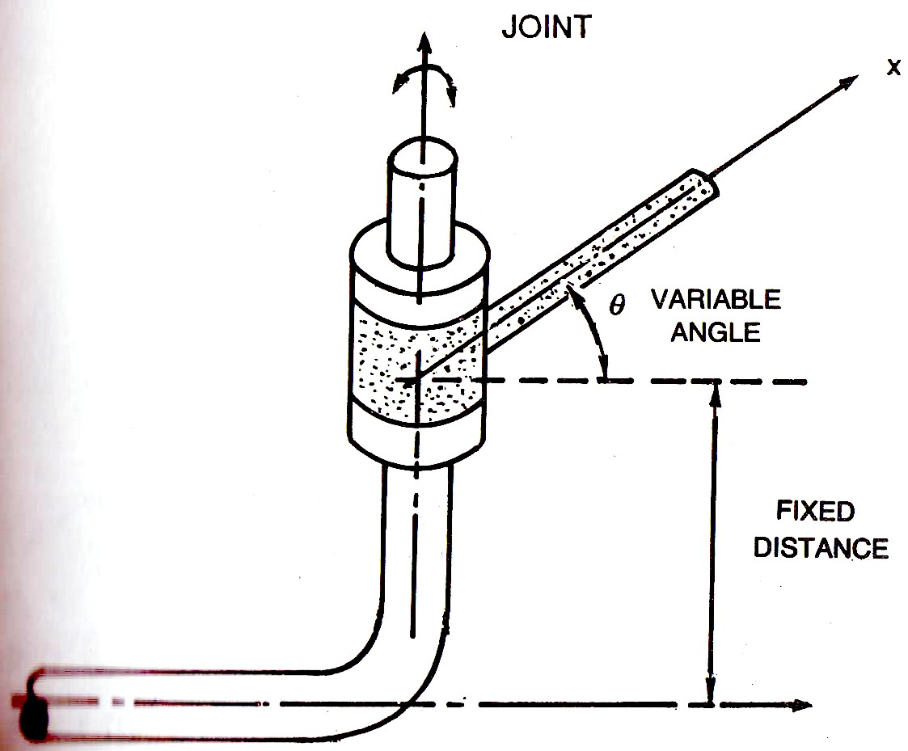
Revolute pair (1 DOF)

Slide 7
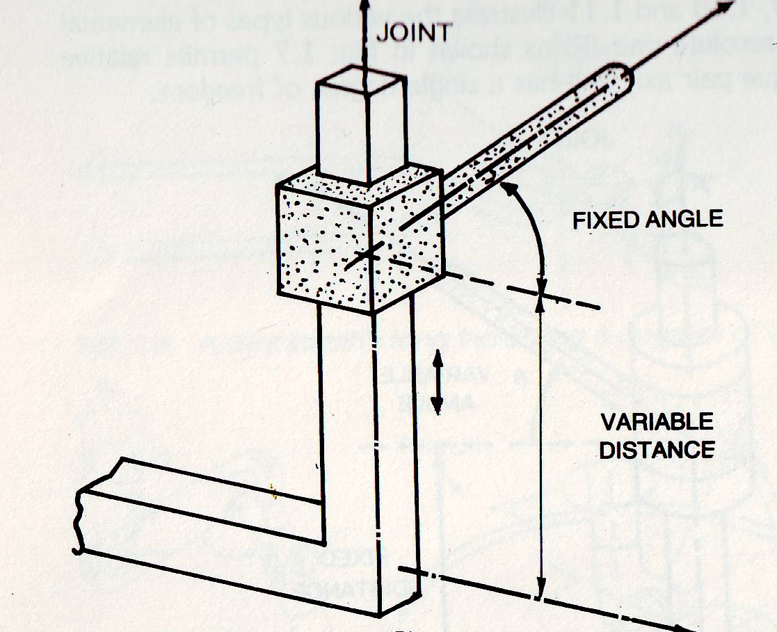
Prismatic pair (1 DOF)

Slide 8
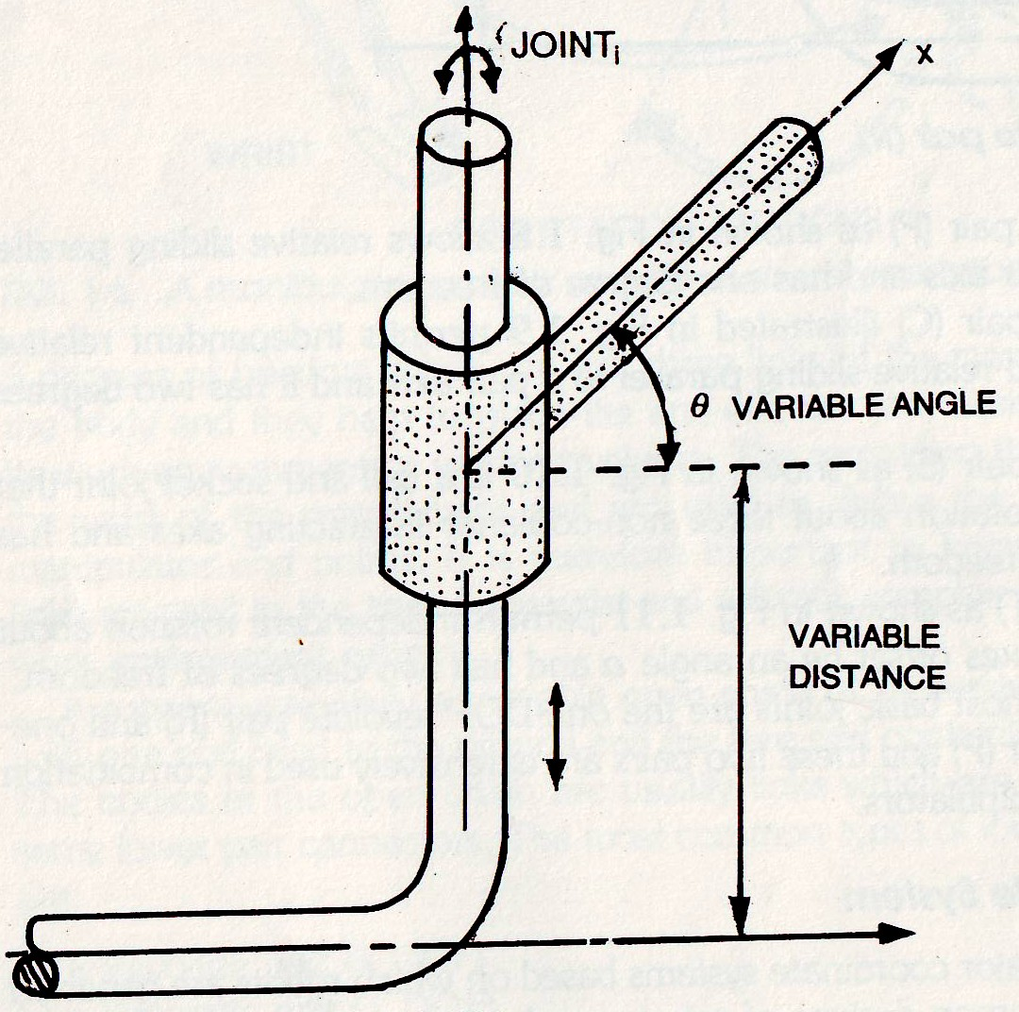
Cylindrical pair (2 DOF)

Slide 9
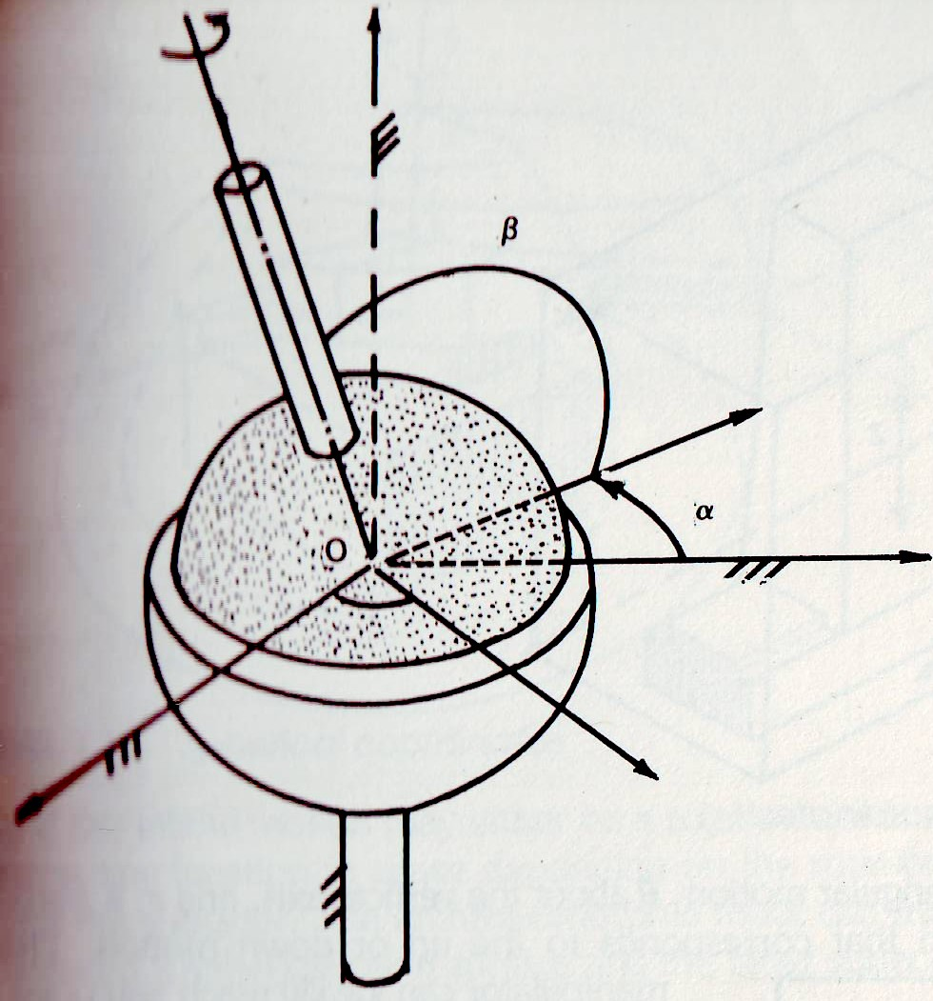
Spherical pair (3 DOF)

Slide 10
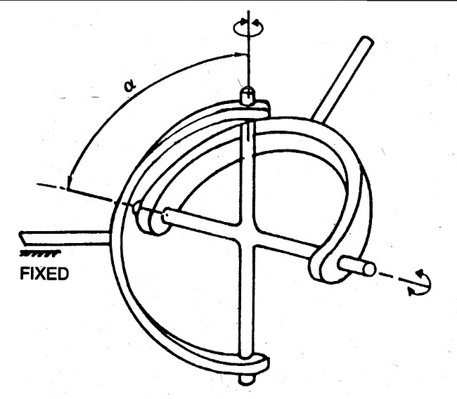
Hooke joint (2 DOF)

Slide 11
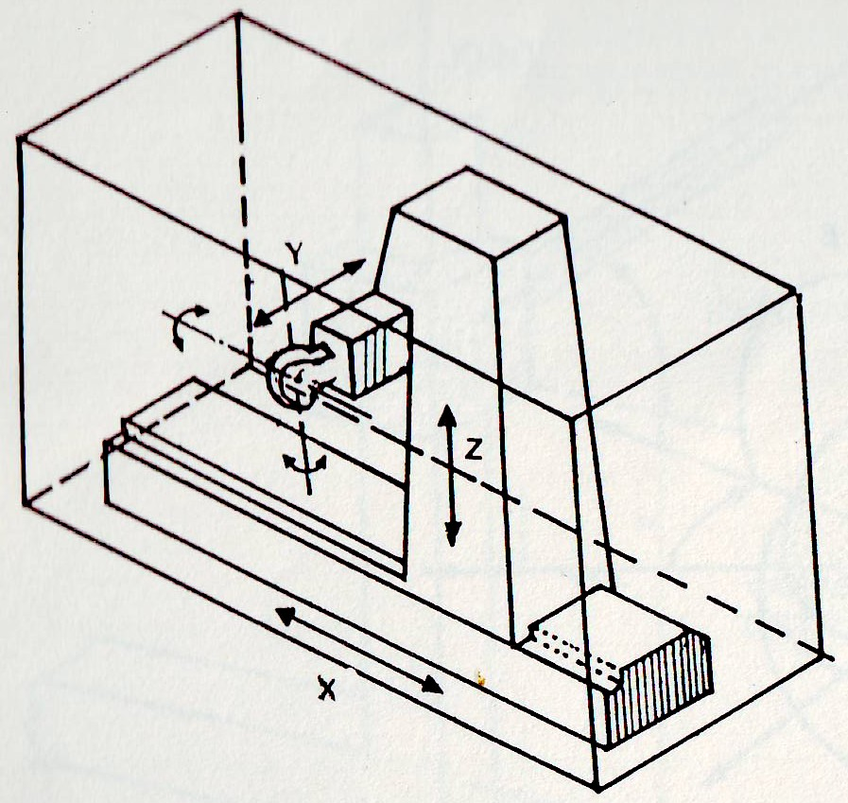
Robot Coordinate System
In the Cartesian coordinate configuration, the three orthogonal directions are X, Y and Z.
X-coordinate axis may represent left and right motion.
Y-coordinate axis may describe forward and backward motion.
Z-coordinate axis may be used to represent up and down motions.

Slide 12
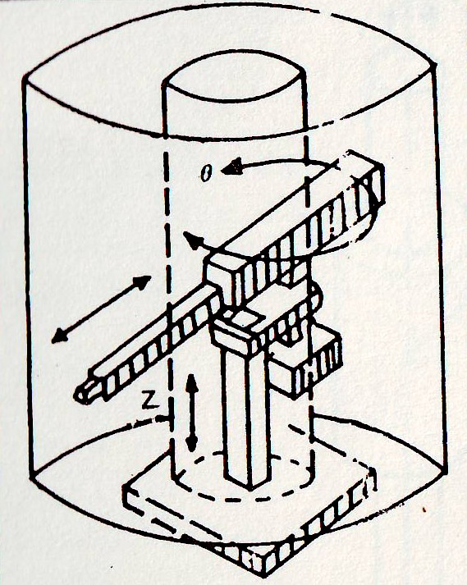
Robot Coordinate System
In cylindrical coordinate configuration, 3 DOF, two linear motions and one rotational, correspond to a radial in or out translation r.
An angular motion, θ about the vertical axis.
And z, a translation in the z-direction that corresponds to the up or down motion.

Slide 13
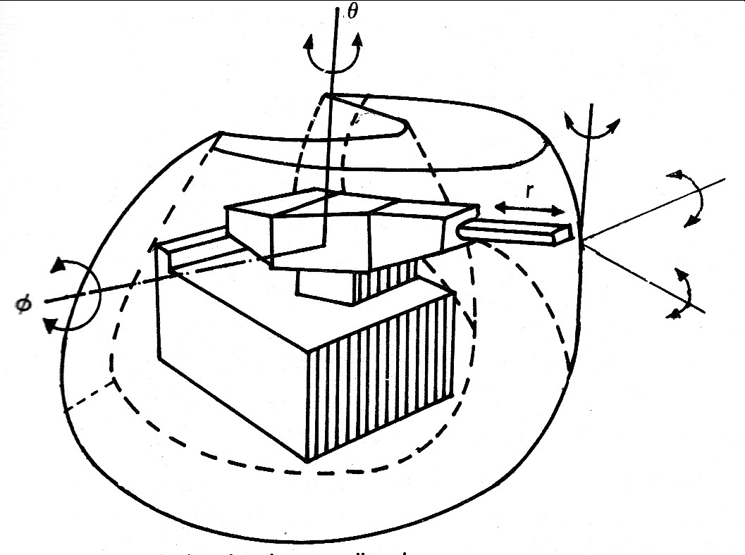
Robot Coordinate System
In the spherical coordinate confi­guration, the robot has one linear and two angular motions.
The linear motion, r corres­ponds to a radial in or out translation, the first angular motion corresponds to a base rotation, θ about a vertical axis, and the second angular motion, ф is the one that rotates about an axis perpendicular to the vertical through the base and is sometimes termed as elbow rotation.

Slide 14
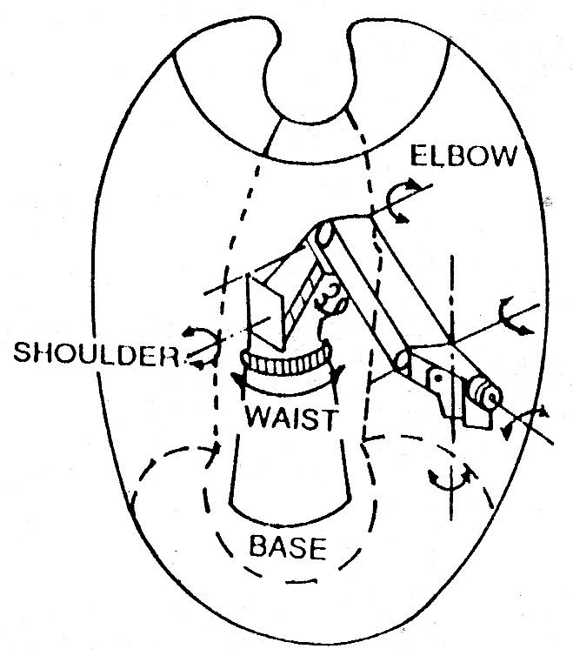
Robot Coordinate System
In the revolute coordinate (anthropomorphic or jointed arm) configuration, a robot uses three rotations.
This is like a human arm having waist, shoulder and elbow joints.
The link of the arm mounted on the base joint can rotate around the base about the Z-axis and the two links, namely the shoulder and the elbow.
The shoulder can rotate about a horizontal axis and the elbow motion may either be a rotation about a horizontal axis or may be any location in space depending on the rotational motions of the base and the soulder.

Slide 15
Robot Coordinate System
A simple way to define the manipulator­ body or arm in terms of lower pair connectors is to represent the robots in a rectangular coordinate system as P-P-P robot
in a cylindrical coordinate system as P-R-P robot
in a spherical coordinate system as R-R-P robot
And in a revolute coordinate system as R-R-R robot.

