Slide 1
Robot End-Effectors
Robot end-effector is the gripper or end-of-arm tooling mounted on the wrist of the robot manipulator arm.
The wide range of gripping methods include
Mechanical clamping
Magnetic gripping
Vacuum (suction) gripping
Mechanical type of grippers may simply use mechanical clamping with vice-type mechanism; it may use hooking or lifting mechanisms and mechanisms for scooping or ladling powders, molten metal or plastics. Mechanical type of grippers find wide applications in forging and metal working industry.
Magnetic grippers may be employed for transfer of steel sheets or chips.
Vacuum cups may be used for transfer of sheets of glass, plastic or thin sheets of papers.

Slide 2
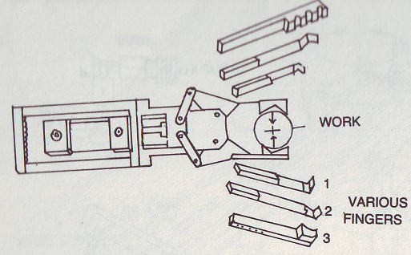
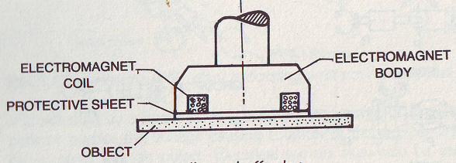
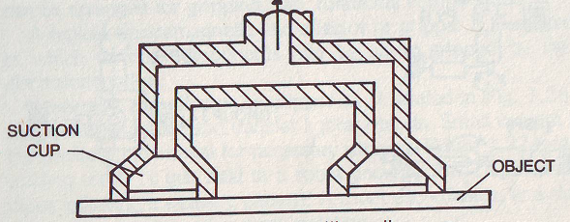
Robot End-Effectors

Slide 3
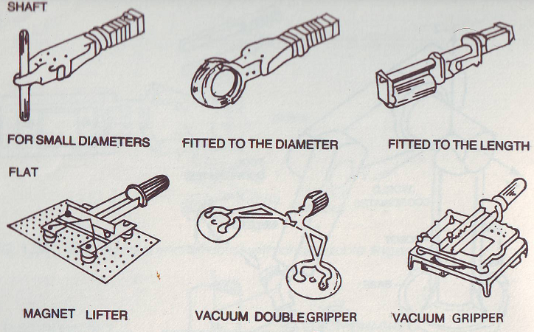
Robot End-Effectors

Slide 4
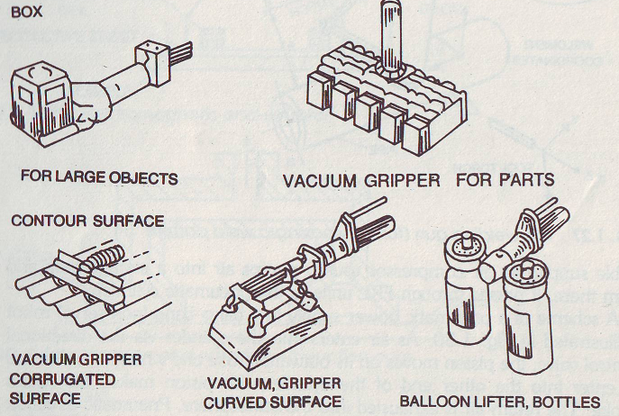
Robot End-Effectors

Slide 5
Robot Actuators
The robot arm can be put to a desired motion with its payload if actuator modules are fitted in to provide power drives to the systems. There are three different types of power drives in common use. They are
Pneumatic
Hydraulic
Electric

Slide 6
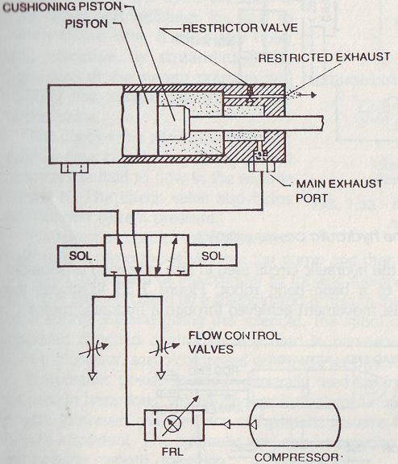
Pneumatic Power Drives
FRL unit, advantage, repeatability error and robot accuracy

Slide 7
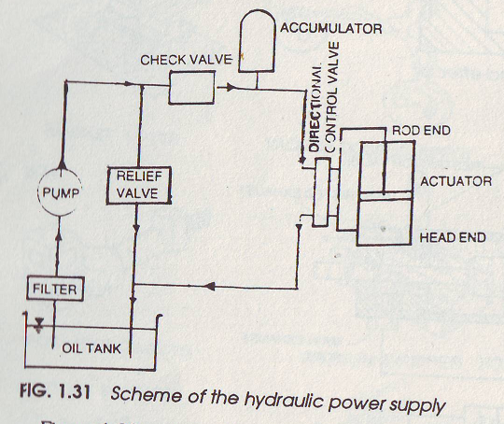
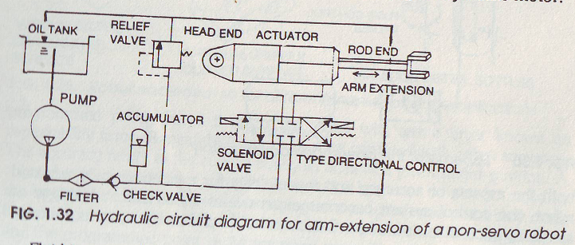
Hydraulic Systems

Slide 8
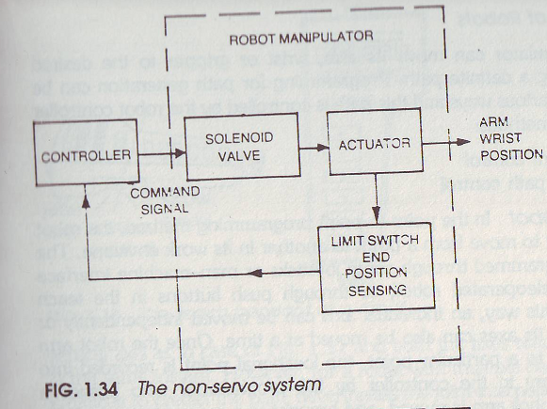
Robot Controllers : Control Systems

Slide 9
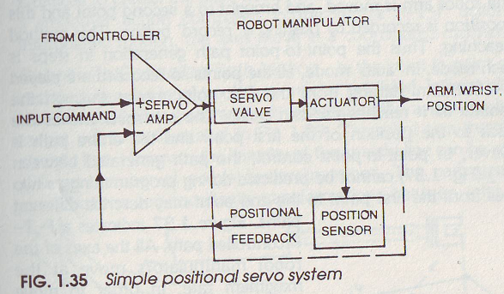
Robot Controllers : Control Systems

