Slide 1
CSE 452
Digital Image Processing

Slide 2
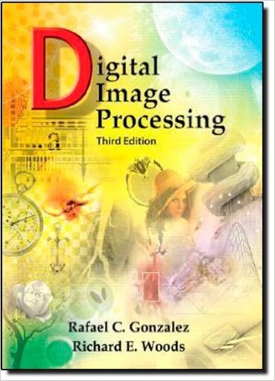
Reference Book
Digital Image Processing (3rd Edition)
Gonzalez and Woods

Slide 3
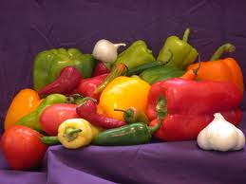
What is an Image/Digital Image?

Slide 4
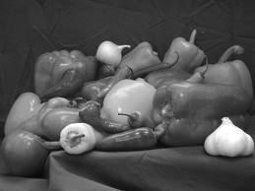
What is an Image/Digital Image?
Let us consider this gray scale image

Slide 5
What is an Image/Digital Image?
A gray scale image
y
f(x, y)
x
2 attributes:
A location (x, y): picture element, pixel,
A value f(x, y) at pixel (x, y): gray scale value
f(x, y) is known as the intensity of the image at (x,y)

Slide 6

What is an Image/Digital Image?
A gray scale image
y
f(x, y)
x
f(x, y) can take any value from 0.0 (black) to 1.0 (white)

Slide 7
What is an Image/Digital Image?
A gray scale image
y
f(x, y)
x
Digital image means
pixels locations (x, y) are discrete
gray level values f(x,y) are also discrete

Slide 8
What is an Image/Digital Image?
An image may be defined as a two-dimensional function, f(x, y), where x and y are spatial (plane) coordinates, and the amplitude of f at any pair of coordinates (x, y) is called the intensity or gray level of the image at that point.
When x, y, and the amplitude values of f are all finite, discrete quantities, we call the image a digital image.
The field of digital image processing refers to processing digital images by means of a digital computer.

Slide 9
Digital Image Processing
Processing of digital images using digital devices (computers)
DIP

Slide 10
Why we need DIP
Core area
Application area

Slide 11
Why we need DIP
Core area
Image enhancement
Image de-noising
Image segmentation
Image & video retrieval
Image compression

Slide 12
Why we need DIP
Application area
Security and surveillance
Biometric application: face, iris, finger print, palm print recognition . .
Medical imaging
Automatic scanning and detection: X-ray, CT, MRI, PET, angiogram, ECG, echo, endoscopy, ….

Slide 13
Why we need DIP
Application area
Document Classification
character recognition
Object and shape recognition
Intelligent transport system
Environmental monitoring
and so on, . . .

Slide 14
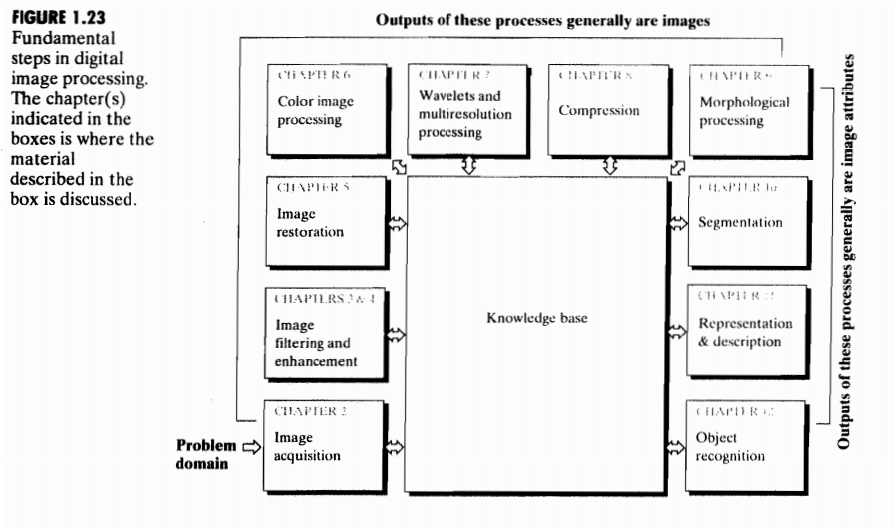
Fundamental Steps in DIP

Slide 15
Fundamental Steps in DIP
1. Image Acquisition
This is the first step or process of the fundamental steps of digital image processing. Image acquisition could be as simple as being given an image that is already in digital form. Generally, the image acquisition stage involves preprocessing, such as scaling etc.
2. Image Enhancement
Image enhancement is among the simplest and most appealing areas of digital image processing. Basically, the idea behind enhancement techniques is to bring out detail that is obscured, or simply to highlight certain features of interest in an image. Such as, changing brightness & contrast etc.
3. Image Restoration
Image Restoration is the operation of taking a corrupt/noisy image and estimating the clean, original image. Corruption may come in many forms such as motion blur, noise and camera mis-focus. ... More advanced image processing techniques must be applied to recover the object.

Slide 16
Fundamental Steps in DIP
4. Color Image Processing
Color image processing is an area that has been gaining its importance because of the significant increase in the use of digital images over the Internet. This may include color modeling and processing in a digital domain etc.
5. Wavelets and Multiresolution Processing
Wavelets are the foundation for representing images in various degrees of resolution. Images subdivision successively into smaller regions for data compression and for pyramidal representation.
6. Compression
Compression deals with techniques for reducing the storage required to save an image or the bandwidth to transmit it. Particularly in the uses of internet it is very much necessary to compress data.

Slide 17
Fundamental Steps in DIP
7. Morphological Processing
Morphological processing deals with tools for extracting image components that are useful in the representation and description of shape.
8. Segmentation
Segmentation procedures partition an image into its constituent parts or objects. In general, autonomous segmentation is one of the most difficult tasks in digital image processing. A rugged segmentation procedure brings the process a long way toward successful solution of imaging problems that require objects to be identified individually.
9. Representation and Description
Representation and description almost always follow the output of a segmentation stage, which usually is raw pixel data, constituting either the boundary of a region or all the points in the region itself. Choosing a representation is only part of the solution for transforming raw data into a form suitable for subsequent computer processing. Description deals with extracting attributes that result in some quantitative information of interest or are basic for differentiating one class of objects from another.

Slide 18
Fundamental Steps in DIP
10. Object recognition
Recognition is the process that assigns a label, such as, “vehicle” to an object based on its descriptors.
11. Knowledge Base:
Knowledge may be as simple as detailing regions of an image where the information of interest is known to be located, thus limiting the search that has to be conducted in seeking that information. The knowledge base also can be quite complex, such as an interrelated list of all major possible defects in a materials inspection problem or an image database containing high-resolution satellite images of a region in connection with change-detection applications.

Slide 19
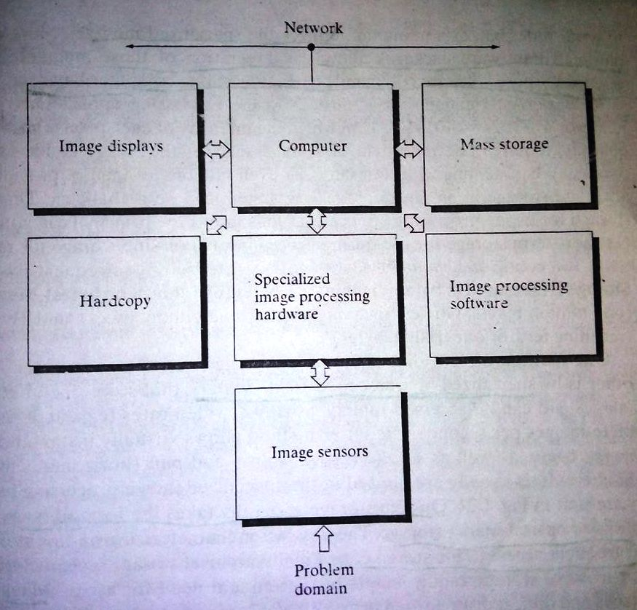
Components of an Image Processing System

Slide 20

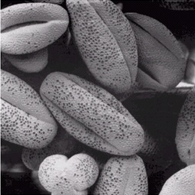
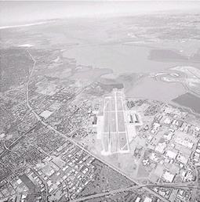
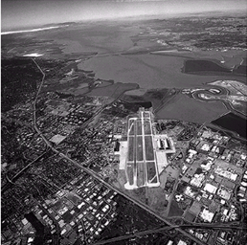
Image Enhancement

Slide 21
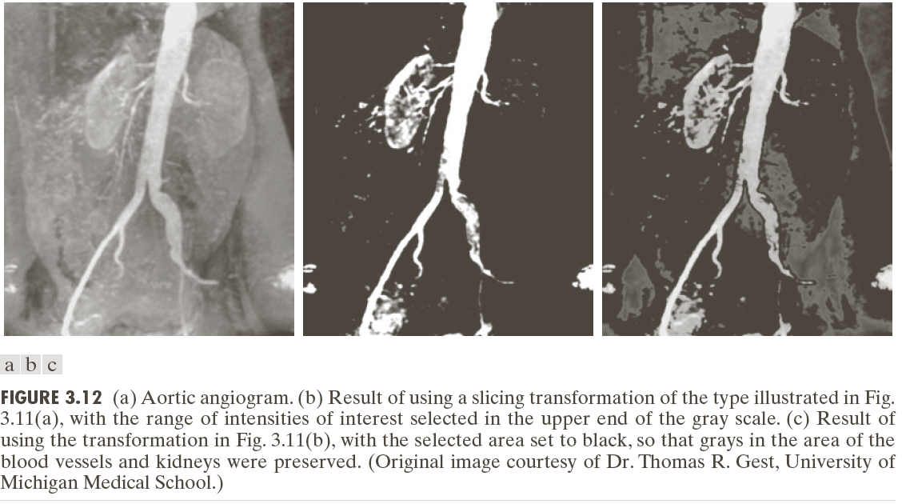
Image Enhancement

Slide 22
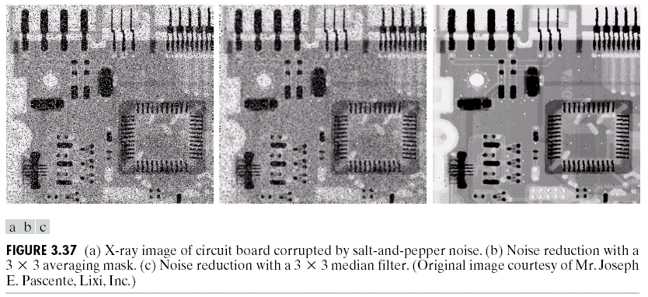
Image De-noising
Noisy image
Noise reduction by median filter

Slide 23
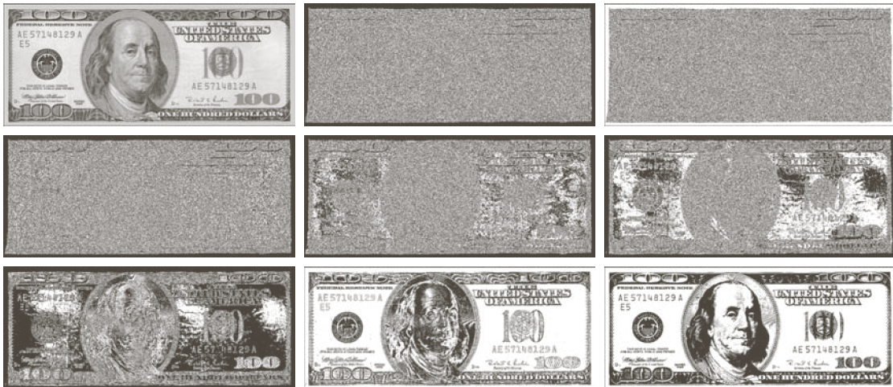
Image Compression
0
1
2
3
4
5
6
7

Slide 24

Image Compression
Image Reconstruction from fewer bits
Be careful

Slide 25
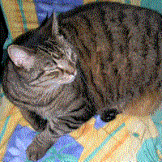
Image Compression
Image Reconstruction from fewer bits

Slide 26

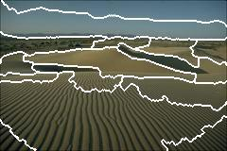


Image Segmentation

Slide 27
THANK YOU!!!

