Slide 1
Chapter 2
Digital Image Fundamentals

Slide 2
A Simple Image Formation Model
we shall denote images by two-dimensional functions of the form f(x, y).
The value or amplitude of f at spatial coordinates (x, y) is a positive scalar quantity whose physical meaning is determined by the source of the image.
When an image is generated from a physical process, its values are proportional to energy radiated by a physical source (e.g., electromagnetic waves).As a consequence, f(x, y) must be nonzero and finite; that is

Slide 3
A Simple Image Formation Model
As a consequence, f(x, y) must be nonzero and
finite; that is
0 < f(x, y) < ∞ --------------(1)
The function f(x, y) may be characterized by two components:
(1) the amount of source illumination incident on the scene being
viewed, and
(2) the amount of illumination reflected by the objects in the scene.
Appropriately, these are called the illumination and reflectance
components and are denoted by i(x, y) and r(x, y), respectively.

Slide 4
A Simple Image Formation Model
The two functions combine as a product to form f(x, y):
f(x, y) = i(x, y) × r(x, y) ------------- (2)
where
0 < i(x, y) < ∞ ---------------------- (3)
and 0 < r(x, y) < 1 --------------------- (4)

Slide 5
(4) indicates that reflectance is bounded by 0 (total absorption) and 1 (total reflectance).
The nature of i(x, y) is determined by the illumination source, and r(x, y) is determined by the characteristics of the imaged objects

Slide 6
Image Digitization
Two steps :
Sampling : Digitizing the coordinates values is called sampling.
Quantization : Digitizing the amplitude values is called quantization.

Slide 7
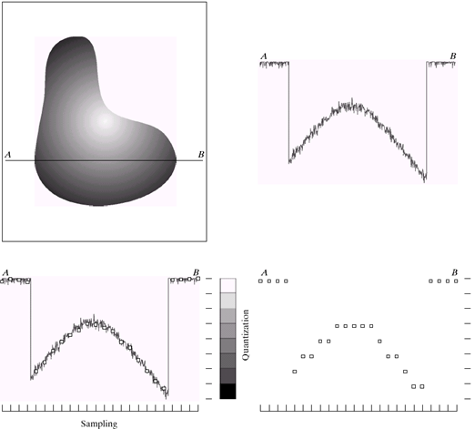
Image Digitization
Let’s start with a gray scale image.
We will try to digitize this image along the horizontal line segment AB

Slide 8
Image Digitization
This ia a plot of amplitude values of the continuous image along the line segment AB. Random variations are due to image noise.

Slide 9
Image Digitization
To sample this function, we take equally spaced samples along line AB

Slide 10

Image Digitization
The values of the samples still span a continuous range of intensity values

Slide 11
Image Digitization
Intensity scale is divided into eight discrete intervals.

Slide 12
Image Digitization

Slide 13
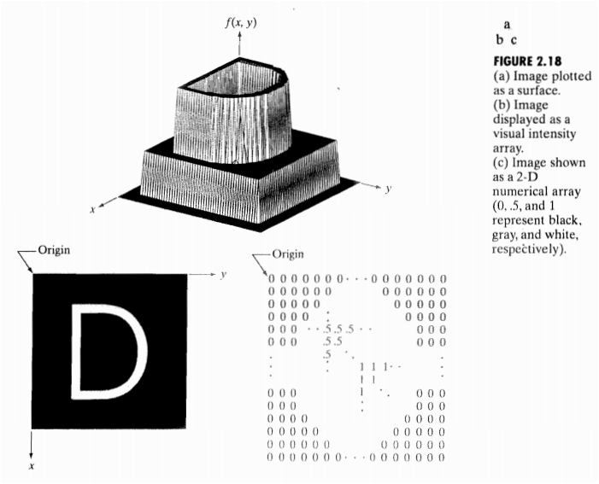
Representing Digital Images

Slide 14
Assume that an image f(x, y) is sampled so that the resulting digital image has M rows and N columns. The values of the coordinates (x, y) now become discrete quantities.
For notational clarity and convenience, we shall use integer values for these discrete coordinates. Thus, the values of the coordinates at the origin are (x, y)=(0, 0). The next coordinate values along the first row of the image are represented as (x, y)=(0, 1).
It is important to keep in mind that the notation (0, 1) is used to signify the second sample along the first row. It does not mean that these are the actual values of physical coordinates when the image was sampled.

Slide 15
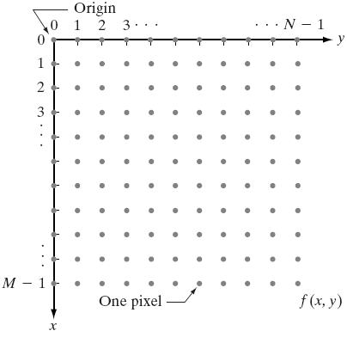
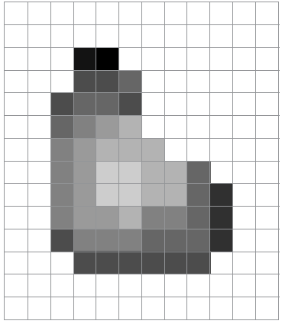
Representing Digital Images

Slide 16
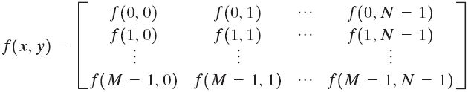
Representing Digital Images
Each element of this matrix is called pixel or pel
Matrix Representation

Slide 17
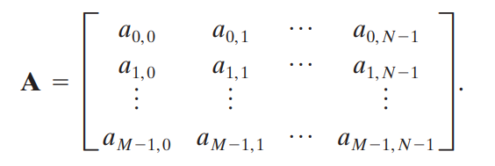
It is advantageous to use a more traditional matrix notation to denote a digital image and its elements:
Clearly, aij=f(x=i, y=j)=f(i, j), so this and above are identical matrices.

Slide 18
Pixel and their Relationships

Slide 19
Neighbors of a pixel
3 types of neighbors
N₄(p): 4-neighbor
N_{D}(p): diagonal neighbor
N₈(p): 8-neighbor

Slide 20
Neighbors of a pixel
N₄(p): 4-neighbor
Defined as the pixels at (x+1, y), (x-1, y), (x, y+1), (x, y-1)

Slide 21
Neighbors of a pixel
N_{D}(p): diagonal neighbor
Defined as the pixels at (x+1, y+1), (x+1, y-1), (x-1, y+1), (x-1, y-1)

Slide 22
Neighbors of a pixel
N₈(p): 8-neighbor
Defined as the pixels at (x+1, y), (x-1, y), (x, y+1), (x, y-1),(x+1, y+1), (x+1, y-1), (x-1, y+1), (x-1, y-1)

Slide 23
Pixel Adjacency
Adjacencies depends on both
Neighborhood
Pixel gray values
Adjacent pixels must be neighbors and have gray values from the same set, V

Slide 24
Pixel Adjacency
Adjacent pixels must be neighbors and have gray values from the same set, V
Can not be adjacent
Can be adjacent

Slide 25
Pixel Adjacency
3 types of adjacencies
4-adjacency
8-adjacency
m-adjacency

Slide 26
4-adjacency
Two pixels p, q are 4-adjacent if
q in N₄(p)
p, q have values from set V
p
q
r

Slide 27
8-adjacency
Two pixels p, q are 8-adjacent if
q in N₈(p)
p, q have values from set V
q
r
p

Slide 28
m-adjacency
Two pixels p, q are m-adjacent if
p, q have values from set V and
q in N₄(p), or
q in N_{D}(p) and N₄ (p) ∩ N₄ (q) has no pixel with value from V
q
q
p
p
Not m-adjacent
m-adjacent

Slide 29
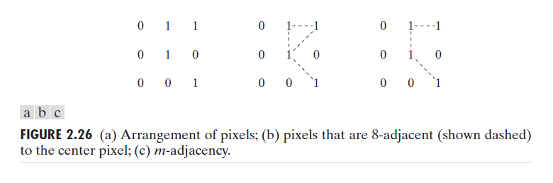
m-adjacency
Mixed adjacency is a modification of 8-adjacency. It is introduced to eliminate the ambiguities that often arise when 8-adjacency is used.
For example:

Slide 30
m-adjacency
In this example, we can note that to connect between two pixels (finding a path between two pixels):
In 8-adjacency way, you can find multiple paths between two pixels.
While, in m-adjacency, you can find only one path between two pixels.
So, m-adjacency has eliminated the multiple path connection that has been generated by the 8-adjacency.

Slide 31

Distance Measures
For pixels p, q and z with co-ordinates (x, y), (s, t) and (v, w) respectively, D is a distance function or metric if

Slide 32

Euclidean distance
The Euclidean distance between p(x, y) and q(s, t) is defined as
For this distance measure, the pixels having a distance less than or equal to some value r from (x, y) are the points contained in a disk of radius r centered at (x, y)

Slide 33

D₄ distance
The city-block distance or D₄ distance between p(x, y) and q(s, t) is defined as

Slide 34
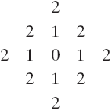
D₄ distance
For this distance measure, the pixels having a distance less than or equal to some value r from (x, y) form a diamond centered at (x, y.)

Slide 35
D₈ distance
The chessboard distance or D₈ distance between p(x, y) and q(s, t) is defined as

Slide 36
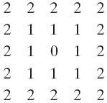
D₈ distance
For this distance measure, the pixels having a distance less than or equal to some value r from (x, y) form a square centered at (x, y.)

Slide 37

D_{m} distance
D_{m} distance: depends on adjacency
Shortest m-path between p(x, y) and p₄(s, t)
Let, V = {1}
p₁ , p₃ =0 and p, p₂ , p₄ =1
Find distance, D_{m}(p, p₄)?
D_{m}(p, p₄) = 2
path : pp₂p₄

Slide 38
D_{m} distance
D_{m} distance: depends on adjacency
Shortest m-path between p(x, y) and p₄(s, t)
Let, V = {1}
p₃ =0 and p, p_{1,} p₂ , p₄ =1
Find distance, D_{m}(p, p₄)?
D_{m}(p, p₄) = 3
path : pp₁p₂p₄

Slide 39
D_{m} distance
D_{m} distance: depends on adjacency
Shortest m-path between p(x, y) and p₄(s, t)
Let, V = {1}
p, p_{1,} p₂, p_{3,} p₄ =1
Find distance, D_{m}(p, p₄)?
D_{m}(p, p₄) = 4
path : pp₁p₂p₃p₄

Slide 40
THANK YOU!!!

