Slide 1
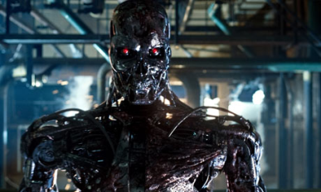
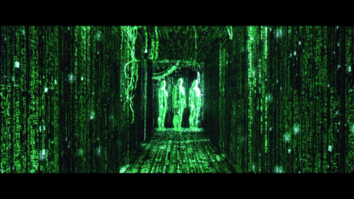
AI in Fiction
An intelligent killing robot
Smart machines that took over the human race and made them live in a simulated world

Slide 2
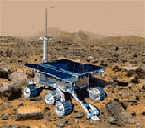

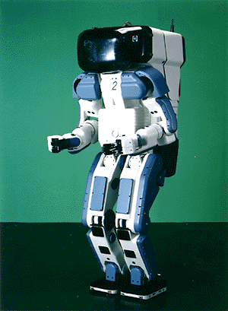

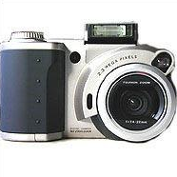

What’s interesting with AI
Search engines
Science
Medicine/
Diagnosis
Appliances
Labor
Movies Recommendation
slide mostly borrowed from Laurent Itti

Slide 3
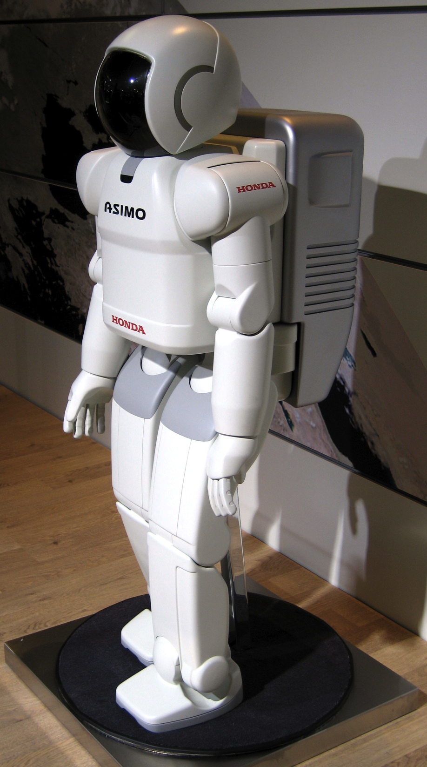
What’s interesting with AI
Honda AISMO
Advanced Step in Innovation MObility
Humanoid Robot
Capable of recognizing:
Moving objects
Postures
Gestures
Handshake
Sounds
Capable of walking and running
http://en.wikipedia.org/wiki/ASIMO

Slide 4
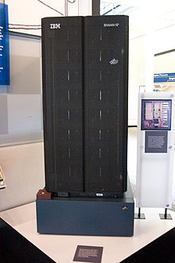
What’s interesting with AI
1996, Deep Blue first machine to beat chess world champion
But lost in the series – 4 to 2
1997, won the series 3.5 to 2.5
Search 6 to 8 moves a head
The evaluation function is set by the system after examining thousands of master games
http://en.wikipedia.org/wiki/Deep_Blue_(chess_computer)

Slide 5
Introduction – Chapter 1

Slide 6
AI Definition
The exciting new effort to make computers thinks … machine with minds, in the full and literal sense” (Haugeland 1985)
The automation of activities that we associate with human thinking, activities such as decision-making, problem solving, learning,…(Bellman, 1978)
Think Like Humans

Slide 7
AI Definition
“The art of creating machines that perform functions that require intelligence when performed by people” (Kurzweil, 1990)
“The study of how to make computers do things at which, at the moment, people do better”, (Rich and Knight, 1991)
Act Like Humans

Slide 8
AI Definition
“The study of mental faculties through the use of computational models”,(Charniak et al. 1985)
“The study of the computations that make it possible to perceive, reason and act”,(Winston, 1992)
Think Rationally

Slide 9
AI Definition
“Computational Intelligence is the study of the design of intelligent agents” (Poole et al, 1998)
“AI….is concerned with intelligent behavior in artifact”, (Nilsson, 1998)
Act Rationally

Slide 10
How to Achieve AI?
AI
Acting humanly
Thinking rationally
Acting rationally
Thinking humanly

Slide 11
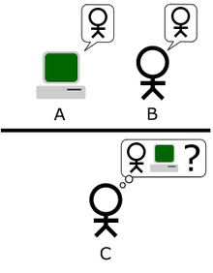
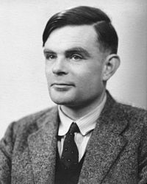
Acting Humanly: The Turing Test
http://en.wikipedia.org/wiki/Turing_test
Alan Turing
1912-1954
To be intelligent, a program should simply act like a human

Slide 12
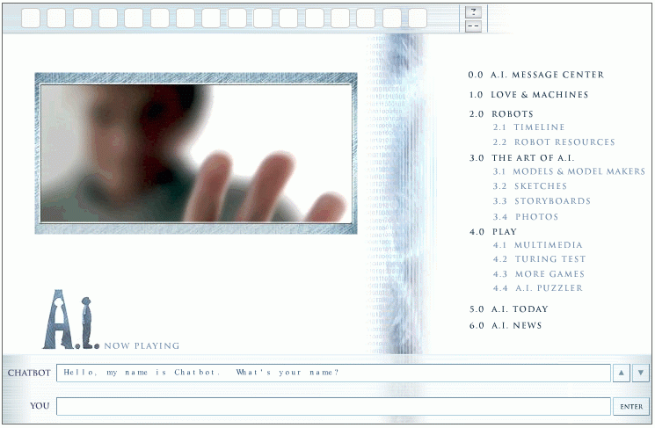
The Turing Test - Example
http://aimovie.warnerbros.com
http://www.ai.mit.edu/projects/infolab/
slide mostly borrowed from Laurent Itti

Slide 13

The Turing Test - Example
http://aimovie.warnerbros.com
http://www.ai.mit.edu/projects/infolab/
slide mostly borrowed from Laurent Itti

Slide 14

The Turing Test - Example
http://aimovie.warnerbros.com
http://www.ai.mit.edu/projects/infolab/
slide mostly borrowed from Laurent Itti

Slide 15

The Turing Test - Example
http://aimovie.warnerbros.com
http://www.ai.mit.edu/projects/infolab/
slide mostly borrowed from Laurent Itti

Slide 16

The Turing Test - Example
FAILED!
http://aimovie.warnerbros.com
http://www.ai.mit.edu/projects/infolab/
slide mostly borrowed from Laurent Itti

Slide 17
Acting Humanly – for Total Turing
To pass the Turing test, the computer/robot needs:
Natural language processing to communicate successfully.
Knowledge representation to store what it knows or hears.
Automated reasoning to answer questions and draw conclusions using stored information.
Machine learning to adapt to new circumstances and to detect and extrapolate patterns.
Computer vision to perceive objects. (Total Turing test)
Robotics to manipulate objects and move. (Total Turing test)
These are the main branches of AI.

Slide 18
Thinking Humanly
Real intelligence requires thinking → think like a human !
First, we should know how a human think
Introspect ones thoughts
Physiological experiment to understand how someone thinks
Brain imaging – MRI…
Then, we can build programs and models that think like humans
Resulted in the field of cognitive science: a merger between AI and psychology.

Slide 19
Acting Rationally
Rational agent: acts as to achieve the best outcome
Logical thinking is only one aspect of appropriate behavior: reactions like getting your hand out of a hot place is not the result of a careful deliberation, yet it is clearly rational.
Sometimes there is no correct way to do, yet something must be done.
Instead of insisting on how the program should think, we insist on how the program should act: we care only about the final result.
Advantages:
more general than “thinking rationally” and more
Mathematically principled; proven to achieve rationality unlike human behavior or thought

Slide 20
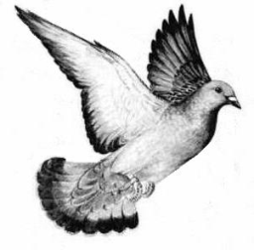
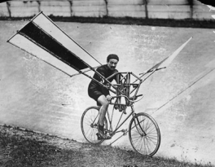
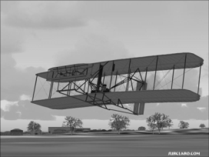
Acting Rationally
This is how birds fly
Humans tried to mimic
birds for centuries
This is how we finally achieved “artificial flight”

Slide 21
Relations to Other Fields
Philosophy
Logic, methods of reasoning and rationality.
Mathematics
Formal representation and proof, algorithms, computation, (un)decidability, (in)tractability, probability.
Economics
utility, decision theory (decide under uncertainty)
Neuroscience
neurons as information processing units.
Psychology/Cognitive Science
how do people behave, perceive, process information, represent knowledge.
Computer engineering
building fast computers
Control theory
design systems that maximize an objective function over time
Linguistics
knowledge representation, grammar
slide mostly borrowed from Max Welling

Slide 22
AI History
Gestation of AI (1934 - 1955)
In 1943, proposed a binary-based model of neurons
Any computable function can be modeled by a set of neurons
A serious attempt to model brain
1950, Turing’s “Computing Machinery and Intelligence ”: turing test, reinforcement learning and machine learning
The Inception of AI (1956)
Dartmouth meeting to study AI
an AI program ”Logic Theorist” to prove many theorems
Early Enthusiasm and great Expectation (1952-1969)
General Problem Solver imitates the human way of thinking
LISP (AI programming language) was defined
1965, Robinson discovered the resolution method – logical reasoning
AI Winter (1966-1973)
Computational intractability of many AI problems
Neural Network starts to disappear

Slide 23
AI History
Knowledge-based systems (1969-1979)
Use domain knowledge to allow for stronger reasoning
Becomes an Industry (1980-now)
Digital Equipment Corporation selling R1 “expert sytem”
From few million to billions in 8 years
The return of neural network (1986-now)
With the back-propagation algorithm
AI adopts scientific method (1987-now)
More common to base theorems on pervious ones or rigorous evidence rather than intuition
Speech recognition and HMM
Emergence of intelligent agent (1995-now)
search engines, recommender systems,….
Availability of very large data sets (2001 – now)
Worry more about the data

Slide 24
The State of the Art
Robotics Vehicle
DARPA Challenge
Speech Recognition
United Airlines
Autonomous Planning and Scheduling
Remote Agent: Plan and control spacecraft
MAPGEN: daily planning of operations on NASA’s exploration Rover
Game Playing
IBM Deep Blue
Spam Fighting
Logistic Planning
DART – Dynamic Analysis and Replacing Tool
Gulf War 1991
To plan the logistic for transportation of 50k vehicles, cargo and people
Generated in hour a plan that could take weeks
Robotics
Machine Translation
Statistical models

