Slide 1


Mawlana Bhashani Science and Technology University
5G-Advanced Networks: Key Features
and Evolution Toward 6G
Student ID: IT22003
Sifat Shikder
Department of Information and Communication Technology
Presented by Sifat Shikder, ICT Department
Notes:
Good morning. I am Sifat Shikder, IT22003, from the ICT Department of MBSTU. This talk looks at 5G-Advanced, 3GPP Releases 18 to 20, and how it leads toward 6G (IMT-2030).

Slide 2

Presentation Outline
01
Introduction and research problem
02
Related work and research gap
03
Proposed approach and methodology
04
Analysis and results
05
Conclusion
5G-Advanced & the Path to 6G
02
Notes:
The talk has five parts. I start with the problem and related work, then explain the review approach. After that I show the comparison results and finish with conclusions.

Slide 3
Introduction and Research Problem
01
XR, massive IoT and satellite coverage push Rel-15/16 5G hard on capacity, energy use and device cost [3].
02
5G-Advanced (3GPP Rel-18 to Rel-20) adds many features, but its gains are rarely compared with 6G goals [5].
03
IMT-2030 sets far higher targets than IMT-2020, so the size of the remaining gap is unclear [1], [2].
Objective
Map the key 5G-Advanced enhancements and compare 5G, 5G-Advanced and 6G on published ITU and 3GPP values.
5G-Advanced & the Path to 6G
03
Notes:
New services such as XR, massive IoT and satellite access stretch the first 5G releases. 5G-Advanced adds many features, but it is not obvious how close they bring us to the 6G targets. So the objective is a side-by-side comparison using published values only.

Slide 4
Related Work and Research Gap
Study / approach | Key idea | Relevant limitation
Lin, Release 18 overview [3] | First 5G-Advanced package: AI/ML, energy saving, XR, eRedCap. | Written before Rel-18 was finished; no KPI view.
Chen et al., JSAC survey [5] | Reviews 5G-Advanced technologies and research paths to 6G. | Rel-19 outlook only; Rel-20 not covered.
ITU-R M.2160 (IMT-2030) [1] | Defines 6G usage scenarios and target ranges for capabilities. | Sets goals only; no link to 5G-Advanced features.
Research gap
Few studies place 5G, 5G-Advanced (Rel-18–20) and IMT-2030 targets side by side on the same KPIs.
5G-Advanced & the Path to 6G
04
Notes:
Lin's Release 18 overview and the JSAC survey by Chen and co-authors describe the 5G-Advanced features. ITU-R M.2160 gives the 6G targets. None of them puts the three generations on the same KPI scale.

Slide 5
Methodology
5G-Advanced enhancement stack toward 6G
6G / IMT-2030 Rel-20 studies → Rel-21 specs [6]
01
Step 1: Input preparation
Performance
Coverage & devices
Intelligence & services
Collect ITU-R targets and Rel-18–20 feature descriptions.
Rel-18 → Rel-19 → Rel-20
Uplink & MIMO evolution
NTN / satellite
AI/ML for air interface
02
Step 2: Core procedure
XR support
eRedCap (Rel-18)
ISAC / sensing
Group features into the stack and map each to KPIs.
Network energy saving
Sidelink & positioning
Network slicing / NWDAF evolution
03
Step 3: Output
5G baseline (Rel-15/16) eMBB · URLLC · mMTC
Compare 5G, 5G-Advanced and 6G in a chart and a table.
5G-Advanced & the Path to 6G
05
Notes:
The diagram stacks the main Release 18 to 20 features on top of the 5G baseline. They are grouped into performance, coverage and devices, and intelligence and services. Release 20 also starts the 6G studies that lead to the Release 21 specifications.

Slide 6
Study Setup
Data / sources
ITU-R M.2083 and M.2160; 3GPP Rel-18, 19, 20 overviews [1]–[6].
Baselines / comparisons
5G baseline (Rel-15/16) vs. 5G-Advanced (Rel-18–20) vs. 6G vision (IMT-2030).
Evaluation metrics
Peak and user data rate, latency, connection density, mobility, spectrum efficiency.
Review protocol
Published targets compared side by side; no simulation or field tests.
5G-Advanced & the Path to 6G
06
Notes:
This is a standards review, not a simulation. The sources are the two ITU-R recommendations and the three 3GPP release overviews. Every number later in the talk is a published target.

Slide 7
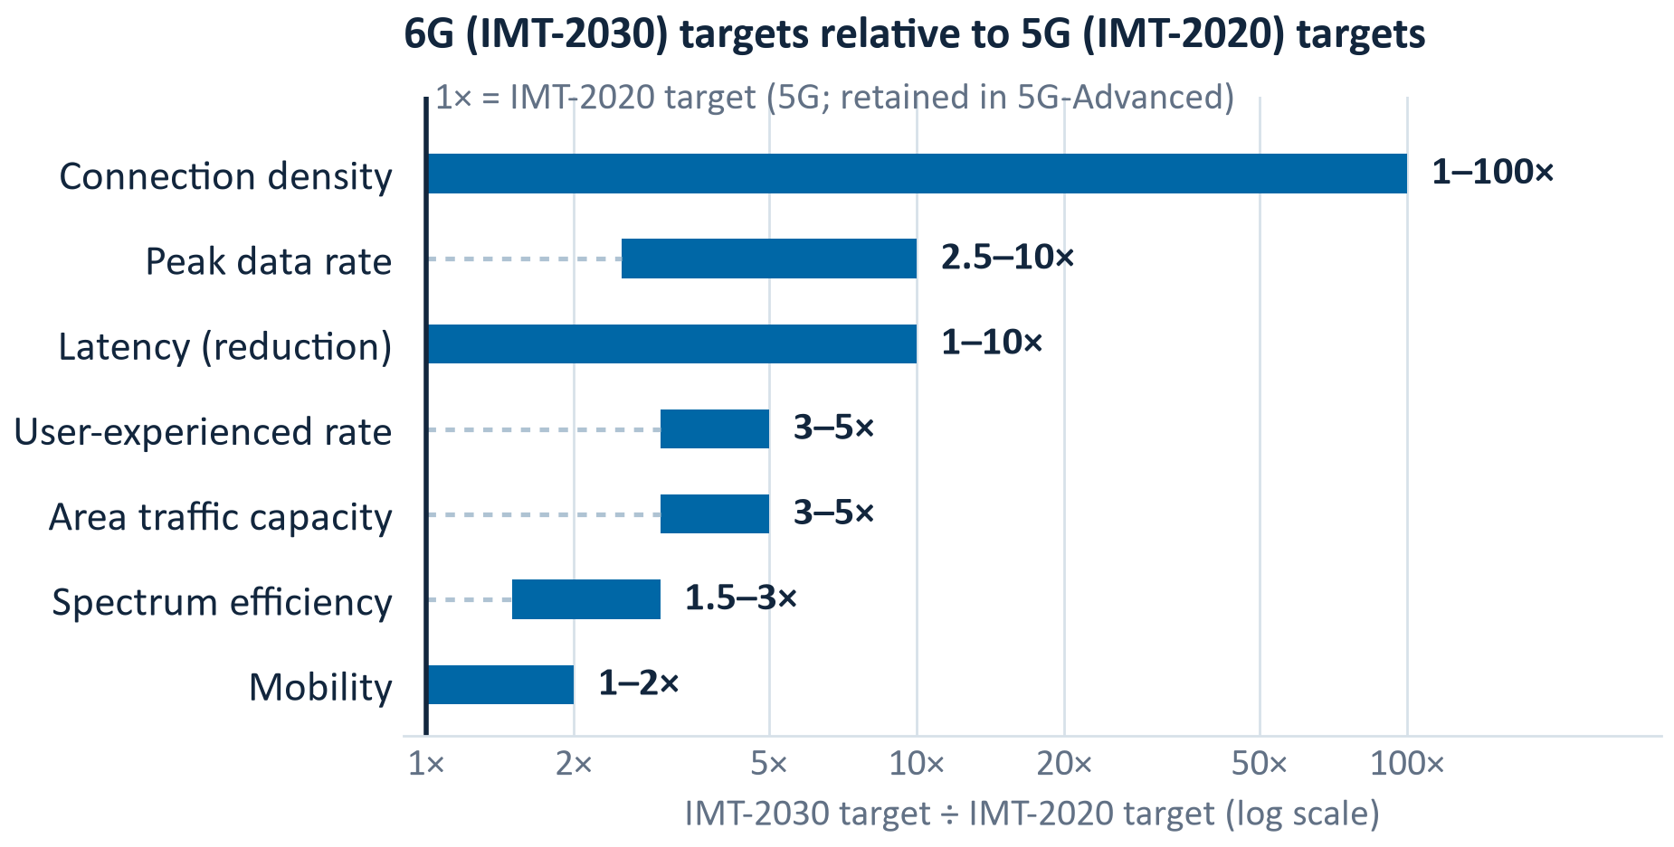
Results and Discussion
Main finding
At the high end, IMT-2030 targets are 2× to 100× the IMT-2020 values.
5G-Advanced keeps the 5G targets and adds AI/ML, energy saving, NTN and sensing — the base 6G builds on.
Figure: bars span the example target range in ITU-R M.2160 [1], divided by the IMT-2020 target in M.2083 [2]. Targets, not measurements.
5G-Advanced & the Path to 6G
07
Notes:
Each bar shows how far the 6G target range goes beyond the 5G target. Connection density has the largest jump, up to 100 times, followed by peak rate and latency at up to 10 times. These are ITU-R targets, not measured results.

Slide 8
Quantitative Comparison
Generation (target set) | Peak data rate | Latency | Connection density | Mobility
5G baseline (Rel-15/16) IMT-2020 targets [2] | 20 Gbit/s (DL) | 1 ms (URLLC) | 10⁶ devices/km² | 500 km/h
5G-Advanced (Rel-18/19/20) | No new ITU-R target: the IMT-2020 values above still apply [2].
6G vision (IMT-2030) M.2160 targets [1] | 50–200 Gbit/s | 0.1–1 ms | 10⁶–10⁸ devices/km² | 500–1000 km/h
ITU-R sets targets for IMT-2020 and IMT-2030 only. 5G-Advanced improves efficiency, coverage and intelligence under the same IMT-2020 framework [3]–[6].
5G-Advanced & the Path to 6G
08
Notes:
The 5G and 6G rows are ITU-R targets from M.2083 and M.2160. ITU-R defines no separate 5G-Advanced targets, so that row points back to the IMT-2020 values. The 6G ranges are design targets, not guarantees.

Slide 9
Conclusions and Future Work
5G-Advanced is an evolution step: it makes 5G more efficient, wider-reaching and smarter, and prepares the ground for 6G.
01
Rel-18 to Rel-20 features (AI/ML, energy saving, NTN, RedCap, XR, ISAC) map onto the IMT-2030 usage scenarios.
02
Limitation: values are published targets, not field measurements; real networks perform below them.
03
Future work: follow the Rel-20 6G studies and Rel-21 specifications [6], and add measured 5G-Advanced field data.
5G-Advanced & the Path to 6G
09
Notes:
5G-Advanced improves 5G and prepares several 6G building blocks. The main limitation is that I compared targets, not measurements. Next steps are to follow the Release 20 and 21 work and add real field data.

Slide 10
Selected References
[1] ITU-R, “Framework and overall objectives of the future development of IMT for 2030 and beyond,” Rec. ITU-R M.2160-0, Nov. 2023.
[2] ITU-R, “IMT Vision – Framework and overall objectives of the future development of IMT for 2020 and beyond,” Rec. ITU-R M.2083-0, Sep. 2015.
[3] X. Lin, “An overview of 5G Advanced evolution in 3GPP Release 18,” IEEE Commun. Stand. Mag., vol. 6, no. 3, pp. 77–83, Sep. 2022, doi: 10.1109/MCOMSTD.0001.2200001.
[4] X. Lin, “The bridge toward 6G: 5G-Advanced evolution in 3GPP Release 19,” IEEE Commun. Stand. Mag., vol. 9, no. 1, pp. 28–35, Mar. 2025, doi: 10.1109/MCOMSTD.0001.2300063.
[5] W. Chen et al., “5G-Advanced toward 6G: Past, present, and future,” IEEE J. Sel. Areas Commun., vol. 41, no. 6, pp. 1592–1619, Jun. 2023, doi: 10.1109/JSAC.2023.3274037.
[6] X. Lin, “A tale of two mobile generations: 5G-Advanced and 6G in 3GPP Release 20,” IEEE Commun. Stand. Mag., 2025, doi: 10.1109/MCOMSTD.2025.3613219.
5G-Advanced & the Path to 6G
10
Notes:
These are the six sources used in the talk: two ITU-R recommendations and four IEEE papers. All of them were checked against the ITU website or Crossref.

Slide 11
Thank you
Questions and Discussion
Sifat Shikder (ID: IT22003)
Mawlana Bhashani Science and Technology University
Email address : it22003@mbstu.ac.bd
5G-Advanced & the Path to 6G
11
Notes:
Thank you for listening. I am happy to take questions. My email is it22003@mbstu.ac.bd if you want to follow up.

