Slide 1

EEE 402 : Artificial Intelligence & Machine Learning Laboratory January 2025 Level – 4 Term – 1 Section G1 Project Final Presentation
Brain Tumor Detection & Segmentation using Convolutional Neural Network(CNN) from MRI Images
By
Group 5(G1)
2006102 2006117 2006118
Date: July 30 , 2025

Slide 2
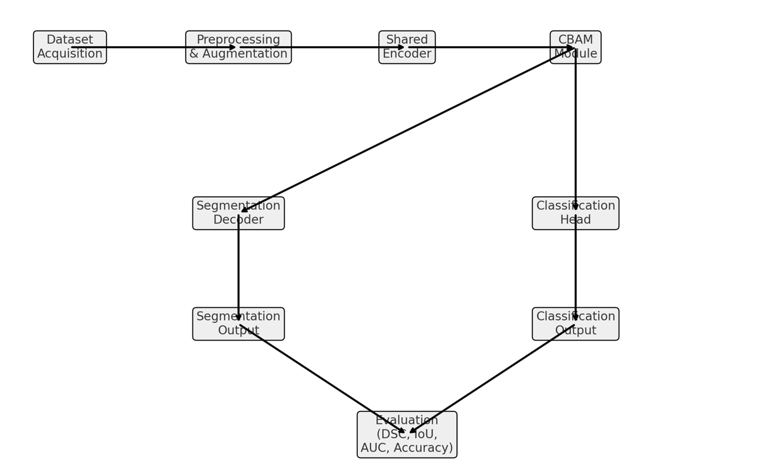
Introduction and workflow
Presented by: 2006117

Slide 3
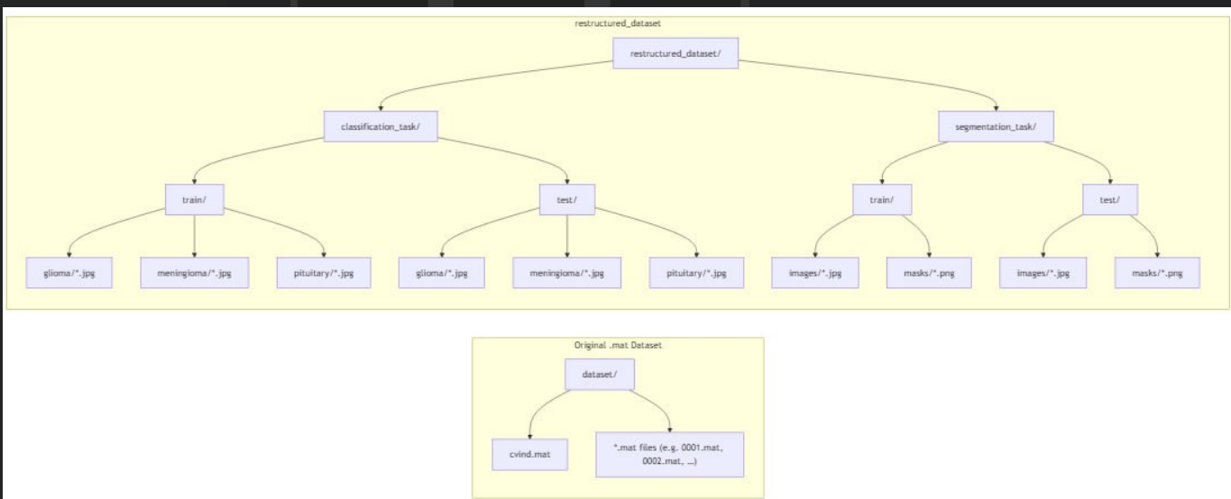
Dataset

Slide 4
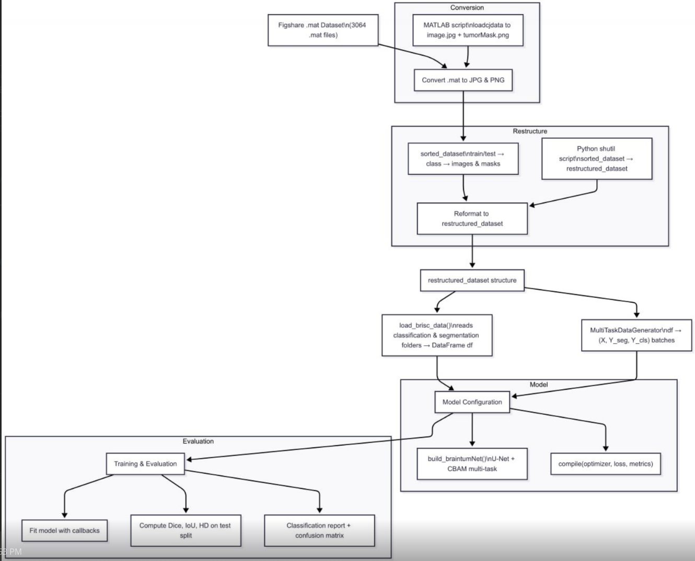
Data Preprocessing

Slide 5
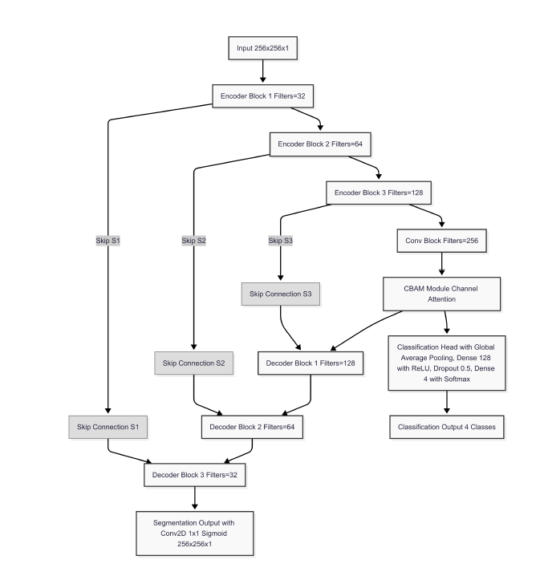
Model Architecture

Slide 6
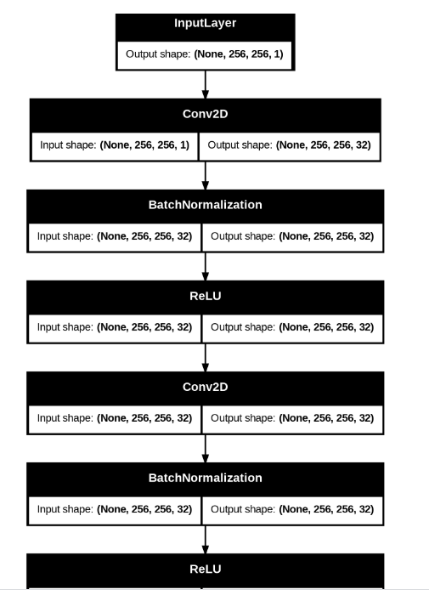
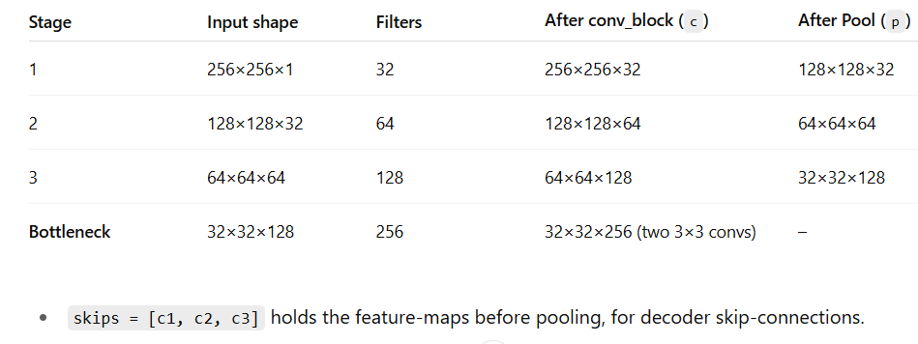
Model Description
Input
Shape: (256 × 256 × 1) (single‐channel MRI slice)
Output
Segmentation head → (256 × 256 × 1) binary mask
Classification head → (3,) one‐hot vector over {glioma, meningioma, pituitary}
Shared Encoder

Slide 7
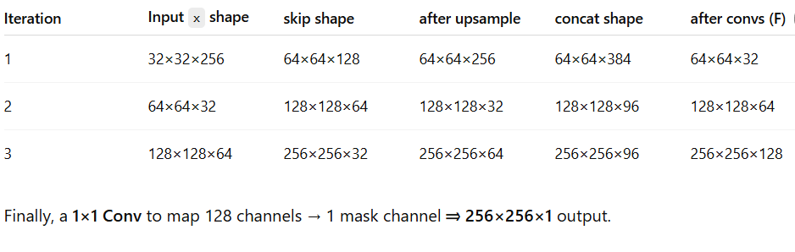
CBAM Module
We squeeze spatial dims via avg & max pooling → two 256-d vectors.
A tiny MLP (256→32→256) learns which channels to emphasize/suppress.
Sigmoid gate per channel → broadcast multiply → refined (32×32×256) feature map.
Decoder

Slide 8
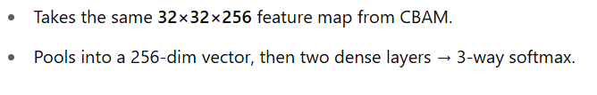
Classification Head
Multi‐Task Loss & Metrics
We used Categorical crossentropy for Classification Loss
We used Binary cross entropy and Dice coefficient loss both for segmentation loss

Slide 9
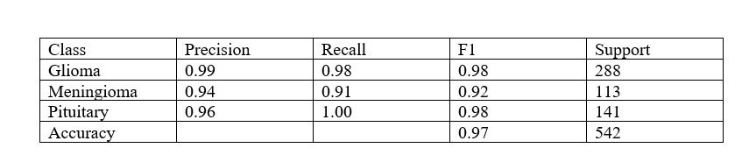
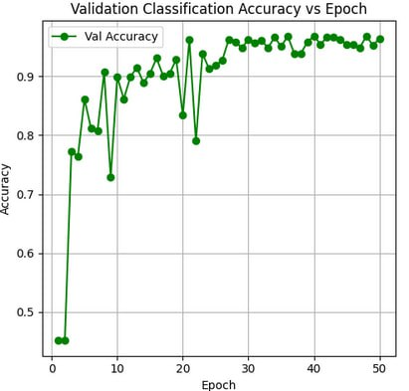
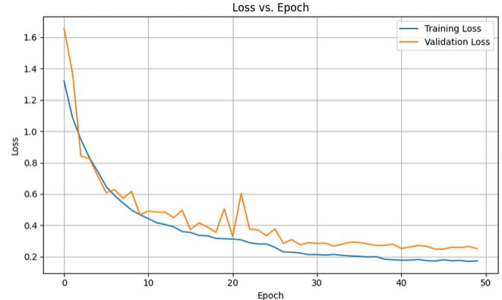
Result
Classification Results
Presented by: 2006117

Slide 10
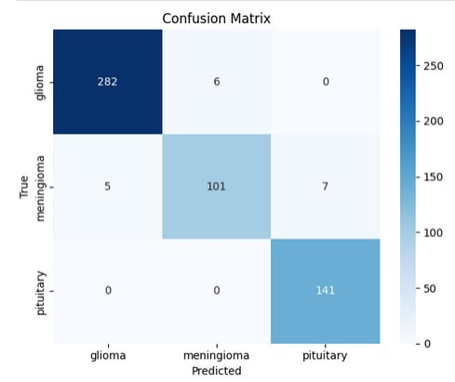
Conffusion Matrix
Presented by: 2006117

Slide 11
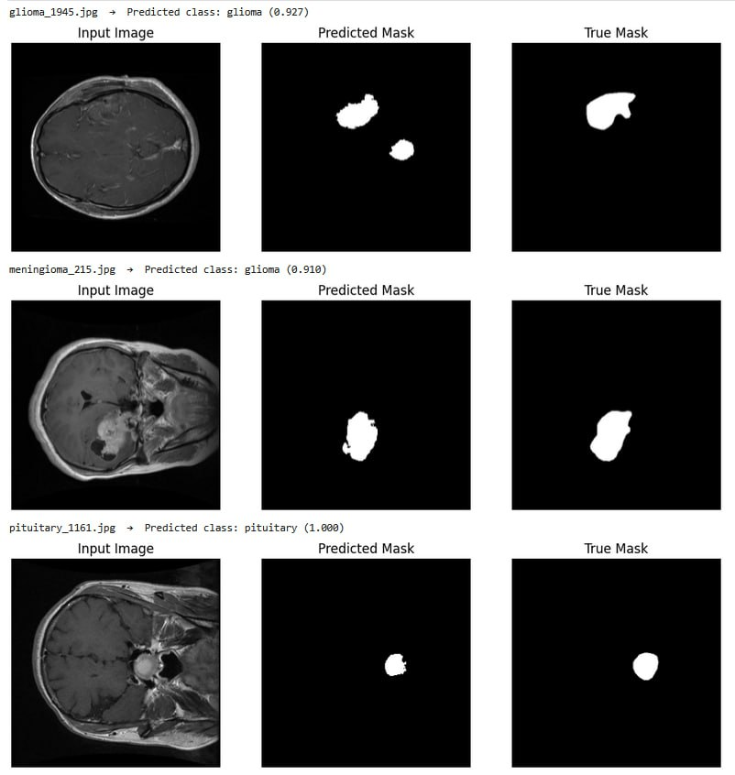
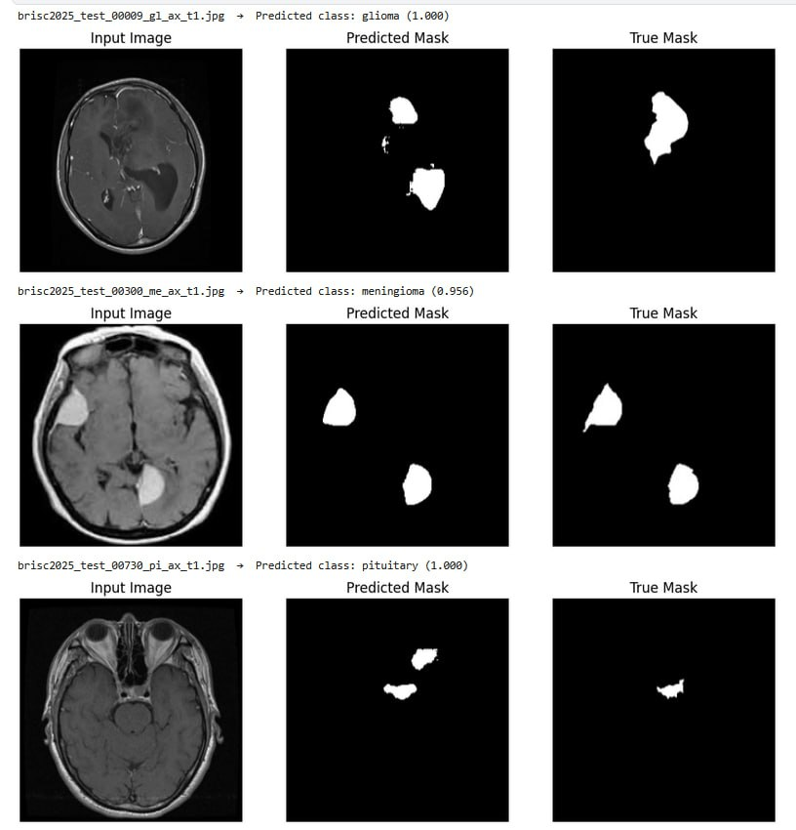
Segmentation Results.
dice score for 0.7046 for testing
0.7930 for validation
With figshare dataset
With brics dataset
Presented by: 2006117

Slide 12
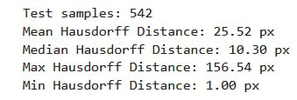
IoU
Hausdorff Distance
Presented by: 2006117

Slide 13
Over all loss vs Epoch
Presented by: 2006117

Slide 14
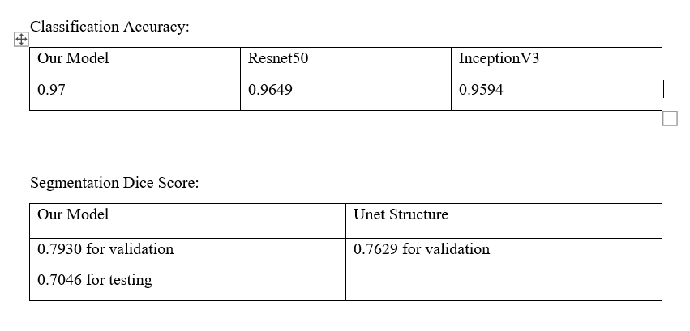
Comparison
Presented by: 2006117

Slide 15
References
Lv, C., Shu, X.-J., Liang, Q., Qiu, J., Xiong, Z.-C., Ye, J.-B., Li, S.-B., Liu, C.-Q., Niu, J.-Z., Chen, S.-B. & Rao, H. (2025). BrainTumNet: multi-task deep learning framework for brain tumor segmentation and classification using adaptive masked transformers. Frontiers in Oncology, 15: 1585891. https://doi.org/10.3389/fonc.2025.1585891
S. Rajaraman and G. Thoma, “BrainTumNet: Multi-task Deep Learning Framework for Brain Tumor Segmentation and Classification Using Adaptive Masked Transformers,” in IEEE Transactions on Artificial Intelligence, vol. 5, no. 1, pp. 72–81, Feb. 2024, doi: 10.1109/TAI.2023.3330354.
Presented by: 2006117

