Slide 1

AMERICAN INTERNATIONAL UNIVERSIY BANGLADESH (AIUB)
Where leaders are created
Course Code: EEE 4103 Course Name: Microprocessor and Embedded System
PIKO: Smart Multifunctional Robot Using Arduino With Obstacle Avoidance, Voice Control & Bluetooth Navigation
SL # | Students ID | Students Name | Program | Section
1 | 23-51412-1 | SULTANA BOBI | BSc in CSE | L
2 | 23-50146-1 | SIFAT AL MUQTADIR | BSc in CSE | L
3 | 23-54466-3 | NAHIAN ISLAM RISHAD | BSc in CSE | L
4 | 23-50143-1 | TANIM MAHBUB ALAM | BSc in CSE | L
5 | 23-50003-1 | SYED ABDULLAH-AL NOMAN | BSc in CSE | L

Slide 2

Outline of the Presentation
MICROPROCESSOR AND EMBEDDED SYSTEMS
Aims and Objectives
Introduction
Literature Review
Research/Working Method
Description of the Work
Survey Report
Gantt Chart
Results and Discussions
Conclusions
Future Works

Slide 3
MICROPROCESSOR AND EMBEDDED SYSTEMS
Aims and Objectives of the Work
To design a complete embedded hardware architecture for PIKO using Arduino Uno, HC-SR04, HC-05, SG90 servo, and L298N motor driver.
To implement dual-mode wireless control: voice commands and manual Bluetooth control via Android application.
To implement autonomous obstacle avoidance using ultrasonic sensing and servo-assisted lateral scanning.
To simulate ARMO navigation logic and circuits using Tinkercad / Wokwi before hardware deployment.
To analyze system performance: detection range, command latency, motor accuracy, and navigation reliability.
To evaluate social, safety, and ethical acceptance of ARMO based on 45 respondent survey findings.

Slide 4
MICROPROCESSOR AND EMBEDDED SYSTEMS
Introduction
Autonomous robots are reshaping everyday life from factories to homes or building them has required expensive proprietary platforms.
PIKO challenges that limitation: built on the Arduino Uno (ATmega328P) one of the most accessible and widely taught embedded platforms.
PIKO combines three complementary modes in one system: autonomous obstacle avoidance, voice control, and manual Bluetooth control.
All three modes share a single Arduino Uno, common power supply, L298N motor driver, and unified firmware architecture.
Target use cases: home assistance, educational demonstration, and research exploration in embedded robotics.
Survey conducted with 45 respondent’s data directly guided design priorities for safety, interactivity, and control preferences.

Slide 5
MICROPROCESSOR AND EMBEDDED SYSTEMS
Literature Review
[1] Jang & Lee (Sustainability, 2020) — Safety and perceived usefulness are key drivers of robot acceptance in service settings.
[2] Gaikwad et al. (IJRASET, 2023) — HC-05 + HC-SR04 on Arduino Uno reliably handles simultaneous sensing and serial communication.
[3] Priyadarshini Team (2024) — Multifunctional BT + voice + avoidance robot; demonstrates Arduino expandability toward AI integration.
[4] Pavitha et al. (ICTCS Springer, 2023) — Optimal ultrasonic detection ranges and servo turn angles identified for Arduino navigation.
[5] Gupta et al. (IEEE, 2023) — MIT App Inventor + HC-05 UART pipeline validated as effective voice robot control interface…

Slide 6
MICROPROCESSOR AND EMBEDDED SYSTEMS
Literature Review (Continued)
[6] Al-Tarawneh et al. (IEEE, 2023) — L298N + Arduino Uno provides precise PWM motor control; HC-05 covers ~100m indoor range.
[7] Waqas et al. (ICOSST, 2022) — Ultrasonic avoidance offers best cost-reliability balance for low-power mobile robots.
[8] Das et al. (IJSCI, 2025) — Bluetooth voice command latency of 0.5-1s validated as acceptable for real-time robotic control.

Slide 7
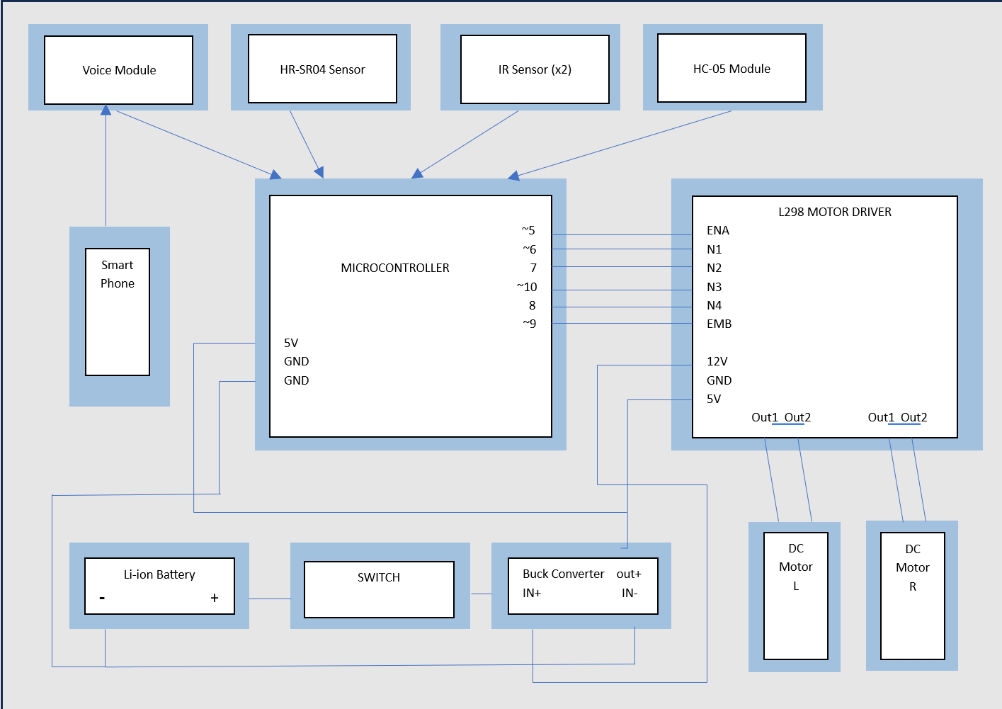
MICROPROCESSOR AND EMBEDDED SYSTEMS
Working Method
PIKO uses Arduino Uno (ATmega328P) as the central brain, controlling all sensors, modules, and actuators through unified firmware.
Input 1: HC-SR04 ultrasonic sensor (Trig/Echo) continuously detects obstacles within 20 cm threshold.
Input 2: HC-05 Bluetooth module receives voice commands and manual directional inputs via UART serial from Android app…
Block diagram of the system

Slide 8
MICROPROCESSOR AND EMBEDDED SYSTEMS
Working Method (Continued)
Processing: Arduino reads sensor distance, interprets command strings, and executes motor/servo actions in real time.
Output: L298N motor driver actuates DC Motors A & B; SG90 servo scans left/right during obstacle avoidance; Buzzer alerts on detection.
Power: 9V Li-Ion battery pack → 5V regulated to Arduino & sensors; 12V direct to L298N for sufficient motor torque.
Block diagram of the system

Slide 9
MICROPROCESSOR AND EMBEDDED SYSTEMS
Methodology of the Work
Mode 1: Autonomous Obstacle Avoidance: HC-SR04 pings continuously; obstacle <20 cm→motors halt→servo scans L/R→robot steers to path.
Mode 2: Voice Control: User speaks into paired Android app→speech-to-text conversion→HC-05 sends command via UART→Arduino actuates motors.
Mode 3: Bluetooth Control: User taps directional buttons in app → real-time PWM commands sent to Arduino→precise manual navigation.
Mode Switching: A software flag in Arduino firmware determines active mode — switches seamlessly without hardware reset.
Key components: Arduino Uno, HC-SR04, HC-05, SG90 servo, L298N motor driver, 2x N20 DC motors, buzzer, 9V battery.
Simulation: Tinkercad Circuits used to validate code and circuit connections prior to physical hardware assembly.

Slide 10
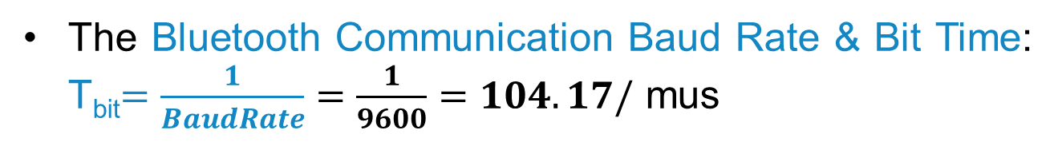

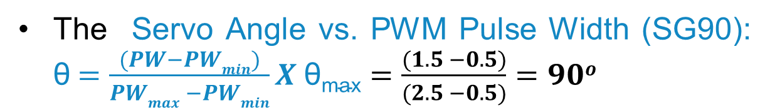
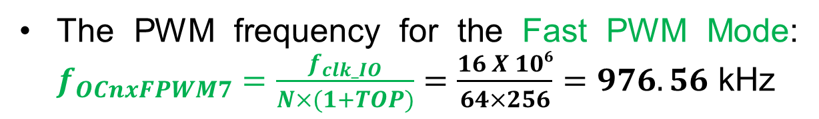
MICROPROCESSOR AND EMBEDDED SYSTEMS
Mathematical Model
The PWM frequency for the Fast PWM Mode: $f_{OCnxFPWM7}=\frac{f_{clk_IO}}{N×(1+TOP)}=\frac{16 X 106}{64×256}=976.56$ kHz
The Servo Angle vs. PWM Pulse Width (SG90): θ$=\frac{(PW−PWmin)}{PWmax −PWmin}X \text{θ}\text{max}=\frac{(1.5 −0.5)}{(2.5 −0.5)}=90o$
The Motor Speed via PWM Duty Cycle: $Duty Cycle\left(\%\right)=\frac{OCR}{TOP}X100=\frac{178}{255}X100=69.8\%$
The Bluetooth Communication Baud Rate & Bit Time: T_{bit}$=\frac{1}{BaudRate}=\frac{1}{9600}=104.17/$ mus

Slide 11
MICROPROCESSOR AND EMBEDDED SYSTEMS
Survey Report
Survey Link: User Perception on Multifunctional Robot – Form
Survey Responses: Responses.xlsx
Detailed Summary: Summary.pdf

Slide 12
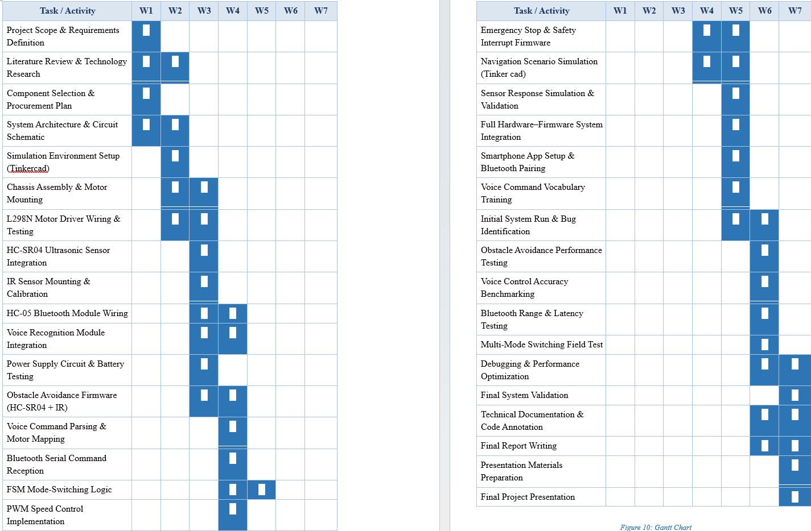
MICROPROCESSOR AND EMBEDDED SYSTEMS
Gantt Chart
Start: 20 March 2026 | Deadline: 7 May 2026
Duration: 7 Weeks

Slide 13
MICROPROCESSOR AND EMBEDDED SYSTEMS
Results and Discussions
Enhanced safety: Multi-sensor obstacle avoidance allows PIKO to navigate without collision addressing concern of 44.4% of survey respondents.
Hands-free accessibility: Voice control enables users with physical limitations to operate PIKO without touching any device.
Educational platform: PIKO demonstrates multi-sensor integration, PWM motor control, and wireless communication for embedded systems courses.
Low-cost innovation: Full BOM under 4000 TAKA proves capable robotics is achievable with affordable components in Bangladesh.
Cultural advancement: 75.6% of respondents believe autonomous robots will be accepted in Bangladeshi homes and institutions.

Slide 14
MICROPROCESSOR AND EMBEDDED SYSTEMS
Conclusions
PIKO successfully demonstrates that a single Arduino Uno can support three simultaneous operational modes: autonomous obstacle avoidance, voice control, and Bluetooth control.
Survey data from 45 respondents directly shaped the design safety, voice interaction, and seamless mode-switching emerged as the highest-priority features.
The system is affordable (<4000 TAKA BOM), accessibleand educational making advanced robotics achievable for students in Bangladesh.
Cultural acceptance is trending positively: 75.6% of respondents believe autonomous robots will gain acceptance in Bangladeshi society.
PIKO proves that embedded engineering, guided by real user data, can produce a functional, safe, and socially relevant robotic system.

Slide 15
MICROPROCESSOR AND EMBEDDED SYSTEMS
Future Scopes
Integrate Vision-Based Object Detection.
Add IMU Sensor Fusion for Stable Navigation.
Implement IoT Cloud Connectivity via Wi-Fi Communications.
Transition from SLAM-Based Autonomous Mapping.
Add Emergency Stop & Safety Indicator System.
Extended Battery Life with Battery Management System.
Upgrade Natural Language Processing Commands or Voice Commands
Develop Multi-Robot Coordination via Bluetooth Mesh or Wi-Fi to Coordinate tasks

Slide 16
MICROPROCESSOR AND EMBEDDED SYSTEMS
Thanks For Listening our Presentation…
?

