Slide 1

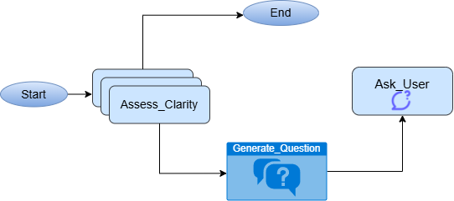
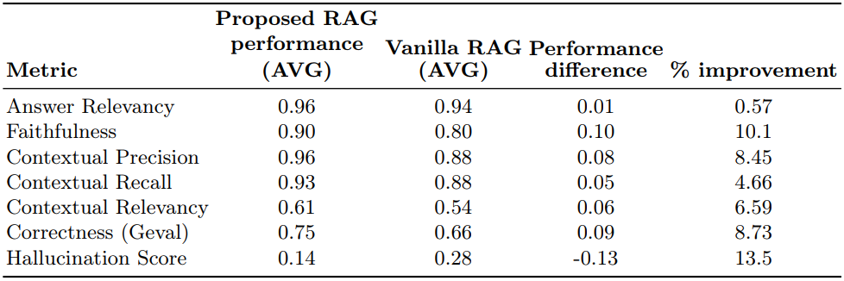
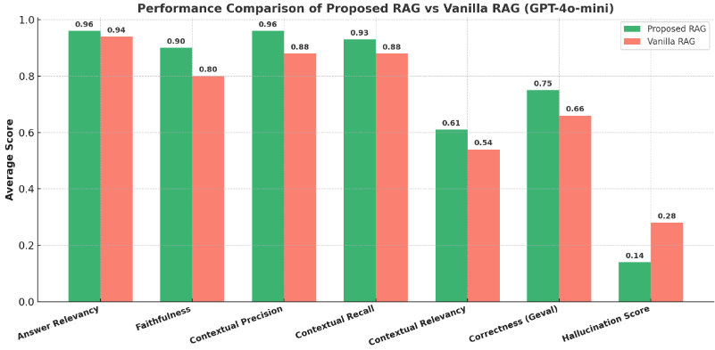
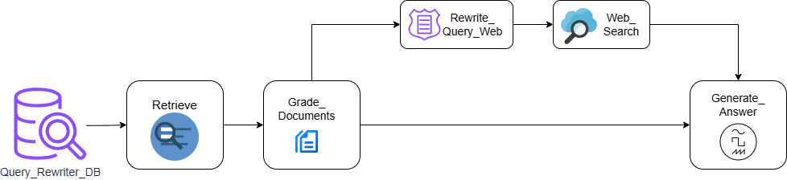
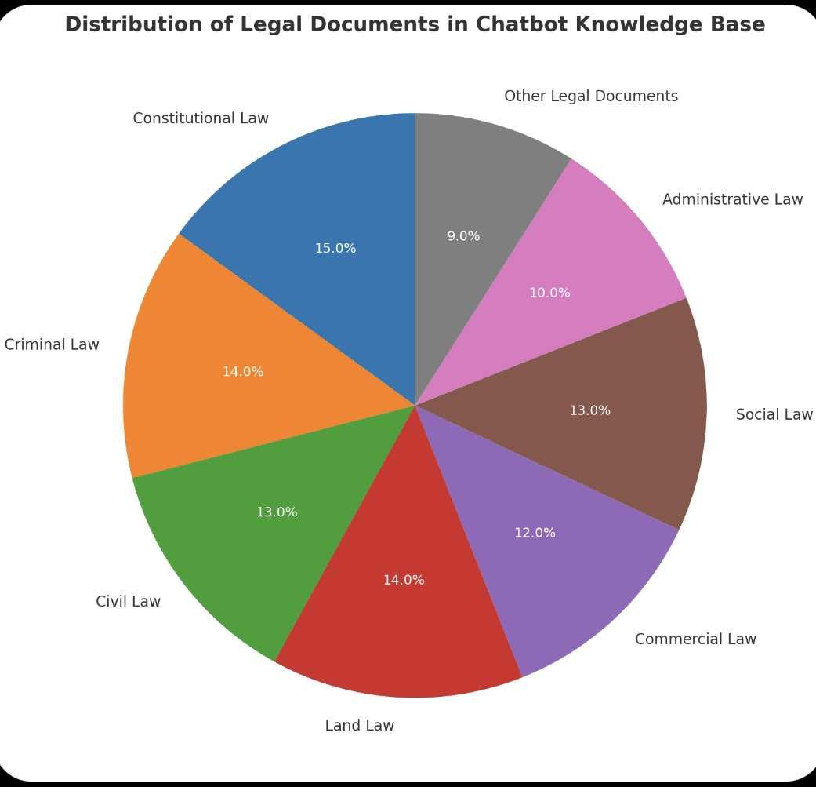
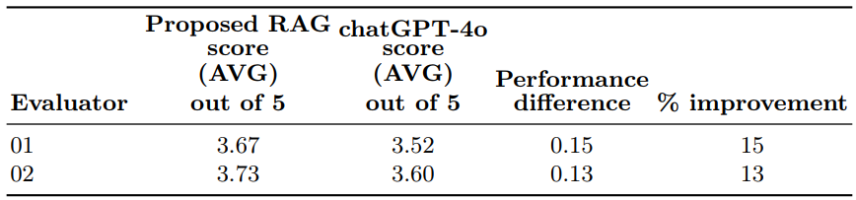
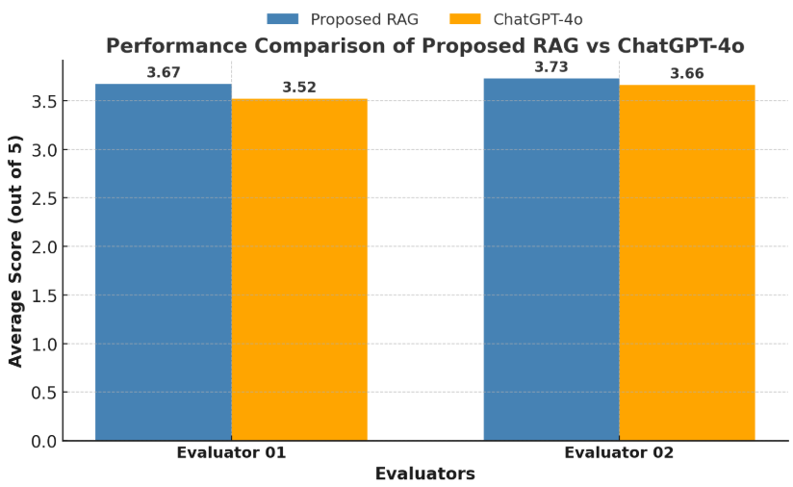
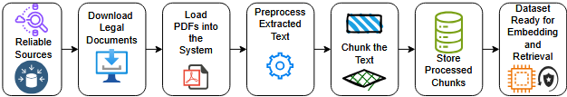
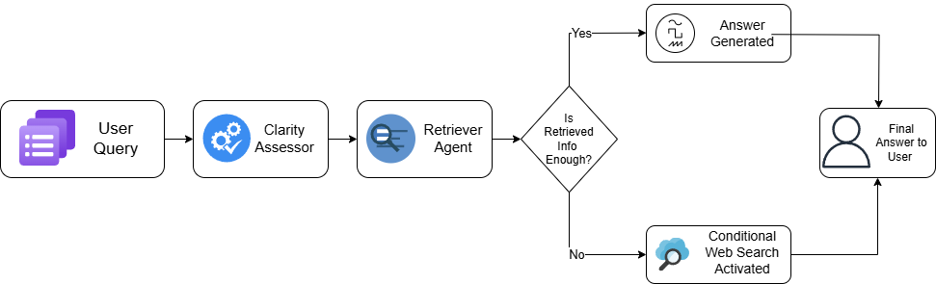
A Multi-Agent RAG system for Legal Information Retrieval in Bangladesh
Abdullah Al Raiyan, Md. Sifat Haque Zidan, Rahil Mehnaz
Department of Electrical and Computer Engineering, North South University, Dhaka–1229, Bangladesh
Supervisor :
Rashedur M. Rahman
Abstract
Clarification Agent: This agent serves as the initial point of contact. Its primary function is to ensure query quality and precision. It first assesses the user's initial query for ambiguity. If the query is unclear or lacks sufficient detail, the agent interactively generates and asks targeted follow-up questions to refine it before passing it to the main RAG agent.
Evaluation
Access to legal information presents a significant impediment in Bangladesh, where the populace lacks legal literacy & access to professional counsel. This paper introduces a Multi-Agent Retrieval Augmented Generation (RAG) system specifically designed for Bangladeshi legal information retrieval. The system employs a novel two-agent architecture: a Clarification Agent that refines user queries through Large Language Model (LLM)-driven clarity assessment & interactive questioning & a primary RAG Agent. The RAG Agent executes a comprehensive process involving document retrieval from a curated legal corpus, relevance grading, conditional web search & final answer synthesis. The multi-agent RAG pipeline is designed to improve the relevance & contextual accuracy of responses to complex legal queries. A conversational interface built with Streamlit for real-time user interaction. The Agentic RAG model outperforms general legal bots (using GPT-4o-mini and Gemma 3B) on 20 diverse legal queries showing better contextual relevance, accuracy & fewer hallucinations.
To assess the performance the evaluation is conducted using two distinct criteria: (1) Deepeval framework for automated evaluation & (2) Evaluation by legal experts based on 15 questions formulated by the evaluators themselves.
System performance was quantitatively measured against baseline models on a set of 20 diverse legal queries representative of common concerns in Bangladesh. The Deepeval framework was employed to assess key RAG metrics: Answer Relevancy, Faithfulness, Contextual Precision, Contextual Relevancy, Correctness (GEval) & Hallucination Score. 2 LLM models were used for this research work, GPT-40-mini & Gemma3-4B run locally via Ollama. The comparison results are show in table 1 and 2.
Figure 3: Clarification agent workflow
  b. RAG Agent: This is the primary agent responsible for the core retrieval and generation process. It executes a comprehensive workflow upon receiving a clear query:
  Query Rewriting: An LLM rewrites the user's query to optimize it for retrieval from both the vector database and potential web searches.
  Document Retrieval: The agent retrieves the most relevant document chunks from the ChromaDB knowledge base.
  Relevance Grading: A structured LLM-based grader evaluates the relevance of each retrieved document to filter out noise and ensure context quality.
  Conditional Web Search: A key decision-making node (should_search) determines if the retrieved local context is sufficient. If not, the system triggers a real-time web search using the Tavily Search Tool to find supplementary information.
  Answer Synthesis: Finally, a generative LLM synthesizes a comprehensive, factually grounded answer based on the retrieved, graded, and potentially web-augmented context.
In recent years, Large Language Models (LLMs) have shown remarkable success. Tools like ChatGPT, LLAMA & other models have been explored for their potential in the legal domains. However, despite their potential, LLMs frequently generate hallucinated outputs & answers that seem accurate but are actually incorrect or they are based on outdated information. This can be dangerous in the legal context, where accuracy & up-to-date knowledge are critically important.
To address these limitations, we developed a Multi-Agent Retrieval-Augmented Generation (RAG) chatbot, tailored for Bangladeshi legal information retrieval. Our solution integrates curated datasets into a knowledge base designed to support factual retrieval. By utilizing LangChain & LangGraph frameworks, the system introduces a multi-agent architecture. Furthermore, the system is equipped with a conditional web search mechanism to extend support when local resources are insufficient.
For user interaction, a Streamlit-based conversational interface was developed, allowing individuals to input queries & get clear, relevant legal information in real time.
Table 1: Performance comparison of proposed RAG system using GPT-4o-mini against the Vanilla RAG using GPT-4o-mini.
Dataset & Preprocessing
Figure 6: Performance comparison of the proposed RAG system using Gemma3-4b against the Vanilla RAG using Gemma3-4b.
Data collection: Legal documents in PDF format were gathered from official sources, including Bangladesh Supreme Court judgments, Laws of Bangladesh & articles from reputable legal blogs like BD Law Post and BD Law Help.
2. For human evaluation, each evaluator rates responses on a 1–5 scale based on two criteria: correctness & quality. Table 3 shows the scores assigned by the 2 expert evaluators.
Figure 4: RAG agent workflow
Implementation
The system was developed to be flexible, utilizing OpenAI's GPT-4o mini for high-performance generation and the open-source Gemma-3:4b model (deployed locally via the Ollama framework) to demonstrate a cost-effective, scalable path.
A user-friendly conversational interface was built using Streamlit to facilitate accessible, real-time interaction. Figure 3 illustrates the combined operation of the clarification agent and the RAG agent.
Table 2: Performance comparison of the proposed RAG system against chatGPT4o.
Figure 7: Performance comparison of the proposed RAG system against chatGPT4o.
Figure 1: Distribution of legal documents in chatbot Knowlegde Base
Conclusion
2. Data preparation: The data was processed python library PyPDFLoaderDirectory and its data extracted via recursive character text splitter technique.
Figure 2: Data Preparation Workflow
The development of our multi-agent RAG system marks a significant advancement in improving access to legal information in Bangladesh. Through a comparative evaluation against baseline models, our LangGraph-based architecture demonstrated clear performance gains over monolithic RAG systems. The core strength lies in the division of labor between a Clarification Agent and a RAG Agent, which led to notable improvements using the GPT-4o-mini model: +10.1% in Faithfulness, +8.7% in Correctness (GEval) & 13.5% reduction in Hallucination. Each component query refinement, retrieval optimization, and noise filtering.
Human evaluators rated our system higher than ChatGPT-4o, with relative gains of 13–15%, underscoring the system’s effectiveness in domain-specific tasks like Bangladeshi legal queries.
Importantly, the architecture retained its advantages when paired with the locally deployed open-source Gemma3-4b model via Ollama, achieving a 14.4% improvement in Answer Relevancy over vanilla RAG. This confirms the model-agnostic nature of our approach and its suitability for cost-effective, privacy-preserving deployments in low-resource settings.
Methodology
1. Vectorization & Storage: Each text chunk was converted into a high-dimensional vector representation using OpenAI Embeddings. These embeddings were then stored & indexed in a local ChromaDB vector store, enabling efficient similarity search.
2. Multi-Agent System with LangGraph: The core of our system is a dual-agent architecture implemented using the LangGraph framework, which allows for cyclical & conditional logic flows. This structure divides the task into two distinct roles:
Figure 5: Combined agent workflow
SUMMER 2025
SUMMER 2025

