Slide 1
Bengali Sentiment Analysis with Deep Learning Models
Group No - 14
Saurav Das - 20101100
Kaushik Roy - 20101185
Md. Sifat Kamal - 20101231
Md Mahfujul Haque - 20101445
ST - Mehnaz Ara Fazal
RA - Md Sabbir Hossain Course instructor: Annajiat Alim Rasel

Slide 2
Table of Contents
Introduction
Motivation
Existing Work
Our Goal
Dataset
Proposed Methodology
Limitation
Reference

Slide 3
Introduction
Understanding public sentiment is crucial in today's global society.
There's a significant gap in sentiment analysis for the Bangla language.
With over 284 million speakers globally, Bangla is one of the most spoken languages.
It holds promise for marketing, business intelligence, and socio-political trend analysis.

Slide 4
Motivation
Sentiment analysis helps understand opinions and emotions expressed in text.
Bangla sentiment analysis is needed to analyze sentiments in the Bangla language.
Existing sentiment analysis models do not cater to underrepresented languages like Bangla.
Bangla sentiment analysis enables businesses to understand customer preferences and market trends specific to the Bangla-speaking regions.
It contributes to social and cultural understanding by capturing sentiment nuances in Bangla.
Conducting sentiment analysis in Bangla enhances decision-making and customer satisfaction.

Slide 5
Existing work
Plenty amount of works exists on different languages
New techniques are involving with the works
Limited work has been done on deep learning techniques for Bengali Sentiment analysis
Promising to bring good outcome

Slide 6
Our Goal
Aims to develop an sentiment analysis in the Bengali language by exploring deep learning approaches
Main objective is to examine the efficiency of BERT, LSTM and MLP classifier deep learning model in sentiment analysis
Getting better accuracy and a good results from the model

Slide 7
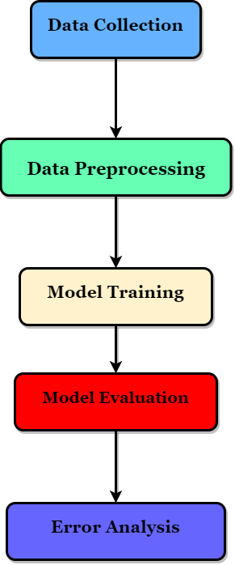
Workflow
5

Slide 8
Dataset
3307 Negative reviews
8500 Positive reviews
Collected and manually annotated from Youtube Bengali drama
Has No Null Value

Slide 9
Proposed Methodology
Use the Bengla dataset on deep learning models like BERT, LTSM and MLP to evaluate the results between the models

Slide 10
Limitation/ Challenges
Uneven Dataset
Sentiment on Only Positive and Negative Reviews
Additional dataset is required to enhance performance.

Slide 11
Reference
Sazzed, S. (2020). Cross-lingual Sentiment Analysis in Bengali Utilizing A New Benchmark Corpus. In Online (pp. 50–60). https://aclanthology.org/2020.wnut-1.8.pdf
‌Sazzed, S. (2020). Bangla ( Bengali ) sentiment analysis dataset. Data.mendeley.com, 3. https://doi.org/10.17632/p6zc7krs37.3

