Slide 1
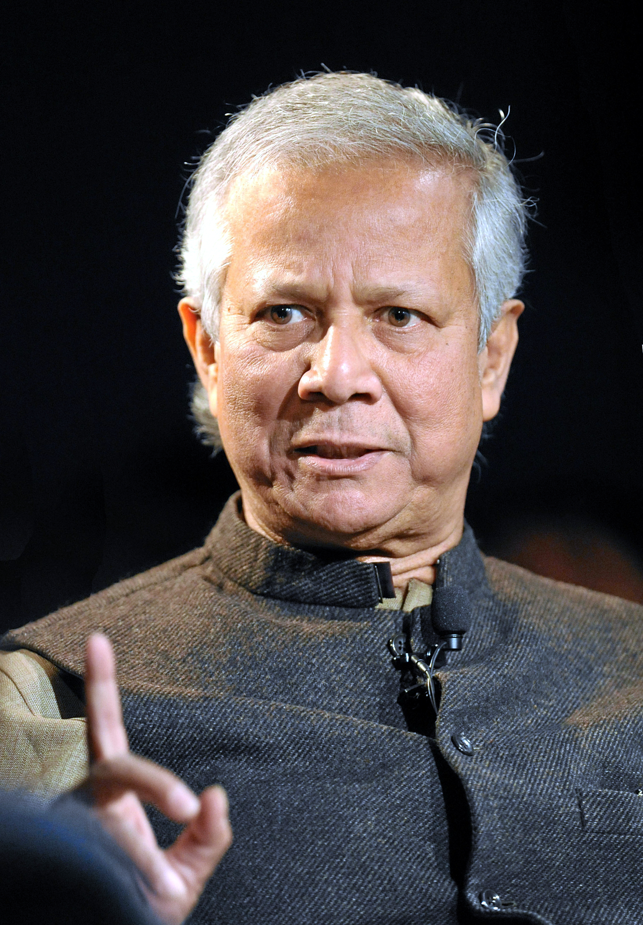
Muhammad
Yunus
Zed Oparaugo Ukenye(40734642),
Al Sifat Sidiki(40735842),
Muhammad Usman Rasool(40736151),
Huraira Tabassum(40736966)
Fig 1. Muhammad Yunus
Source. Wikimedia Commons

Slide 2
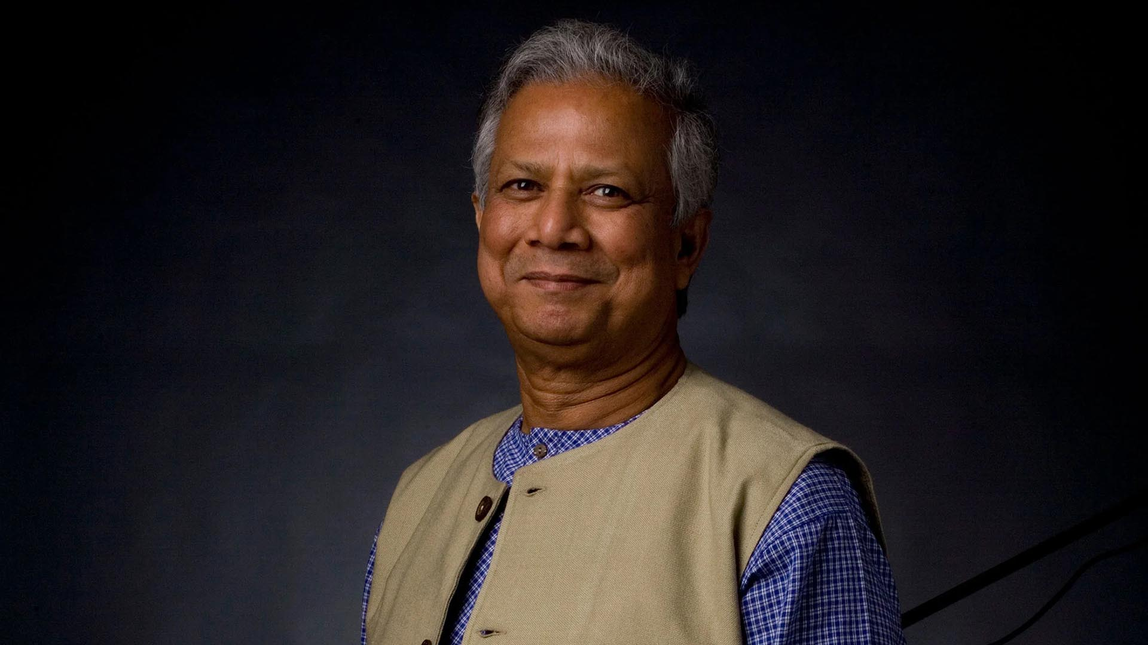
Contents
  Introduction
  Muhammad Yunus
  The Creation of Grameen Bank & Microfinance
  Impact of Dr. Yunus’s Work & Global Recognition
  Criticism, Challenges, and Future of Microfinance
  Conclusion
Fig2. Muhammad Yunus
Source. Wikimedia

Slide 3

Introduction
Who is an influential person?
What makes an influential person?
What makes an influential person?
Fig3. Leadership
Source. Aunun Studios

Slide 4
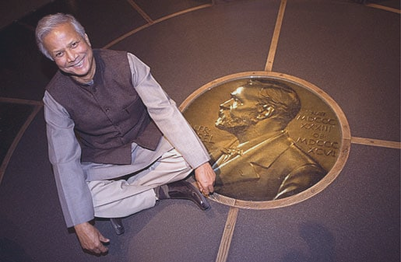
Dr. Muhammad Yunus
  A Bangladesh citizen
  Nobel Peace prize winner 2006
  Founder of Grameen Bank in 1983
  Former Chancellor of Glasgow Caledonian University (2012-2018)
  Current Chief adviser of interim government
Fig4. Muhammad Yunus
Source. www.nobelprize.org

Slide 5

Grameen Bank
History
Fig5. Grameen’s Bank logo
Source. Wikimedia commons
Introduction Muhammad Yunus The Creation of Grameen Bank & Microfinance ⁠Impact of Dr. Yunus’s Work & Global Recognition Criticism, Challenges, and Future of Microfinance Conclusion

Slide 6
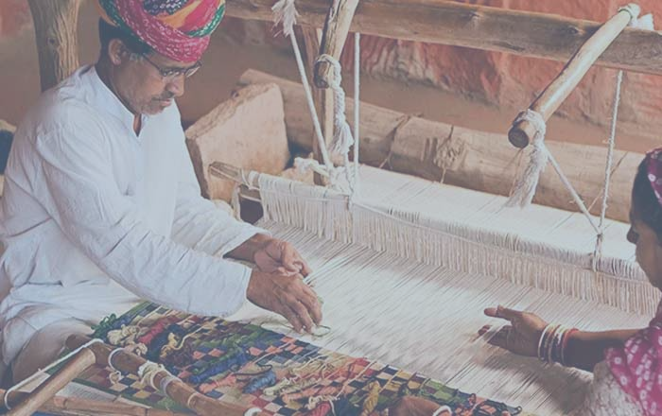
Main Objectives
The objectives of Grameen bank summarized is the reduction of poverty by creating business and employment opportunities for local people for raw materials.
Fig6. People Working with raw Materials
Source. www.jkgb.in

Slide 7
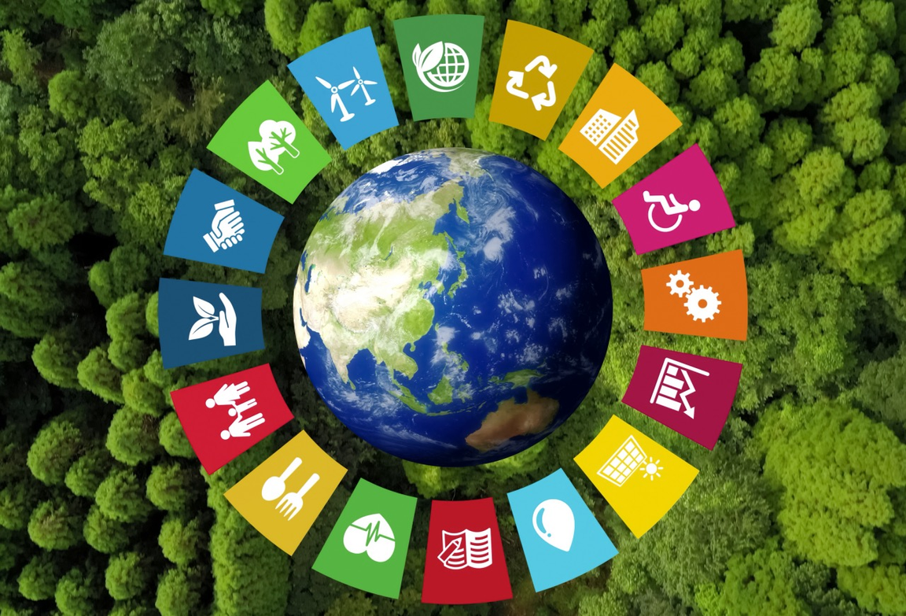
Muhammad Yunus & Grameen Bank's Link to SDGs
  SDG 1: No Poverty
  SDG 5: Gender Equality
  SDG 8: Decent Work & Economic Growth
  SDG 10: Reduced Inequality
  SDG 2: Zero Hunger
  SDG 17: Partnerships for the Goals
  SDG 3: Good Health & Well-Being
  SDG 9: Industry, Innovation & Infrastructure
Fig7. Sustainable Development Goals img
Source. impact-investor.com

Slide 8
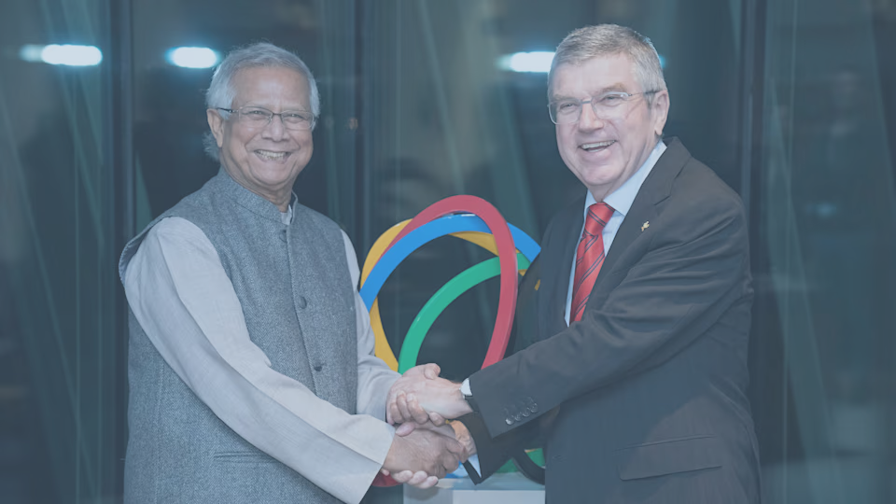
Global Recognition of His Work
  Nobel Peace Award (2006)
  Presidential Medal of Freedom (2009)
  Congressional Gold Medal (2010)
  World Most Influential Person (2010)
Fig8. Yunus at the Nobel award ceremony
Source. olympics.com

Slide 9
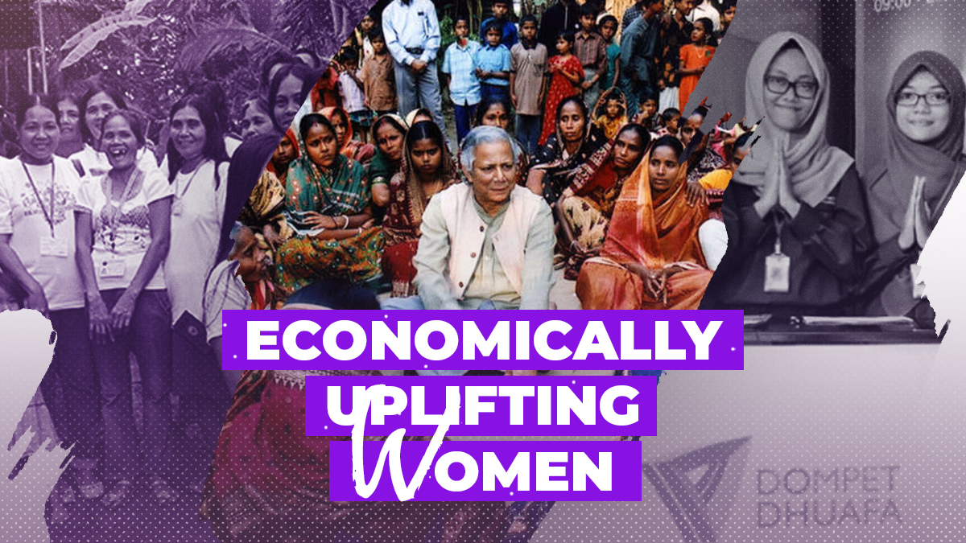
Impact
  Women’s Empowerment
  Poverty Reduction
  Financial Inclusion
  Replication
  Challenges
Fig9. Empowering Women’s Economics
Source. rmaward.asia

Slide 10
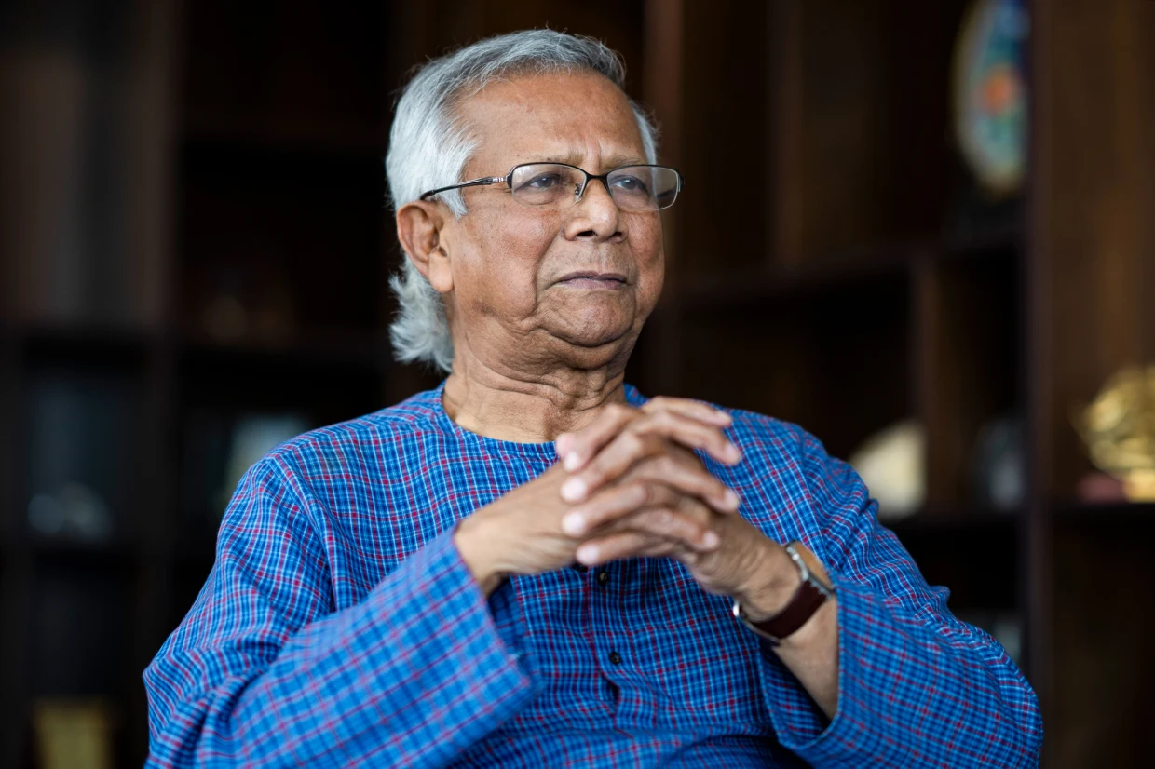
Criticism and Challenges
  Sustainability of Microfinance
  High Interest rates
  Debt Cycles
  Profit versus Purpose
Fig10. Muhammad Yunus
Source. www.nbcnews.com

Slide 11
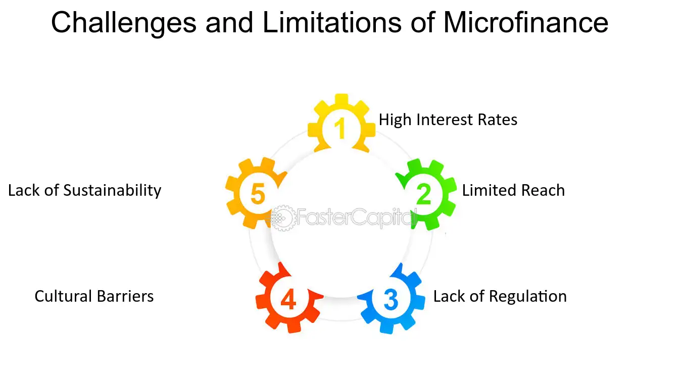
Fig11. Challenges of Micro Finance
Source. fastercapital.com

Slide 12
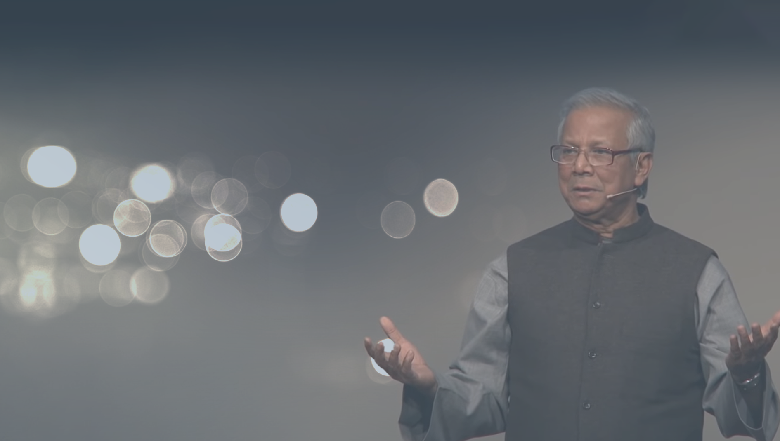
Dr. Yunus’s Legacy and Vision
Dr. Yunus changed how we thought about lending and poverty reduction, by showing the poor that they are creditworthy and can become self-sufficient if helped.
He never ceases to press world leaders to take their money and invest in socially driven companies with a social purpose as well as making money, and to look to entrepreneurship as a changemaker.
Fig12. Dr, Yunus Legacy and visions
Source. kingsbusinessreview.co.uk

Slide 13
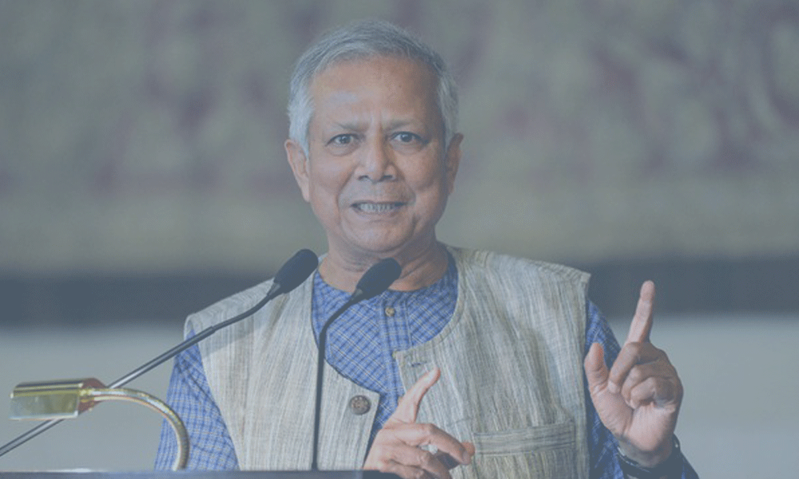
Summary
In conclusion, Muhammad Yunus's Grameen Bank transformed microfinance, empowering many, especially women, to escape poverty. His work, which earned him the Nobel Peace Prize, aligns with the UN Sustainable Development Goals, demonstrating the power of financial solutions to address global challenges. Thank you!
Fig13. Muhammad Yunus
Source. daily-sun.com

