Slide 1
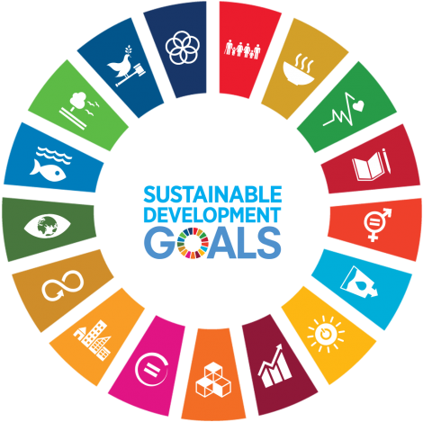
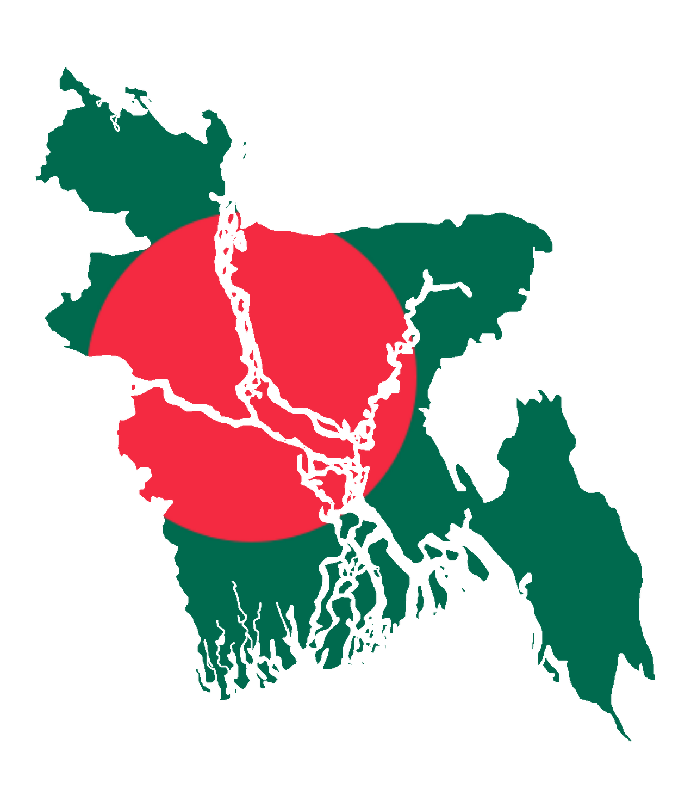


Challenges in Implementing the United Nations Sustainable Development Goals (SDGs) in Bangladesh
Presented By
Al Sifat Siddiki - ID: 40735842
Fig 2.Sustainable Development Goals Circle
Source: https://www.vhv.rs/viewpic/hoRwooJ_un-sustainable-development-goals-circle-hd-png-download/
Fig 1.Bangladesh Map Flag
Source: https://en.wikipedia.org/wiki/File:Flag_Map_of_Bangladesh.png

Slide 2

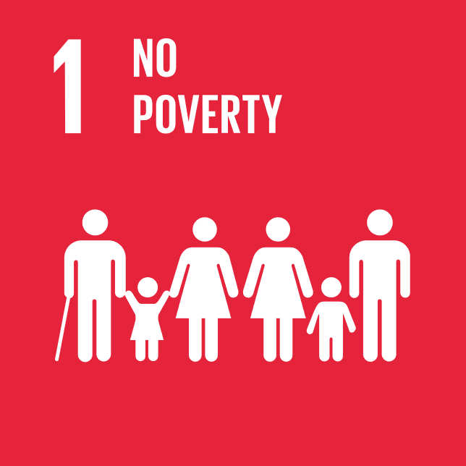
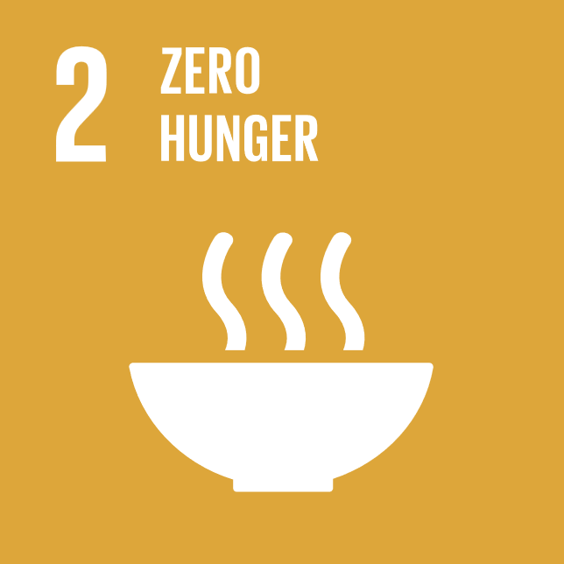
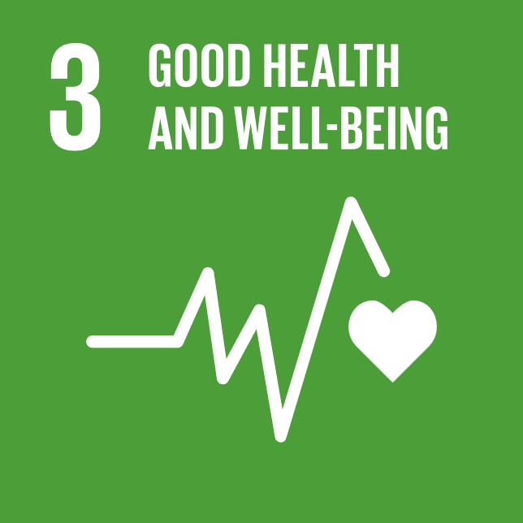
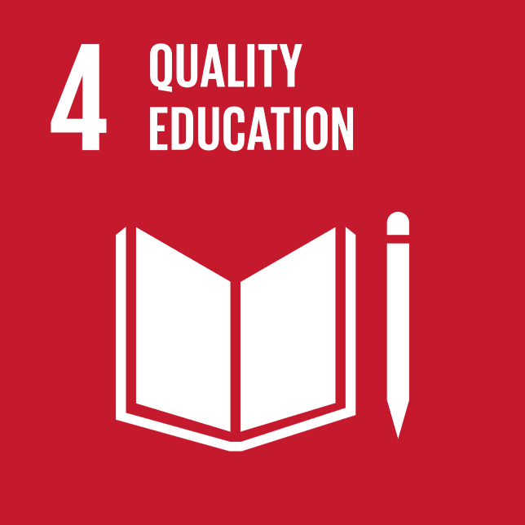
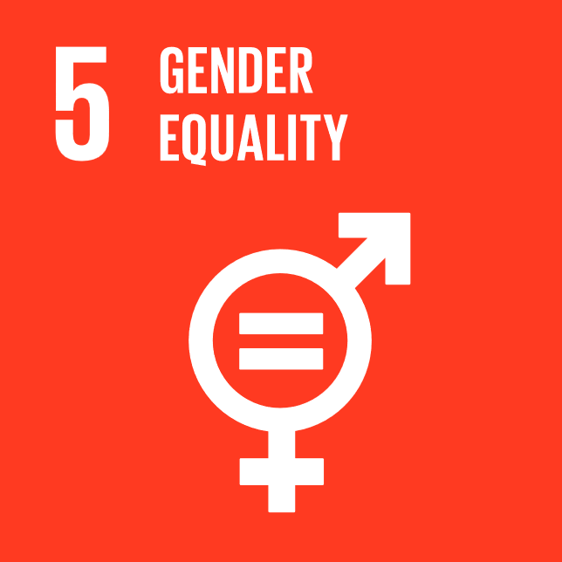
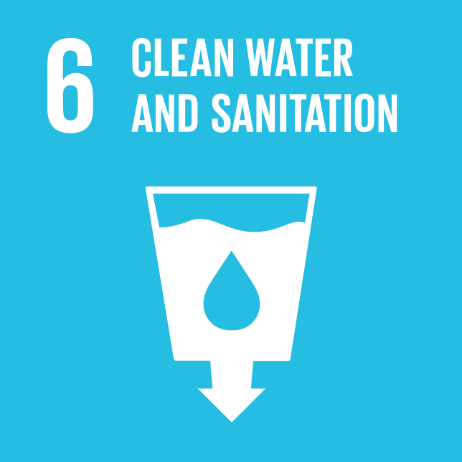
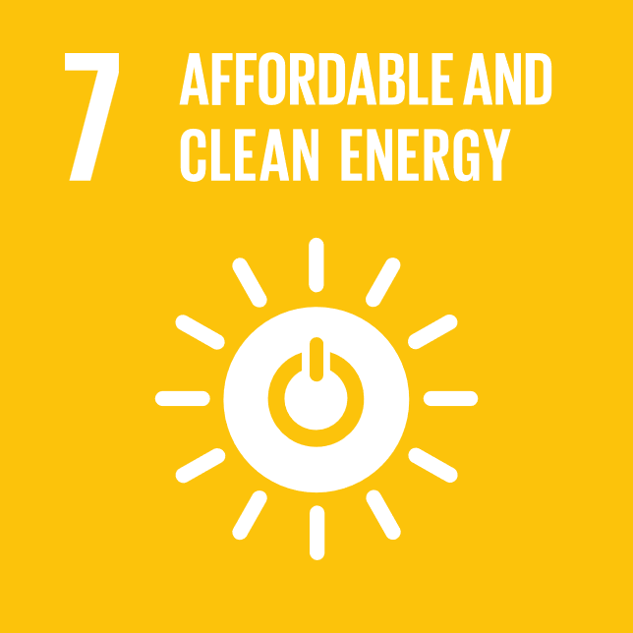
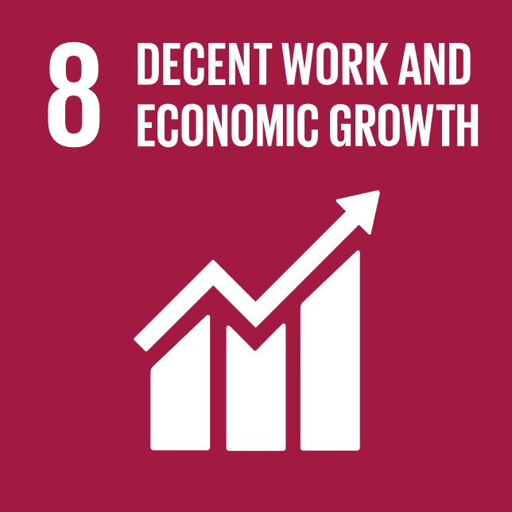
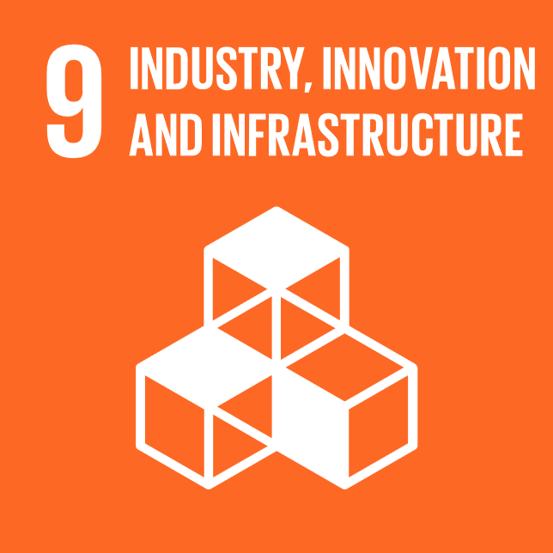
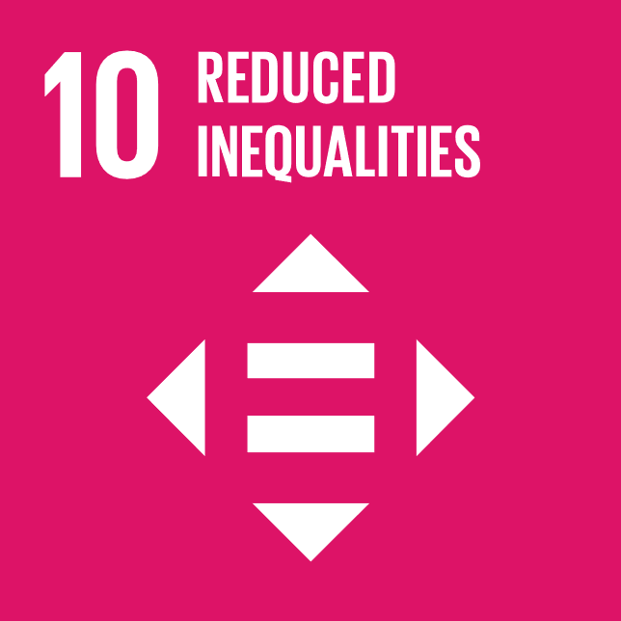
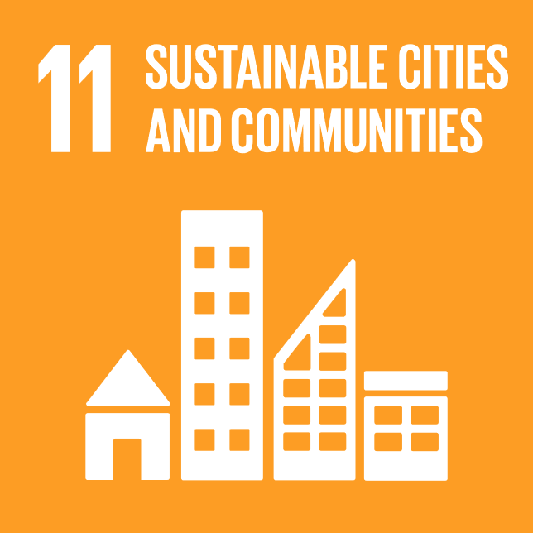
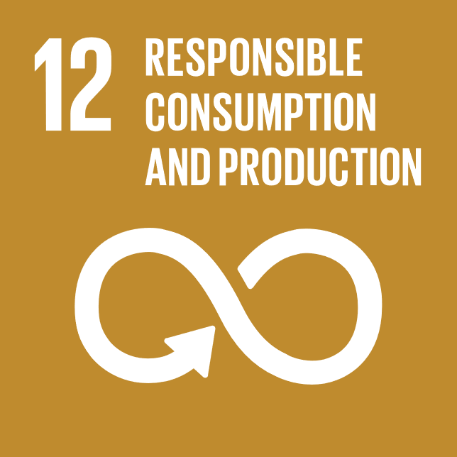
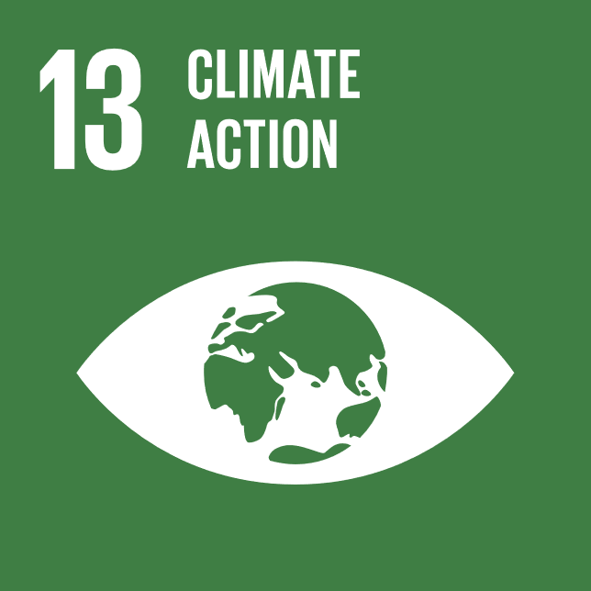
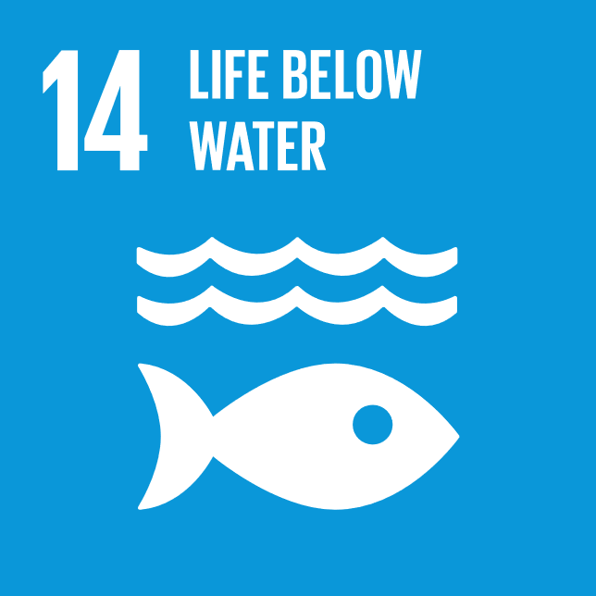
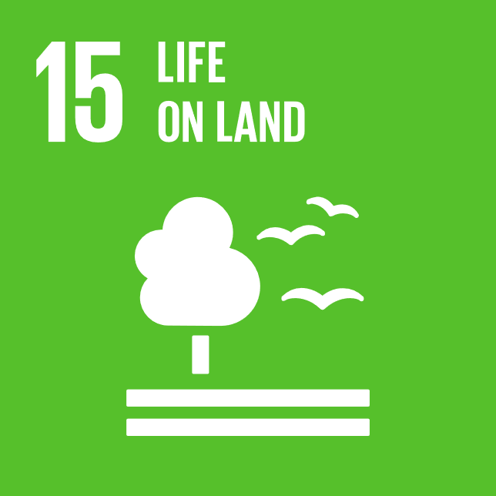
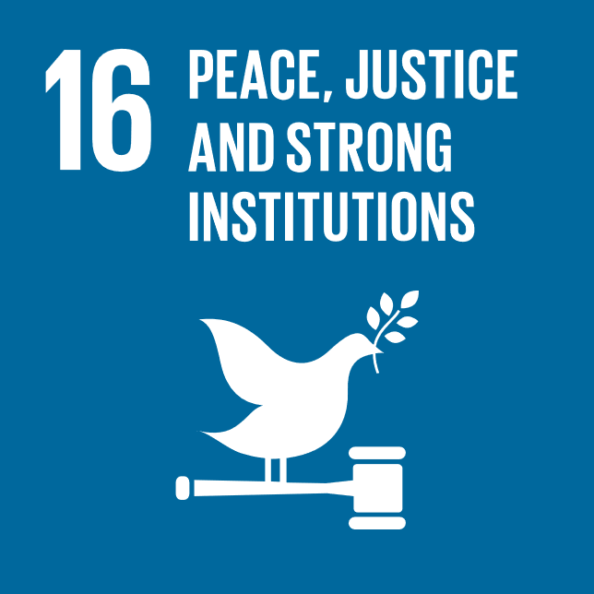
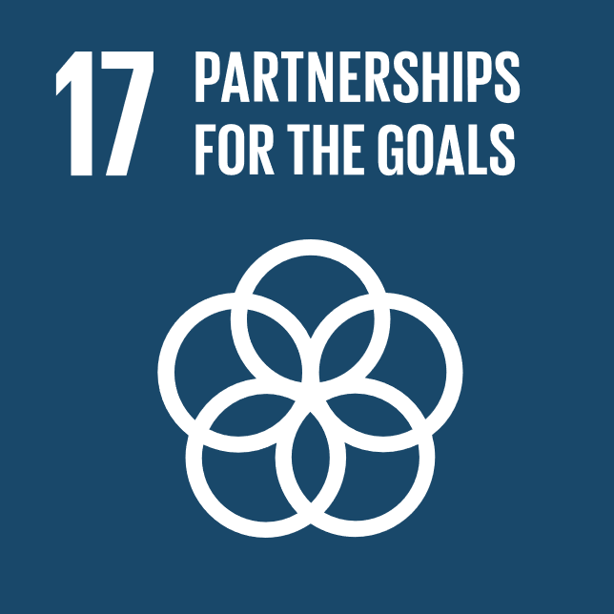
What is Sustainable Development Goals (SDGs)?
The SDGs are 17 international goals established by the United Nations in 2015 to tackle pressing global issues like poverty, inequality, climate change, environmental degradation, peace, and justice by the year 2030.
Key SDGs :
SDG 1 : No Poverty
SDG 3 : Good Health and Well-being
SDG 4 : Quality Education
SDG 5 : Gender Equality
SDG 13: Climate Action
Fig 3.The Global Goals
Source: https://commons.wikimedia.org/wiki/File:The_Global_Goals_Icon_Color_18.png
Fig 4.The Sustainable Development Goals in Bangladesh
Source: https://bangladesh.un.org/en/sdgs

Slide 3
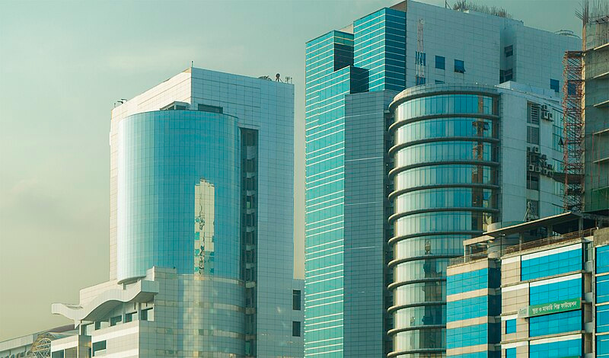
Why concentrate on Bangladesh?
Focus on its significant advancements regarding poverty reduction and women's empowerment and on the challenges faced in reaching the SDGs.
Key Reason
Bangladesh is a developing nation in South Asia with over 160 million people.
The overall performance in SDGs of all 193 Member states Bangladesh's Ranking is 107, with a score of 64.35.
It has fast economic development but deep-seated poverty and vulnerability to climate change.
fig 5.Bashundhara City Complex,Dhaka,Bangladesh
Source: https://en.wikipedia.org/wiki/Bashundhara_City

Slide 4
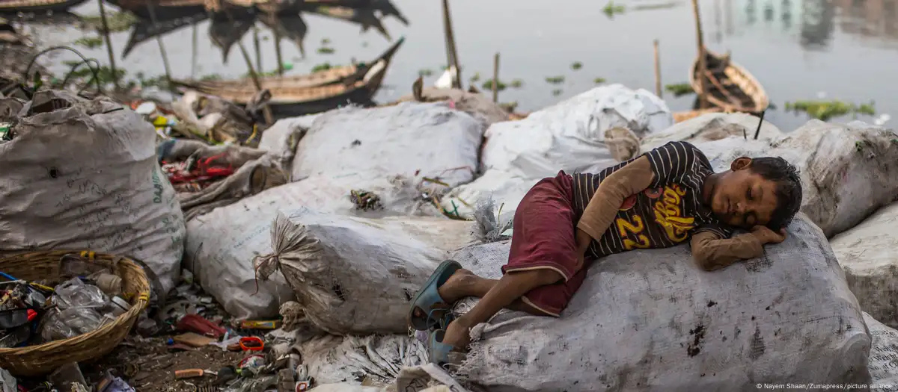
"Challenges Facing Bangladesh in the Implementation of SDGs"
Poverty and Inequality
Despite progress, the population remains the majority below the poverty line, and income disparity is still an issue.
Climate Change
Bangladesh is extremely vulnerable to the impacts of climate change like flooding, cyclones, and sea-level rise, which pose threats to agriculture and livelihoods.
Political Instability
Political instability and governance issues can hamper SDG implementation.
Access to Quality Healthcare and Education
There has been progress, but inequalities still exist, particularly in rural areas.
Overpopulation
Uncontrolled population growth overloads resources, infrastructure, and services.
Fig 6.Living on a ‘Dead’ river on Bangladesh
Source: https://www.dw.com/en/living-on-a-dead-river-in-bangladesh/g-65395105

Slide 5
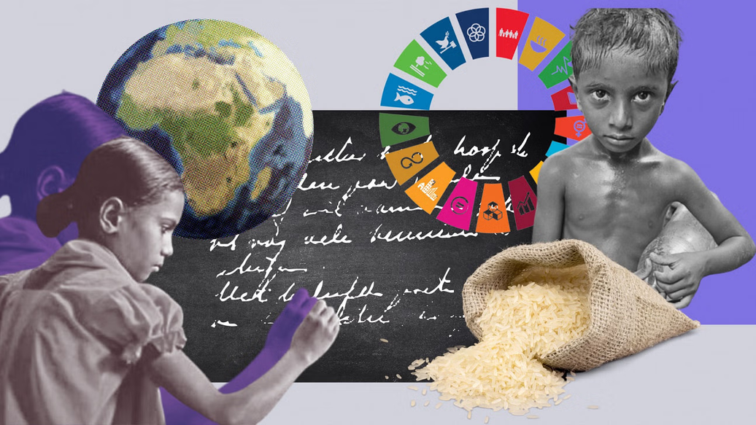
Challenges in the Implementation of SDGs in Bangladesh
+
=
Persistent Poverty and Inequality
+
=
Climate Vulnerability and Environmental Degradation
+
=
Weak Infrastructure and Urbanization
Pressures
+
=
Governance and Institutional
Capacity Gaps
Fig 7.Can the world meet its targets. The Daily Star.
Source: https://www.thedailystar.net/opinion/views/macro-mirror/news/sdgs-crossroads-can-the-world-meet-its-targets-3709401#lg=1&slide=0
Fig 8.The Sustainable Development Goals in Bangladesh
Source: https://bangladesh.un.org/en/sdgs

Slide 6
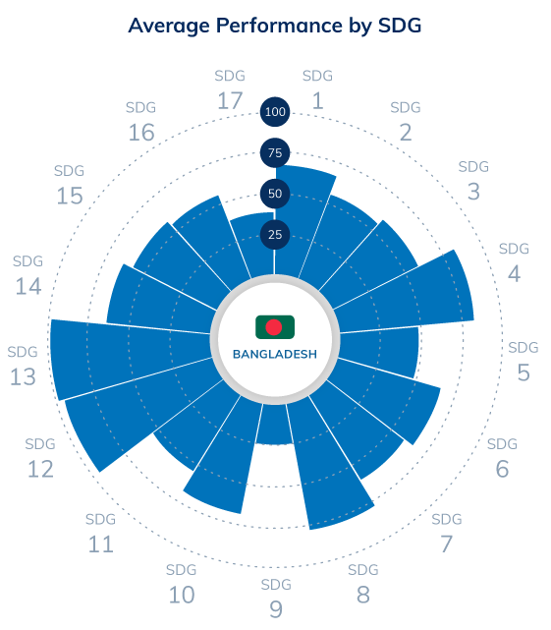
"Possible Solutions for Bangladesh"
4.7%
11.9%
29.3%
4.1%
8%
5.5%
1.2%
10.6%
1.5%
3.6%
1%
2.8%
8.1%
1%
2.6%
Fig 9. Meeting the SDGs
Source:https://lightcastlepartners.com/insights/2020/10/meeting-the-sdgs-how-will-bangladesh-play-the-game/
Source: https://bangladesh.un.org/en/sdgs
3.8%
0.2%
Fig 10.The Sustainable Development Goals in Bangladesh
Source: https://bangladesh.un.org/en/sdgs

Slide 7
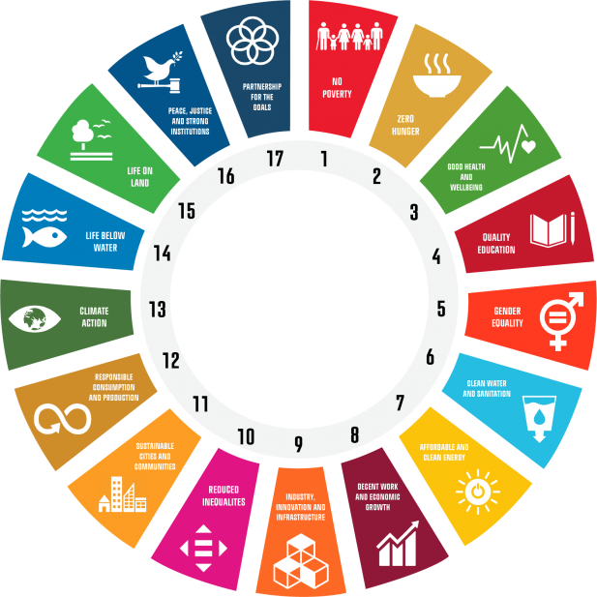
Potential solution for achieving the
SDGs
Strong Governance & Policy Reforms – Clear rules, anti-corruption policies, and policy enforcement (Morton et al., 2017).
Community-Led Development – Grassroots participation, local empowerment, and participatory decision-making (Stewart, 2015).
Public-Private Partnerships – Between government, private sector, and NGOs, cooperating to achieve SDGs (Australia SDG Report, 2018).
Green Infrastructure & Renewable Energy – Green technology, renewable energy, and smart cities investments (Bangladesh).
Education & Skill Development – Enabling people with knowledge and skills to drive sustainable change (Globally).
Climate Action & Resilience – Focusing on climate adaptation efforts, disaster risk preparedness, and sustainable agriculture (Crucial for Bangladesh & the globe).
Fig 11.Sustainable Development Goals
Source: https://www.cbs.dk/en/cbs-impact/areas/green-office/principles-responsible-management-education/our-commitment/sustainable-development-goals

Slide 8



Conclusion
"With targeted policy, global cooperation, and green innovation, Bangladesh can turn challenges into opportunities for inclusive, resilient growth by 2030."
Bangladesh is making progress with SDG implementation, but there are also significant challenges.
HIGHLIGHT 1
Bangladesh's two most important issues under the SDG agenda are climate change and poverty.
HIGHLIGHT 2
Solutions require committed investments in governance, education, women's empowerment, and sustainability.
HIGHLIGHT 3

Slide 9
References
1. Morton et al .2017
2. Stewart .2015
3. Implementing SDGs in Australia .2018
4. The Sustainable Development Goals in Bangladesh
5. United Nations Bangladesh

Slide 10
Thank You
Fig 13.Sustainable Development Goals Circle
Source: https://www.vhv.rs/viewpic/hoRwooJ_un-sustainable-development-goals-circle-hd-png-download/
Fig 12.Bangladesh Map Flag
Source: https://en.wikipedia.org/wiki/File:Flag_Map_of_Bangladesh.png

