Slide 1



Slide 2


COMPANY PROFILE
Subbrand of Aarong
Launched in 2003
In Somali, Taaga means ‘To Standup’
To create modern and comfortable products with an ethnic touch.
Tamara Hasan Abed
MD, Taaga

Slide 3

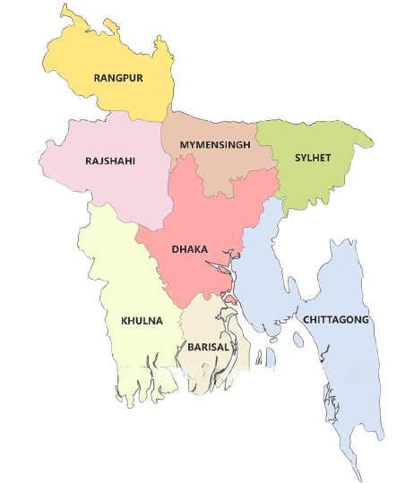
]
]
DEMOGRAPHICAL
PSYCHOLOGICAL
DIFFERENTIATION
POSITIONING
GEOGRAPHICAL
RANGPUR
MYMENSINGH
Aarong Taaga targets urban areas in Bangladesh with outlets in major cities and divisional headquarters.
RAJSHAHI
SYLHET
DHAKA
KHULNA

Slide 4
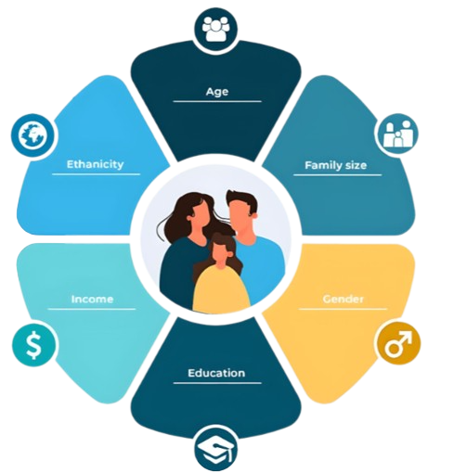
]
]
BEHAVIOURAL
TAREGT MARKET
COMPETITORS
GEOGRAPHICAL
DEMOGRAPHICAL
PSYCHOLOGICAL
Aarong Taaga's main customers are women aged 18-35 with moderate to high incomes, regardless of religious background.
Age
Gender
Age

Slide 5


]
]
COMPETITORS
PERCEPTUAL MAPING
POSITIONING
GEOGRAPHICAL
DEMOGRAPHICAL
PSYCHOLOGICAL
BEHAVIOURAL
TAREGT MARKET
DIFFERENTIATION
Aarong Taaga appeals to ambitious, extroverted women, empowering them and catering to both fashion enthusiasts and cultural appreciators.

Slide 6

]
]
TAREGT MARKET
COMPETITORS
MARKET TRENDS
GEOGRAPHICAL
DEMOGRAPHICAL
PSYCHOLOGICAL
BEHAVIOURAL
Aarong Taaga heavily focuses on occasions like Bangla New Year, Eid, Puja etc. Moreover, they are on social mission to support local artisans which creates brand loyalty amongst interested customers.

Slide 7


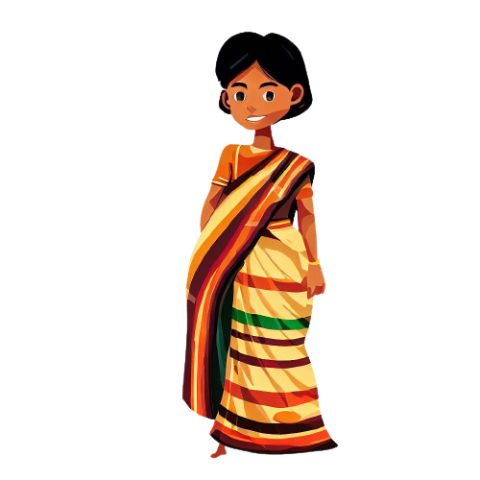

]
]
TAREGT MARKET
COMPETITORS
MARKET TRENDS
GEOGRAPHICAL
PSYCHOLOGICAL
BEHAVIOURAL
DEMOGRAPHICAL
YOUNG URBAN PROFESSIONALS
COLLEGE STUDENTS
CULTURAL APPRECIATORS
ONLINE SHOPPERS

Slide 8
]
]
TAREGT MARKET
COMPETITORS
MARKET TRENDS
BEHAVIOURAL
YOUNG URBAN PROFESSIONALS
01
Aarong Taaga targets working women aged 18-35 who appreciate fashion
and cultural values.
COLLEGE STUDENTS
02
Aarong Taaga appeals to trend-conscious college students who want to
express their style despite financial limitations.
CULTURAL APPRECIATORS
03
Aarong Taaga caters to those who admire cultural traditions, offering a
fusion of cultural styles and modern fashion.
ONLINE SHOPPERS
04
Aarong Taaga reaches customers who prefer the convenience of online shopping, providing their latest collections and offers through their website, app, and social media.

Slide 9





]
TAREGT MARKET
]
COMPETITORS
MARKET TRENDS
PERCEPTUAL MAPPING
BEHAVIOURAL
Competitors of Aarong
Aarong Taaga competes with local brands like Kay Kraft, Anjans, Rang, Deshal, Bibiana, etc. They target young urban women seeking fashionable, comfortable, and affordable clothing like Aarong Taaga.

Slide 10

[
]
COMPETITORS
MARKET TRENDS
PERCEPTUAL MAPPING
Traditional clothes with modern style
Products made from environmental-friendly materials
Supports local artisans

Slide 11





]
TAREGT MARKET
MARKET TRENDS
]
PERCEPTUAL MAPPING
High Price
Not Ethnic
Ethnic
Low Price

Slide 12
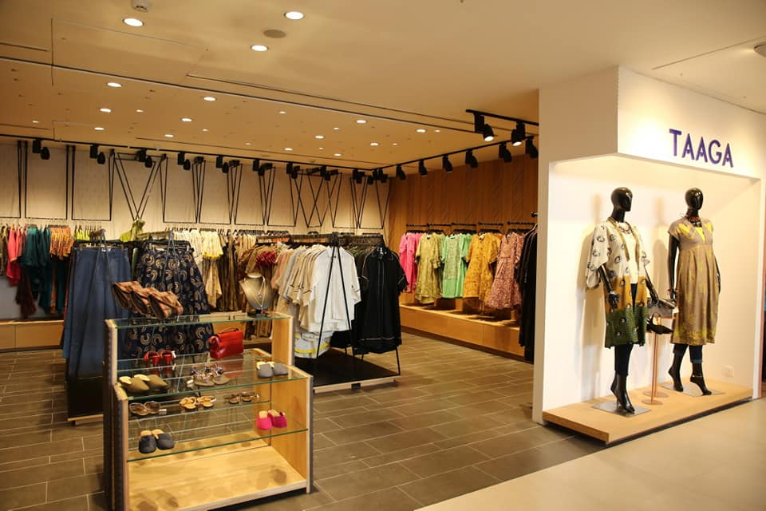
PRODUCT

Slide 13
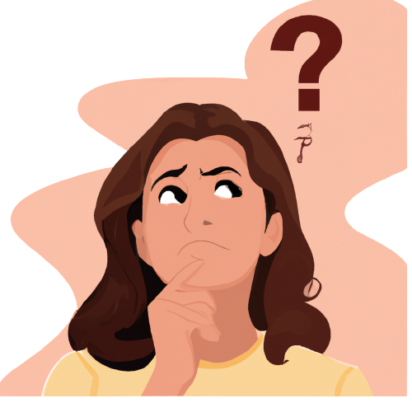
Have you ever…
Worried about your financial flexibility?
Want to buy a Taaga product but your pocket seems empty?
Wish you could own fashion without paying for it instantly?

Slide 14
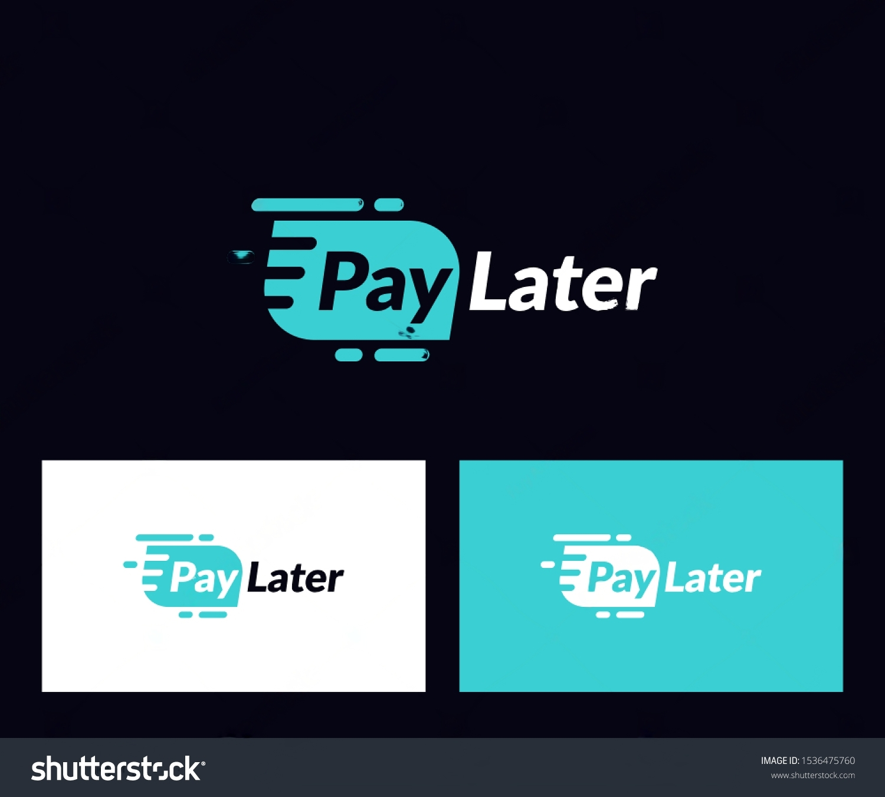
INTRODUCING
"Shop now, PayLater, Smile forever"

Slide 15
What is this?
A CREDIT system which ENABLES our customers to purchase their desired products without having to pay for them IMMEDIATELY.
Customers can choose this payment method for selected products, and pay for them at a LATER DATE of their CHOICE.
"Shop now, PayLater, Smile forever"

Slide 16


Satisfied Needs
Financial Flexibility
Convenience of Payment

Slide 17
Do we have competitors?

Slide 18
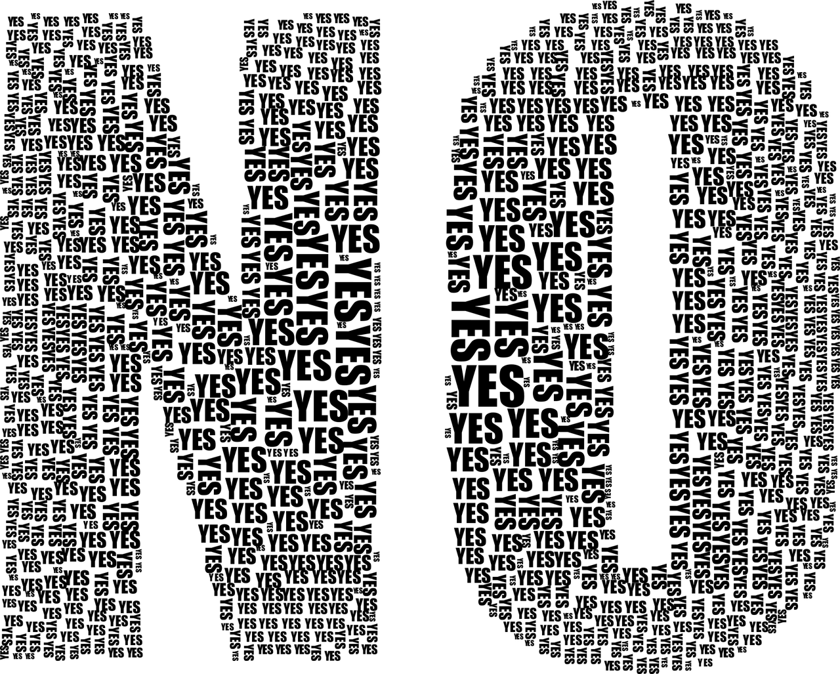
Do we have competitors?

Slide 19
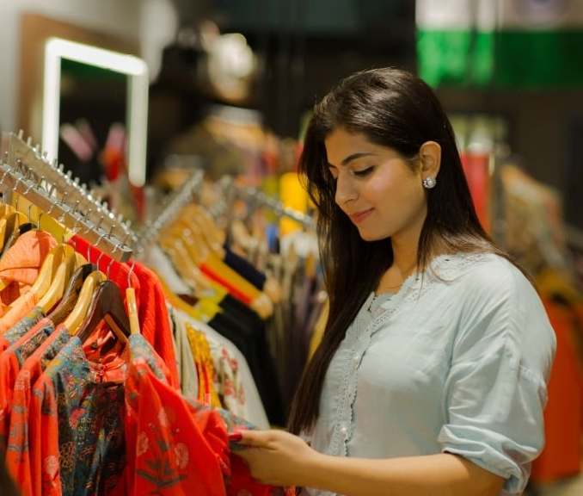
PRICING
PRICING

Slide 20

Value Proposition
Enables the opportunity for the customers to purchase without paying upfront.
It creates a strong sense of financial flexibility in its customers.
Students, who has limited financial freedom, will be the most benefitted from this service.

Slide 21

Price sensitivity
No pre-established price points. As a result, Taaga has the liberty of setting the price to both their and their customers’ liking.
Target customers for this service mainly consists of students and young professionals with limited financial freedom and they exhibit a very strong sense of price sensitivity
Customers should be able to perceive the how this service will enable them to afford Taaga products without having to worry about immediate financial burdens.
This service needs to be positioned as a cost-effective and advantageous option for the customers to attract their interest and participation.

Slide 22

Pricing Strategy -
Market penetration pricing strategy needs to be deployed.
It is crucial to keep a balance between generating demand and maintaining profitability.
Offer the pay-later service for free for the first three months, and then charge a flat fee.

Slide 23
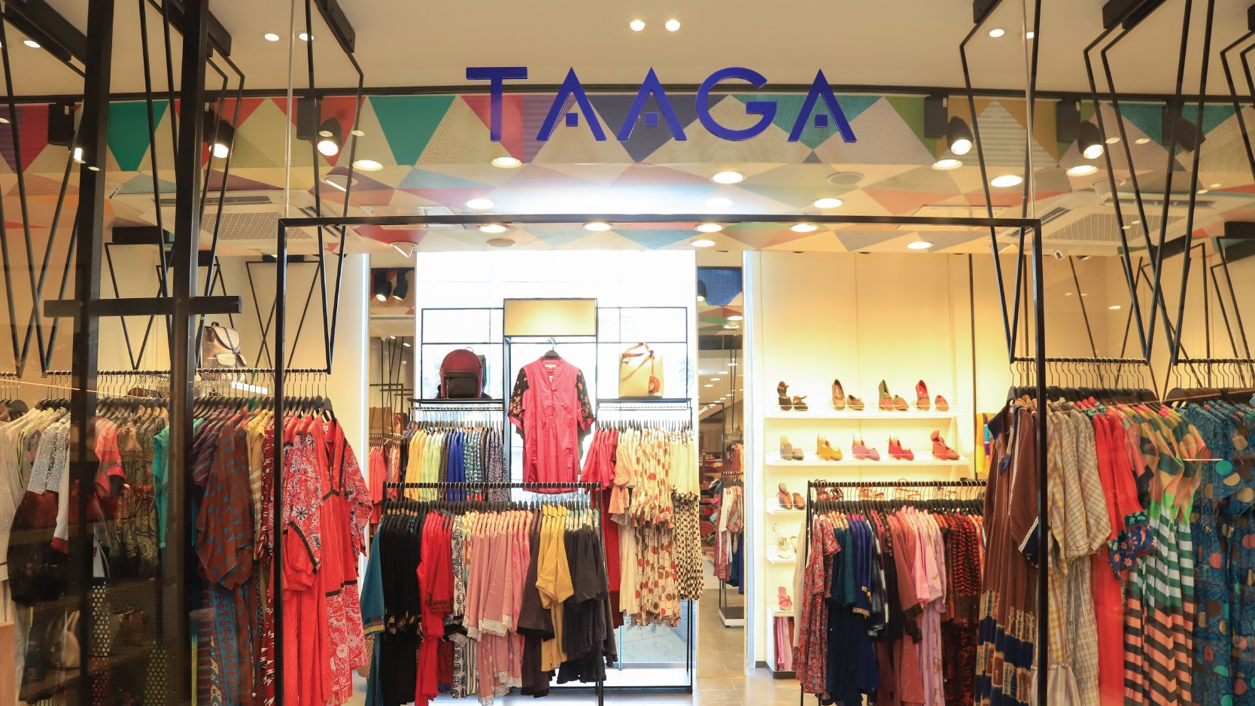
PLACEMENT

Slide 24

Service Availability-
Customers will most likely look for this service
specifically at existing outlets.
Only available in Taaga outlets. Customers need to verify their identity using NID and institutional ID card first.
Will not be available for everyone online because of security issues, but can only use this service online after buying Taaga products worth at least 15,000 BDT through PayLater.

Slide 25
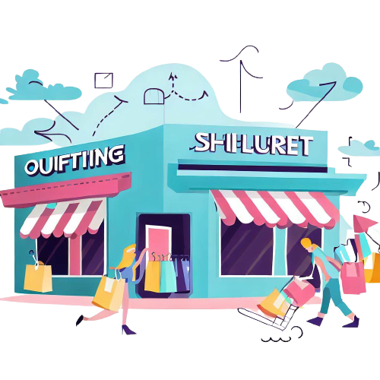
Distribution-
Pursue a direct sales distribution channel, or a Zero Level distribution channel
Using other intermediaries is unnecessary for this service
Enables us to enhance customer experience and build strong relationships with customers

Slide 26

Sales Force Structure-
The customer sales force structure is best suited to promote
this product.
They can be sent to various marketing campaigns.
Enable us to use the push marketing strategy.

Slide 27
PROMOTION

Slide 28
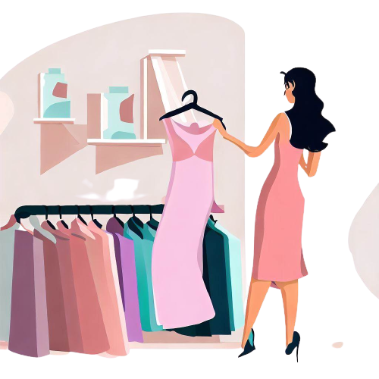

Location of Target Customers
Can be found near the existing outlets of Aarong Taaga.
These customers prefer to buy their products from a physical shop.
Majority of the customers of Aarong Taaga prefer window shopping.

Slide 29
Marketing Channel
04
01
02
03
PERSONALIZATION
They offer to personalize their items for those who are choosy customers.
SOCIAL MEDIA
WORD-OF-MOUTH
DIRECT MARKETING
Positive word-of-mouth can create buzz and viral effects among our target customers, build trust and reputation, and increase customer retention and loyalty
We can create brand awareness and loyalty by posting engaging content and offers about our products and services
Most straight-forward approach, can engage with customers directly through one-to-one conversations, SMS marketing, catalogs, and coupons

Slide 30

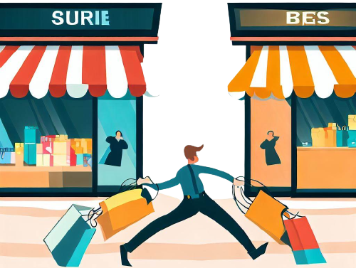
Competition
Past Promotions
Competitors usually use the same channels to promote different products, as it is the most effective for this market
The same marketing channels have also worked for us to promote our products.

Slide 31
Conclusion
“PayLater” by Aarong Taaga is an innovative approach in the apparel market, which is sure to attract interests from its target customers. By providing the ability to exercise financial flexibility and freedom from its burdens, “PayLater” will surely help Taaga to create a wide base of loyal customers. If positioned correctly, “PayLater” can be the most popular method of transaction for Taaga.

