Slide 1
The Perl Regression Tester (PRT)
Overview and Manifesto
Dr. David J. Musliner
Smart Information Flow Technologies
musliner@sift.info

Slide 2
Overview
Designed to test full systems of multiple software components, running both sequentially and in parallel.
Based on per-program log file comparison.
“Rubrics” are “blessed” baseline or expected logfile contents.
  May be full logs or trimmed to key lines.
“Comparos” are software components that PRT runs to compare new result logs to blessed rubrics. Can select what lines in log to compare.
  Different comparos may be used for each tested software component.
Runs anywhere. Free. Easy common uses.

Slide 3
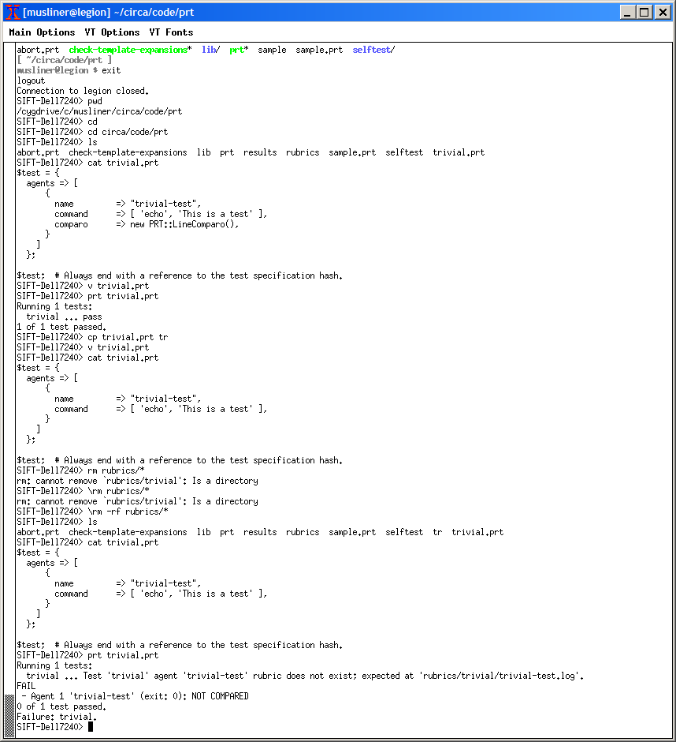
Test Specification
Agent name.
Command with arguments.
Line at a time comparisons.
Simple defaults.

Slide 4
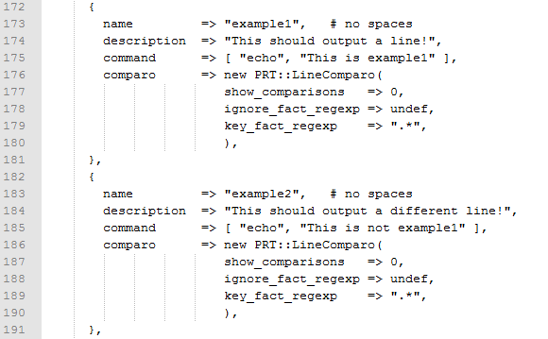
Comparos
Line at a time comparisons.
Simple defaults.
Easy to ignore irrelevant or changing info like timestamps.

Slide 5
Comparos
“LineComparo” (the default- compares lines in order):
  For every result line that doesn’t match ignore_fact_regexp
  And does match key_fact_regexp
  Make sure result line matches the key_fact part of the corresponding rubric line.
  So: extra non-matching result lines are permitted.
  Case_sensitive defaults to 0
“StrictLineComparo”
  Every not-ignored result line must have a corresponding rubric line.

Slide 6
Comparos
“UnorderedComparo” (compares lines in any order):
  For every result line that doesn’t match ignore_fact_regexp
  And does match key_fact_regexp
  Make sure result line matches the key_fact part of some corresponding rubric line.
  Extra non-matching result lines are permitted.
  If strict=0 (default), extra matching result lines permitted.
  If strict=1, must have exact same number of occurrences of matches in rubric and results.
  Case_sensitive defaults to 0

Slide 7
Results and Rubrics
Results are stored in auto-named directories, with auto-named logfiles.
The first time you run, you will have no rubrics.
  Therefore any test you run that includes a non-undef comparo will “fail”.
If you inspect the results and like them, you bless them.

Slide 8

Run a Trivial Test

Slide 9
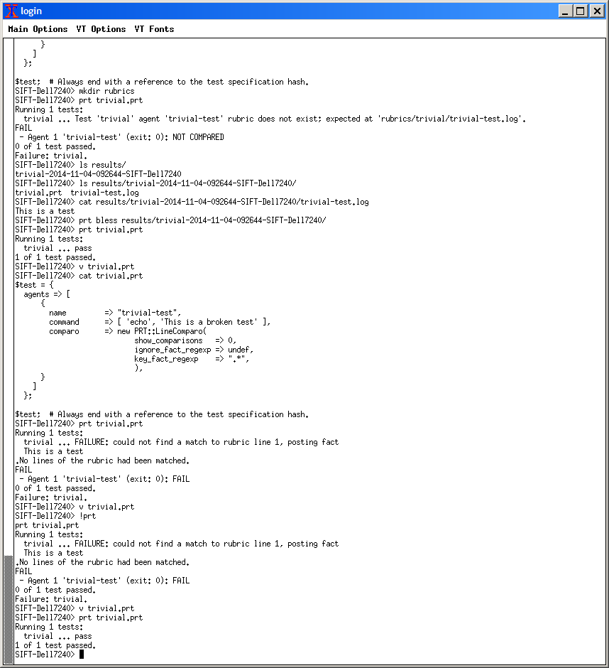
Examine Results, Bless, Re-run Test

Slide 10
Change the command, Break the Test

Slide 11
Test Development Process
As you prototype tests, you can commit intermediate versions in svn with defaultIgnore=1 so Jenkins ignores them...that way your work is revision controlled but will not break things for others. Tests w/ defaultIgnore set should typically have comments inside them or in commit msgs saying why they are not yet ready.
Once a test is ready to be defaultIgnore=0, so that Jenkins and other developers run it, you must of course commit the corresponding rubrics as well.

Slide 12
Command Line Options
‘prt’ : runs all .prt tests in current directory.
  Results named results/prt-suite*/testname*
  Skips those with defaultIgnore=1
Add filenames of .prt files if you want a subset.
-v : verbose
-k keyword : all those tagged with keyword
  Useful for creating sub-suites of tests that use different components, e.g. –k RTS.
-n : don’t actually run tests, but say which ones you would have done (ala make).
-c results/dir : re-compare an old result to rubric.
-s : print a commented sample .prt file

Slide 13
Best Practices
Make comparos easy: label results.
  Eg.: <timestamp> <tags> RESULT: The answer is 42.
  key_fact_regex: “RESULT:.*”
Clean up your own mess.
  Use complete_before_continuing.
  Use a final-agent to make sure all agents and daemons dead – see examples.
Hooking PRT into Jenkins for continuous build/test has been done. Don’t start from scratch.
If you want to delay starting later agents until one has reached a certain state of readiness, use a ‘logwatcher.pl’ agent. See examples.
Setting timeouts on agents is easy with Linux ‘timeout’ command.

Slide 14
And Now the Manifesto
PRT is what it is. It is semi-awesome at what it was meant to do, and sucks at everything else.
Never start to write a .prt file from scratch. Either use prt –sample or copy an old one.
  There is obscure syntax. Tough.
PRT is an unfinished work of art– there are things that have been designed but never funded/built.
  Stay on the common paths, and you’ll be fine. Straying is for red shirts.
Ask before guessing. Most things have already been done. If you think it is complicated, you’re probably doing it wrong.

Slide 15
If You are Trying to Use PRT For This, You are Probably Wrong
Complex data structure comparisons and calculations.
  Do them in the code. Log and compare the results.
Multi-line comparisons.
  Put it on one line or go home.
Out of order comparisons.
  Usually you should just be accumulating what you care about in the code and reporting it in log lines.
  UnorderedComparo is available, particularly when asynchronous operations make logfile ordering not repeatable.
Serial suites of many separate tests in one prt file.
  If you have a serial suite and you don’t want all-or-nothing behavior, break it into multiple prt files.

Slide 16
Performance Comparo
If you have slightly varying output, e.g., runtimes, and you want your test to make sure the values stay within some range of the rubric.
This functionality exists, as described next, but is not yet widely used.
It is slightly trickier to use than normal PRT.

Slide 17
PRT performance checking
Collect various statistics from the log.
Test spec gives regular expressions for discovering stats, whether bigger is better, smaller is better, allowed variation, etc.
$test = {
description => "I am a tutorial.",
agents => [
{
name => "Jerry Mathers",
command => ["cat", "$FindBin::RealBin/selftest/perf-comparers-src.log"],
exit_code => 0,
comparo => new PRT::LineComparo( key_fact_regexp => "^This" ),
perfchecks => [ … ], # more on next slide
},
],
};
The Comparo has to know about perf checking.
Rubric gives current “best” results.
Checking stats is separate from line-by-line comparison to rubric. Can do both, or just one.
Lots of Perldoc in the code.

Slide 18
Performance checking defaults
perfchecks => [
{
regex => "^([a-zA-Z0-9]+) +([a-zA-Z0-9_]*) +([0-9.]+)",
tests => [
{ labels => ['.*', 'catPower'],
compFn => smaller_is_better(pct => 0.20) },
{ labels => ['.*', 'dogAmplitude'],
compFn => bigger_is_better(abs => 7) },
{ labels => ['Rabbit.*', 'rabbitForce'],
compFn => numeric_in_range(boundBelowAbs=>5, boundAboveAbs=>10) },
],
},
],
The regex tells PRT how to extract statistics from a line of the log.
  The “value” is the last captured substring.
  The other captured strings (aka labels) identify the property.
    Different names, or a different number of names ==> different property
The tests array gives a semantics to the value associated with certain labels.
  If no labels regex list matches what the line regex captures for one line, then we don't extract stats from that line.
C1 catPower 500 is a line with value 500 for property C1/catPower
The line C2 catPower 300 gives no properties
Rabbit1 rabbitForce 57 has property Rabbit1/rabbitForce at 57
Dog2 rabbitForce 90 does not give a property!

Slide 19
Another example
perfchecks => [
{ # note forth and and fifth groups are optional
regex => "^FUBAR val ([a-z0-9]+) <- ([a-zA-Z0-9_]*) ([a-z]*) ([A-Z]*)? ([a-z]*)?",
value => 1, # value is NOT the last one --- because 3rd party s/w, etc.
labelIndices => [2, 3, 5], # ignore 4th group
defaultCompFn => PRT::Perf::smaller_is_better(pct => 0.10),
tests => [
{ labels => ['.*', 'air', 'speed'],
compFn => bigger_is_better(pct => 0.05) },
{ labels => ['.*', 'land', 'speed'], # Use that defaultCompFn up there
combineFn => sum_combiner() }, # Take the sum of values
{ labels => ['.*', 'color'], # ignore 3rd part of label
combineFn => ignore_combiner(), # If property repeated, ignore after 1st
compFn => same_string }, # values need not be numeric
{ labels => ['.*', 'bigOK'], # Default combineFn is to take the last value
compFn => numeric_in_range(limitBelowPct => 0.05) },
{ labels => ['.*', 'capBoth'],
compFn => numeric_in_range(limitBelowAbs => 14,
limitAbovePct => 0.1) }
]
},
],
More examples in the PRT self-tests.

Slide 20
Slots and defaults
The function in an agent's combineFn slot (or a test spec's defaultCombineFn slot) describes how to deal with two values for the same property in the logs.
The default is to throw away the older one, use the newer one.
Can give an arbitrary function via Perl sub { … }: first argument is the previously found value, second argument is the newly found value, return what we should use as the value going forward.
PRT::Perl exports overwrite_combiner (the default), ignore_combiner, sum_combiner, max_combiner, min_combiner.
The function in an agent's compFn slot (or a test spec's defaultCompFn slot) for each property is called after scanning the whole log and rubric to see if the new value passes or fails.
Can give an arbitrary function via Perl sub { … }: first argument is the rubric value, second argument is the log's value, return boolean true if pass (but see PRT::Perl for how errors are detailed back to PRT).
PRT::Perl exports numeric_in_range, smaller_is_better, bigger_is_better, same_number, same_string, boolean.

Slide 21
PRT
PRT
  name
  description
  keywords
  defaultIgnore
  agent_delay
  agents
    name
    description
    command
    exit_code
    complete_before_continuing
    comparo

Slide 22
Old stuff comes below this

Slide 23
PRT
Example:
  Agents:

Slide 24
Jenkins
Jenkins is a continuous integration agent
  Ensures the code in the repository works as it should
Currently on a laptop at SIFT HQ
Every 5 minutes it checks for a commit
  It then runs the HAMMER PRT tests
It will email everyone on our mailing list on failure of the PRT tests
  Emails the list on each failure and once when returns to stable
Outside access
  Login feature
  DropBox results/logs

Slide 25
Testing Manifesto
If a test is not fully automated, it is not a test.
A test must tell you when it succeeds.
A test must tell you when it fails.
A test must be proven to detect both conditions, success and failure (or at least have a reason to believe that the test framework can detect both).

Slide 26
Software Delivery Manifesto
Software that is not in the repository is not delivered.
Software that is not delivered does not “work”.
Software that is not tested does not work.
Software behavior that is not tested by (automated) tests does not work. See above.
So to get your software to work, it must be delivered in the repo and tested automatically. Easy.

