Slide 1
IDS-1
16,000
Raw
Reports
Interesting events
IDS-2
Clustering
Reports
into Events
Evidence
Analysis
1000
Believable Interesting events
10
IDS-3
4000
Uninteresting events

Slide 2
IDS-1
16,000
Raw
Reports
Interesting events
IDS-2
Clustering
Reports
into Events
Evidence
Analysis
1000
Believable Interesting events
10
IDS-3
4000
Uninteresting events

Slide 3
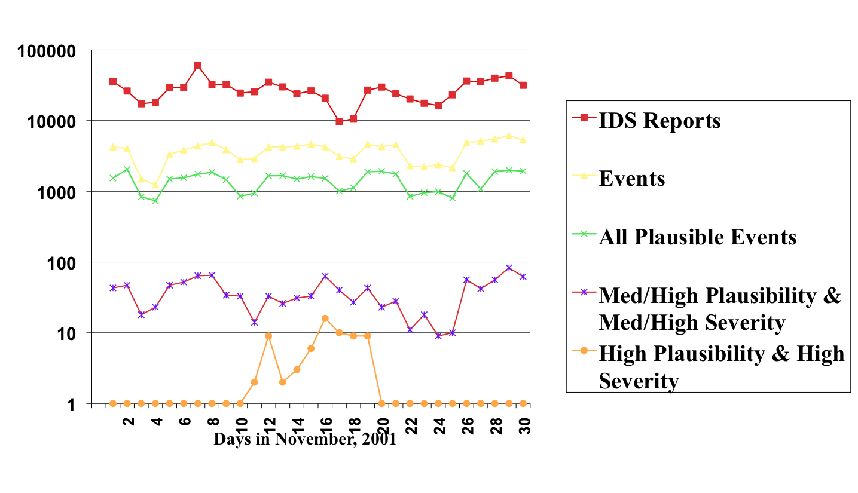

Slide 4
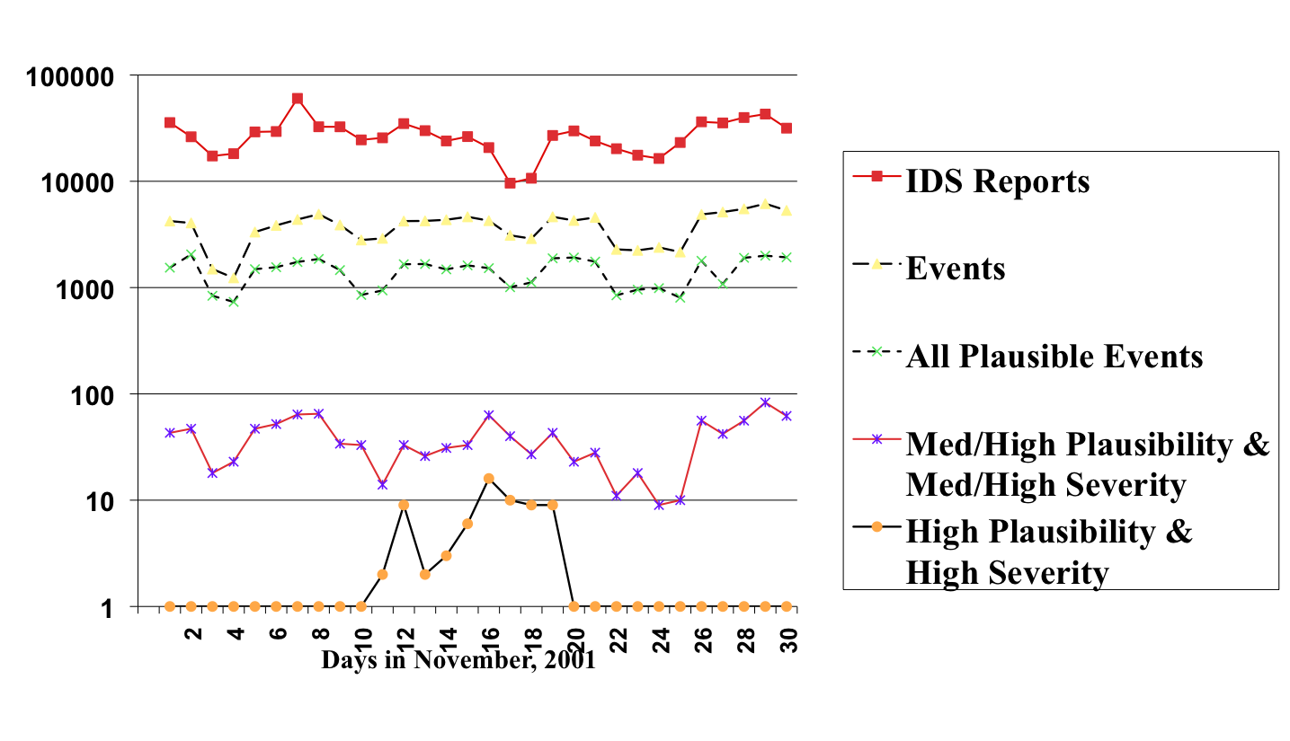

Slide 5
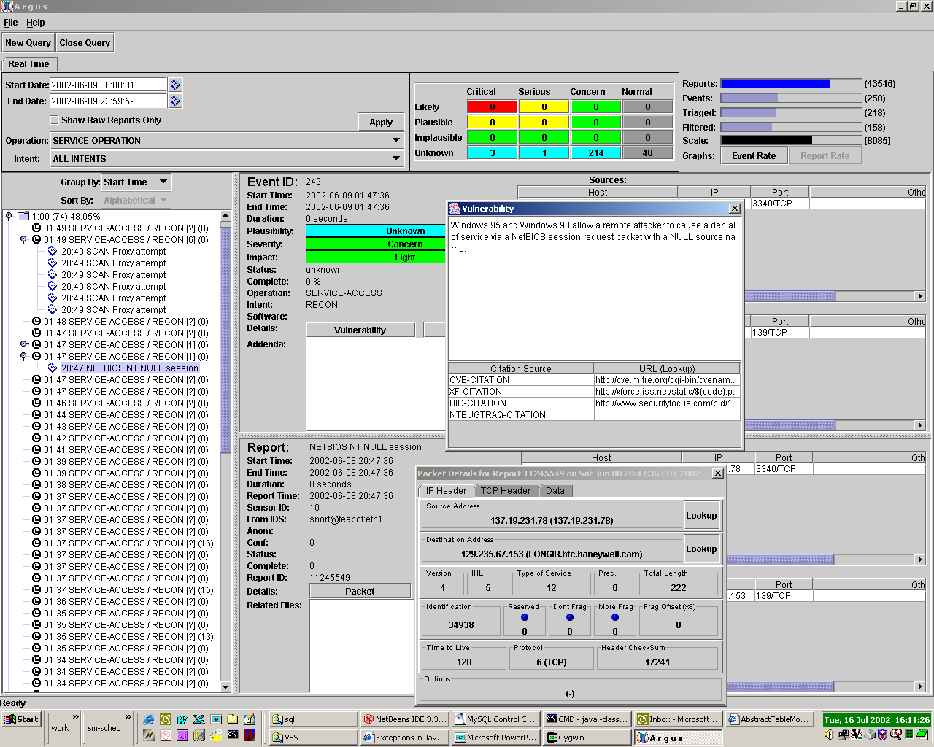
“TRIAGE” TABLE - to quickly select most plausible / critical events
STATISTICS - number of reports and events processed
[logarithmic scale]
Selects real-time event display
FILTERS - to select events/reports of interest
CITATIONS - provide details on vulnerabilities or exploits
EVENT DETAILS - including color-coded scores for plausibility, severity, and impact
PACKET DETAILS - details from packet data in the report
EVENTS - explanations
for reports from various
intrusion detection sensors
REPORT DETAILS - details of the re port(s) linked to the event
Notes:
[Walt]
Insert a Scyllarus screen shot here.

Slide 6
IRM – a Layered Ontology
Specialized Extensions
  Local Network Entities - this is the NERD (Network Entity Relation Database)
  Vendor Specific Data – these are descriptions of the various IDSs and their reports
Local
Net
RealSec
IDS
Dragon
IDS
Snort
IDS
Cisco
IDS
Other Sources:
IPChains, Tripwire, etc.
IRM Base Ontology
IRM Base Ontology
      Abstract concepts
      Vulnerabilities

Slide 7
IRM Construction
Local IRM built on generic one
Compiled and loaded into the analyzer program
Various Scanning Tools
  NMAP
    Existence of nodes, services
    Guess at their OS
  SunScan
    Gather details about local Unix hosts, versions, patches
  DumpSec
    Details about windows machines, groups, users
Local Instances
And Extensions
Host and
Network
Scanning
Utilities
IRM Base
Ontology
Ontology
classes
Ontology instances
Ontology
LISP Classes
Localized
Scyllarus
Runtime
Analyzer
Scyllarus
LISP
Sources
~ 750 event concepts

Slide 8
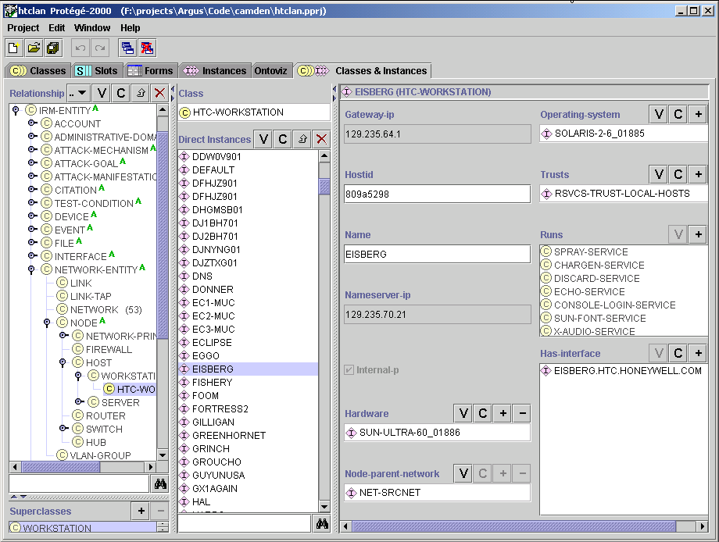
Classes
Instances
Attributes of an instance

Slide 9
Scyllarus Architecture
Real
-
time
report feed
Intrusion
Intrusion
Reference Model
Static
Reference Model
Information
Sensor
Scyllarus
Sensor
Sensor
Analyzer
Converter
Converter
Converter
Sensor
Sensor
Sensor
Events &
Sensor
Converter
Concentrator
updates
Converter
Converter
Sensor
Real
-
time
Sensor
Sensor
Event
event feed
Converter
Converter
Converter
Distributor
RT Java
Reports
Archive
Events
Console
&replay
Intrusion
reports
Queries
Report/Event
Archive
IDMEF correlation reports to
other
correlators
or analyzers

Slide 10
Scyllarus Capability Summary
Process reports from a variety of intrusion detection sensors
  network, host, and hybrid
  commercial, open-source, research
Process substantial report volume
  thousands/hour
Provide significant reductions in report volume
  thousands -> tens
Monitor sizeable networks
  up to 1000 nodes with one system
Cluster and correlate reports from multiple sensors
  more effective detection of stealthy attacks
  vast reduction in false alarms and noise
Categorize events for efficient review
  plausibility, severity, utility events
Discount attacks on unsusceptible targets
Retain events and reports in database for forensic analysis
Notes:
[All]
Is this a fair representation of our accomplishments?

