Slide 1

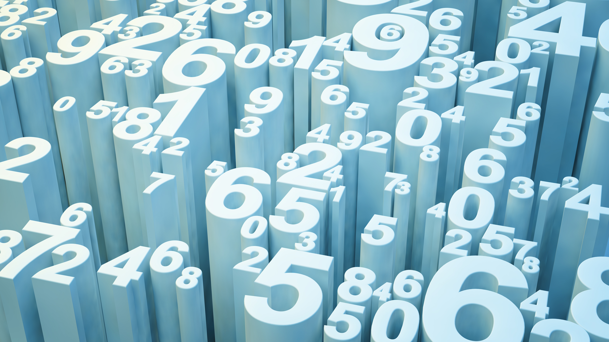
Number System
Presentation by Saifur Rahman

Slide 2
Decimal → Binary
Decimal: This is the common number system we use every day. It uses 10 digits (0 through 9). The position of each digit is based on powers of 10.
Example: 5₁₀
Binary: This system is used by computers. It only uses 2 digits: 0 and 1. Each position is based on powers of 2.
Example: 1011₂ (This is 11 in decimal)
To convert a Decimal number to a Binary number we have divide the decimal number with 2 like below and arrange from Most Significant Bit (MSB) to Less Significant Bit (LSB).
Division | Quotient | Remainder
5 / 2 | 2 | 1
2 / 2 | 1 | 0
1 / 2 | 0 | 1
LSB
MSB
So: 5₁₀ = 101₂

Slide 3
Binary → Decimal
To convert a binary number to a decimal number we have to follow the beneath instruction.
1. Write down the binary number. Starting from the rightmost digit, assign increasing powers of 2 to each digit's position, starting with 2⁰ (which is 1).
2. Multiply each binary digit (0 or 1) by its corresponding power of 2.
3. Sum all the results from Step 2. This final sum is the decimal equivalent.
Binary Digit (b_{n}) | Power of 2 (2^{n}) | Positional Value (b_{n} x 2^{n})
1 | 2⁰ = 1 | 1 x 1 = 1
0 | 2¹ = 2 | 0 x 2 = 0
1 | 2² = 2 | 1 x 4 = 4
Rightmost
Leftmost
So: 101₂ = 1 + 0 + 4 = 5₁₀

Slide 4
Fractional Decimal → Binary
The method involves repeatedly multiplying the fractional part by 2 and recording the integer part as the binary digit. The process stops when the fractional part becomes exactly 0.00.
Fractional Part | Result | Binary Digit (Integer Part)
0.625 x 2 | 1.25 | 1
0.25 x 2 | 0.50 | 0
0.50 x 2 | 1.0 | 1
MSB
LSB
So: 0.625₁₀ = 0.101₂

Slide 5
Two’s Compliment → Decimal 1st part
Two’s Compliment is used to represent negative integers in computers. The leftmost bit (0 or 1) shows the sign.
Converting Two's Complement and Signed Binary (Sign-Magnitude) numbers back to decimal requires slightly different processes, especially for negative numbers.
The method depends on whether the number is positive or negative. In a Two's Complement system, you must know the total bit length (e.g., 8-bit, 16-bit).
1. If the Most Significant Bit (MSB), or the leftmost digit, is 0, the number is positive. Convert it to decimal just like a regular binary number.
Example: Convert the 4-bit Two's Complement number 0101₂
0101₂ = (0 x 2³) + (1 x 2²) + (0 x 2¹) + (1 x 2⁰)
0101₂ = 0 + 4 + 0 + 1 = +5
P. T. O

Slide 6
Two’s Compliment → Decimal 2nd part
2. If the Sign Bit is 1 (Negative Number)If the MSB is 1, the number is negative. To find its magnitude, you must first convert it back to its positive form by finding its Two's Complement again.
Find the One's Complement (flip all the bits: 0 -> 1, 1 -> 0).
Add 1 to the result to get the positive magnitude (Two's Complement).
Convert the resulting positive binary number to decimal and then add a minus sign (-).
Example: Convert the 4-bit Two's Complement number 1101₂
Step | Operation | Result
Original | Negative Number | 1101
1’s Compliment | Flip all bits | 0010
2’s Compliment | Add 1 | 0011
Decimal Conversion | 1101₂ --> 3₁₀ | ―3₁₀

Slide 7
Signed Binary → Decimal 1st part
Signed Binary A simple way to represent positive or negative numbers where the leftmost bit is reserved purely for the sign.
Look at the MSB (leftmost bit) to determine the sign.
  0 = Positive (+)
  1 = Negative (-)
Convert the remaining magnitude bits to a decimal number using the standard positional method.
Combine the sign and the magnitude.
Example 1 (Positive): Convert the 4-bit Signed Binary number 0101₂
      Sign Bit: 0 (Positive +)
      Magnitude Bits: 101₂
      Magnitude Decimal: 101₂ = (1 x 2²) + (0 x 2¹) + (1 x 2⁰) = 4 + 0 + 1 = 5
      Result: +5
P. T. O

Slide 8
Signed Binary → Decimal 2nd part
    Example 2 (Negative): Convert the 4-bit Signed Binary number 1101₂
      Sign Bit: 1 (Negative ―)
      Magnitude Bits: 101₂
      Magnitude Decimal: 101₂ = 5
      Result: -5

Slide 9
Decimal → Hex
The method involves repeatedly dividing the decimal number by 16 and recording the remainders.
Example: Converting 497₁₀ to Hex
Division | Quotient | Remainder | Hex Digit (Remainder Conversion)
497 / 16 | 31 | 1 | 1
31 / 16 | 1 | 15 | F (Since 15 = F )
1 / 16 | 0 | 1 | 1
Reading the Hex Digits from bottom to top: 497₁₀ = 1F1₁₆

Slide 10
Hex → Decimal
Converting a Hexadecimal (Base-16) number back to a Decimal (Base-10) number uses the same Positional Notation Method as binary-to-decimal, but with powers of 16.
1. Write down the Hex number. Starting from the rightmost digit, assign increasing powers of 16 to each position, starting with 16⁰ (which is 1).
2. Convert any Hex letters (A-F) into their corresponding decimal values (10-15, e.g., A=10, B=11, C=12, D=13, E=14, F=15).
3. Multiply the decimal value of each Hex digit by its corresponding power of 16.
4. Sum all the results from Step 3. This final sum is the decimal equivalent.
Hex Digit | Decimal Value | Power of 16 (16^{n}) | Positional Value (Digit x 16^{n})
1 | 1 | 16² = 256 | 1 x 256 = 256
F | 15 | 16¹ = 16 | 15 x 16 = 240
1 | 1 | 16⁰ = 1 | 1 x 1 = 1
Leftmost
Rightmost
So: 1F1₁₆ = 256 + 240 + 1 = 497₁₀

Slide 11
Binary → Hex
Binary numbers are grouped into sets of four bits (nibbles), and each group is converted directly into a single Hex digit.
1. Starting from the right, divide the binary number into groups of four bits. (If the last group on the left is incomplete, add leading zeros.)
2. Convert each 4-bit group into its single Hexadecimal equivalent (0-F).
3. Combine the Hex digits to get the final result.
Example: Convert 10110111₂ to Hex
Steps | Binary Group | Decimal Value | Hex Digit
Group1 | 1011 | 11₁₀ | B
Group2 | 0111 | 7₁₀ | 7
Combine | 1011 0111 |  | B7
So: 10110111₂ = B7₁₆

Slide 12
Hex → Binary
Each single Hex digit (0-F) is directly expanded into its corresponding four-bit binary representation.
1. Separate the Hex digits.
2. Convert each Hex digit into its equivalent four-bit binary number. Crucially, include leading zeros if necessary.
3. Combine the 4-bit groups together to form the final binary number.
Example: Convert 5C₁₆ to Binary
Steps | Hex Digit | Decimal Value | Hex Digit
Digit 1 | 5 | 5₁₀ | 0101
Digit 2 | C | 12₁₀ | 1100
Combine | 5C |  | 01011100
So: 5C₁₆ = 01011100₂

Slide 13
Thank you!

