Slide 1

Master Thesis Defense in Computer Engineering Title: Transformer-based Approach For Hand Gesture Recognition Through EMG Signals
People’s Democratic Republic of Algeria Ministry of Higher Education and Scientific Research University M’Hamed BOUGARA – Boumerdes
Institute of Electrical and Electronic Engineering
Department of Electronics
Presented By:
Rayane MESSALIT
Yacine SIF
Under Supervision of:
Dr. Elhocine BOUTELLAA
Dr. Rachid NAMANE
2024/2025
Notes:
Thank u mister dmch, Good [morning/afternoon], everyone, and welcome to our Master’s thesis defense. My name is Rayane Messalit, we are excited to present our research titled 'Transformer-based Approach for Hand Gesture Recognition Through EMG Signals.' This work was completed under the guidance of Dr. Elhocine Boutellaa, and Dr. Rachid Namane, as part of our Master’s program in Computer Engineering at the institute of electrical and electronic engineering, University of Boumerdes. As the title says, this research will be about using the transformer-based model to recognize and classify hand gestures using the EMG of the hand muscles, so now Let’s get started!

Slide 2
Plan
1
2
3
4
5
✔
Introduction and Background
Methodoloy
Evaluation and Results
Conclusion
Problem Statement and Approach Motivation
Notes:
Our presentation is structured into five main sections. We’ll start with an Introduction and Background to set the context, followed by the Problem Statement and Approach Motivation to explain why we chose this approach. Next, we’ll dive into our Methodology, showing our model, dataset, preprocessing technqiues. Then, we’ll cover Experiments and Results to showcase our findings, and finally, we’ll wrap up with a Conclusion to summarize our contributions and future directions.

Slide 3
1
Introduction and
Background
Notes:
So let’s begin with the Introduction and Background

Slide 4
Introduction: Hand-Gesture Recognition
Hand-Gesture Recognition (HGR): translating physical gestures into digital commands.
Key Applications: prosthetics control, Virtual reality/Augmented reality interface, robotics & assistive devices.
Modalities: vision-based vs. wearable EMG.
Robotics & assistive devices
Vision-Based
VR/AR interfaces
[5]
[2]
[3]
[1]
[4]
Wearable EMG
Prosthetics control
[4] Engineering.com, “Myo Armband in Use”, https://res.cloudinary.com/engineering-com/image/upload/w_350,c_limit/Myo-on-arm_dgslu4.jpg
[2] GeekWire, “HaptX raises $12M, partners with Advanced Input Systems to develop next-generation VR gloves”, 2019, https://www.geekwire.com/2019/haptx-raises-12m-partners-advanced-input-systems-develop-next-generation-vr-gloves/
[5] REST Publisher, “Title of the Paper”, Engineering and Automation Engineering, Vol. 2, No. 1, 2023, https://restpublisher.com/wp-content/uploads/2023/04/10.46632-eae-2-1-7.pdf
[1] Imgur, “Teen Controls His Bionic Arm with App on His iPhone”, https://imgur.com/gallery/teen-controls-his-bionic-arm-with-app-his-iphone-PwiO7
[3] Freepik, “Handshake of a human hand and a robot hand: collaboration between human and machine”, https://www.freepik.com/premium-ai-image/handshake-human-hand-robot-hand-collaboration-human-machine-isolated_51414450.htm
Notes:
Hand-Gesture Recognition, or HGR, is about translating physical hand movements into digital commands.
it has several applications, one of this application is :
Prosthetics control [Image 1] where it Allows people with prosthetic limbs to control them with greater precision, and improving their quality of life.
Another application is :
Virtual reality/Augmented reality interfaces [Image 2]: where it Enables interactions within virtual environments without needing large controllers.
Robotics & Assistive devices [Image 3]: where it facilate human-robot collaboration.
There are two main modalities for HGR:
vision-based systems using cameras to identify the hand mouvements and wearable EMG-based systems that detect muscle electrical activity, which is what we focus on in this research.
So lets move on to these emg signals

Slide 5
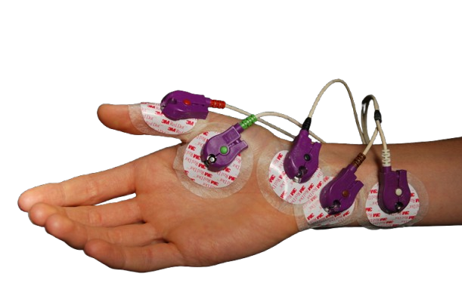
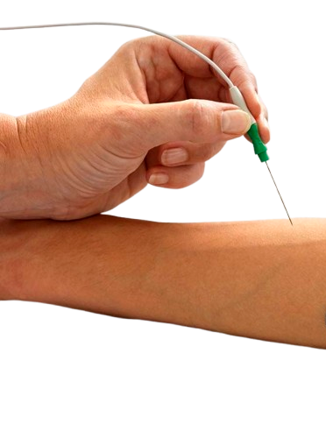
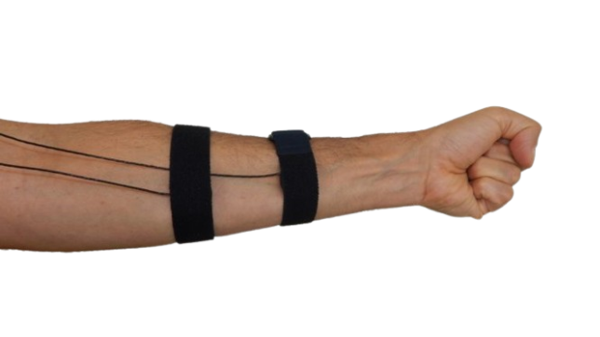
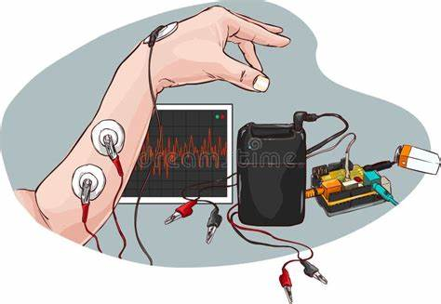
Background: EMG Signals
Electromyography (EMG): recording of the electrical activity produced by muscles during contraction.
EMG are used for gesture recognition in prosthetics and Human-Machine Interfaces.
Captured via surface (gelled/dry) or inserted (needle/fine-wire) electrodes.
[9]
[6]
[8]
[7]
Dry Electrodes
Needle Electrode
Gelled Electrodes
[7] Wikipedia, “Postoperative residual curarization”,https://en.wikipedia.org/wiki/Postoperative_residual_curarization (accessed June 20, 2025)
[9] Bestfoot 4 Ward Blog, “NCS VS EMG: What’s Needed for a CMT Diagnosis”, January 21, 2020, https://bestfoot4wardblog.com/2020/01/21/ncs-vs-emg-whats-needed-for-a-cmt-diagnosis/
[6] Depositphotos, “Experiment recording electrical impulses (EMGs - electromyograms) from muscles”, https://depositphotos.com/fr/vector/experiment-recording-electrical-impulses-emgs-electromyograms-muscles-vector-illustration-506786168.html
[8] Wearable Sensing, “Electromyography (EMG)”, product information page, https://wearablesensing.com/emg/ (accessed June 20, 2025)
Notes:
EMG, or Electromyography, are the signals recorded, from the muscles contraction.
These signals are key for gesture recognition, especially in prosthetics and human-machine interfaces
The acquisition of EMG signals can be done through different types of What we call electrodes :
We have
Gelled Electrodes [Image 1: Gelled Electrodes]: These are commonly used in clinical settings. They require a gel to ensure good contact with the skin.
Dry Electrodes [Image 2: Dry Electrodes]: These do not need gel and are more comfortable then gel electrodes. But they can be Sensitive to noise due to less stable contact.
Last is the
Needle Electrode [Image 3: Needle Electrode]: These involve inserting a fine needle into the muscle. They provide high localized and precise readings of muscle activity, typically used for medical puposes.
To get a deep understanding of these emg signals lets see how they are generated

Slide 6
Background: EMG Signal Generation
[10]
An alpha motor neuron (in the spinal cord) sends an electrical impulse (action potential) down its axon.
The action potential arrives at the neuromuscular junction.
Muscle fiber generates its own action potential.
EMG electrodes detect summed bioelectric potentials from activated muscle fibers.
Neuromuscular junction
[10] GetBodySmart (Scott A. Sheffield, MS), “Types of Neurons”, updated November 1, 2022, https://www.getbodysmart.com/nerve-cells/neurons-classification/
Notes:
It starts with an alpha motor neuron in the spinal cord sending an electrical impulse, or action potential, down its axon. This reaches the neuromuscular junction, as shown in the diagram, triggering the muscle fiber to produce its own action potential. EMG electrodes then detect the summed bioelectric potentials from all activated muscle fibers, forming the signals we analyze for gesture recognition.
So that was a resumed explanation on how are they generated and we reached the end of our background and intro section
The next section will be explained by my friend here

Slide 7
Problem Statement and Approach Motivation
2
Notes:
Now, let’s move to the Problem Statement and Approach Motivation, where we identify the challenges and our proposed solution.

Slide 8
Problem Statement and Approach Motivation
Challenges in EMG Gesture Recognition
High variability: muscle fatigue, motion artifacts, subject differences.
Noise: cross-talk and electrode noise reduce signal quality.
Impact: unreliable control challenges high-precision in Human-Machine Interfaces and prosthetics.
Notes:
EMG gesture recognition faces several challenges. High variability in signals comes from muscle fatigue, motion artifacts, and differences between subjects, making consistent recognition tough. Noise, such as cross-talk between muscles and electrode noise, further degrades signal quality. These issues lead to unreliable control, which is a major concern in high-precision applications like prosthetics and human-machine interfaces, where accuracy is critical.

Slide 9
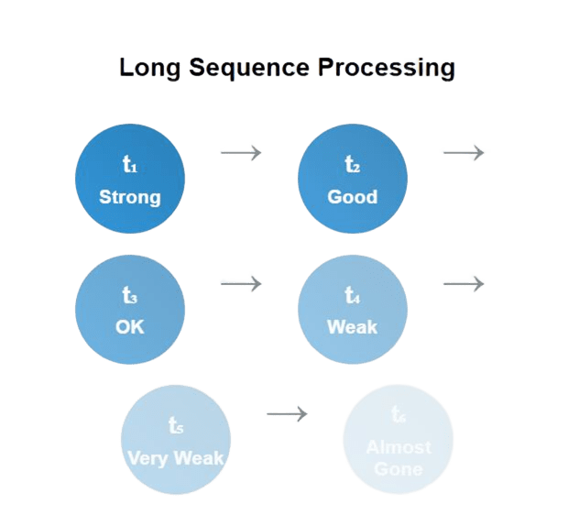
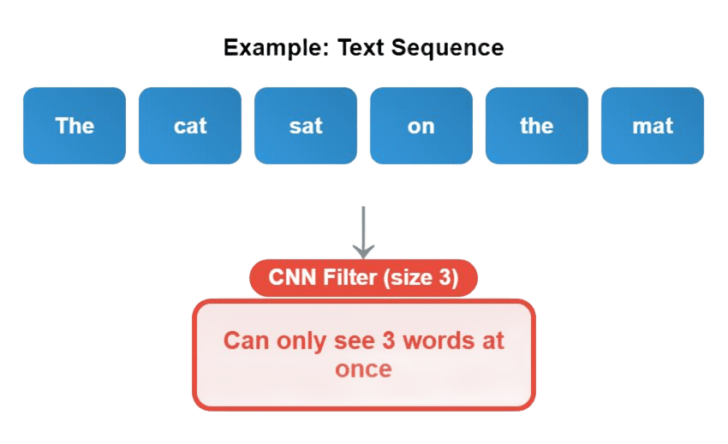
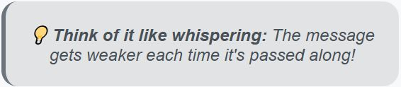
Problem Statement and Approach Motivation
Limitations of Traditional Approaches
CNNs: good for local patterns, weak for long-term signal relationships.
RNNs: struggle with long sequences due to vanish gradient.
Result: poor generalization and slow processing for real-time use.
Notes:
Traditional deep learning methods also have limitations. Convolutional Neural Networks, or CNNs, are good at capturing local patterns but struggle with long-term relationships in EMG signals.
Recurrent Neural Networks, or RNNs, are designed for sequences but strugle with long sequences due to gradient vanishing.
This results in poor generalization across subjects and lower overall classification accuracy, and also slow processing
Explanation of figures:
Cnn can process text also, each word is converted into a word embedding. Think of a word embedding as a dense, fixed-size numerical vector (e.g., a list of 50 or 100 numbers) that represents the meaning of the word. So it change it into numerical values( like images they are pixels numerical values).
Adapting Filters for 1D Data: 1D Convolutions
2D Filters for Images: In image CNNs, filters are typically 2D matrices (e.g., 3x3, 5x5). They slide across both the width and height of the image, performing dot products to extract features.
1D Filters for Text: For text, we use 1D convolutional filters. Instead of sliding across a 2D grid, these filters slide along the single dimension of the word sequence (i.e., along the sentence length).
Shape of a 1D Filter: A 1D filter for text would have a "width" (or kernel size) that determines how many consecutive words it looks at. For example, a filter of size 3 would look at three consecutive word embeddings at a time. The "depth" of the filter would match the dimensionality of the word embeddings.
Detecting N-grams/Phrases: As the 1D filter slides over the word embeddings, it's essentially looking for patterns in sequences of words.
A small filter (e.g., size 2 or 3) might learn to detect common bigrams or trigrams (e.g., "very good," "not bad," "financial crisis").
Larger filters might capture patterns across longer phrases.
Feature Maps: Each time a filter slides over a "window" of words, it computes a single value, indicating the presence or strength of the pattern it's designed to detect. As it slides along the entire sentence, it creates a "feature map," which is a sequence of these detected patterns.
For rnn I think its obvious

Slide 10
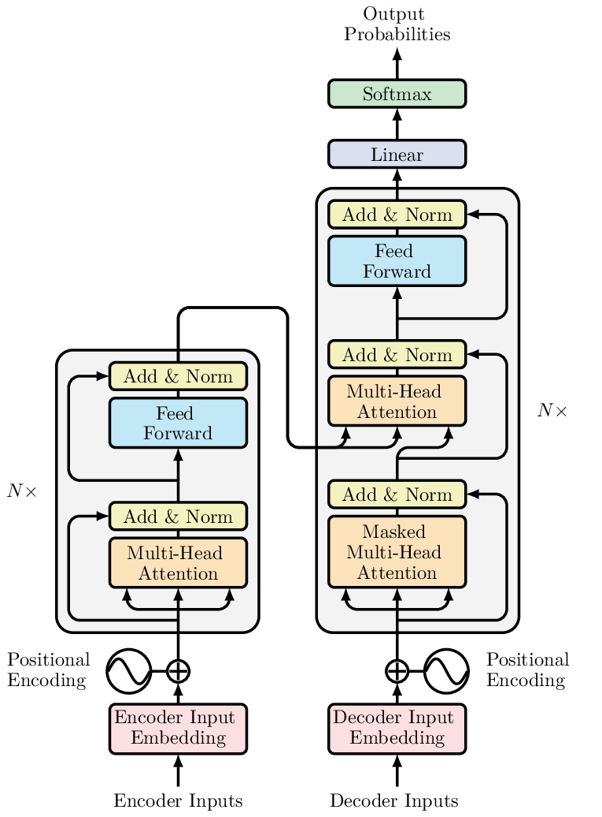
Problem Statement and Approach Motivation
Proposed Approach: Transformer Model
Proven in Natural language Processing (NLP).
Self-attention: could captures long-range dependencies in EMG signals, and weighs critical signal regions dynamically.
Parallel processing: faster data processing.
Notes:
To overcome these, we propose a Transformer model. Originally proven in Natural Language Processing and demonstrated state-of-the-art performance in various AI systems, including large language models like ChatGPT.
Transformers use a self-attention mechanism That allows the model to examine all parts of the input sequence simultaneously and determine which elements are most relevant to each other. This is ideal for EMG signals with complex temporal patterns.
also, their parallel processing capability speeds up computation, making them suitable for real-time use.

Slide 11
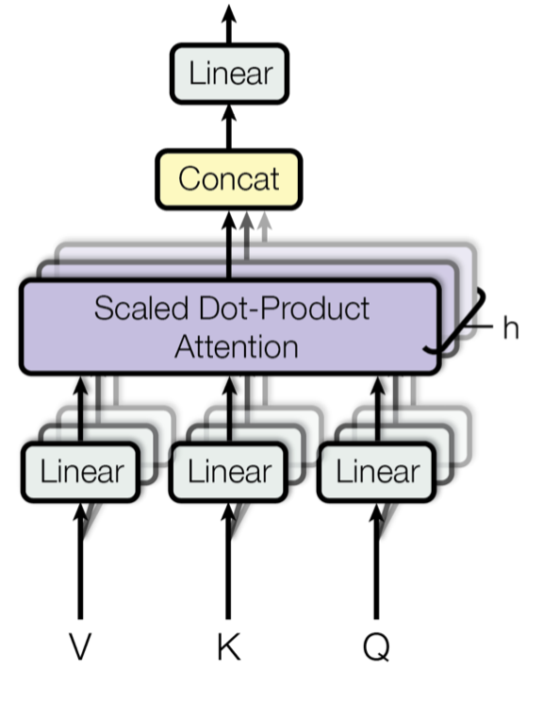
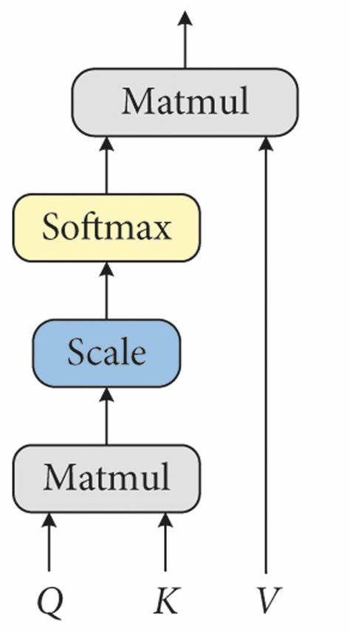
Transformer Architecture
scaled dot-product attention
Multi-head Attention

Slide 12
Methodology
3
Notes:
Now, let’s discuss our Methodology, detailing how we implemented this approach.

Slide 13
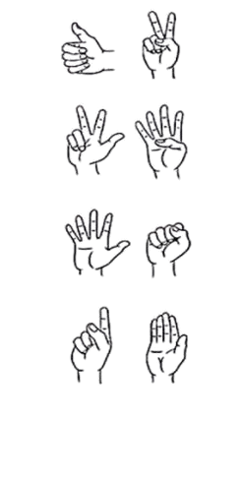
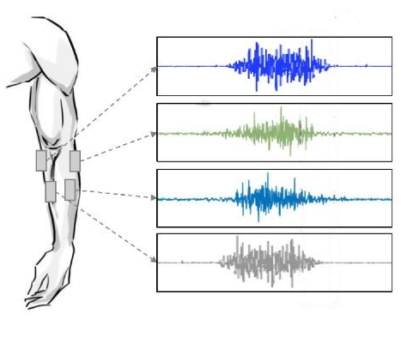
Methodology: Overview
Data
Pre-processing
Proposed Model
Hand Gesture Predictions
Data Collection
Notes:
Our methodology follows a structured pipeline. It begins with data preprocessing, where we clean and enhance the raw EMG signals. These processed signals are then passed into our proposed Transformer model, which predicts hand gestures. Now that we’ve seen the overview, let’s look at the dataset that feeds into this pipeline.

Slide 14
Methodology: Dataset Used
Database: NinaPro DB2
Largest public EMG dataset for hand gestures.
Contain signals from 40 subjects.
15 gesture from basic finger/wrist movements for our model to predict.
Signal Details:
12 EMG channels.
Sampling Rate: 2 kHz.
Duration: 5s per gesture, 3s rest, 6 repetitions.
Notes:
We used the NinaPro DB2 dataset, the largest public EMG dataset for hand gestures. It includes data from 40 subjects performing 15 basic finger and wrist movements, which our model aims to predict. Each gesture lasts 5 seconds with 3 seconds of rest, repeated 6 times, captured via 12 EMG channels at a 2 kHz sampling rate. This rich dataset gives us a robust foundation for testing

Slide 15
15 Target Gestures for Classification
1.Thumb up
2.Two-finger point
3.Ring/little flexed, others extendeds
4.Thumb to pinky base
5.Abduction of all fingers
6.Closed fist
7.Pointing index
8.Adduction of extended fingers
9.Wrist supination
10.Wrist pronation
11.Wrist flexion
12.Wrist extension
13.Wrist radial deviation
14.Wrist ulnar deviation
15.Wrist extension with closed hand

Slide 16
Methodology: Data Pre-processing Steps
Data Splitting
Normalization
Data Splitting: divide data per subject using repetition ID. Train: Reps 1,2,4,6 Test: Reps 3,5.
Normalization: scale EMG amplitudes across all 12 channels with Z-score.
Bandpass Filtering (20–500 Hz): 4th-order Butterworth filter, with cuttoff : 20 Hz (high-pass), 500 Hz (low-pass).
Notch Filtering (50 Hz): 10 Hz bandwidth centered at 50 Hz.
Windowing: segment continuous signals into fixed-length slices of 150ms windows, with stride of 100ms.
Bandpass Filter
Notch Filter
Windowing
Notes:
Pre-processing is critical for signal quality. We began by splitting the data per subject using repetition IDs: repetitions 1, 2, 4, and 6 for training, and 3 and 5 for testing.
Then, we normalized the EMG amplitudes across all 12 channels using Z-score normalization.
To clean the signal further, We applied a bandpass filter from 20 to 500 Hz with a 4th-order Butterworth filter to remove irrelevant frequencies, followed by a notch filter at 50 Hz with a 10 Hz bandwidth to cut power line interference which can be for example arise due to electrode impedance mismatch.
Finally, we segmented the signals into 150 ms windows with a 100 ms stride generating overlapping sequences of 50 ms for model input.

Slide 17
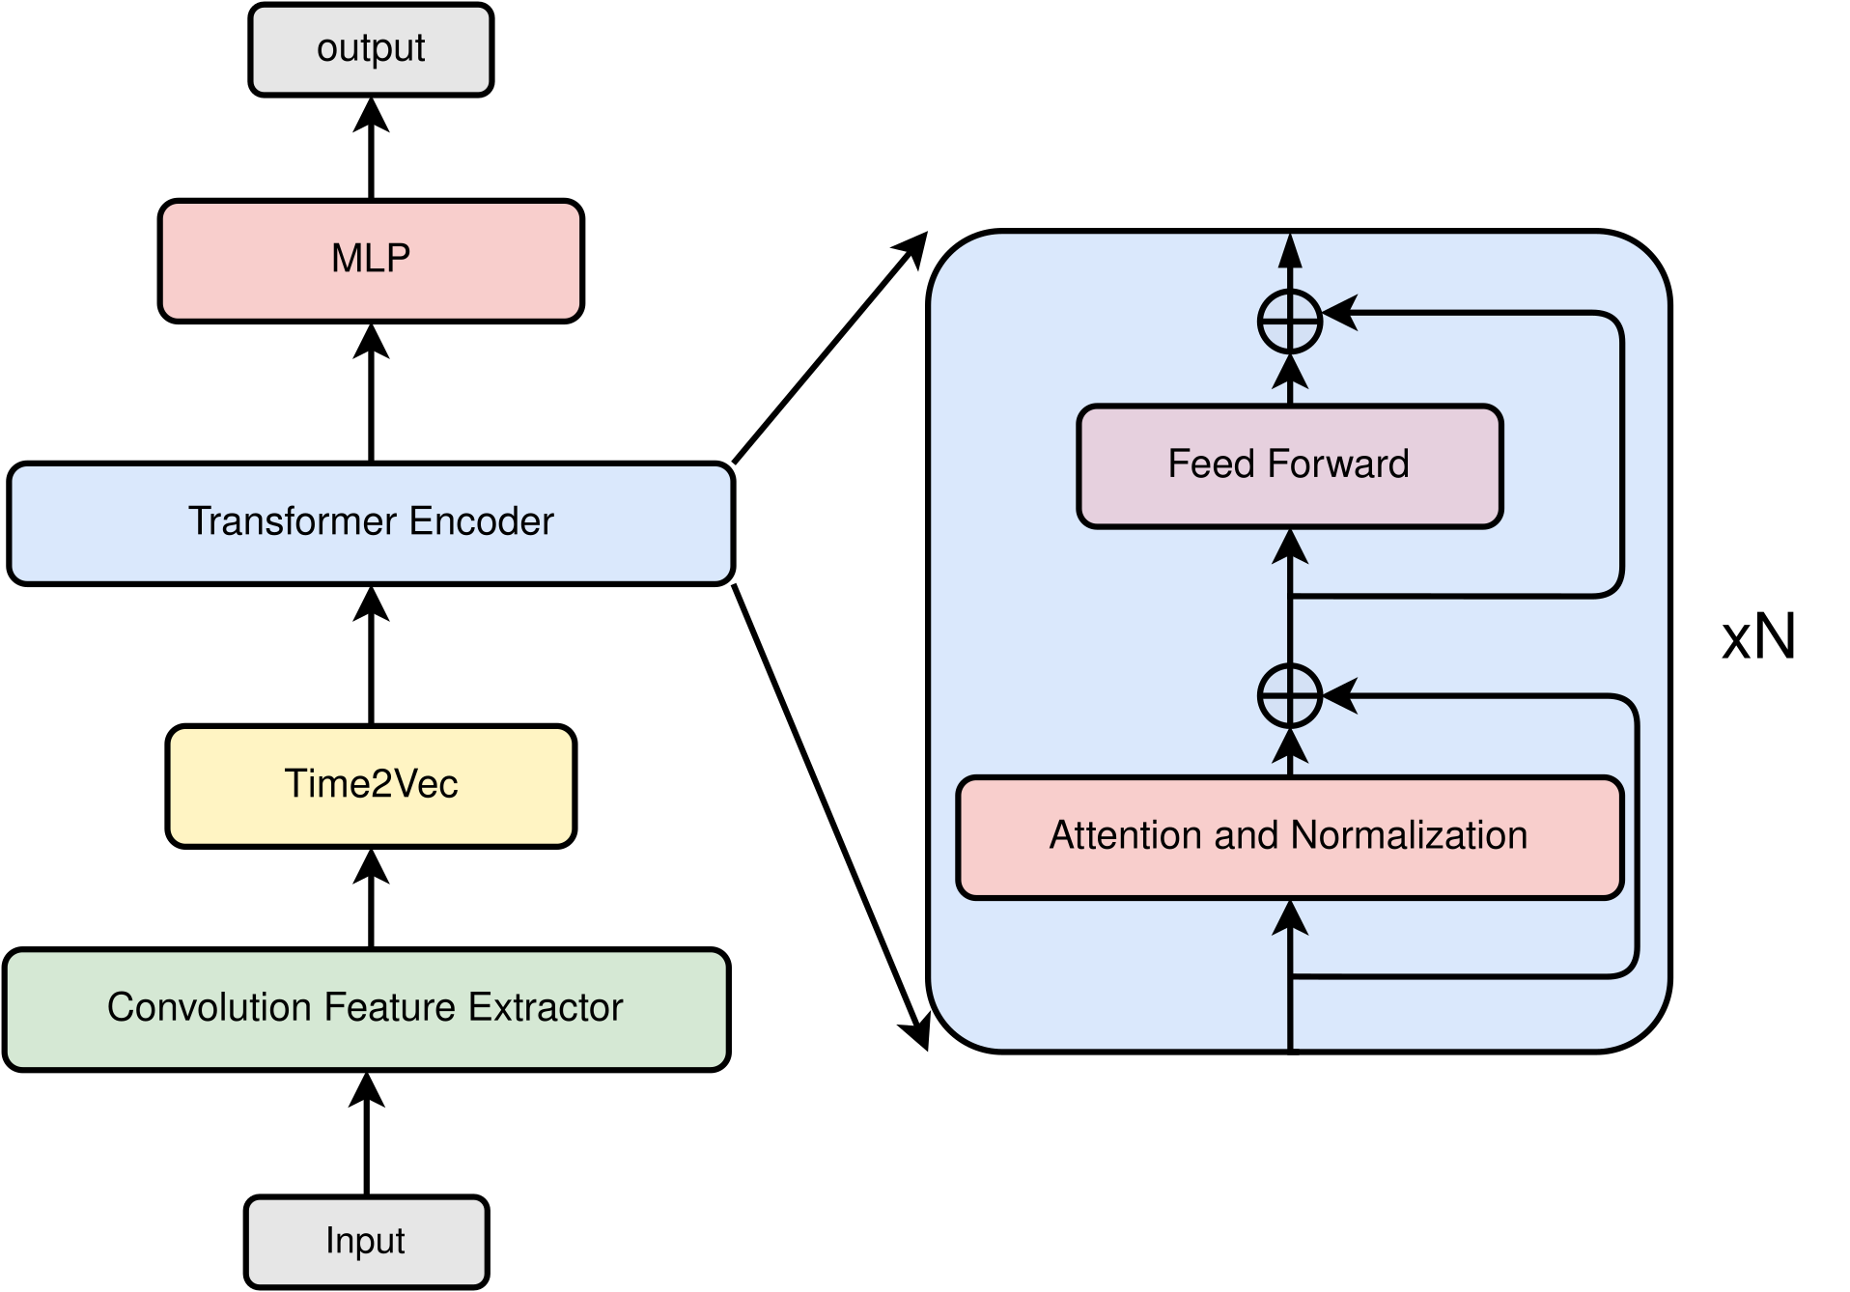
Methodology: Proposed Model
Proposed Model Architecture
No decoder block.
Capturing local patterns using convolutional layer by what we named as Convolutional Feature Extractor.
Time2Vec encoding that learns temporal context (linear + cyclical trends).
Classification head to classify the hand gestures.
Notes:
Now, let's move to the core of our work: our proposed model, Unlike the standard model, we omit the decoder since we are trying classify gesture, and not generating sequences. We use what we called a Convolutional Feature Extractor where we used convolutional layer to to capture local patterns.
We also used Time2Vec which is a method for encoding temporal information into a vector representation, which will help us to preserve temporal context of the emg signal.
Finally, We also added a classification head to outputs the predicted gestures.

Slide 18
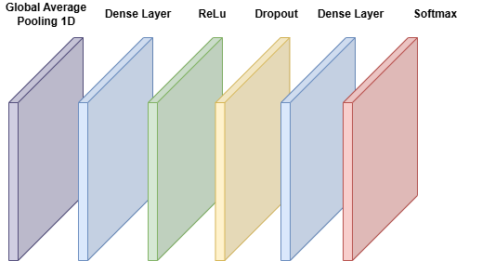
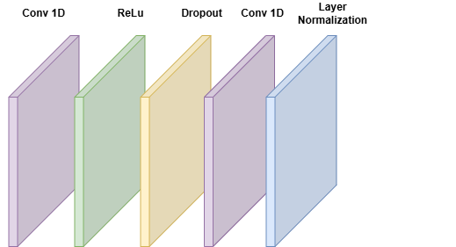
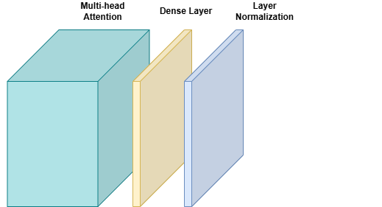
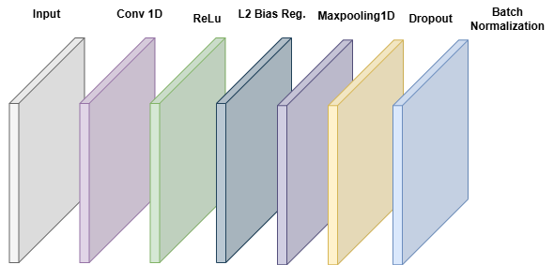
Proposed Model Architecture in Details

Slide 19
Evaluation and Results
4
Notes:
Now with our model architecture defined and the preprocessing pipeline in place, the next step is to test its performance.

Slide 20
Evaluation and Results
Evaluation Metrics for Model Performance
Overall Accuracy (ACC): percentage of correctly classified predictions across entire dataset.
Confusion Matrix: visual representation of model predictions vs actual classes.
Matthews Correlation Coefficient (MCC): balanced metric for binary classification quality.
Range -1 to +1:
+1: Perfect classifier
0: Random performance
-1: Total disagreement
Notes:
But before that lets go through the metrics that are used to evaluate our model performance
Overall accuracy, or ACC, measures the percentage of correct predictions. The confusion matrix visually compares predicted versus actual classes, showing where errors occur. The Matthews Correlation Coefficient, or MCC, ranges from -1 to +1: +1 is perfect, 0 is random, and -1 is total disagreement, offering a balanced quality metric.
In our case, the overall accuracy represents the model’s average accuracy across all subjects.

Slide 21
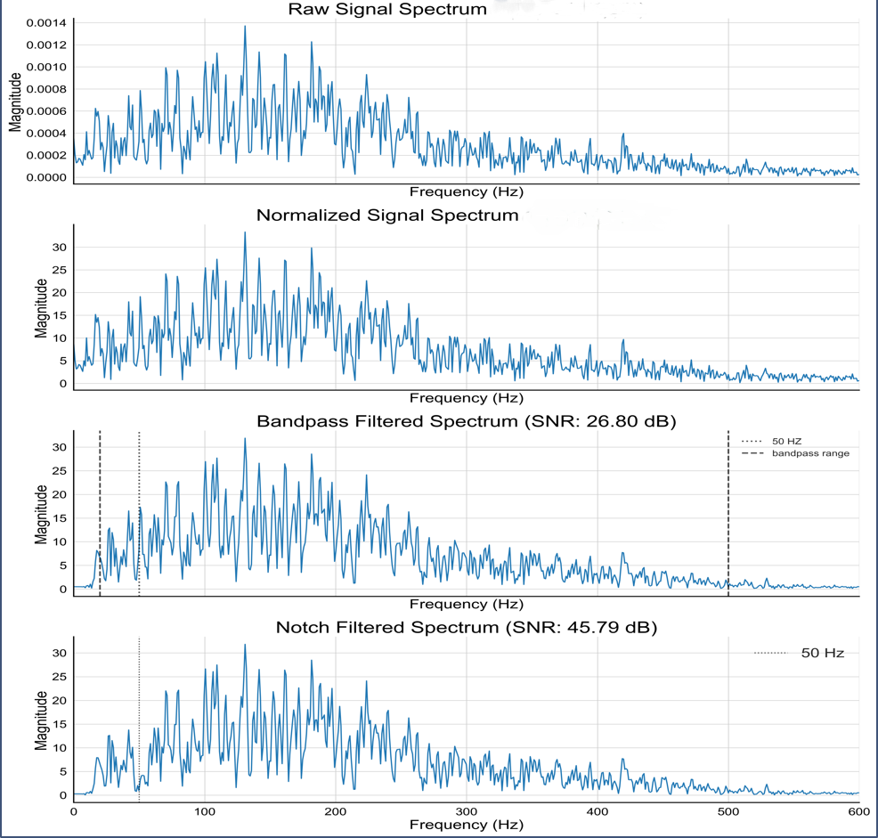
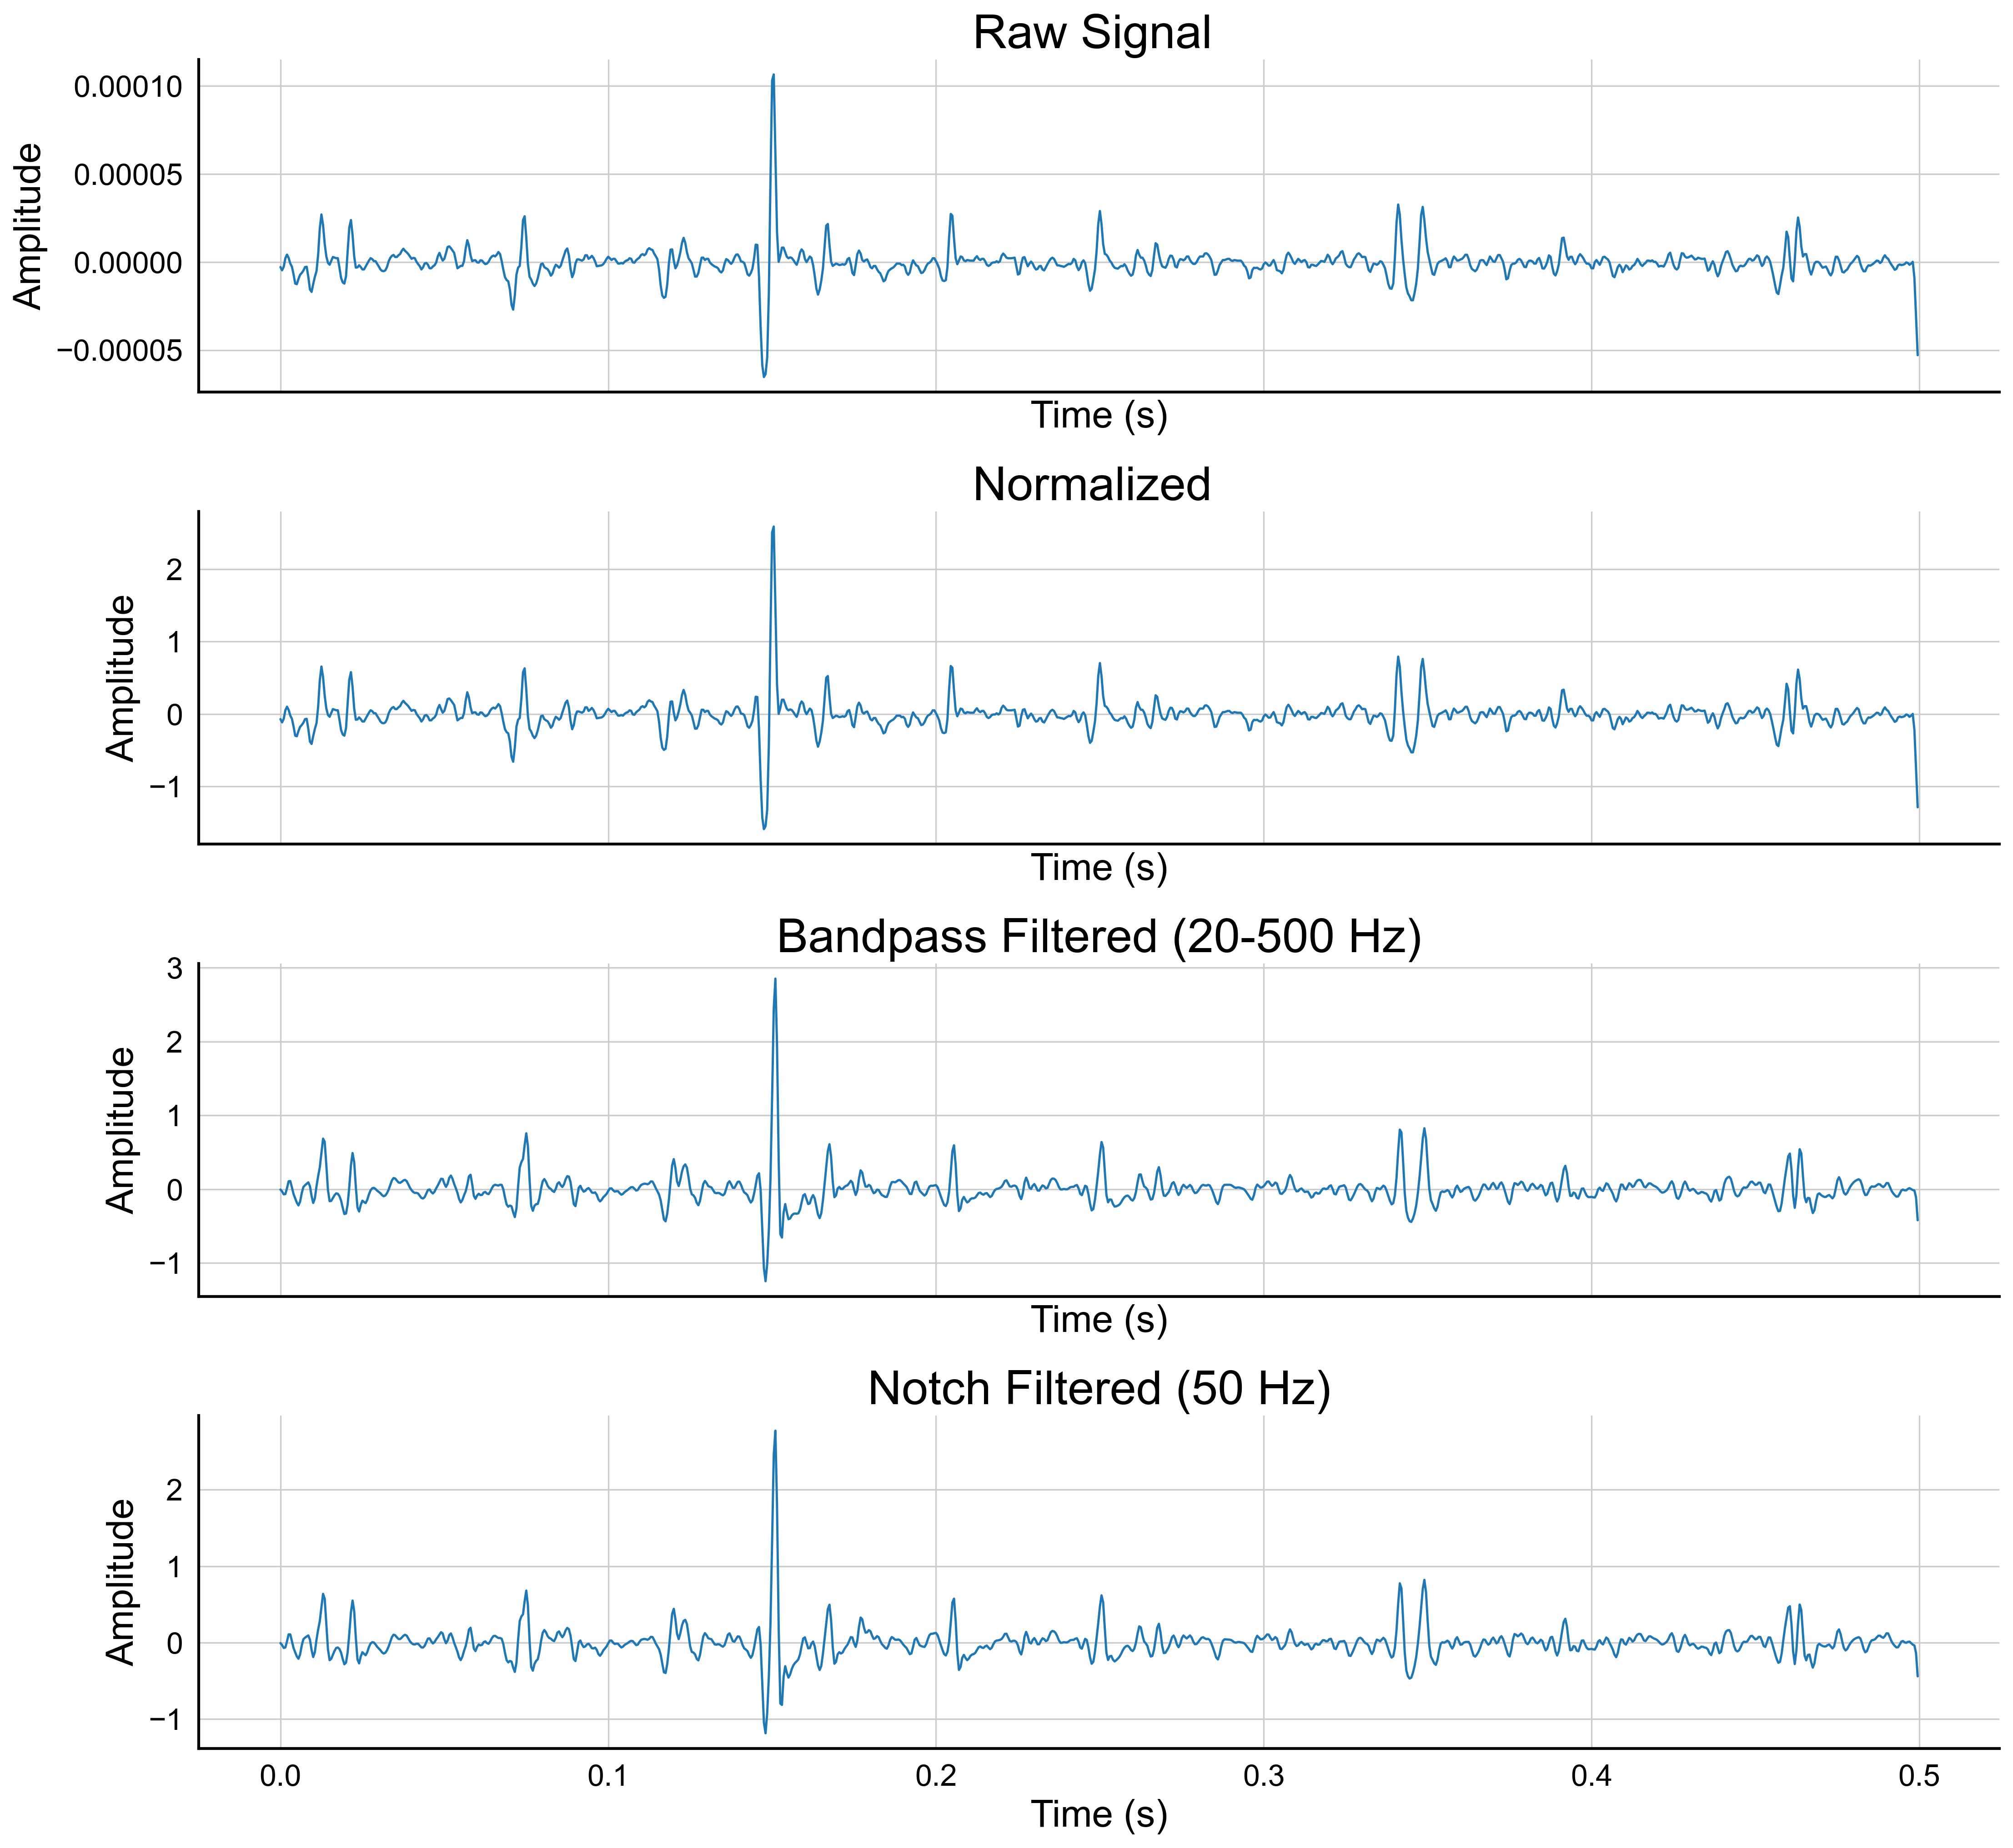
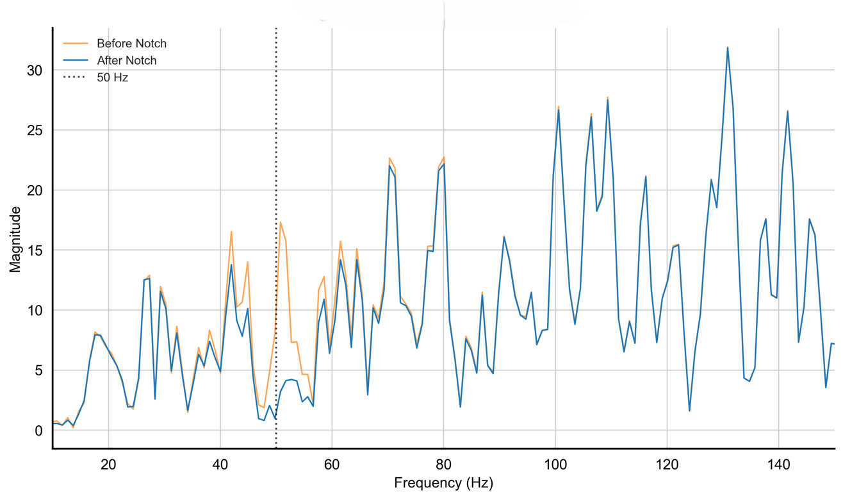
Effects of the Pre-processing Techniques on the Signal
Close-up of Notch Filter Effect
Notes:
So We’ll start by visually showing how preprocessing affects the signal itself to understand how our preprocessing pipeline enhances the EMG signals
, then we move on to the model’s performance along with the numerical impact of the preprocessing techniques.
(Click to show first figure)
(Point at the figure) this figure demonstrates the time domain representation of EMG signal at different
pre-processing stages. The figure shows only the first 1000 sample from channel 0 of the first subject.
As we can see, its clear from the amplitude that the normalization scaled the raw data. However, the noise remains, showing that normalization adjusts amplitude without reducing noise.
Now In order To clearly see the effect of the filters lets switch to the frequency domaine, Here, we have the frequency spectrum of the same signal.
As we can see The filter has successfully reduced frequencies outside the bandwidth ( point at the range 20hz and 400hz).
The notch filter created a clear reduction in the signal power at precisely 50 Hz.
( click to show next fig close up 50hz)
This reduction is clearly showed here in this graph as we can see.
Now that we’ve seen how preprocessing affects the signal visually, let’s move on to how it influences model performance. So we will compare the model final performance on the preprocessed data against the model performance on the raw data.

Slide 22
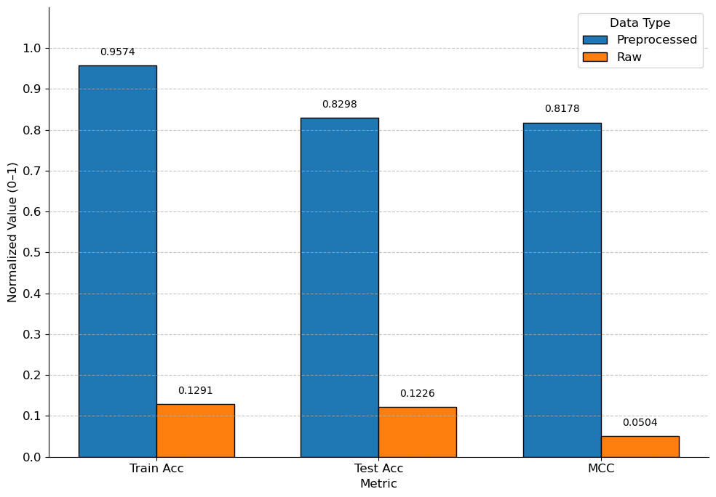
Evaluation and Results
Model Performance and Impact of the Pre-processing Techniques
Model Behaviour on Raw Data:
Test vs. train accuracy nearly identical (12.26 % vs. 12.91 %)
Indicates inability to learn.
MCC ≈ 0 (0.0504) confirms mostly random predictions.
Metric | Pre-processed | Raw | Gain
Avg.Test Acc. (%) | 82.98 | 12.26 | +70.72
Avg.Train Acc. (%) | 95.74 | 12.91 | +82.83
Avg. MCC | 0.8178 | 0.0504 | +0.7674
Notes:
On raw data, the model achieved just 12.26% test accuracy, this poor performance is probably due to noise and artifacts. We can also see that the train data is also low and almost identical to the test one, meaning that the model didn’t probably even learn on the raw data. The MCC also is almost 0 showing that the model predictions were random.
in contrast, after applying the preprocessing techniques, the avg train accuracy jumped to 82.98%, a 70.72% improvement, as shown in the table.
The train accuracy also improved with 82.83%, and the MCC teached 0.88, near 1, proving that the model performance is reliable.
This results shows the crucial role of the pre-processing pipeline for ehnahncing the signal quality and improving model performance. Now lets take a look to how we did optimaze the model to reach our final model performance

Slide 23
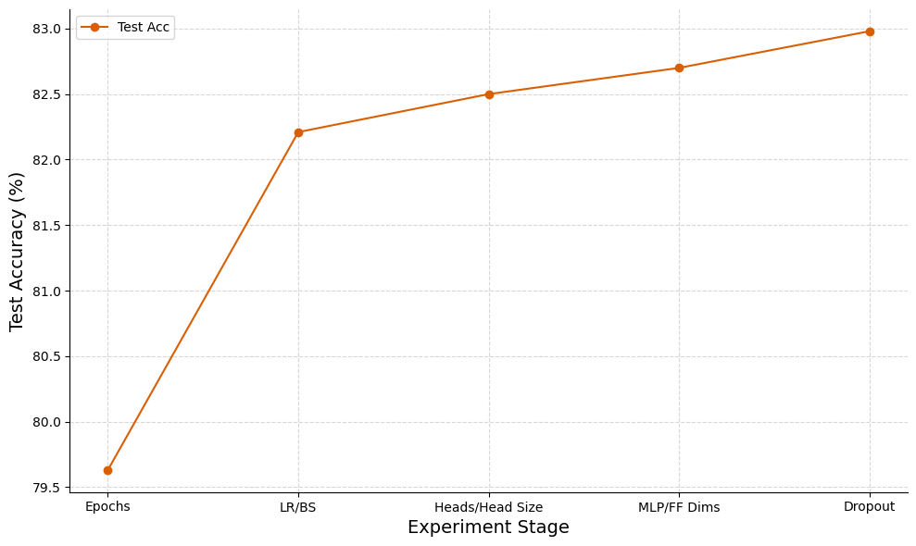
Evaluation and Results
Model Hyperparameter Tuning
Epochs tuning: 79.78 % test accuracy with default settings.
LR & Batch Size tuning: Jump to 82.21 % (+2.43 %)
Attention heads/size: Further to 82.50% (+0.29 %)
MLP/FF dimensions: Up to 82.70 % (+0.20 %)
Dropout adjustment: Peaks at 82.98 % (+0.28%)
Notes:
This graphs shows test accuracy improvements.
starting from the initial setup, we adjusted epochs, learning rate and batch size, attention heads and the size of each head, the mlp and the feed forward dimension and finally the dropout.
We can see that at each step the accuracy has improved, showing the importance of optimization.
We move now to evaluate the model performance in more detail in order to .

Slide 24
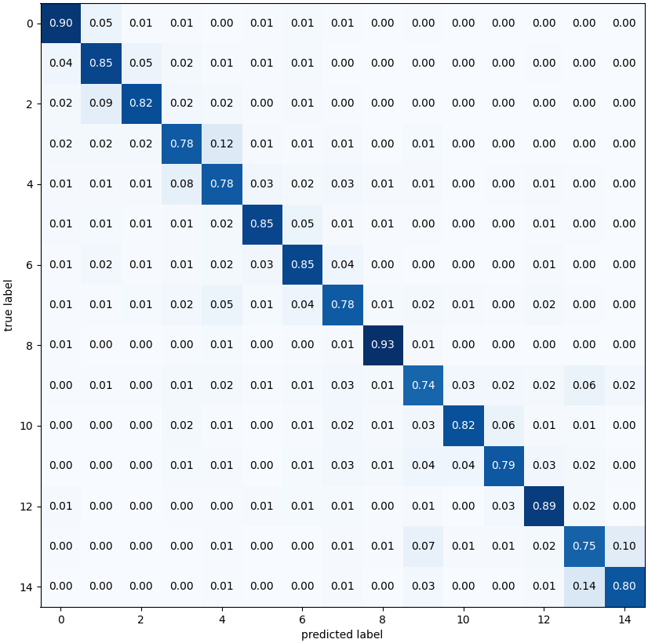
Performance Results of the Proposed Model
3
4
Gesture 3 ↔ Gesture 4 confusion:
12 % of true Gesture 3 → predicted as Gesture 4.
8 % of true Gesture 4 → predicted as Gesture 3.
Gesture 2 → Gesture 1 confusion:
9 % of true Gesture 2 → predicted as Gesture 1.
Gesture 14 ↔ Gesture 13 confusion:
14 % of true Gesture 14 → predicted as Gesture 13.
10 % of true Gesture 13 → predicted as Gesture 14.
Matrix overview:
row‑normalized 15×15 confusion matrix showing true‑label vs. predicted proportions.
High-performing classes (recall ≥ 0.80):
Gesture 8: 0.93
Gesture 12: 0.89
Lowest-performing classes:
Gesture 9: 0.74
Gesture 13: 0.75
2
1
8
12
14
13
9
13
Notes:
Here, we have the confusion matrix, which gives us a deeper look at how well the model distinguishes between different gesture classes.
The matrix highlights strong recognition for certain gestures, with gesture 8 achieving a recall of 0.93 and gesture 12 reaching 0.89.
However, we can also see some challenges with other gestures , such gesture 9 at 0.74 recall and gesture 13 at 0.75.
We can also see that some classes are sometimes misclassifie.
( point at the matrix and show the misclassification)
So overall, the confusion matrix shows that while the model performs very well on many gestures, there are still some misclassifications that are possibly due to similartiesi in signals or due to noise.
Tu further examine the model performance, escpecially across subjects
Go next slide

Slide 25
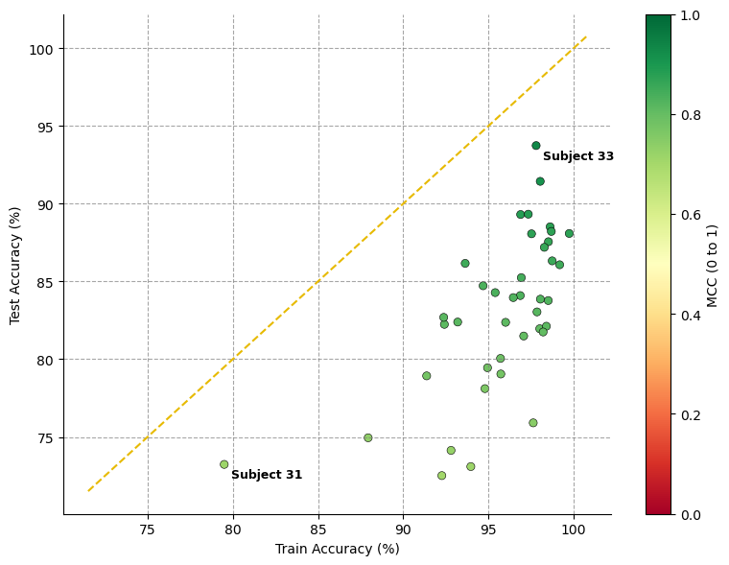
Performance Results of the Proposed Model
Figure overview:
X‑axis: training accuracy (left → right)
Y‑axis: test accuracy (bottom → top)
Color scale: MCC from 0 (random) to +1 (perfect)
Diagonal line: train = test accuracy; points far below indicate overfitting
Balanced performance visible: Greener (higher MCC) points cluster toward higher test accuracies, reflecting stronger classification.
Wide variability across subjects.
Subject 31 exception: Training accuracy for Subject 31 is only 79.5 %, suggesting the model struggled even on its own training data.
Some overfitting issues: Some subjects far below the line indicate overfitting.
Notes:
Lets look at this plot that show each subject test versus train accuracy, along with the MCC.
We can see that most subjects test accuracies are 80% and 95%, and between

Slide 26
Evaluation and Results
Model Time Complexity
Subject per-window timing: for each of the 40 subjects, compute train and test time per window by dividing total time by that subject’s number of windows.
Average time per-window: average those per‑window times across all subjects to yield overall train and test timings.
Reminder: windows are 150 ms long with a 100 ms stride (as noted earlier).
Notes:
we’re now going to look at computational efficiency which is important for real-time EMG gesture recognition. We’ll do this by measuring the average training and testing time per window for all 40 subjects in our dataset. For each subject, we’ll divide their total training and testing time by the number of windows in their sets to get per-window times. Then, we’ll average those times across all subjects.

Slide 27
Evaluation and Results
Model Time Complexity
67.63 min train vs 1.31 min test
101.45 s train / 1.96 s test per subject
46.48 ms train / 1.86 ms test per 150ms window
Window times vary by subject
Metric | Training Time | Testing time
Total Time Across Subjects (min)
Average Total Time per Subject (s)
Average Time per Window (s)
Per-Window Time Range (s)
67.63
101.45
0.046484
0.033262
–
0.068706
1.31
1.96
0.001862
0.000191
–
0.003369

Slide 28
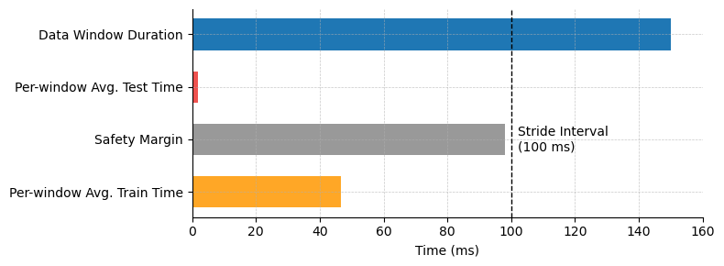
Evaluation and Results
Model Time Complexity
150 ms window vs 1.86 ms processing.
100 ms stride → ~98 ms spare time.

Slide 29
Evaluation and Results
Model Performance Comparison
The model performance is compared against three other models: CNN-1D, CNN-2D, and CNN-LSTM.
The models were tested on the same dataset, on all the 40 subjects and the same 15 hand gestures.
Comparison focus on the test accuracy and Matthews Correlation Coefficient (MCC), and model complexity as indicated by the total and trainable parameters.

Slide 30
Evaluation and Results
Model Performance Comparison
Highest test accuracy & MCC among all models.
consistent (lowest test‑accuracy SD).
Tight performance spread across subjects.
Superior accuracy with only ~128K parameters.
Demonstrates transformer efficiency in temporal learning.
Metric | Proposed Model | CNN-1D | CNN-LSTM | CNN-2D
Avg. Test Acc. (%)
Avg. MCC
Total Parameters
Trainable Parameters
82.98 ±5.34
0.8178
128,536
128,408
75.35 ±5.93
0.7379
47,536
47,408
73.79 ±6.19
0.7216
444,176
443,664
73.12 ±6.48
0.8009
342,256
342,256

Slide 31
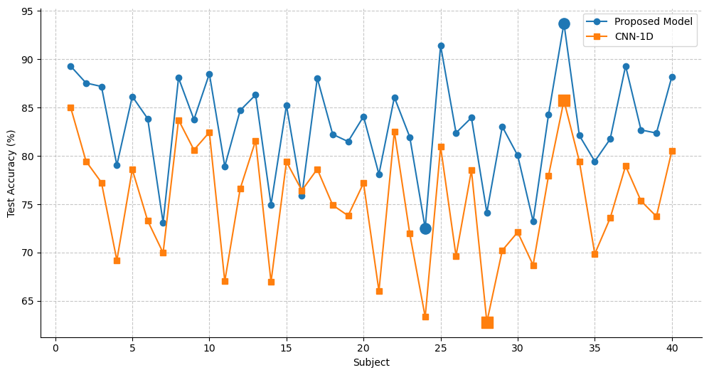
Evaluation and Results
Proposed Model vs. CNN-1D Subject-wise Performance
Proposed model curve always above CNN‑1D, indicating better average performance.
Both models excel on clean‑signal subjects (1–3, 8–10, 33), but proposed never falls below 72.52 % (robustness)

Slide 32
Conclusion
5

Slide 33
Conclusion
✔
Our Transformer-based Approach For Hand Gesture Recognition Through EMG Signals achieved:
82.98 % test accuracy and 0.8178 MCC with tuned model.
Real-time inference: 1.86 ms avg. test time per window.
Confirms Transformer as a robust solution for EMG-based gesture classification.
Comparison:
Outperformed CNN-1D, CNN-2D, and CNN-LSTM on accuracy and efficiency.
Efficient architecture: 128K parameters vs. 342K– 444K in baseline models.
Captures temporal & global context better than traditional deep models.
Future Work:
Strong base for future improvements: generalization & hybrid models.

Slide 34
Thank you for your Attention!

