Slide 1
When Conceptual Models Collide
Aggregates in IFLA’s Library Reference Model Jacob Jett and David Dubin
Conceptual Models in Digital Libraries, Archives, and Museums Workshop
JCDL ‘19, Urbana-Champaign, IL, 6 June 2019

Slide 2
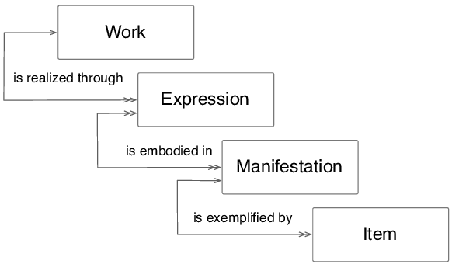
Summary of the Problem in Four Parts
IFLA’s Library Reference Model clarifies the Work-Expression-Manifestation-Item (WEMI) model first deployed in FRBR .
Conceptual Models in Digital Libraries, Archives, and Museums Workshop
JCDL ‘19, Urbana-Champaign, IL, 6 June 2019

Slide 3
Summary of the Problem in Four Parts
But LRM manifestations are modeled with a different approach than LRM works, expressions, and items.
Manifestation
element of
Item
Conceptual Models in Digital Libraries, Archives, and Museums Workshop
JCDL ‘19, Urbana-Champaign, IL, 6 June 2019

Slide 4
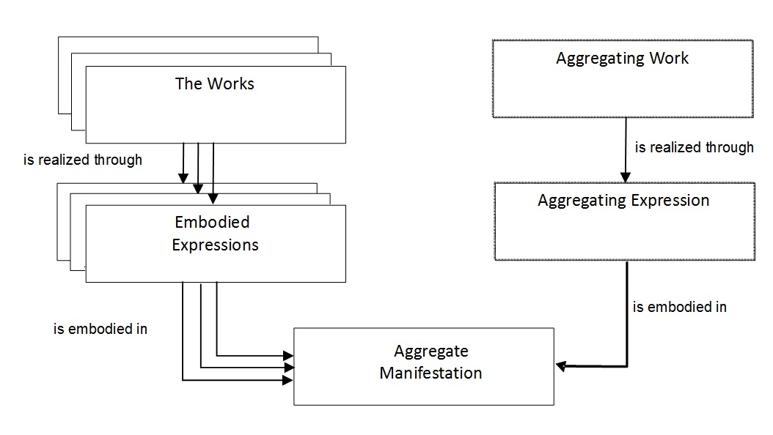
Summary of the Problem in Four Parts
This difference poses consistency problems for the modeling of bibliographic aggregates, which LRM declares to be a kind of manifestation.
Conceptual Models in Digital Libraries, Archives, and Museums Workshop
JCDL ‘19, Urbana-Champaign, IL, 6 June 2019

Slide 5
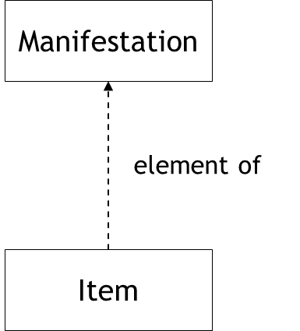
Summary of the Problem in Four Parts
Those problems invite us to revisit the role of conceptual models in metadata standards
Conceptual Models in Digital Libraries, Archives, and Museums Workshop
JCDL ‘19, Urbana-Champaign, IL, 6 June 2019

Slide 6
FRBR
In FRBR the Group 1 entities were defined primarily by their participation in realization, embodiment, and exemplifcation relationships .
For example, a FRBR expression is a realization of a work.
Cardinality constraints: a manifestation may embody multiple expressions, but an expression may realize only one work and an item may exemplify only one manifestation.
Work
is realized through
Expression
Conceptual Models in Digital Libraries, Archives, and Museums Workshop
JCDL ‘19, Urbana-Champaign, IL, 6 June 2019

Slide 7
A narrower interpretation of WEMI
A work is the intellectual or artistic content of a distinct creation.
An LRM expression is an abstract combination of signs that convey intellectual or artistic content.
An LRM item is a physical object that carries meaningful signs.
But an LRM manifestation is a set of carriers sharing relevant physical and intentional properties.
This exception recalls the reductionist model of bibliographic entities proposed by Elaine Svenonius .
Conceptual Models in Digital Libraries, Archives, and Museums Workshop
JCDL ‘19, Urbana-Champaign, IL, 6 June 2019

Slide 8
Manifestation attributes
Attributes at the LRM manifestation level, such as physical extent and type of material, aren’t properties of sets.
LRM avoids this problem by defining the domain of those properties to the elements rather than the set itself.
To say that a particular manifestation has, for example, a physical extent of one hundred pages or twenty centimeters is to count those among the physical properties common to the manifestation’s items/elements.
Conceptual Models in Digital Libraries, Archives, and Museums Workshop
JCDL ‘19, Urbana-Champaign, IL, 6 June 2019

Slide 9
Aggregates as manifestations
LRM defines an aggregate as "a manifestation embodying multiple expressions." This is in contrast to approaches that model aggregation as a whole/part relationship.
Whole/part relationships in LRM are reserved for combinations of entities that don’t carry distinct works. For example, a novel may have a chapter as a proper part, but a short story is not a part of the anthology in which it is published.
Conceptual Models in Digital Libraries, Archives, and Museums Workshop
JCDL ‘19, Urbana-Champaign, IL, 6 June 2019

Slide 10
Serial works and their manifestations
Manifestations of serial works have issue level manifestations as proper parts. We’re told that "the manifestation constituting the complete serial as a whole is issued in a sequence of parts over time, in a whole/part relationship at the manifestation level ." [2]
Conceptual Models in Digital Libraries, Archives, and Museums Workshop
JCDL ‘19, Urbana-Champaign, IL, 6 June 2019

Slide 11
Cardinality Problem
All manifestations are sets of items.
Therefore LRM issue (or volume) manifestations must be subsets, not elements of series-level manifestations.
So a copy of an issue will be an element of more than one manifestation set.
But items aren’t allowed to exemplify more than one manifestation.
Manifestation
is exemplified by
Item
Conceptual Models in Digital Libraries, Archives, and Museums Workshop
JCDL ‘19, Urbana-Champaign, IL, 6 June 2019

Slide 12
Manifestation level attributes
The basis for manifestation attributes are properties common to the items. But some features of aggregates relevant to ongoing stewardship aren’t common to the items in the manifestation set.
For example, issues of a serial are ordered, but that order obtains among the issues; it’s not common to the issues (and sets aren’t ordered).
The run of a journal takes up some amount of shelf space, but issue thickness (unlike width and height) typically isn’t consistent.
Conceptual Models in Digital Libraries, Archives, and Museums Workshop
JCDL ‘19, Urbana-Champaign, IL, 6 June 2019

Slide 13
Editorial content?
Some information concerning these features could be considered the content of a serial work, recorded in expression-level editorial signs like volume and issue numbers. But those wouldn’t be manifestation level attributes, and aggregates are supposed to be manifestations.
Conceptual Models in Digital Libraries, Archives, and Museums Workshop
JCDL ‘19, Urbana-Champaign, IL, 6 June 2019

Slide 14
What basis should a model contribute to a standard?
We don’t mean to suggest that a system based on LRM can’t record order relations for a serial or physical extents like shelf space.
But guidelines for how those should be handled would seem to require either stipulations in an encoding standard or judgment calls from system designers: the conceptual model offers no basis for them.
The infelicities we’ve identified invite us to think more carefully about the roles conceptual models are supposed to contribute to standardization.
Conceptual Models in Digital Libraries, Archives, and Museums Workshop
JCDL ‘19, Urbana-Champaign, IL, 6 June 2019

Slide 15
References
[1] IFLA Study Group on the Functional Requirements for Bibliographic Records 1998. Functional Requirements for Bibliographic Records, Final Report. De Gruyter Saur.
[2] Riva, P. et al. 2017. IFLA Library Reference Model A Conceptual Model for Bibliographic Information. International Federation of Library Associations; Institutions.
[3] Svenonius, E. 2000. The intellectual foundation of information organization. MIT Press.
[4] Wickett, K. and Renear, A. 2009. A first order theory of bibliographic objects. Proceedings of the American Society for Information Science and Technology. 46, 1 (2009), 1–8.
Conceptual Models in Digital Libraries, Archives, and Museums Workshop
JCDL ‘19, Urbana-Champaign, IL, 6 June 2019

