Slide 1


HALISI
APP
By Halisi Group
For GOMYCODE HACKATHON
SEPTEMBER 2026

Slide 2
TABLE OF CONTENTS
01
Introduction
05
Who’s Halisi For?
02
The Problem
06
The Team
03
The Solution
07
Impact & The Road Ahead
04
How It Works

Slide 3

INTRODUCTION
Halisi is an AI-powered brand impersonation detection platform that helps Kenyan businesses identify fraudulent accounts, websites and payment details pretending to be them.
Developed by a passionate team of developers, Halisi aims to reduce online fraud and protect both businesses and their customers from the growing threat of digital impersonation. By analysing multiple signals such as visual identity, account information, language and payment details, Halisi helps businesses detect potential threats and take action before they cause further harm.

Slide 4
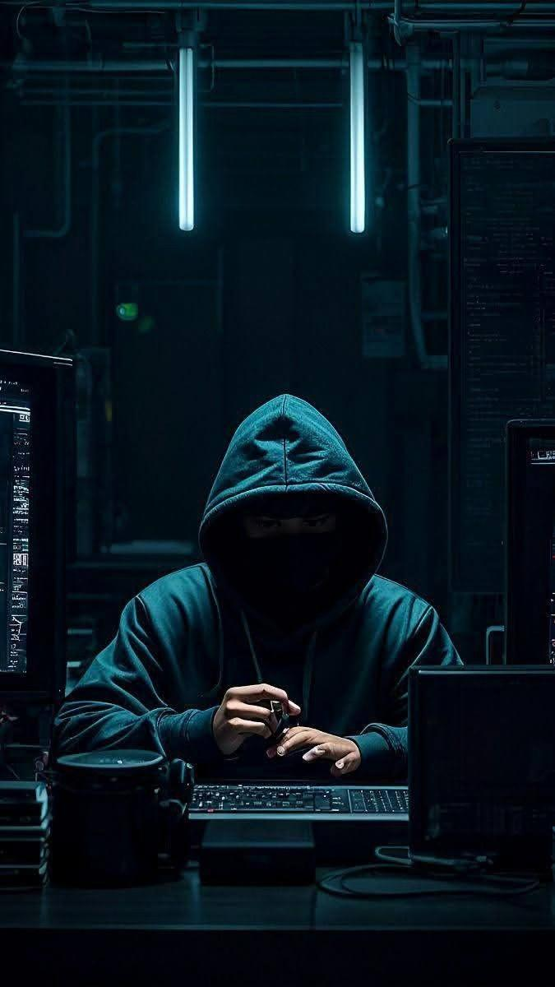
THE PROBLEM
Online Impersonation
Fake social media accounts and pages use lookalike branding and usernames to impersonate legitimate businesses. They trick unsuspecting users and potential customers into making fraudulent payments through personal M-Pesa accounts, Till numbers, Paybill numbers, or Pochi La Biashara.
This creates a serious problem for legitimate businesses because affected customers may believe they have been scammed by the actual business, damaging its reputation and eroding customer trust.

Slide 5




THE SOLUTION
Detect, Compare, Analyse & Report
The Halisi App uses AI to detect suspicious impersonation attempts by comparing usernames, handles and visual identities across social media platforms. It also checks page content for M-Pesa numbers, Till numbers, Pochi La Biashara details and Paybill numbers.
Halisi analyses language and other scam related signals, combining them into an overall threat assessment. Instead of simply flagging a page as suspicious, it provides a detailed report with evidence and actionable recommendations to help businesses respond to the threat.

Slide 6


TARGET
Identify the page or account being investigated.
Halisi takes a social media page, account or website suspected of impersonating a legitimate business and begins collecting relevant information
HOW IT WORKS
DATA EXTRACTION
FROM SIGNAL TO VERDICT
Extract the information needed for verification.
Halisi collects usernames, handles, visual elements page content and payment details such as M-Pesa numbers, Till numbers, Paybill numbers and Pochi La Biashara details
Halisi analyzes the digital identity of a business across multiple signals, combining visual, identity, payment and language evidence into a single confidence-based assessment.
SIGNAL ANALYSIS
Compare and analyse the extracted information.
The system compares visual identity, usernames and other account details while analysing language and scam related signals to identify similarities and suspicious patterns.

Slide 7


COMPOSITE SCORE
Combine the signals into a single threat assessment.
Halisi weighs the different signals and generates an overall score that indicates how likely the account or page is to be impersonating the legitimate business.
VERDICT
Understand the evidence.
Halisi presents the signals behind the result, showing why the account was flagged and which pieces of evidence contributed to the assessment.
ALERT/ ACTION
Turn detection into action.
The result gives businesses a clear next step, helping them respond to suspected impersonation rather than discovering it only after customers have been affected.

Slide 8



WHO’S HALISI FOR?
Kenyan Merchants
Everyday Buyers
Platforms and consumer-protection responders
Small businesses selling on Instagram, Facebook and TikTok who get cloned — a fake page copies their logo, undercuts on price, and collects payment on a different Till or number. Halisi flags the clone and tells them what to do next.
Shoppers can't tell a real seller's page from a lookalike before they pay. Halisi lets them check a handle, Till, or Paybill before sending money.
Instagram, Facebook and TikTok trust-and-safety teams, plus bodies like KE-CIRT/CC, need evidence to act on impersonation reports — not just a complaint, but a hash match, a scored comparison, and a paper trail.

Slide 9
THE TEAM
01
Siganga Ndegwa
Frontend Application & Experience
02
Collins Kimanzi
Lead, Detection Engine, AI Remediation & Design Direction
03
Geoffery Obwocha
backend API, Data Ingeston & Alerts

Slide 10

IMPACT & THE ROAD AHEAD
  Every cloned page costs a merchant sales, and their customers real money sent to the wrong Till or number
  Halisi turns a manual, easy-to-miss comparison into a scored verdict in seconds, so a merchant or buyer can catch a clone before money moves

