Slide 1
Category review: Chips
June 2020
Retail Analytics
Brand note: If client logo is not required, use alternate title page layout right click slide thumbnail > Layout > Title

Slide 2
Notes:
To view Privacy video explaining how important data privacy is to Quantium, please click here: https://www.youtube.com/watch?v=Zq1QDAkoRzU
or here Q:\Company Reference\Brand & Design\Brand videos\Q Privacy.mp4
At Quantium, we believe that data is the behavioural footprint of humanity and that it has to be treated with the utmost care and responsibility.
Histories, attitudes, indeed lives are stored within it in ways that aren’t always apparent – and that’s what makes its potential so powerful.
To work with it responsibly, sensitively, we set ourselves the highest data privacy protection and governance standards.
We have spent 17 years perfecting privacy-by-design and secure-by-design principles. Central to this is not holding any personally identifiable information about people –
we neither receive it, and put the necessary protections in place to be unable to decipher it.
Every aspect of handling data is safeguarded: from its de-identification, to its encryption – data security is paramount and of the highest grade.
We pride ourselves on gaining the trust of iconic organisations around the world through years of securely working with their data,
and in turn the trust that builds with their stakeholders.

Slide 3
Executive summary
01
Chips analysis
Stores experience an increase in sales of chips leading up to Christmas, maxing out on Christmas even and returning to normal levels on Boxing day.
Pack size with highest purchase number is the 175g at 25 % of the total sales.
Mainstream Customers make up a bulk of the customers, but Older families on Budget make up the highest purchase numbers, followed by Young Mainstream Customers, and Mainstream Retires close out the top 3.
Kettle Doritos and Pringles are the most popular chips in that order.
02
Trial store analysis
The results for trial stores 77 ,86 and 88 during the trial period show a significant difference in at least two of the three trial months.

Slide 4
01
Customer Analysis

Slide 5
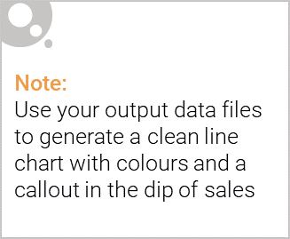
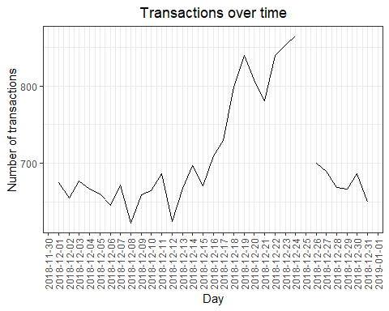
Sales over a one year period.
The increase in sales of chips start around mid December and max out on Christmas eve
before returning to normal levels.

Slide 6
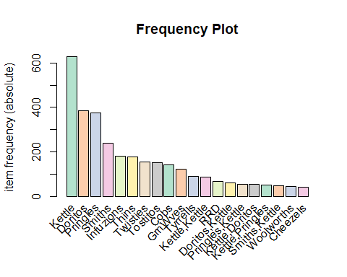
Chip type.
Kettle, Doritos and Pringles are the most popular with Smith coming in at fourth.

Slide 7
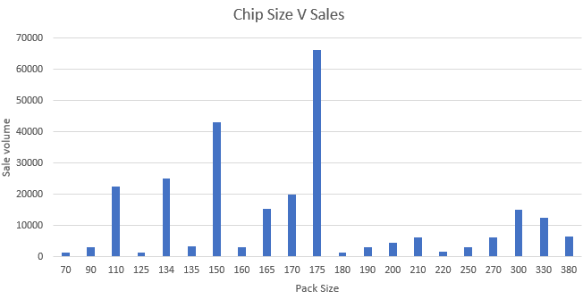
Top 3 most popular weights are 175 at 25%, 150 at 16 %, 134 at 9% of the total sales.
These make up half of all sales.

Slide 8

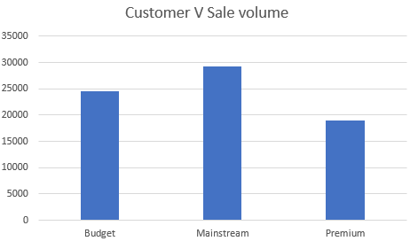
This slide will be commentary on affluence and its effect on consumer buying for the category of chips
Mainstream Families make up the largest faction of customers purchases.
With premium customers making up the lowest percentage of Chips consumer.

Slide 9
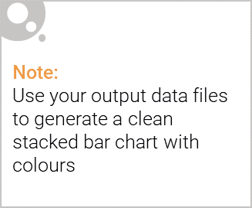
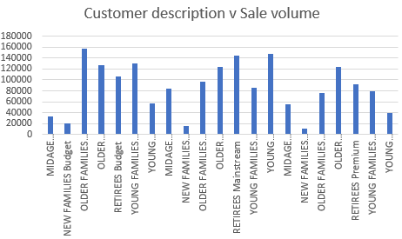
Editable (delete this)
Older families and retirees make up the majority of chips consumers. With Older Families Budget, Retirees Budget and Young budget consumer making the top 3.
.

Slide 10
Recommendations.
It is advisable to stock up before med-December as this is when the rise is sales begins.
Maintain a high stock of the most popular chips:Kettle, Smiths, Doritos and Pringles during this period.
At least half your stock should have the following weights 175 at 25%, 150 at 16 %, 134 at 9%
Mainstream midage and young singles and couples are more willing to pay more per packet of chips compared to their budget and premium counterparts. Manage needs to target these customers to improve sales.

Slide 11
02
Trial store performance

Slide 12
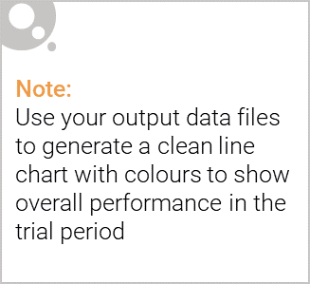
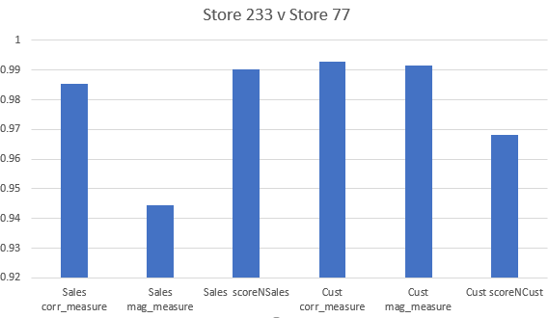
Explanation of the control store vs other stores
In order to select a control store, we looked at the similarities between the stores based on sales and number of Customers
The selected store had the highest value that isn’t the control store.
In this case of trial store 77, the control store is 233, 86 had 155 and 88 had 237.

Slide 13
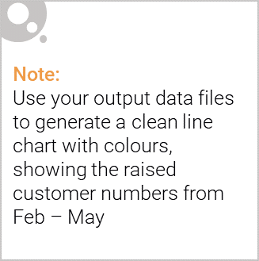
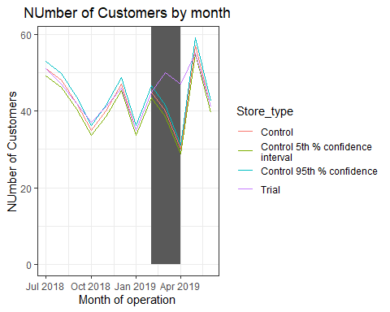
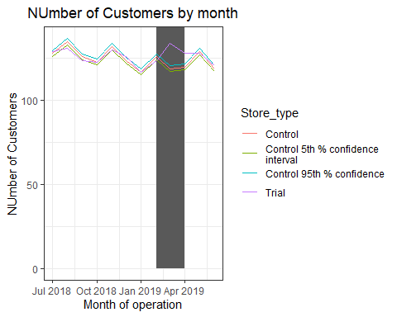
All trial Stores had an increase in the number of sales and customer vistist experienced in the trial period. Thus
Store 77
Store 88

Slide 14
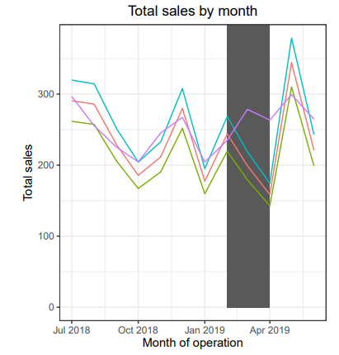
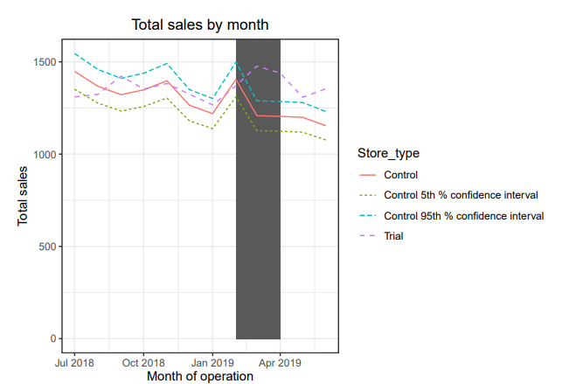
Store 77
Store 88

Slide 15
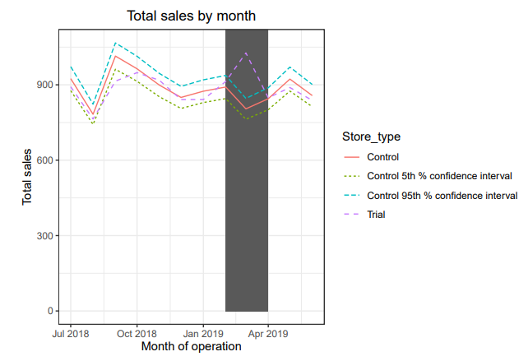

Slide 16
Conclusion
All trial strores have experienced an increase in the total sales and the number of Customers visiting the stores during the trial period.

