Slide 1

Business Meeting
March 13, 2020
October 6, 2020
Repeated – October 13, 2020

Slide 2
Logistics
Non-presenter microphones are automatically muted
Chat is available, please do not post questions in chat, please post questions in Q&A
Questions that are submitted to Q&A may be addressed right away or at the end of presentations or appropriate breaks in the presentation.
Questions in Q&A may also be directly answered in Q&A

Slide 3
Agenda
Introduction of 2019-2022 Board
Some highlights of the first 1+ years
Technical Symposium 2020
2020 Conferences
Treasurer’s Report for FY 2019 and FY 2020
2021 Conferences
Beyond 2021
Other SIGCSE Programs
Questions?

Slide 4
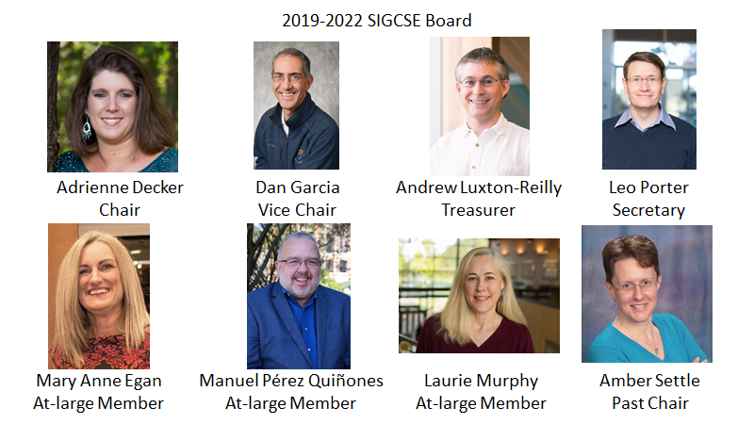

Slide 5
Board Highlights July 2019-September 2020
Redesigned website was launched
SIGCSE Historian appointed
Briana Morrison, University of Nebraska Omaha
SIGCSE Social Media Director position created
Zahra Atiq, Ohio State University

Slide 6
Board Highlights July 2019-September 2020
Issued a call for leadership for the formation of a SIGCSE Committee on Diversity, Equity, Inclusion and Anti-Racist work for the SIG
Leadership: Nicki Washington, Leigh Ann DeLyser, Matt Jadud
Issued a call for participation in SIGCSE-wide Reviewing Task Force
In the queue

Slide 7
SIGCSE TS 2020 Timeline
Wednesday, March 11 – Pre-symposium events started in Portland; Exhibit hall set up and exhibitors moved in, venue is prepared for conference
Late evening March 11 – Governor of Oregon declared that assemblies of more than 250 persons are not allowed
Thursday, March 12 – Conference Leadership informed attendees that Symposium is cancelled
Exhibit hall is torn down, exhibits moved out, all other conference setups dismantled, conference leadership and attendees return home
At this point, we have not been released from any financial obligations associated with the conference (~$1M)

Slide 8
SIGCSE TS 2020 Timeline
March 25: ACM completed negotiations with Portland Convention Center and Hotels on behalf of SIGCSE to ease financial obligations
March-April: dLPlan (Conference Exhibits Management) works with supporters and exhibitors to refund or forward support from conference
April: Attendees who requested refund (less $100 fee) have refund processed

Slide 9
SIGCSE TS 2020 Timeline
May 4: SIGCSE TS 2020 online content available
June: SIGCSE TS 2020 Financials settled
Expenses: $323K
Supporter income: $170K (includes money donated and money credited toward 2021 support ~$100K)
Registration: $200K
Surplus: $14K
Notes:
By comparison, TS 2019 had income 838,263 and expenses 697,268, giving profit of 140,994

Slide 10
ITiCSE 2020
March 2020: Decided that ITiCSE 2020 should be an online event held on original dates in June 2020
June 2020: Conference held online over Zoom with additional discussion in Moodle
Top 5 ITiCSE Papers and Top 5 ITiCSE Working Group reports recognized
Support for ITiCSE Doctoral Consortium by ACM-Europe
Attendance: 391
Surplus: $17K
Any penalties incurred from the cancellation were absorbed by NTNU (former host institution - ~$15K)

Slide 11
ICER 2020
March 2020: Decided ICER should be a virtual event
August 2020: ICER held online using Discord and Zoom
Doctoral Consortium held online in conjunction with conference as planned
Attendance: 319 (unofficial)
Announced the formation of the ICER Steering Committee

Slide 12
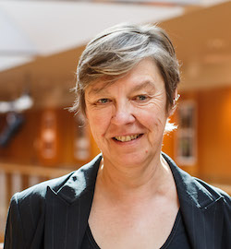
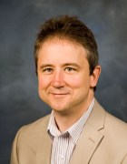
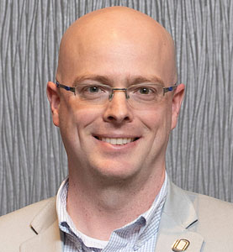
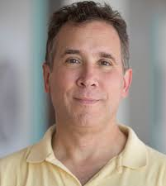
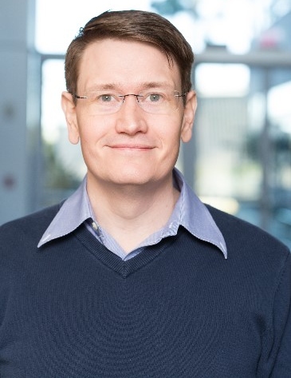
ICER Steering Committee
Sally Fincher University of Kent
Quintin Cutts University of Glasgow
Brian Dorn University of Nebraska Omaha
Chair
Leo Porter SIGCSE Board Rep
Mark Guzdial University of Michigan

Slide 13
Treasurer’s Report
Andrew Luxton-Reilly
SIGCSE Business Meeting

Slide 14
Summary
Year | Revenue | Expenses | Net | Fund balance | Total ACM
FY 2010 | $669,991 | $718,181 | ($48,190) | $439,869 | $89,975
FY 2011 | $691,798 | $625,947 | $65,851 | $505,720 | $79,271
FY 2012 | $273,772 | $260,402 | $13,370 | $519,090 | $34,908
FY 2013 | $709,428 | $635,111 | $74,317 | $593,407 | $86,004
FY 2014 | $751,108 | $775,506 | ($24,398) | $569,009 | $95,665
FY 2015 | $769,948 | $733,950 | $35,998 | $605,007 | $91,088
FY 2016 | $833,465 | $755,149 | $78,316 | $683,324 | $95,095
FY 2017 | $800,779 | $739,750 | $61,028 | $744,352 | $94,097
FY 2018 | $1,969,293 | $1,659,267 | $310,026 | $1,053,122 | $183,493
FY 2019 | $436,795 | $406,911 | $29,884 | $1,082,505 | $40,396
FY 2020 | $1,274,031 | $1,045,780 | $228,250 | $1,310,755 | $135,899
Notes:
Despite recent disruption, SIGCSE organization has a healthy fund balance.
FY 2020 includes revenue and expenses up until end June 2020
But conference finances close around 6 months after the conference, so FY 2020 includes all 2019 conferences, but none of the 2020 conferences
Some unevenness due to when conference closes, so the FY 2018 included SIGCSE TS 2017 and 2018, which means that the FY 2018 is higher than normal and FY 2018 is lower than normal

Slide 15
Source | FY 2018 | FY 2019 | FY 2020
Dues, subscriptions, etc. | $93,488 | $90,558 | $84,609
Digital library | $71,598 | $86,669 | $79,226
Conferences | $1,777,325 | $217,083 | $1,074,450
Total income | $1,969,293 | $436,794 | $1,274,031
Administrative | $32,401 | $26,662 | $22,792
SIGCSE Awards, ICER Doctoral Consortium, (New Ed & Chairs) Roundtables, KidsCamp | $71,192 | $72,082 | $50,925
Speaker’s Fund & Special Projects Awards | $22,962 | $30,161 | $39,283
Inroads Production Costs | $38,726 | $46,264 | $44,041
Subtotal | $172,407 | $179,286 | $157,041
Conferences | $1,303,366 | $162,745 | $875,828
ACM allocations | $183,493 | $64,879 | $135,899
Total expenses | $1,659,267 | $406,910 | $1,045,780
Surplus/(Loss) | $310,026 | $29,884 | $228,250
Notes:
Most income is from conferences
Admin costs in 2020 are lower due to reduced travel costs
TS Events cancelled which has reduced some of the FY 2020 expenses
ACM allocation starts at 16% and decreases by 0.8% for every $125K of expenses

Slide 16
Conferences
 | Year | Location | Attendance | Surplus/(Loss)
Technical Symposium | 2018 | Baltimore, USA | 1735 | $81,010
 | 2019 | Minneapolis, USA | 1870 | $144,994
 | 2020 | Portland, USA | 0 | $14,568
ITiCSE | 2018 | Larnaka, CY | 180 | $22,036
 | 2019 | Aberdeen, SCT | 367 | $31,395
 | 2020 | Trondheim, NO (online) | 391 | $17,812
ICER | 2018 | Helsinki, FI | 127 | ($376.67)
 | 2019 | Toronto, CA | 150 | $6,396
 | 2020 | Dunedin, NZ (online) | 95** | $7,183**
CompEd | 2019 | Chengdu, CH | 104 | $18,826
**Budgeted
Notes:
CompEd 2019: Steve Cooper and Andrew Luxton-Reilly
ITiCSE 2019: Bruce Scharlau and Roger McDermott
ICER 2019: Robert McCartney, Anthony Robins, Andrew Petersen, Adon Moskal
All conferences except ICER 2020 are closed. Numbers updated Oct 2020

Slide 17
Special Projects
Year | Total Amount | Received/ Funded
FY 2017 | $19,518 | 24/5
FY 2018 | $26,168 | 27/6
FY 2019 | $40,998 | 66/9
FY 2020 | $23,285 | 38/5
May 2020 round cancelled due to financial uncertainty See all awards: https://sigcse.org/sigcse/programs/special/index.html
Notes:
ALR: Updated Oct 2020

Slide 18
Speaker’s Fund
Year | Conference | Speaker/Title | Amount | Total
FY 2019 | CCSC-Central Plains | David Hayes Mobile Web App Development for All! | $324 | $825
FY 2019 | JADIPRO | Jocelyn Simmonds A Teacher Workshop for Introducing Computational Thinking in Rural and Vulnerable Environments | $500
FY 2020 | CCSC-Central Plains | Brian Hare and David Heise Booting Into AI: Startup Instructions for Teaching Artificial Intelligence | $1,000*
* Estimated
See all previous awards: https://sigcse.org/sigcse/programs/speakers/list.html
Notes:
ALR: Complete

Slide 19
Travel Fund Program
Recipients from K-12, community college and university
 | Number | Countries | Total
FY 2019 | 50 | Brazil, Canada, China, Finland, Ghana, Ireland, Kenya, Mexico, USA | $25,000 + 50 registrations
FY 2020 | 20 | USA, Brasil, Ireland, Netherlands, Sweden, India | $10,000 + 20 registrations
See all recipients:
https://sigcse.org/sigcse/programs/travel-grants/index.html

Slide 20
Membership numbers
Start of Year
End of Fiscal Year
Current
Category | Jan-19 | Jan-20 |  | Jun-19 | Jun-20 |  | Aug-20
Prof., print | 849 | 794 |  | 818 | 749 |  | 737
Prof., online | 1056 | 1118 |  | 1112 | 1056 |  | 1061
Professional | 1905 | 1912 |  | 1930 | 1805 |  | 1798
Affiliate, print | 111 | 104 |  | 106 | 92 |  | 90
Affil, online | 841 | 685 |  | 683 | 439 |  | 455
Affiliate | 952 | 789 |  | 789 | 531 |  | 545
Student, print | 14 | 18 |  | 18 | 16 |  | 15
Student, online | 91 | 81 |  | 83 | 71 |  | 71
Student | 105 | 99 |  | 101 | 87 |  | 86
Total | 2962 | 2800 |  | 2820 | 2423 |  | 2429
2017 membership average: 2524
2018 membership average: 2818
2019 membership average: 2830
2020 membership average: 2506

Slide 21
Membership numbers

Slide 22
2021 Conferences

Slide 23
2021 Conferences
SIGCSE Technical Symposium 2021
March 2021
Was: Toronto, Canada
Now: Virtual
ITiCSE 2021
June 2021
Was: Paderborn, Germany
Now: Virtual
ICER 2021
August 2021
Charleston, SC
CompEd 2021
Was: December 2021
Now: December 2022 in Hyderabad, India

Slide 24
Beyond 2021
Technical Symposium 2022 March 2-5 Providence, RI, USA
ITiCSE 2022 (June) Dublin, Ireland
ICER 2022 (August) Lugano, Switzerland
CompEd 2022 (December) Hyderabad, India
Technical Symposium 2023 March 16-19 Toronto, Canada
ITiCSE 2023
TBA [Europe]
ICER 2023
TBA [North America]

Slide 25
2021 and Beyond
Current questions
Hybrid conferences
Virtual conferences
Challenges
Mitigating different levels of experience and engagement with hybrid events
Funding may not be available for virtual events
Are faculty able to take the time off needed to meaningfully engage with virtual events that happen during an academic term?
Suitable platforms that support hybrid or virtual events

Slide 26
2021 and Beyond
Current questions
Addressing inclusivity and calls for social justice within our community; more than broadening participation
Challenges
Understanding and facing our weaknesses
Creating lasting and meaningful change

Slide 27
2021 and Beyond
Challenge: Maintaining a growing and changing SIGCSE community
Growth in events
Growth in participation
Supporting volunteers
Growing programs

Slide 28
Other SIGCSE Programs
Special Projects
May 2020 round was cancelled
November 2020 round will proceed – applications due Nov 15
Travel Grants
Suspended for 2020 round (to fund travel for 2021)
Awardees from 2019 who did not use funds will be able to use them in 2022
SIGCSE Committees
Committee work can and should continue

Slide 29
Other SIGCSE Programs
In-Cooperation
Virtual conferences are eligible for in-cooperation status
Speaker’s Fund
Still available (funds can only be used for travel, not registration or honoraria)
Awards
Deadline Oct 1 (reviewing applications now)

Slide 30
Report from SIGCSE committee on Computing Education in Liberal Arts Colleges

Slide 31
SIGCSE Committee on Computing Education in Liberal Arts Colleges
Presentation Outline (Historical)
Pre History and 2016 Committee Formation
2018 Report
2019 Refocused Committee and SIGCSE 2020 Workshop
Planned SIGCSE 2021 Workshop
Many details available at SIGCSE Committee Web page:
https://sigcse.org/sigcse/programs/committees/index.html

Slide 32
Pre History and 2016 Committee Formation
Informally, for many years prior to 2016, anecdotal discussions among CS faculty suggested
a perceived sense of isolation
an interest in networking
involvement in national curricular discussions
SIGCSE Board established Committee in 2016 to explore 2 questions:
Does the liberal arts computing education community need some sort of organization to support its activities?
Does the larger computing education community need some identified organization it can turn to as the voice of liberal arts computing?

Slide 33
2018 Report
Through 2016-2018, Committee
developed SIGCSE email list
surveyed all SIGCSE members
held discussions and SIGCSE 2017, 2018, and 2017 BoF
reviewed computing education literature
Report developed by Doug Baldwin (SUNY Geneseo), Amanda Holland-Minkley (Wash.&Jefferson), Grant Braught (Dickinson)
Provided broad, working definition of "liberal arts"
Identified characteristics of liberal arts computing programs
Basic conclusions:
(Main) That an organization be created to support and represent liberal arts computing educators.
(Subsidiary) That a small group immediately begin identifying and implementing specific ways to make the liberal arts computing organization a reality.

Slide 34
2019 Refocused Committee and SIGCSE 2020 Workshop
In 2018, charge to SIGCSE Committee evolved to consider how an organization might be developed and implemented.
First main activity: Half-day Pre-SIGCSE 2020 Event scheduled
Core group of 5 on the program committee
Event held day before SIGCSE 2020 canceled
Two main topics
Curricular innovations for CS in the liberal arts (16 submissions)
Challenges and opportunities for computing with a liberal arts setting (15 submissions)
For each topic,
mini-presentations and group discussions
"poster" session, videos
Reporting back
Further events and directions
Wonderful discussion, brainstorming, engagement from 25 attendees (58 expressed interest pre-pandemic)

Slide 35
Planned SIGCSE 2021 Workshop
Accepted day-long event, divided into two half-days
Organizing group expanded to 12
In new virtual world
likely to take place a week or so before SIGCSE 2021 itself
scheduling details evolving
Three Planned Sessions, reflecting 3 on-going Working Groups
Liberal Arts Approaches to Computing Curricula
CS + X Courses
Mentoring, Recruiting, Hiring for Liberal Arts CS Education
As with SIGCSE 2020 event:
plan to solicit 2 page statements (for 1, 2), 1-page (for 3)
"Submissions most suitable to adaptation/adoption across institutions will be given preference for presentation and discussion." "All on-topic submissions ... shared"
Expect announcements/details forthcoming (e.g., on SIGCSE-LIBARTS-COMM@LISTSERV.ACM.ORG0

Slide 36
Questions? Comments?
chair@sigcse.org – for comments or questions later

Slide 38
Statement about SIGCSE Technical Symposium 2020
In making the decision on whether or not to hold the SIGCSE 2020 Technical Symposium the SIGCSE Board considered many factors:
Health and safety of the participants at the conference following advice from health professionals and recommendations from the Oregon Department of Health
Economic impact of cancellation on the Portland area
Financial impact on and continued viability of the SIGCSE organization
Financial impact on attendees
Supporting personal choice and agency
It was not a decision taken lightly. The situation rapidly evolved producing a high level of uncertainty. We considered multiple alternatives and implemented those that were feasible.
Given all of this, we made the decision to hold the Symposium while supporting individuals to make their own choices. We owe a debt of gratitude to the Symposium and program chairs this year who have been asked to work under unbelievable circumstances and have shown tremendous grace under pressure.

