Slide 1
Beyond the Bias: Unveiling the Quality of Implicit Causality Prompt Continuations in Language Models
Bielefeld University | Faculty of Linguistics and Literary Studies | Computational Linguistics
Judith Sieker & Oliver Bott & Torgrim Solstad & Sina Zarrieß
Judith Sieker, INLG 2023, Prague
Notes:
Hello everyone, my Name is Judith Sieker and I am from Bielefeld University.
Together with Oliver Bott, Torgrim Solstad and Sina Zarrieß I conducted a study to analyse the generation capabilities of Large Language Models with the use of Implicit Causality prompts

Slide 2
Linguistics with Large Language Models
Large-scale neural language model (LLM)
/19
Notes:
Large language models are increasingly used for text generation.
However, their black-box nature makes their generated texts unpredictable
So, it becomes more and more important to understand the strengths and limitations of these models

Slide 3
Linguistics with Large Language Models
Linguistic
Knowledge?
Large-scale neural language model (LLM)
/19
Notes:
Particularly, it is crucial to understand the linguistic knowledge that is captured in these models

Slide 4
Linguistics with Large Language Models
Linguistic
Knowledge?
Large-scale neural language model (LLM)
→ We probe LLMs for discourse knowledge
/19
Notes:
With this study, we aim to improve our understanding of what language models know about language,
and with this we focus specifically on their discourse knowledge
However, while many tasks that probe the linguistic knowledge in language models involve single word predictions, it is worth to explore more than that

Slide 5
Linguistics with Large Language Models
Linguistic
Knowledge?
Large-scale neural language model (LLM)
→ We probe LLMs for discourse knowledge → We go beyond single-word predictions
/19
Notes:
Therefore, in our work, we go beyond single word-predictions and evalute the text generation capabilities of Large Language models with a linguistically controlled task

Slide 6
A little task
Think of a continuation for the following sentence. Remember the first thing that comes to your mind.
Paul admired Isabel ...
/19
Notes:
Now, before we dive into our investigation, I would like to start with a little task: " "

Slide 7
A little task
Think of a continuation for the following sentence. Remember the first thing that comes to your mind.
What is your continuation about?
Paul admired Isabel ...
/19
Notes:
Now think about: what was your continuation about?

Slide 8
Paul admired Isabel because she was the top student in all subjects.
Paul admired Isabel because she played the piano so well.
Paul admired Isabel because she was a very good swimmer.
Paul admired Isabel because she gave such a good talk.
/19
Notes:
I guess that most of you have thought of something similar to these continuations here.
That is, I guess that probably most of you have thought of a continuation that is rather prototypical and expectable

Slide 9
Paul admired Isabel because she was the top student in all subjects.
Paul admired Isabel because she played the piano so well.
Paul admired Isabel because she was a very good swimmer.
Paul admired Isabel because she gave such a good talk.
/19
Notes:
Also, I guess that most of you have thought of a continuation that gives an explanation of why Paul would admire Isabel,
like her being a great swimmer or her giving a really good talk.

Slide 10
Paul admired Isabel because she was the top student in all subjects.
Paul admired Isabel because she played the piano so well.
Paul admired Isabel because she was a very good swimmer.
Paul admired Isabel because she gave such a good talk.
→ admire triggers an explanation
/19
Notes:
This is because, verbs such at “admire“ are prone to trigger explanations in subsequent discourse
////
Furthermore, the verbs that exhibit a pronounced Implicit Causality bias also tend to display a coherence bias, this means that they are prone to trigger explanations in subsequent discourse
In Kehler et al. (2008), participants were prompted to continue sequences such as Peter annoyed Mary after a full stop (no because pre- sent). In such cases, IC verbs triggered 60% explanations – sentence continuations that in a broad sense were causes of the state of affairs offered in the prompt –, whereas “non-IC verbs” were followed by only 25% explanations (see Bott and Solstad 2014 for the same result in German and Norwegian).

Slide 11
Paul admired Isabel because she was the top student in all subjects.
Paul admired Isabel because she played the piano so well.
Paul admired Isabel because she was a very good swimmer.
Paul admired Isabel because she gave such a good talk.
→ admire triggers an explanation
/19
Notes:
Furthermore, in sentence contination tasks like these, about 90% of participants would also continue the sentence with a mention of the verbs object, so with Isabel in this case

Slide 12
Paul admired Isabel because she was the top student in all subjects.
Paul admired Isabel because she played the piano so well.
Paul admired Isabel because she was a very good swimmer.
Paul admired Isabel because she gave such a good talk.
→ admire triggers an explanation → admire comes with a strong next-mention-bias
/19
Notes:
This is bacause verbs such as „admire“ also come with a very strong next mention bias
And this strong next-mention bias is what is refered to as the Implicit Causality bias

Slide 13
Implicit Causality (IC)
Interpersonal verbs that favor one argument for coreference → IC Coreference bias
/19
Notes:
More spefically:
Implicit Causality (or: IC) is a property of a broad range of interpersonal verbs that show strong preferences for establishing coreference to one of the verb’s arguments over the other

Slide 14
Implicit Causality (IC)
Interpersonal verbs that favor one argument for coreference → IC Coreference bias
Paul admired Isabel because she was the top student in all subjects.
IC
Paul fascinated Isabel because he found a solution immediately.
IC
/19
Notes:
Some of these verbs exhibit a coreference bias towards the object, like "admire"
And other verbs trigger a coreference bias towards the subject, like "fascinate"
Several studies from psychology and psycholinguistics have shown that the Implicit Causality bias is not only highly reliable but also robust across different languages
So, IC prompts such as these offer a well-controlled diagnostic of discourse knowledge
//////////////////////////////
Experiencer-stimulus verbs (or ES verbs) exhibit a coreference bias towards the object;
also: "hate" or "respect"
Stimulus-experiencer verbs (or SE verbs) exhibit a coreference bias towards the subject, which is Paul here:
or also "shock" "disappoint"
Furthermore, the verbs that exhibit a pronounced Implicit Causality bias also tend to display a coherence bias, this means that they are prone to trigger explanations in subsequent discourse
Also, we refer to continuations like the ones in these example as bias-congruent, as these continuations align with the coreference bias. Continuations that go against the bias are referred to as bias-incongruent

Slide 15
IC in LLMs
/19
Notes:
Therefore the IC bias has become an intriguing domain for probing discourse knowledge in language models

Slide 16
IC in LLMs
Focus on the next word prediction
For example: Upadhye et al., 2020; Davis and van Schijndel, 2020; Kementchedjhieva et al., 2021; Zarrieß et al., 2022
Paul admired Isabel because [MASK]
IC?
/19
Notes:
Prior research has mostly focused on single-word prediction tasks
that is, they investigated the predictions of language models in examples like this one here and examined whether these predictions follow the same coreference bias that we find in human data

Slide 17
IC in LLMs
Focus on the next word prediction
For example: Upadhye et al., 2020; Davis and van Schijndel, 2020; Kementchedjhieva et al., 2021; Zarrieß et al., 2022
Studies suggest that LLMs lack congruence with human IC bias, indicating difficulties in discourse understanding
Paul admired Isabel because [MASK]
IC?
/19
Notes:
And their findings suggest that language models only display limited ability to incorporate this coreference bias in their continuations, indicating difficulties in discourse understanding
//////////////////////////////
but see Cai et al., 2023 (ChatGPT)

Slide 18
IC in LLMs – our contribution
/19
Notes:
This now brings us the the focus of our study

Slide 19
IC in LLMs – our contribution
We go beyond the bias: Utilize IC prompts to evaluate the text generation capabilities of LLMs
/19
Notes:
In this work, we propose that such IC prompts cannot only be used for analyzing the comprehension in language models but that these prompts also are well-suited for evaluating their generation capabilities

Slide 20
IC in LLMs – our contribution
We go beyond the bias: Utilize IC prompts to evaluate the text generation capabilities of LLMs
Paul admired Isabel because [MASK] …
/19
Notes:
That is, in contrast to most previous studies, we are not only interested in the next mention but, beyond, in what comes after it
-- so we go beyond the bias

Slide 21
Human-produced continuations
Vincent inspired Clara because he had so many talents.
Pia hated Malte because he was constantly annoying her.
Isabel admired Paul because he was such a good swimmer.
Björn disappointed Celina because she expected more from him.
/19
Notes:
For instance, consider these continuations that were produced by human participants
What we can find here are prototypical and sensible explanations for the given prompts (similar to those that we saw some slides ago)
For example, it is totally natural to inspire someone by having many talents and it is also natural to admire someone because he or she is particulary good at something

Slide 22
Human-produced continuations
Model-generated continuations
Vincent inspired Clara because he had so many talents.
Pia hated Malte because he was constantly annoying her.
Isabel admired Paul because he was such a good swimmer.
Björn disappointed Celina because she expected more from him.
Vincent inspired Clara because she had received a gift from her husband.
Pia hated Malte because he was too busy with the fact that he didn't even have a real lawyer.
Isabel admired Paul because he was able to explore the world without leaving her.
Björn disappointed Celina because he had forgotten him and then took the boy.
/19
Notes:
Now, let's look at what large language models produce when prompted with the same sentence beginnings
Here, we can see that the models tend to produce continuations that lack coherence and meaning with regard to the given prompt
It, thus, seems that language models fail to produce continuations that are sensible, despite the fact that this task is really simple

Slide 23
Can LLMs generate such continuations?
Human-produced continuations
Model-generated continuations
Vincent inspired Clara because he had so many talents.
Pia hated Malte because he was constantly annoying her.
Isabel admired Paul because he was such a good swimmer.
Björn disappointed Celina because she expected more from him.
Vincent inspired Clara because she had received a gift from her husband.
Pia hated Malte because he was too busy with the fact that he didn't even have a real lawyer.
Isabel admired Paul because he was able to explore the world without leaving her.
Björn disappointed Celina because he had forgotten him and then took the boy.
/19
Notes:
Therefore, wha we are primarily interested in in this study is, is to evaluate whether language models are able to generate explanations that are similar to those of the humans
///
And with this also to investigate the factors that influence the quality of the model-generated texts

Slide 24
Human-produced continuations
Model-generated continuations
Vincent inspired Clara because he had so many talents.
Pia hated Malte because he was constantly annoying her.
Isabel admired Paul because he was such a good swimmer.
Björn disappointed Celina because she expected more from him.
Vincent inspired Clara because she had received a gift from her husband.
Pia hated Malte because he was too busy with the fact that he didn't even have a real lawyer.
Isabel admired Paul because he was able to explore the world without leaving her.
Björn disappointed Celina because he had forgotten him and then took the boy.
/19
Notes:
Furthermore, there is another interesting thing that we can see here

Slide 25
Human-produced continuations
Model-generated continuations
Vincent inspired Clara because he had so many talents.
Pia hated Malte because he was constantly annoying her.
Isabel admired Paul because he was such a good swimmer.
Björn disappointed Celina because she expected more from him.
Vincent inspired Clara because she had received a gift from her husband.
Pia hated Malte because he was too busy with the fact that he didn't even have a real lawyer.
Isabel admired Paul because he was able to explore the world without leaving her.
Björn disappointed Celina because he had forgotten him and then took the boy.
IC bias-congruent, but not coherent
IC bias-incongruent, yet still coherent
/19
Notes:
That is, the IC bias can be violated without any loss of discourse coherence (like in the example on the left)
And, vice versa, a bias-congruent continuation does not guarantee that this continuation is also coherent (like in the example on the right)
This is another aspect to which, to date, only little consideration, has been given to in the study of IC in large language models
Therefore, in our study, we further investigate the extent to which bias congruency is related with the quality of the generated continuations
//////////////////////////////
But see Huynh et al., 2022: In addition to examining the IC bias, Huynh et al., 2022 conducted a human evaluation of the quality of the continuations predicted by an English GPT-2 model. Asking the participants to judge the "reasonability" of the generated continuations on a 5-point Likert scale (with 5 being strongly reasonable), their results showed that only 32% of all the continuations retained an average rating greater than or equal to 4.

Slide 26
Experiment – Set-Up
/19
Notes:
We carry out an evaluation study with human ratings to assess the quality of generated IC continuations
////
With this study, we are primarily interested in evaluating whether th e language are able to generate explanations that are similar to those of the humans

Slide 27
Experiment – Set-Up
German Data from Bott and Solstad, 2021
/19
Notes:
We ground our study on German IC data from Oliver Bott and Torgrim Solstad from 2021
and use their experimental items to generate prompts to be completed by the language models
//////////////////////////////
Also, their data provide us with human-produced sentence continuations, which offer a valuable reference point to evaluate the continuations generated by the language models

Slide 28
Experiment – Set-Up
German Data from Bott and Solstad, 2021
Conditions
1) "Standard" prompt constructions
2) Prompts extended with adverbial modifications
Clara inspired Vincent because...
Clara inspired Vincent by her innovative lecture because...
/19
Notes:
We investigate different prompt conditions;
On the hand, we are using the "standard" IC Prompts, like the ones that we have seen so far
And, on the other hand, we introduce an additional prompt condition; where we extend these standard prompts with adverbial modifiers
I will explain later on why we chose to introduce this additional prompt condition
//////////////////////////////
This extension is motivated by the insight that the biases of IC verbs are strongly modulated by linguistic context
For instance, in their study from 2021, Bott and Solstad showed that modifying standard IC prompts with adverbial phrases leads to a change in the biases of IC verbs
This aspect has, to our knowledge, not yet received attention in the study of IC in LLMs
In this study, we therefore compare standard IC prompts with such modified prompts, using the experimental data of Bott and Solstad, 2021, in order to investigate to what extent this added contextual information may not only influence the ability of LLMs to capture the IC bias but, beyond, also the quality of the model-generated continuations.
//////
In particular, not only did their results show that the IC coreference bias was in fact eliminated when adverbial modifiers were added to the prompts, they further found fewer and distinct types of explanations after these modifications compared to the default explanation types observed in the "standard" condition.

Slide 29
Experiment – Set-Up
German Data from Bott and Solstad, 2021
Conditions
1) "Standard" prompt constructions
2) Prompts extended with adverbial modifications
Models: GPT-2 & mGPT
Clara inspired Vincent because...
Clara inspired Vincent by her innovative lecture because...
/19
Notes:
We employ two open-source German language models to generate the continuations.
For both models we do not employ any fine-tuning
And for both models we test different decoding procedures
//////////////////////////////
a pretrained German GPT-2 model
and a pretrained multilingual mGPT model which reproduces the GPT-3 architecture
For reproducibility, we use the Hugging Face framework
Following the reasoning of Huynh et al., 2022, we use GPT-2 and mGPT, despite the availability of newer and more advanced language models, as they offer a manageable size that is compatible with standard hardware and a favorable trade-off between complexity and efficiency.
//////////////////////////////
Beam search: we consider beam search to be an appropriate candidate for the task of generating sentence continuations for (short) IC prompts, since Meister et al., 2020 have shown that beam search incorporates an inductive bias that aligns with the UID principle to distribute information uniformly across an utterance. However, as it has been shown that beam search tends to reduce diversity by favoring likelihood (Schüz et al., 2021; Zarrieß et al., 2021), in this paper, we will utilize the Diverse Beam Search method proposed by Vijayakumar et al., 2018, which, in essence, encourages diverse candidates by categorizing candidates into groups and then enforcing diversity within those groups.
Nucleus Sampling: we consider Nucleus Sampling (Holtzman et al., 2019) to be an appropriate stochastic decoding method for our investigation. By truncating the model distribution, this method effectively addresses the drawback of sampling based methods to potentially select very low probability outputs that may considerably reduce the overall quality and coherence.
Typical Sampling: we consider another, third decoding procedure called Local Typical Sampling (Meister et al., 2022) to generate continuations for the two IC prompt conditions. Including this method in our study seems worthwhile, given that the authors introduced it as a potential solution to the shortcomings of beam search and Nucleus Sampling and, beyond, that it was designed to embody the characteristics of human language, aligning with the information-theoretic perspective discussed in this context (cf. Meister et al., 2022).
In a nutshell, in Local Typical Sampling, the options to sample from are limited to strings that have a similar information content to what would be expected based on the prior context.
Decoding hyperparameters
We set the hyperparameters of our decoding methods by validating them on the continuation data from Bott and Solstad, 2021, using other IC verbs (and thus, items) than those tested in the final experiments and the metrics BLEU, GLEU, METEOR, ROUGE(-L) and BERTScore, as provided by the Hugging Face library.
We chose ranges of hyperparameters based on the authors’ self-reported best-performing values and/or standard values recommended in literature and found the following settings to be best performing in at least four of the five metrics:
Diverse Beam Search: beam size and beam group size = 10; diversity penalty λ = 0.7
Nucleus Sampling: top p value = 0.85; temperature = 0.7
Typical Sampling: temperature = 0.7

Slide 30
Experiment – Set-Up
German Data from Bott and Solstad, 2021
Conditions
1) "Standard" prompt constructions
2) Prompts extended with adverbial modifications
Models: GPT-2 & mGPT
Evaluation
Automatic Measures
Human Evaluation
Clara inspired Vincent because...
Clara inspired Vincent by her innovative lecture because...
/19
Notes:
For evaluation we employ both automatic measures and human evaluation ((as human evaluation remains to be the gold standard when it comes to assessing the overall quality of a system))
//////////////////////////////
To investigate the overall quality of the models’ continuations, we calculate the three automatic measures: BLEU, ROUGE-L and BERTScore. In this way, we we compare the model's continuations to the ones produced by participants in the studies conducted by Bott and Solstad, 2021
//////////////////////////////
We used the Prolific framework and overall collected approximately 5.000 human judgments.
Obtained ratings from 40 different annotators on 96 examples for each model’s continuations, 128 examples for each prompt condition, 64 examples for each decoding method and 64 examples for human-produced continuations of which one half was bias congruent and the other half bias incongruent.
We restricted potential evaluators to native speakers of German with their country of residency being Germany.
We chose the criteria of naturalness and coherence following recommendations from van der Lee et al., 2021 and elicited informativity to investigate our assumption
Before evaluators were asked to provide ratings on the three criteria, they were presented with instructions as well as an example item on the basis of which the criteria were explained.
Evaluators were paid £9,00/hour and IRB approval was obtained prior to conducting the study.
.

Slide 31
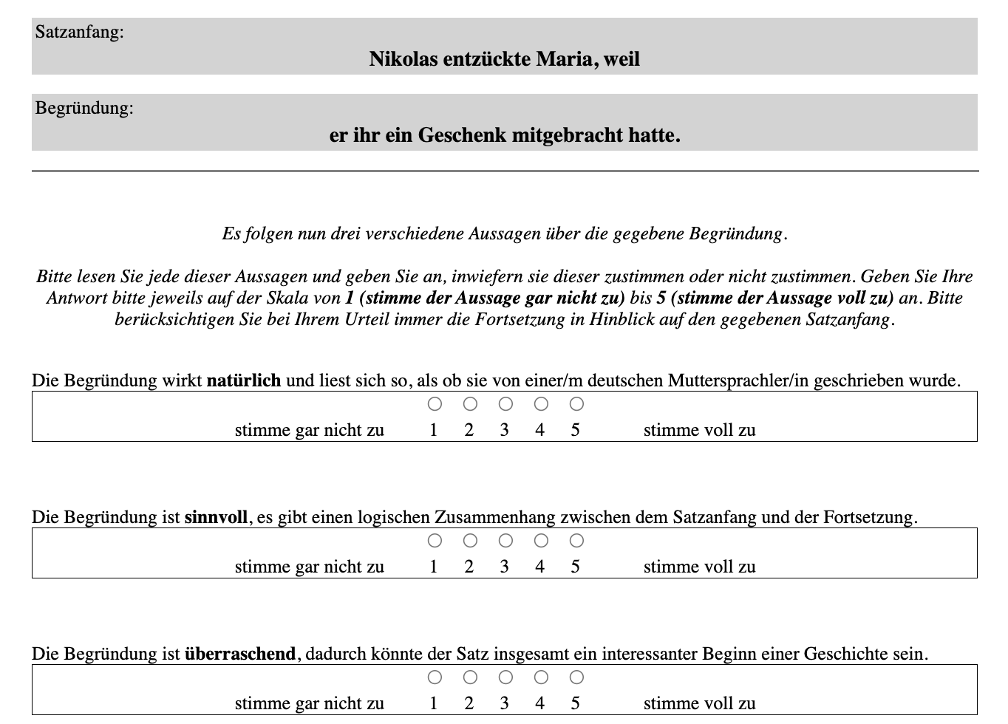
/19
Notes:
Here you can see a screenshot from our human evaluation study.

Slide 32
Nicolas delighted Maria because
he had brought her a gift.
/19
Notes:
We designed this as a rating task, and always presented a sentence beginning together with a respective model-generated (or human-produced) continuation

Slide 33
Nicolas delighted Maria because
he had brought her a gift.
Naturalness
Coherence
Informativity
/19
Notes:
We then presented three questions to the participants to evaluate the given continuation, asking for Naturalness, Coherence and Informativity

Slide 34
Nicolas delighted Maria because
he had brought her a gift.
Naturalness
The explanation is natural and sounds like it was written by a German native speaker.
/19
Notes:
For naturalness we asked wether a given continuation is a "natural" explanation for the respective sentence beginning and if it reads as if it was written by a German native speaker

Slide 35
Nicolas delighted Maria because
he had brought her a gift.
Naturalness
The explanation is natural and sounds like it was written by a German native speaker.
Coherence
The explanation is meaningful, there is a logical connection between the beginning of the sentence and its continuation.
/19
Notes:
For coherence, we asked wether a given continuation is a "meaningful" explanation for the respective sentence beginning and if it there is a logical connection between the beginning of the sentence and its continuation
////////////////////////
We chose both the criteria of naturalness and coherence following recommendations from van der Lee et al., 2021

Slide 36
Nicolas delighted Maria because
he had brought her a gift.
Naturalness
The explanation is natural and sounds like it was written by a German native speaker.
Coherence
The explanation is meaningful, there is a logical connection between the beginning of the sentence and its continuation.
Informativity
The explanation is surprising, as a result the sentence as a whole could be an interesting start to a story.
/19
Notes:
And for informativity, we asked if the given continuation is "suprising" and if the whole sentence, as a result, could be an interesting start to a story.
We chose the word "surprising" in order to assess informativity, building on Information Theory where the informativity of linguistic tokens is generally measured in terms of surprisal
I will refer back to Information Theory in a minute, when we discuss our results
////
For each criterion, the participants could indicate their agreement on a five-point Likert scale ((ranging from 1 (‘strongly disagree’) to 5 (‘strongly agree’)))

Slide 37
Experiment – Results I
Naturalness, Coherence & Informativity
/19
Notes:
So now we can finally look at our results :)

Slide 38
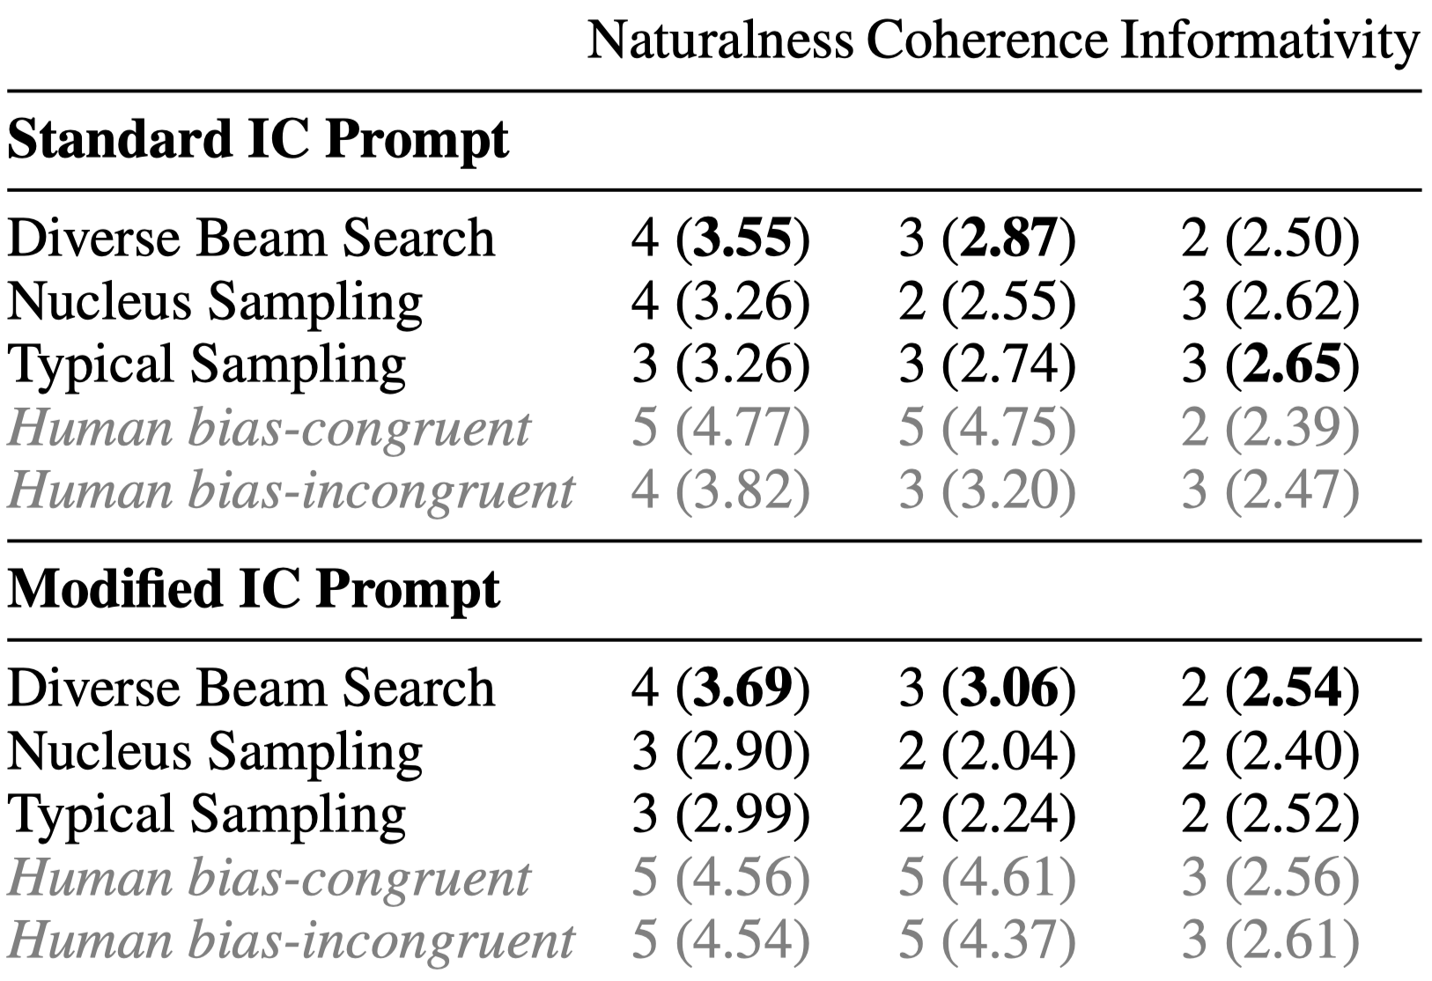
Experiment – Results I
Naturalness, Coherence & Informativity
/19
Notes:
This table shows the results of the human evaluation ((for each decoding procedure and each prompt condition))
For each criterion, we take the median score across evaluators as the final score (mean values are in brackets)
((We focus our analys on differences between the prompt conditions and decoding methods and aggregate over the models because we did not find substantial differences in continuation quality between GPT-2 and mGPT.))
////////////////////////
In general, when comparing the two language models, GPT-2 and mGPT, the automatic metrics in Table 5 in the Appendix indicate that mGPT exhibits a tendency to generate more favorable, or rather, more similar continuations compared to the humanproduced ones. However, this observation holds limited significance since, as detailed in a subsequent paragraph, there is a notably low correlation between automatic and human metrics.

Slide 39

Experiment – Results I
Naturalness, Coherence & Informativity
Human continuations excel in naturalness and coherence
Informativeness ratings don't strongly favor human continuations
/19
Notes:
First, as expected, we can see that the human-produced continuations achieve the best results for naturalness and coherence
That the ratings for informativity do not favor human continuations suggest that these align more closely with prototypical explanations, which is also expected
//////// regarding decoding:
Then, further, we can see that there are differences between different decoding procedures
For example, we can see, that for naturalness and coherence, Diverse Beam Search yields the best results ((which is also true for the automatic metrics))
And if we look at informativity, we see that the sampling-based methods produce continuations that are rated most informative
Interestingly, for Nucleus Sampling, the higher informativity comes with an increase in naturalness,
And for Typical Sampling, it is linked to higher coherence
////////////////////////
Human-produced: in Table 1, we can find higher naturalness and coherence ratings for the bias-congruent continuations than for the bias-incongruent continuations, in particular for the standard IC prompts, which aligns with expectations based on Bott and Solstad, 2021. The observation that the bias-incongruent continuations of the modified prompts appear to be more acceptable than the bias-incongruent continuations of the standard prompts further aligns with the findings of Bott and Solstad, 2021, who demonstrated that modified prompts elicit different types of explanations, often referring to elements other than the verbs’ arguments.

Slide 40

Experiment – Results I
Naturalness, Coherence & Informativity
Differences between naturalness and coherence: → High naturalness medians indicate fluency → Low coherence medians indicate lack of logical consistency
/19
Notes:
Then next for the model-generated continuations, we can in general observe a big distinction between naturalness and coherence ((across decoding procedures))
That is, naturalness consistently exhibits higher values, indicating that the continuations are perceived as fluent
However, the average ratings for coherence are lower, suggesting that the generated texts lack logical consistency (which is something that we also saw some slides ago when we looked at the example model continuations)
This difference between naturalness and coherence underscores that it is important to consider multiple evaluation criteria to assess the outputs of LLMs.
Also, these results highlight that, even in this rather simple task, language models face challenges in generating sensible continuations

Slide 41
Experiment – Results I
Naturalness, Coherence & Informativity
Differences between naturalness and coherence: → High naturalness medians indicate fluency → Low coherence medians indicate lack of logical consistency
Why do the models struggle especially with generating coherent continuations?
/19
Notes:
So the question that pertains is: why is this so?

Slide 42
A short excursion to Information Density
/19
Notes:
In our paper, in this regard, we formulate an expectation that we base on Information Theory (which is why we also included the criterion of informativity in our human evaluation) and I will give a short excursion to it

Slide 43
A short excursion to Information Density
Information Theory: low probability units = more informative("surprising")
Uniform Information Density (UID): speakers prefer to distribute information uniformly across their utterances (Levy and Florian Jaeger, 2007; Jaeger, 2010)
Uniform distribution of information is linked to higher linguistic acceptability (e.g., Meister et al., 2021)
/19
Notes:
In a nutshell, within information theory, linguistic units with low probability are considered to be more informative.
((This reflects the intuition that unpredictable elements convey more information than predictable ones))
Also, according to the Uniform Information Density Hypothesis, speakers prefer to distribute information uniformly across their utterances.
((This means, if speakers wish to convey more information, they are more likely to distribute this information across more words.))
((That a uniform information distribution is also linked to higher linguistic acceptability has been shown by, for example, Clara Meister and colleagues ))
////////////////////////
Information Theory: The use of natural language for communication is often explained through information theory (Shannon, 1948), an approach that views linguistic units as messages aimed at conveying information, quantified by their probability of being produced, which is also termed "surprisal".
Previous studies have shown that a more uniform distribution of information is strongly associated with higher linguistic acceptability (cf., e.g., Meister et al., 2021). As such, assertions that adhere to the UID hypothesis are considered to be of higher quality and receive better evaluations.

Slide 44
A short excursion to Information Density
Standard IC prompts are brief and contain only minimal information
Information Theory: low probability units = more informative("surprising")
Uniform Information Density (UID): speakers prefer to distribute information uniformly across their utterances (Levy and Florian Jaeger, 2007; Jaeger, 2010)
Uniform distribution of information is linked to higher linguistic acceptability (e.g., Meister et al., 2021)
Clara inspired Vincent because...
/19
Notes:
Now, the standard IC prompts are short and only contain minimal information

Slide 45
A short excursion to Information Density
Standard IC prompts are brief and contain only minimal information
Information Theory: low probability units = more informative("surprising")
Uniform Information Density (UID): speakers prefer to distribute information uniformly across their utterances (Levy and Florian Jaeger, 2007; Jaeger, 2010)
Uniform distribution of information is linked to higher linguistic acceptability (e.g., Meister et al., 2021)
Clara inspired Vincent because...
→ continuations require more information to maintain a uniform distribution of information
/19
Notes:
Therefore, building on the UID, the continuations that follow the short prompts are expected to include rather a lot of information in order to maintain a uniform distribution of information

Slide 46
A short excursion to Information Density
Standard IC prompts are brief and contain only minimal information
Information Theory: low probability units = more informative("surprising")
Uniform Information Density (UID): speakers prefer to distribute information uniformly across their utterances (Levy and Florian Jaeger, 2007; Jaeger, 2010)
Uniform distribution of information is linked to higher linguistic acceptability (e.g., Meister et al., 2021)
Clara inspired Vincent because...
→ continuations require more information to maintain a uniform distribution of information
We posit posit that LLMs encounter difficulties in producing continuations that are informative and still sensible
/19
Notes:
We posit, however, that language models encounter difficulties in producing informative yet sensible continuations

Slide 47
A short excursion to Information Density
Standard IC prompts are brief and contain only minimal information
Information Theory: low probability units = more informative("surprising")
Uniform Information Density (UID): speakers prefer to distribute information uniformly across their utterances (Levy and Florian Jaeger, 2007; Jaeger, 2010)
Uniform distribution of information is linked to higher linguistic acceptability (e.g., Meister et al., 2021)
Clara inspired Vincent because...
→ continuations require more information to maintain a uniform distribution of information
We posit posit that LLMs encounter difficulties in producing continuations that are informative and still sensible
Modified IC prompts inherently carry more more information
Clara inspired Vincent by her innovative lecture because...
/19
Notes:
In order to test this proposition, we included the additional prompt condition in our study that I have shortly mentioned some slides ago
That is, the condition where we extend the standard prompts with adverbial modifiers
////////////////////////
This extension is motivated by the insight that the biases of IC verbs are strongly modulated by linguistic context
For instance, in their study from 2021, Bott and Solstad showed that modifying standard IC prompts with adverbial phrases leads to a change in the biases of IC verbs
This aspect has, to our knowledge, not yet received attention in the study of IC in LLMs
In this study, we therefore compare standard IC prompts with such modified prompts, using the experimental data of Bott and Solstad, 2021, in order to investigate to what extent this added contextual information may not only influence the ability of LLMs to capture the IC bias but, beyond, also the quality of the model-generated continuations.
//////
In particular, not only did their results show that the IC coreference bias was in fact eliminated when adverbial modifiers were added to the prompts, they further found fewer and distinct types of explanations after these modifications compared to the default explanation types observed in the "standard" condition.

Slide 48
A short excursion to Information Density
Standard IC prompts are brief and contain only minimal information
Information Theory: low probability units = more informative("surprising")
Uniform Information Density (UID): speakers prefer to distribute information uniformly across their utterances (Levy and Florian Jaeger, 2007; Jaeger, 2010)
Uniform distribution of information is linked to higher linguistic acceptability (e.g., Meister et al., 2021)
Clara inspired Vincent because...
→ continuations require more information to maintain a uniform distribution of information
We posit posit that LLMs encounter difficulties in producing continuations that are informative and still sensible
Modified IC prompts inherently carry more more information
Clara inspired Vincent by her innovative lecture because...
→ less informative continuations are required
/19
Notes:
These modified prompts, contain another information-carrying part, namely the adverbial modification, and therefore contribute a greater amount of information to the (yet to be completed) sentence
Therefore, building on the UID, we make the assumption that continuations of the modified prompts compared to those of the shorter prompts will require less information to maintain a uniform distribution of information across the whole sentence

Slide 49
A short excursion to Information Density
Standard IC prompts are brief and contain only minimal information
Information Theory: low probability units = more informative("surprising")
Uniform Information Density (UID): speakers prefer to distribute information uniformly across their utterances (Levy and Florian Jaeger, 2007; Jaeger, 2010)
Uniform distribution of information is linked to higher linguistic acceptability (e.g., Meister et al., 2021)
Clara inspired Vincent because...
→ continuations require more information to maintain a uniform distribution of information
We posit posit that LLMs encounter difficulties in producing continuations that are informative and still sensible
Modified IC prompts inherently carry more more information
Clara inspired Vincent by her innovative lecture because...
→ less informative continuations are required
Extended IC prompts expected to result in higher quality continuations due to reduced burden on LLMs
/19
Notes:
Therefore, we expect that the continuations that follow the modified prompts will be evaluated as of higher quality than those that follow the standard IC prompts
((because the aditional information reduces the model’s burden to generate informative content on its own))
…

Slide 50
Experiment – Results II
Naturalness, Coherence & Informativity
/19
Notes:
Let's check if this assumption holds true….

Slide 51
Experiment – Results II
Naturalness, Coherence & Informativity
/19
Notes:
Here in the lower part of the table you can now also see the results of our human evaluation for the modified prompts

Slide 52

Experiment – Results II
Naturalness, Coherence & Informativity
Modified prompts do lead to continuations that are less informative
/19
Notes:
First we can see that the modified prompts do indeed lead to continuations that are evaluated as less informative

Slide 53


Experiment – Results II
Naturalness, Coherence & Informativity
Modified prompts do lead to continuations that are less informative
But: modified prompts don't consistently lead to better evaluations
/19
Notes:
However, contrary to our expectations, it is not the case that this also means that the continuations of the modified prompts are evaluated better in terms of coherence or also naturalness;
((instead: in comparison, they even tend to perform worse))

Slide 54
Experiment – Results III
Relation of bias congruency and continuation quality
/19
Notes:
Interestingly, if we now look at models' ability to capture the IC bias, we can see that here, the modification of the prompts does have an effect

Slide 55
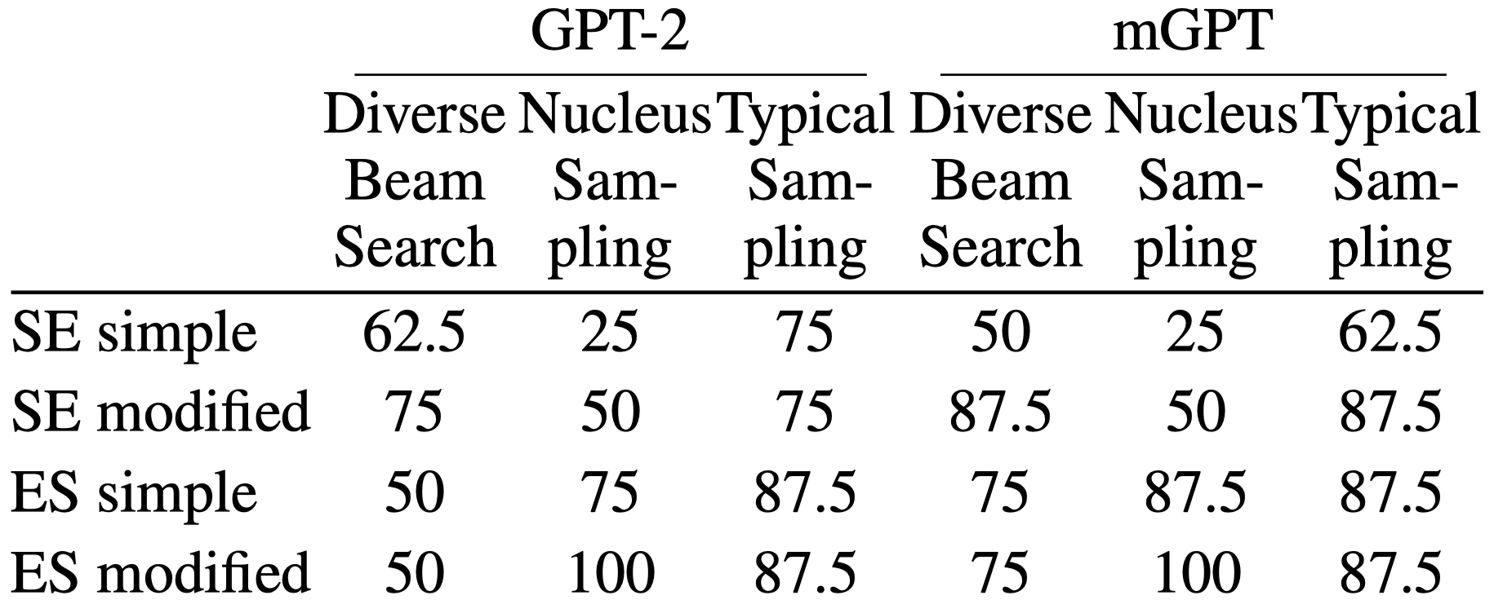
Experiment – Results III
Relation of bias congruency and continuation quality
Completion Sensitivity
/19
Notes:
In this table you see Completion Sensitivity scores which are the percentage of prompts for which the model’s predicted pronoun aligns with the bias
((for each deocding method)) ((, aggregated across the two prompt conditions and across the generations of both LLMs))
////////////////////////
(please refer to the paper for an analysis separated according to conditions)

Slide 56
Experiment – Results III
Relation of bias congruency and continuation quality
Completion Sensitivity
Modifying IC prompts affects IC bias capture, depending on decoding strategy
/19
Notes:
And, we can see that the modfication of the prompts has an impact on the extent to which the models can capture the IC bias, and that this depends on the decoding strategy
Next, let us look at how bias congruency and continuation quality are related with our table from before
////////////////////////
However, in general, the models are more likely to capture the object bias, as can be noted by the (almost) overall higher values for the ES verbs, aligning with results from prior research
Also, we can see that for each decoding procedure the ability to capture the IC bias of SE verbs tends to improve when prompts are augmented with adverbial modifiers.

Slide 57

Experiment – Results III
Relation of bias congruency and continuation quality
Completion Sensitivity
Modifying IC prompts affects IC bias capture, depending on decoding strategy
Typical Sampling: most bias-congruent continuations, but not always better evaluation scores
/19
Notes:
Now in the Completion Sensitivity table we can see that, for example, Typical Sampling tends to generate mostly bias-congruent continuations
However, as visible in the table on the right, this does not necessarily result in better scores on the evaluation metrics
////////////////////////
((However, only in particular for Diverse Beam Search (on the left), It can be observed that bias-congruent continuations are preferred to be as more natural than bias-incongruent continuations))

Slide 58
Experiment – Results III
Relation of bias congruency and continuation quality
Completion Sensitivity
Modifying IC prompts affects IC bias capture, depending on decoding strategy
Typical Sampling: most bias-congruent continuations, but not always better evaluation scores
→ Bias-congruent continuations don't always equate to better quality
/19
Notes:
These results, thus, indicate that a bias congruent continuation does not equate to a qualitatively better continuation.
////////////////////////
Human-produced: in Table 1, we can find higher naturalness and coherence ratings for the bias-congruent continuations than for the bias-incongruent continuations, in particular for the standard IC prompts, which aligns with expectations based on Bott and Solstad, 2021. The observation that the bias-incongruent continuations of the modified prompts appear to be more acceptable than the bias-incongruent continuations of the standard prompts further aligns with the findings of Bott and Solstad, 2021, who demonstrated that modified prompts elicit different types of explanations, often referring to elements other than the verbs’ arguments.

Slide 59
Experiment – Results IV
Correlation between automatic and human evaluation
/19
Notes:
Now, as a last step, let us quickly look at the correlation between automatic and human evaluation, as this is another intriguing finding of our study

Slide 60
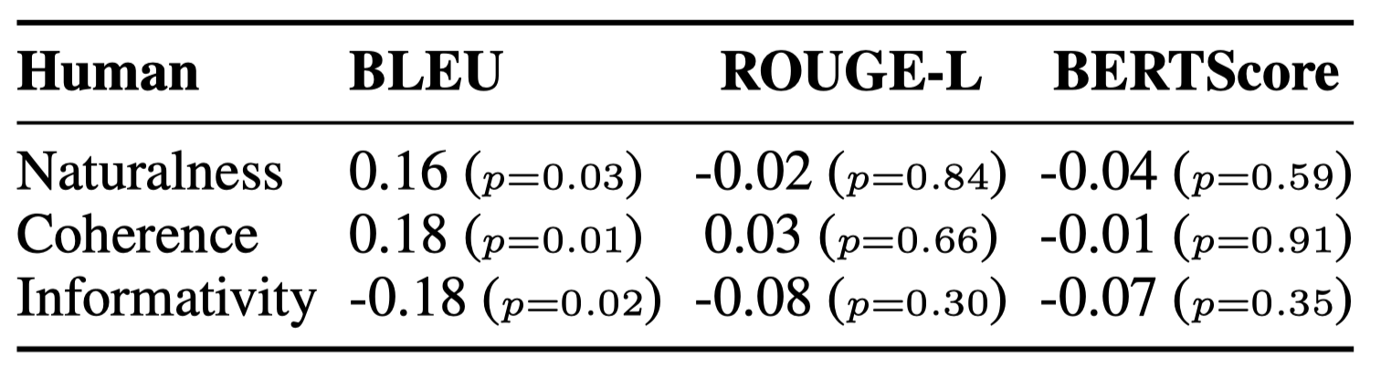
Experiment – Results IV
Correlation between automatic and human evaluation
/19
Notes:
This table shows Pearson’s correlation coefficients between the automatic metrics of our study and the human evaluation metrics
Intriguingly, we observe a surprisingly low correlation between automatic metrics and human judgments
////////////////////////
((As you can see, we included BLEU, ROUGE-L and BERTScore as automatic measures. For these metrics, we compared the model's continuations to the ones produced by participants in the studies conducted by Oliver Bott and Torgrim Solstad))
Pearson's correlation: it is s a number between –1 and 1 that measures the strength and direction of the relationship between two variables.
BLEU: (Bilingual Evaluation Understudy) is an algorithm for evaluating the quality of text which has been machine-translated from one natural language to another. Quality is considered to be the correspondence between a machine’s output and that of a human:
Scores are calculated for individual sentences—by comparing them with a set of good quality reference translations. Those scores are then averaged over the whole corpus to reach an estimate of the translation’s overall quality. Neither intelligibility nor grammatical correctness are taken into account.
ROUGE-L: ROUGE is a set of metric used for evaluating automatic summarization and machine translation The metrics compare an automatically produced summary or translation against a reference or a set of references (human-produced) summary or translation.
Rouge L = Longest common subsequence problem; takes into account sentence-level structure similarity naturally and identifies longest co-occurring in sequence n-grams automatically.
BERTScore: BERTScore leverages the pre-trained contextual embeddings from BERT and matches words in candidate and reference sentences by cosine similarity. Moreover, BERTScore computes precision, recall, and F1 measure, which can be useful for evaluating different language generation tasks.

Slide 61

Experiment – Results IV
Correlation between automatic and human evaluation
No significant correlation between ROUGE-L, BERTScore, and human ratings
/19
Notes:
For example, it is apparent that there is no significant correlation between ROUGE-L and BERTScore and the human ratings

Slide 62

Experiment – Results IV
Correlation between automatic and human evaluation
No significant correlation between ROUGE-L, BERTScore, and human ratings
BLEU scores weakly correlate with coherence
A negative (hardly significant) relationship between BLEU and informativity
/19
Notes:
BLEU scores do achieve a weakly significant correlation with coherence ratings, but not with naturalness or informativity
And, there even seems to be a negative relationship between BLEU and informativity.

Slide 63
Experiment – Results IV
Correlation between automatic and human evaluation
No significant correlation between ROUGE-L, BERTScore, and human ratings
BLEU scores weakly correlate with coherence
A negative (hardly significant) relationship between BLEU and informativity
Automatic metrics struggle in our linguistically controlled task → Scoring differences in this task may demand a deeper understanding of language nuances that is not captured by current metrics
/19
Notes:
Thus, these automatic metrics seem to fail miserably on our linguistically controlled task
We believe that his might be because scoring differences in this task require a deeper understanding of language nuances and understanding of discourse than these metrics can currently capture

Slide 64
Conclusion
/19
Notes:
Now, to conclude…

Slide 65
Conclusion
LLMs struggle with coherent continuations for relatively simple prompts, beyond the IC bias
/19
Notes:
Our study shows that language models struggle with generating coherent continuations in this rather simple setting.
This indicates a lack of discourse knowledge that goes beyond the well-known IC bias

Slide 66
Conclusion
LLMs struggle with coherent continuations for relatively simple prompts, beyond the IC bias
Information density of the prompt and decoding method impact text quality
/19
Notes:
Our study also shows that both the decoding method and the information density of the prompt are factors with a substantial impact on the quality of text generations
((In our study, these factors even surpassed the the influence of the specific language model that was used))
////////////////////////
Also, here sampling based methods are particularly sensitive to the information density of the prompts.

Slide 67
Conclusion
LLMs struggle with coherent continuations for relatively simple prompts, beyond the IC bias
Information density of the prompt and decoding method impact text quality
Modifying IC prompts affects capture of IC bias, depending on decoding strategy; however bias congruence doesn't guarantee higher continuation quality
/19
Notes:
Our results also suggest that modifying the standard IC prompts has a notable effect on the models’ capability to capture the IC bias, depending on the decoding strategy
At the same time, we find that a bias congruent continuation does not necessarily equate to a higher continuation quality

Slide 68
Conclusion
LLMs struggle with coherent continuatios for relatively simple prompts, beyond the IC bias
Information density of the prompt and decoding method impact text quality
Modifying IC prompts affects capture of IC bias, depending on decoding strategy; however bias congruence doesn't guarantee higher continuation quality
Surprisingly low correlation between automatic metrics and human judgments, underscoring NLG metric challenges and caution in interpretation
/19
Notes:
And, maybe most importantly, with the surprisingly low correlation between automatic and human evaluation, our study underscores the significant challenge that NLG metrics face when they aim to capture all the aspects of human evaluation and it emphasizes the need for cautious interpretation of automatic evaluation scores
This calls for future research to enhance the evaluation metrics used in NLG systems.
////////////////////////
Another potential future direction for our study is to expand the scope beyond German data, as this is a major limitation of this work. While IC is known to be cross-linguistically stable, the inclusion of other languages in our investigation should be performed to validate our findings.
Also, it would be interesting to more extensively investigate the models’ strategy for choosing the first word of the continuation (i.e. the pronoun), which may simply consist in selecting the most recently mentioned discourse element.
Further, it could be valuable to investigate the effects of additional prompt modifications on bias congruency and the quality of continuations.
For this, one possible foundation could be the research conducted by Koornneef and Van Berkum (2006), for instance, where IC prompts are integrated within a larger pre-context, making them arguably a more natural option for evaluating LLMs compared to the prompts investigated in this study.
Also, Hoek et al., 2021, for example, investigated IC in the context of relative clauses, which could provide another compelling starting point for further examination of LLMs in this context.

Slide 69
References
Oliver Bott and Torgrim Solstad. 2014. From verbs to discourse: A novel account of implicit causality. In Barbara Hemforth, Barbara Mertins, and Cathrine Fabricius-Hansen, editors, Psycholinguistic Approaches to Meaning and Understanding across Languages, pages 213–251. Springer International Publishing, Cham.
Oliver Bott and Torgrim Solstad. 2021. Discourse expectations: explaining the implicit causality biases of verbs. Linguist. Philos., 59(2):361–416.
Forrest Davis and Marten van Schijndel. 2020. Discourse structure interacts with reference but not syntax in neural language models. Proceedings of the 24th Conference on Computational Natural Language Learning, pages 396–407
Evelyn C Ferstl, Alan Garnham, and Christina Manouilidou. 2011. Implicit causality bias in english: a corpus of 300 verbs. Behav. Res. Methods, 43(1):124–135.
E. Goikoetxea, G. Pascual, and J. Acha. 2008. Normative study of the implicit causality of 100 interpersonal verbs in Spanish. Behavior Research Methods, 40:760–772.Hartshorne et al., 2013
Ari Holtzman, Jan Buys, Li Du, Maxwell Forbes, and Yejin Choi. 2019. The curious case of neural text degeneration.
Hien Huynh, Tomas O Lentz, and Emiel van Miltenburg. 2022. Implicit causality in GPT-2: a case study.
T Florian Jaeger. 2010. Redundancy and reduction: speakers manage syntactic information density. Cogn. Psychol., 61(1):23–62.
Ziwei Ji, Nayeon Lee, Rita Frieske, Tiezheng Yu, Dan Su, Yan Xu, Etsuko Ishii, Ye Jin Bang, Andrea Madotto, and Pascale Fung. 2023. Survey of hallucination in natural language generation. ACM Comput. Surv., 55(12):1–38.
Yova Kementchedjhieva, Mark Anderson, and Anders Søgaard. 2021. John praised Mary because _he_? implicit causality bias and its interaction with explicit cues in LMs. In Findings of the Association for Computational Linguistics: ACL-IJCNLP 2021, pages 4859–4871, Online. Association for Computational Linguistics.
Roger Levy and T Florian Jaeger. 2007. Speakers optimize information density through syntactic reduction. Adv. Neural Inf. Process. Syst., 19.
Clara Meister, Tiago Pimentel, Patrick Haller, Lena Jäger, Ryan Cotterell, and Roger Levy. 2021. Revisiting the Uniform Information Density hypothesis. In Proceedings of the 2021 Conference on Empirical Methods in Natural Language Processing, pages 963980, Online and Punta Cana, Dominican Republic. Association for Computational Linguistics.
Clara Meister, Tiago Pimentel, Gian Wiher, and Ryan Cotterell. 2022. Locally typical sampling.
Shiva Upadhye, Leon Bergen, and Andrew Kehler. 2020. Predicting reference: What do language models learn about discourse models? Proceedings of the 2020 Conference on Empirical Methods in Natural Language Processing (EMNLP), pages 977–982.
Ashwin Vijayakumar, Michael Cogswell, Ramprasaath Selvaraju, Qing Sun, Stefan Lee, David Crandall, and Dhruv Batra. 2018. Diverse beam search for improved description of complex scenes. AAAI, 32(1).
Sina Zarrieß, Henrik Voigt, and Simeon Schüz. 2021. Decoding methods in neural language generation: A survey. Information, 12(9):355.
Sina Zarrieß, Hannes Groener, Torgrim Solstad, and Oliver Bott. 2022. This isn’t the bias you’re looking for: Implicit causality, names and gender in German language models. In Proceedings of the 18th Conference on Natural Language Processing (KONVENS 2022), pages 129–134, Potsdam, Germany. KONVENS 2022 Organizers.
/19

Slide 70
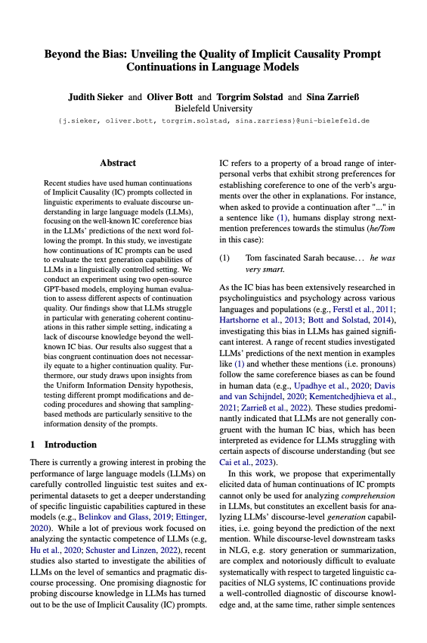
Thanks for listening!
Judith Sieker & Oliver Bott &
Torgrim Solstad & Sina Zarrieß
Bielefeld University
j.sieker@uni-bielefeld.de
/19
Notes:
Thank you very much for your attention.
You can find more details in the paper.
Sina and I are around at the conference so don’t hesitate to approach us. Or get in touch via mail.

