Slide 1
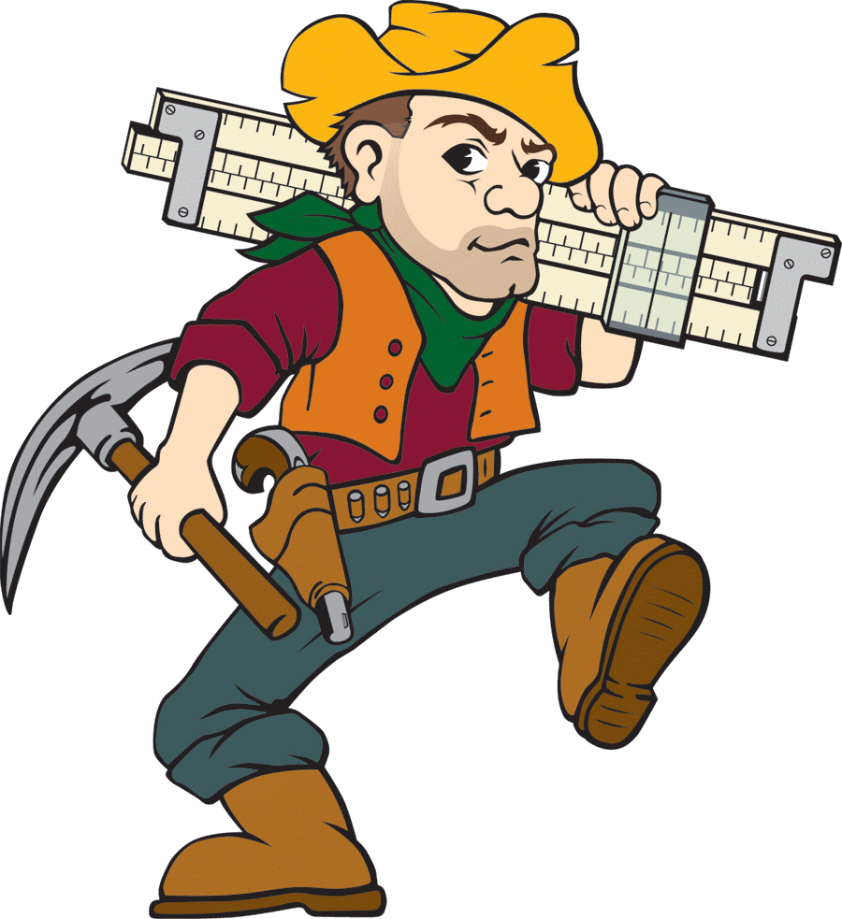

MegaMiner AI Tournament

Slide 2
The Story
Our story takes place on an island-nation named Rollania. There the wise king ruled for many years, but his greedy twin sons were always anxious to inherit the kingdom. One day, a foreign surveyor came and informed them that the island was full of the rare metal expensivium. The two brothers were overcome with the promise of wealth, and arranged a tragic plumbing accident occur with their father.
In his will, they found he had left each son just 100 grams of expensivium, and that the island would be given to the son who could produce the most expensive statue of him 1 year after his death. And so, on the very day of his death the 2 sons start their fledgling enterprises on opposite ends of the island's deposit.

Slide 3
Rules
There will be 24 hours to work on your AI.
You are not required to stay the entire 24 hours, you can come and go as you please.
However, ALL CODE must be completed in the lab.
Work will be limited to lab machines in CS207 and CS213.
NO CHEATING(You can Google whatever you want, but all code must be written by team members in the 24 hours allotted)

Slide 4
Game Description
The game is a 2 player RTS based game.
Board size is 25x25.
All client code is in C++.
Each game will be 730 turns.
The player with the most resources at the end of the game wins.
Units are purchased with resources, spend them wisely!

Slide 5
Gameplay Details
The further a resource node is from your base, the higher the resource multiplier will be.
Turns to do not occur simultaneously.
Units with negative attack damage are healers.
Friendly fire is disabled(except for healing).
When a resource node runs out of “juice” it is relocated.
When mining from a resource node you get 2 x the multiplier amount of juice.
Multiplier 1 applies to player starting in corner (0,0)Multiplier 2 applies to player starting at (25,25)

Slide 6
Unit Types
Fighter – short range combat
Healer – heals.
Bomber – sacrifices self(i.e. kamikaze), with a splash diameter of 5. note: splash damage IS NOT friendly fire. Damage is constant within range.
Sniper – long range attack.

Slide 7
Coding
in the shellAI files fill in the code for the constructor, destructor, Play, and PlayerName functions.
The constructor should be used for initialization.
The destructor should be used for cleanup.
PlayerName should return the player's name

Slide 8
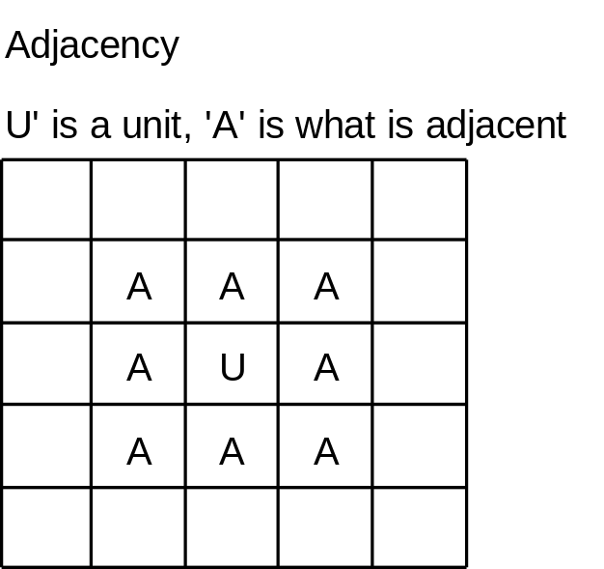
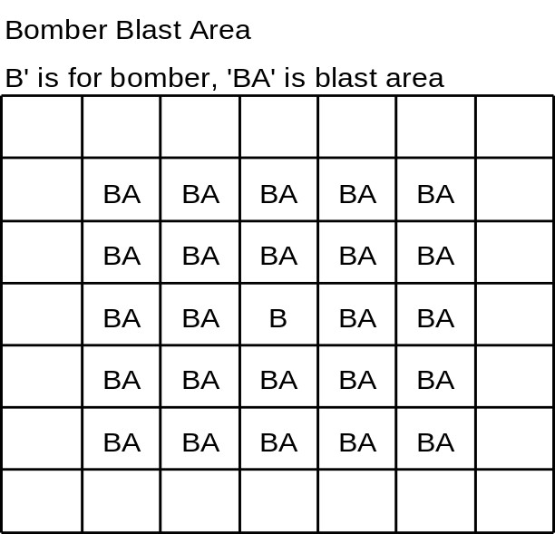
Coding (continued)
In the shellAI files...
void BuyUnit(unitInfo* typeToBuy) //Purchases a unit and places it at your base
void Move(const unit& toMove, const coordinate& moveTo) //moves the unit to the coordinate moveTo, must be adjacent to the unit's current location
void Attack(const unit& attackWith, const coordinate& attackCoord) //attacks unit at attackCoord with attackWith unit. attackCoord must hold an enemy unit.
void Gather(const unit& toGather) //gathers resources with toGather, to Gather must be adjacent to a resource node.

Slide 9
How To
Run make in the directory
Run the client with the IP and port # of the server you want to play on. Either include the game ID of an existing game, or no ID to start a new game.
On the local machine, run the visualizer.bat with the dump file named “input.gameplay” in the visualizer’s directory. Push right arrow to step to the next turn.
Mouse scroll wheel zooms, middle click drags the view.

