Slide 1
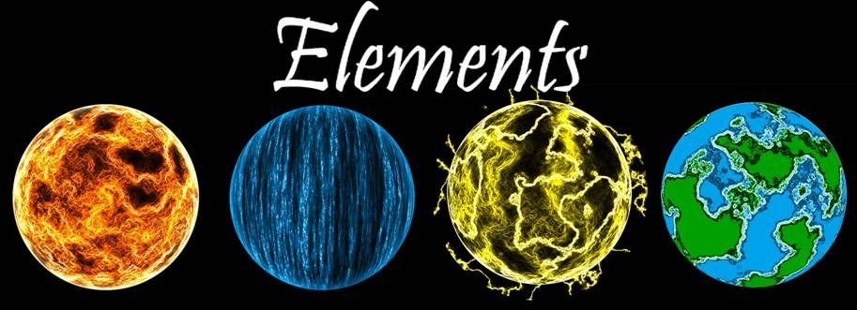

Missouri S&T ACM Presents:
2008 MegaMiner AI Tournament
Missouri S&T ACM Presents:
MegaMiner AI Tournament ,FS08

Slide 2
Welcome!
Meet the Team
  Stephen Mues : Server
  Steven Wallace : Visualizer
  Ben Murrell : Client
  Gerald Holt : Visualizer
  Andrew Schrader : PR (Wounded in Action)

Slide 3
The Story
Our story takes place a little after our last story. After building your grand statue and rightfully winning your father's kingdom, you stood at your coronation ceremony. But 'lo! As you are about to be crowned your father appears! He had been alive this whole time and was unhappy with the socio-economic terror you wrought in building the statue. So great was his unhappiness that he banished you to the magical wilderness of the Marktwainational Forest.
There you met a druid who taught you how to harness the power of nature... to create artificial servants! You realized the solution: if you couldn't have your father's kingdom you'd build your own. Thus, using the lodestone deposits of the forest, you made magical robots to use the lodestone deposits to make magical robots to use the lodestone deposits to make magical robots...! Laughing as your new contraptions began working, you looked across the clearing. Your evil brother had come to the same idea! Now you must show him who the master golemcraftsmen is and again stop him from stealing your kingdom.

Slide 4
Rules
There will be 24 hours to work on your AI (barring IT breaking things)
You aren’t required to stay the entire 24 hours – you can come and go as you please
However, ALL CODE must be completed in the lab!
No Cheating! Googling is fine – copy-pasting is not.

Slide 5
Teams
3 people recommended
Anything up to 3 is fine

Slide 6
Game Description

Slide 7
Game Description - General
The game is a 2 player RTS based game.
The board size is 26x26
  Corners are (0,0) and (25,25)
Each game will last 400 turns, or until a team is annihilated.
The winner is the survivor, or whoever has the most points at the end of 400 turns

Slide 8
Game Description - General
Turns do not occur simultaneously.
Friendly fire is disabled

Slide 9
Game Details

Slide 10
Game Description - Units
Units are elementals that consist of fire(Red), water (Blue), electricity (Yellow), and earth(Green)
The unit’s overall level is equal to the sum of its individual color levels.
Units can split and combine – they cannot be bought!

Slide 11
Game Description - Units
Units can split into rotated copies of themselves.
  Rotation: Yellow -> Red -> Blue -> Green -> Yellow
  This costs buildPoints – the unit must accumulate the maximum number of buildPoints for their level to split. (overall level * 3)
Units can combine with other units
  The resultant unit is the sum of the two units
  This is free

Slide 12
Game Description - Units
* R = red, G = green, B = blue, Y = yellow
* HP = 15G + 50
* Range = Y + 1
* Attack = 6R + 20
* Movement = B + 2
* Heal = x * min(G, Y)
* Splash = x * min(Y, R)
* Poison = x * min(R, B)
* Regen = x * min(B, G)
* level = R + G + B + Y
* maxBuildPoints = level *3
These may not be accurate!
Check Parser::instance()->formulas() for the current formulas!

Slide 13
Game Description – The Rest
There is a very detailed list of rules and formulas included in the zip file you will receive.
If you have any questions, ask us!
  Ben – Client
  Stephen Mues – Server
  Steven Wallace - Visualizer

Slide 14
In the lab…

Slide 15
Coding
Write the constructor, destructor, play, init, playerName, and playerPassword functions of myAI in the shellAI files.
playerName should return your team’s name
playerPassword should return your team’s password

Slide 16
Coding (continued)
void CombineUnits(Unit& first, Unit& second);
void SplitUnit(Unit& toSplit, Coordinate& newUnitLoc);
void SplitUnit(Unit& toSplit);
void Move(Unit& toMove, const Coordinate& moveTo);
void Attack(Unit& attackWith, const Coordinate& attackCoord);
All distances are the Manhattan Distance
  (abs(x1 – x2) + abs(y1 – y2))
Adjacent positions have a Manhattan Distance of 1.

Slide 17
How To
Linux:
  Run make in the directory
Windows:
  Build the included VS2005 project
Both:
  Run the client: ./client serverIP (game#)
Visualizer:
  Drag the resultant gamelog file onto visualizer.bat in the visualizer folder.

Slide 18
Arena
To play in the Arena, you have to build for Linux and submit it.
Submit your AI with the included shell script

Slide 19
In the lab… Today
Because IT is shutting down from 8:00 am – 12:00pm

Slide 20
Logging in
CS207 Lab Machines have a local user
  Username: elements
  Password: We’ll write it on the whiteboard
Each team will receive an ACM shell account
  Putty to acmshell.device.mst.edu
  Usernames: elements##
  Password: We’ll tell each team

Slide 21
Editing
Edit in your Putty session, OR
  Map ACM server as a network drive
  My Computer -> Tools -> Map Network Drive
    Connect using a different username:
      User: elements## --Pass: We’ll tell each team
    Folder: \\acmshell.device.mst.edu\elements##
  Use your editor of choice

