Slide 1
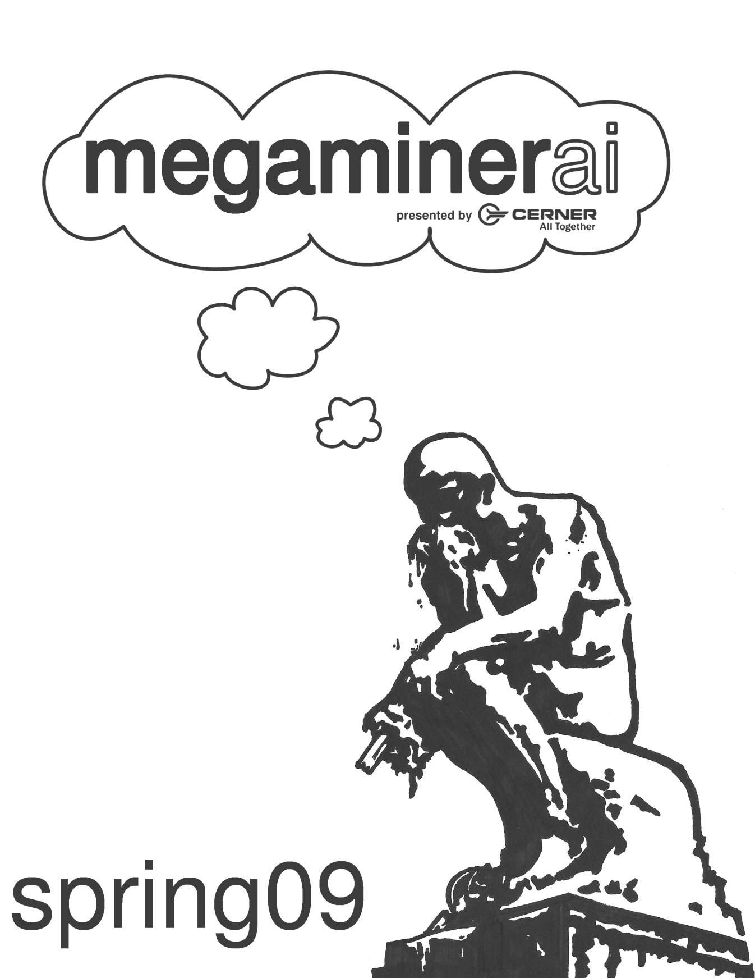

Slide 2




MegaMinerAI Tournament
Spring 2009
Codename: SURVIVE

Slide 3
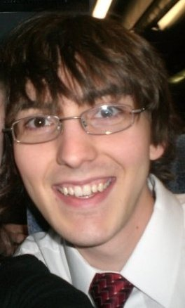
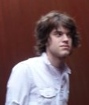
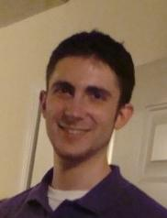
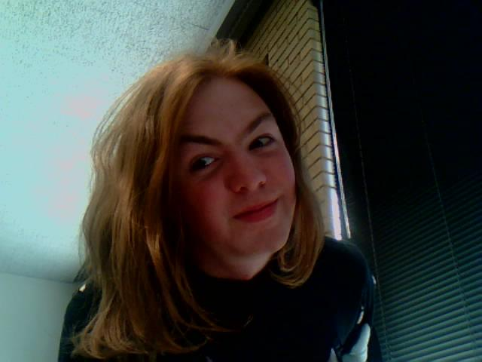
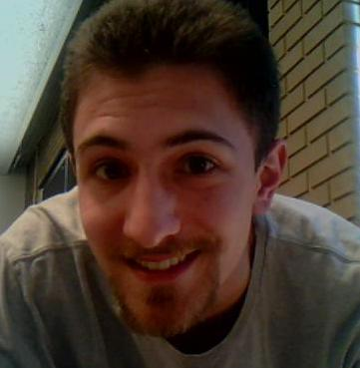
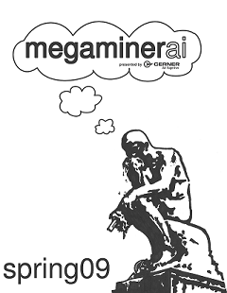
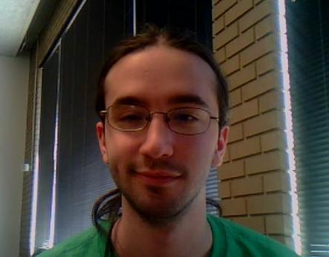
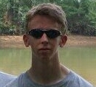
Meet the Team
Server
  Stephen Mues
  Josh Bohde
Client
  Steven Wallace
Visualizer
  Ben Murrell
Testing & Balancing
  Brian Goldman
  Kyle Steinert
PR
  Andrew Schrader

Slide 4
The Story
Our story takes place in the pleasant town of Pleasanton. It is a nice town, and if you have fond memories of a town, that town is a lot like Pleasanton. Everyone knew each other and pleasant things always happened. Nothing bad ever happened, until you came to town.
You're a scientist working in the fine field of air freshening. You and your five colleagues developed a new kind of air freshener. A freshener that creates a freshness beyond what a mortal mind can handle. Soon, your product testers show strange signs. Upon experiencing the latest batch, they are taken with a queer mood. "Freshness! Freshness!" they howl. They break free of the quarantine and escape into the town with enough fresheners to freshen the entire world. Those not aware of the danger happily take complementary air fresheners and join the horde. There are those in your company who try to escape, imitating these seemingly unliving freshness monsters, but they are soon found and freshened. It is clear that these former humans can smell the unfreshness of your body!
As luck would have it, however, your company has anticipated these events and has an emergency procedure in place. In 8 hours an evacuation plane will arrive, followed with the activation of the antimatter charges. With nothing but your wits, and your company's trans-military grade weapons and air support, you must survive these 8 hours or face... freshness.

Slide 5
The Story
Our story takes place in Freshness. An hour and a lifetime ago you were helping your friendly neighborhood research facility by evaluating their new freshener. Then, you smelled the light. This ambrosia touched your mind in a higher place than any experience this world had thus far shown. "Freshness," you muttered, "freshness!" You don't recall the old world so well anymore. The box of Freshness was in the room, and you could smell; there were so many outside that were unfresh. They reeked! Thousands all around! You couldn't stand it! Somehow, you got it. You ran toward the foul smells, and they smiled when they caught your whiff. They welcomed the Freshness and joined you. Soon, the whole town was Fresh. Except one building. Six foul monsters who fear the Freshness. Don't worry, however. You now claw the walls of their building in company of dozens. More still approach, ready to share Freshness. By nightfall, Freshness will be all.

Slide 6
Tournament Rules
All work must be completed in the tournament lab (Centennial 105). Competitors are free to come and go.
All code must be written by the team during the 24 hours given for coding.
External resources are allowed (feel free to Google anything or use books - just don’t copy/paste code from outside sources).

Slide 7
TEAMS
“The buddy system is essential to your survival; it gives the enemy somebody else to shoot at.”
–Murphy’s Law, part 6

Slide 8
GAME DESCRIPTION
“The only way to kill a zombie is to destroy its brain…”
– eHow, How to Kill a Zombie Onslaught

Slide 9
General Description
Two player game
Two phases
  1st Phase: Zombies vs. Humans
  2nd Phase: Humans vs. Zombies
Goal: Survive the longest
  Match is over when the humans are dead
  Maximum turn limit: 1000

Slide 10
General Description
Friendly Fire: Yes
Simultaneous Turns: No

Slide 11
GAME DETAILS
“As part of a previously mentioned required test protocol, we can no longer lie to you.”
- GLaDOS

Slide 12
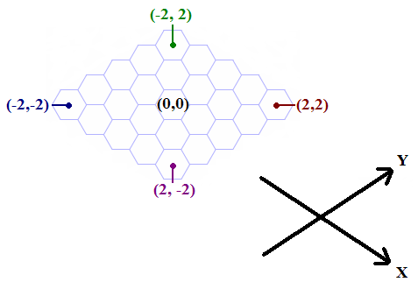
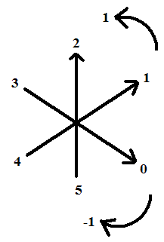
Details – The Map
Hexagonal Coordinate System, Diamond Map
Zombie Orientation

Slide 13
Details - Humans
Can see far
Can make 3 moves per turn
  Can drop weapon, pick up crate, attack, build/fortify walls, call in air drops
Each weapon has different stats & uses different amounts of ammo
Airdrops can contain weapons or ammo. They will smash whatever they land on.

Slide 14
Details - Zombies
Can’t see very far
Can smell humans
In a turn, has one move
  Can turn, move forward, attack, or eat each other

Slide 15
Details – Everything Else
Detailed rules file on your desktop
  Constants like max moves, weapon stats, etc. are controlled by the server. There are calls in the API to retrieve these values.
If you have any questions, ask us!

Slide 16
IN THE LAB
“Adverse side effects weren’t noticed in the lab – only after we moved to consumer trials did the infection become apparent…”
– Pleasanton Lab Log

Slide 17
Accounts
Username: mst000##
Password: (given to you)
Can putty to linux machines:
  rc##xcs213.managed.mst.edu

Slide 18
API Documentation
Doxygen! Shortcuts are on your desktop
  http://acm.mst.edu/~mstai/sp09/doxygen

Slide 19
Coding – C++
What you write:
  AI.h, humanAI.cpp, zombieAI.cpp, commonAI.cpp, util.cpp
What you run:
  Windows: Build in VS
  Linux: Use makefile
  Both: ./client hostname [game#]

Slide 20
Coding - Java
What you write:
  AI.java [optional: util.cpp, client.java]
What you run:
  Windows: No JDK ☹
  Linux:
    Build with make
    Run with “java -cp jna.jar:. Main [hostname] [game#]”

Slide 21
Coding - Python
What you write:
  AI.py [optional: util.cpp, library.py]
What you run:
  Windows: Python not available
  Linux: “python main.py [hostname] [game#]”

Slide 22
Arena
The Arena will be running throughout the competition – it randomly pits the AI’s against each other.
To submit your AI to the arena, you must build on the Linux machines then submit your AI with the included submission script.
Edit submit.sh and change the team name to your team name.

Slide 23


