Slide 1
Section I: Coulomb Friction
Notes:
With a basic framework in place for generating impulses in the contact frame, this next section will take a closer look at the mathematical model used to simulate realistic frictional contact.
These models dictate how large friction forces can become, and in what directions they may be applied

Slide 2

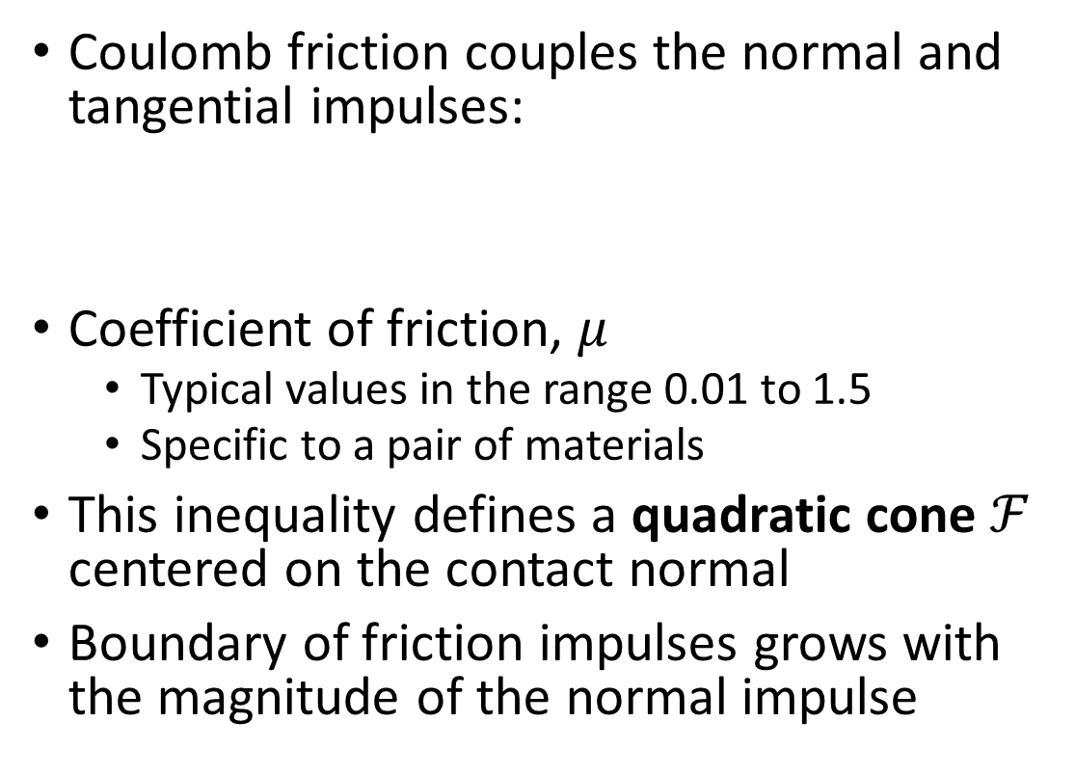






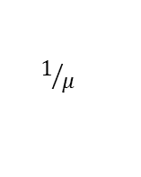
Isotropic Coulomb Friction
Coulomb friction couples the normal and tangential impulses:
Coefficient of friction, $μ$
Typical values in the range 0.01 to 1.5
Specific to a pair of materials
This inequality defines a quadratic cone $ℱ$ centered on the contact normal
Boundary of friction impulses grows with the magnitude of the normal impulse
friction cone, $ℱ$
$$\left\|λ_{\hat{t}} \right\|≤μλ_{\hat{n}}$$
$$\hat{n}$$
$$λ_{\hat{n}}$$
$$1/μ$$
$$\hat{t}$$
$$\hat{b}$$
contact plane
$$λ_{\hat{t}}$$
Notes:
That is to say: we can’t simply generate friction forces “willy nilly”. There are some rules.
And one of the most widely used models of friction in computer graphics is Coulomb friction. It is an empirical model based on observations of friction generated between pairs of surfaces of different materials.
The Coulomb friction law couples the normal and tangential forces according to the inequality shown here.
Where the magnitude of friction forces must be equal to or less than the normal forces times the friction coefficient, mu
mu here is a single material parameter, but in reality it represents an aggregate effect for a very complex phenomenon happening at a microscale level between pairs of surfaces . But let’s not get too off topic.
Instead, we observe that the inequality defines a quadratic cones that is centered around the contact normal and parameterized by the coefficient of friction.
And so as the magnitude of the non-interpenetration impulse grows, so can the friction forces.
Note that for this part of the course, we’ll assume the case of isotropic coulomb friction, which simply means that the cross section of the cone is a circle and the friction forces behave similarly in all directions of the contact plane.
Whereas for anisotropic friction, the shape would be an ellipse, or possibly some other convex shape.

Slide 3

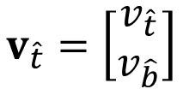
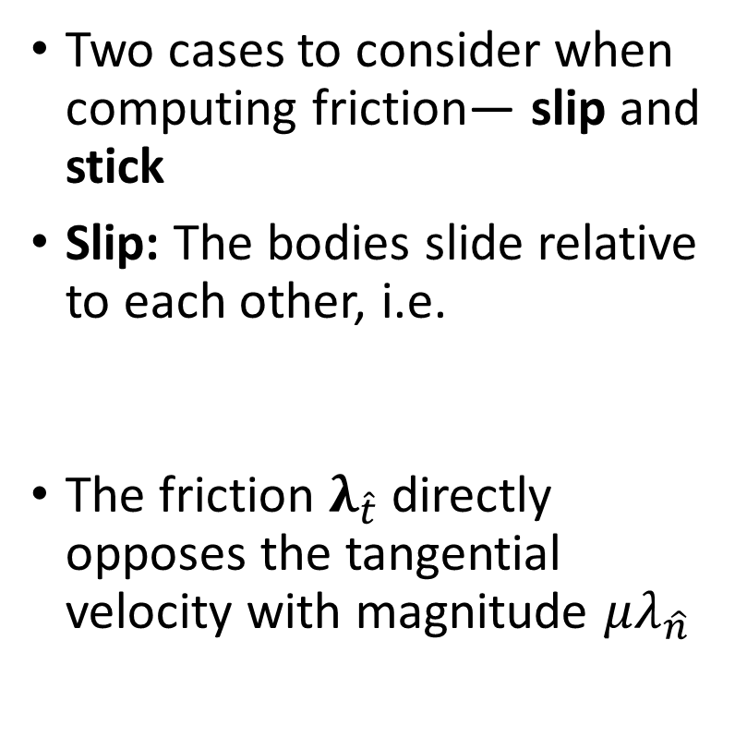









Coulomb Friction Law - Slipping
slipping
Two cases to consider when computing friction— slip and stick
Slip: The bodies slide relative to each other, i.e.
The friction $λ_{\hat{t}}$ directly opposes the tangential velocity with magnitude $μλ_{\hat{n}}$
$$\hat{n}$$
$$v_{\hat{t}}=\left[\begin{matrix}v_{\hat{t}} \\ v_{\hat{b}}\end{matrix}\right]$$
$$\hat{t}$$
$$\hat{b}$$
$$λ_{\hat{t}}$$
$$v_{\hat{t}}≠0$$
$$v_{\hat{t}}$$
$$\hat{b}$$
$$μλ_{\hat{n}}$$
$$λ_{\hat{t}}$$
$$\hat{t}$$
Notes:
Role of friction is to resist relative tangential motion. Depending on the magnitude of the friction forces, and whether or not they are limited by Coulomb’s friction law, the objects will either be sliding relative to each other, or stationary.
That is, there are two cases to consider when computing friction forces: slip or stick.
During slip, the bodies are sliding against each other, and so there is some relative motion. Therefore, the residual velocity in the tangent direction, v_t hat, is not zero.
But friction is the antagonist in this story of slip and stick, and it will always act to oppose the tangential velocity with a direction that maximizes dissipation of the velocity and the largest magnitude allowed by the friction cone, which is mu times the normal impulse. This means that lambda t hat has a value defined by the limit surface of the cone, and furthermore it has a direction directly opposite the residual velocity.

Slide 4

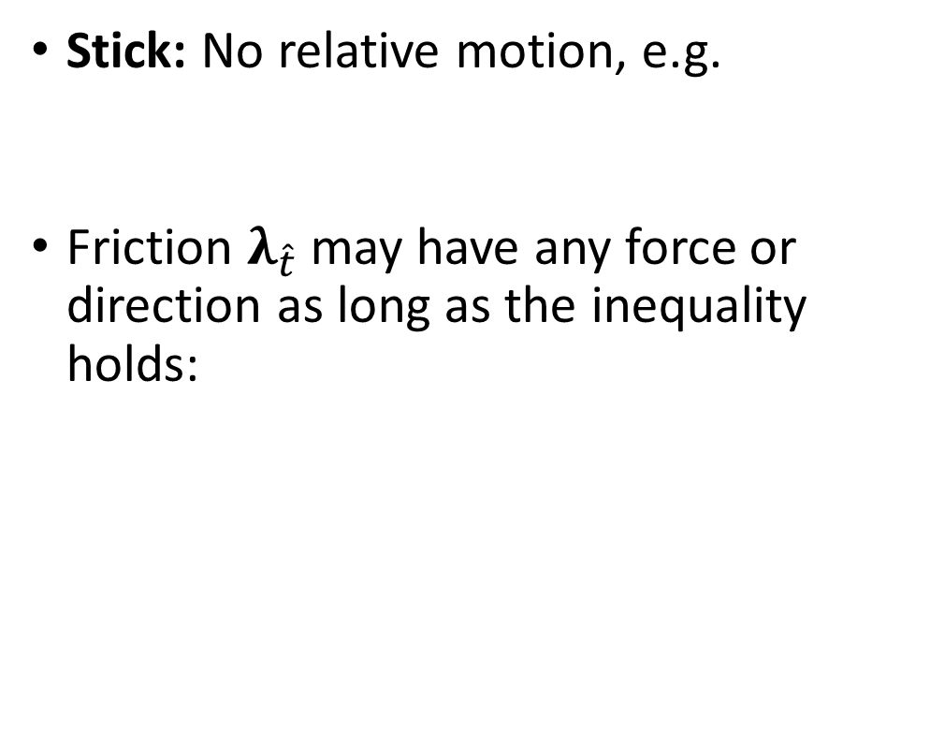








Coulomb Friction Law - Sticking
sticking
Stick: No relative motion, e.g.
Friction $λ_{\hat{t}}$ may have any force or direction as long as the inequality holds:
$$\hat{n}$$
$$v_{\hat{t}}=0$$
$$\hat{t}$$
$$\hat{b}$$
$$λ_{\hat{t}}$$
$$\left\|λ_{\hat{t}} \right\|<μλ_{\hat{n}}$$
$$\hat{b}$$
$$λ_{\hat{t}}$$
$$\hat{t}$$
Notes:
Conversely, with the case of sticking, there is no tangential velocity. In other words, v t hat is zero
And in this case, the friction forces can have any value so long as they do not exceed the bounds imposed by the friction cone.

Slide 5




Non-linear Complementarity Problem
Formally write the stick-slip as conditions on $v_{\hat{t}}$ and $λ_{\hat{t}}$:
These conditions represent the non-linear complementarity problem (NCP) formulation of frictional contact
Energy dissipation term gives insight into physical interpretation of friction
$$μλ_{\hat{n}}− \left\|λ_{\hat{t}}\right\|≥0$$
$$\left\|v_{\hat{t}}\right\|\left(μλ_{\hat{n}}− \left\|λ_{\hat{t}}\right\|\right)=0$$
rate of energy dissipation
$$\left\|v_{\hat{t}}\right\|\left\|λ_{\hat{t}}\right\|=−v_{\hat{t}}^{T}λ_{\hat{t}}$$
Notes:
We can write the stick-slip behavior more formally by a series of conditions on the relative tangential velocities and the frictional impulses.
First, we have the condition based on the friction cone definition, which is that the tangential impulses are bounded by the coefficient of friction times the normal impulse magnitude.
Next, we have the condition that the product of the of tangent velocities and the difference between the friction forces and their bound is zero. Intuitively, this condition says that either i) the tangent velocities are zero and the friction forces are less than their bounded value. In other words, they are inside the cone. Or ii) there is some tangential sliding, in which case the friction forces are being bounded by the limit surface of the cone.
Finally, we have the condition that, if there is some sliding velocity, then the friction force must directly oppose the sliding direction in the contact plane.
We observe the similarity of these conditions and the complementarity conditions we introduced earlier for the non-interpenetration forces. In fact, together these conditions give the non-linear complementarity model of frictional contact.
Also, in the final condition, we note there is a term that represents the rate of energy dissipation of the friction forces. This notion of energy dissipation gives us some important insight into the non-linear model and how we might solve for friction

Slide 6




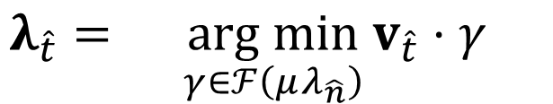

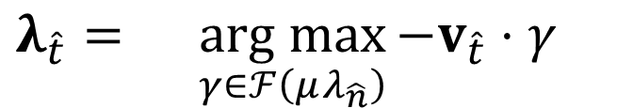
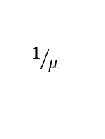
Energy Dissipation
Principle of maximum dissipation: friction forces maximize the rate of energy dissipation
Determining the friction impulses $λ_{\hat{t}}$ can be written as a maximization problem:
The NCP formulation requires a non-linear solver, e.g. Newton type
$$λ_{\hat{t}}={\underset{γ∈ℱ\left(μλ_{\hat{n}}\right)}{arg max}{{−v}_{\hat{t}}⋅γ}{}}$$
$$ℱ\left(μλ_{\hat{n}}\right)$$
$$λ_{\hat{t}}={\underset{γ∈ℱ\left(μλ_{\hat{n}}\right)}{arg min}{v_{\hat{t}}⋅γ}{}}$$
$$\hat{n}$$
$$1/μ$$
$$ℱ\left(μλ_{\hat{n}}\right)=\left\{γ∈ℝ^{2 } | \left\|γ\right\|≤μλ_{\hat{n}}\right\}$$
$$\hat{t}$$
$$\hat{b}$$
Notes:
And this brings us to the principle of maximum dissipation. As we’ve already seen, it states that friction must maximize the rate of energy dissipation.
We can therefore write the problem of determining friction forces as a maximization problem.
And the solution vector, gamma, is the friction force that maximizes the rate of energy dissipation, but remains inside the limit surface defined by the friction cone.
However, a downside to this formulation is a non-linear solver, such as a Newton type method is required to compute the friction forces, which can be expensive
As an side, we could alternatively change the sign of the formulation and write is as a minimization problem, as we do in the course notes.

Slide 7
Linear Complementarity Problem
Linear approximations are often preferred for computer graphics
The NCP model can be approximated by a linear form, or a linear complementarity problem (LCP)
Easier to solve, but sacrifices some precision
Examine two different linear models:
Polyhedral LCP
Boxed LCP
Polyhedral
Box
Notes:
Rather, for many graphics applications, linear models of frictional contact are preferred.
So we’ll next consider how to linearize the nonlinear complementarity problem we saw previously in order to obtain the linear complementarity problem, or LCP, formulation.
This formulation is an approximation of the isotropic friction cone, but will be easier to solve since there are wide variety of efficient linear solvers available to use.
Specifically, we’re going to examine two different linear models: the polyhedral cone, and the box friction model. And as you can see, both of these are approximations of the quadratic cone

Slide 8

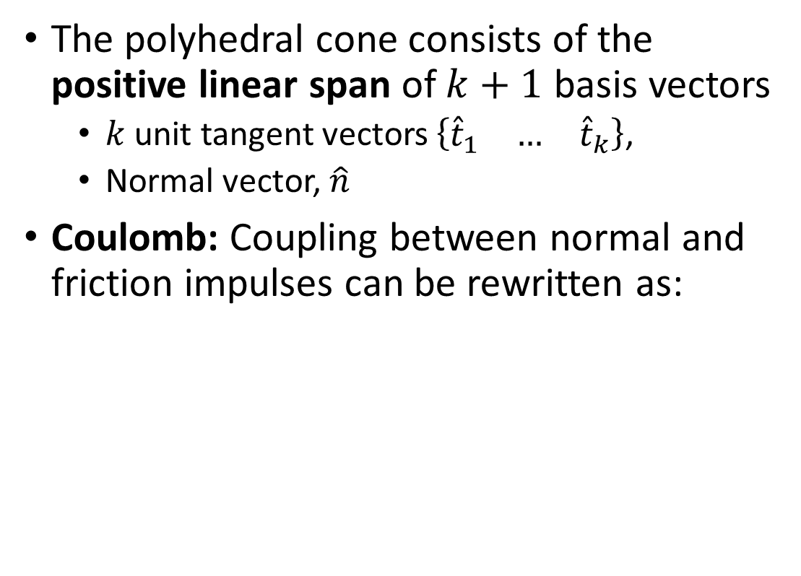







Polyhedral Friction Cone
The polyhedral cone consists of the positive linear span of $k+1$ basis vectors
$k$ unit tangent vectors $\left\{\begin{matrix}{\hat{t}}_{1} & … & {\hat{t}}_{k}\end{matrix}\right\}$,
Normal vector, $\hat{n}$
Coulomb: Coupling between normal and friction impulses can be rewritten as:
polyhedral cone
$$\hat{n}$$
$${\hat{t}}_{4}$$
$${\hat{t}}_{2}$$
$$0≤\left(μλ_{\hat{n}}−\sum_{i=1}^{k}{λ_{{\hat{t}}_{i}}}\right)$$
$${\hat{t}}_{1}$$
$${\hat{t}}_{3}$$
s.t.
$$∀i∈\left\{1…k\right\} : λ_{{\hat{t}}_{i}}≥0$$
$$λ_{\hat{n}}≥0$$
Notes:
Beginning with the polyhedral cone, we can approximate the limit surface by sampling it in “k” different tangent directions.
For example, in the cone shown here there are k = 4 unit length tangent vectors
Then, together with the contact normal, the quadratic cone is approximated by positive linear span of the basis vectors.
Then, the coupling introduced by Coulomb friction law can be restated as the condition that the sum of tangent friction impulses must be less than the friction coefficient mu times the normal impulse.
And this condition is written here as an inequality.
Furthermore, recall that the cone is approximated by the positive span of the vectors, and so we require that each frictional force is non-negative, as well as the normal force.

Slide 9



Polyhedral Cone Accuracy
Increase accuracy by adding more tangent vectors:
Want: symmetry of basis vectors
$$k=4$$
$$k=6$$
$$k=8$$
Notes:
The accuracy of the polyhedral cone approximation can be increased by adding more tangent vectors, as is shown here.
However, this increases the problem size, since there will be more tangent impulses and hence more unknown variables in the resulting linear system.
Note the symmetry of the tangent vectors, and this is required in order for us to compute friction forces using a non-negative scaling of the basis vectors.

Slide 10

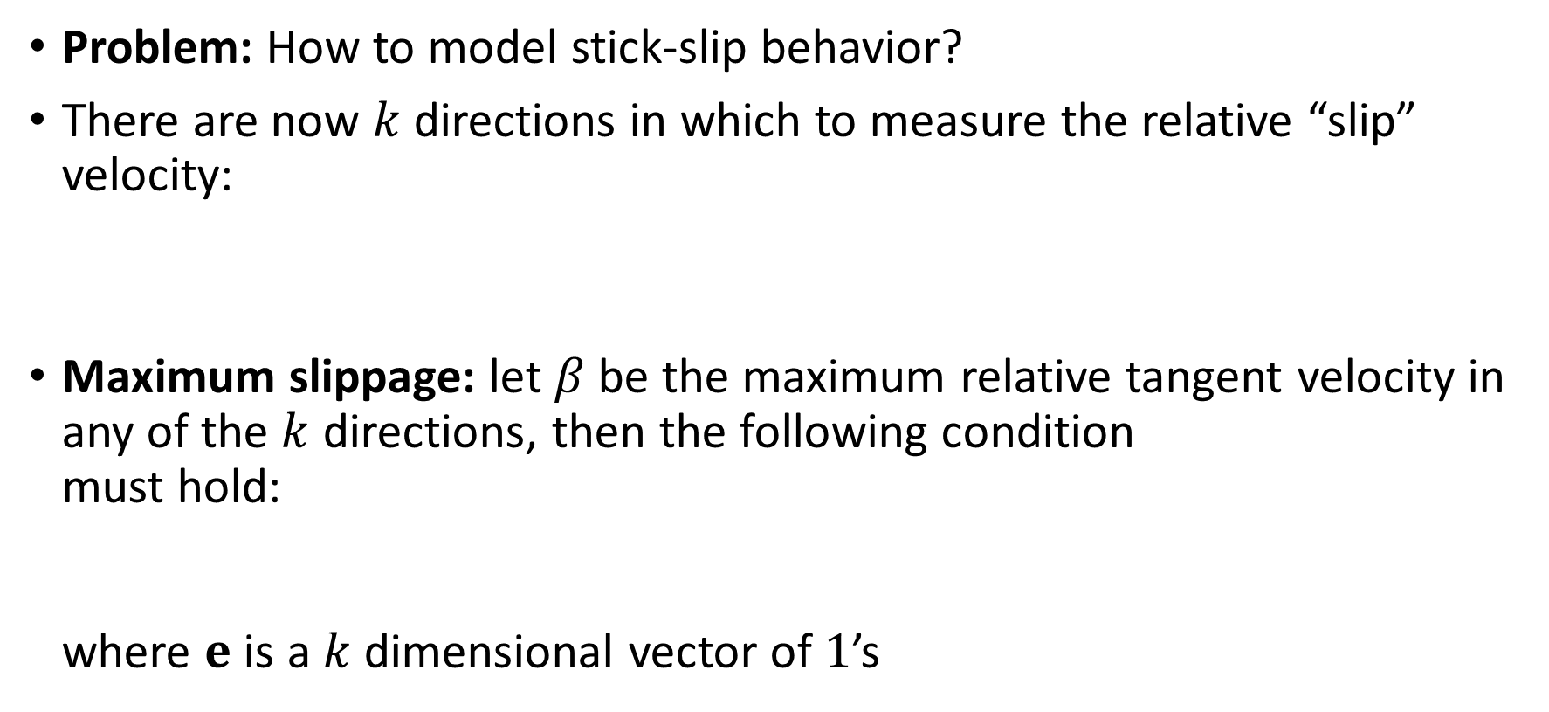







LCP: Stick-slip Condition
Problem: How to model stick-slip behavior?
There are now $k$ directions in which to measure the relative “slip” velocity:
Maximum slippage: let $β$be the maximum relative tangent velocity in any of the $k$ directions, then the following condition must hold: where $e$ is a $k$ dimensional vector of $1$’s
$$v_{\hat{t}}={\left[\begin{matrix}v_{{\hat{t}}_{1}} & … & v_{{\hat{t}}_{k}}\end{matrix}\right]}^{T}$$
$$λ_{\hat{t}}={\left[\begin{matrix}λ_{{\hat{t}}_{1}} & … & λ_{{\hat{t}}_{k}}\end{matrix}\right]}^{T}$$
Recall:
$$v_{\hat{t}}$$
$$0≤\left(βe+v_{\hat{t}}\right)$$
$$\hat{b}$$
$$β>0$$
$$λ_{\hat{t}}$$
$$\hat{t}$$
Notes:
In order for the linear cone model to be physically accurate, it must be able to reproduce the stick-slip behavior we described previously.
However, now there are k directions in which the relative tangential velocity can be measured, which is shown here as a k-dimensional vector. And there is a corresponding number of elements for the tangential impulse vector.
One strategy here is to simply identify the tangent direction of maximum slippage.
Denoting a variable beta as the maximum “slip” velocity in any of the tangent directions, then we can write an equality that must hold.
Why is this important? Quite simply, when beta becomes positive, we know that a transition from sticking to slipping occurs.
And recall that when slipping begins to occur, the direction of the friction force is defined to be the opposite direction of the sliding direction and with a magnitude imposed by the limit surface of the cone.
On the other hand, if there is no slipping, then beta must be zero, and therefore the v t hat must also be zero. Then, the friction force lies strictly on the inside of the friction cone.

Slide 11




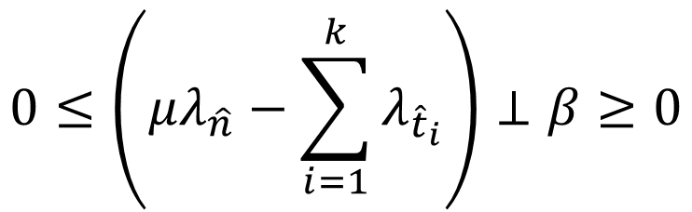
LCP: Complementarity Conditions
Rewrite the Coulomb friction complementarity conditions as:
$$β=\max_{i}\left\{−t_{\hat{k}}^{T}\right\}v_{\hat{t}}$$
$$0≤v_{\hat{n}}⊥λ_{\hat{n}}≥0$$
“Friction forces oppose sliding”
$$0≤\left(βe+v_{\hat{t}}\right)⊥λ_{\hat{t}}≥0$$
$$0≤\left(μλ_{\hat{n}}−\sum_{i=1}^{k}{λ_{{\hat{t}}_{i}}}\right)⊥β≥0$$
$$λ_{\hat{t}}$$
“If positive, friction forces must be at their limit. ”
“Contact forces must be inside the cone. ”
Notes:
With these observations in mind, we can write the full set of complementarity condition for the linear cone model.
First, we have the complementarity conditions of the non-interpenetration forces. These are the same as before, so nothing new there.
Next, on the second line, we have the condition that says either there will be tangential sliding and a beta that is positive, in which case the tangential forces directly oppose the sliding motion. Or we have the case that there is no slipping, in other words a sticking contact, and so the tangent forces can have some non-negative value.
Let’s spend a minute to think about this condition. In the simple case, the condition implies that only one element of lambda t hat will be non zero, and this will correspond to the tangent vector that maximizes energy dissipation. In other words, friction forces should aligned with a tangent direction that opposes sliding.
Whereas in the more complex case, we have that more than one element of lambda t hat that is positive. And this is where the last condition comes in, which couples normal and tangential forces, keeping tangent forces inside the limits of the polyhedral cone. But the complementarity with the beta variable also means that if beta is non-zero, then the friction forces have a magnitude at the limit mu times lambda n hat.

Slide 12

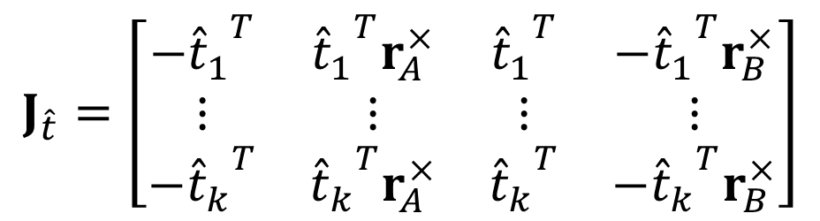
LCP: Jacobian Matrices
The non-interpenetration constraint Jacobian is the same as before:
The friction Jacobian encodes the $k$ tangent directions:
$$J_{\hat{n}}=\left[\begin{matrix}−{\hat{n}}^{T} & {\hat{n}}^{T}r_{A}^{×} & {\hat{n}}^{T} & −{\hat{n}}^{T}r_{B}^{×}\end{matrix}\right]$$
$$J_{\hat{t}}=\left[\begin{matrix}−{{\hat{t}}_{1}}^{T} & {{\hat{t}}_{1}}^{T}r_{A}^{×} & {{\hat{t}}_{1}}^{T} & −{{\hat{t}}_{1}}^{T}r_{B}^{×} \\ ⋮ & ⋮ & ⋮ & ⋮ \\ −{{\hat{t}}_{k}}^{T} & {{\hat{t}}_{k}}^{T}r_{A}^{×} & {{\hat{t}}_{k}}^{T} & −{{\hat{t}}_{k}}^{T}r_{B}^{×}\end{matrix}\right]$$
Notes:
… and the last piece of the LCP model is to construct the constraint Jacobians that we can use in constrained equations of motion.
Here we’ll construct two separate Jacobians, one for the normal direction and another for the tangent directions.
The non-interpenetration Jacobian is the same as before
Whereas now the friction Jacobian contains k rows, one for each tangent direction.

Slide 13

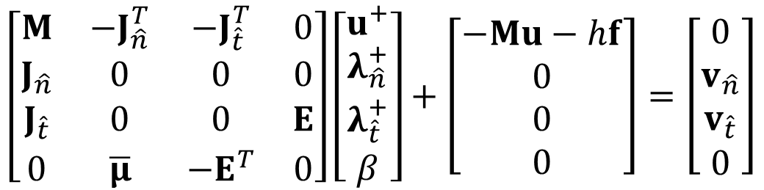






LCP: Linear System
Constrained equations of motion revisited:
$$\left[\begin{matrix}M & −J_{\hat{n}}^{T} & −J_{\hat{t}}^{T} & 0 \\ J_{\hat{n}} & 0 & 0 & 0 \\ J_{\hat{t}} & 0 & 0 & E \\ 0 & \overline{μ} & −E^{T} & 0\end{matrix}\right]\left[\begin{matrix}u^{+} \\ λ_{\hat{n}}^{+} \\ λ_{\hat{t}}^{+} \\ β\end{matrix}\right]+\left[\begin{matrix}−Mu−hf \\ 0 \\ 0 \\ 0\end{matrix}\right]=\left[\begin{matrix}0 \\ v_{\hat{n}} \\ v_{\hat{t}} \\ 0\end{matrix}\right]$$
$$A$$
$$b$$
Asymmetric
Larger problem size
$$\overline{μ}=diag\left(\left[\begin{matrix}μ_{1} & … & μ_{p}\end{matrix}\right]\right)$$
$$0≤v_{\hat{n}}⊥λ_{\hat{n}}^{+}≥0$$
$$E=diag\left(\left[\begin{matrix}e_{1}^{T} & … & e_{p}^{T}\end{matrix}\right]\right)$$
$$0≤\left(βE+v_{\hat{t}}\right)⊥λ_{\hat{t}}^{+}≥0$$
$$0≤\overline{μ}λ_{\hat{n}}^{+}−E^{T}λ_{\hat{t}}^{+}⊥β≥0$$
Notes:
Finally we can assemble a global linear system for an arbitrary number of contacts and bodies as shown here, with careful consideration required for the dimensions of each sub-matrix. Please see the course notes for more details on this point.
Additionally, note the introduction of two new matrices: mu bar and E
Mu bar is simply a diagonal matrix of friction coefficient, one for each contact in the system
Whereas E is a matrix consisting of a k-dimension all-ones vectors along the diagonal. When multiplied with the corresponding elements in the lambda sub t hat vector, this effectively computes the sum of the non-negative friction forces.
And let’s not forget the complementarity conditions, which in the end are what gives us the correct friction behavior.
One important thing to note here is that the lead matrix, A, corresponding to the polyhedral cone model is asymmetric. This has some consequences with regards to the types of solvers that can be applied here.
Furthermore, the dimensionality of the problem has increased due to the use of k tangent directions per contact, plus the introduction of the slack variable, beta.
However, next, we’ll take a look at the boxed model, which breaks the coupling of tangent directions and ultimately will result in a symmetric lead matrix with fewer variables.

Slide 14

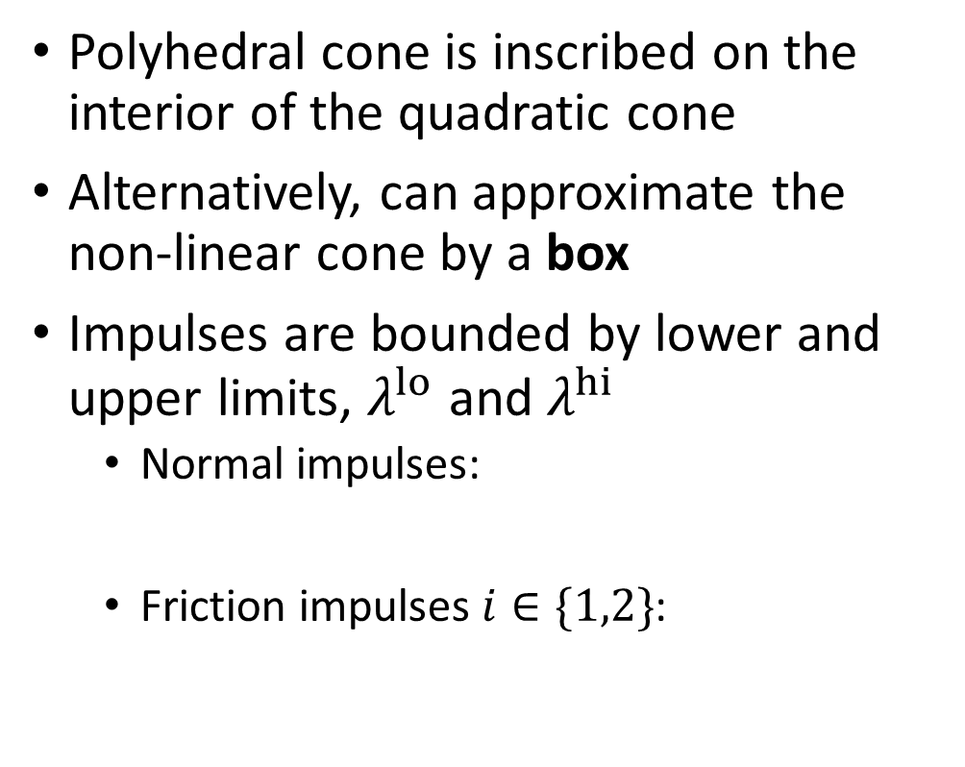








Boxed Friction Model
normal
Polyhedral cone is inscribed on the interior of the quadratic cone
Alternatively, can approximate the non-linear cone by a box
Impulses are bounded by lower and upper limits, $λ^{lo}$ and $λ^{hi}$
Normal impulses:
Friction impulses $i∈\{1,2\}$:
box cone
$$λ_{\hat{n}}$$
$$λ_{{\hat{t}}_{1}}^{lo}$$
$$λ_{{\hat{t}}_{2}}^{lo}$$
$${\hat{t}}_{2}$$
$${\hat{t}}_{1}$$
tangent
$$λ_{{\hat{t}}_{2}}^{hi}$$
$$λ_{{\hat{t}}_{1}}^{hi}$$
$$0≤λ_{\hat{n}}<∞$$
$$−μλ_{\hat{n}}≤λ_{{\hat{t}}_{i}}<μλ_{\hat{n}}$$
Notes:
Rather than using a polyhedral cone, which gives an approximate limit surface that is inscribed on the interior of the quadratic cone,
We can instead approximate the cone by an axis aligned box in the contact frame that contains the entire cone
With the box model, all impulses are bounded by some lower and upper limit.
This includes both the normal and the tangential impulses.
And please note the limit surface is not quite as shown here, since the tangent part of the surface does actually scale with the normal direction. However, we think this to be a sufficiently intuitive drawing to present the general idea.

Slide 15
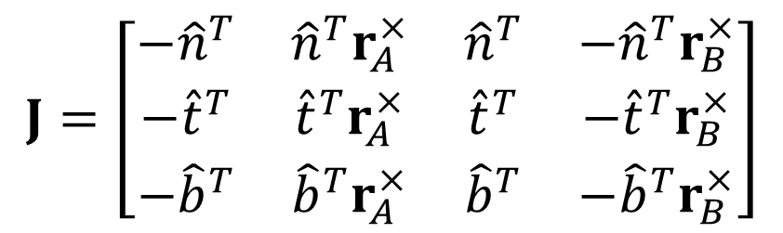


Boxed Friction Model
normal
Only two frictional basis vectors
BLCP is more compact, but more approximate that the polyhedral LCP
Jacobian contains rows for both normal and tangential directions:
box cone
$$λ_{\hat{n}}$$
$$λ_{{\hat{t}}_{1}}^{lo}$$
$$λ_{{\hat{t}}_{2}}^{lo}$$
$${\hat{t}}_{2}$$
$${\hat{t}}_{1}$$
tangent
$$λ_{{\hat{t}}_{2}}^{hi}$$
$$λ_{{\hat{t}}_{1}}^{hi}$$
$$J=\left[\begin{matrix}−{\hat{n}}^{T} & {\hat{n}}^{T}r_{A}^{×} & {\hat{n}}^{T} & −{\hat{n}}^{T}r_{B}^{×} \\ −{\hat{t}}^{T} & {\hat{t}}^{T}r_{A}^{×} & {\hat{t}}^{T} & {−\hat{t}}^{T}r_{B}^{×} \\ −{\hat{b}}^{T} & {\hat{b}}^{T}r_{A}^{×} & {\hat{b}}^{T} & −{\hat{b}}^{T}r_{B}^{×}\end{matrix}\right]$$
$$0≤λ_{\hat{n}}<∞$$
$$−μλ_{\hat{n}}≤λ_{{\hat{t}}_{i}}<μλ_{\hat{n}}$$
Bounds are enforced independently
Notes:
Something important to note here is that now there are only two tangent basis vectors, compared to k vectors with the polyhedral cone model. This is nice, since the problem size is reduced.
The Jacobian matrix is also easier to construct, and both normal and tangent directions may be combined in a simple three row matrix. And this is pretty much the same Jacobian we saw earlier on in the notes.
But what we lose here is the coupling between tangent impulses, since the bounds of each frictional impulse are now enforced independently of the other, and so there’s some loss of accuracy with this model
Nevertheless, the boxed model is very popular in many computer graphics applications due to its compactness and efficiency.

Slide 16
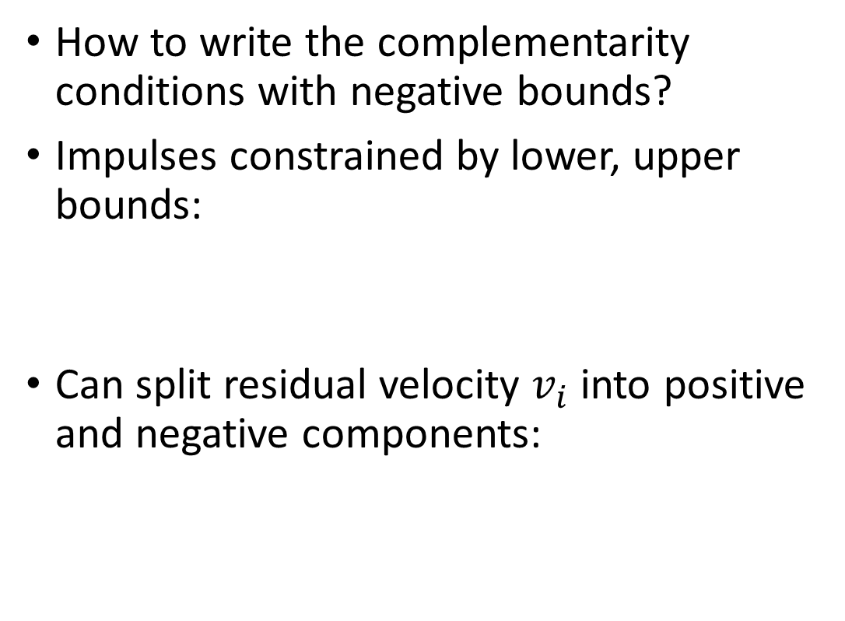





Boxed LCP: Complementarity Conditions
normal
How to write the complementarity conditions with negative bounds?
Impulses constrained by lower, upper bounds:
Can split residual velocity $v_{i}$ into positive and negative components:
box cone
$$λ_{\hat{n}}$$
$$λ_{{\hat{t}}_{1}}^{lo}$$
$$λ_{{\hat{t}}_{2}}^{lo}$$
$$\left(λ_{i}−λ_{i}^{lo}\right)≥0$$
$${\hat{t}}_{2}$$
$${\hat{t}}_{1}$$
tangent
$$\left({λ_{i}^{hi}−λ}_{i}\right)≥0$$
$$λ_{{\hat{t}}_{2}}^{hi}$$
$$λ_{{\hat{t}}_{1}}^{hi}$$
$$0≤λ_{\hat{n}}<∞$$
$$−μλ_{\hat{n}}≤λ_{{\hat{t}}_{i}}<μλ_{\hat{n}}$$
$$v_{i}=+v_{i}−−v_{i}$$
s.t.
$$+v_{i}≥0$$
and
$$−v_{i}≥0$$
Notes:
However, now we have a problem. Lambda must be allowed to take on a negative value, depending on the lower bounds of each specific variable.
But the traditional LCP formulation assume non-negative values for both the lambdas and the residual velocities.
However, we can rewrite the conditions by noting that the impulses should always have a value greater than the lower bound and less than the upper bound. And thus the differences in the inequalities shown here must be non-negative.
Similarly, we can rewrite the residual velocities as the difference of positive and negative components, vplus and vminus, where both of the these components are non negative.

Slide 17



Boxed LCP: Complementarity Conditions
normal
Gives three separate LCPs:
box cone
$$λ_{\hat{n}}$$
$$0≤+v_{i}⊥ \left(λ_{i}−λ_{i}^{lo}\right)≥0$$
$$λ_{{\hat{t}}_{1}}^{lo}$$
$$λ_{{\hat{t}}_{2}}^{lo}$$
$$0≤−v_{i}⊥ \left({λ_{i}^{hi}−λ}_{i}\right)≥0$$
$${\hat{t}}_{2}$$
$${\hat{t}}_{1}$$
tangent
$$λ_{{\hat{t}}_{2}}^{hi}$$
$$λ_{{\hat{t}}_{1}}^{hi}$$
$$0≤−v_{i}⊥+v_{i}≥0$$
$$0≤λ_{\hat{n}}<∞$$
$$−μλ_{\hat{n}}≤λ_{{\hat{t}}_{i}}<μλ_{\hat{n}}$$
Notes:
This then allows us to write three separate LCPs to formulate the Box complementarity problem
Observe that for the first condition, if the impulse has the lower bound value, then the residual velocity can be in the positive direction
Whereas with the second condition, if the impulse Is limited by the upper bound, then the residual velocity must have a negative value. In other words, v minus is positive.
… I hope that’s not too confusing.

Slide 18

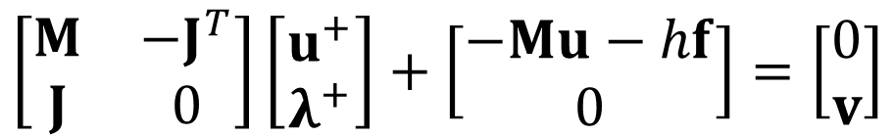




BLCP: Linear System
$$\left[\begin{matrix}M & −J^{T} \\ J & 0\end{matrix}\right]\left[\begin{matrix}u^{+} \\ λ^{+}\end{matrix}\right]+\left[\begin{matrix}−Mu−hf \\ 0\end{matrix}\right]=\left[\begin{matrix}0 \\ v\end{matrix}\right]$$
$$JM^{−1}J^{T}λ^{+}+\left(−Ju−hJM^{−1}f\right)=v$$
$$A$$
$$b$$
$$0≤+v ⊥ \left(λ^{+}−λ^{lo}\right)≥0$$
$$0≤−v ⊥ \left(λ^{hi}−λ^{+}\right)≥0$$
$$0≤−v ⊥+v≥0$$
Notes:
Finally, we can assemble a global linear system accounting for all contact. Note that for the vector of impulses, lambda, and the residual velocities, v, both the normal and tangential components have been combined into single vectors.
… and let’s not forget the boxed complementarity conditions which determine the relationship between the impulse bounds of the box and the residual velocities.
Furthermore, it’s easy to reduce this system using the Schur complement trick we used early. And this is the form used by many simulation engines.

Slide 19

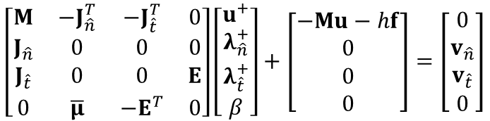






Summary of Cone Models
Two models of frictional contact:
Polyhedral cone LCP
Boxed LCP
$$\left[\begin{matrix}M & −J_{\hat{n}}^{T} & −J_{\hat{t}}^{T} & 0 \\ J_{\hat{n}} & 0 & 0 & 0 \\ J_{\hat{t}} & 0 & 0 & E \\ 0 & \overline{μ} & −E^{T} & 0\end{matrix}\right]\left[\begin{matrix}u^{+} \\ λ_{\hat{n}}^{+} \\ λ_{\hat{t}}^{+} \\ β\end{matrix}\right]+\left[\begin{matrix}−Mu−hf \\ 0 \\ 0 \\ 0\end{matrix}\right]=\left[\begin{matrix}0 \\ v_{\hat{n}} \\ v_{\hat{t}} \\ 0\end{matrix}\right]$$
$$JM^{−1}J^{T}λ^{+}+\left(−Ju−hJM^{−1}f\right)=v$$
$$0≤v_{\hat{n}}⊥λ_{\hat{n}}^{+}≥0$$
$$0≤+v ⊥ \left(λ^{+}−λ^{lo}\right)≥0$$
$$0≤\left(βE+v_{\hat{t}}\right)⊥λ_{\hat{t}}^{+}≥0$$
$$0≤−v ⊥ \left(λ^{hi}−λ^{+}\right)≥0$$
$$0≤\overline{μ}λ_{\hat{n}}^{+}−E^{T}λ_{\hat{t}}^{+}⊥β≥0$$
$$0≤−v ⊥+v≥0$$
Notes:
In this side by side comparison, we see there are some obvious trade-offs between the polyhedral cone version of the LCP and the Boxed LCP model.
The former is a more accurate representation of the quadratic cone model, whereas the latter is more compact and easier to solve due to the symmetry of the lead matrix.

Slide 20
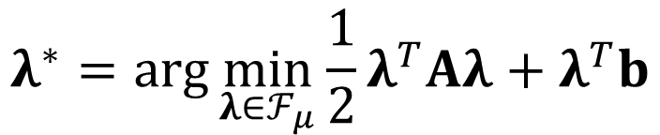
More in the Notes…
Cone complementarity problem (CCP) formulations
Equivalent to solving the second order cone problem, e.g.
Baumgarte style stabilization
Reduces position “drift” for non-interpenetration constraints
Spring-damper version
Error reduction and constraint force mixing parameters
$$λ^{∗}=\arg{\min_{λ∈ℱ_{μ}}{\frac{1}{2}λ^{T}Aλ+λ^{T}b}}$$
Notes:
In the courses notes, you can also find some details about the cone complementarity formulation of friction contact, which solves a second-order cone problem.
Furthermore, we demonstrate how the linear dynamical equations for our contact models may be stabilized to avoid penetration artefacts and other constraints errors that may accumulate in the simulation due to our discrete time stepping scheme.
Specifically, a spring-damper version of Baumgarte constraint stabilization is presented along with some tunable parameters for controlling how constraints errors are resolved.

