Slide 1
Section III: Pivoting Methods
Notes:
So let’s begin with pivoting methods

Slide 2





Traditional LCP
$$Ax+b≥0$$
$$x≥0$$
$$x^{T}\left(Ax+b\right)≥0$$
6
$$λ$$
$$v$$
Notes:
And to understand pivoting, we’ll first revisit the standard linear complementarity problem. Shown here is a variation of the polyhedral LCP and boxed LCP problems we saw earlier.
* But essentially, the variable “x” here is analogous to the constraint impulses,
* whereas the residual “Ax +b” corresponds to the relative velocities we compute for the contact frame.

Slide 3






LCP classification of variables
Pivoting methods exploit the combinatorial nature of complementarity problems
Each variable classified into one of two categories:
$x_{i}≥0 → v_{i}=0$
$x_{i}=0 →v_{i}≥0$
$$x_{1},v_{1}$$
$$x_{2},v_{2}$$
$$x_{3},v_{3}$$
$$x_{4},v_{4}$$
Notes:
Pivoting methods are based on the idea that complementarity problems are fundamentally combinatorial in their nature.
With the LCP formulation, variables may be labeled as one of two categories.
In the first category, the relative velocity of the ith variable is zero, which means that x can have a non-negative value . For instance, this would be the case for sticking contact.
Whereas in the second category, the relative velocity is non-zero, in which case the corresponding primary variable, x, must be zero. For instance, if we have the case of a separating contact.
The general idea is that we can group variables into these categories.
As the algorithm proceeds to compute new solutions, for instance is new variables are added or they change their value, variables are moved or pivoted between these categories.

Slide 4
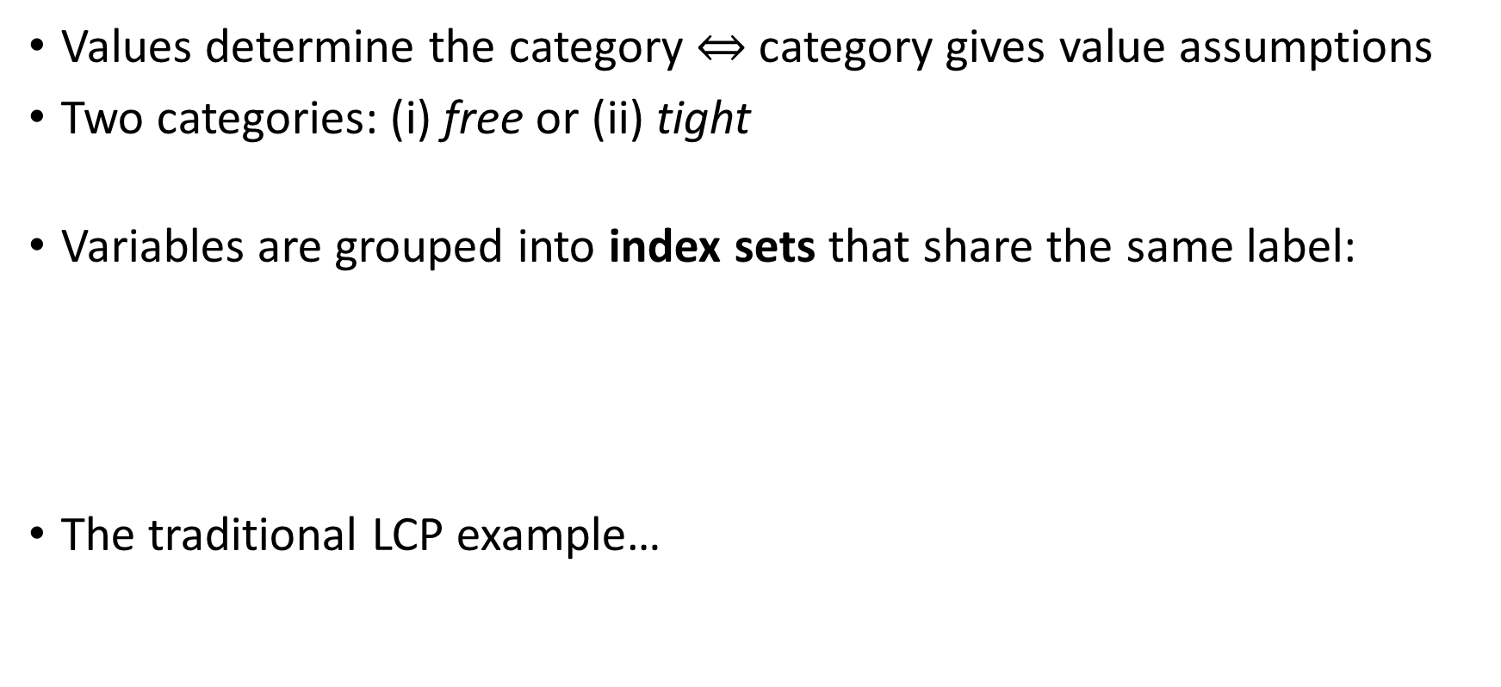


Pivoting Methods
Values determine the category $⇔$ category gives value assumptions
Two categories: (i) free or (ii) tight
Variables are grouped into index sets that share the same label:
The traditional LCP example…
tight lower
tight upper
F – index set giving all free variables
L – index set giving all tight lower variables
U - index set giving all tight upper variables
$∀i∈\text{F}: x_{i}>0, v_{i}=0$
free
$∀i∈\text{L}: x_{i}=0, v_{i}>0$
lower tight
Notes:
From this simple analysis, we propose to place each variable into a specific group based on its value. Another way to think of this is that by being in a specific category, there are certain presumptions we can make about the values of a variable.
* There are two main categories we will consider: the free set, and the tight set.
* And the tight category is further decomposed into tight lower and tight upper.
* Together, these categories allow a labeling of the indices of all variables of a complementarity problem. These groups are often called the index sets of the variables, meaning that they index variables that share the same label.
* For example, for the traditional LCP we saw just a moment ago…
* free variables would be define as having a positive “x” with zero relative velocity, and tight variables would have x = 0.
Essentially, “tight” describes a variable that is directly against the hyperplane defining the limit of the inequality constraint, whereas “free” variables are not and they have some room on all sides
Also note that in the context of pivoting methods, we combine “x” and “v” into our definition of a variable, since the two are coupled by the complementarity conditions.

Slide 5
Pivoting Methods
General idea is to systematically pivot variables between index sets
Objective is to find the index set such that satisfy feasibility and complementarity conditions
Incremental pivoting [Baraff 1994]
Incrementally compute solution one variable at a time
Changes to the index sets avoid violating complementarity conditions of variables already processed
Principal pivoting [Murty 1974]
Start with a “guess” of the index sets
Pivot the most violated variable
Block version: pivot all violated variables at once [Judice and Pires 1994]
Notes:
The general strategy used by pivoting methods is to find the index sets that give the correct solution.
And the correct solution is determined by a labeling of variables such that none of the variables violate their feasibility or complementarity conditions.
In graphics, Baraff introduced an incremental pivoting algorithm that solves for one variable at a time, pivoting variables between index sets as required. An important characteristic about this method is that previously processed variables will never violate their complementarity condition, since they’re pivoted if they do. So the method can solve the problem in $n$ steps, even though each step may be computationally costly.
However, In earlier methods developed for pivoting, they start with an estimate of the index sets for all variables. They then begin pivoting variables one at a time according to how badly they violate their feasibility or complementarity conditions.
The principal pivoting method proposed by Murty falls into this class of method.
Later, a block pivoting version of this method was developed to pivot multiple violate variables simultaneously.
And we’ll take a closer look at block principal pivoting in just a second, but first…

Slide 6











Review: BLCP contact model
Consider the BLCP where $x=λ$ are the constraint impulses
residual velocity
$$\left(JM^{−1}J^{T}\right)λ^{+}+b=v$$
$$⊥$$
$$λ^{+}$$
$$∈[λ^{lo} ,λ^{hi}]$$
normal
$$A$$
Friction cone
$$\hat{n}$$
Feasibility conditions:
Normal impulse
$$λ_{\hat{n}}∈[0,∞)$$
Friction impulse
$$λ_{{\hat{t}}_{i}}∈[−μ λ_{\hat{n}},μλ_{\hat{n}}]$$
$${\hat{t}}_{2}$$
$${\hat{t}}_{1}$$
Friction coeff.
tangent
Notes:
Let’s do a quick revision of the boxed LCP we saw in part 1 of the course, since it’s the formulation we’ll use to understand how block pivoting methods function.
Here, the vector of unknowns “x” is simply the vector of impulse constraints, “lambda”. Recall that there are lower and upper bounds on each lambda, and these determine if the value of a variable is feasible, or not.
The complementarity conditions, highlighted here, likewise determine which index set a variable belongs to. Remember here that the residual velocity is split here into positive and negative velocity components.

Slide 7



Principal Pivoting for BLCPs : Index sets
Define the index sets:
$$\left\{∀i∈\text{F} :λ_{i}^{lo}<λ_{i}<λ_{i}^{hi} and v_{i}=0\right\}$$
No residual velocity for “free” variables
e.g., resting contact or sticking
6
$$\left\{∀i∈\text{L} :λ_{i}=λ_{i}^{lo} and v_{i}>0\right\}$$
$$\left\{∀i∈\text{U} :λ_{i}=λ_{i}^{hi} and v_{i}<0\right\}$$
“Tight” impulses have a known value, which is defined by a bound e.g., $−μλ_{\hat{n}}$ for lower bounded friction
Notes:
These conditions on the impulses and residual velocities allow us to explicitly define the index sets for each category as follows.
* The “free” set are variables where the corresponding constraint impulse is not restricted by the upper or lower bound. This would be the case if the variable is a sticking friction constraint, or a resting contact. And in this case we know that the residual velocity must be zero.
We will later exploit this fact to help use solve the related linear system.
* Furthermore, variables in the tight index set have their constraint impulses limited by one of the lower or upper bounds. That is, the lambdas of this category are defined by the limit surface of the friction cone.
In this case, their value is known. For instance, if the variable with index i is a frictional impulse, then the value would either be negative mu or positive mu times the normal impulse.

Slide 8
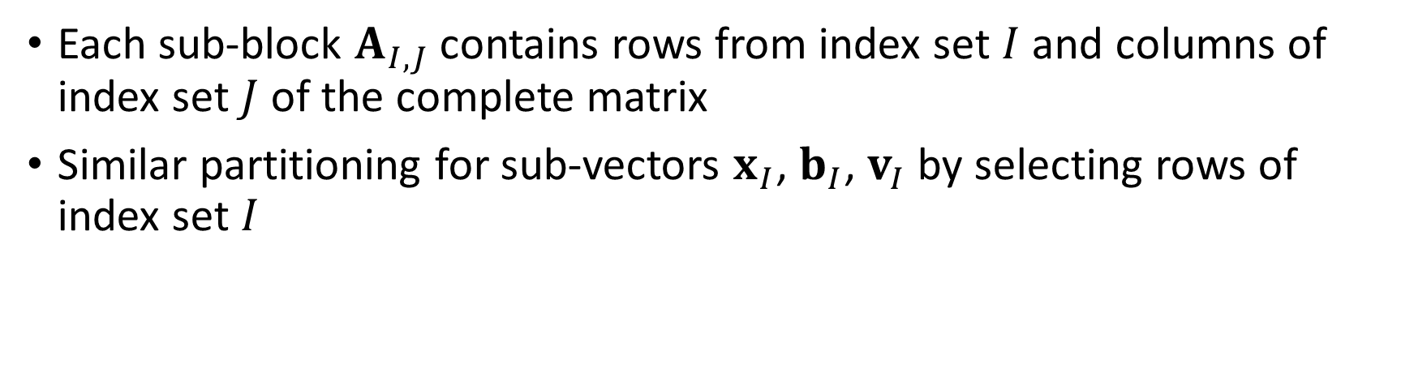

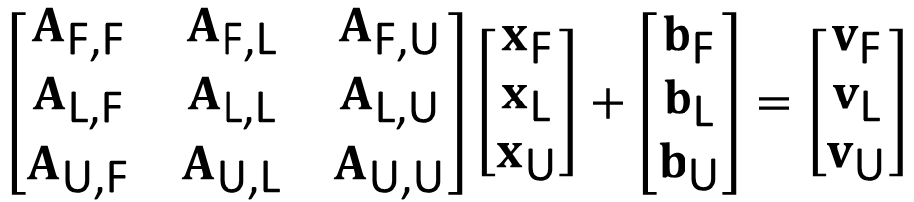
Principal Pivoting for BLCPs : Partitioning
Value defined by the lower or upper bounds
vector of unknowns
$$v_{\text{F}}=0$$
6
$$\left[\begin{matrix}A_{\text{F}\text{,}\text{F}} & A_{\text{F}\text{,}\text{L}} & A_{\text{F}\text{,}\text{U}} \\ A_{\text{L}\text{,}\text{F}} & A_{\text{L}\text{,}\text{L}} & A_{\text{L}\text{,}\text{U}} \\ A_{\text{U}\text{,}\text{F}} & A_{\text{U}\text{,}\text{L}} & A_{\text{U}\text{,}\text{U}}\end{matrix}\right]\left[\begin{matrix}x_{\text{F}} \\ x_{\text{L}} \\ x_{\text{U}}\end{matrix}\right]+\left[\begin{matrix}b_{\text{F}} \\ b_{\text{L}} \\ b_{\text{U}}\end{matrix}\right]=\left[\begin{matrix}v_{\text{F}} \\ v_{\text{L}} \\ v_{\text{U}}\end{matrix}\right]$$
Each sub-block $A_{I,J}$ contains rows from index set $I$ and columns of index set $J$ of the complete matrix
Similar partitioning for sub-vectors $x_{I}$, $b_{I}$, $v_{I}$ by selecting rows of index set $I$
Notes:
Once each variable in the system has been assigned an index set label, this permits a repartitioning of the boxed LCP according to the free and tight sets.
Note that in addition to the partitioning of the lead matrix, the vectors may also be partitioned.
*Here we recall once again that for the free variables, by definition, the residual velocities v sub F are zero.
*Furthermore, for the tight lower and tighter upper sets, the unknown variables x, are in fact known and have a value defined by their bounds.

Slide 9
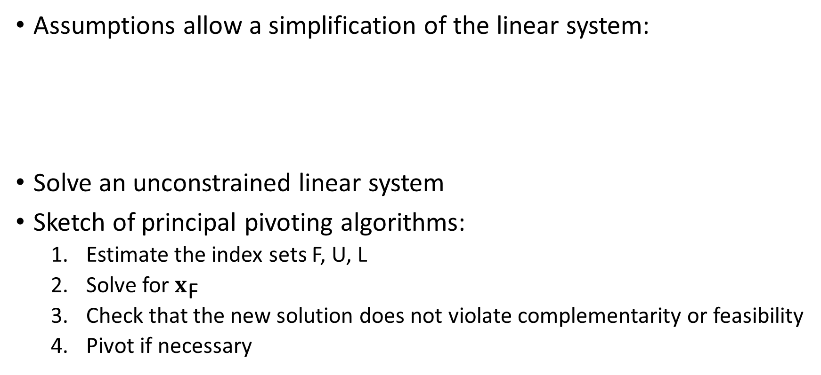
Principal Pivoting for BLCPs : Solving for $x_{\text{F}}$
Assumptions allow a simplification of the linear system:
Solve an unconstrained linear system
Sketch of principal pivoting algorithms:
Estimate the index sets F, U, L
Solve for $x_{\text{F}}$
Check that the new solution does not violate complementarity or feasibility
Pivot if necessary
$$A_{\text{F}\text{,}\text{F}}x_{\text{F}}=−b_{\text{F}}−A_{\text{F}\text{,}\text{L}}x_{\text{L}}^{lo}−A_{\text{F}\text{,}\text{U}}x_{\text{U}}^{hi}$$
Notes:
This allows a rewrite of the equations involving only the first row of the partitioned system, which is the one associated with the free index set.
* This is nice, since here we have reduced the problem to a simple unconstrained linear system, and any number of linear solvers may be used to solve for x sub F.
* Furthermore, this allows us to sketch out the main steps of the principal pivoting algorithm. Starting from an estimate of the index sets, we solve for the free variables. Then, check if the new solution violates any of the feasibility or complementarity constraints. If any do, then pivot the violated variables according to a set of rules and try again. Rinse and repeat.

Slide 10
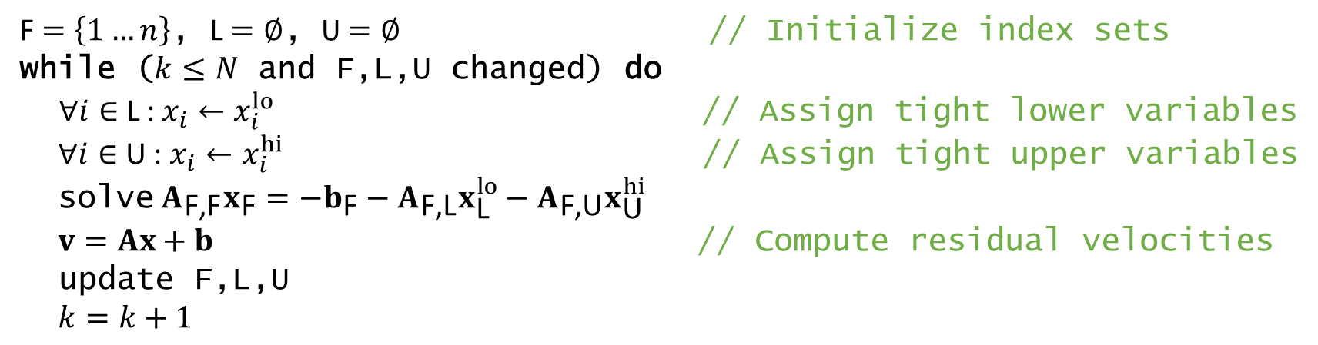
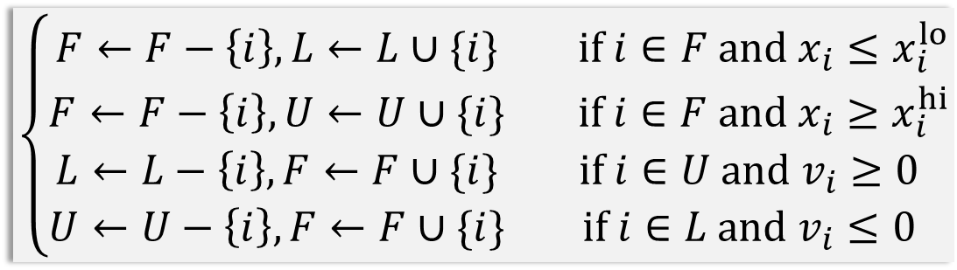
Principal Pivoting for BLCPs : Pseudocode
F $=\left\{1…n\right\}$, L$=∅$, U$=∅$ // Initialize index sets
while ($k≤N$ and F,L,U changed) do
$∀i∈$L : $x_{i}←x_{i}^{lo}$ // Assign tight lower variables
$∀i∈$U : $x_{i}←x_{i}^{hi}$ // Assign tight upper variables
solve $A_{\text{F}\text{,}\text{F}}x_{\text{F}}=−b_{\text{F}}−A_{\text{F}\text{,}\text{L}}x_{\text{L}}^{lo}−A_{\text{F}\text{,}\text{U}}x_{\text{U}}^{hi}$
$v=Ax+b$ // Compute residual velocities
update F,L,U
$k=k+1$
“Free” variables pivoted if feasibility conditions are violated
Pivoting Rules
$$\left\{\begin{matrix}F←F−\left\{i\right\}, L←L∪\{i\} & if i∈F and x_{i}≤x_{i}^{lo} \\ F←F−\left\{i\right\}, U←U∪\{i\} & if i∈F and x_{i}≥x_{i}^{hi} \\ L←L−\left\{i\right\}, F←F∪\{i\} & if i∈U and v_{i}≥0 \\ U←U−\left\{i\right\}, F←F∪\{i\} & if i∈L and v_{i}≤0\end{matrix}\right.$$
“Tight” variables pivoted to “free” if wrong residual velocity
Notes:
The pseudo code for the block principal pivoting algorithm is perhaps a bit clearer.
* One of the most important steps here is how the index sets are updated, and it is during this step in which variables change index sets according to the pivoting rules
* Taking a closer look, we observe that free variables are pivoted to the tight set whenever the feasibility conditions are violated
* Whereas tight variables are pivoted to the free set whenever the residual velocity has the wrong sign. In other words, complementarity is violated

Slide 11












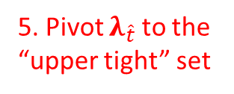














Principal Pivoting for BLCPs : Example
$$\text{F}=\{ \}$$
1. Initially, all variables are “free”
$$λ_{\hat{n}}$$
$$λ_{\hat{t}}$$
5. Pivot $λ_{\hat{t}}$ to the “upper tight” set
$$\text{L}=\{ \}$$
$$\text{U}=\{ \}$$
$$λ_{\hat{n}}$$
6. Move “tight” variables to the right-hand side
$$λ_{\hat{t}}$$
$$\hat{n}$$
2. Solve:
$$A_{\hat{n},\hat{t}}$$
$$\left[\begin{aligned} \\ \\ \end{aligned}\right]=$$
$$−\left[\begin{aligned} \\ \\ \end{aligned}\right]$$
$$λ_{\hat{t}}^{hi}$$
3. Friction impulse, $λ_{\hat{t}}$, infeasible due to box bounds
$$A_{\hat{n},\hat{n}}$$
$$λ_{\hat{n}}$$
$$=$$
$$−$$
$$b_{\hat{n}}$$
$$−$$
$$A_{\hat{t},\hat{n}}$$
$$A_{\hat{t},\hat{t}}$$
$$λ_{\hat{t}}$$
$$b_{\hat{t}}$$
$$\hat{t}$$
7. Solve again
4. Clamp it and label as tight!
$$λ_{\hat{t}}≤μ\left|λ_{\hat{n}}\right|$$
Notes:
To better understand principal pivoting, let’s consider a straightforward example– a box sliding on a plane.
* To simplify the analysis, we’ll assume that only one non-interpenetration constraint and one friction constraint is generated by the collision.
The algorithm begins with all variables in the “free” set. Here we show just the normal and tangential constraint impulses, but there are associated residual variables.
The next steps solve for the free variables, which computes a specific value for but the non-interpenetration and tangent impulse components.
However, upon examining the friction impulse, the feasibility conditions of the constraint have been exceeded. This indicates that the variable needs to be pivoted
Thus the impulse is clamped to the bounds of the friction limit surface of the box model and then moved to the tight lower index set.
This now requires an update to the linear system, and we re-solve for the free variables, which now only includes the non-interpenetration variable.

Slide 12
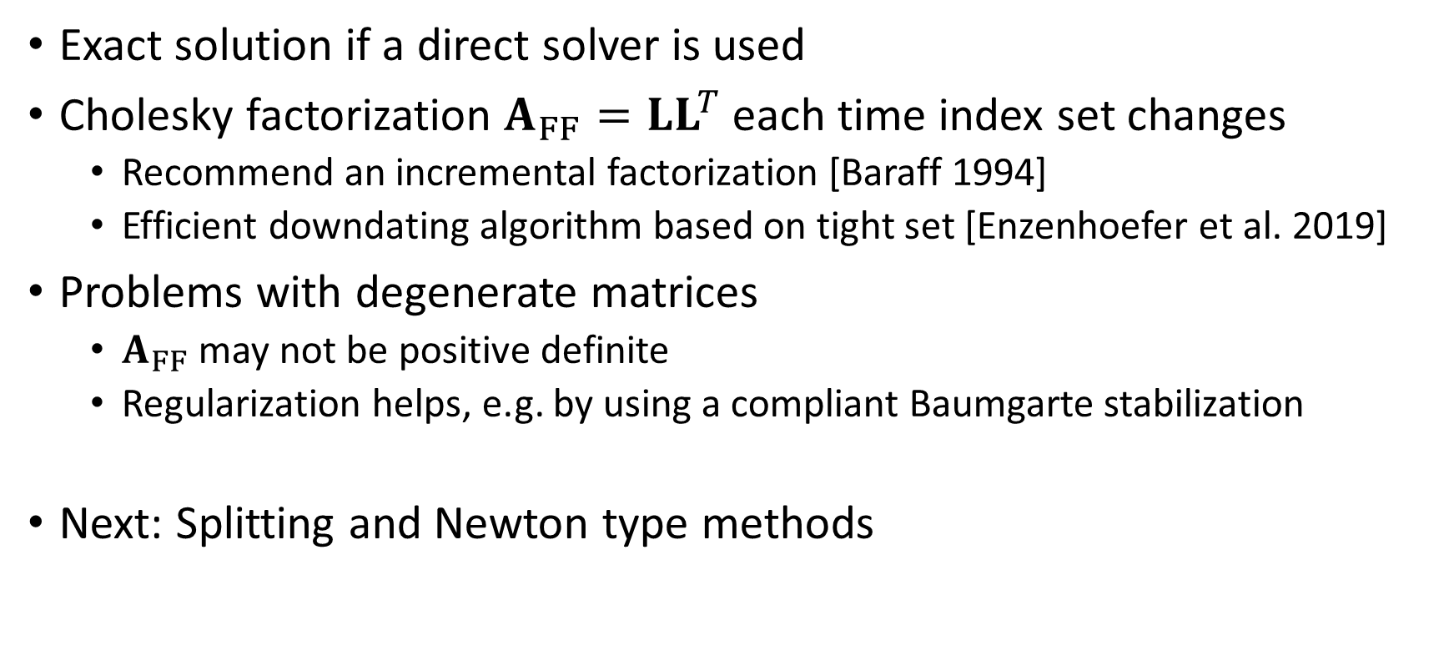
Principal Pivoting for BLCPs : Additional Notes
Exact solution if a direct solver is used
Cholesky factorization $A_{FF}={LL}^{T}$ each time index set changes
Recommend an incremental factorization [Baraff 1994]
Efficient downdating algorithm based on tight set [Enzenhoefer et al. 2019]
Problems with degenerate matrices
$A_{FF}$ may not be positive definite
Regularization helps, e.g. by using a compliant Baumgarte stabilization
Next: Splitting and Newton type methods
Notes:
Observe that at each step of the pivoting algorithm, there is a linear system to solve.
If a direct linear solver is used, we can obtain an exact solution to the LCP, at least to the numerical precision permitted by the hardware. This is a nice characteristic of pivoting methods, since iterative methods often produce more approximate solutions.
However, there is often a higher computational cost associated with using a direct linear solver, especially for larger problems.
For instance, if a Cholesky factorization is used to solve for the free variables, the factorization must been recomputed each time variables change index sets. Early work on pivoting methods has suggested using incremental factorization, and more recently researchers have noted efficiency improvements with low rank updates to an initial factorization.
It’s also possible that the principal submatrix may non positive definite, which can occur for degenerate cases. For instance, when there are multiple redundant contact constraints. In this cause, some matrix regularization can help.
Next up, we’ll learn more about these iterative method I just mentioned.

