Slide 1
Section I: Introduction to Contact Simulation
Equations of Motion, Time Integration, and Constraints
Notes:
With that, let’s dive into some essentials of multibody dynamics and see how they may be used as part of a discrete time integration scheme to actually simulate objects with contact. Then we’ll introduce constraints, since they are fundamental for many of the contact models we present in this course.

Slide 2








Review of multibody dynamics
center of mass
$$x_{B}$$
$$x_{C}$$
$$f(t)$$
$$x_{A}$$
Body
Body
Body
Accelerations
$$\dot{u}(t)$$
Mass matrix
Forces
$$M(t)\dot{u}(t)=f(t)$$
Rigid bodies:
$$\dot{u}\left(t\right)= {\left[\begin{matrix}\dot{v}{\left(t\right)}^{T} & \dot{ω}{\left(t\right)}^{T} & …\end{matrix}\right]}^{T}$$
Soft bodies:
$$\dot{u}\left(t\right)= {\left[ \begin{matrix}\ddot{x}{\left(t\right)}^{T} & …\end{matrix}\right]}^{T}$$
Notes:
A multibody simulation is exactly what it sounds like: multiple body moving around in space.
These bodies have a position and mass, but also kinematic and dynamic properties such as acceleration (shown here in blue) and forces (shown here in red)
From a classical mechanics perspective, their movement is governed by equations and laws that determine the relationship between the acceleration of the bodies and the forces acting on them.
Specifically, we use Newton’s second law, as shown here, to compute the dynamical behavior of bodies. Notice that the mass, acceleration, and forces are dependent on the time,.
If we are discussing rigid bodies, the vector u dot here are the generalized accelerations of the bodies, containing both linear and angular quantities. Similarly for the forces, there will be linear forces and torques.
Whereas for soft bodies, the u dot vector typical just gives the linear accelerations of the nodal coordinates. For instance, the accelerations of the vertices a tetrahedral mesh

Slide 3

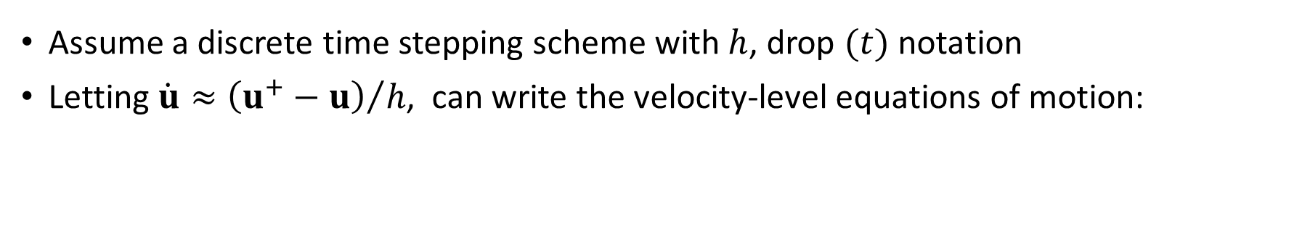




Velocity-level Dynamics
$$t$$
$$t+h$$
$$u$$
$$u^{+}$$
Assume a discrete time stepping scheme with $h$, drop $(t)$ notation
Letting $\dot{u}≈{\left(u^{+}−u\right)}/h$, can write the velocity-level equations of motion:
Implicit velocities
Explicit velocities
Mass matrix
Impulses
$$Mu^{+}=Mu+hf$$
Notes:
In computer graphics, we are often only interested in determining the dynamical behavior at a particular instants in time. For example, whenever an animation frame is to be drawn on the screen.
So, let us drop the “t” from our dynamics equations and assume that a discrete time stepping scheme is being use to evolve the state of our system. In other words, given the current time instant, we are only interested to compute the state at time t + h
Euler integration is a popular choice in graphics and animation applications, which uses a linearized version of the dynamics to advance the state at each time step. We can use a first order Taylor expansion of the velocities to approximate the accelerations as the difference of the velocities at the beginning and end of the time step, divided by duration “h”
This allows us to write the equations of motion using only velocities. Note here that the forces are transformed into impulses, and that we assume a constant mass matrix “M” which now appears on both sides of the equation.
This velocity-level formulation is popular for many simulation frameworks. We further note the use of a special notation here, which is the “+” symbol as a superscript . This denotes a variable or vector whose value is not known until the end of the integration step. In other words, they are “implicit”.
Note that it’s trivial to compute the velocities u plus from the new dynamical equation if all values on the rhs are known. In fact they may be directly computed since the mass matrix is often trivial to invert. However, we’ll soon see versions of this system of equations that require us to use a linear or non-linear solver.

Slide 4







Time Integration
$$q^{+}$$
$$q$$
e.g. quaternions for orientation…
Rotation matrix or quaternion, etc…
$$q∈ℝ^{7n}$$
Position
$$u∈ℝ^{6n}$$
Rigid bodies:
$$q= {\left[\begin{matrix}x_{1}^{T} & R_{1}^{T} & …\end{matrix}\right]}^{T}$$
Vertex positions
Soft bodies:
$$q= {\left[ \begin{matrix}x_{1}^{T} & x_{2}^{T} & …\end{matrix}\right]}^{T}$$
Euler integration of positions and orientations:
Kinematic mapping
$$q^{+}=q+hH(u^{+})$$
Notes:
However, once the velocities have been computed, we can again make use of an Euler integration scheme to advance the generalized positions, q, and compute their value at the end of the time step, q plus.
Note that for rigid bodies, q is a state vector that included both the linear positions and orientations of bodies
The orientations are the tricky part here, since there are several representations we can use. But rotation matrices and quaternions are common in computer graphics
Whereas for soft bodies, where mesh representations are common, the q vector would contain the vertex positions of the mesh.
Now, we again employ the workhorse of many simulation engine, the Euler method, to update the generalized positions using the most recent velocities, u plus, and the time step.
Also note that we have the kinematic mapping, H, which defines a mapping between the generalized velocities and instantaneous position changes. This is needed when the dimensions of the generalized positions do not match the velocities, for instance, when quaternions are used to store the orientations or rigid bodies. There is a dimension mismatch.

Slide 5

Constraint Forces and Impulses
Contact
Body
Body
Constraints
Body
Forces to model complex interactions between bodies
Constraints model coupling between bodies, e.g. ball joints, hinges
But also interactions, such as contact
$$Mu^{+}=Mu+hf$$
$$+hf_{c}$$
Notes:
Let us now come back to the velocity level dynamics and consider the forces, or rather the impulses, that are applied to our bodies at each time step.
We see the term “f” appearing on the right hand side of our dynamical equations. We could easily lump all forces acting on bodies into this vector, but instead let’s assume these are only the external forces, such as gravity, that act on bodies
However we can also add other forces, or impulses, that model complex and interesting behavior.
Let’s call these forces “f_c”, and the reason we call them that is because they can be used to model constraints that couple the movement of bodies.
For instance, to implement a ball and socket joint, or a hinge.
But also we can use these forces to model contact. And this is the beginning of our journey of understanding how to compute contact forces.

Slide 6






Bodies in Contact
Contact relationship between two bodies is described by the gap function, $φ$
Measures the penetration or separation of two bodies
Contact occurs at a point $p$, with normal direction $\hat{n}$
Forces and impulses applied in the direction of the normal
contact plane
$$φ=0$$
$$\hat{n}$$
$$p$$
$$x_{B}$$
$$x_{A}$$
Notes:
However, to understand how to compute contact forces, we first need a way to formally define how two bodies that might be in contact are interacting.
So, to this end, we’ll introduce something called the “gap function”, which for all intents and purposes is a scalar value that tells us the amount of separation or penetration between two bodies
For example, in the figure shown here, the gap function would have a value of zero, since the two bodies are exactly touching at a point on their surfaces without any overlap.
The point at which the bodies touch is called the contact point. And if we assume that the surfaces of both bodies is smooth, there will be a direction that is perpendicular to both surfaces, which is called the contact normal.
Of course, having a point and a perpendicular direction, this defines a plane which will be helpful for describing the kinematics and dynamics of the bodies during contact.
We’ll see later on how to actually compute contact point and normal for different types of geometries, but for now let’s just be content to know that they exist.
But as it turns out, the contact normal is also the direction in which we want to push in order maintain a penetration free configuration of the bodies.

Slide 7









Gap Function States
The value of the gap function gives three discrete states of the contact between bodies:
$$φ=0$$
$$φ>0$$
$$φ<0$$
$$x_{B}$$
$$x_{B}$$
$$x_{B}$$
$$x_{A}$$
$$x_{A}$$
$$x_{A}$$
resting
separation
penetration
Notes:
So when should contact impulses be applied?
As it turns out, the gap function gives us three distinct cases to consider.
First, we have the case already shown on the previous slide, where the bodies are just touching at their surface and the gap function is zero. Let’s call this “resting” contact.
Then, we have the case where this is a separation, between the bodies and the gap function has a positive value in this case. This is appropriately called the state of “separation”
Finally, there is the case where the bodies not only touch, but there is a measurable overlap between their shapes. In this case, the gap function is negative, and we call it the state of “penetration”.

Slide 8
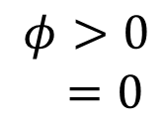

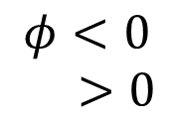
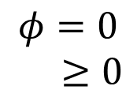

Gap Function vs Contact Forces
How does this relate to the forces (or impulses) used to model contact?
Consider a contact force with magnitude , that can “push” bodies apart
Applied equally and opposite to each body
Direction of the contact normal
$$φ=0 \\ ≥0$$
$$φ>0 \\ =0$$
$$φ<0 \\ >0$$
$$x_{B}$$
$$x_{B}$$
$$x_{B}$$
$$x_{A}$$
$$\hat{n}$$
$$x_{A}$$
$$x_{A}$$
$$\hat{n}$$
resting
separation
penetration
Notes:
So what does this all mean for the contact forces applied to the bodies.
Well, consider the proposal to compute a contact force that is then applied, equally and oppositely, at the point of contact. The role of this force is to push bodies apart and keep them from interpenetrating. Let’s further assume that a scalar value Lambda is the magnitude of the pushing forces, and assume that we always push in the direction of the normal.
In the case of resting contact, it may or may not be necessary to push the bodies, and so Lambda will have a positive or zero value in this case. For instance, if one object is resting on another object but not moving, then it may be necessary to apply a small force to combat the effects of gravity. Whereas if we have the same scenario with gravity removed, then no “push” force is necessary
Let’s next consider the case of separation, where the gap function is positive. In this case, there is no need to “push”, since the objects do not touch or overlap, and hence lambda is zero.
Note that Lambda would never become negative here, since that would imply that there is an attractive force at the surface that “pulls” bodies together, such as adhesion.
Finally, in the case of penetration, the bodies are thoroughly overlapping and thus a positive Lambda must be used to push them apart.
Note that here, the “push” force can be seen to have a restorative effect, with the objective is to move the configuration of the bodies from a state of interpenetration to non-interpenetration.

Slide 9
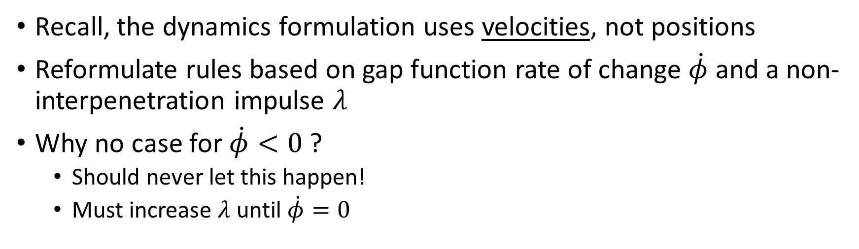




Velocity-level Gap Function
$$\dot{φ}=0$$
$$\dot{φ}>0$$
“The relative velocity is positive. There’s no need to apply a force since they are already separating”
“The relative velocity is zero (or negative), so push to keep them from interpenetrating”
$$λ≥0$$
$$λ=0$$
Recall, the dynamics formulation uses velocities, not positions
Reformulate rules based on gap function rate of change $\dot{φ}$ and a non-interpenetration impulse $λ$
Why no case for $\dot{φ}<0$ ?
Should never let this happen!
Must increase $λ$ until $\dot{φ}=0$
Notes:
We now have a basic set of rules that tell us when to apply non-interpenetration forces.
However, our analysis was done by considering the gap function, which is a position-level quantity.
And while we can certainly use this to determine, for example, if a collision exists between two bodies, we will need to reformulate our rules about when, or when not, to push by considering the velocity or rate of change of the gap function.
Here, write this as phi dot, and since we’re talking about velocity-level dynamics, let’s use lower case lambda to denote the non-interpenetration impulse that we apply to keep bodies apart.
Let’s presume that we have a case where two bodies just touch at the current time instant, as shown here in the 2D example
Now, if phi dot is zero, this indicates that their relative velocity in the direction of the contact normal is zero. A small amount of “push” may be added to ensure that the overlap between the bodies does not increase. That is, lambda will be non-negative
Next, let’s consider the case where phi dot is positive, meaning that relative velocity at the contact point is positive. The bodies are separating, and therefore there is no need to apply an impulse to keep them separate.
At this point, you may be asking, why isn’t the case for phi dot less then zero shown?
Well, that’s because it should never be allowed to happen! If phi dot is negative, the non interpenetration impulse must be increased to avoid having worse interpenetration at the next time step. In other words, lambda will be used to drive phi dot to zero.

Slide 10




Complementarity Conditions
$$\dot{φ}=0$$
$$\dot{φ}>0$$
$$λ≥0$$
$$λ=0$$
$$\dot{φ}≥0$$
$$λ≥0$$
$$\dot{φ}⋅λ=0$$
$$0≤\dot{φ} ⊥ λ≥0$$
Notes:
Given this analysis of the gap velocity and the non-interpenetration forces, we observe a couple of things…
1. phi dot is always greater than or equal to zero
2. Lambda is similarly non-negative
… and finally 3. If phi dot is positive, then lambda must be zero, and if lambda is positive, then phi dot must be zero. These three conditions together are referred to the complementarity conditions of contact.
Often, they are written more succinctly in the form shown here at the bottom of the slide.
In order to have physically valid contact behavior, our model must adhere to these rules.

Slide 11





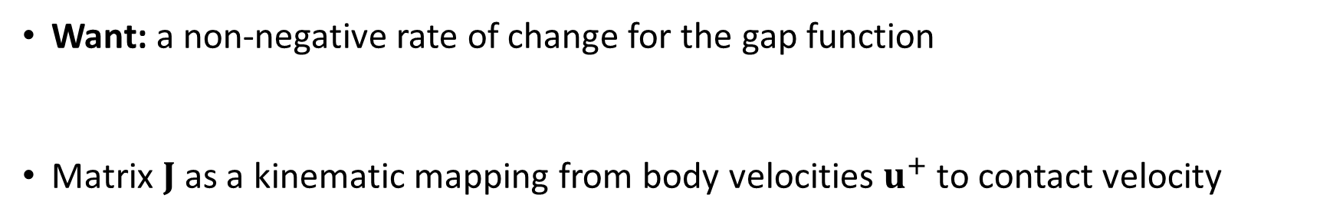

Kinematic Constraint
$$Ju^{+}=\dot{φ}$$
$$\dot{φ}$$
Body
$$u^{+}$$
Body
$$\hat{n}$$
Constraints
Body
Want: a non-negative rate of change for the gap function
Matrix $J$ as a kinematic mapping from body velocities $u^{+}$ to contact velocity
$$\dot{φ}≥0$$
Constraint Jacobian
$$Ju^{+}≥0$$
Notes:
So how do we enforce that phi dot is non-negative? Afterall, our simulations update the generalized velocities of the rigid bodies, and not the velocities of the gap function, phi dot
Well, let’s assume that a kinematic mapping exists between these two spaces– body velocities and contact velocities.
This mapping, represented by the matrix J, allows us to transform body velocities into instantaneous changes in the gap function.
And this word “instantaneous” is important here, since this mapping is only valid at the current instant in time. If the contact location or direction changes, we must update J.
Now, we can use J to write the write the our non-negativity condition in terms of the body velocities
And the matrix J is commonly referred to as constraint Jacobian matrix, since it is the gradient of the constraint gap function, phi.

Slide 12

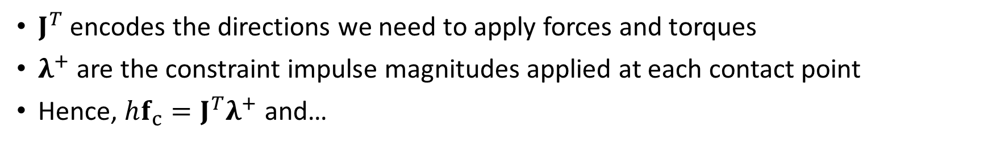




Rewriting Constraint Impulses
$$hf_{c}$$
$$J^{T}λ^{+}$$
Body
Body
Body
$J^{T}$ encodes the directions we need to apply forces and torques
$λ^{+}$ are the constraint impulse magnitudes applied at each contact point
Hence, $hf_{c}=J^{T}λ^{+}$ and…
Constraint impulses
$$Mu^{+}=Mu+hf+hf_{c}$$
$$Mu^{+}−J^{T}λ^{+}=Mu+hf$$
$$λ^{+}≥0$$
Notes:
As it turns out, J also encodes the directions in which we need to push to keep the bodies from interpenetrating. That is, the direction of our constraint forces f_c.
We can therefore decompose the constraint impulses as a product of the transposed Jacobian matrix, giving the direction of the forces, and the impulse magnitude, lambda.
And note that here the lambda values implicit, which means that are unknown. Even though the Jacobian is often computed at the start of the time step and for our purposes we consider it to be constant over the time step.
This allows us to substitute the constraint impulses with J transpose lambda expression in the equations of motion. And since it’s involves an unknown quantity, we’ll move it to the left hand side of the equation.
Finally, let’s not forget the condition that the lambdas must be non-negative

Slide 13
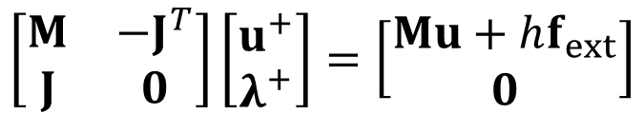



Constrained Equations of Motion
Body
Body
Body
$$Mu^{+}−J^{T}λ^{+}=Mu+hf_{ext}$$
$$Ju^{+}≥0$$
$$\left[\begin{matrix}M & −J^{T} \\ J & 0\end{matrix}\right]\left[\begin{matrix}u^{+} \\ λ^{+}\end{matrix}\right]=\left[\begin{matrix}Mu+hf_{ext} \\ 0\end{matrix}\right]$$
s.t.
$$λ^{+}≥0$$
Notes:
Putting this all together, we now have two equations describing the behavior of the simulation:
The first is the dynamical equation of motion of bodies which includes the constraint forces
… and the second is the kinematic constraint equation that defines the restrictions of the body velocities
Conveniently ,this may be rewritten as a linear system in matrix form as shown here on the bottom of the slide.
Note here that we lose the inequality on the kinematic equation of the gap function, but as we will see this will be handled later by use of auxiliary variables.
And of course let’s not forget the non-negativity condition of the constraint impulses.

Slide 14

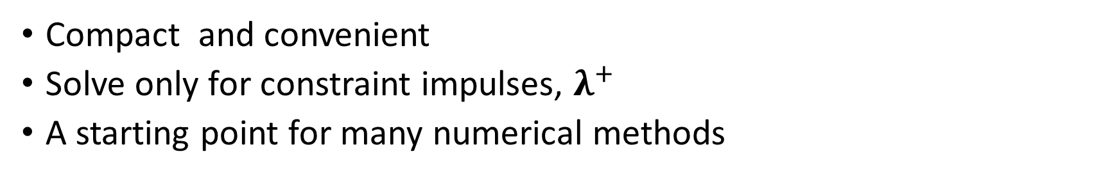


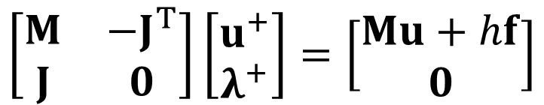
The Schur complement “trick”
$$\left[\begin{matrix}M & −J^{T} \\ J & 0\end{matrix}\right]\left[\begin{matrix}u^{+} \\ λ^{+}\end{matrix}\right]=\left[\begin{matrix}Mu+hf \\ 0\end{matrix}\right]$$
Schur complement
$$\left(JM^{−1}J^{T}\right)λ^{+}+JM^{−1}\left(Mu+hf_{ext}\right)=0$$
$$A$$
$$b$$
$$λ^{+}≥0$$
Compact and convenient
Solve only for constraint impulses, $λ^{+}$
A starting point for many numerical methods
Notes:
Rather than solving for both body velocities and constraint impulses, we can form the Schur complement of the upper-left block and reduce the linear system so that we only need to solve for the constraint impulses lambda.
This is a more compact form, and is much more convenient for many of the numerical methods we’ll see later on, since we only have to deal with one type of variable.
.. And again, let’s not forget the nonnegativity of lambda.

Slide 15








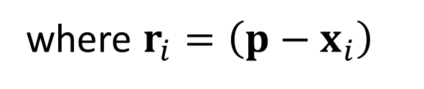





Computing the non-interpenetration Jacobian
The relative velocity at the contact point $p$:
$$v_{A}$$
$$p$$
$$r_{B}$$
$$ω_{B}$$
$$r_{A}$$
$$x_{B}$$
$$v_{B}$$
$$ω_{A}$$
$$x_{A}$$
$$Δv= −$$
$$\left(v_{A}−r_{A}^{×}ω_{A}\right)$$
$$\left(v_{B}−{r_{B}^{×}ω}_{B}\right)$$
where $r_{i}=\left(p−x_{i}\right)$
skew-symmetric cross product matrix
Notes:
However, forming this linear system requires actually computing the constraint Jacobian that maps body velocities to contact space velocities in order to compute the gap function rate of change.
It turns out it’s fairly easy to determine this mapping.
Let’s consider how to compute the relative velocity at the point of contact by using the generalized velocities of two bodies, A and B.
We can do this by first computing the contact point velocity using the linear and angular velocity of body A….
…. and then the contact point velocity using the same kinematic terms from body A.
Finally, we subtract one from the other to obtain the relative velocity of the two bodies at the contact point.
And note here that the skew symmetric matrix is used to compute the cross product with the moment arm, r.

Slide 16




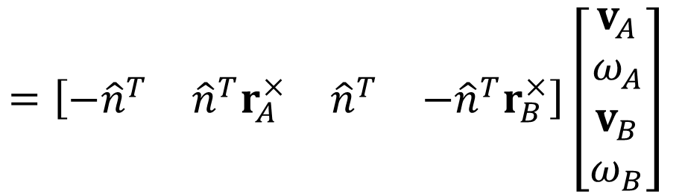
Non-interpenetration Jacobian
Gap function rate of change is perpendicular to the contact plane
Project to $\hat{n}$ using a dot product:
$$=\left[\begin{matrix}−{\hat{n}}^{T} & {\hat{n}}^{T}r_{A}^{×} & {\hat{n}}^{T} & −{\hat{n}}^{T}r_{B}^{×}\end{matrix}\right]\left[\begin{matrix}v_{A} \\ ω_{A} \\ v_{B} \\ ω_{B}\end{matrix}\right]$$
$${\hat{n}}^{T}Δv$$
$$J$$
Non-interpenetration constraint Jacobian
$$u$$
Notes:
But recall that we’re only interesting in the value of this velocity in the direction that is perpendicular to the contact plane. Or in other words, the direction parallel to the contact normal.
This is easily computed using the dot product, and voila, we have a means to compute the gap function rate of change.
We can furthermore separate this as the product of a vector and row matrix.
Where the column vector contains the generalized velocities…
… and the row matrix is the Jacobian of the non-interpenetration constraint.
Note that here the Jacobian for a simple two body system is shown. But in more complex system, one of these matrices would be computed for each contact, and the blocks corresponding to bodies A and B would be inserted at their correct locations so that the product with the velocities in vector u are correctly computed.

Slide 17

Friction Forces
Friction forces resist relative sliding motion of objects
Non-interpenetration forces are generated in direction perpendicular to the contact plane
Frictional forces are generated in directions that are tangent to the contact plane
Notes:
Thus far, we’ve seen how to compute constraint force (or impulses) to keep bodies from interpenetrating.
Friction is another contact phenomena that we would like to simulate, and it is the force responsible for resisting sliding.
For example, the friction force between the box and the floor in this example video are responsible for the box eventually slowing down and coming to rest.
Recall that for the non-interpenetration impulses, their direction is perpendicular to the contact plane
Whereas friction is a dissipative force that works in directions that are tangent to the contact plane

Slide 18







Contact Frame
Revised contact model with an orthogonal bases
Direction $\hat{t}$ and $\hat{b}$ span the contact plane
$$B$$
$$\hat{n}$$
$$p$$
$$\hat{b}$$
$$\hat{t}$$
$$A$$
Contact plane
Notes:
In order that the contact model can generate forces in tangent directions, we need to extend the constraint modell by adding a tangent and bitangent direction, t hat and b hat.
These are basis vectors that span the contact plane and together with the contact normal, n hat, they form the contact frame.

Slide 19



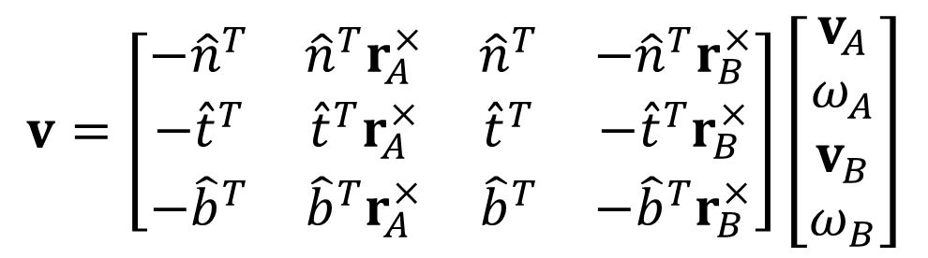


Contact Jacobian with Tangent Directions
Relative velocity $Δv$ projected to contact space:
Or in matrix-vector form:
$${v=\left[\begin{matrix}\hat{n} & \hat{t} & \hat{b}\end{matrix}\right]}^{T}Δv$$
$$v=\left[\begin{matrix}−{\hat{n}}^{T} & {\hat{n}}^{T}r_{A}^{×} & {\hat{n}}^{T} & −{\hat{n}}^{T}r_{B}^{×} \\ −{\hat{t}}^{T} & {\hat{t}}^{T}r_{A}^{×} & {\hat{t}}^{T} & {−\hat{t}}^{T}r_{B}^{×} \\ −{\hat{b}}^{T} & {\hat{b}}^{T}r_{A}^{×} & {\hat{b}}^{T} & −{\hat{b}}^{T}r_{B}^{×}\end{matrix}\right]\left[\begin{matrix}v_{A} \\ ω_{A} \\ v_{B} \\ ω_{B}\end{matrix}\right]$$
$$v=\left[\begin{matrix}v_{\hat{n}} \\ v_{\hat{t}} \\ v_{\hat{b}}\end{matrix}\right]$$
$$J$$
$$u$$
Notes:
Using all three basis vectors, we can once again project the relative velocity of the bodies at the contact point into the contact frame.
… and this may also be written in the form of a matrix-vector product that separates the jacobian matrix from the body velocities
Note that the constraint Jacobian has been extended to include two new rows, each one mapping body velocities to the two new tangent basis vectors
Also, going forward, we’ll write the relative velocity, which is sometimes called the residual velocity, in contact space using the vector “v”.
And of course “v” can be decomposed into individual scalar components giving the residual velocity in the normal, tangent, and bitangent directions

Slide 20






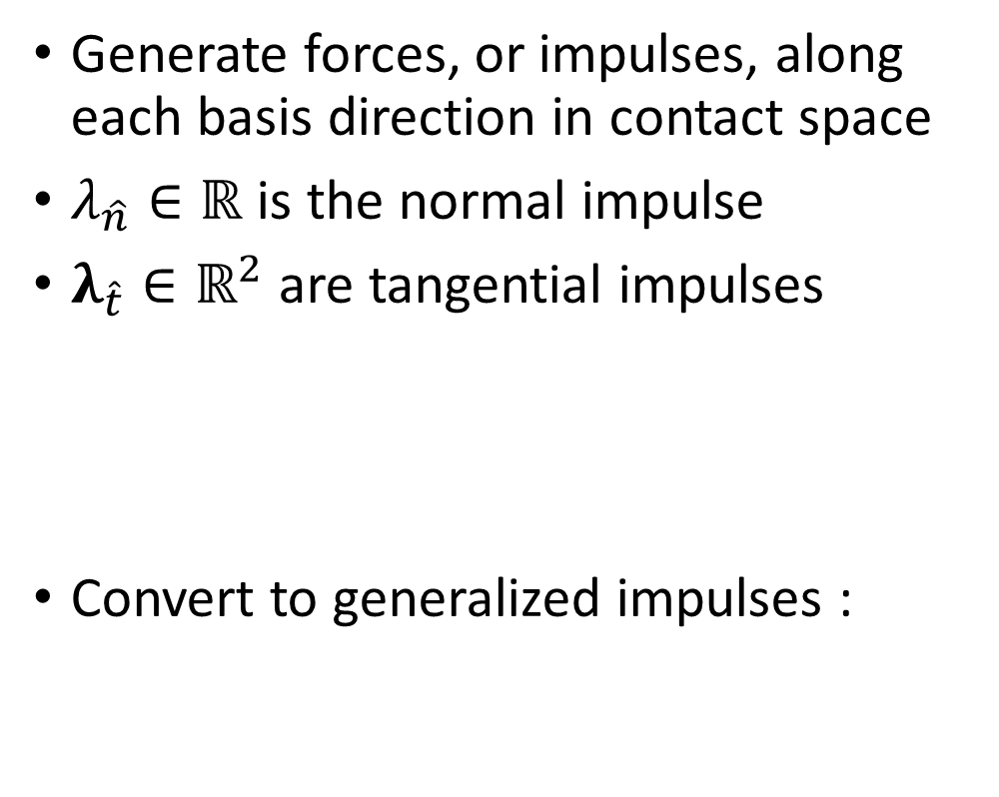





Impulses in the Contact Frame
Generate forces, or impulses, along each basis direction in contact space
$λ_{\hat{n}}∈ℝ$ is the normal impulse
$λ_{\hat{t}}∈ℝ^{2}$ are tangential impulses
Convert to generalized impulses :
$$λ_{\hat{n}}$$
$$B$$
$$\hat{n}$$
$$λ_{\hat{t}}=\left[\begin{matrix}λ_{\hat{t}} \\ λ_{\hat{b}}\end{matrix}\right]$$
$$λ_{\hat{n}}$$
$$p$$
non-interpenetration impulse
$$\hat{b}$$
friction impulses
$$\hat{t}$$
$$λ_{\hat{t}}$$
$$A$$
$$hf_{c}=J^{T}\left[\begin{matrix}λ_{\hat{n}} \\ λ_{\hat{t}} \\ λ_{\hat{n}}\end{matrix}\right]$$
Notes:
In addition to representing the velocities in the contact frame, constraint impulses may also be generated for each basis direction
For instance, we’ve already seen how a non-interpenetration impulse, which we now write using the n hat subscript, may be used to push bodies apart.
Generating friction impulses forces is also possible by using two additional lambda coefficients. Together, these form a 2D vector that acts in a space tangent to the contact plane.
And similar to before, we can computed the constraint impulses as a generalized force vector by computing the product of the transposed Jacobian matrix with the lambda vector.

