Slide 1
Section II: Contact Generation
Notes:
Now that we know how to model frictional contact, we’ll examine aspects related to actually *generating* contacts during the simulation.

Slide 2
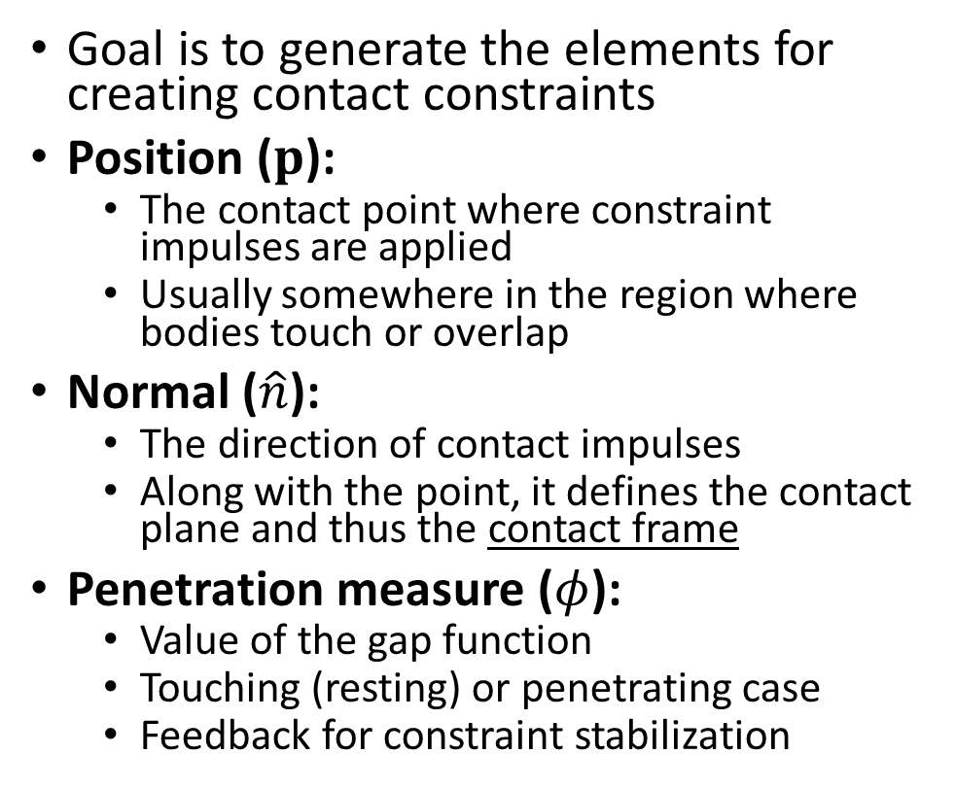



Role of Contact Generation
Goal is to generate the elements for creating contact constraints
Position ($p$):
The contact point where constraint impulses are applied
Usually somewhere in the region where bodies touch or overlap
Normal ($\hat{n}$):
The direction of contact impulses
Along with the point, it defines the contact plane and thus the contact frame
Penetration measure ($φ$):
Value of the gap function
Touching (resting) or penetrating case
Feedback for constraint stabilization
$$\hat{n}$$
$$p$$
$$φ$$
Notes:
The contact models introduced in the first part of the course are all based on the kinematics at a single point in the overlapping or touching region between bodies. And for this type of constraint formulation there are three critical elements that are needed:
The position of the contact point. This is the point in 3D space where the contact forces are actually applied to the bodies in an equal and opposite manner. As we’ll see, this is usually a point that lies in the overlapping region between the bodies.
Next, we need a contact normal. This allows us to compute a contact frame that defines the direction of non-interpenetration, but also the tangential directions of friction forces.
Finally, we need some estimate of the penetration between the two bodies, and essentially this will determine the value of the gap function. This is important for determining the amount of violation of non-interpenetration, and whether a contact is in a resting or penetrating state. Most often it’s the latter case, and thus the penetration is an important term in constraint stabilization to combat drift in the simulation.

Slide 3






Collision detection
$$t=0$$
$$t=h$$
Discrete
Discrete collision detection: check for collision only at specific time instants, e.g. at the start of each time step
Matches discrete time stepping
Interpenetration unavoidable
Continuous collision detection: determine exactly when a collision occurs during a time period
Helps prevent “tunneling” and extreme overlap
Generally, computationally more expensive
$$x_{j}$$
$$x_{i}$$
collide!
Continuous
$$x_{j}$$
$$x_{i}$$
Focus on discrete case, but details on continuous collision detection in the notes.
Notes:
Collision detection is at the heart of contact generation, and there are two main types of collision detection: discrete collision detection, and continuous collision detection.
* Discrete collision detection checks for overlap between bodies only at specific time instant. For example, at each time step. This is in agreement with the discrete time stepping scheme used to integrate the simulation.
However, from one time step to the next, as body positions are updating using velocities, it’s possible that bodies not only touch, but overlap. While it’s generally impossible to avoid this type of interpenetration with discrete collision detection since the exact moment of contact is not known, impulses or forces will then be generated to resolve the overlap.
With continuous collision detection, the exact moment of collision is computed. This is particularly important for certain types of object shapes, for instance if there is thin or sharp geometry, in order to prevent “tunneling” or extreme interpenetration scenarios.
The simulation state is advanced (or reversed) to the moment of contact at which point a contact constraint may be generated and the simulation can continue from a penetration free state.
In this presentation, we’ll cover just the discrete collision detection case, but please note that details on CCD are provided in the course notes.

Slide 4
Collision detection
Broad-phase collision detection focuses on simple, but conservative tests, to quickly eliminate pairs of object that do not collide
e.g., bounding volume hierarchy (BVH), spatial hash grid
Narrow-phase collision detection uses exact, but more costly, tests to compute contact points and normal and penetration
Specialized tests crafted for different object geometries
Analytic Shapes
Mesh-based
Signed Distance Fields
Notes:
In addition to discrete versus continuous types, it’s important to also consider the scale at which collision detection is performed.
A broad phase collision detection algorithm uses simple, conservative tests of body shapes to quickly eliminate which pairs of bodies need to be tested with more exact collision tests. Examples off this class of collision detection include bounding volume hierarchies of simple geometries such as spheres or boxes, and even spatial grid data structures.
Whereas narrow phase collision detection is more focused on performing exact collision test between pairs of geometry used to approximate the body shape. These are more costly, but they are also the tests we’ll use to generate the contact points and normal, and to compute a measure of penetration between pairs of bodies. Often, these tests boil down to special, carefully crafted functions that perform a test between two object geometries. The geometry of each object may the same type, or they may be different. In the course notes we present details on narrow phased collision tests for different type of geometry, including
Analytic shapes
Polygonal meshes
And signed distance fields
For the sake of brevity, we’ll take a closer look at the latter example, signed distance fields, and how the essential components of our contact models may be produced using this shape representation.

Slide 5
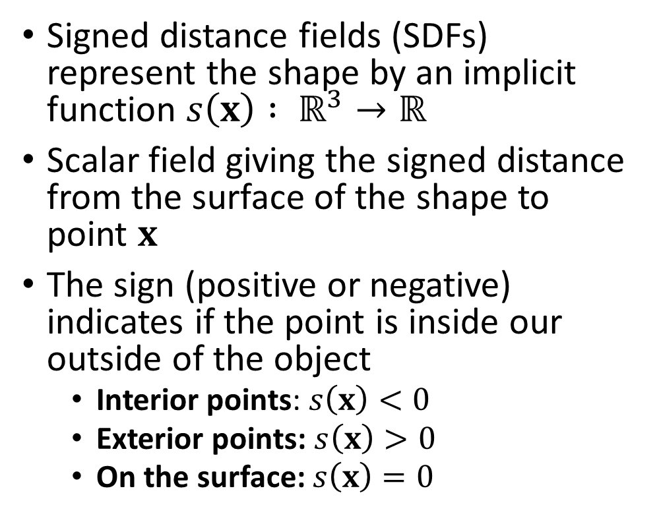




Signed Distance Fields
= exterior
Signed distance fields (SDFs) represent the shape by an implicit function $s\left(x\right) : ℝ^{3}→ℝ$
Scalar field giving the signed distance from the surface of the shape to point $x$
The sign (positive or negative) indicates if the point is inside our outside of the object
Interior points: $s\left(x\right)<0$
Exterior points: $s\left(x\right)>0$
On the surface: $s\left(x\right)=0$
= on the surface
= interior
$$x$$
$$s\left(x\right)>0$$
$$x$$
$$s\left(x\right)<0$$
Notes:
Signed distance fields are an implicit function that encode the shape of an object.
Specifically, they are a scalar field that maps a 3d position to a signed distance from the surface of the object. This is quite literally an encoding of the gap function.
The sign returned by the scalar field is important, with points inside the object returning a negative value
and points outside the object having a positive value.
And points that lie directly on the surface have a value of zero
For example, in the figure on the right, the signed distance field of a circle is shown.
The point “x” has a positive since it is outside of the circle.
Whereas for a point on the inside of the circle, s of (x) would have a negative value.

Slide 6
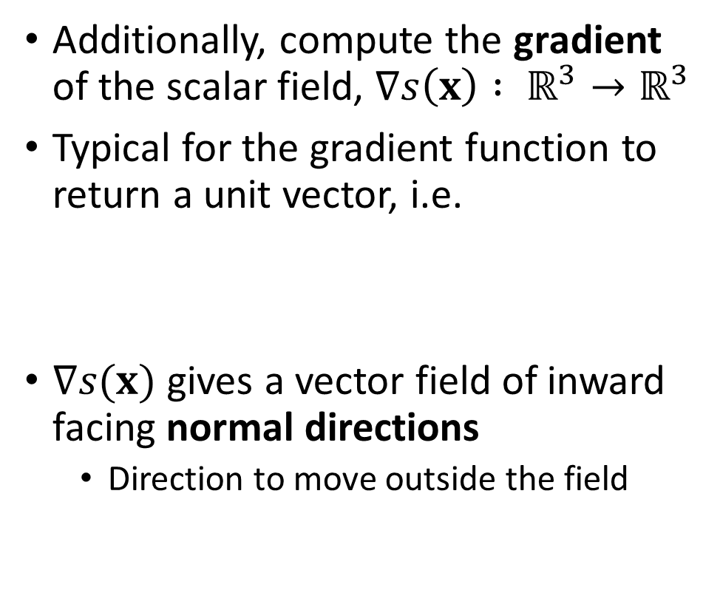


Signed Distance Fields
= exterior
Additionally, compute the gradient of the scalar field, $∇s\left(x\right) : ℝ^{3}→ℝ^{3}$
Typical for the gradient function to return a unit vector, i.e.
$∇s(x)$ gives a vector field of inward facing normal directions
Direction to move outside the field
= on the surface
= interior
$$∇s(x)$$
$$x$$
$$\left\|∇s(x)\right\|=1$$
Notes:
In addition to the signed distance, the gradient of the scalar field may be computed which gives a vector field of gradient values at each point in the domain of the field.
Typically, the gradient can be computed with a unit vector length. Conveniently, this is the inward facing normal direction of the surface encoded by the field.
* For example, coming back to the 2d field for a circle and the point “x” shown in the figure on the right
* … then the gradient at “x” points away from the surface of the circle However, the negative gradient direction gives the shortest path if “x” needs to move outside the object.

Slide 7





SDF-Point Contact Generation
Canonical collision test with SDFs is for a point
SDF-Point contact generation is trivial
Penetration (gap function):
Contact normal:
Contact position:
$$φ=s(x)$$
Inward
Outward
$$\hat{n} =∇s(x)$$
$$\hat{n} =−∇s(x)$$
Project to the surface
$$p=x−∇s{\left(x\right)}^{T}s(x)$$
$$p=x$$
Alternative: use the query point
Notes:
With the scalar and gradient fields of the SDF available, let’s consider how to generate a contact using this information. As you can probably tell, the canonical test for collision with an sdf is using a point.
* If the query shape is a point, generating a contact is trivial.
* As we’ve already noted, the penetration is simply the scalar value returned by the field. That is, phi is equal to s of x
* And the contact normal is simply the gradient of the signed distance field at the query point. Recall that the gradient is the inward facing normal. Note that care must be taken to compute either the inward or outward facing normal, depending on the convention used for the contact simulation.
* Finally for the contact position, there are several options. One option is to project the query point back to the surface along the gradient direction by a distance equal to the penetration. * Alternatively, the query point itself may be used as the contact point.

Slide 8






SDF-Mesh Contact Generation
SDF-Point case is a building block for SDF-Mesh contact generation
Consider body $A$ with surface represented by a polygonal mesh:
$$B$$
vertices $V_{B}$
A second body $B$ modeled using a polygon mesh
Test vertices of mesh of body $B$ against the SDF of body $A$
Vice versa, vertices of $A$ versus SDF of $B$
vertices $V_{A}$
$$A$$
Notes:
Using the case of SDF-point collision as a building block, we can test collisions for more complex shapes.
Consider an object whose shape is modeled using a polygonal mesh, which is a common geometry used in many computer graphics applications
An SDF can be computed based on the mesh, giving regions inside and outside the surface of a mesh. Computing the SDF for a mesh may sometimes require that the mesh have certain properties, for instance this it is watertight. However, robust algorithms do exist that can deal with more general “polygon soups”
Then consider a second body also modeled using a polygonal mesh
In order to generate contact between body A and B, we can test each vertex of body B against the SDF of body A using the SDF-Point methodology proposed on the previous slides.
Then, we can swap the order of the test by computing an SDF for body B and then testing all vertices from mesh A against the SDF of B.

Slide 9



SDF-Mesh Contact Generation
Loop over all vertices of one mesh
Transform to local SDF space, test for collision
$$B$$
for $x∈V$
$x_{local}←$ transform $x$ to SDF
if $s\left(x_{local}\right)<0$ then
$φ=s\left(x_{local}\right)$
$\hat{n}=∇s(x)$
$p=x_{local}$
transform $\hat{n}$,$p$ to world coordinates
add $\left\{\hat{n},p,φ\right\}$ to contacts
end
$$\hat{n}$$
$$p$$
$$A$$
Notes:
The algorithm for mesh-sdf collision can then be written rather concisely, as with the pseudo code shown here. It simply requires looping over all vertices in one body…
.. And then transforming the vertices into the local coordinate space of the SDF of the other body. This is far easier than trying to transformed the SDF into some other coordinate system.
Finally, whenever a vertex with signed distance less then zero is found, a contact point and normal is generated.

Slide 10
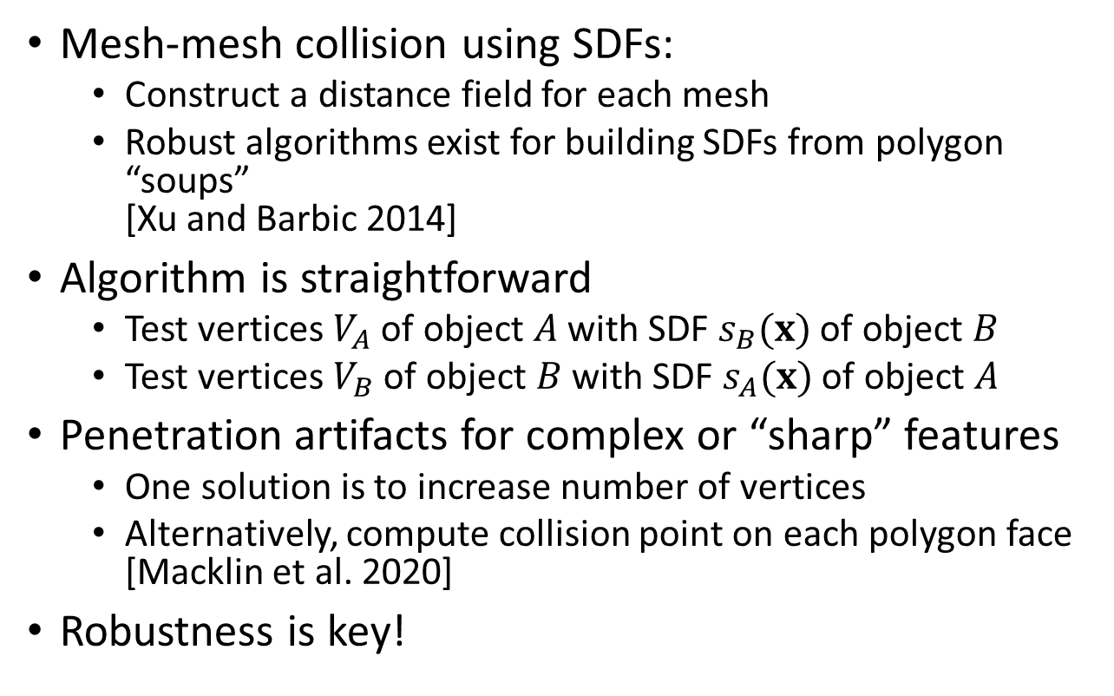
Summary of SDF-Mesh Contact Generation
Mesh-mesh collision using SDFs:
Construct a distance field for each mesh
Robust algorithms exist for building SDFs from polygon “soups” [Xu and Barbic 2014]
Algorithm is straightforward
Test vertices $V_{A}$ of object $A$ with SDF $s_{B}(x)$ of object $B$
Test vertices $V_{B}$ of object $B$ with SDF $s_{A}(x)$ of object $A$
Penetration artifacts for complex or “sharp” features
One solution is to increase number of vertices
Alternatively, compute collision point on each polygon face [Macklin et al. 2020]
Robustness is key!
Source: Macklin et al. (2020) “Local Optimization for Robust Signed Distance Field Collision”
Notes:
To summarize, the process of generating contacts using signed distance fields and polygonal meshes is based on a point-sdf collision test, which ultimately results in a straightforward algorithm for collision between objects with complex geometry.
* However, artifacts can arise when the geometry contains “sharp” or thin features, as is shown here in an image from a related paper on SDF collision detection.
One solution to avoid such problems is to increase the density of vertices used for the collision tests.
Alternatively, recent work on sdf collision detection with meshes has proposed computing more exact collision points by a local optimization over each face of the mesh
However, regardless of the geometry used, robustness and exactitude are important characteristics for any collision detection method that is used for contact generation.
This section has given you a taste about how contacts are generated from object geometry. In the next section, we’ll return to the complementarity formulations of frictional contact and explore some of the numerical methods used in graphics to solve these types of problems.

