Slide 1
Data Base Check Point RDBMS

Slide 2

What’s MySQL?
MySQL is a relational database management system (RDBMS) based on the SQL (Structured Query Language) queries. It is one of the most popular languages for accessing and managing the records in the table. MySQL is open-source and free software under the GNU license. Oracle Company supports it.
The following are the most important features of MySQL:
Relational Database Management System (RDBMS)
MySQL is a relational database management system. This database language is based on the SQL queries to access and manage the records of the table.

Slide 3
Easy to use
MySQL is easy to use. We have to get only the basic knowledge of SQL. We can build and interact with MySQL by using only a few simple SQL statements.
It is secure
MySQL consists of a solid data security layer that protects sensitive data from intruders. Also, passwords are encrypted in MySQL.
Client/ Server Architecture
MySQL follows the working of a client/server architecture. There is a database server (MySQL) and arbitrarily many clients (application programs), which communicate with the server; that is, they can query data, save changes, etc.
Free to download
It is scalable
MySQL supports multi-threading that makes it easily scalable. It can handle almost any amount of data, up to as much as 50 million rows or more. The default file size limit is about 4 GB. However, we can increase this number to a theoretical limit of 8 TB of data.
Speed
High Flexibility

Slide 4

What’s Postgre SQL ?
PostgreSQL known as Postgres, is a free and open-source relational database management system (RDBMS) emphasizing extensibility and SQL compliance. It was originally named POSTGRES, referring to its origins as a successor to the Ingres database developed at the University of California, Berkeley. In 1996, the project was renamed to PostgreSQL to reflect its support for SQL.
Commonly supported objects include views, stored procedures, indexes, triggers and object-defined data types, in addition to general RDBMS features such as primary keys, foreign key relationships and atomicity.

Slide 5

What’s SQL server?
Microsoft SQL Server is a relational database management system (RDBMS) that supports a wide variety of transaction processing, business intelligence and analytics applications in corporate IT environments. Microsoft SQL Server is one of the three market-leading database technologies, along with Oracle Database and IBM's DB2.
The core component of Microsoft SQL Server is the SQL Server Database Engine, which controls data storage, processing and security. It includes a relational engine that processes commands and queries and a storage engine that manages database files, tables, pages, indexes, data buffers and transactions. Stored procedures, triggers, views and other database objects are also created and executed by the Database Engine.

Slide 6
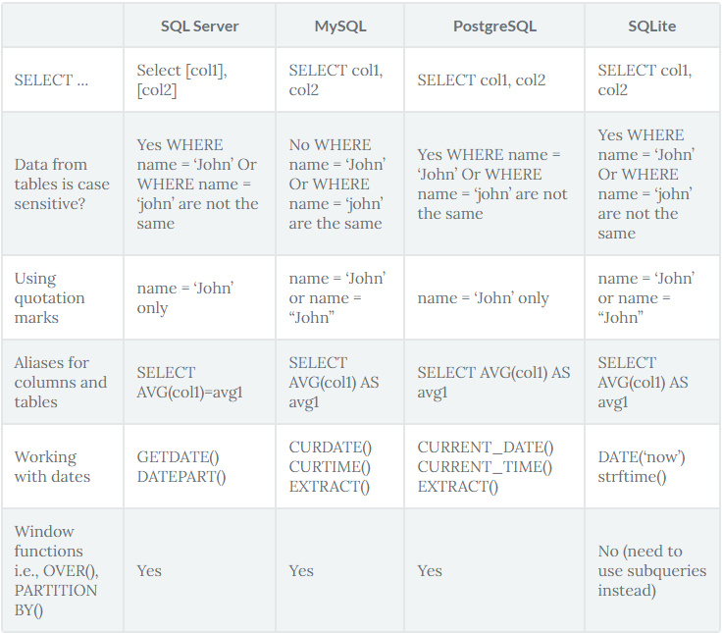
Comparison between the three RDBMS

