Slide 1
Pure Imagination Website
CMST 332 – Web Development Project

Slide 2
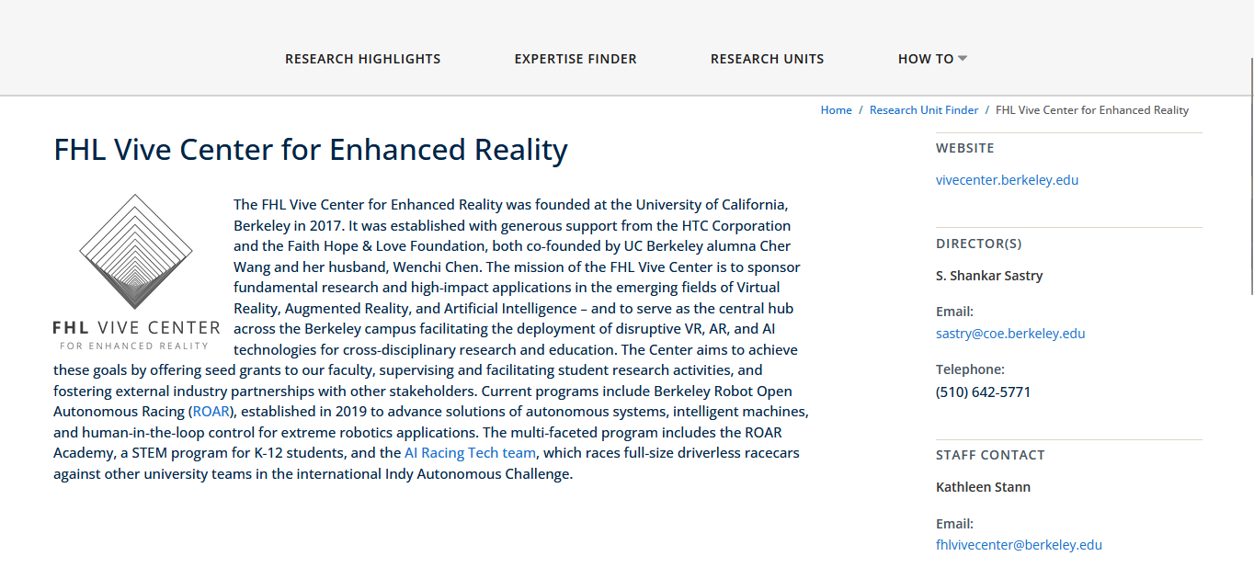
Research
Researched competitor sites
- Includes the design of the website. Researched Universities and companies such as Berkeley, Metalenz, and UCF Pegasus Innovation Lab
Researched WebXR
- Researched A-Frame to make WebXR virtual environment.
Researched ChatBot
- Microsoft Bot Framework, Rasa, Botpress, Bot Libre

Slide 3
Use Case
Title | Visit the site for information
Primary Actor | Site Visitor
Secondary Actor(s) | Mailing list Database
Business Goal | Attract Students, collaborators, and Interested Parties
Precondition | The website is up to date on information
Minimal Guarantee | Site Information is present
Success Guarantee | The visitor inputs information in the form for the mailing list
Trigger Event(s) | Visitor Loads Browse Webpage or Uses Search Bar
Primary Pathway | Load Page, view Information on KAIRES, watch WEBXR demo, input information into the form
Alternate Pathway(s) | Load page, views information on KAIRES, sends email directly to KAIRES email
Exception Pathway(s) | Load Page, person not interested, leaves page
Main Sequence | Load Browse Page View Information View WebXR tutorial Inputs information into form Confirmation email sent
Variant Sequence(s) | 1 2 4 3 5

Slide 4
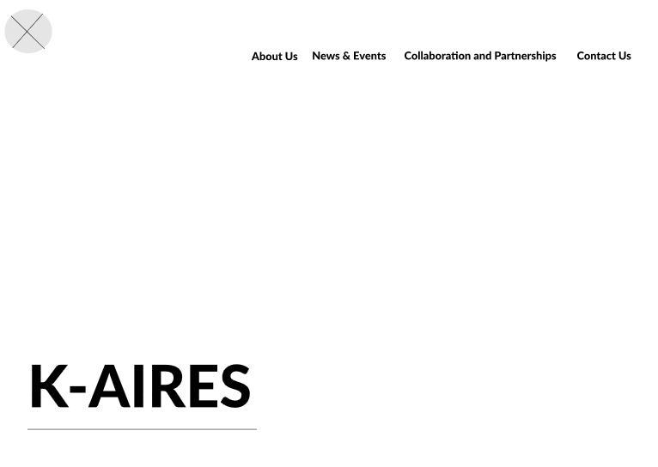
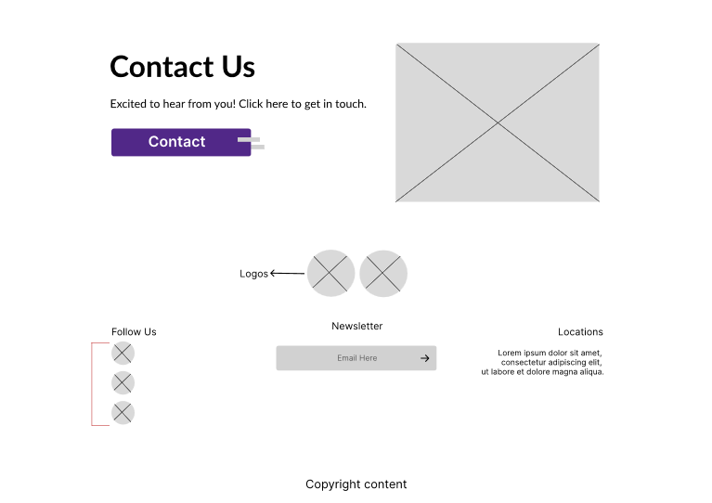
Wireframes

Slide 5
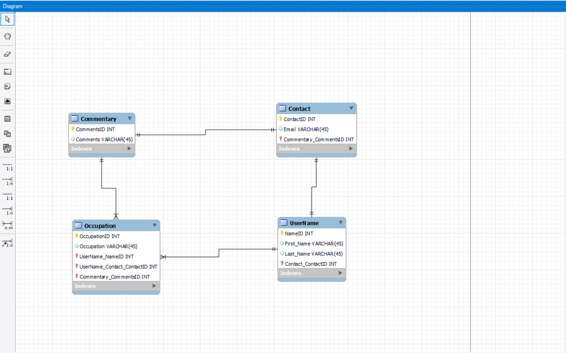
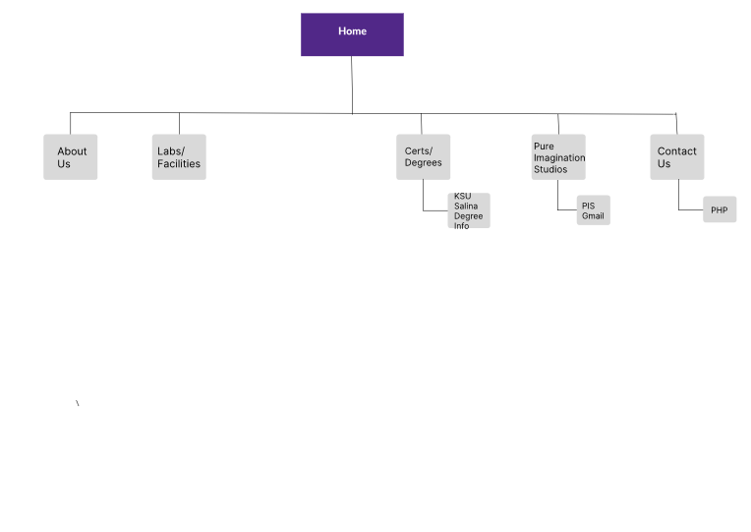
Site Map & ER Diagram

Slide 6
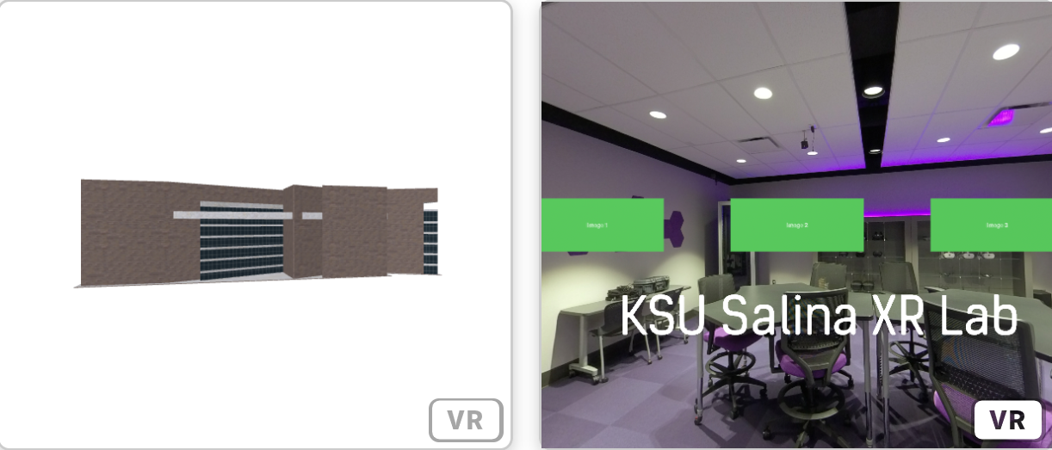
WebXR/A-Frame

Slide 7
Work Explained
Alec & Jacob
Front End (HTML, CSS)
Will, Justin, Zach
Back End (MySQL, PHP, Ajax)
Simon
- Virtual Environment (WebXR)
Extra Stuff
Zach – Bot press ChatBot
Alec & Jacob – Bootstrap
Justin – RSS Feed
Will –CPanel

Slide 8
Challenges
Technical Challenges
Bot development
XAMPP/Database Issues
A-frame/WebXr
Team-Work Challenges
Distribution of work
Communication with uploading HTML pages to server

Slide 9
Website Demo

Slide 10
Questions?

