Slide 1
Delegate
A person gives an assistant limited permission to deal with government.
The service checks that permission. The person can inspect the activity and remove access.
Independent synthetic prototype
1
Notes:
This is an independent prototype using synthetic people and services. An agent here is software that can use a service for someone. The person chooses the assistant. The demo explores the arrangement government could offer, rather than asking government to build everyone's assistant. Allow about ten minutes including the short demonstration.
Sources
Implemented behaviour at the briefing baseline: https://github.com/sighmoan1/govuk-delegate-starter/blob/6b4f3895f246cfe9e274059c57e4dc1ea7989650/docs/CURRENT_BEHAVIOUR.md
Prepared 10 October 2026. Main baseline 6b4f3895f246cfe9e274059c57e4dc1ea7989650. Observatory PRs 109–110 unmerged at preparation.

Slide 2
Government already recognises representatives
HMRC has an agent request and client approval journey. Clients can remove that authorisation.
Delegate adapts that relationship to software agents and makes the permission available to participating services.
Independent synthetic prototype
2
Notes:
HMRC is the main product precedent. Keep its request, independent approval and removal pattern visible. Existing human representation rules do not by themselves establish the legal status of AI actions. The sources addendum covers other relevant precedents and their limits.
Sources
HMRC digital handshake: https://www.gov.uk/guidance/how-to-use-the-digital-handshake-to-get-authorised-as-a-tax-agent
HMRC removal of agent authorisation: https://www.gov.uk/guidance/change-or-remove-your-tax-agents-authorisation
Government delegated authority guidance: https://www.gov.uk/guidance/delegated-authority-guidance
Prepared 10 October 2026. Main baseline 6b4f3895f246cfe9e274059c57e4dc1ea7989650. Observatory PRs 109–110 unmerged at preparation.

Slide 3
Sam chooses the permission
Sam lets her Personal assistant read her tax code and submit a job-expenses claim.
She leaves employment changes outside the grant. HMRC refuses that attempt.
Independent synthetic prototype
3
Notes:
Demo A: use the prepared synthetic approval and action rehearsal described in DEMO_RUNBOOK.md. Show the unchecked consent choices and expiry. The assistant has its own credential and never needs Sam's password. Demonstrate the refusal as well as the successful claim. If using a scripted API client, identify it as scripted.
Sources
Implemented behaviour at the briefing baseline: https://github.com/sighmoan1/govuk-delegate-starter/blob/6b4f3895f246cfe9e274059c57e4dc1ea7989650/docs/CURRENT_BEHAVIOUR.md
Service-defined restrictions: https://github.com/sighmoan1/govuk-delegate-starter/blob/6b4f3895f246cfe9e274059c57e4dc1ea7989650/docs/MANDATE_CONSTRAINTS.md
Prepared 10 October 2026. Main baseline 6b4f3895f246cfe9e274059c57e4dc1ea7989650. Observatory PRs 109–110 unmerged at preparation.

Slide 4
Sam can inspect and withdraw access
The account shows permission checks and service-reported outcomes.
After Sam removes access, HMRC refuses the next request.
Independent synthetic prototype
4
Notes:
Complete Demo A with the account detail and Remove access controls. Show a later refusal with the same client identity. A prior completed action stays in the record. A job durably accepted before removal may still finish. Explain this if someone expects revocation to undo submitted work.
Sources
Implemented behaviour at the briefing baseline: https://github.com/sighmoan1/govuk-delegate-starter/blob/6b4f3895f246cfe9e274059c57e4dc1ea7989650/docs/CURRENT_BEHAVIOUR.md
Prepared 10 October 2026. Main baseline 6b4f3895f246cfe9e274059c57e4dc1ea7989650. Observatory PRs 109–110 unmerged at preparation.

Slide 5
More requests can mean different things
Traffic | Service response
Repeated attempts for one claim | One claim, with repeat attempts recorded
Claims from different people | Separate claims received and recorded
Excessive polling or retries | Technical limits and retry guidance
Independent synthetic prototype
5
Notes:
Demo B: run the existing seven-scenario runner at N=10 during rehearsal, then show its actual results. Compare repeated attempts for one person with claims from different people. Read the technical load and claim outcome measures separately. Demo limits are illustrative. HMRC supplies duplicate handling and queue processing in both authority designs.
Sources
Swarm scenarios and accounting: https://github.com/sighmoan1/govuk-delegate-starter/blob/6b4f3895f246cfe9e274059c57e4dc1ea7989650/apps/about/src/app/swarm/page.tsx
Recorded E2 comparison and preserved raw records: https://github.com/sighmoan1/govuk-delegate-starter/blob/6b4f3895f246cfe9e274059c57e4dc1ea7989650/docs/evidence/RUN-20261009-E2-01.md
Prepared 10 October 2026. Main baseline 6b4f3895f246cfe9e274059c57e4dc1ea7989650. Observatory PRs 109–110 unmerged at preparation.

Slide 6
Authority gives government direct evidence
Available evidence | Government can establish
Verified agent and current permission | The registered actor and permitted action
Self-declared agent name | What the caller claims
Browser or traffic clues | A judgement with uncertainty
Independent synthetic prototype
6
Notes:
A declaration supplies a claimed name. Verification establishes the configured identity or signature, and a live relationship establishes scope. Unknown activity may include legitimate people, assistive technology and agents that cannot integrate. A signed-in human route can still conceal automation. Keep these distinctions separate on screen.
Sources
Implemented behaviour at the briefing baseline: https://github.com/sighmoan1/govuk-delegate-starter/blob/6b4f3895f246cfe9e274059c57e4dc1ea7989650/docs/CURRENT_BEHAVIOUR.md
Architecture and ownership: https://github.com/sighmoan1/govuk-delegate-starter/blob/6b4f3895f246cfe9e274059c57e4dc1ea7989650/docs/ARCHITECTURE.md
Prepared 10 October 2026. Main baseline 6b4f3895f246cfe9e274059c57e4dc1ea7989650. Observatory PRs 109–110 unmerged at preparation.

Slide 7
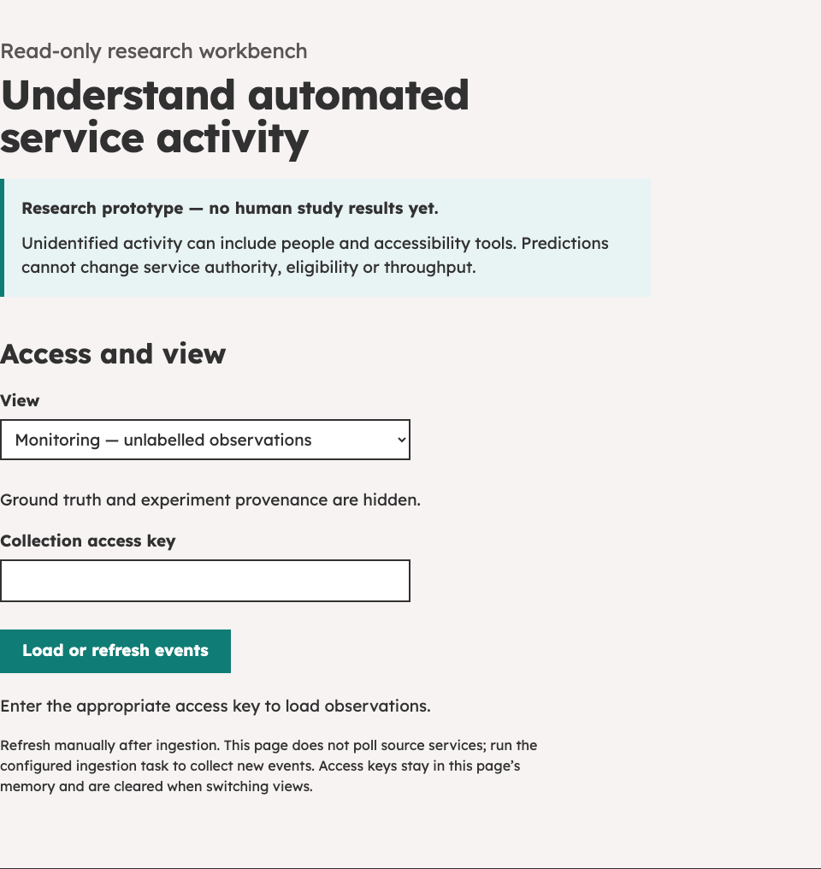
Observatory makes the evidence inspectable
The event explorer connects service attempts with recorded authority checks and outcomes.
Comparing several clues may improve understanding. Sensor coverage and recorded predictions stay visible.
Review interface, 10 October 2026. PRs 109–110.
Independent synthetic prototype
7
Notes:
Demo C requires the unmerged dashboard and classifier PRs in a reviewed isolated stack. Use the read-only monitoring view first. Ground truth in research view describes audited scripted execution, not an inferred label. Combining clues is the proposed approach; its accuracy still needs testing on varied agents and people. Protected execution labels remain separate from predictions. The current deterministic signature stub reports observed signature evidence. It is not a trained AI detector. Actual vendor validation remains outstanding.
Sources
Observatory dashboard, PR 110, unmerged at preparation: https://github.com/sighmoan1/govuk-delegate-starter/pull/110
Blind classifier contract, PR 109, unmerged at preparation: https://github.com/sighmoan1/govuk-delegate-starter/pull/109
Real vendor validation still outstanding, issue 68: https://github.com/sighmoan1/govuk-delegate-starter/issues/68
Prepared 10 October 2026. Main baseline 6b4f3895f246cfe9e274059c57e4dc1ea7989650. Observatory PRs 109–110 unmerged at preparation.

Slide 8
Independent work appeared alongside this project
Tom Loosemore published WhenIsBins observations on 9 October while Delegate was already underway.
He found variable browser clues and agents choosing APIs. Some named themselves when asked.
Independent synthetic prototype
8
Notes:
His small exploratory study is a comparison point. The project chronology comes from the author's account. Compare behaviours on equivalent routes before treating a difference as disagreement. Our test count does not establish broader agent coverage.
Sources
Tom Loosemore: How Agents Show Up, 9 October 2026: https://loosemore.com/2026/10/09/how-agents-show-up-what-muse-and-other-agents-reveal-when-they-use-whenisbins/
Existing exploratory route observations: https://github.com/sighmoan1/govuk-delegate-starter/blob/6b4f3895f246cfe9e274059c57e4dc1ea7989650/apps/about/src/app/which-route/page.tsx
Prepared 10 October 2026. Main baseline 6b4f3895f246cfe9e274059c57e4dc1ea7989650. Observatory PRs 109–110 unmerged at preparation.

Slide 9
The adoption hypothesis
A useful Delegate route could draw most well-behaved agents into identified, authorised activity.
That could substantially reduce Observatory's inference burden and shift effort towards helping people use the route.
Independent synthetic prototype
9
Notes:
This is the project's central adoption and operational-burden hypothesis. It remains unmeasured. Tool limitations, service coverage and consent barriers may leave legitimate agents outside. Authorised agents can still malfunction or abuse permission. Measure residual unexplained activity, investigation effort and access failures alongside adoption.
Sources
Architecture and ownership: https://github.com/sighmoan1/govuk-delegate-starter/blob/6b4f3895f246cfe9e274059c57e4dc1ea7989650/docs/ARCHITECTURE.md
Open national decisions: https://github.com/sighmoan1/govuk-delegate-starter/blob/6b4f3895f246cfe9e274059c57e4dc1ea7989650/docs/DECISION_BACKLOG.md
Participant pilot proposal, PR 108, awaiting approval: https://github.com/sighmoan1/govuk-delegate-starter/pull/108
Prepared 10 October 2026. Main baseline 6b4f3895f246cfe9e274059c57e4dc1ea7989650. Observatory PRs 109–110 unmerged at preparation.

Slide 10
Evidence so far
Recorded work | Conclusion supported
Permission and service regression | Specific synthetic behaviours work
Matched service-local / Delegate comparison | Equal outcomes for the fixed workload
Scripted ledger replay | Trace collection can be audited
Genuine participant research | Still outstanding
Independent synthetic prototype
10
Notes:
The technical comparison used twenty synthetic citizen fixtures across four blocks. Both routes completed all tested legitimate tasks and prevented tested forbidden or duplicate effects. There were no real-agent or human participants in that comparison. Hundreds of checks describe software coverage. They cannot provide a detection accuracy estimate or an adoption rate. Show the preserved evidence if challenged.
Sources
Recorded E2 comparison and preserved raw records: https://github.com/sighmoan1/govuk-delegate-starter/blob/6b4f3895f246cfe9e274059c57e4dc1ea7989650/docs/evidence/RUN-20261009-E2-01.md
Recorded combined validation and manual walkthrough: https://github.com/sighmoan1/govuk-delegate-starter/issues/90#issuecomment-6090819665
Protected execution ledger: https://github.com/sighmoan1/govuk-delegate-starter/blob/6b4f3895f246cfe9e274059c57e4dc1ea7989650/docs/observatory/GROUND_TRUTH.md
Prepared 10 October 2026. Main baseline 6b4f3895f246cfe9e274059c57e4dc1ea7989650. Observatory PRs 109–110 unmerged at preparation.

Slide 11
Discussion
Could you use this demonstration to explain delegated agent access to a service team?
Which citizen task would make the next experiment useful, and which department could help test it?
Independent synthetic prototype
11
Notes:
Ask the audience to explain the idea in their own words. Record what they find confusing and any precedents we have missed. Seek a bounded service example and relevant product, policy, accessibility and security owners. Offer the detailed briefing for people who want to inspect the design. Do not ask them to endorse a national platform on the basis of this demo.
Sources
Open national decisions: https://github.com/sighmoan1/govuk-delegate-starter/blob/6b4f3895f246cfe9e274059c57e4dc1ea7989650/docs/DECISION_BACKLOG.md
Participant pilot proposal, PR 108, awaiting approval: https://github.com/sighmoan1/govuk-delegate-starter/pull/108
Prepared 10 October 2026. Main baseline 6b4f3895f246cfe9e274059c57e4dc1ea7989650. Observatory PRs 109–110 unmerged at preparation.

