Slide 1
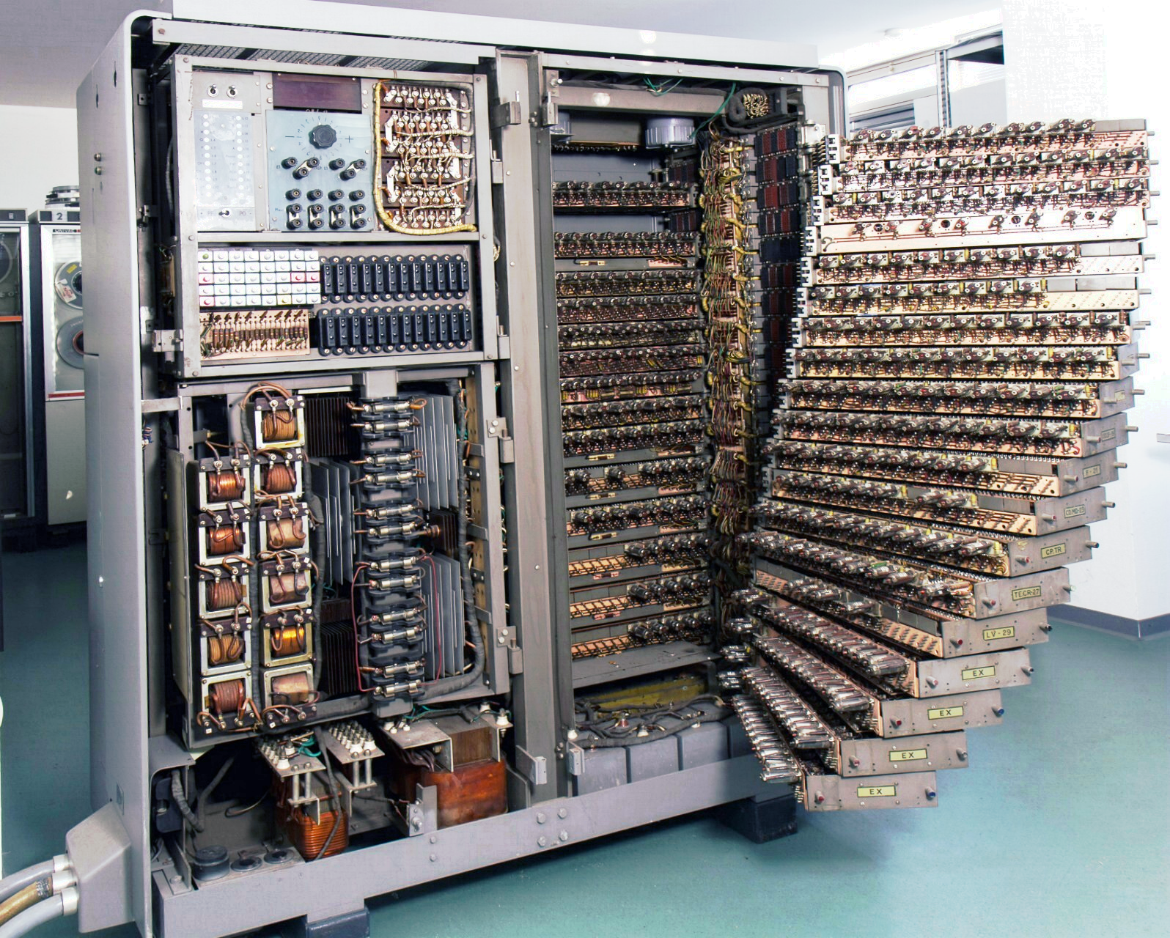
Hoon School Live · Lesson –1
Introduction to Computing

Slide 2
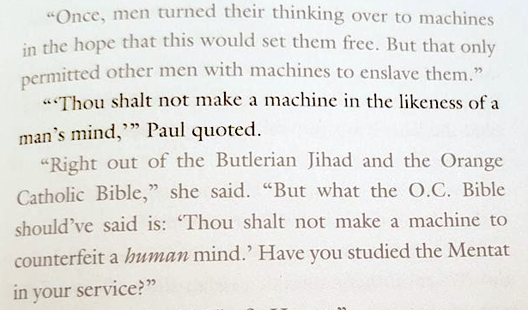
“Thou shalt not make a machine in the likeness of a human mind.”
—Orange Catholic Bible

Slide 3
Computational Principles
Representations are interchangeable.
Any computation requires a representation.
Computation requires values, operations, and state.
All of these can be represented unambiguously on the machine.
Higher-level languages map to lower-level representations for the machine.

Slide 4
𝍩
𝍪
𝍫
𝍬
𝍸
tally marks
(base 1)

Slide 5
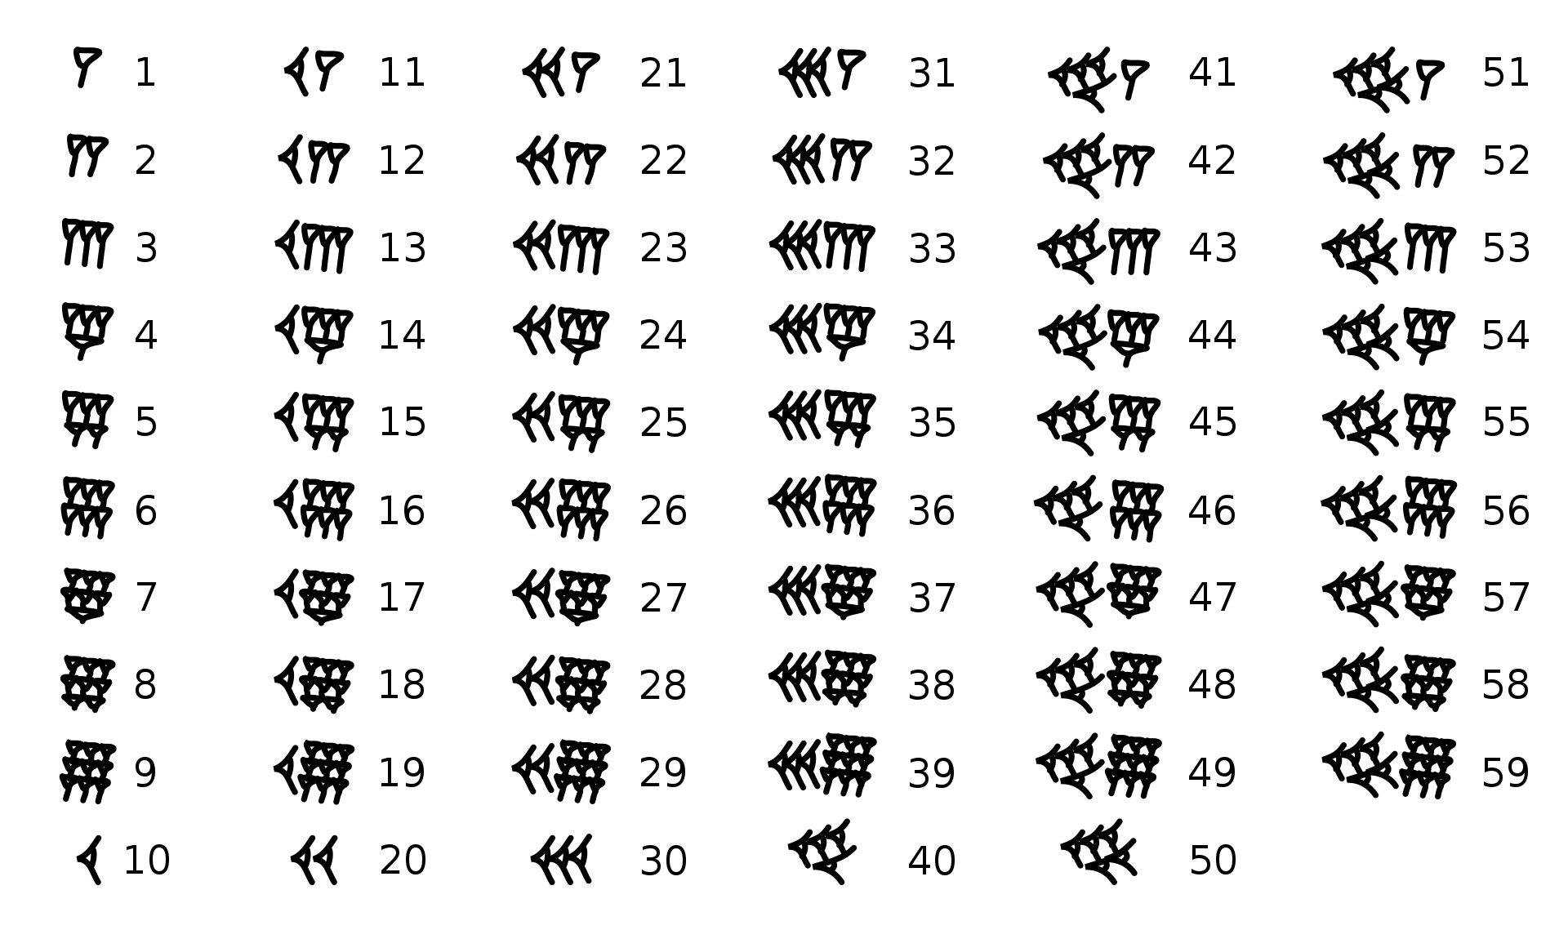
Babylonian numerals
(base 60)
Wikipedia

Slide 6
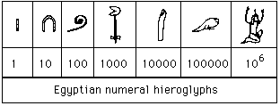

Egyptian numerals
(base 10)
Wikipedia

Slide 7
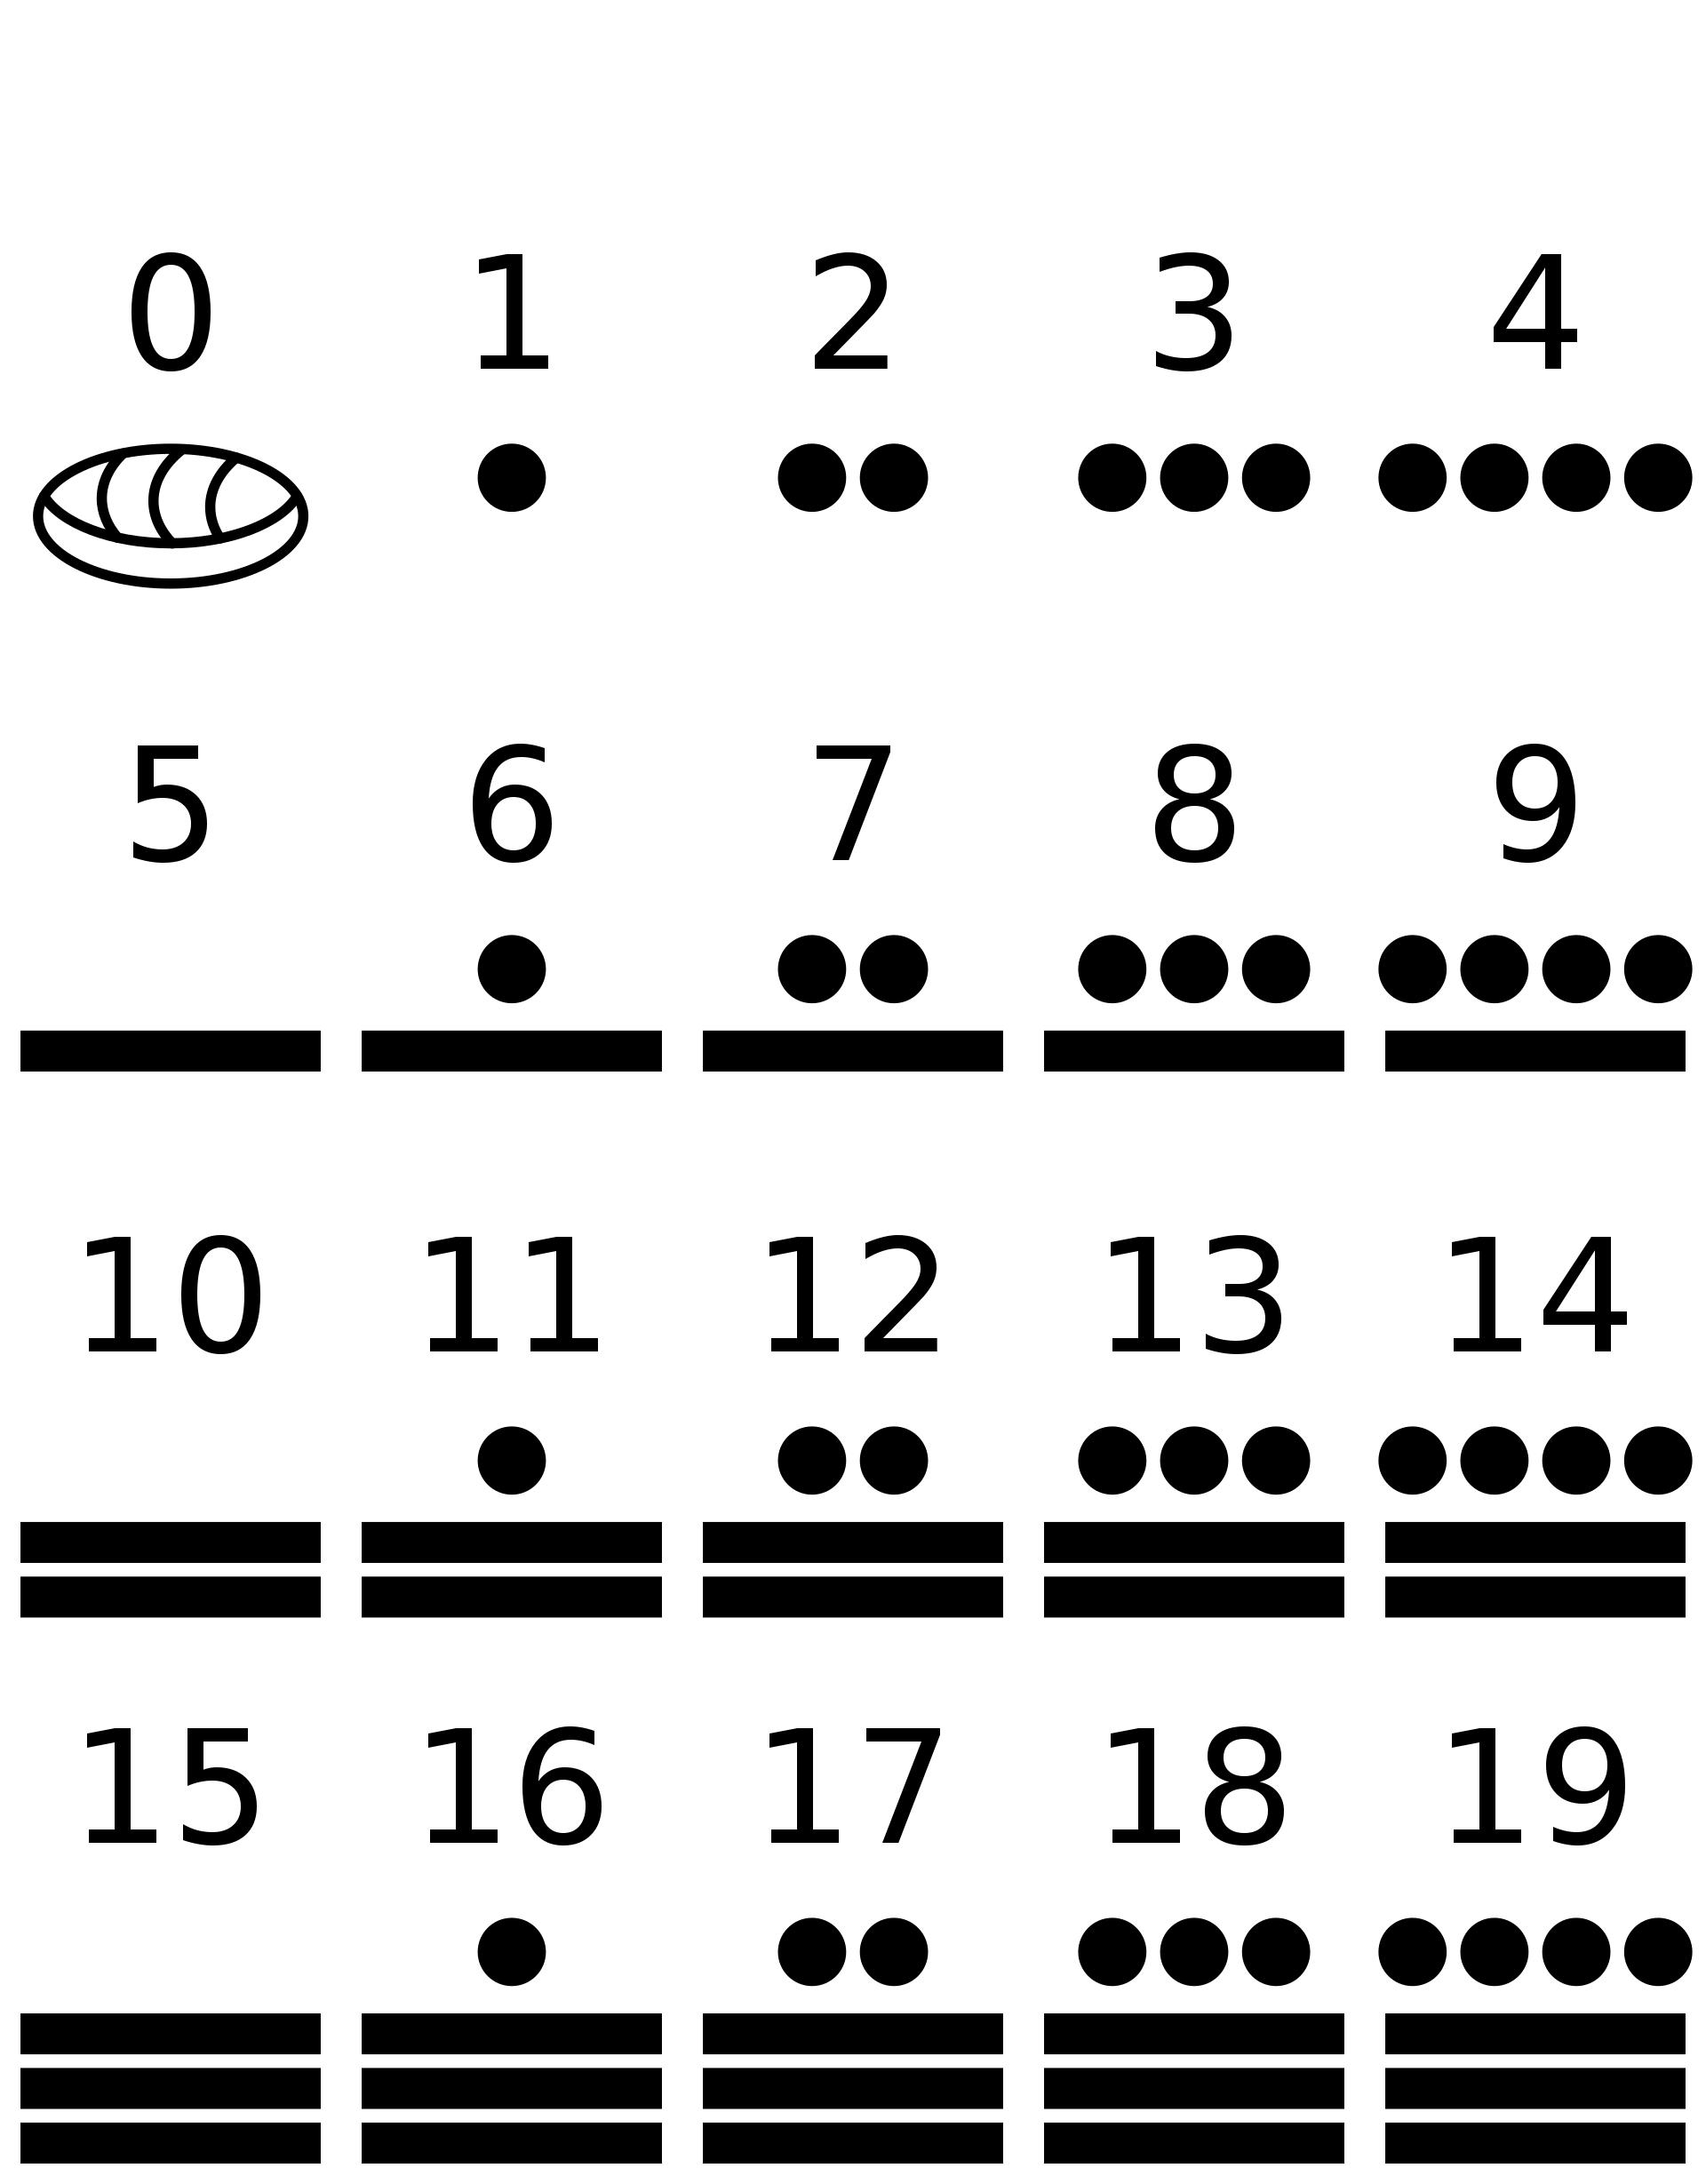
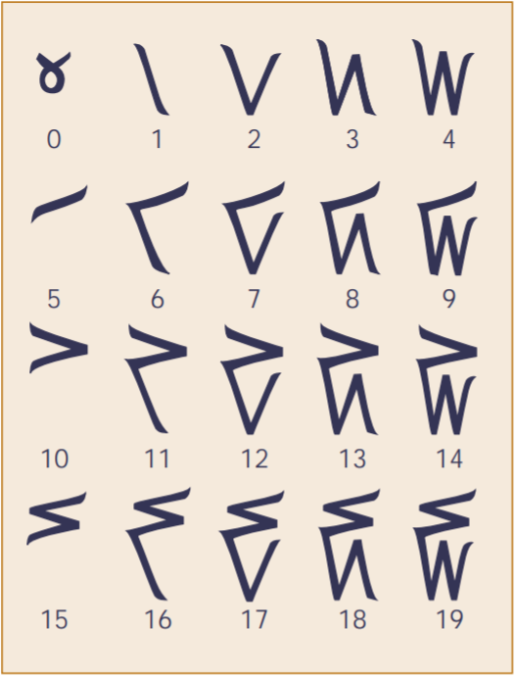
Maya numerals
(base 20)
Kaktovik (Inuit) numerals
(base 20)
Wikipedia

Slide 8
☷
☶
☵
☴
☳
☲
☱
☰
000₂ = 0₁₀
100₂ = 4₁₀
001₂ = 1₁₀
101₂ = 5₁₀
010₂ = 2₁₀
110₂ = 6₁₀
011₂ = 3₁₀
111₂ = 7₁₀
I Ching numerals
(base 2)
[never actually used for counting]
Wikipedia

Slide 9
1110.0001.1011₂
2¹¹+2¹⁰+2⁹+2⁸+2⁷+2⁶+2⁵+2⁴+2³+2²+2¹+2⁰
2048+1024+512+16+8+2+1 = 3611₁₀
Binary numerals
(base 2)

Slide 10
0₁₆ 0₁₀ 9₁₆ 9₁₀
1₁₆ 1₁₀ a₁₆ 10₁₀
2₁₆ 2₁₀ b₁₆ 11₁₀
3₁₆ 3₁₀ c₁₆ 12₁₀
4₁₆ 4₁₀ d₁₆ 13₁₀
5₁₆ 5₁₀ e₁₆ 14₁₀
6₁₆ 6₁₀ f₁₆ 15₁₀
7₁₆ 7₁₀ 10₁₆ 16₁₀
8₁₆ 8₁₀ 11₁₆ 17₁₀
0000₂ = 0₁₆ = 0₁₀
0010₂ = 2₁₆ = 2₁₀
0100₂ = 4₁₆ = 4₁₀
1010₂ = a₁₆ = 10₁₀
1011₂ = b₁₆ = 11₁₀
1.0000₂ = 10₁₆ = 16₁₀
11.0010₂ = 32₁₆ = 50₁₀
Hexadecimal numerals
(base 16)

Slide 11
Computational Principles
Representations are interchangeable.

Slide 12
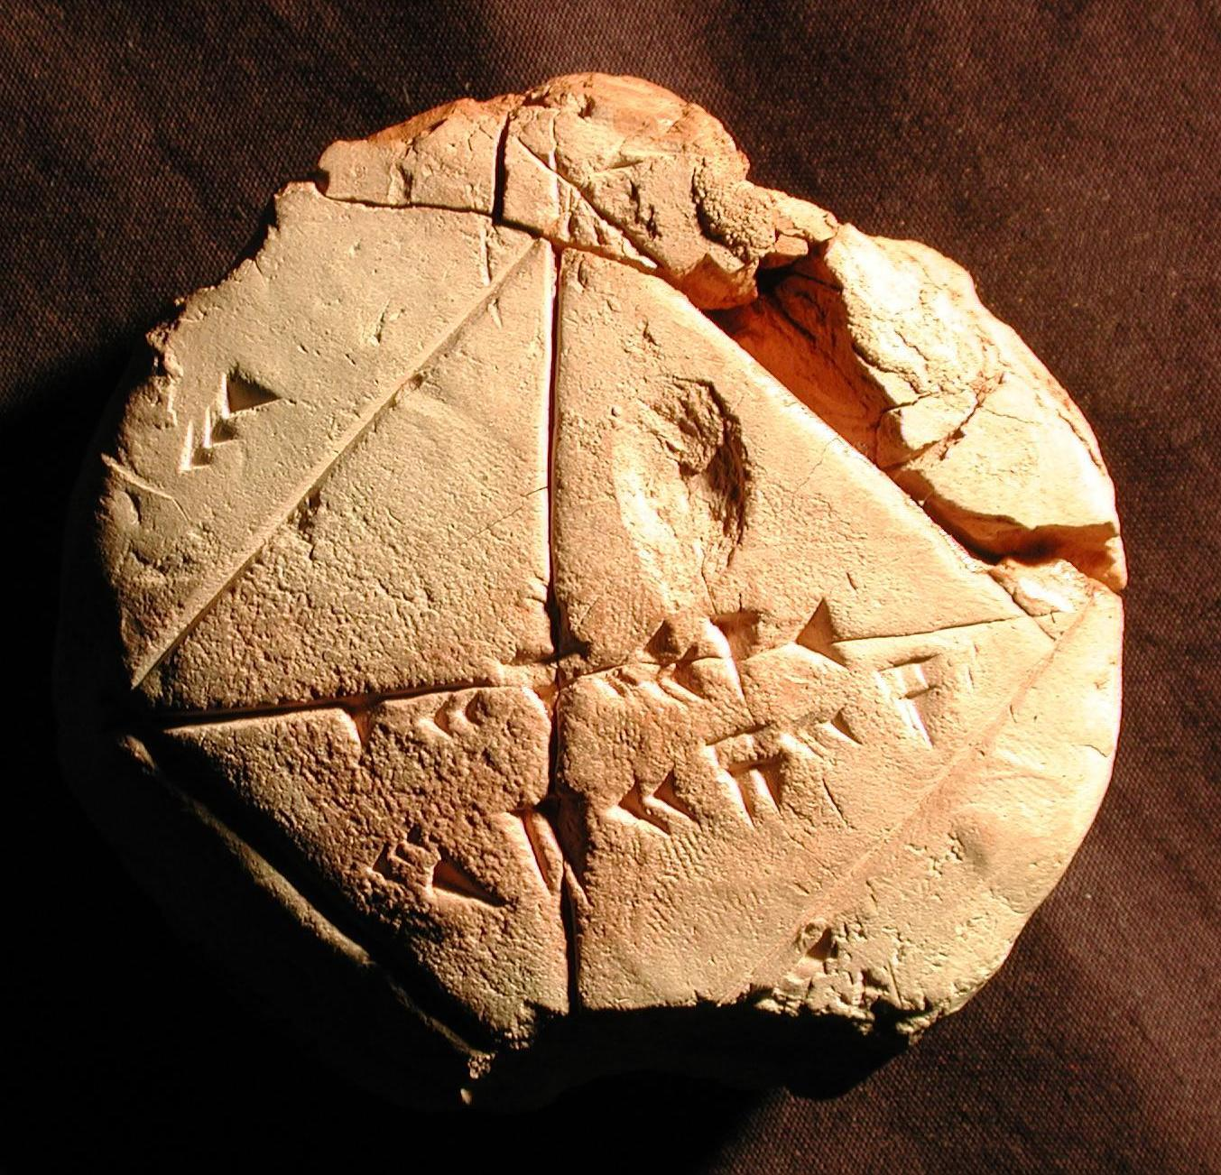
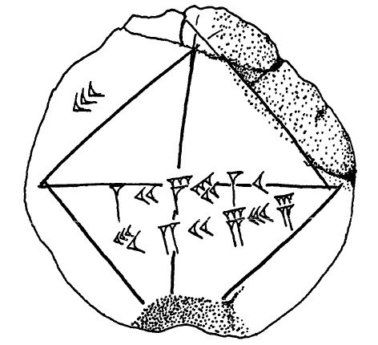
Babylonian tablet YBC 7289

Slide 13
24 51 10
1 + + + = 1.41417129...
60 3600 216000
(compare √2 ≈ 1.41421356...)
Babylonian tablet YBC 7289

Slide 14
sin θ
θ
sine-based geometry
(modern)
Wikipedia

Slide 15
crd θ
θ
chord-based geometry
(ancient Greek)
Wikipedia

Slide 16
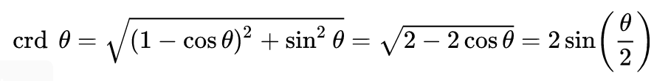
crd θ
sin θ
θ
θ
chord-based geometry
(ancient Greek)
sine-based geometry
(modern)
Wikipedia

Slide 17
Computational Principles
Representations are interchangeable.
Any computation requires a representation.

Slide 18
To multiply together two numbers:
Find the larger of the two.
Decompose it into powers of
two.
Multiply each component by
the corresponding power of
two.
Add these together to find
the multiple.
Ancient Egyptian multiplication algorithm

Slide 19
To multiply together two numbers:
Find the larger of the two.
Decompose it into powers of
two.
Multiply each component by
the corresponding power of
two.
Add these together to find
the multiple.
25 × 13 = ???
Ancient Egyptian multiplication algorithm

Slide 20
To multiply together two numbers:
Find the larger of the two.
Decompose it into powers of
two.
Multiply each component by
the corresponding power of
two.
Add these together to find
the multiple.
25 × 13 = ???
25 × 13 = ???
Ancient Egyptian multiplication algorithm

Slide 21
To multiply together two numbers:
Find the larger of the two.
Decompose it into powers of
two.
Multiply each component by
the corresponding power of
two.
Add these together to find
the multiple.
25 × 13 = ???
25 × 13 = ???
25 = 16 + 8 + 1
Ancient Egyptian multiplication algorithm

Slide 22
To multiply together two numbers:
Find the larger of the two.
Decompose it into powers of
two.
Multiply each component by
the corresponding power of
two.
Add these together to find
the multiple.
25 × 13 = ???
25 × 13 = ???
25 = 16 + 8 + 1
16 × 13 = 208
8 × 13 = 104
1 × 13 = 13
Ancient Egyptian multiplication algorithm

Slide 23
To multiply together two numbers:
Find the larger of the two.
Decompose it into powers of
two.
Multiply each component by
the corresponding power of
two.
Add these together to find
the multiple.
25 × 13 = ???
25 × 13 = ???
25 = 16 + 8 + 1
16 × 13 = 208
8 × 13 = 104
1 × 13 = 13
25 × 13 = 208
+ 104
+ 13 = 325
Ancient Egyptian multiplication algorithm

Slide 24
Computational Principles
Representations are interchangeable.
Any computation requires a representation.
Computation requires values, operations, and state.

Slide 25
“Zero is not the successor of any natural number.”
Gödel, Escher, Bach (Hofstadter)

Slide 26

“Zero is not the successor of any natural number.”
Gödel, Escher, Bach (Hofstadter)

Slide 27
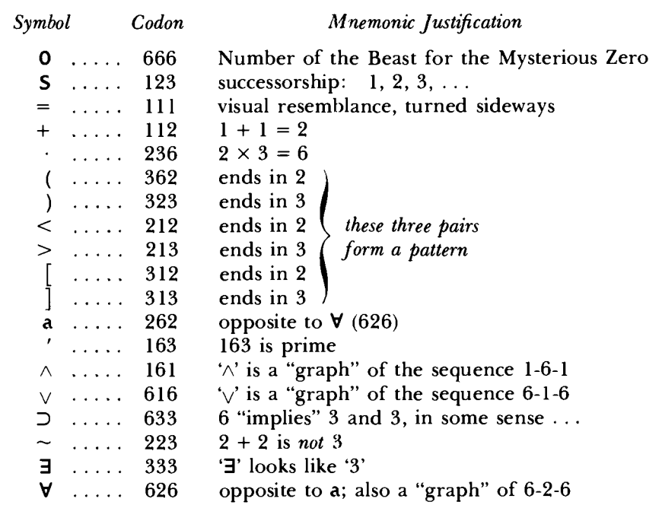
“Zero is not the successor of any natural number.”
Gödel, Escher, Bach (Hofstadter)

Slide 28
“Zero is not the successor of any natural number.”
Gödel, Escher, Bach (Hofstadter)

Slide 29
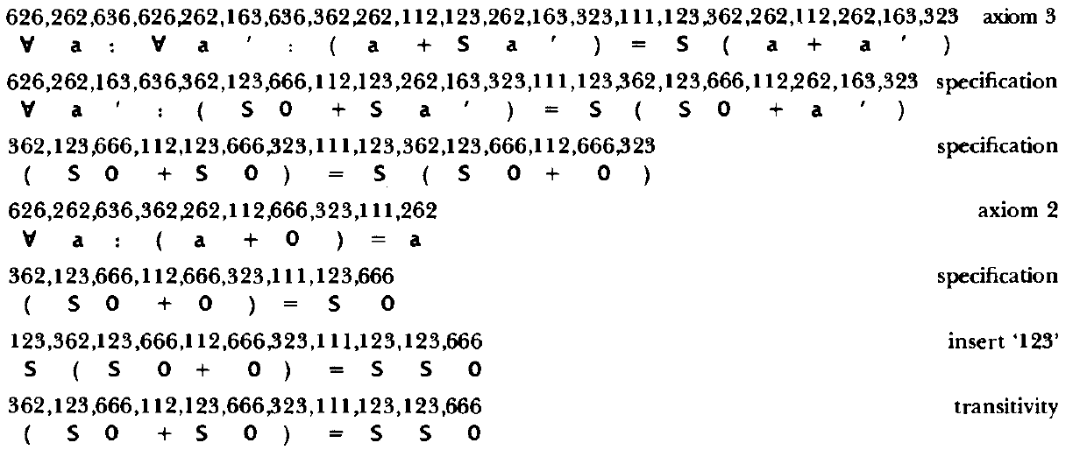
Gödel, Escher, Bach (Hofstadter)

Slide 30
Computers use assembler (or assembly) language as their fundamental binary language.
Each instruction has a determinate length.
The first number represents the operation, which determines the interpretation of the other numbers (values or addresses, which access stored state).
0b11.0101.1110.0000.0000.0000.0110.0101.1110.0000.0001.0000.0111.0000.0010.0101.1110.0000.0010
0x35e.0006.5e01.0702.5e02
MOVMA 5E00 ; Move data from address 0x5e00 into A
MOVBA 5E01 ; Move data from address 0x5e01 into A
ADDAB ; Add A and B and put result in A
MOVAM 5E02 ; Move data from A to address 0x5e02
Intel 8088 assembler language; example from https://faculty.etsu.edu/tarnoff/ntes2150/assembly/assembly.htm

Slide 31
Computers use assembler (or assembly) language as their fundamental binary language.
Each instruction has a determinate length.
The first number represents the operation, which determines the interpretation of the other numbers (values or addresses, which access stored state).
0b11.0101.1110.0000.0000.0000.0110.0101.1110.0000.0001.0000.0111.0000.0010.0101.1110.0000.0010
0x35e.0006.5e01.0702.5e02
MOVMA 5E00 ; Move data from address 0x5e00 into A
MOVBA 5E01 ; Move data from address 0x5e01 into A
ADDAB ; Add A and B and put result in A
MOVAM 5E02 ; Move data from A to address 0x5e02
Intel 8088 assembler language; example from https://faculty.etsu.edu/tarnoff/ntes2150/assembly/assembly.htm

Slide 32
8-bit: 2⁸ = 256 [NES, IBM System/360]
16-bit: 2¹⁶ = 65,536 [8088, SNES]
32-bit: 2³² ≈ 4MM [Pentium Pro, PS]
64-bit: 2⁶⁴ ≈ 1.8×10¹⁹ [modern CPUs]

Slide 33
Computational Principles
Representations are interchangeable.
Any computation requires a representation.
Computation requires values, operations, and state.
All of these can be represented unambiguously on the machine.

Slide 34
Fibonacci sequence
Fn = Fn-1 + Fn-2
1, 1, 2, 3, 5, 8, 13, 21, 34, 55, 89, 144, ...
Python 3.9

Slide 35
Fibonacci sequence
Fn = Fn-1 + Fn-2
1, 1, 2, 3, 5, 8, 13, 21, 34, 55, 89, 144, ...
def fib(n):
if n <= 2:
return 1
return fib(n-1) + fib(n-2)
Python 3.9

Slide 36
Fibonacci sequence
Fn = Fn-1 + Fn-2
1, 1, 2, 3, 5, 8, 13, 21, 34, 55, 89, 144, ...
0 LOAD_FAST 0 (n)
2 LOAD_CONST 1 (2)
4 COMPARE_OP 1 (<=)
6 POP_JUMP_IF_FALSE 12
8 LOAD_CONST 2 (1)
10 RETURN_VALUE
12 LOAD_GLOBAL 0 (fib)
14 LOAD_FAST 0 (n)
16 LOAD_CONST 2 (1)
18 BINARY_SUBTRACT
20 CALL_FUNCTION 1
22 LOAD_GLOBAL 0 (fib)
24 LOAD_FAST 0 (n)
26 LOAD_CONST 1 (2)
28 BINARY_SUBTRACT
30 CALL_FUNCTION 1
32 BINARY_ADD
34 RETURN_VALUE
def fib(n):
if n <= 2:
return 1
return fib(n-1) + fib(n-2)
Python 3.9

Slide 37
Computational Principles
Representations are interchangeable.
Any computation requires a representation.
Computation requires values, operations, and state.
All of these can be represented unambiguously on the machine.
Higher-level languages map to lower-level representations for the machine.

Slide 38
The lambda calculus is a formal mathematical specification for computation.
Mathematical functions are anonymous.
f(x) = (x+1)² ⇒ (x) ↦ (x+1)² ⇒ λx.(λx.x² (λx.x + 1 x))
The lambda calculus consists of lambda terms and defines a set of formal operations for manipulating them.
Other (equivalent) logic systems exist; Urbit’s
Nock language is most closely related to the
SKI combinator calculus.
TRUE := λx.λy.x
FALSE := λx.λy.y
AND := λp.λq.p q p
OR := λp.λq.p p q
NOT := λp.p FALSE TRUE
IFTHENELSE := λp.λa.λb.p a b
I := λx.x
S := λx.λy.λz.x z (y z)
K := λx.λy.x
B := λx.λy.λz.x (y z)
C := λx.λy.λz.x z y
W := λx.λy.x y y
ω/Δ := λx.x x
Ω := ω ω
Lambda calculus

Slide 39
Computational Principles
Urbit consists of these parts:
  Nock is a virtual machine, a computational behavior specification (like assembler).
  Hoon is a high-level language which compiles to Nock (like C or Python).
  Arvo is the Urbit OS, the event handler and event log which together define system state.
  Azimuth is the identity system.

